Slide 1
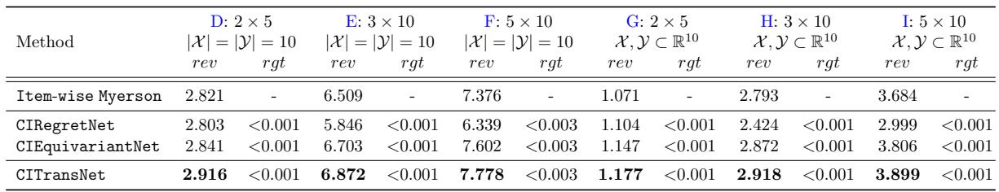
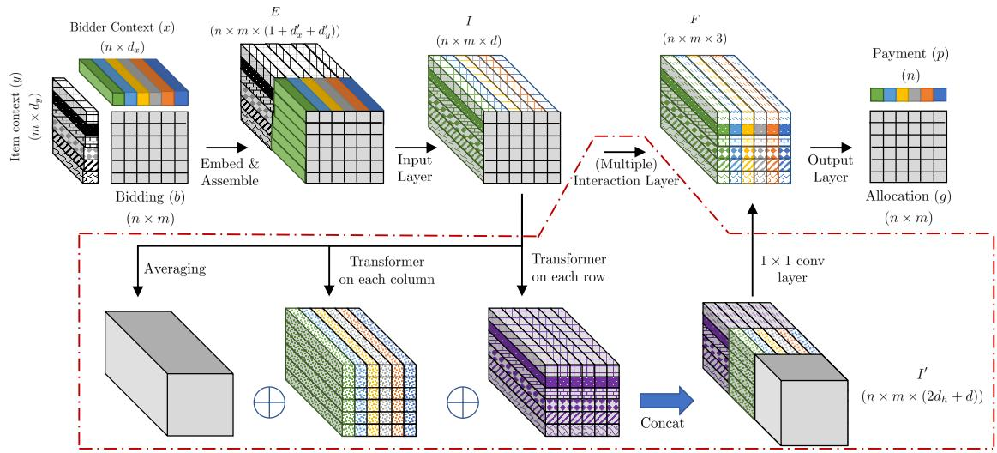
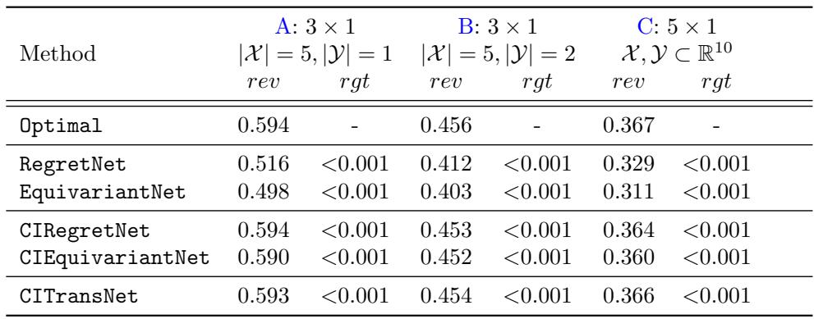
A Context-Integrated Transformer-Based Neural Network for Auction Design
Zhijian Duan¹, Jingwu Tang¹, Yutong Yin¹, Zhe Feng², Xiang Yan³, Manzil Zaheer⁴, Xiaotie Deng¹
¹ Peking University, Beijing, China; ² Google Research, Mountain View, US; ³ Google DeepMind, Mountain View, US; ⁴ Shanghai Jiao Tong University, Shanghai, China
▶ Introduction
▶ Contextual Auction Learning
▶ Conclusion
•Study contextual auctions with bidder and item context features
•Extend RegretNet to learn context-aware mechanisms
•Prove sample complexity bounds on mechanism generalization
•Introduce CTransNet, permutation-equivariant beyond symmetric auctions
•Target revenue-maximizing auctions in realistic multi-item settings
•Formulates contextual auction design as supervised learning problem
•Defines ex-post regret; DSIC holds iff regret equals zero
•Parameterizes allocation and payment via shared-parameter mechanisms over contexts
•Optimizes revenue under DSIC and IR using empirical samples
•Derives generalization bounds via covering numbers for revenue and regret
•Introduces CITransNet, a transformer architecture for contextual auction design
•Ensures permutation equivariance to bids and contexts; handles asymmetric information
▶ Model Architecture
▶ Experiments
•Propose CITRansNet for allocation and payment with contextual signals
•Embed each bidder-item pair using bid, bidder context, item context
•CITransNet achieves best revenue across settings D–I with low regret.
•Context-integrated models recover Myerson-optimal solutions; non-context fail.
•Recovers optimal analytical solutions in simple auctions via experiments
•Demonstrates effective interaction layers versus context-integrated RegretNet and EquivariantNet
•Generalizes across bidder/item counts; next: industry-scale and online tests
▶ Abstract
•Transformer-based interaction captures bidder–item influence, driving gains.
•Permutation-equivariance boosts large-scale auction performance.
•Demonstrates out-of-setting generalization across bidders and items.
•Introduces CITransNet: context-integrated transformer for optimal auction design
•Encodes public bidder and item contexts within learning framework
•Enforces permutation equivariance over bids and contexts; supports asymmetric mechanisms
•Recovers known optima in single-item auctions via experiments
•Outperforms baselines and generalizes beyond training in multi-item settings
•Use transformer interaction layer with multi-head self-attention
•Preserve bidder/item permutation equivariance via per-pair 1x1 convolutions
•Capture higher-order interactions across pairs for improved mechanism design

