Slide 1
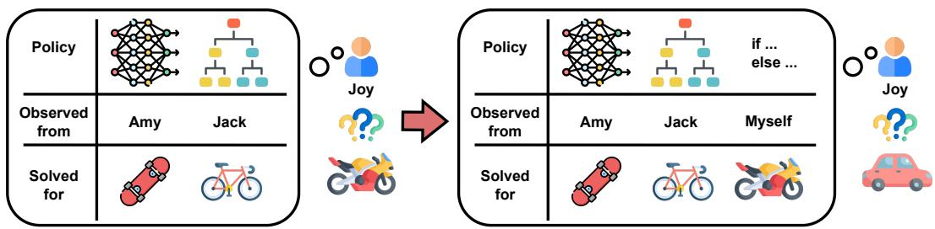
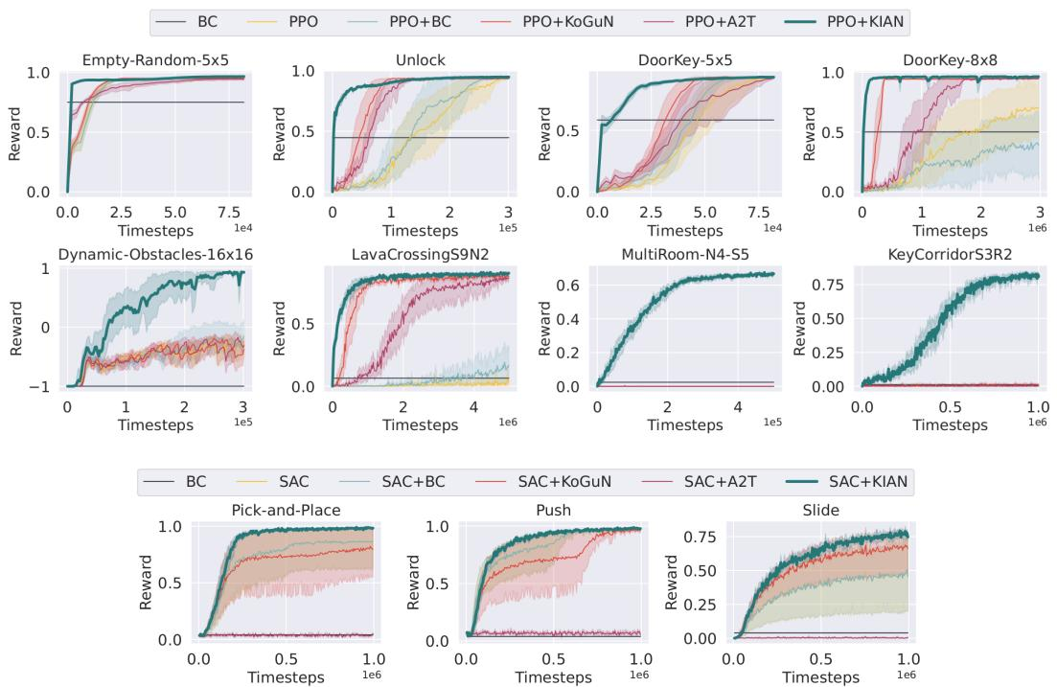
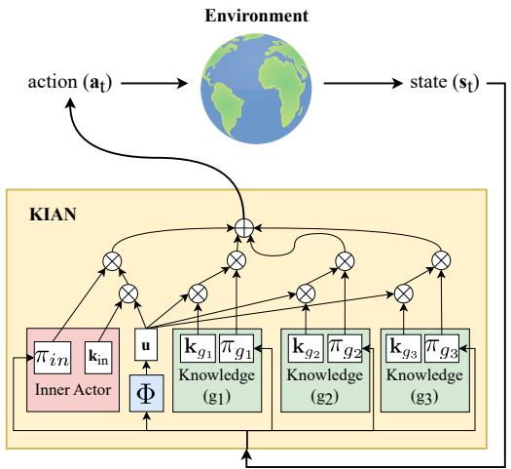
Flexible Attention-Based Multi-Policy Fusion for Efficient Deep Reinforcement Le
Zih-Yun Chiu¹⁎, Yi-Lin Tuan²⁎, William Yang Wang², Michael C. Yip¹
¹ University of California, San Diego; ² University of California, Santa Barbara
▶ Introduction
▶ Knowledge-Inclusive Attention
▶ Experiments
•Introduces KGRL with external policies
•Defines knowledge as state-action mappings for compositional learning
•Proposes KIAN actor for KGRL
•KIAN: KGRL actor integrating knowledge keys and query
•End-to-end trainable with Gumbel-softmax action prediction
•Evaluate KIAN on MiniGrid and OpenAI-Robotics with baselines
•All methods share identical, sub-optimal external knowledge
•KIAN consistently solves tasks; gains increase with task complexity
•Unifies policy embeddings; decouples fusion for plug-and-play updates
•Balances entropy via reweighted external-policy distributions
•Outperforms baselines in navigation/manipulation with better generalization
•Reveals entropy imbalance in KGRL via formal analysis
•Attention favors high-entropy or internal policies
•Mitigates bias via adjusted discrete/continuous policies
▶ Related Work
•KoGuN constrains policy via fuzzy logic rules
•A2T fuses policies with attention and learnable internal policy
•KIAN enables incremental learning without retraining
•KIAN balances entropy for exploration—prior methods overlook this
•KGRL fuses policies step-by-step; HRL selects one per step
•KIAN fuses multiple external policies for efficient exploration
•KIAN shows superior generalization and reuses policies compositionally and incrementally
•Ablation: fixing entropy imbalance improves performance; discrete tasks most sensitive
▶ Problem Formulation
▶ Conclusion Discussion
▶ Abstract
•Introduces KGRL via external knowledge policies
•Formalizes KGMDP: states, actions, transitions, rewards, discount, init dist, policies
•Learns knowledge-conditioned policy to maximize expected return
•External policies may misalign with MDP, lowering returns
•Defines: knowledge-acquirable, sample-efficient, generalizable
•Properties: compositional (policy union); incremental (growing knowledge)
•KGRL: efficient RL via external policies
•KIAN actor: fuses policies with attention
•Balances entropy for stable learning
•Outperforms in sample efficiency, generalization, and composition
•Performance drops with large irrelevant policy sets
•Enables cross-env querying via shared policy knowledge
•Introduces KGRL with multi-policy fusion
•Proposes KIAN actor for embedding-driven action prediction
•Enables flexible knowledge rearrangement for generalization
•Balances entropy via policy distributions
•Outperforms SOTA with efficient exploration
•Open-source code available on GitHub

