Slide 1
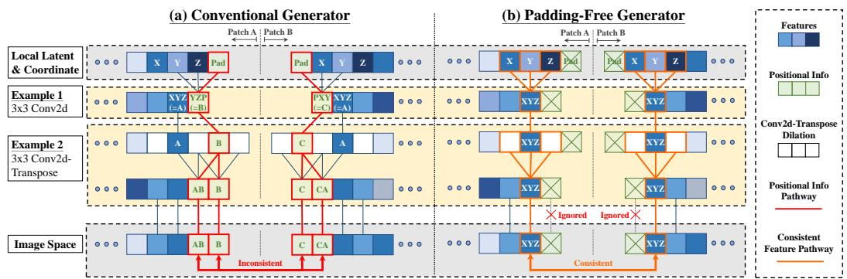
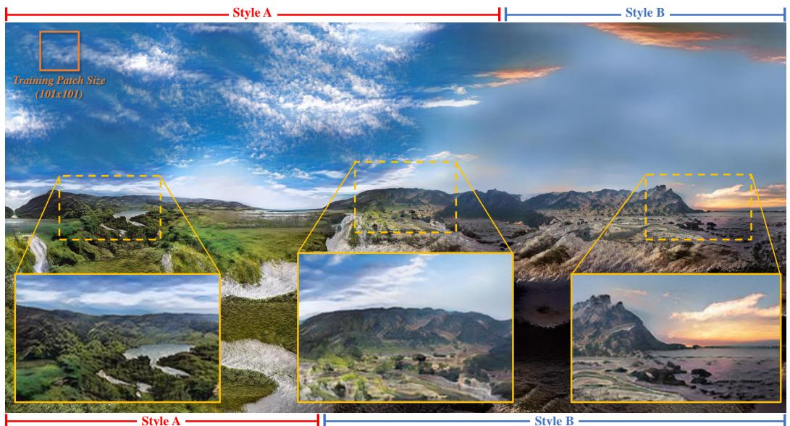
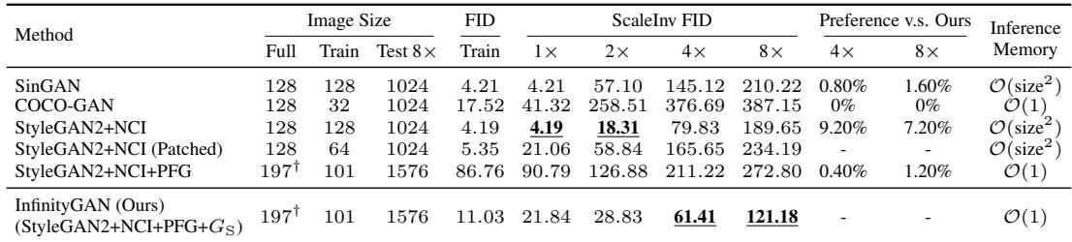
InfinityGAN Towards Infinite-Pixel Image Synthesis
Chieh Hubert Lin¹, Hsin-Ying Lee², Yen-Chi Cheng³, Sergey Tulyakov², Ming-Hsuan Yang¹⁴⁵
¹ UC Merced; ² Snap Inc.; ³ Carnegie Mellon University; ⁴ Yonsei University; ⁵ Google Research
▶ Introduction
▶ Proposed Method
▶ Ethics Statement
•Aim to generate infinite-pixel images from partial observations
•Train a patch-based generator
•Infer arbitrarily large images at test time
•Synthesize globally plausible structures and heterogeneous textures
•Introduces InfinityGAN with structure and texture synthesizers
•Uses implicit G_S to sample coordinates and build local structure
•Conditions on coordinates via landscape prior: tanh vertical, sinusoidal horizontal
•Adhere to ICLR Code of Ethics
•Acknowledge generative modeling misuse risks
•Do not enhance fine-grained manipulation or human hallucination
•Note potential misuse for fake scenery images
•Commit to ethical modeling and image forensics
▶ Abstract
▶ Related Work
•Proposes InfinityGAN for arbitrary-sized image generation
•Trains and infers patchwise, requiring low compute and no large-FOV data
•Disentangles global appearance, local structure, and texture for consistent, non-repetitive realism
•Latent models mostly fixed-size; 1024×1024 achieved but poor size generalization
•Patch-based GANs synthesize by parts; repeat statistics and barely extrapolate
•ALIS concurrently targets infinite-pixel images via horizontal latent in-betweening
•Autoregressive models can scale arbitrarily; infinite-pixel synthesis remains unexplored
•Modifies StyleGAN2: replace constant input, inject style, remove zero-padding
•Achieves spatially independent generation and consistent per-location synthesis
•Enables patch queries to assemble arbitrarily large images with constant memory
▶ Experimental Results
▶ Conclusions
•Introduces ScaleInv FID for larger-than-training evaluation
•InfinityGAN composes 121 patches into seamless 1024x1024 images
•Delivers reasonable global structure; baselines fail and FID surges
•Propose InfinityGAN for infinite-pixel image synthesis
•Demonstrate applications: image outpainting and inbetweening
•Dataset mixes FoVs and distances, causing scale-composition artifacts
•Foreground leaves induce green textures; model hallucinates trees in sky
•Slight FID drop versus StyleGAN2; suspect joint-training convergence issues
•Generates images with unprecedented spatial size and detail
•Outperforms baselines in realism; supports parallelizable inference
•Enables spatial style fusion, multimodal outpainting, and image inbetweening at arbitrary sizes
•Wins 90%+ preference in 2AFC user study
•Enables arbitrary-size outpainting without seams; supports multimodal sampling
•Uses latent inversion and parallel batching; achieves up to 7.2x speedup
▶ Acknowledgements
•Supported by NSF CAREER Grant 1149783 and Snap Inc. gift

