Slide 1
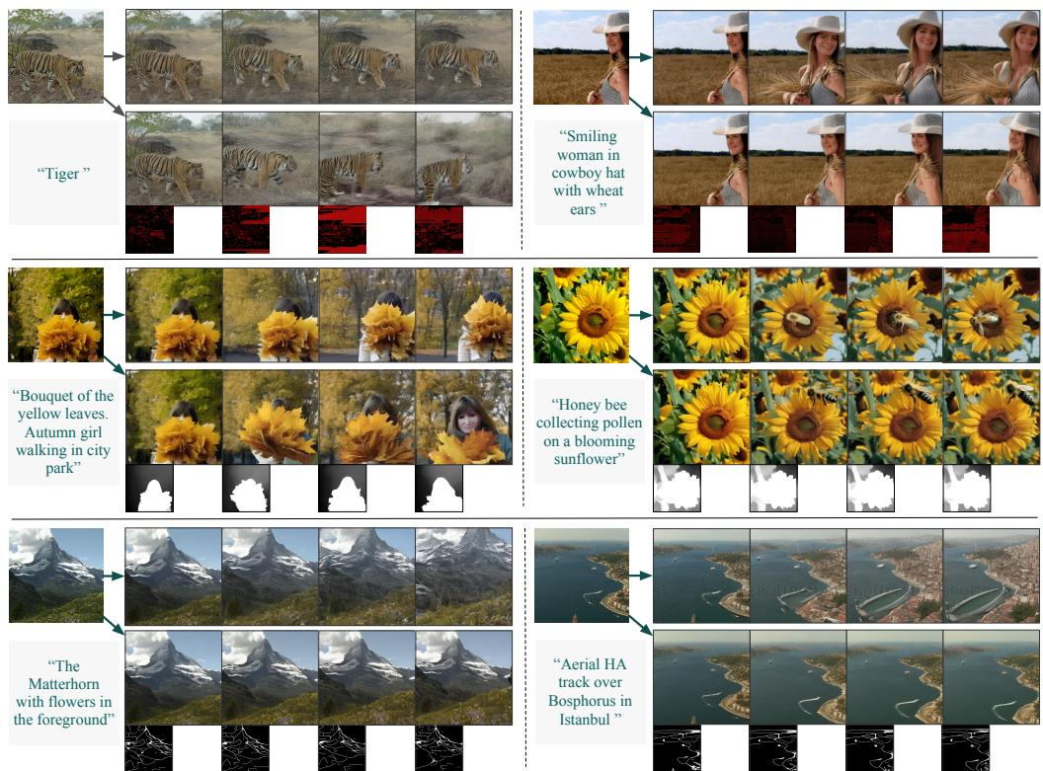
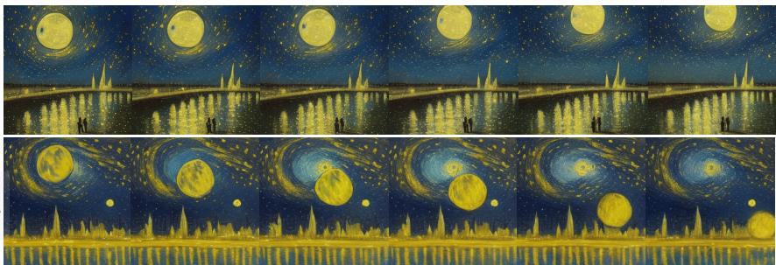
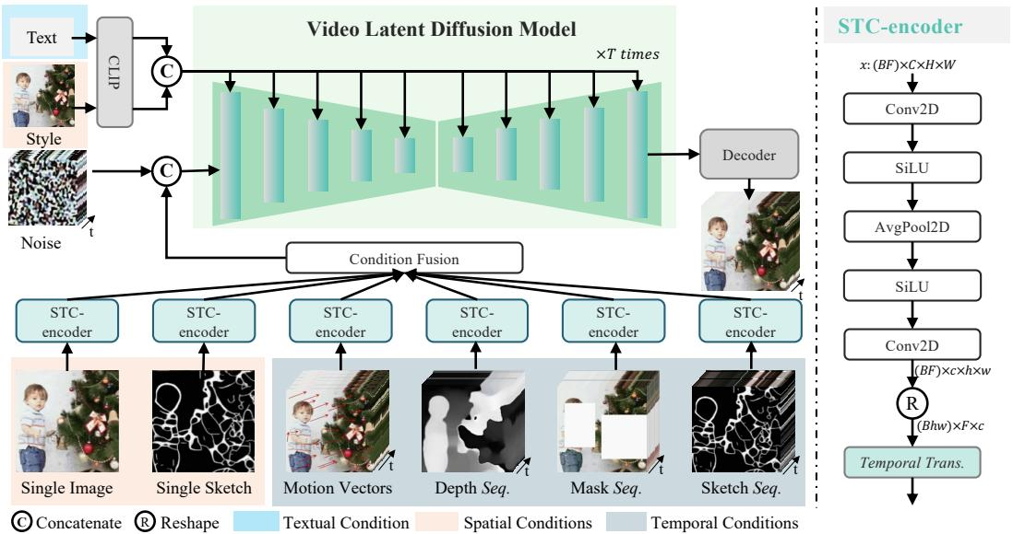
VideoComposer Compositional Video Synthesis with Motion Controllability
Xiang Wang¹⁎, Hangjie Yuan¹⁎, Shiwei Zhang¹⁎, Dayou Chen¹⁎, Jiuniu Wang¹, Yingya Zhang¹, Yujun Shen², Deli Zhao¹, Jingren Zhou¹
¹ Alibaba Group; ² Ant Group
▶ Introduction
▶ VideoComposer
▶ Experiments
•Propose VideoComposer for spatiotemporal controllable video synthesis
•Decompose videos into text, spatial, and temporal conditions
•Train a latent diffusion model to recompose conditioned videos
•Introduce VideoComposer for controllable, highly customized video synthesis
•STC encoder: 2D convs + temporal Transformer unify spatiotemporal conditions
•Leverage four temporal conditions: motion vectors, depth, masks, sketches
•Demonstrates compositional control: image-to-video, inpainting, sketch-to-video.
•Combines depth, sketches, masks, style to strengthen structural control.
•Outperforms Text2Video-Zero and Gen-1 in controllability and appearance consistency.
•Introduce video-specific motion vectors for direct dynamic control
•Present STC-encoder with cross-frame attention for temporal consistency
•Enable flexible multi-condition composition and hand-crafted motion control
•Align, fuse conditions; concatenate with latents; cross-attend text and style
•Optimize with two-stage training: text-to-video pretrain, compositional finetune
•Apply DDIM sampling with classifier-free guidance between condition sets
•Employs motion vectors for flexible, precise, user-guided motion control.
•STC-encoder boosts motion controllability and frame consistency across conditions.
•Quantitative gains: reduced motion error; metrics include CLIP and EPE.
▶ Related Work
•Shift from GANs/VAEs/flows to diffusion for stability, quality, flexibility
•Text-to-image via pixel-space diffusion; guided by CLIP or classifier-free
•Imagen uses large language models to boost fidelity
•LDMs compress with autoencoder for efficient diffusion
•Editing: manipulate cross-attention, embeddings, or masks for text-driven edits
•ControlNet, T2I-Adapter, Composer expand control; video effectiveness remains unproven
▶ Conclusion
▶ Abstract
•Introduce VideoComposer for compositional, controllable video synthesis
•Leverage temporal conditions, especially motion vectors, as control signals
•Design STC-encoder unifying spatial-temporal aggregation for inter-frame consistency
•Combine multiple conditions to boost controllability in experiments
•Demonstrate strong creativity and validate design choices empirically
•Introduces VideoComposer for flexible compositional video control
•Enables text, spatial, and temporal conditioning in one framework
•Uses compressed-video motion vectors as explicit temporal control signals
•Proposes STC-encoder unifying spatio-temporal relations, boosting inter-frame consistency
•Supports diverse inputs: text, sketches, reference video, hand-crafted motions
•Releases code and models at videocomposer.github.io

