Slide 1
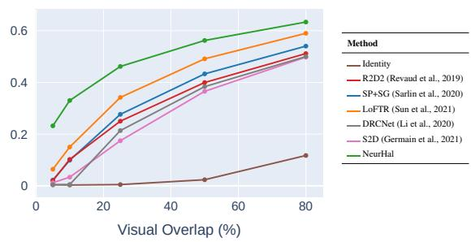
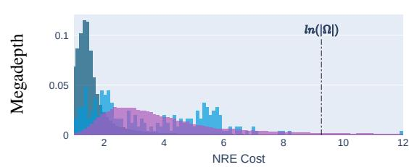
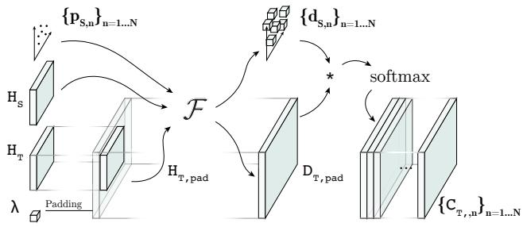
Visual Correspondence Hallucination
Hugo Germain¹, Vincent Lepetit¹, Guillaume Bourmaud²
¹ LIGM, École des Ponts, Univ Gustave Eiffel, CNRS, Marne-la-Vallee, France; ² IMS, University of Bordeaux, Bordeaux INP, CNRS, Bordeaux, France
▶ Introduction
▶ Experiments
▶ Conclusion
•Learn hallucination for non-covisible image regions
•Introduce NeurHal: detects & generates correspondences
•Input: image pair + keypoints → output: per-keypoint target probs
•Architect & loss via problem analysis
•Generalizes to unseen scenes
•Boosts pose estimation beyond SOTA matching
•NeurHal hallucinates correspondences with strong cross-dataset generalization
•Outperforms baselines in inpainting and outpainting correspondences
•More accurate pose estimation under low-overlap conditions
•Introduces first method to learn inpaint and outpaint correspondences
•Analyzes the task to choose loss and design architecture
•Demonstrates strong generalization across unseen indoor/outdoor scenes and datasets
▶ Our Approach
•Train network to localize correspondents despite occlusion and FOV gaps
•Predict per-keypoint probability maps on target image plane
•Unify identification, inpainting, and outpainting via NRE
•SOTA slightly better under high-overlap due to higher-res maps
•Hallucinated outpainting boosts absolute pose robustness
•Overall, hallucination improves pose estimation performance
•Validates on ScanNet, MegaDepth, ETH3D, and NYU
•Boosts absolute pose estimation; outpainted correspondences outperform SOTA feature matching
•Enables robust SfM when few images are available
▶ Ethics Statement
▶ Limitations
•Enhances vision-based industrial apps, especially GPS-denied localization
•Advances robotics and AR relocalization for safer systems
•Enables autonomous driving and drone search-and-rescue missions
•Risks misuse: weaponized UAVs, privacy via environmental re-identification
•Calls for ethical debate and regulatory oversight
•Societal benefits outweigh anticipated harms
•Inpainted maps less peaked than outpainted counterparts
•Architecture limits resolution due to quadratic attention cost
•Finite map extent causes missing correspondents and errors
•Introduce memory-efficient NeurHal architecture with low-res maps
•Use CNN with stride-8 for efficient correspondence map computation
•Low-res maps enable pose estimation via correspondence hallucination
▶ Reproducibility
▶ Abstract
•Release NeurHal architecture + pretrained weights
•Provide eval script for quick qualitative results
•Share notebook demoing indoor smartphone use
•Predicts correspondences despite occlusion or FOV limits
•Outputs peaked keypoint probability maps
•Generalizes to unseen scenes during training
•Enhances robustness for absolute pose estimation vs. SOTA

