Slide 1

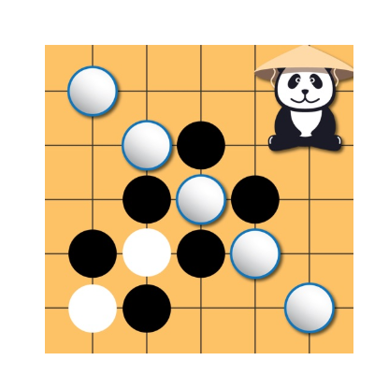
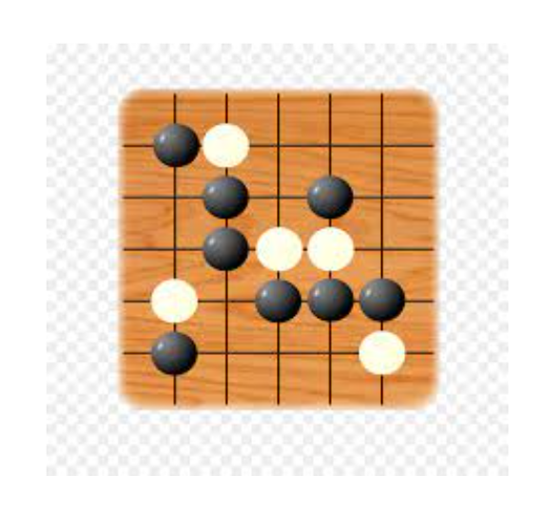
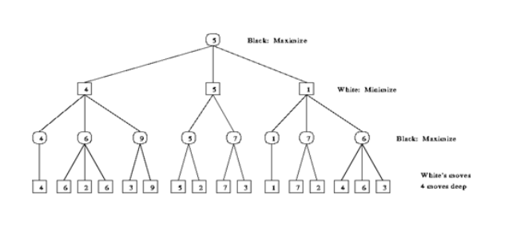
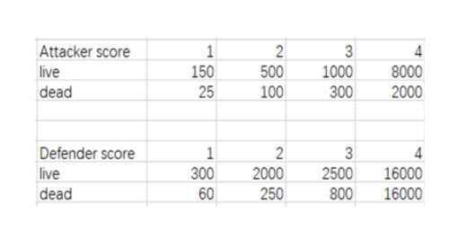
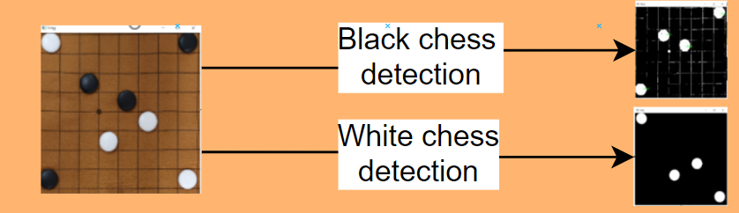
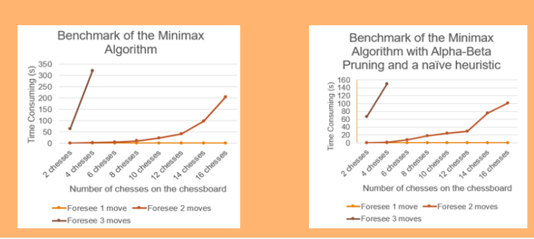
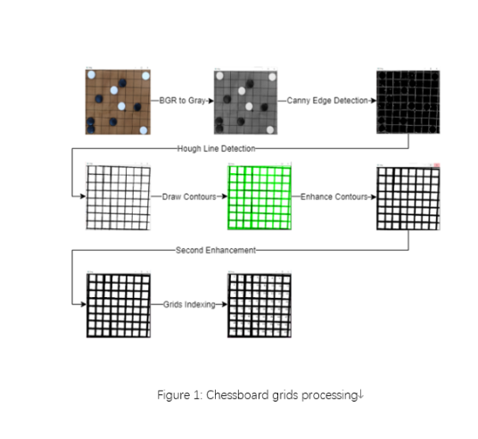
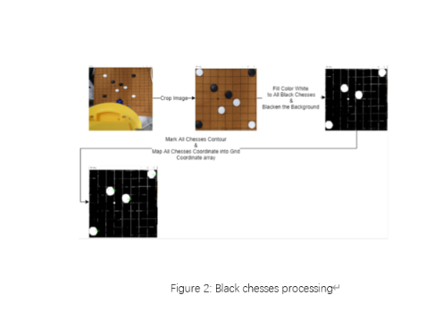
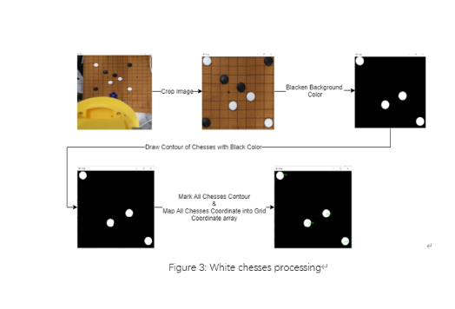
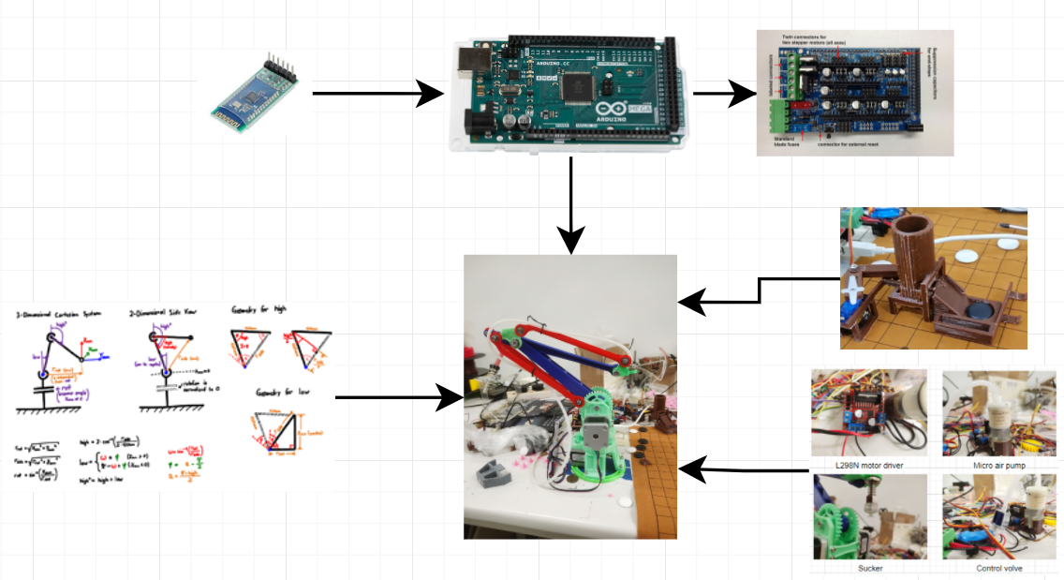
Game App for Pick and Place 3D Printed Robotic Arm
Student Name: Yip Wai Sheung
Supervisor: Dr.T.W.Chim
Abstract
This project proposed to build up a "Compact AlphaGo" which may contribute a new idea for the implementation of an interactive robot. For the software part, an Android chess game application was developed by Flutter with a Flask image processing server which was developed by Python.
The Minimax Algorithm and Alpha-Beta Pruning constructed a "brain" to the AI which is embedded inside the Android app. For the current status, the AI can only foresee 3 steps. A more reliable heuristics for the algorithm should be proposed. Also, image processing was time-consuming, some unnecessary procedures on image processing can be trimmed to speed up efficiency.
For the hardware part, A robotic arm with a chess stacker was built by the 3D modeling software AutoCAD, the cheeses were grasped by the robotic arm precisely and placed on the correct grid of the chessboard. But the chesses can't be placed at the center of the grid. Therefore, using a magnetic chessboard and chesses is recommended.
Minimax Algorithm with Alpha-Beta Pruning
Minimax Algorithm will traverse the tree for the best result which the result is the leaves of the tree. Then backtrack to the root, finally, the algorithm will choose the path which can arrive the optimal leaf, and take its child node, which is along with the path, as the next chess move.
The score sheet shown below is for Maximizer. for the Minimizer, all of the score becomes negative value, and the Minimizer will calculate the sum of all negative score to achieve a minimum value. Each score item shown in the table representing a specific situation of chess pattern.
Methodology
The whole system workflow was simple, it was planned to use a mobile phone, which has two UIs: one for the camera preview and the other one for virtual chessboard, to capture an image of the chessboard.
The image processing procedures were supposed to run within the mobile phone but finally decided to build a Python server to do the image processing procedures by OpenCV, whenever the image processing come up with a result that all the chesses on the chessboard have been located with a unique grid index. Then the system can base on the location of the chesses to calculate a future move that has the highest probability to win the chess game. After that, the command will be sent by g-code to the Arduino Mega board, then it can base on the g-code to fine tune the rotational angle of each stepper motor to control the robotic arm grasp a chess to the grid that was decided by the algorithm.
Result
After around 100 times of experience under the condition of yellow light bulb illumination, the accuracy of chessboard and chesses detection can reach 100%. Under the condition of flash light illumination, the accuracy of chesses detection decreases to around 80%. There are no machine learning algorithms or approaches involved, so the accuracy of the image processing is totally depending on the RGB value of the chesses and chessboard.
As can be seen from the benchmark of the Minimax Algorithm before and after optimization below, the efficiency of the chess game AI is impressively improved. But the algorithm still can’t foresee three or more moves. The improvement is due to the reduction of branching factor and the depth of the minimax tree
Image Processing System
A Gobang chess game must include 3 items: a chessboard, white chesses, and black chesses. By following the computer science problem-solving approach called “Divide and Conquer”, These three items should be counted as three subproblems which are needed to be processed separately. The figure 1, figure 2 and figure 3 show the details of how to process these three items.
Conclusion
The whole project was completed, and all the objectives were achieved eventually, and the experimental result has mentioned.
Some optimization can be done for both software and hardware area in this project. For the software problem, the algorithm efficiency still needs to be improved by some heuristic. To improve the win probability of the AI, some machine learning algorithms can be utilized. Also, the image processing part is still not as intelligent as I thought, which the accuracy under different environment conditions can be improved by implementing the machine learning algorithm, or simply use K-mean as I mentioned before.
For the hardware area, it is suggested to use end-stop which may probably improve the accuracy of motor movement. Also, a quite simple way to place the chess to the center of the grid, the magnetic chesses and chessboard can be used.
Robotic Arm Design
The robotic arm was made by assembled all the 3D printed components of the robotic arm. The geometry structure and kinematic algorithm were contributed by Florin Tobler [1], who is a blogger of Thingiverse. All the resources are available in the open-source community Github. The robotic arm has a vacuum gripper with a self-made chess stacker for automatic chess grasping.
The robotic arm was made by assembled all the 3D printed components of the robotic arm. The geometry structure and kinematic algorithm were contributed by Florin Tobler [1], who is a blogger of Thingiverse. All the resources are available in the open-source community Github. The robotic arm has a vacuum gripper with a self-made chess stacker for automatic chess grasping.
Reference
[1] F Tobler (2016) robotic arm design [Online]. Available: https://www.thingiverse.com/thing:1718984. [2021, January 2].

