Slide 1



X-ray
X-rays are high-energy electromagnetic waves that can penetrate materials, enabling non-invasive imaging and internal structure analysis.
F组：

Slide 2



①
My orgination
X-rays were discovered by Wilhelm Röntgen in 1895 as invisible rays that caused fluorescence on photographic plates.

Slide 3

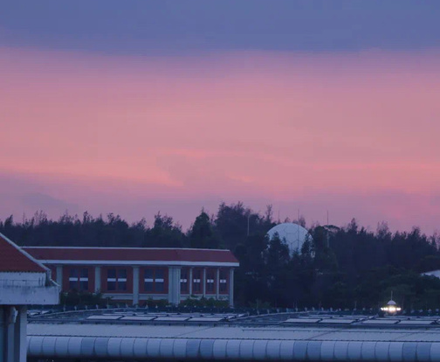
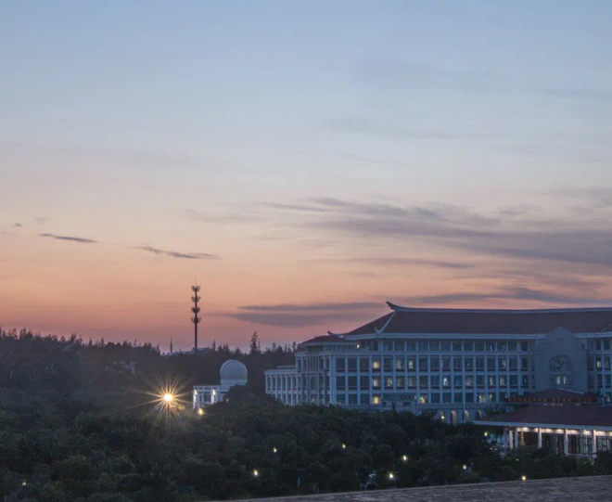
My origination
I’m at
I’m that
I’m everywhere in ur lives---aiports,train stations,subway stations…
I’m from
I’m an electromagnetic wave with a very short wavelength
I was discovered by Wilhelm Röntgen in 1895

Slide 4


My origination
I was doubted
Since I —— X-rays are not as colorful as the light in common sense, I am more like a kind of ghost.
Many scientists
Due to the time
intuitively didn’t believe me
It can’t detect my nature as light
Not identified
After that
until 1912,17 years after I was discovered
I am in a significant role

Slide 5

②
My location
X-rays are commonly used in hospitals, clinics, and laboratories to diagnose bone fractures, infections, and internal conditions.

Slide 6


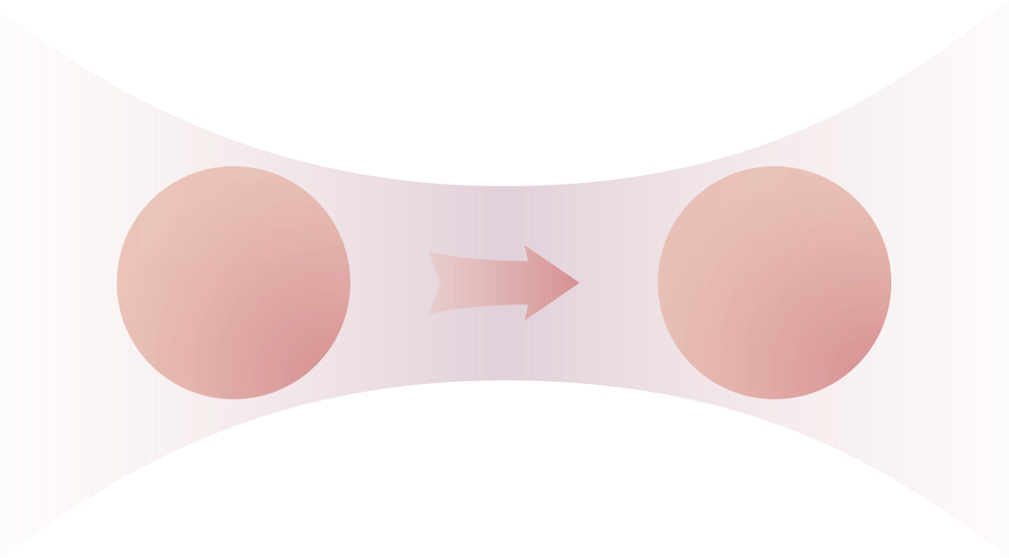


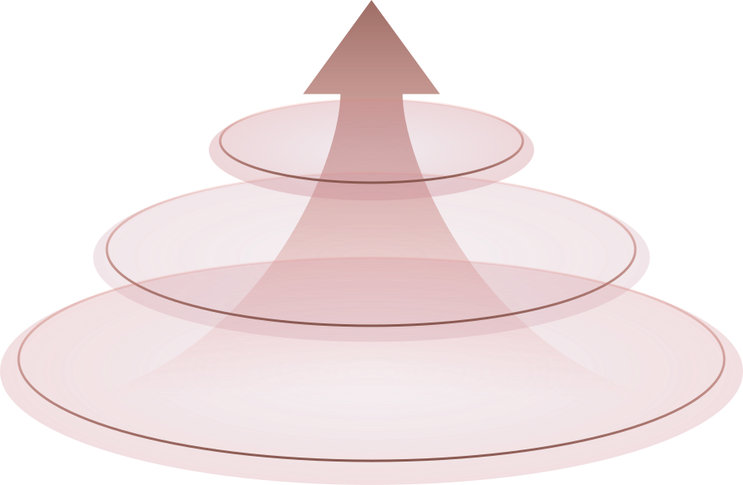


My location: Hospital
When someone break his bone during a football game,I'll be used to examine how serious the wound is to help doctors
check
organ
01
Out of my high energy,I can destroy Pathogens easily,so,I'm also used to cure some illnesses like cancer and lithiasis.
destroy
badness
02
03
Now,I'm used to detect the defects of materials.
detect
packs

Slide 7

③
My usage
X-rays are used to detect fractures, tumors, infections, and monitor the health of bones and organs.

Slide 8
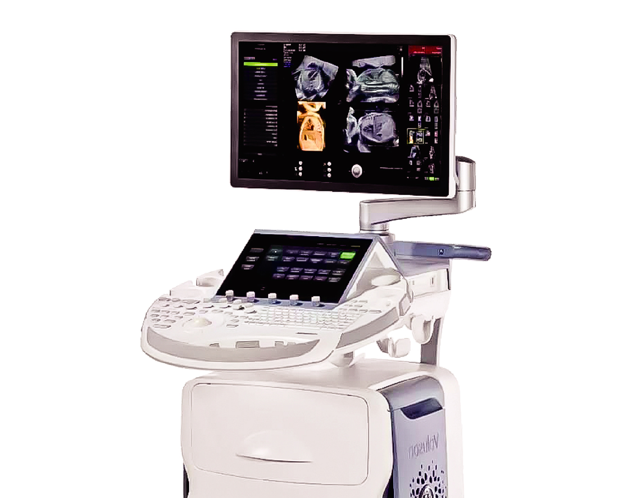

My usage: CT
CT Scans: Enhancing X-Ray Imaging for Detailed Diagnosis
The emergence of CT technology, which utilizes computer technology to record, process, store, and present the results obtained from scans, has enabled the images I produce to be presented more accurately and efficiently.

Slide 9

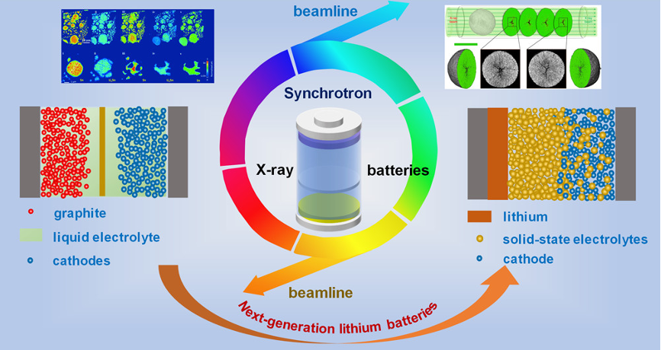
My usage: Tool
A strong tool
At the same time, scientists discovered that extremely strong Xrays can be generated during the operation of synchrotrons, converting energy into powerful rays, which are then widely used in research across fields such as materials, chemistry, environment, and biology.

Slide 10

④
Up to now
X-ray technology is crucial today for diagnosing diseases, guiding treatments, and ensuring safety in various industries

Slide 11


Up to now: DR and SBRT
Digital radiography(DR)
Digital radiography(DR)is widely used,offering clearer and more accurate images of the human body compared to traditional film-based X-ray imaging.
Stereotactic body radiation therapy(SBRT)
Stereotactic body radiation therapy(SBRT)uses a high-precision positioning system to focus on tumor tissues with extreme accuracy,delivering a lethal blow to the tumor while minimizing damage to surrounding healthy tissues.

Slide 12

Up to now: others
I am great in many areas.
In the protection of cultural heritage,I also play an irreplaceable role.
In addition,I also shine in fields such as materials science and security,contributing to the development of human society.
All in all
I am so great that everyone is gazing at me with admiration.

Slide 13
Thank you for watching
感谢您的观看

