Slide 1
HerWatch
Innovative Solutions for Women's Safety
By : Akshay Vardhan
P.Maharshi Revanth
R.Vinoothna

Slide 2
Problem Statement
The increasing incidence of crimes against women in urban areas highlights a critical need for enhanced safety measures. Current surveillance systems lack the capability to analyze gender dynamics and detect potential threats in real-time. This project aims to develop a Women Safety Analytics software that leverages advanced analytics and real-time monitoring to create safer environments for women and assist law enforcement in preventing and addressing crimes

Slide 3
Abstract
Women Safety Analytics is a proposed software solution designed to enhance the safety of women in public spaces through real-time monitoring and advanced analytics. By employing computer vision and machine learning techniques, the system will detect individuals, classify gender, and identify potential threats based on behavioral patterns. Key functionalities include monitoring gender distribution, detecting lone women at night, recognizing SOS gestures, and identifying hotspots for incidents. This proactive approach aims to empower law enforcement and create safer environments for women, ultimately contributing to a reduction in crimes against women.

Slide 4
Existing System and Proposed Solution
Existing Systems | Proposed System
Apps like "bSafe" and "Raksha" require manual trigger. | AI-based automatic detection of distress gestures and lone woman presence.
No real-time video processing to identify SOS gestures. | Real-time video analysis for SOS detection and night surveillance.
Lack of predictive crime hotspot analysis. | Interactive hotspot map based on historical crime datasets.
Fragmented user experience. | Unified platform integrating gesture detection, lone woman detection, and crime hotspot visualization.

Slide 5
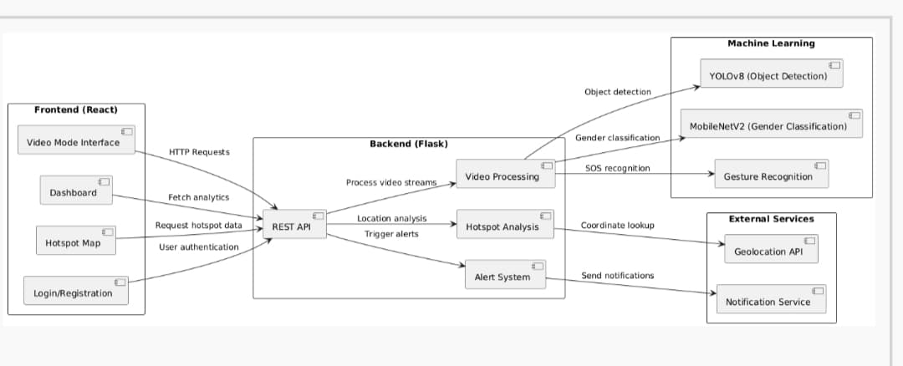
System Architecture

Slide 6
Technology Stack
Frontend: React.js, HTML5, CSS3
Backend: Flask (Python)
Deep Learning Models:
YOLOv8 (yolov8n.pt) for person detection.
MobileNetV2 for gender classification.
Libraries: OpenCV, torch, ultralytics, pandas, scikit-learn, Leaflet.js (maps).
Dataset:
women-crimedataset-India.csv (Crime statistics across states and years in India)
Custom annotated video data for SOS gestures and lone woman scenarios.

Slide 7
Results and Screenshots
Main Modules:
SOS Gesture Detection: Real-time alert triggered upon detecting waving gestures indicating distress.
Lone Woman Detection: Detects a lone woman especially during night times and raises alerts.
Hotspot Map: Interactive map displaying regions with high crime rates against women.

Slide 8
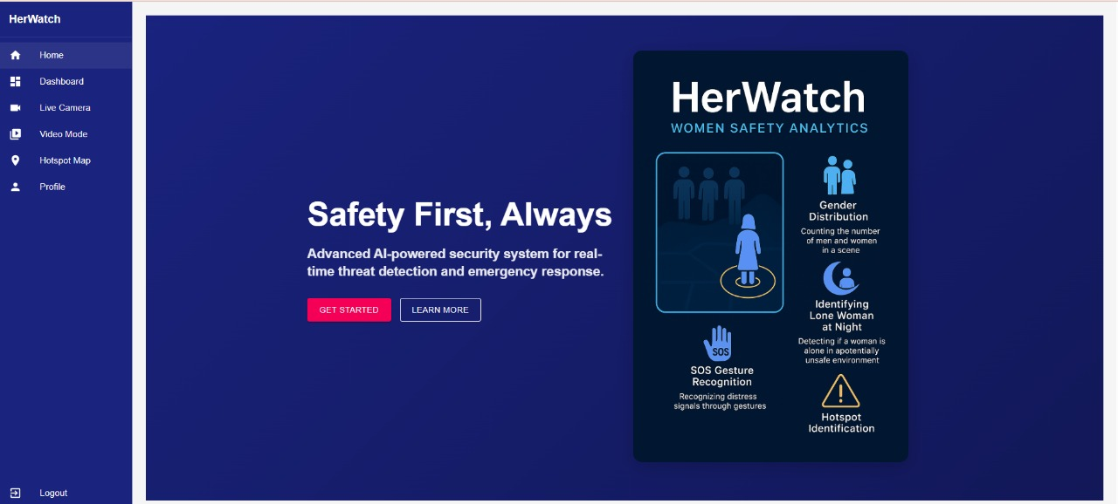
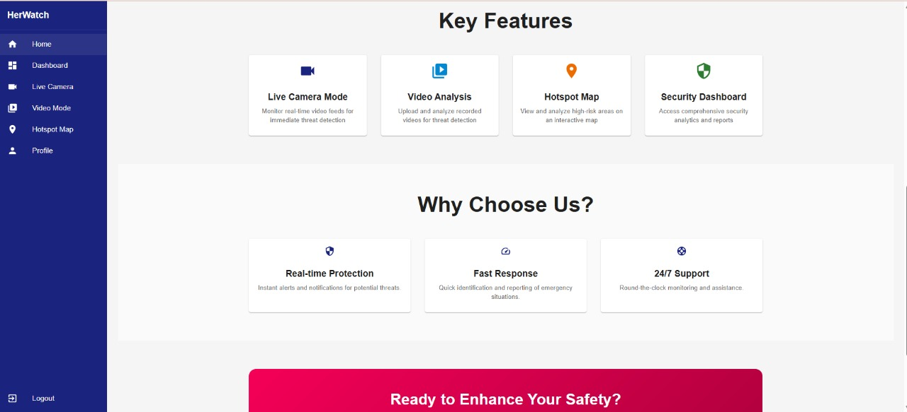
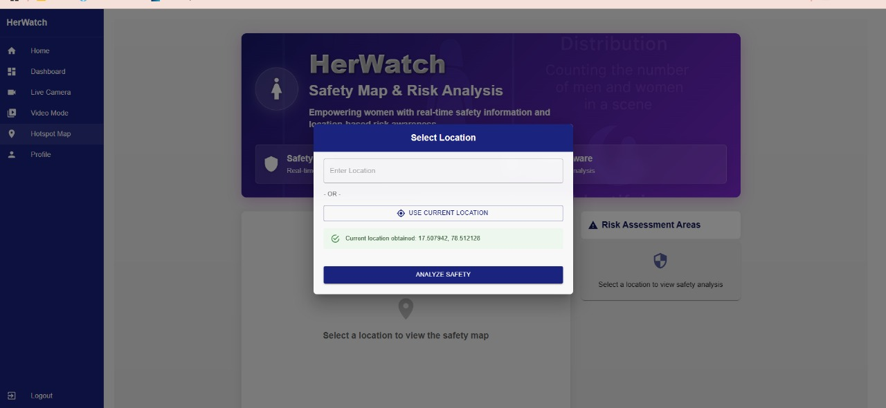
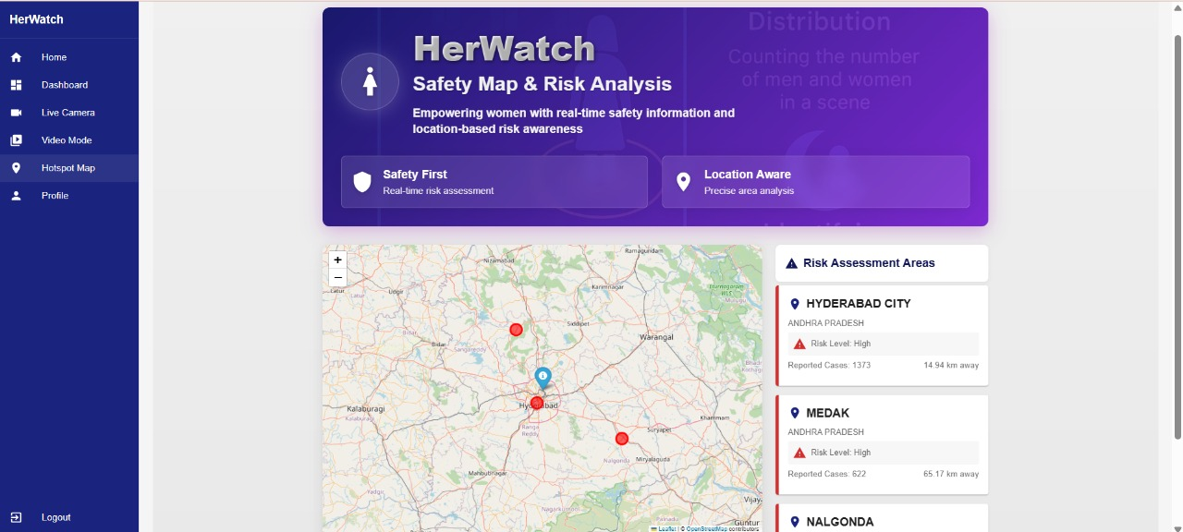

Slide 9
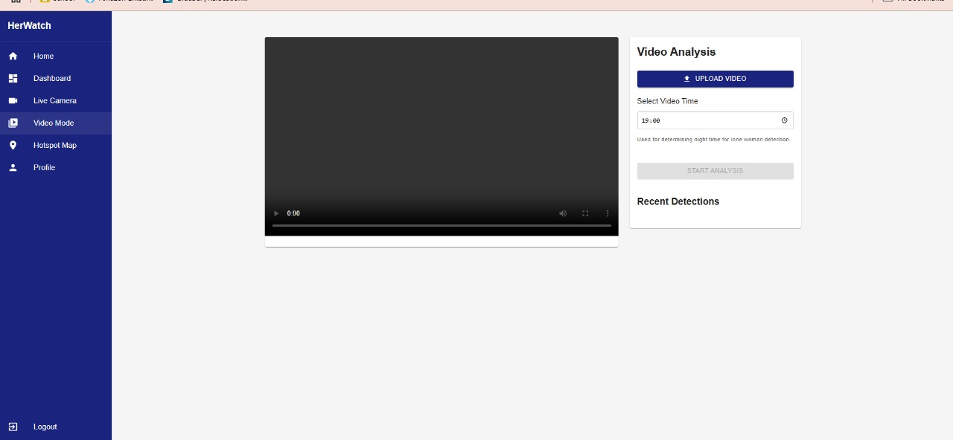
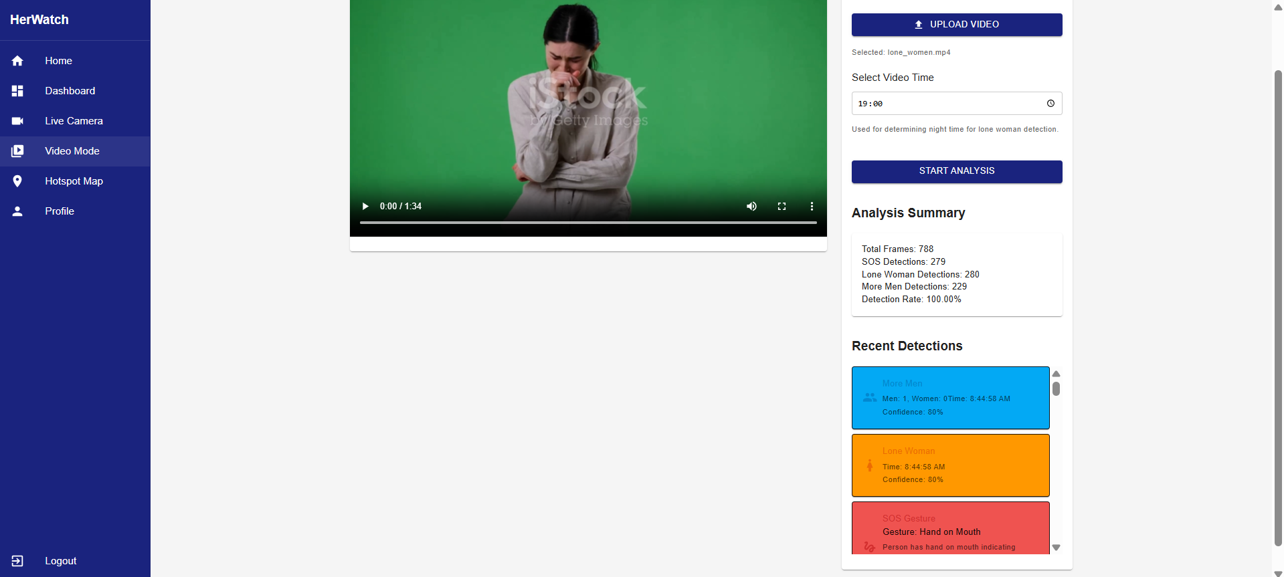

Slide 10
Conclusion
The HerWatch project addresses the urgent need for enhanced safety for women in public spaces through advanced technologies like computer vision and machine learning. Key features include:
Real-Time Gender Classification
Lone Woman Detection
SOS Gesture Recognition
Hotspot Identification
By providing actionable insights, we empower law enforcement to intervene proactively, fostering a safer environment for women. Our commitment to refining this technology and engaging with communities will help create a future where women feel secure in their surroundings.

Slide 11
Future Scope
Integrate emergency contact auto-notifications upon distress detection.
Expand the SOS gesture library with more types of gestures (e.g., hand signals).
Introduce voice-command-based SOS triggers.
Real-time GPS tracking and route recommendation to avoid hotspot regions.
Integration with city CCTV feeds for larger-scale monitoring.

Slide 12
References (in MLA Format)
1."Her Watch" Project. Her Watch AI-powered Women Safety System, 2025. www.herwatch.ai
2.Singh, Mahesh Kumar, et al. "A Smart System for Tracking and Analyzing Human Hand Movements using MediaPipe Technology and TensorFlow." Demystifying Emerging Trends in Green Technology. Bentham Science Publishers, 2025. 201-218..https://mediapipe.dev
3. Jayaraj, Justin, et al. "Person Detection using Proposed YOLOv8 algorithm." 2025 IEEE 14th International Conference on Communication Systems and Network Technologies (CSNT). IEEE, 2025.
4.Hamza, Nisreen Ryadh. "Gender Classification from Human Face Images Using Deep Learning Based on MobileNetV2 Architecture." Journal of Al-Qadisiyah for Computer Science and Mathematics 17.1 (2025): 145-156..https://www.tensorflow.org
5.Lawson, Andrew B. "Hotspot detection and clustering: ways and means." Environmental and Ecological Statistics 17 (2010): 231-245. https://ncrb.gov.in

Slide 13
Thank You … ^^

