Slide 1
Consumer Reviews of Amazon Products
Team 03
Janani Vasudevan
Silky shah
Vinay Vihari Lakamsani
Radhika Malviya
Xiaoxu Xing

Slide 2

Agenda
Data Description
Data Pre-Processing
Exploratory Data Analysis
Modelling
Findings
Deep dive for a product
Recommendations

Slide 3
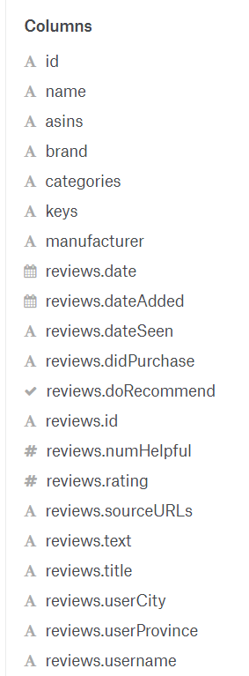
Data Description
Data Source https://www.kaggle.com/datafiniti/consumer-reviews-of-amazon-products
Product Database
The dataset includes basic product information, rating, review text, and more for each product.
The dataset contains about 37 attributes and a list of over 34,000 consumer reviews for Amazon products
Customer reviews are included which has both rating and text.

Slide 4
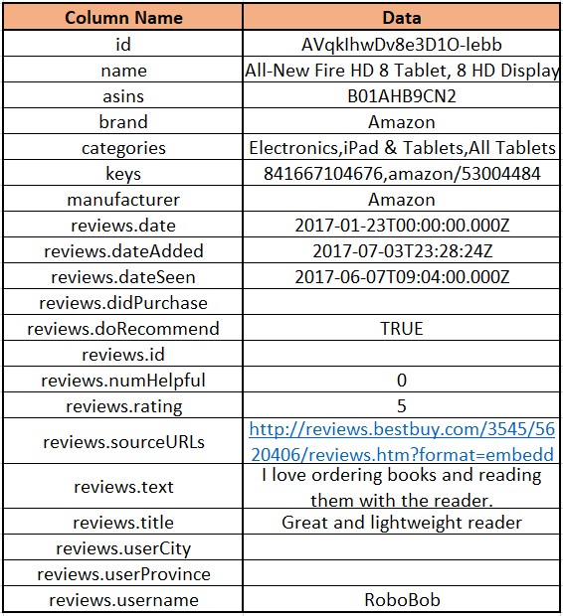
Data Description
Example

Slide 5
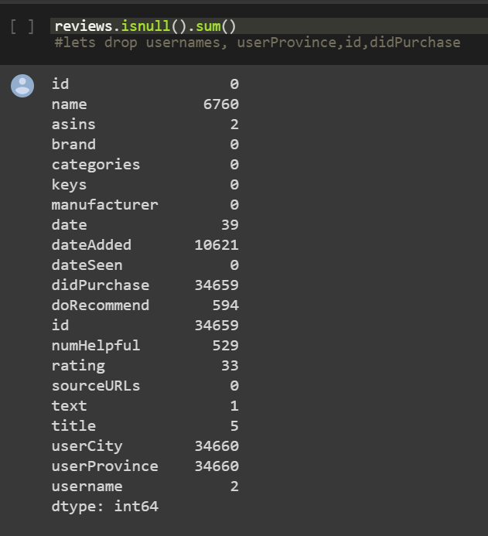
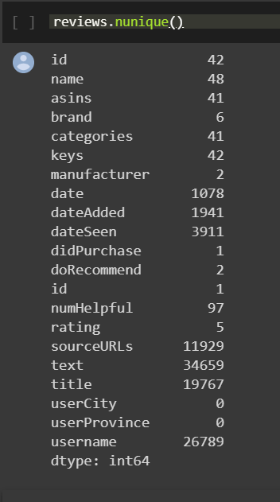
Data Description
Missing Values and Unique Values for each attribute

Slide 6
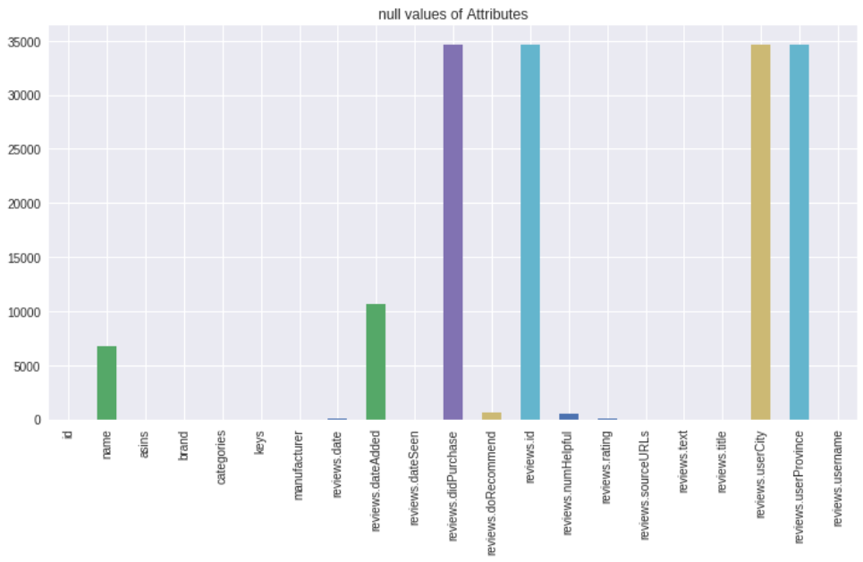
Data Description
Null values
The columns reviews.didPurchase, reviews.id, reviews.UserCity, reviews.UserProvince have null values for more than 34000 rows.

Slide 7
Data Pre-Processing
Drop unwanted variables
Variables chosen are Date, Date added, Rating, Review text, Review title
Filtering non null values which are assigned to array “check”
Classifying reviews as positive and negative based on the ratings provided.
Filter non null values
Classification
Cleaning
Data partition
Ratings | Text classification
>=4 | Positive
<4 | Negative
Tokenizer
Stop words Removal

Slide 8
Data Pre-Processing
Drop unwanted variables
Cleaning the review text
Converting to string
Convert text to lower case
Removing characters like symbols
Data partition into Training and test.
Train : 75%
Test : 25%
Tokenizing each review text into words, for both training and test data set
Stop Words such as articles and prepositions are eliminated
Filter non null values
Classification
Cleaning
Data partition
Tokenizer
Stop words Removal

Slide 9
Data Description
Input variable | Target Variable
reviews.rating reviews.text reviews.title | reviews.senti
GOAL :
Analyse the reviews.text and reviews.title and assign appropriate sentiment to reviews.senti variable based on the reviews.rating.

Slide 10
Exploratory Data Analysis

Slide 11
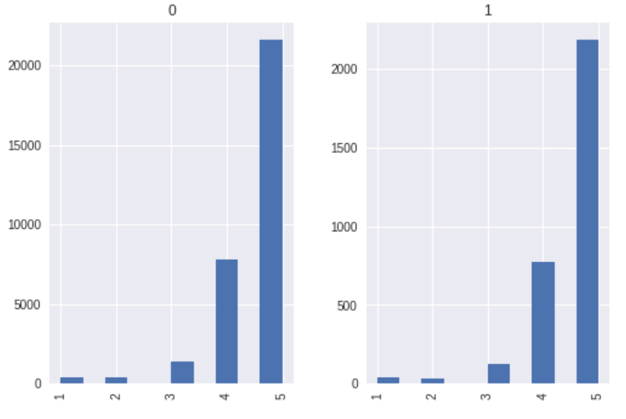
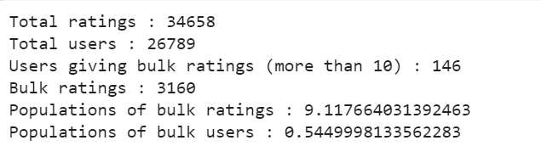
Are all reviews given by same group of users?
The following are some interesting facts:
1) Only 0.55% of users are bulk users
2) Around 9% of ratings have been submitted by 0.55% of users

Slide 12
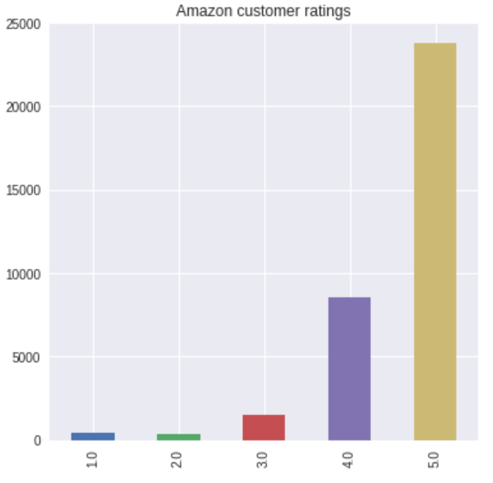
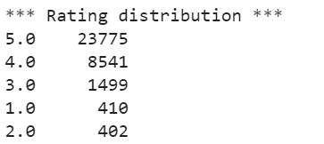
Distribution of User Rating

Slide 13
Net Promoter Score of Amazon
What is NPS Score?
It is an index ranging from -100 to 100 that measures willingness of customers to recommend a company’s products or services
Rating 1,2,3 - Detractors
Rating 4 - Passive
Rating 5 - Promoters
NPS = (Promoters - Detractors)/Total ratings * 100
NPS Score of Amazon is 61.99

Slide 14
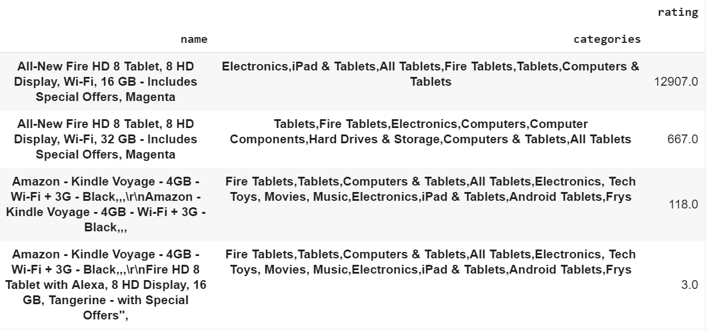
What is the most reviewed Product on Amazon in last 90 days

Slide 15
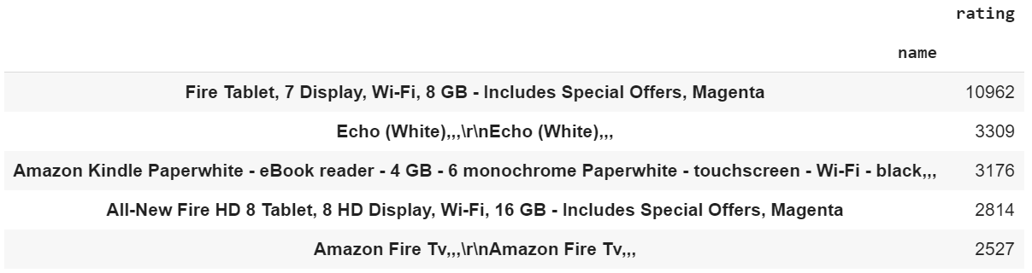
What is the most reviewed Product on Amazon

Slide 16
Modelling

Slide 17
Naïve Bayes classifier
Simple classification of words based on ‘Bayes theorem’
For a document d and class c , By Bayes theorem
P(c|d)=P(d/c)*P(c) / P(d)

Slide 18
Models
Multinomial NB
Bernoulli NB
Models the number of discrete counts of a feature.
Number of times outcome number is observed in n trails (TF)
Models the presence/absence(0,1) of a feature.
Bag of words where 0,1 as classification.
Trail: word occurs in document and doesn’t occur

Slide 19
Naïve Bayes classifier
Sentence to Words
Lemmatize & Stemming
Remove Stop Words
Model Fitting

Slide 20
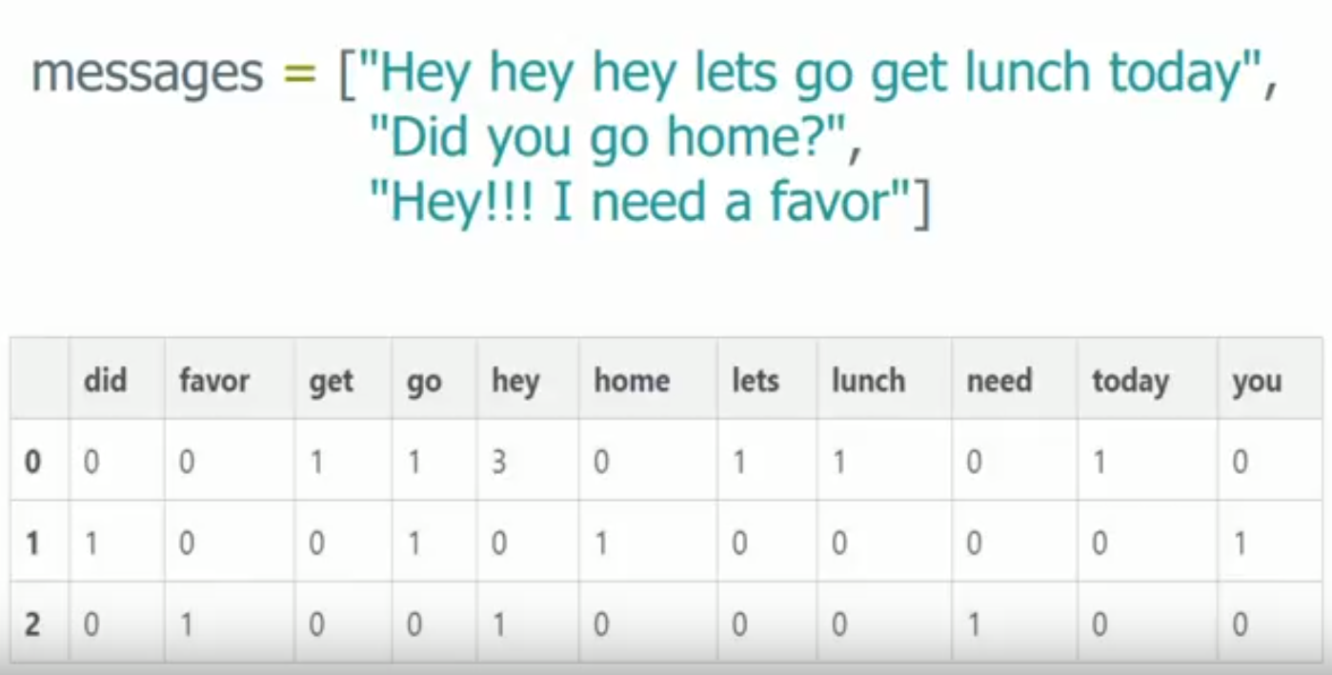
Count Vectorizer
Each message is separated into tokens and number of times each token occurs in message is counted and uses this value as its weight

Slide 21
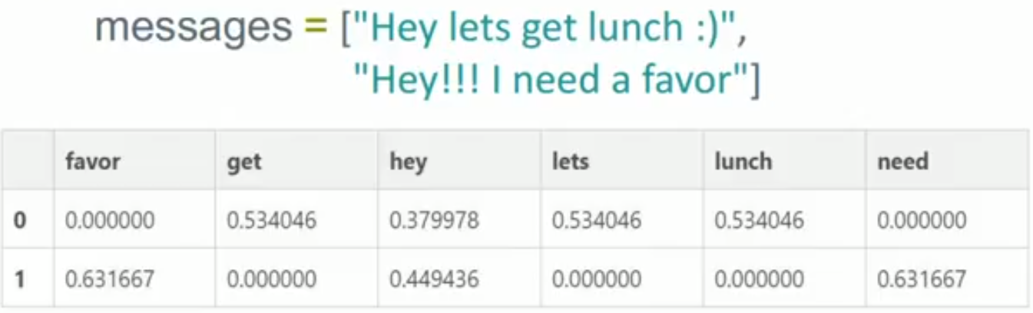
TFIDF vector
Term Frequency and Inverse Document Frequency
Weight is statistical measure to check how important a word is to a document in a collection.

Slide 22
Fitting Models
NLTK Naïve Bayes
Multinomial
Bernouli Naïve Bayes
Logistic Regression
61.5%
93.2%
92.2%
93.4%
Confusion Matrix | Actual Positive | Actual Negative
Predicted positive | True Positive | False Positive
Predicted Negative | False Negative | True Negative

Slide 23
Precision, Recall & F1-Score
Metrics | Multinomial NB | Bernouli NB | Logistic Regression
Precision(+ve) | 0.00 | 0.37 | 0.52
Precision(-ve) | 0.93 | 0.94 | 0.95
Recall(+ve) | 0.00 | 0.19 | 0.36
Recall(-ve) | 1.00 | 0.98 | 0.98
F1-Score(+ve) | 0.00 | 0.25 | 0.43
F1-Score(-ve) | 0.96 | 0.96 | 0.97

Slide 24
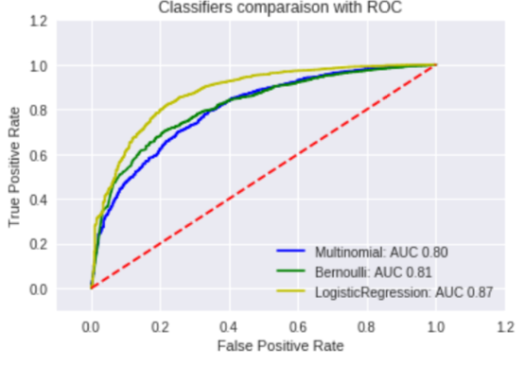
Model comparison ROC Curves
Logistic NB Performs better than the remaining all Models.
Bernouli and Multinomial NB has the similar performance.
Model | AUC
Multinomial NB | 0.80
Bernouli NB | 0.81
Logistic Regression | 0.87

Slide 25
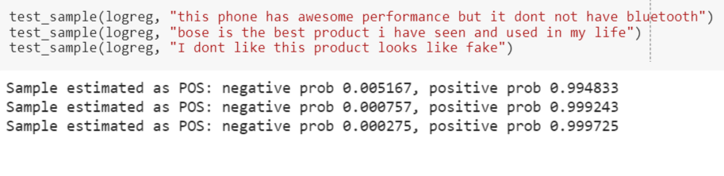
Testing for sample

Slide 26
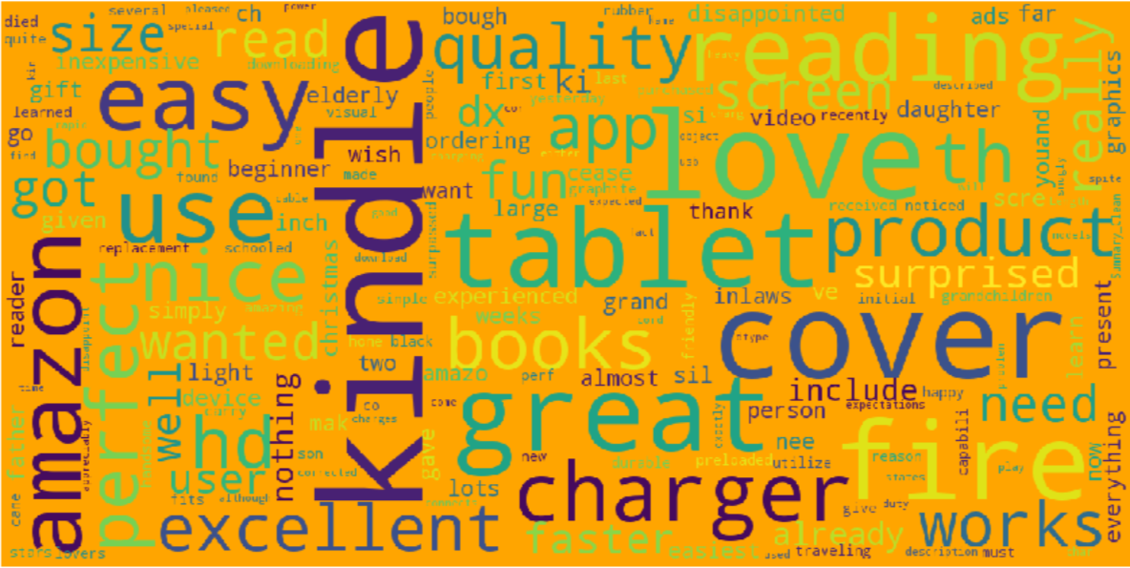
Bag of Words

Slide 27
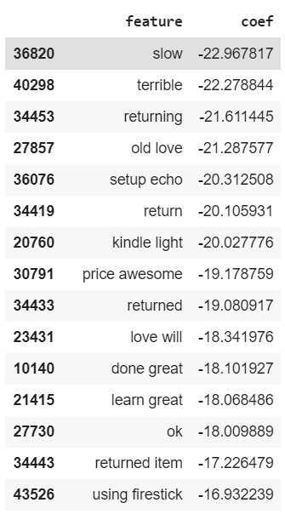
Most occurring words in training set

Slide 28
Repeated Words
Positive Reviews
Wanted
Negative Reviews
Amazon
App
Tab
Use
Cover
Kindle
Love
Reading
Great
Perfect
Wanted
Good
Great
Use
Charger
Hoping
Buy
remote
bought

Slide 29
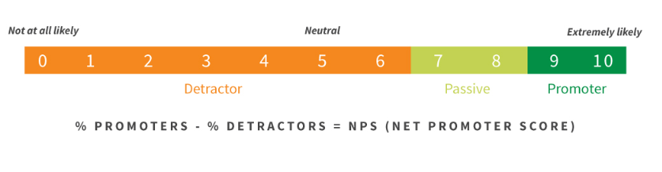
Deep Dive of a product
Analysis of Kindle
Check for the null values
Analysis of Kindle’s rating
Net Promoter Score – 77.08%
Measures customer experience and predicts business growth

Slide 30
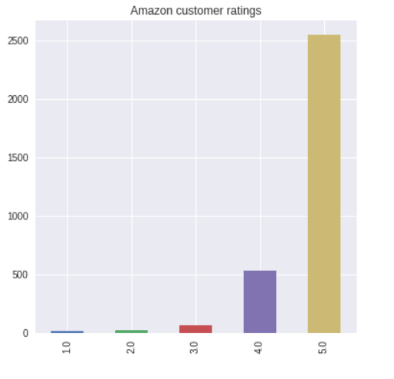
Distribution of Rating

Slide 31
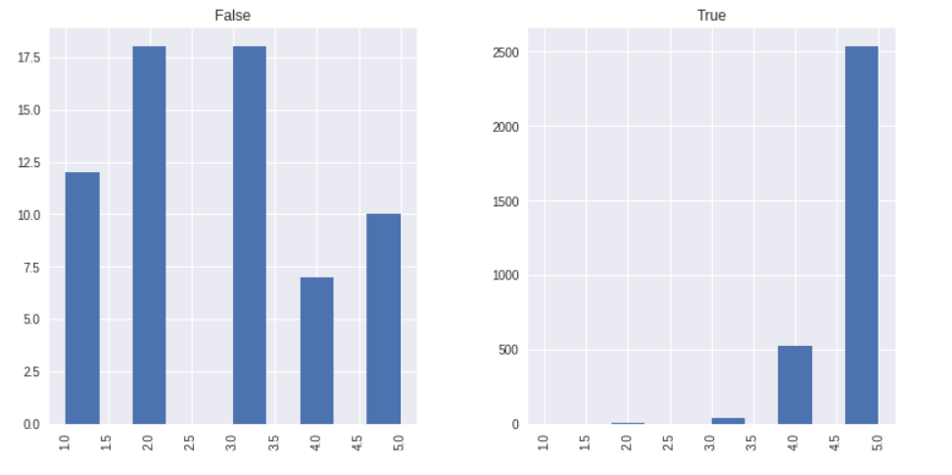
Recommendations
Non Recommenders
Recommenders

Slide 32
Findings
Those who recommend amazon kindle generate high NPS score of 98.23
Those who DO NOT recommend kindle produce a NPS score of 20.0

Slide 33
Business Recommendations
On the Webpage, highlight the traits of product or keywords that have most positive effects
The company can market research and work on product development against the reviews that have negative effects
Provide Incentives/promo code in order to encourage customers to give more reviews.
Provide referral promo code in order to encourage customers to recommend the products to others.

Slide 34
Business Recommendations
Amazon will get to know what is trending and emphasis on increasing the supply of trending product.
Amazon can analyse negative effects and improve on their customer retention model and improve customer service.
Forecast market movement based on news, blogs and social media sentiment.

Slide 35
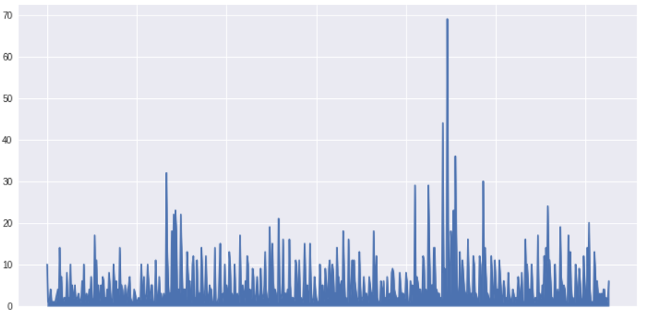
Plots: Time series for reviews

Slide 36
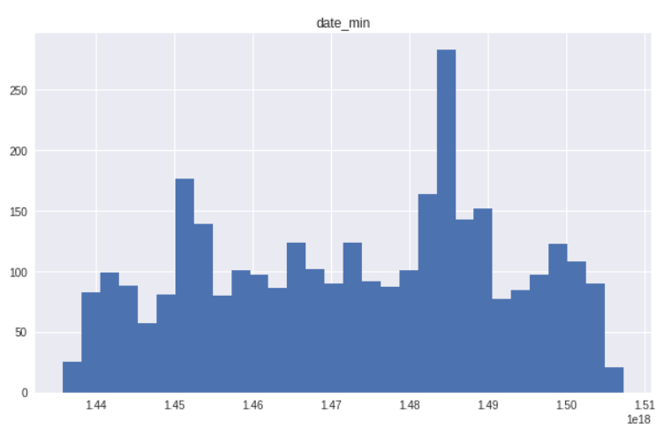
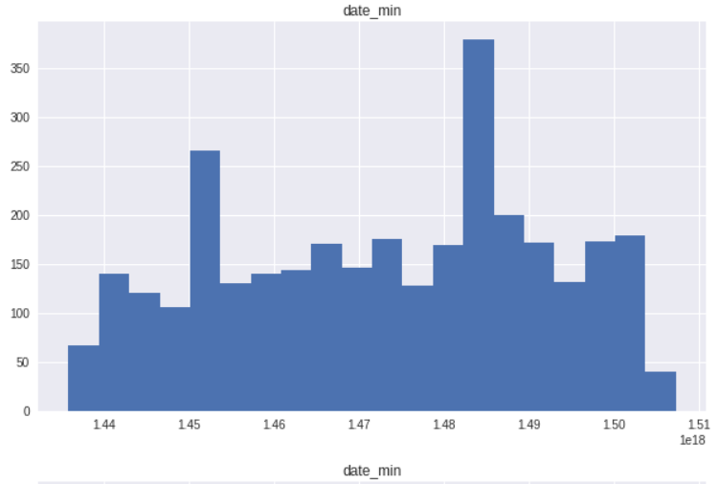
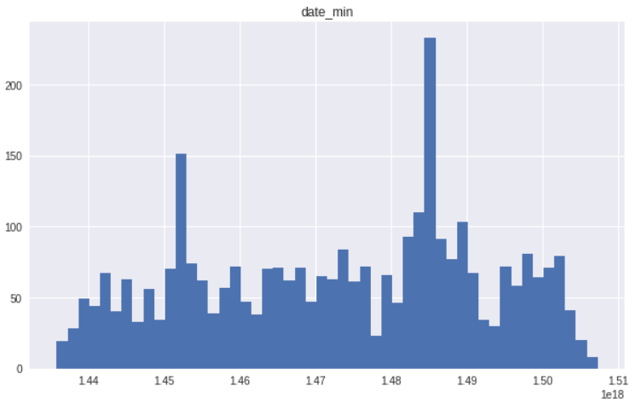
Plots: Time series for reviews

Slide 37
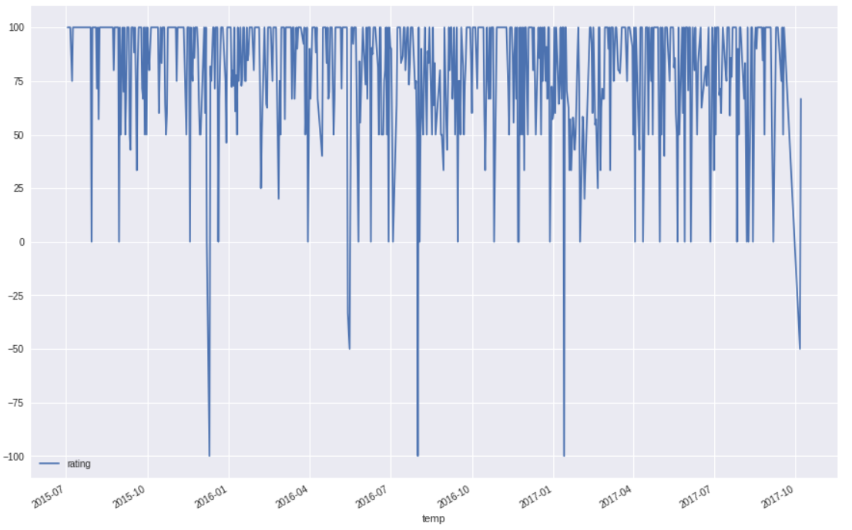
Plots: Time series for reviews

Slide 38
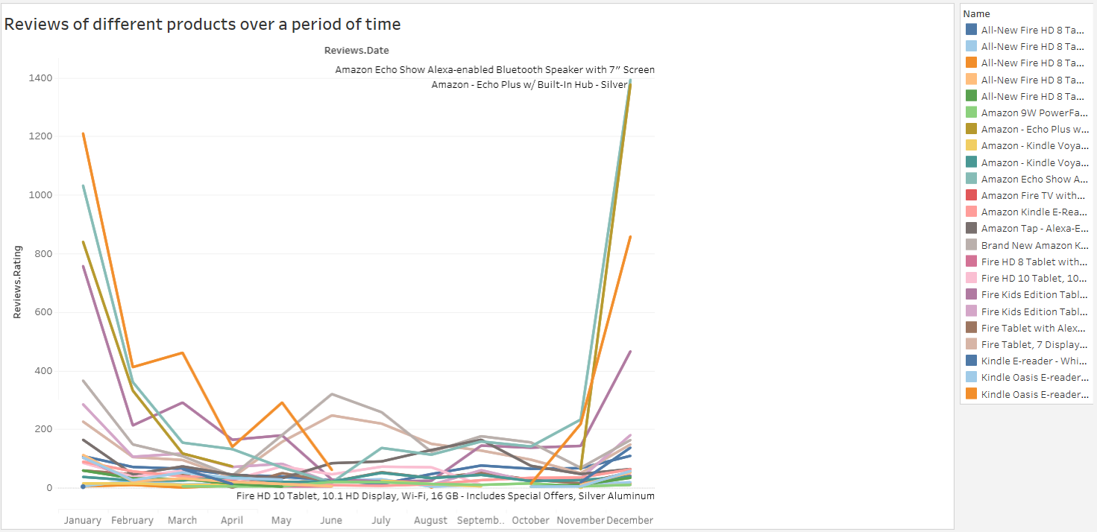
Plots: Rating over month

Slide 39
Thank You & Any Questions ?

