Slide 1
Complex Problem
Wayfair

Slide 2
agenda
Background
Objective

Slide 3
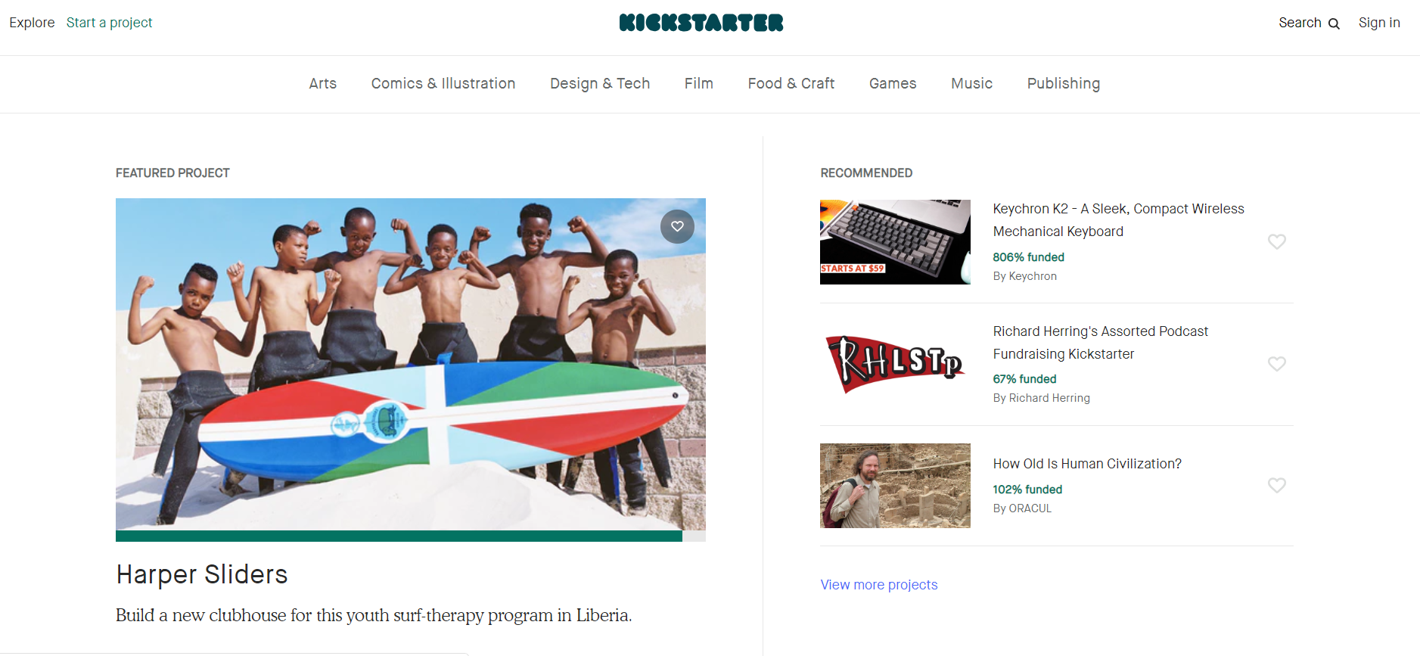
Background
Kick Starter is website which holds start up Projects Ideas for funding from crowd.
Moto : ”Help bring creative projects to life"
Only 35% of projects reached their funding goals.
Total pledged amount of over $4 billion.
15.5M backers to fund 257, 000 projects

Slide 4
Objective
Client Main Objective:
To Increase the company Revenue and reputation by giving the best recommendations to its users and identifying the fraud Projects.
Identified sub goals:
To Identify the Fraud Projects and Fake backers in the kick-starter website.
Finding the Probability of project being successful.
Identifying the optimal parameters for the best Projects.

Slide 5
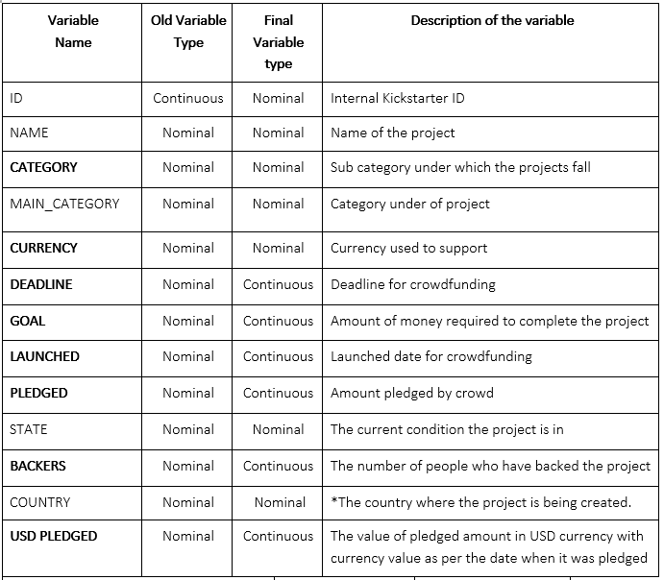
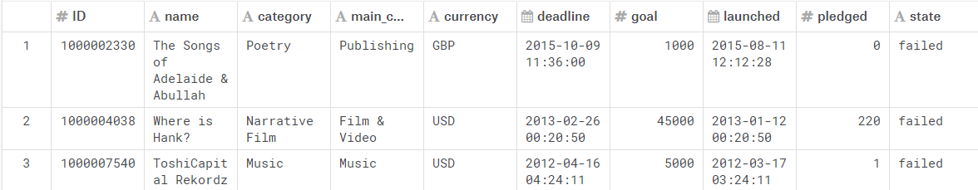
Data
Target: cancelled, failed, live, successful, suspended and undefined
323,750 observations with 13 variables
The categories are Art, Comics, Dance, Design, Fashion, Film & Video, Food, Games, Journalism, Music, Photography, Publishing, Technology and Theatre.

Slide 6
Problems we Faced
Missing data
Data Inconsistency
Currency conversion
Evaluating cost of Error

Slide 7
Issue 01: Missing Data
We had missing values in country and description Field.
After removing the missing data rows we had 320,661 observations.-2% data Lost.
Recommendation:
In Future, These fields has to be made mandatory which reduces the fake Projects.

Slide 8
Issue 02: Data Inconsistency
3082 records with Backers = 0 and Pledged amount > 0 are removed
Some start date are not correct far beyond website start date- launch date of project before 2009.
Most of the variables are not source verified like Backers, Project requirement.
Recommendation:
There should be some source verification for backers and Project-mandatory card details or minimum amount.

Slide 9
Issue 03: Currency Conversion
Pledged amount can be of different currencies which make problem in modelling.
Converting it into one currency USD
Methods:
New variables are created like ratio of Pledged amount to backed amount but cannot be used always.
Exchange rate at 2018.10.31 was used for USD conversion.
Using only USD currency observations for modelling -85% data.

Slide 10
Models
Decision tree, Random Forest, Boosted Tree, Logistic Regression, Neural Networks and Ensemble models were built using Python Notebook, JMP.
Evaluation based on cost of error and AUC.
Best accuracy for Random Forest model with 88% accuracy form base accuracy of 65%.

Slide 11
Issue 04: Cost of Error
Assumptions:
General bank interest rate of 10%.
Profit could be at least 40% of the investment
Cost of error for false positive equals to $20.49.
Cost of Error for False Negative which is $68.32
Methods:
Website Recommendation: reduce FP
Recommending Project: reduce FN
Investors : reduce FN
 | (0) actual Project Failed | (1) actual Project success
(0) Predict as Failed | TN | FN-Type 2 Error Cost=$68.32
(1) Predict as Success | FP –Type 1 Error Cost=$20.49 | TP

Slide 12
Insights
As Pledged amounts averaging eleven times more than failed projects.
Funding amount increases for duration between 30 and 50 days.
can hypothesize that smaller projects are more likely to attract a larger number of backers.
The category of Games received the largest number of Backers, whereas Crafts received the least number of Backers.
2009 recession, there was a decline in the number of Backers.
That successful projects had funding goals averaging six times less than failed projects.

Slide 13
Recommendations
Projects with Goal amounts over 2 Million should not be considered for launching.
For data to be valuable and accurate, Pledged amounts should always be associated with a Backer.
Estimated Start Date and End Date should always be included in analyzing and modelling data so as to provide more accuracy in predicting duration of projects.
The company should take efforts to verify the Goal amount.
Overall, we obtain 99.765% accuracy. So, if someone is going to invest in starter project just before funding duration then they can be 99.765% accurate in their prediction.
Country column should be made a required field because the currency of Goal and Pledged amounts.
Enable feedback system to the backers for each Project Idea.

Slide 14
Resulting Business Impact
Increased percentage of projects that being backed by 5%.
Number of new projects ideas being registered increased by 14%
Reputation has been increased - verified by feedback system.
7% increase in Revenue generation mainly due to recommending successful projects.
Fake Projects and Fraud projects are totally controlled.

Slide 15
Questions

Slide 16
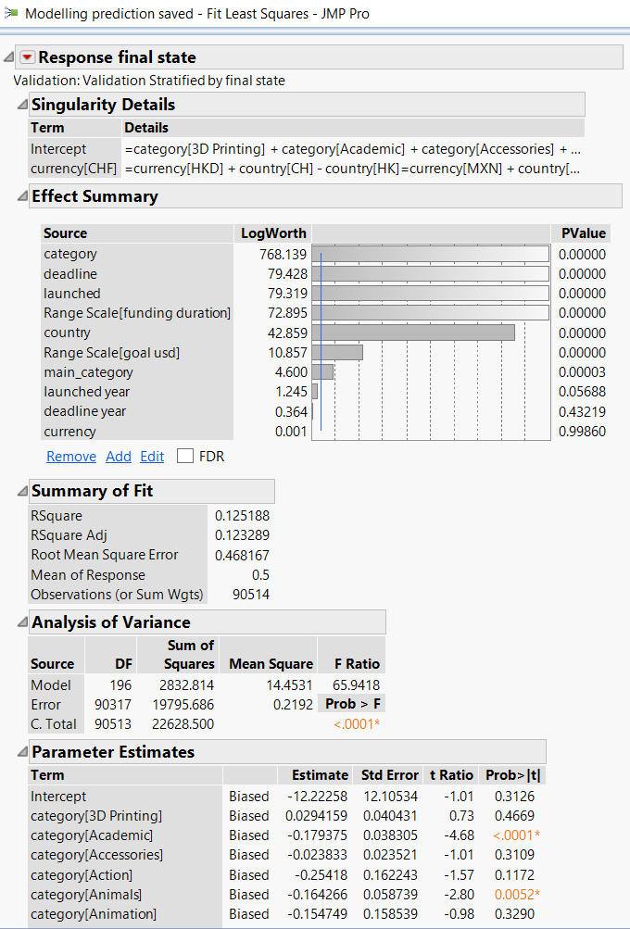
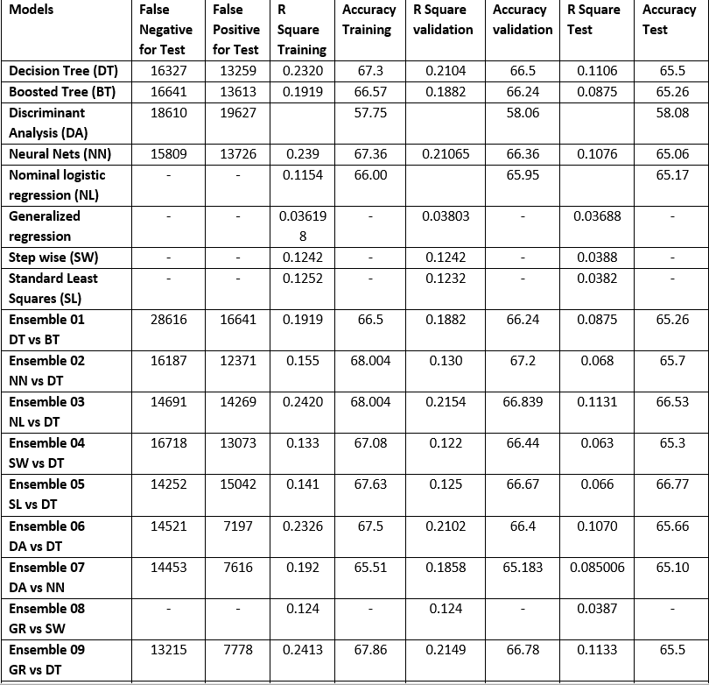
Appendix 01

Slide 17
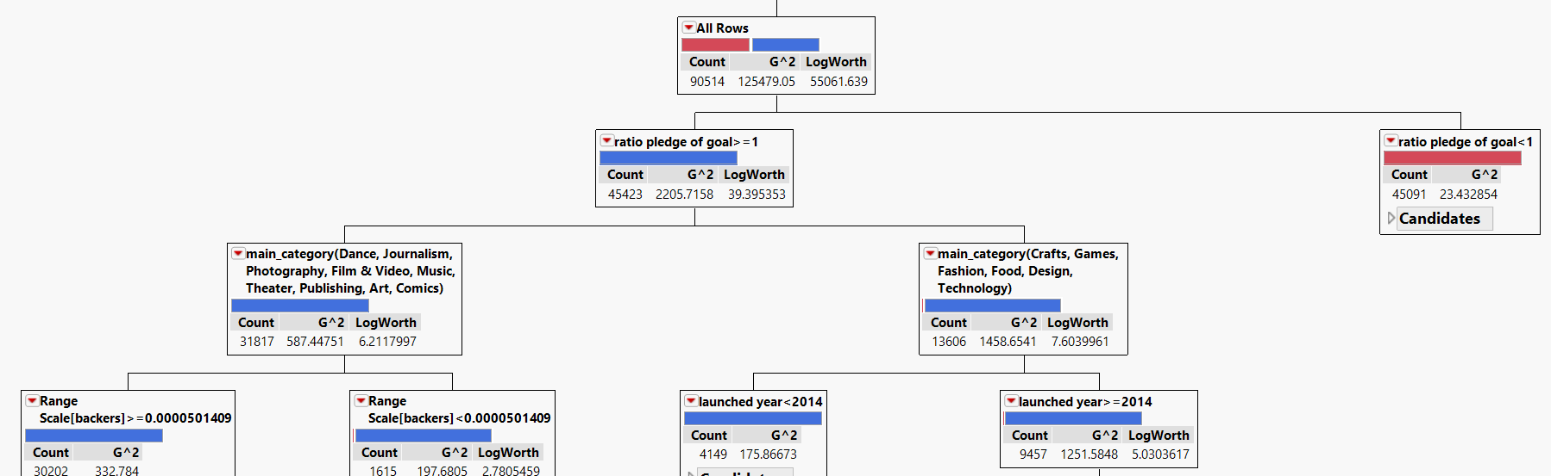
Appendix 02

