Slide 1
NYC Taxi Trip Duration
Team 3
Vinay vihari lakamsani

Slide 2
Agenda
Introduction
Objectives
SEMMA approach
Sample- Kaggle.com
Explore
Modify
Model
Assess
Results and Recommendation
Improvements

Slide 3
Introduction
NYC yellow cab provide over 1.2 million rides to residents and visitors every day.
Huge competition with ridesharing services such as Uber and Lyft that provides the estimated fare and duration before the trip starts.
In order to create more visibility and attract customers during times when ridesharing services have surge pricing, it is imperative to understand the trip duration.

Slide 4
OBJECT IVES
Analyze Data
Predict Ride Duration
Provide Business Recommendations

Slide 5
Dataset
Data Source: www.kaggle.com
Original data from NYC Taxi and Limousine Commission (TLC)
Data year: Jan 2016- June 2016
Training observations= 1.5 million trip records
Test Observation = 630k trip records

Slide 6
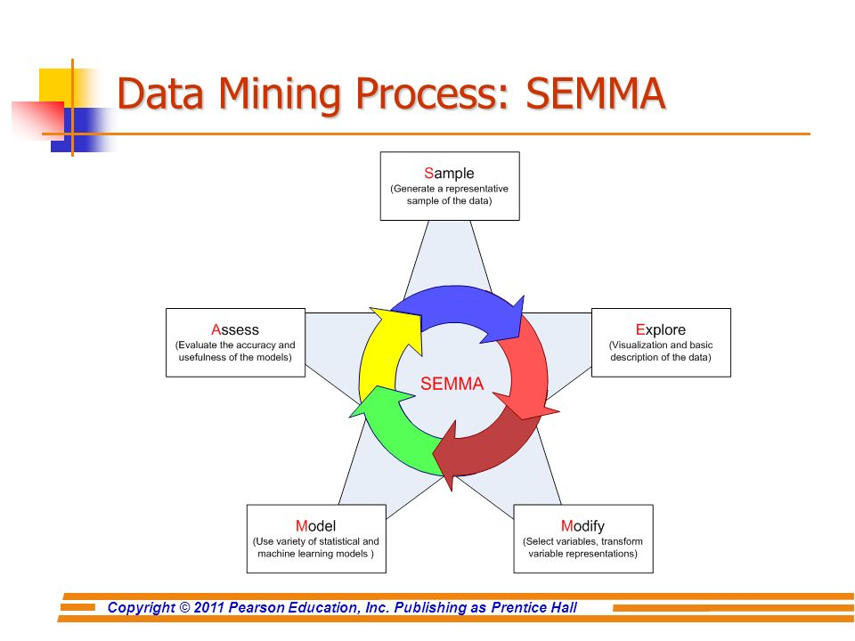
SEMMA Approach
Notes:
Explain SEMMA approach here

Slide 7
Variables
Pickup_datetime
Dropoff_datetime
Passenger_Count
Pickup_latitude
Pickup_longitutde
Trip_duration
ID
Vendor ID
Store_fwd_flag
Dropoff_latitude
Dropoff_longitude

Slide 8
Sample
The NYC Taxi data was made available by New York city
For our project we used a sample of data for year 2016
Our main source for data was Kaggle data source as below https://www.kaggle.com/c/nyc-taxi-trip-duration

Slide 9
Explore
We identified some new features to be added into the Data to analyze it at greater depth
No missing values and duplicates
Outliers detection and removal of those
Data type analysis

Slide 10
Feature Engineering
We tried to split pickup datetime and drop off date time into pickup hour ,
Pickup day , pickup weekday and drop off hour
We calculated distance from pickup latitude / longitude and drop off latitude / longitude
Similarly Speed of the cab was calculated from distance and trip duration
These new features helped a lot in further analysis of the data

Slide 11
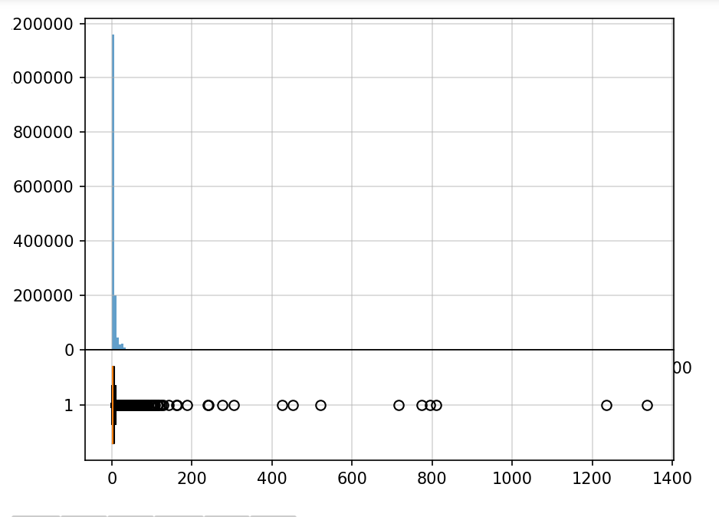
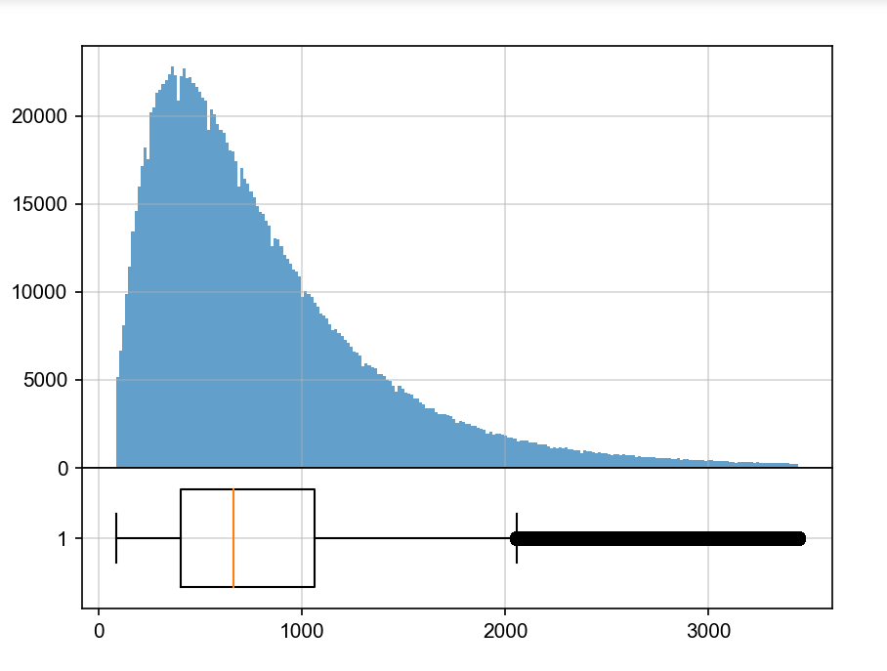
Outlier Detection
Distance Trip duration

Slide 12
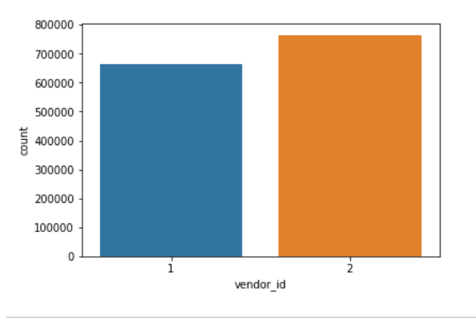
Distribution of different vendors

Slide 13
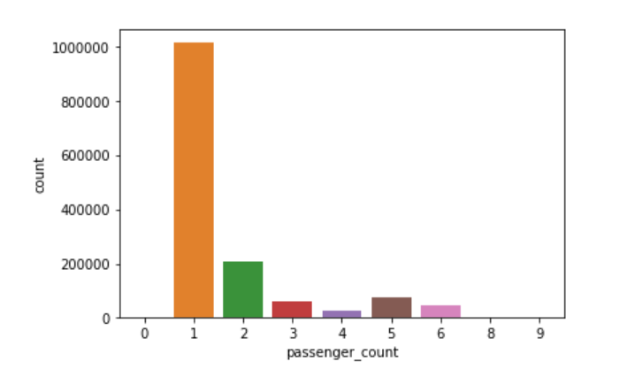
Distribution of Passenger counts

Slide 14
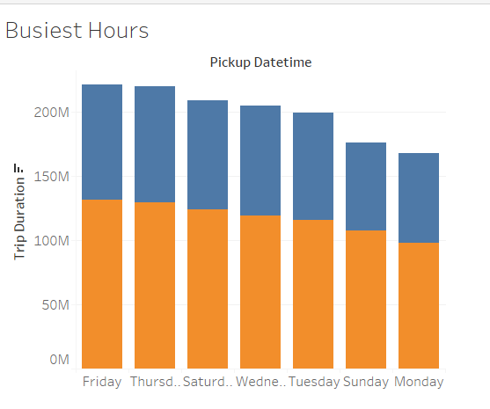
Trip Duration vs Busiest Hours

Slide 15
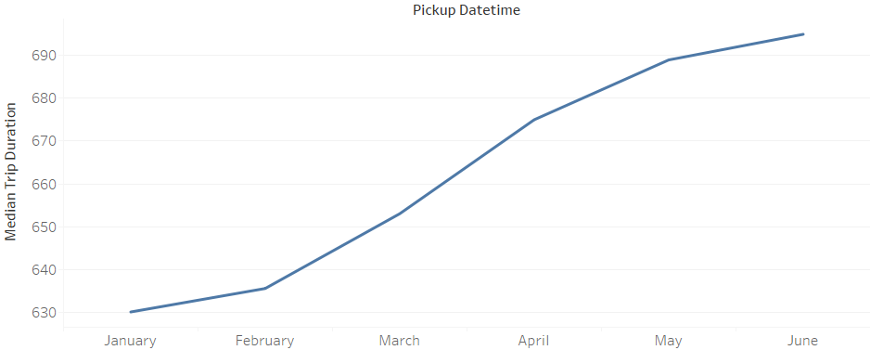
Median Trip Duration vs Pickup Datetime

Slide 16
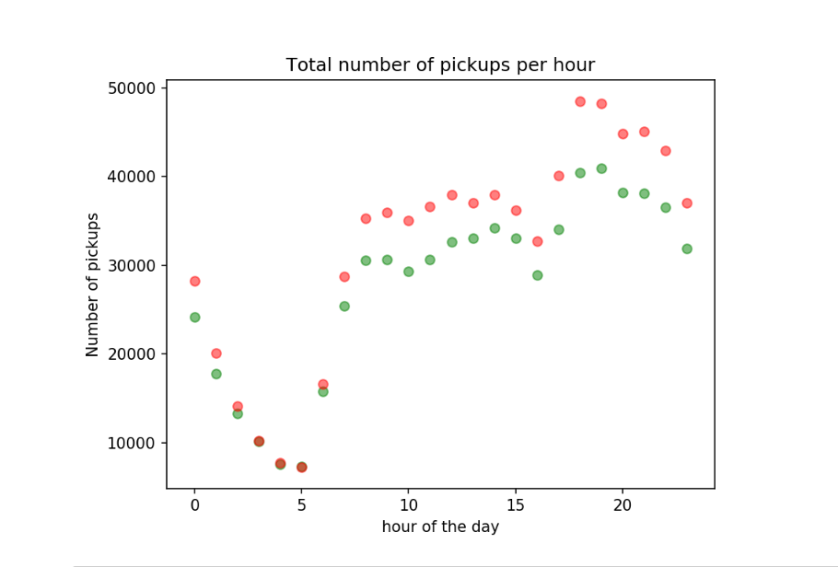
Number of pickups vs Hour of the Day

Slide 17
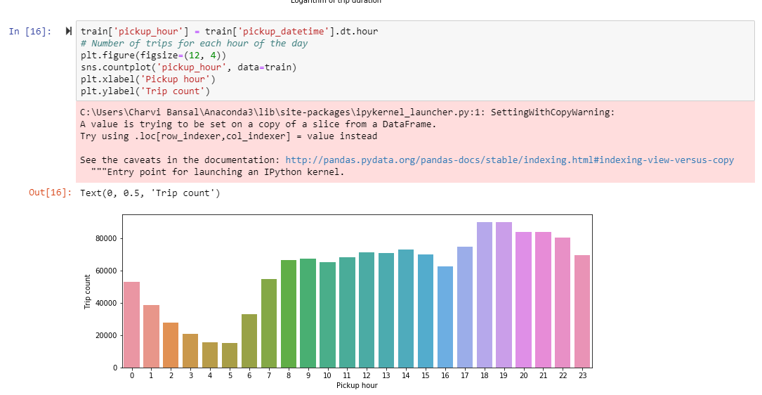
Pickup hour vs Trip Count

Slide 18
Modify
Categorical to Nominal
Changed datetime attributes in datetime format
Outliers were removed using quantile function

Slide 19
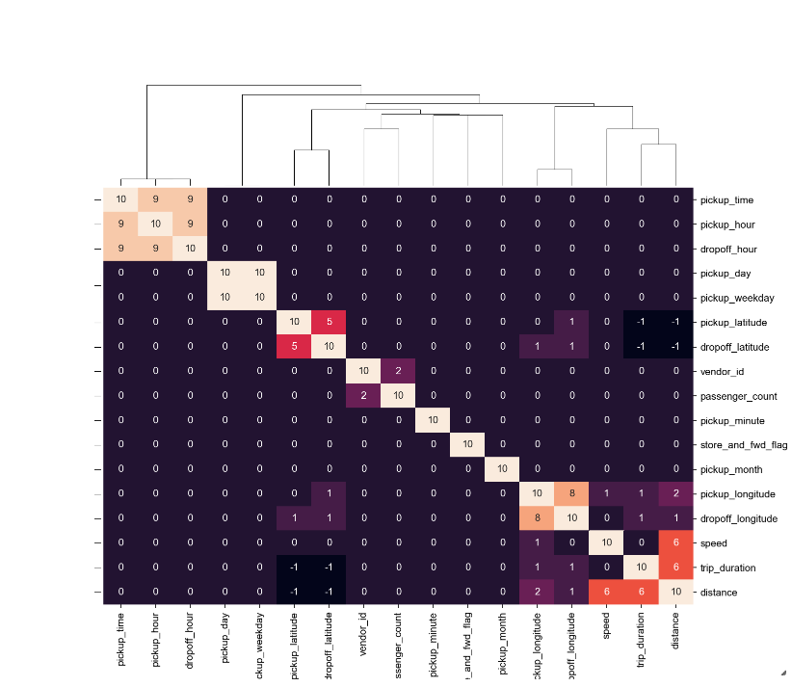
Collinearity

Slide 20
Models
Multiple Linear Regression
K Nearest Neighbor
Random Forest
XGBoost Algorithm

Slide 21
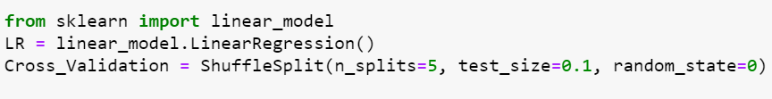
Multiple Linear Regression
As a predictive analysis, the multiple linear regression is used to explain the relationship between one continuous dependent variable and two or more independent variables.

Slide 22

K Nearest Neighbor
KNN is a non-parametric(does not make assumption about underlying data)
This value is the average (or median) of the values of its k nearest neighbors.

Slide 23

Random Forest
Random Forest is an Ensemble model which incorporates the features of many models

Slide 24
XGBoost Algorithm
It is developed with both deep consideration in terms of systems optimization and principles in machine learning.

Slide 25
Model Comparison
Multiple Linear Regression
RMSE : 424.80
KNN
RMSE : 321.02
Random Forest
RMSE: 268.17
XG Boost
RMSE: 265.33

Slide 26
Results and Recommendations
NYC-TLC can maximize their utilization by diverting the cabs into the locations during specific times
As the weekend approaches, most taxi trips increases due to busy weekend night life (trip numbers drop on Sunday evening/night)
Midnight to 6 am is less taxi trips
Majority of taxi trips are going to the airport
The model can be enhanced in future by incorporating features like weather, holiday etc

Slide 27
THANK YOU

