Slide 1

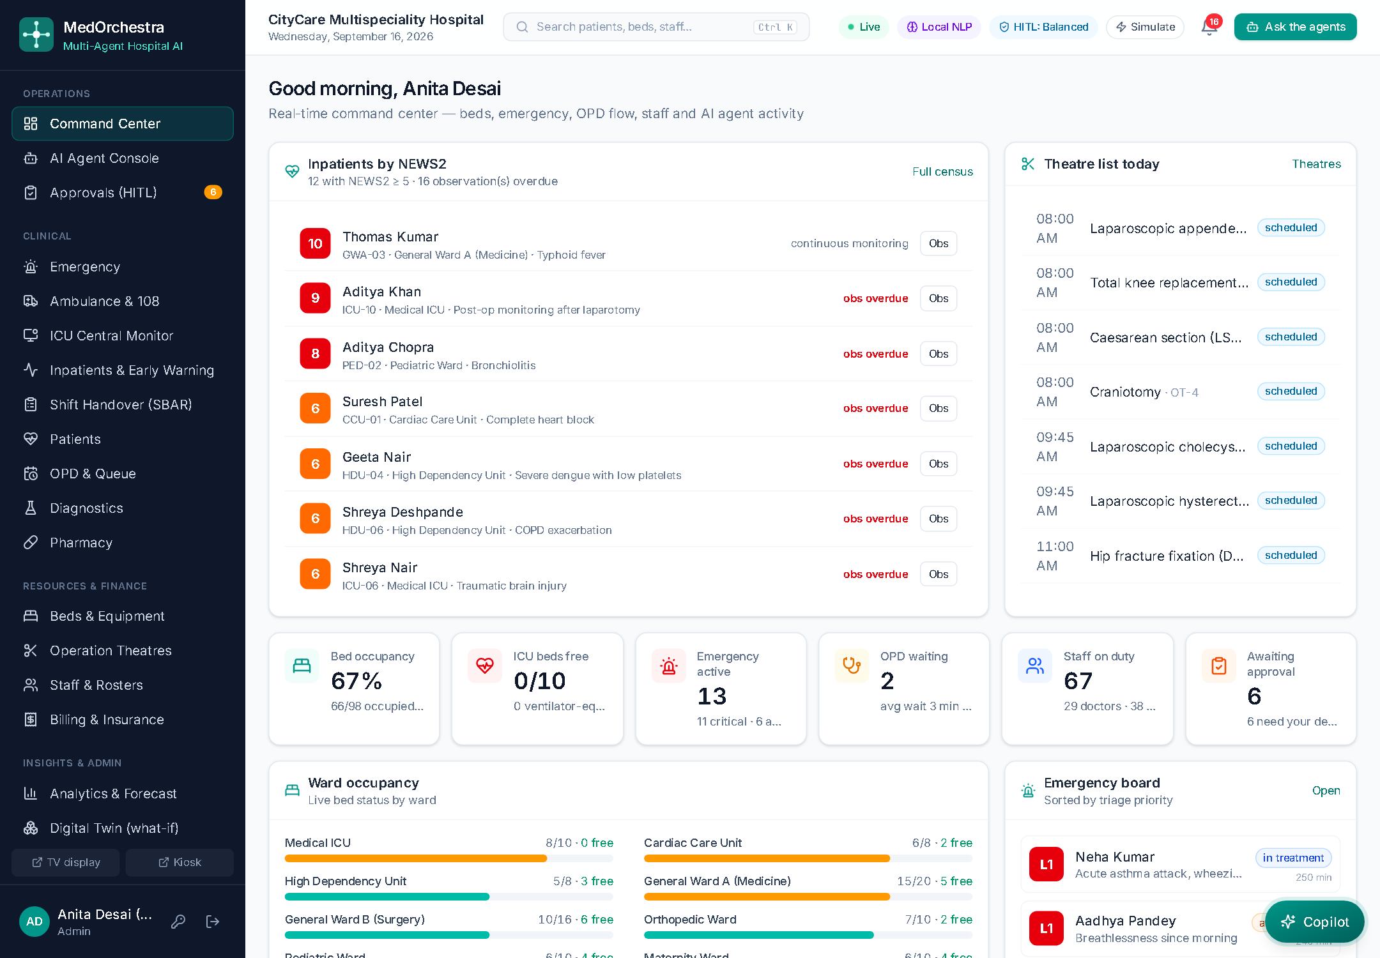
MedOrchestra
Multi-Agent Hospital Intelligence Platform
Multi-Agent AI Systems for Hospital Resource Optimization, Clinical Workflow Automation and Patient Care Coordination
Project presentation
Submitted by: ______________________ Roll No.: ________
Guide: ______________________
Department of ______________________ · 2026–27
Notes:
Introduce the project: a working multi-agent AI platform for hospital operations built from our synopsis. Nine specialised agents coordinated by an orchestrator, with humans approving every critical action.

Slide 2
The problem
Hospital operations run on disconnected systems, phone calls and spreadsheets
1
2
3
4
Fragmented information
Manual allocation
Long waiting times
Communication gaps
Beds, staff, labs, pharmacy and appointments live in separate systems
Beds, ICU, theatres and staff assigned by hand — conflicts and idle capacity
Consultations, diagnostics and departments are not coordinated
Updates between departments are delayed or missed
5
6
7
8
Emergency coordination
Late escalation
No predictive planning
Administrative overload
Critical cases need beds, teams and tests simultaneously
Deteriorating ward patients are noticed too late
Historical data is not used to anticipate demand
Clinicians spend time chasing instead of treating
2
Notes:
These are the problems listed in our synopsis. The core need: an intelligent, coordinated system that optimises resources and automates workflows while keeping clinicians in control.

Slide 3
Our solution: eleven specialised agents, one orchestrator
Each agent owns one domain and uses the right algorithm; the orchestrator composes them per request
1
Natural language in
Bed Mgmt
Notification
Appointment & Queue
Staff describe a need; NLP finds intents and entities
Ambulance Dispatch
Staff Scheduling
2
Plan & coordinate
AI
Orchestrator
Dependency-ordered plan, shared blackboard, FIPA-ACL messages
Billing & Insurance
Diagnostics
3
Optimise & explain
CP-SAT, NEWS2, queueing, forecasting, ML — with factor breakdowns
Resource Optimizer
Pharmacy
4
Humans decide
Emergency
Patient Care
Critical actions wait for approval; approve, modify or reject
3
Notes:
Instead of one big AI model we use eleven agents: the eight from the synopsis plus Notification, Billing & Insurance and Ambulance Dispatch. The orchestrator plans which agents are needed, they share findings on a blackboard and talk using FIPA performatives like PROPOSE and REFUSE.

Slide 4
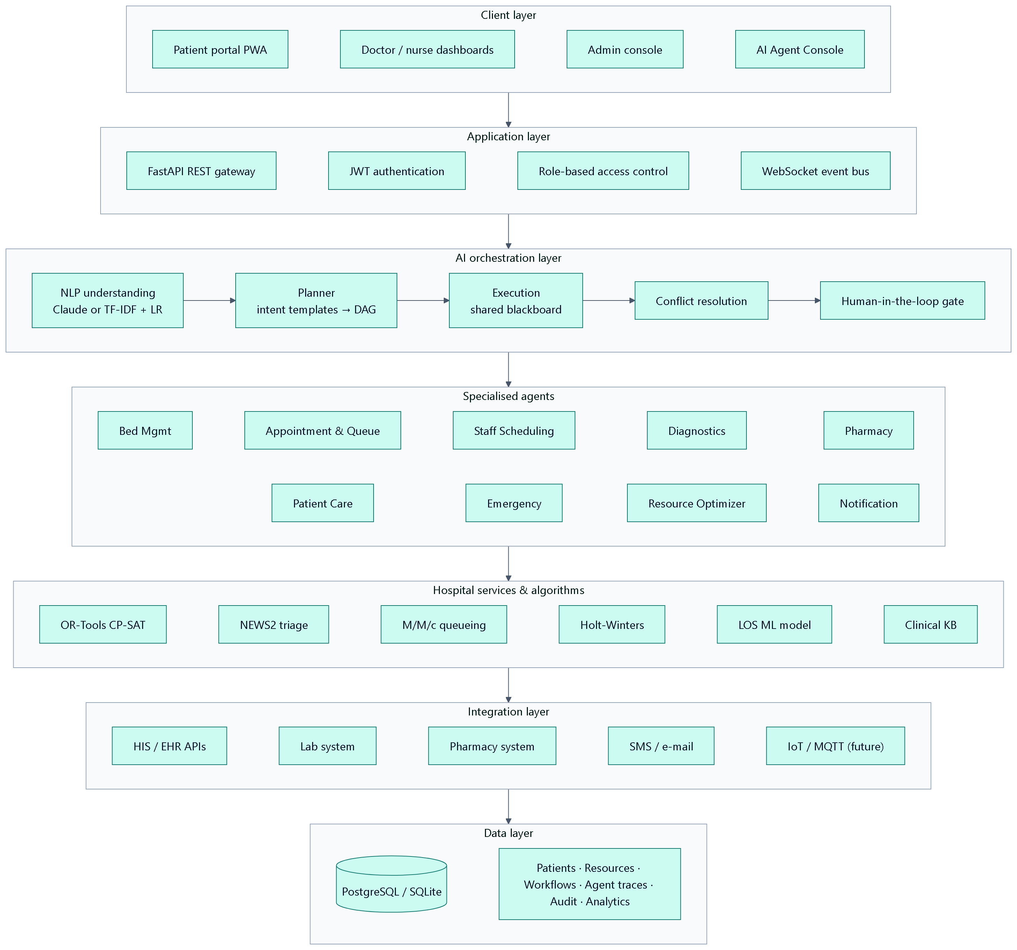
System architecture
Layered design from the synopsis — requests flow down, live events flow back up over WebSockets
Client
React + TypeScript PWA: role dashboards, agent console, patient portal
Application
FastAPI gateway · JWT · role-based access · WebSocket bus
Orchestration
NLP → planner (DAG) → blackboard → conflicts → HITL gate
Agents
11 domain agents proposing explainable actions
Services
OR-Tools CP-SAT · NEWS2 · M/M/c · Holt-Winters · Gradient Boosting
Data
SQLAlchemy → SQLite (dev) / PostgreSQL (Docker)
4
Notes:
Walk through the layers. The key layer is AI orchestration, which is where natural language becomes a plan and where the human-in-the-loop gate sits.

Slide 5
How a request is handled — the 10-step agent pipeline
Exactly the pipeline (i)–(x) proposed in the synopsis, implemented in the orchestrator
1
Understand
2
Plan & execute
3
Resolve & gate
TF-IDF + logistic regression (offline) or Claude with a strict JSON schema; entities grounded against the database (patients, medicines, vitals, beds, tests, procedures).
Intent templates merged into a dependency DAG; agents run level by level, posting to a shared blackboard and exchanging INFORM / REQUEST / PROPOSE / REFUSE messages.
Conflict resolver handles contention, staff overload, missing capacity and safety refusals; the autonomy policy decides what runs automatically and what needs approval.
5
Notes:
Every request, whether typed by a doctor, registered at the ER desk, raised by the early-warning service or booked by a patient, goes through these ten steps and leaves a complete trace.

Slide 6
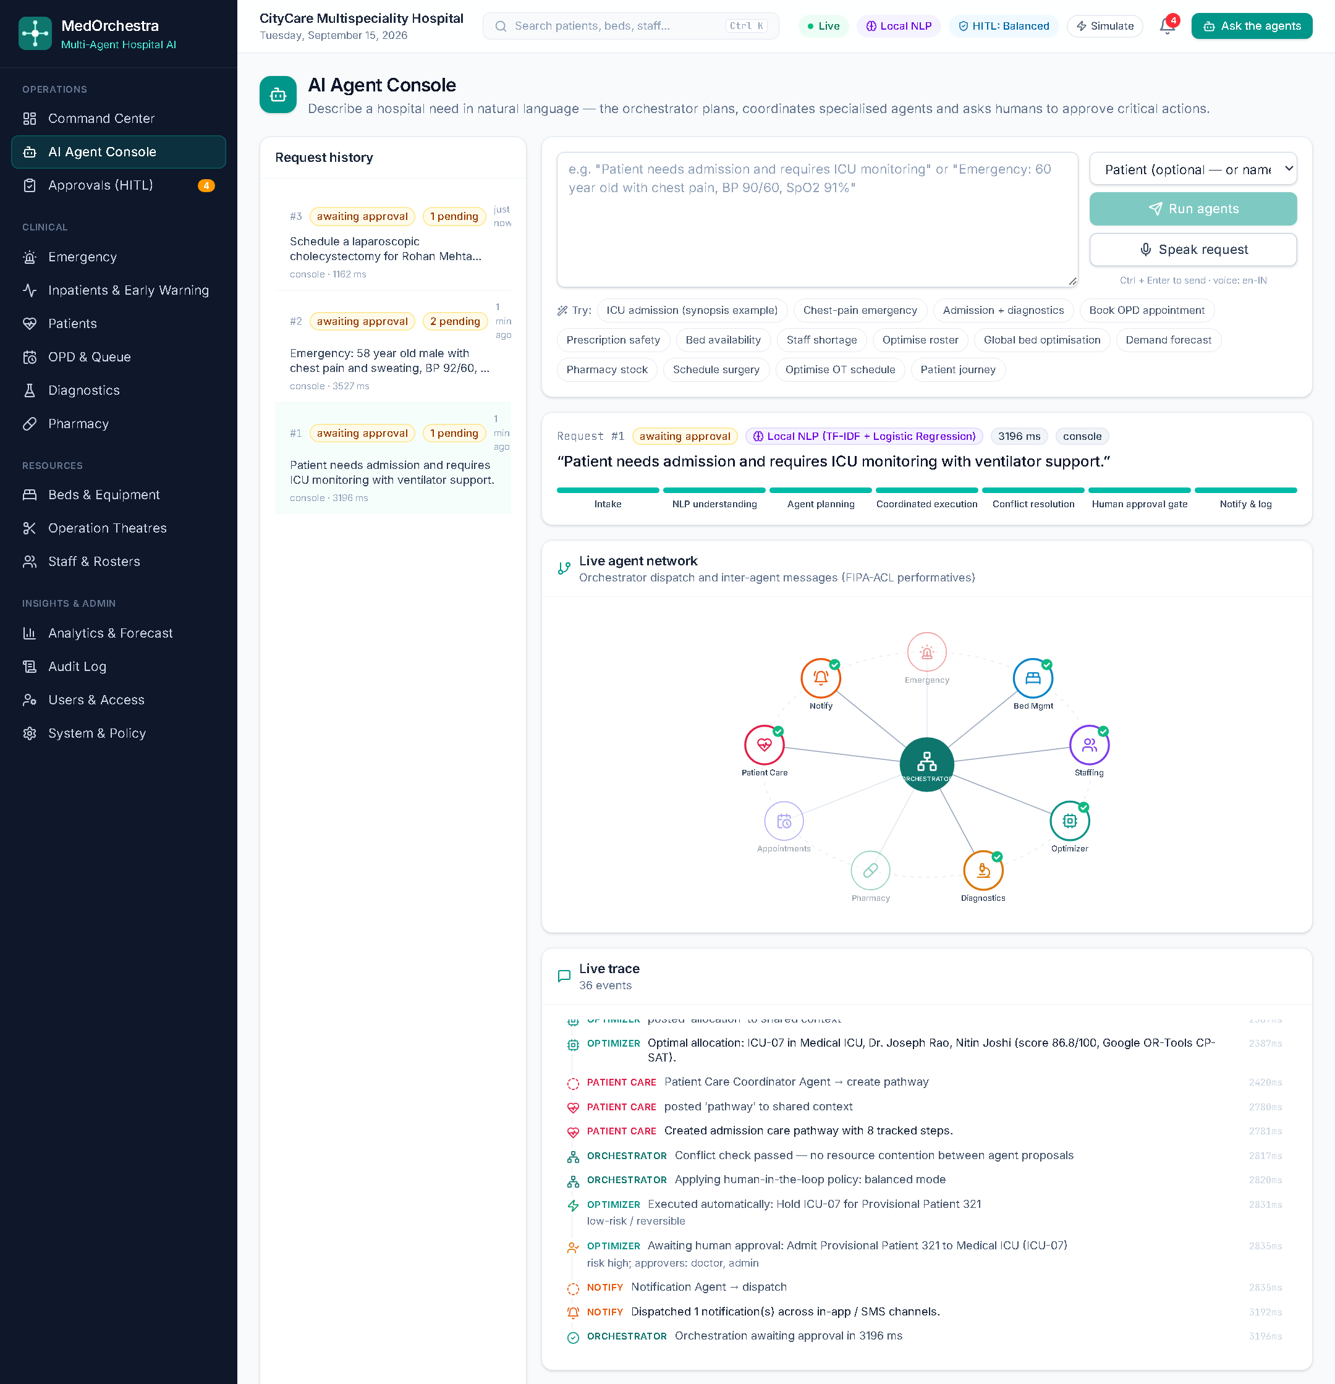
Live demo: the synopsis ICU-admission example
“Patient needs admission and requires ICU monitoring” — running in the AI Agent Console
1
Understood
Intent admission (99%), ICU bed, ventilator + monitor
2
Patient
No name given → provisional registration so care is not delayed
3
Beds & staff
Ventilator ICU bed ranked; Critical Care doctor and ICU nurse chosen
4
Optimised
CP-SAT checks other waiting patients; ML predicts length of stay
5
Human decides
Bed held automatically; admission waits for a doctor
6
Notes:
Demo: click the ICU admission scenario. Watch agents light up in the network, the trace stream in, then open Explain on the bed and staff cards to show the factor breakdown. Finally approve the admission as a doctor.

Slide 7
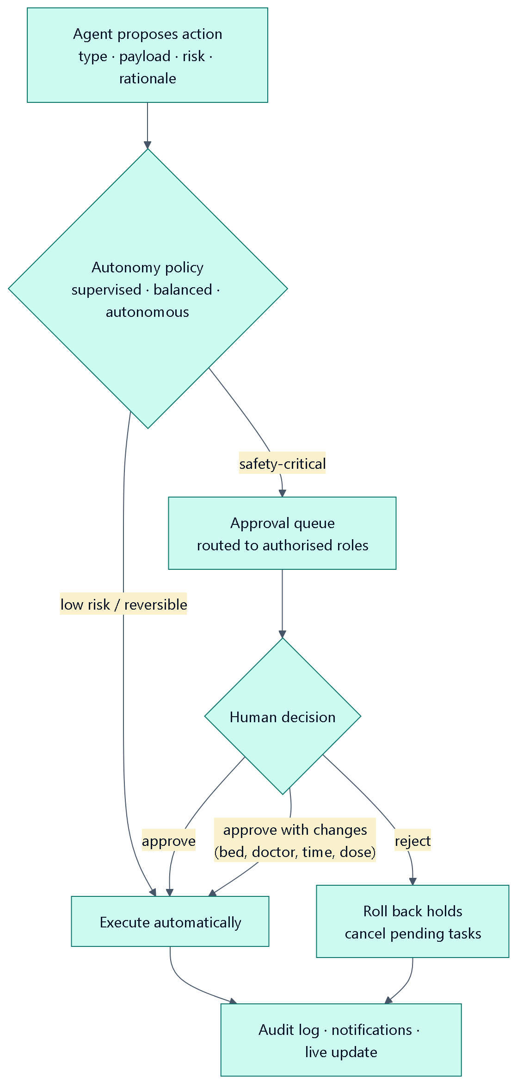
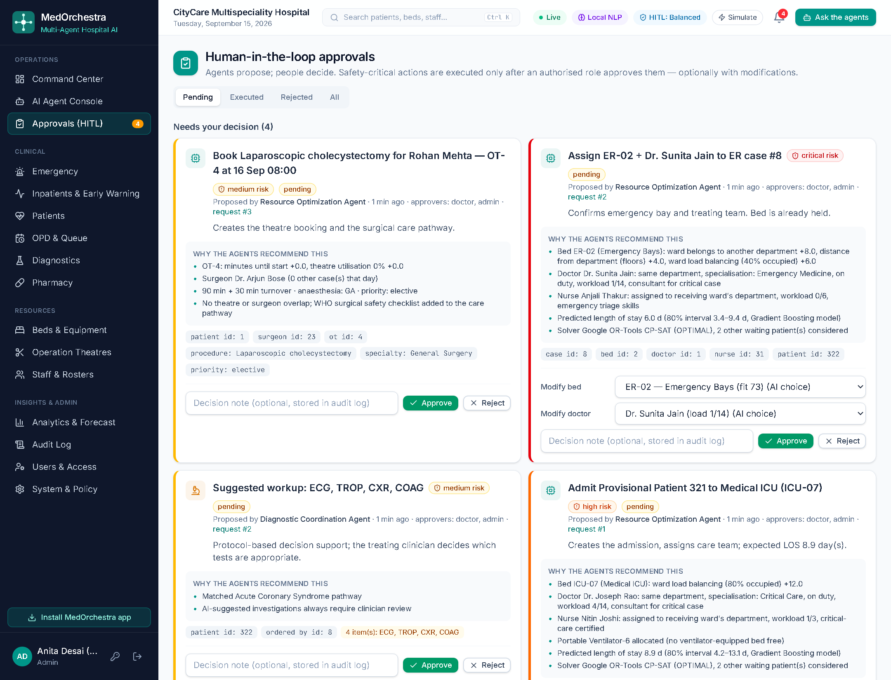
Humans stay in control
Agents propose — authorised people approve, modify or reject; everything is audited
Supervised
Balanced (default)
Autonomous
Every action waits for approval
Low-risk reversible actions run automatically; clinical and risky actions need approval
Low/medium operational actions run automatically; high-risk, prescribing, discharge and staffing still need approval
7
Notes:
Safety is the key design choice. Admissions, emergency assignments, AI-suggested tests, contraindicated prescriptions, surgeries, discharges and rosters all require an authorised approver. The approver can change the bed or doctor before approving. The administrator can switch the autonomy mode.

Slide 8
Real algorithms inside the agents
Transparent, validated methods — not a black box
1
OR-Tools CP-SAT
2
NEWS2 (RCP 2017)
3
M/M/c queueing
Bed allocation, weekly rosters and theatre scheduling with hard constraints and weighted objectives
Early-warning score for ER triage and ward deterioration with the official response policy
Erlang-C waiting-time prediction; dynamic priority queue with ageing
4
Holt-Winters
5
Gradient Boosting
6
NLP
Weekly-seasonal demand forecasting with 95% prediction intervals
Length-of-stay prediction with 80% quantile intervals for discharge planning
TF-IDF + logistic regression over 14 intents, Hinglish normalisation; optional Claude with JSON-schema output
8
Notes:
Explain one or two formulations if asked: CP-SAT maximises priority-weighted placements minus an explainable cost; the theatre model uses optional intervals and NoOverlap per theatre and per surgeon.

Slide 9
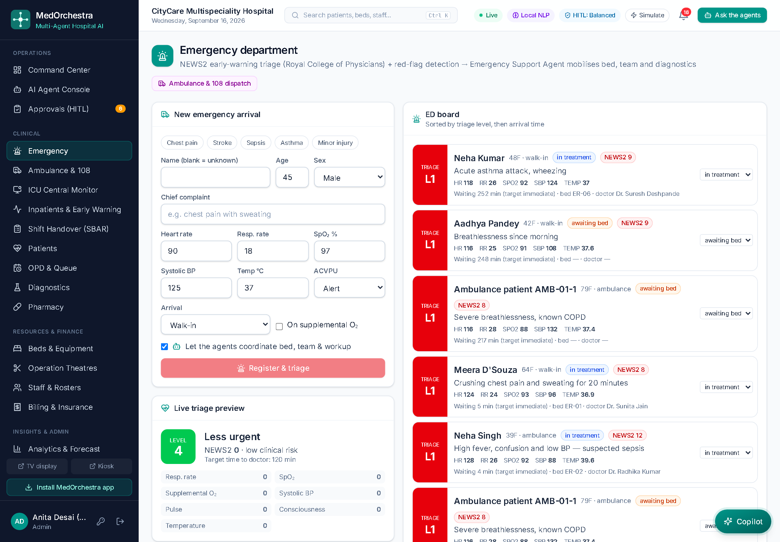
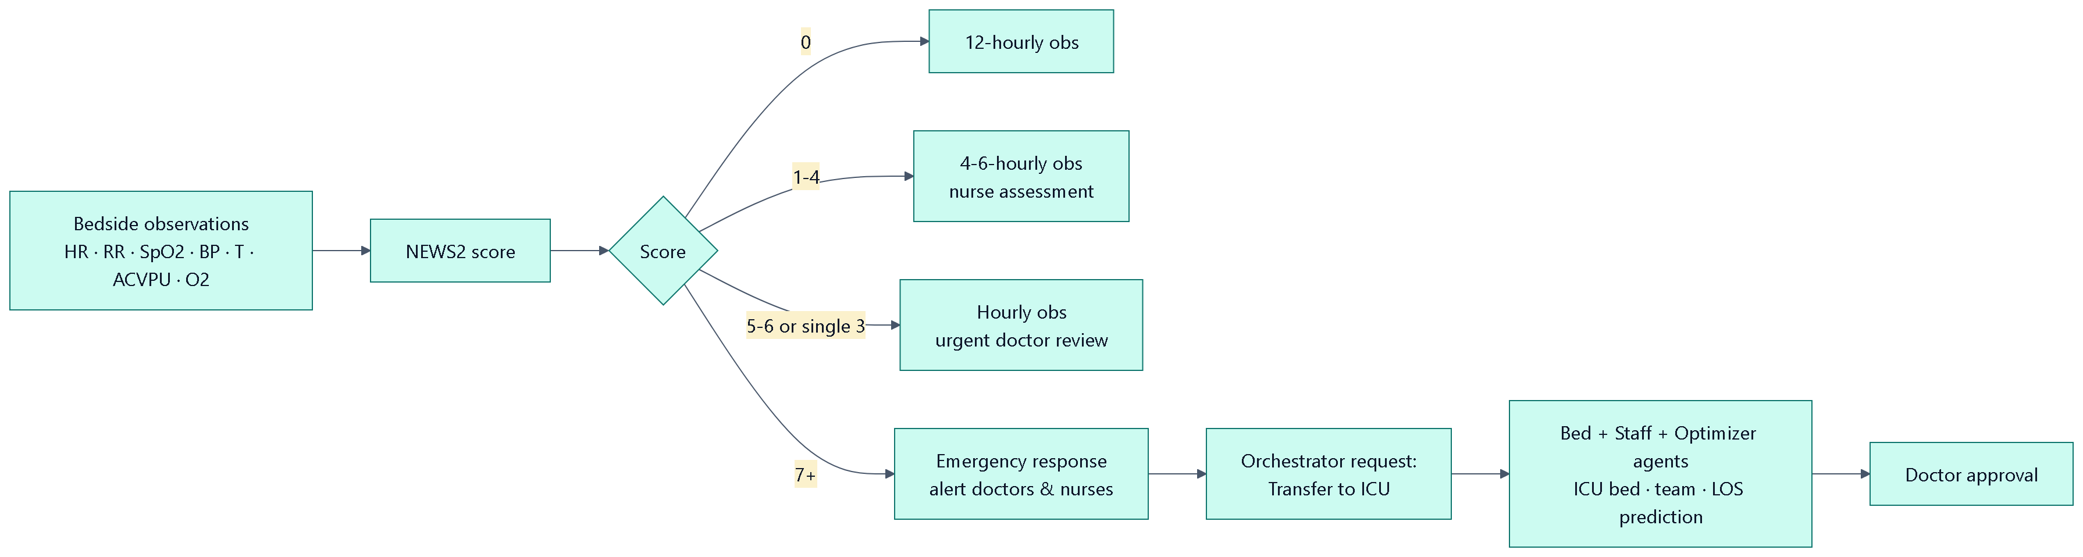
Emergency and ward early warning
NEWS2 on every assessment — escalation reaches the right people and the agents automatically
Live NEWS2 preview while vitals are entered
Level-1 cases get a resuscitation bay, ED team and specialist consult
Ward NEWS2 ≥ 7 → emergency alert + automatic ICU-transfer proposal
Rejecting an assignment releases the held bed
9
Notes:
Demo the chest-pain preset on the Emergency page, then record NEWS2 ≥ 7 observations for a ward patient to show the automatic ICU-transfer proposal.

Slide 10
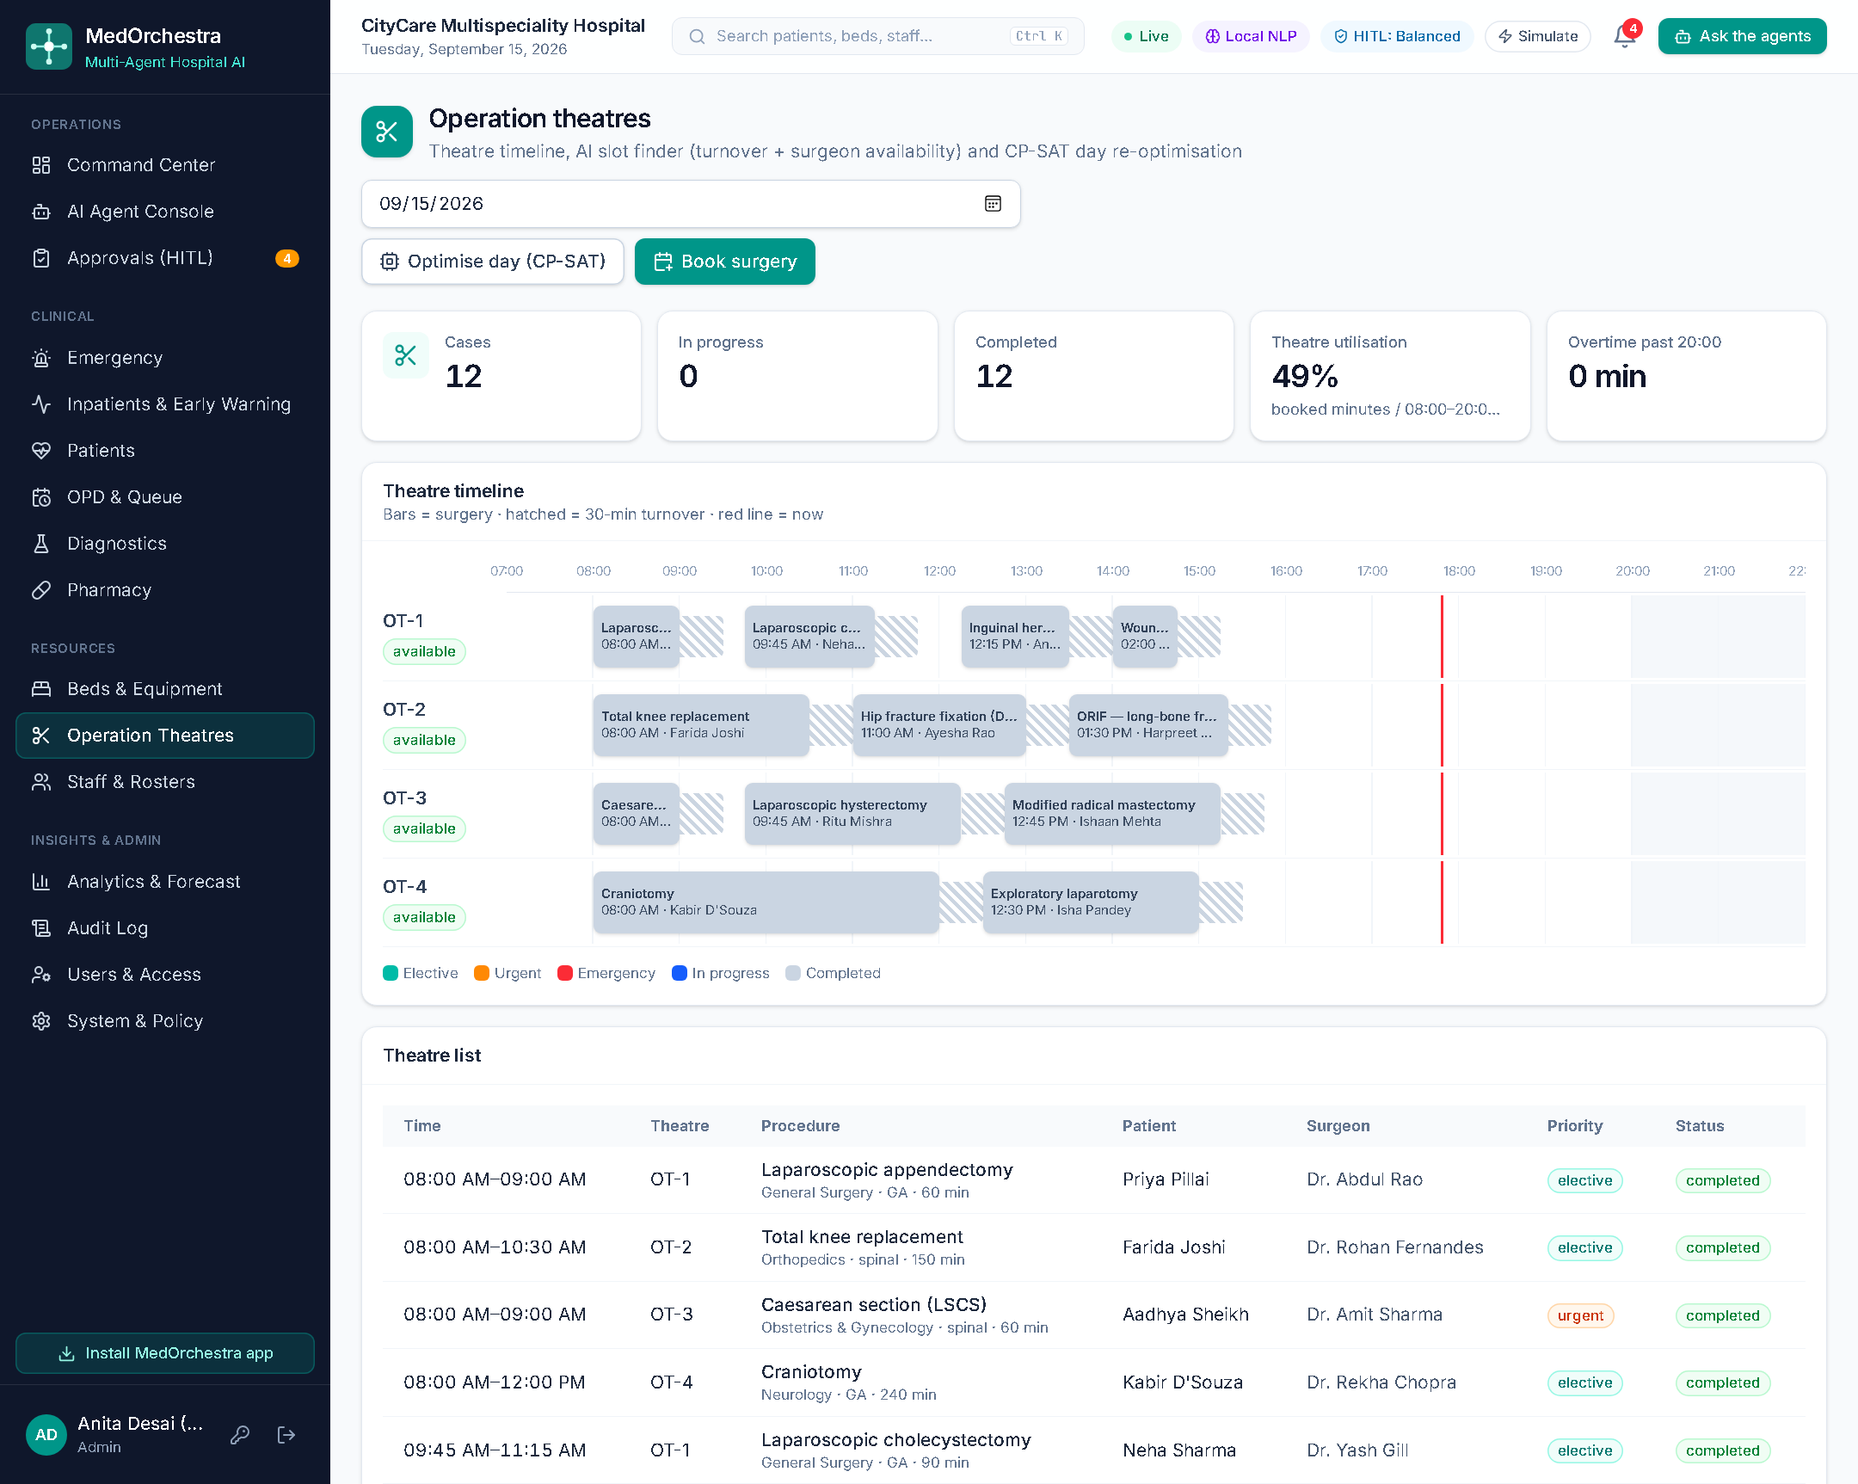
Operation theatres and resources
CP-SAT re-plans a day’s theatre list without overlaps or overtime
75→0
minutes of overtime
1→0
theatre overlaps
20:45→11:15
last case finishes
50 ms
CP-SAT solve time
10
Notes:
Tomorrow’s list was deliberately inefficient in the demo data. One click on Optimise day moves cases earlier and into free theatres, removing overlaps and overtime. Surgeries can also be booked by just asking the agents.

Slide 11
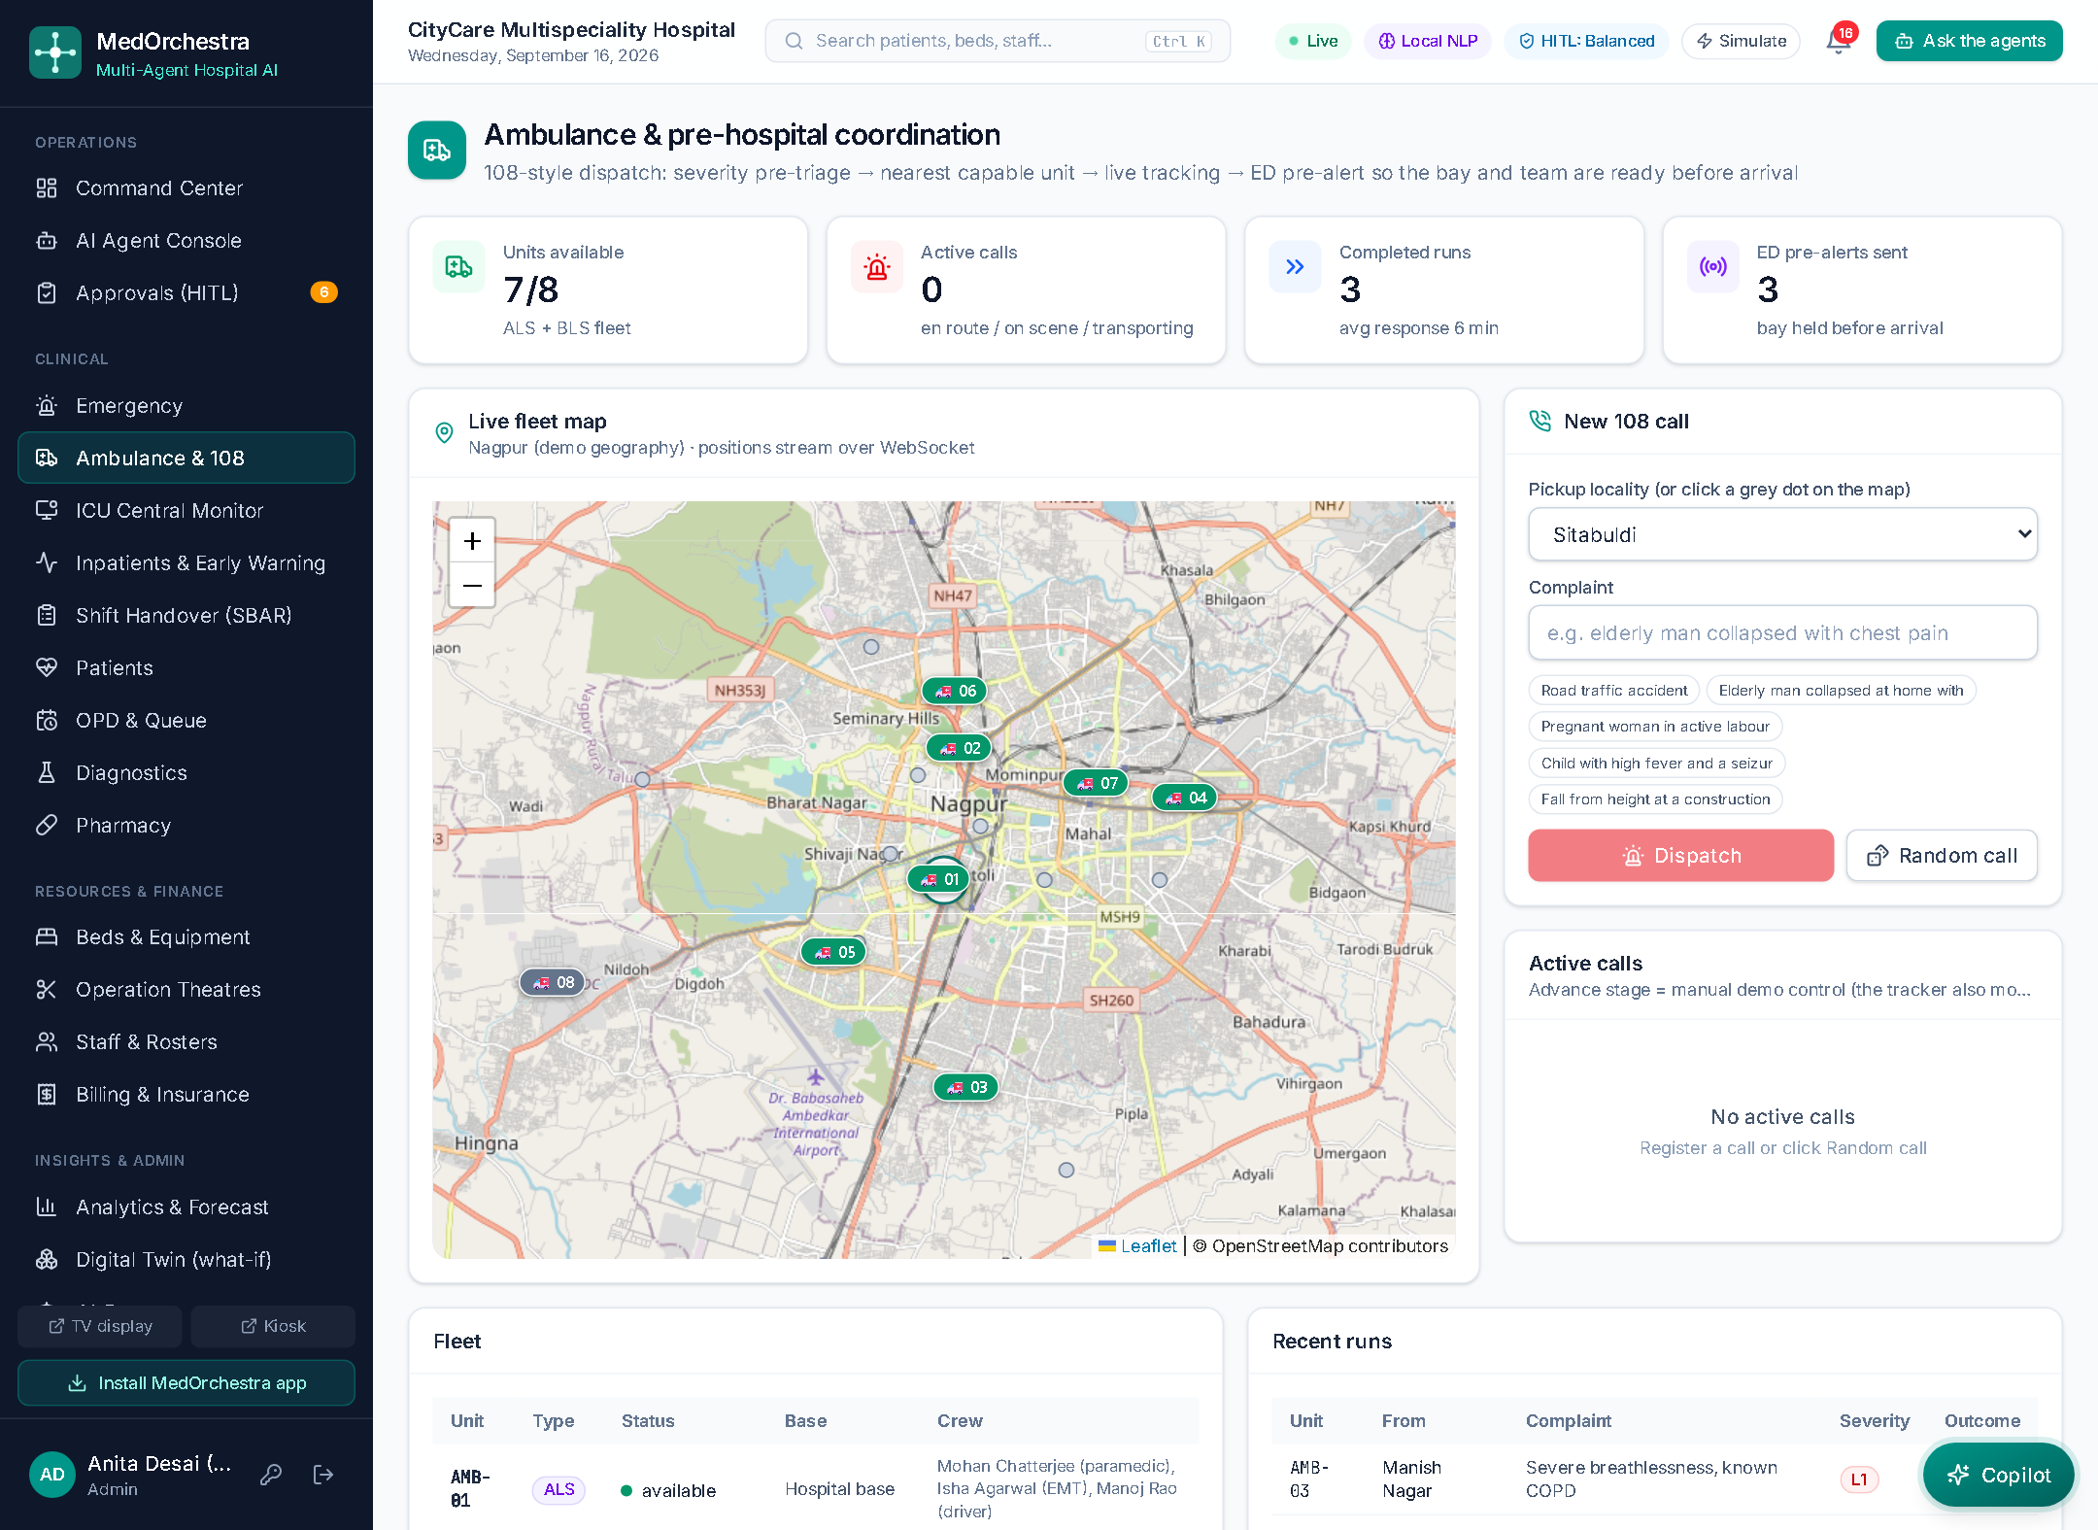
Care starts before the hospital
108 dispatch → live tracking → ED pre-alert: the bay and the team are ready when the patient arrives
1
Pre-triage the call
NEWS2 + red flags from the caller description and paramedic vitals
2
Nearest capable unit
ETA + penalty for a BLS unit on a critical call; dispatched without an approval hold
3
Live tracking
Positions stream to every screen over WebSockets
4
Pre-arrival alert
Incoming ED case created in transit; agents hold a bay and a team
5
Arrival
Straight into the reserved bay — no search, no waiting
11
Notes:
Demo: click Random call on the Ambulance page. Show the unit moving, then the toast when the crew leaves the scene, then approve the bay before the patient arrives.

Slide 12
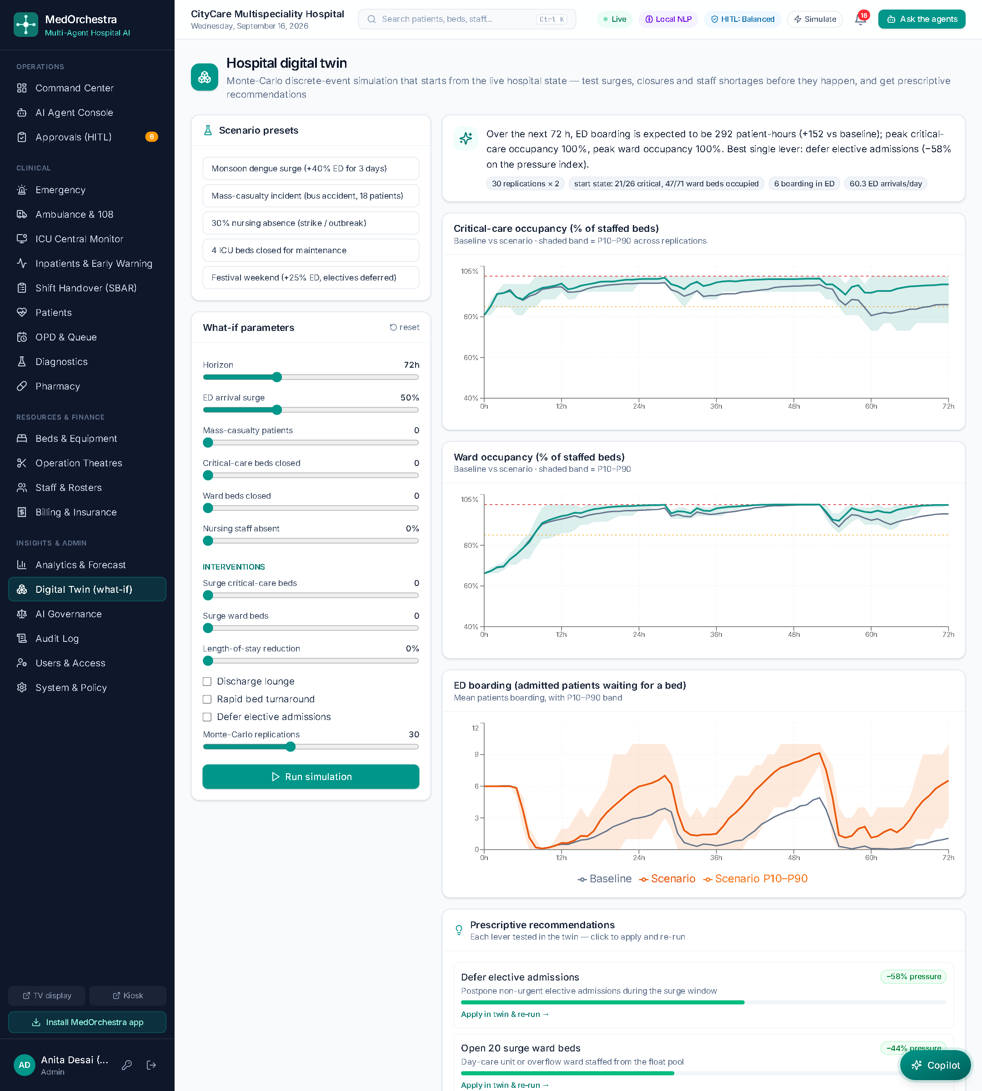
Hospital digital twin: decisions before the pressure arrives
Monte-Carlo simulation starting from the live hospital state — and it recommends what to do
Baseline vs +50% ED arrivals (72 h)
ED boarding
133 → 283 patient-hours
ED saturated
14 → 64 hours
Electives cancelled
13 → 19
Best single lever
Defer elective admissions (−56% pressure)
Same random streams for both runs → the difference is the scenario, not noise
20 replications in 0.5 s — interactive
12
Notes:
Presets: dengue surge, mass-casualty incident, nursing absence, ICU closure. Each recommendation can be applied in the twin and re-run, so the panel answers "what should we do", not just "what will happen".

Slide 13
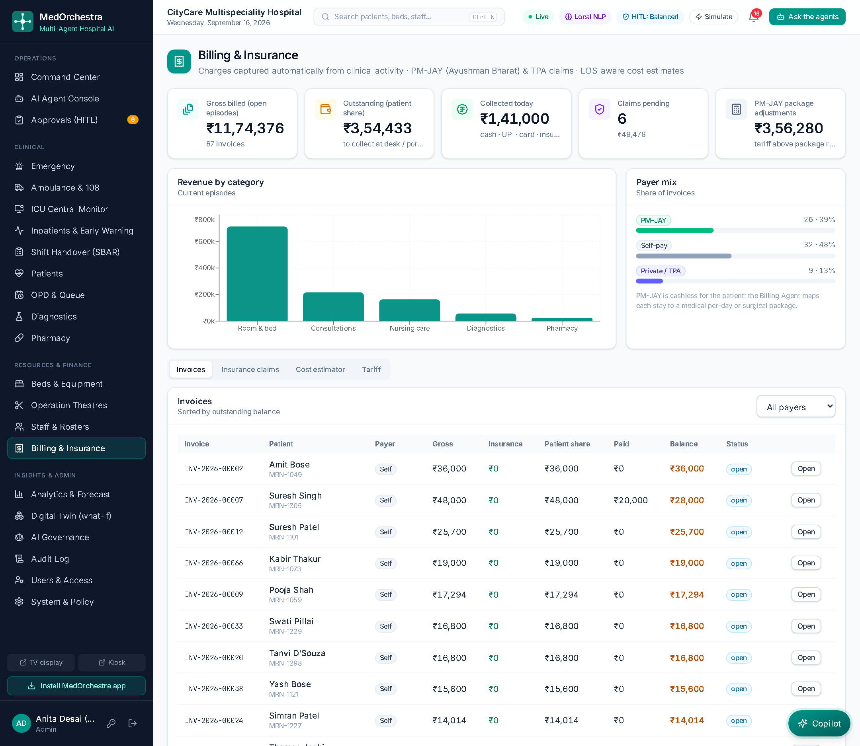
Closing the financial loop
Charges captured from clinical activity · PM-JAY and insurer packages · claims and clearance at discharge
₹11,74,376
billed across 67 open episodes
₹3,54,433
patient share still to collect
₹3,56,280
PM-JAY package adjustment
26 / 9 / 32
PM-JAY / insured / self-pay patients
13
Notes:
Charges carry a stable reference, so re-syncing updates bed-days without duplicating lines. Cost estimates use the P10/P50/P90 stay from the LOS model. On discharge the invoice is finalised and the PM-JAY claim filed automatically.

Slide 14
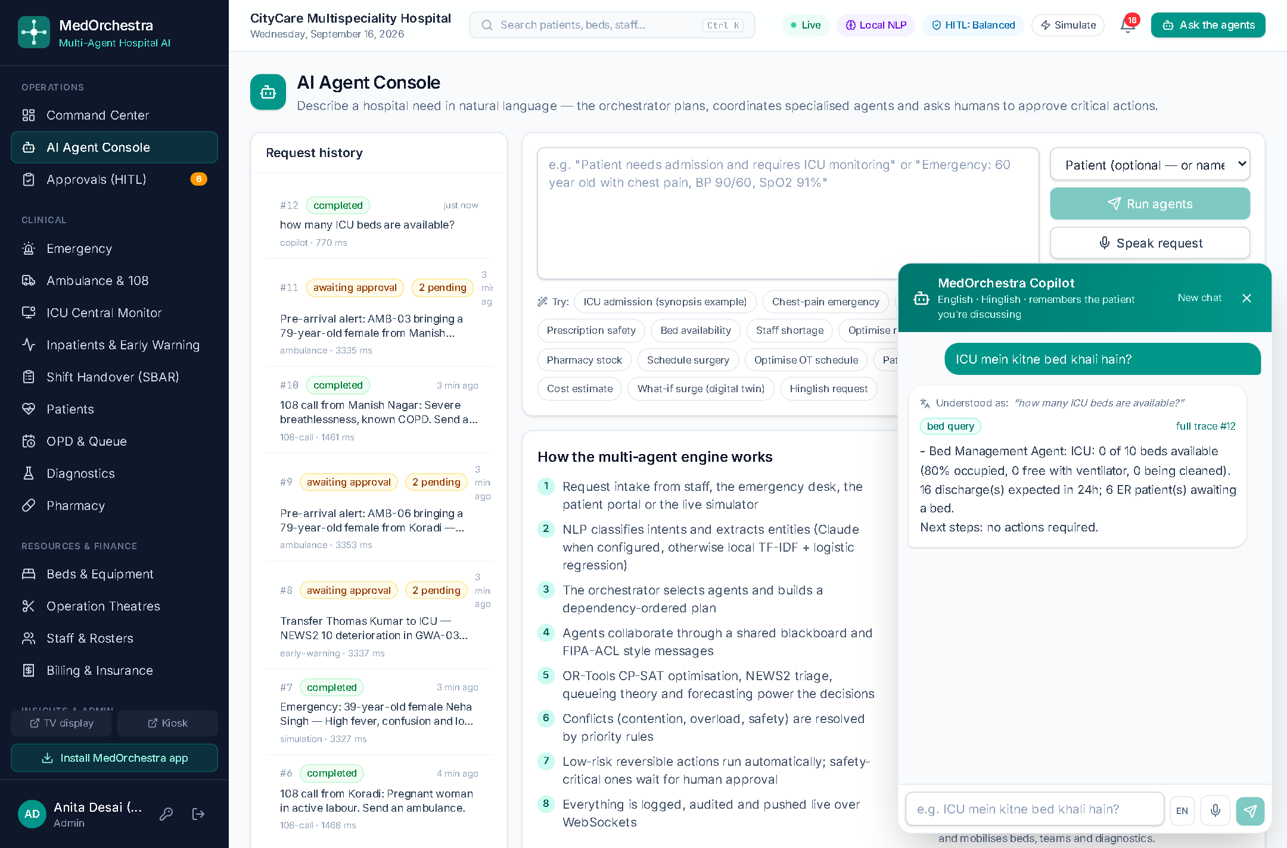
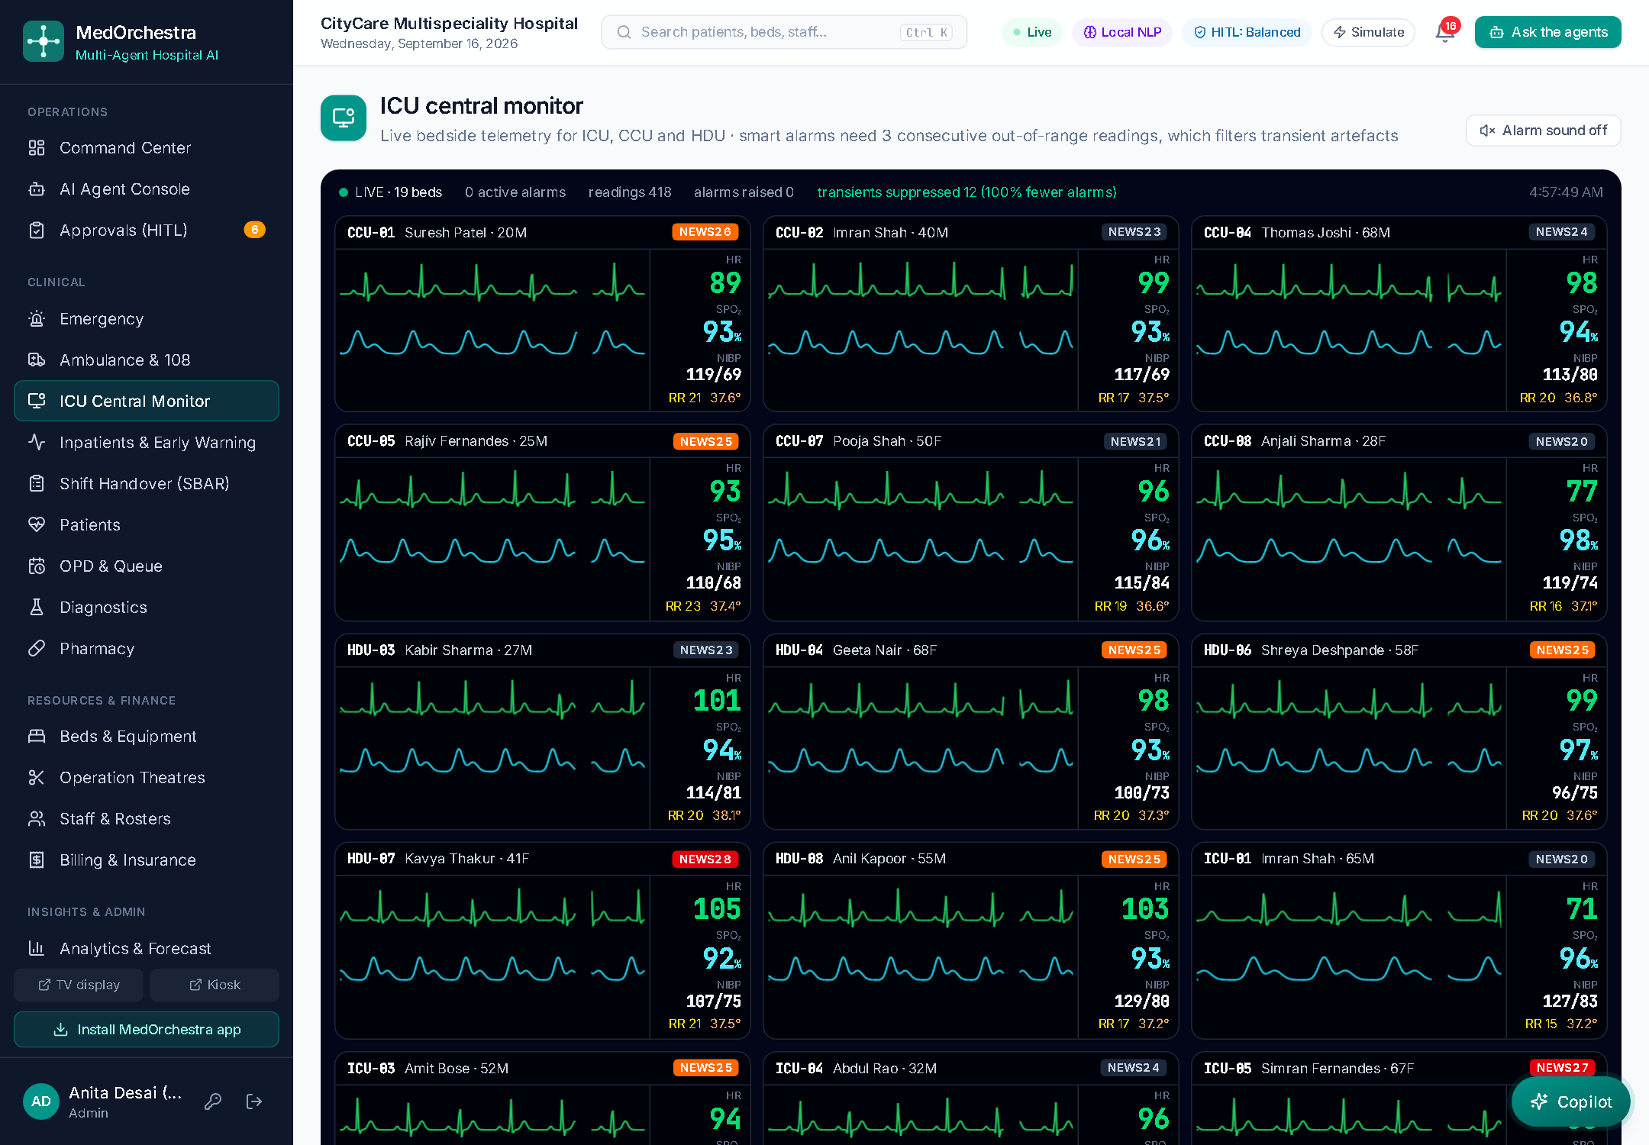
Built for the ward, not just the dashboard
Hinglish copilot · ICU central monitor with smart alarms · AI-drafted notes and SBAR handover
1
Copilot
2
Smart alarms
3
Documentation
“ICU mein kitne bed khali hain?” — Hinglish understood, the patient under discussion remembered, and it asks *which patient* when unsure
A breach must persist for 3 readings before it alarms — transient artefacts are suppressed and counted
SOAP note drafted from the chart (clinician edits and signs) and SBAR handover for every bed in the ward
14
Notes:
These are the features clinicians actually touch during a shift. Mention that the copilot is available on every page and that approvals can be decided inside the chat.

Slide 15
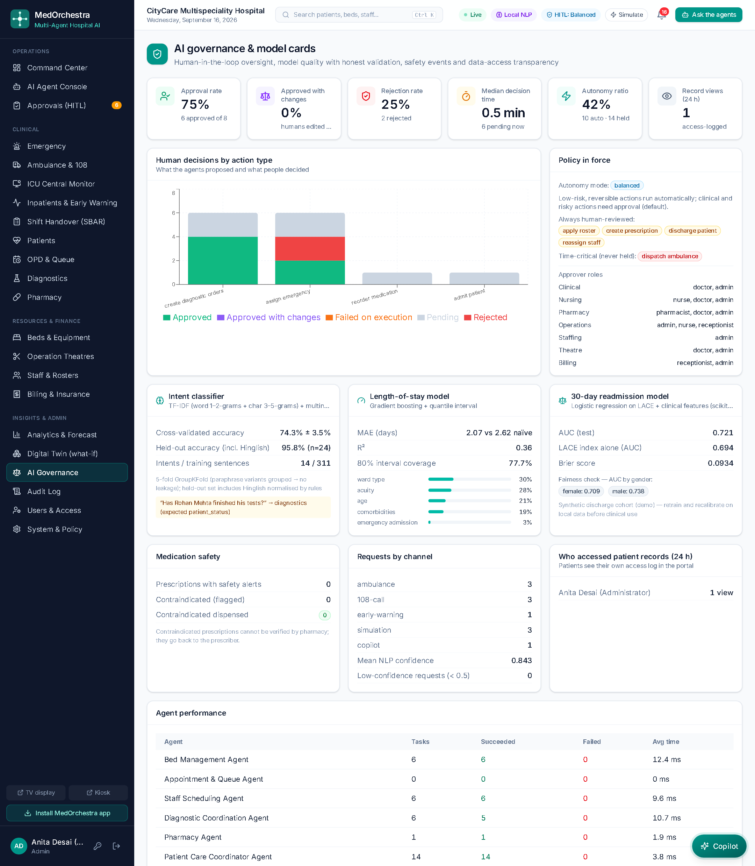
Governance: how do we know the AI is supervised?
Oversight metrics and honest model cards, visible inside the product
Human oversight
Approval, modification and rejection rates, median decision time, autonomy ratio, and which fields humans changed
Model cards
Intent classifier 74% leakage-free cross-validation and 96% held-out (incl. Hinglish); LOS MAE 2.07 d vs 2.62 d naïve; readmission AUC 0.721 with a fairness check
Safety & privacy
Contraindicated prescriptions blocked; record-access log visible to patients; login lock-out and security headers
15
Notes:
This slide usually answers the examiner question about trust: we report leakage-free validation, not training accuracy, and we show how often a human disagreed with the system.

Slide 16
Results
Measured on the synthetic 108-bed hospital
95.8%
3.07%
−21%
intent accuracy on held-out requests (74% cross-validated)
bed-occupancy forecast MAPE (naive: 4.14%)
length-of-stay error vs baseline (MAE 2.07 d)
1.1 s
55 / 55
0.5 s
optimal 7-day roster for 77 staff
automated tests passing
digital twin: 20 replications × 2 scenarios
16
Notes:
All numbers are produced by our evaluation script on the synthetic data. They demonstrate correctness and feasibility; clinical effectiveness would need a real hospital study.

Slide 17
Forecasting accuracy
Holt-Winters vs. seasonal-naive baseline — 14-day hold-out MAPE, reported as measured (lower is better)
Better than the seasonal-naive baseline on 4 of 5 series (admissions, the noisiest, is the exception)
Weekly pattern (Monday peak, Sunday low) captured automatically
Length-of-stay model: MAE 2.07 d vs 2.62 d baseline, R² 0.36
80% interval coverage 78% — honest uncertainty
17
Notes:
Forecasts feed the Resource Optimization Agent: peak days and ICU occupancy above 90% trigger recommendations such as pre-emptive discharges. Be upfront that the naive baseline is slightly better on daily admissions — the noisiest series — and that we report it as measured.

Slide 18
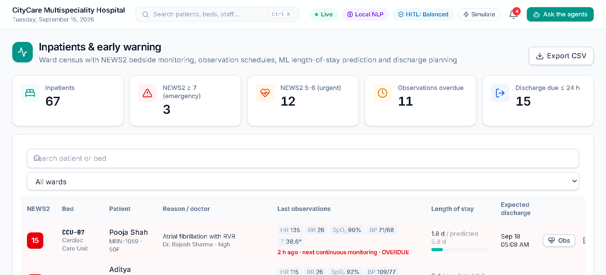
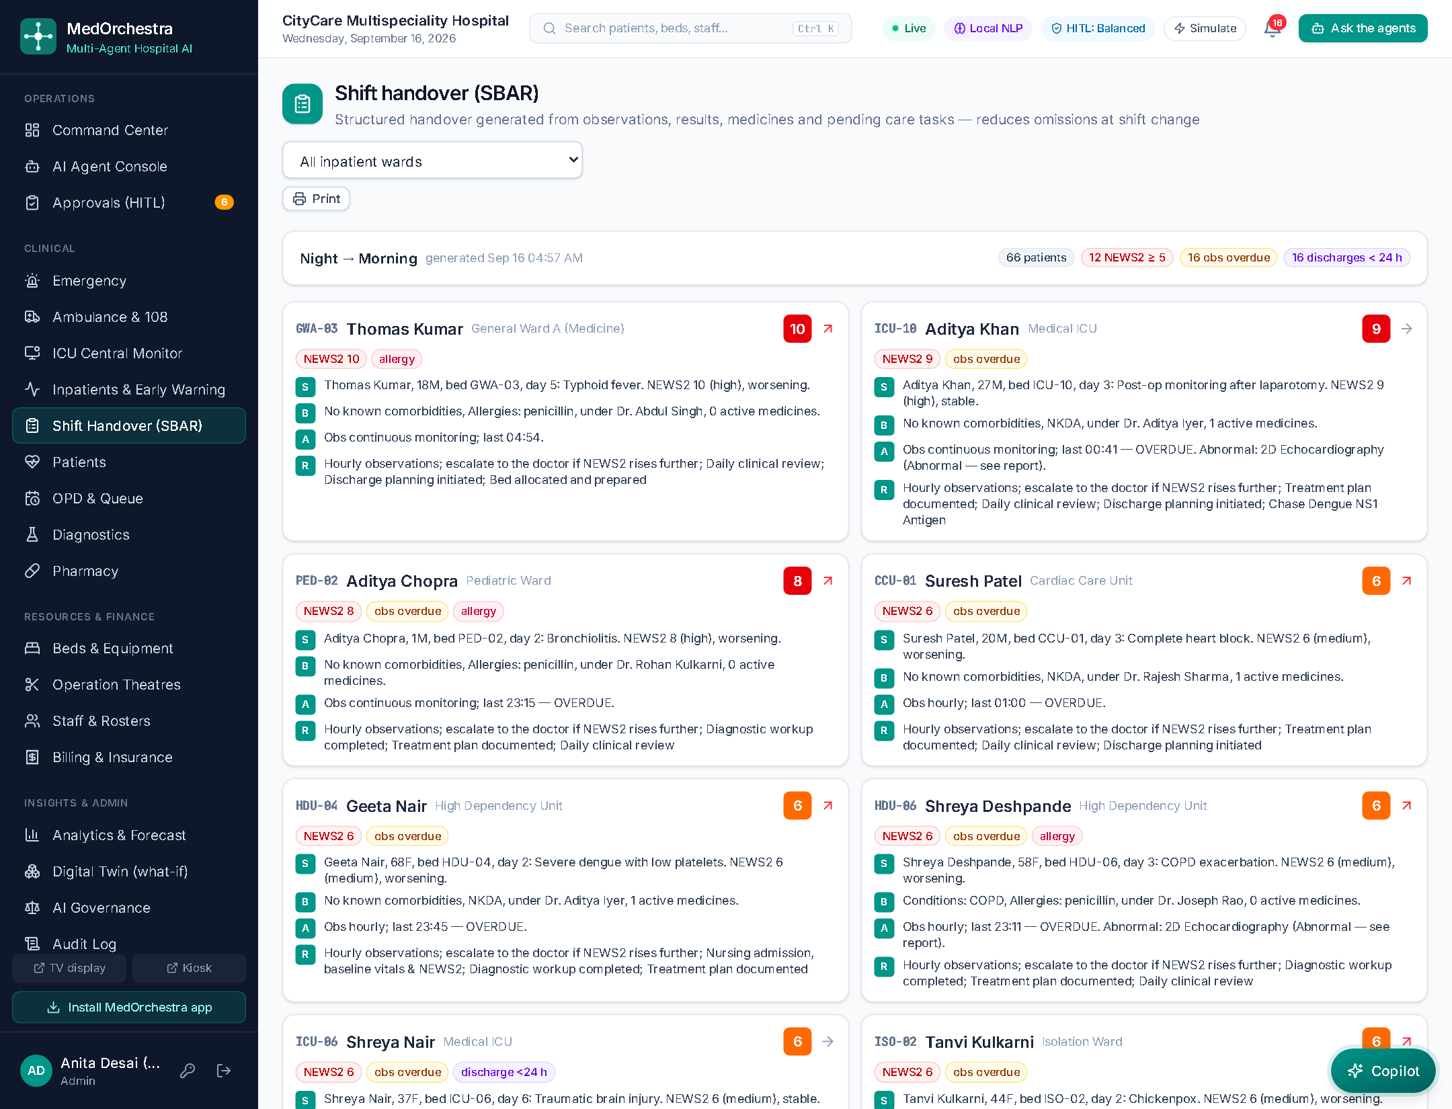
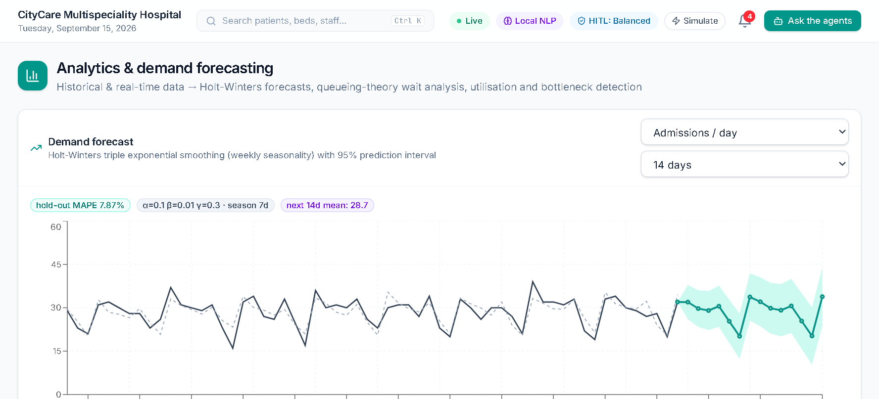
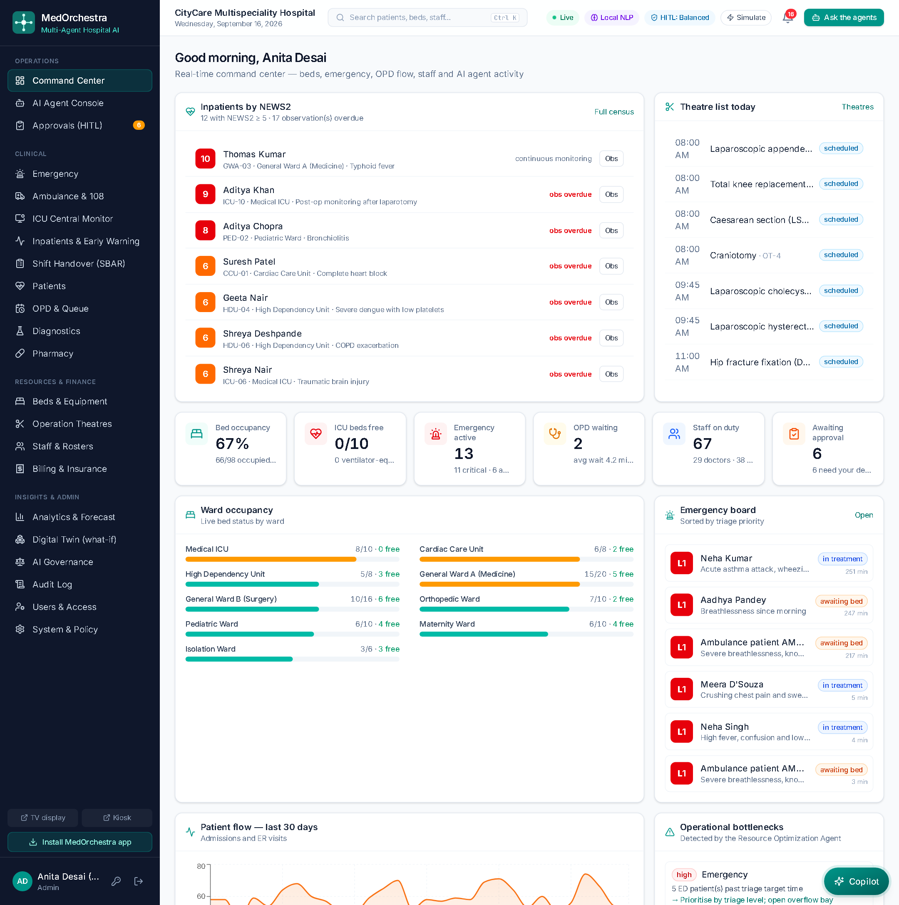
One platform, every role
29 screens — role dashboards, clinical workflows, pre-hospital, finance, analytics, public screens and a patient app
Inpatients & early warning
SBAR shift handover
Forecasts & ML model
Patient portal: bill & access log
18
Notes:
Mention Ctrl+K global search, voice input in the console, printable discharge summaries and the installable PWA.

Slide 19
Technology and quality
Open-source stack, reproducible deployment, automated tests
Frontend
React 19 · TypeScript · Vite · Tailwind · Recharts · PWA
55 / 55
Backend
Python 3.11 · FastAPI · Pydantic · WebSockets
automated tests passing
AI / optimisation
scikit-learn · OR-Tools CP-SAT · NumPy · optional Claude
Unit tests: NEWS2, triage, NLP, optimisers, queueing, forecasting, readmission, smart alarms
Integration tests: agent workflows, approvals and rollbacks, billing and claims, ambulance pre-arrival, digital twin, copilot, security
GitHub Actions CI: tests + TypeScript type-check + production build on every push
End-to-end scenarios verified in the browser
Data
SQLAlchemy · SQLite · PostgreSQL
Security
JWT · PBKDF2 · RBAC · lock-out · security headers · audit log
Deployment
Docker Compose · Nginx · GitHub Actions CI · one-click start.bat
19
Notes:
Tests run in about 15 seconds with a fresh database. Integration tests cover the complete human-in-the-loop flow including rollback on rejection.

Slide 20
Conclusion and future scope
What we achieved
Next steps
All 12 synopsis modules working end-to-end
Eleven cooperating agents with explainable recommendations
Safe by design: risk-tiered human approval, full audit, governance dashboard
Beyond the synopsis: 108 pre-hospital coordination, billing & PM-JAY claims, digital twin, ICU monitor, copilot, public screens
Runs offline; one-click start; Docker-ready; CI on every push
HL7 FHIR / ABDM integration and real PM-JAY claim submission
IoT smart beds and monitors feeding early warning
Retrain and recalibrate the models on real hospital data
Multi-hospital referral coordination
Full Hindi and regional-language interface (copilot already understands Hinglish)
AI coordinates, optimises and explains — qualified clinicians make the decisions.
20
Notes:
Close with the limitation: data is synthetic and integrations are simulated; clinical validation is the next step.

Slide 21
Thank you
Questions & live demo
Demo login: admin / admin123 · doctor / doctor123 · nurse / nurse123 · patient / patient123
Notes:
Keep the app running before the viva: start.bat, then log in as admin.

