Slide 1

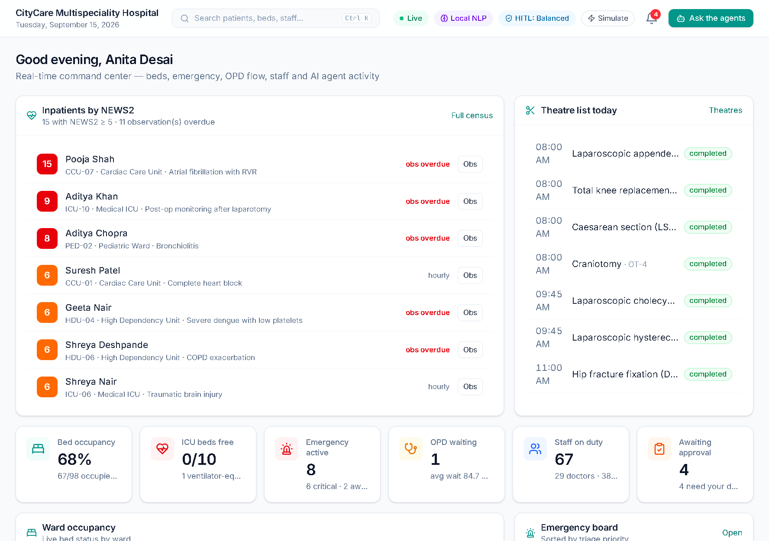
PROJECT TITLE
Multi-Agent AI Systems for Hospital Resource Optimization, Clinical Workflow Automation and Patient Care Coordination
RAMDEOBABA
UNIVERSITY
MedOrchestra — Multi-Agent Hospital Intelligence Platform
Idea Lab
Team members & roll numbers
________________ (Roll No. ______)
________________ (Roll No. ______)
Guide / Mentor
________________________
Department / School
________________________
Academic year
2026 – 27
COURSE CODE
________
Notes:
Introduce the team and the project: MedOrchestra, a working multi-agent AI platform for hospital operations built from our synopsis — nine specialised agents coordinated by an orchestrator, with humans approving every critical action.

Slide 2
PROBLEM STATEMENT
1
What problem are we addressing?
2
Who is affected?
Beds, ICU units, operation theatres, staff, diagnostics and pharmacy are coordinated through disconnected systems, phone calls and spreadsheets — so resources sit idle while patients wait.
Patients (delays, late escalation), doctors and nurses (hours of coordination work), and administrators (no single, real-time view of hospital capacity).
3
Current challenges
4
Why is the problem important?
Manual bed and staff allocation · long OPD queues · slow emergency mobilisation · deteriorating ward patients noticed late · no demand forecasting · decisions without a recorded rationale.
In emergencies minutes decide outcomes; ICU beds and theatres are the costliest resources; clinicians’ time should go to care — and any AI used must stay safe, explainable and accountable.
Core problem: an intelligent, coordinated system is needed that optimises resources and automates workflows through specialised AI agents — while qualified professionals keep control of critical decisions.
16 September 2026
Slide 2 of 10
Notes:
These are the problems from the synopsis. Emphasise the core problem: coordination across departments, with human oversight.

Slide 3
EXISTING SOLUTION / LITERATURE REVIEW
#
EXISTING SOLUTIONS
LIMITATIONS
OUR PROPOSED APPROACH
1
Hospital information systems (HIS / EHR modules)
Departmental silos; bed boards updated by hand; no optimisation or cross-department coordination
One data model for patients, resources and workflows, coordinated by an AI orchestrator
2
Stand-alone scheduling / OR-planning tools [3]
Solve one problem (e.g. roster or theatre list) in isolation, offline
Agents share a blackboard; CP-SAT optimises beds, staff and theatres against live demand
3
Paper NEWS2 charts & triage protocols [2]
Manual scoring; late escalation; not linked to bed or ICU capacity
Every observation NEWS2-scored; score ≥ 7 triggers alerts and an ICU-transfer proposal
4
Single AI model / chatbot assistants
Opaque, hard to validate, unsafe to act on clinical decisions [4]
Nine explainable specialised agents + human-in-the-loop approval and audit trail
Research gap: no system combines multi-agent coordination, constraint optimisation, early warning and human oversight in one explainable workflow [1].
[1] Wooldridge 2009 · [2] RCP NEWS2 2017 · [3] Cardoen et al. 2010 · [4] WHO 2021
16 September 2026
Slide 3 of 10
Notes:
Compare existing approaches with ours; the gap is combining coordination, optimisation, early warning and human oversight.

Slide 4
PROPOSED SOLUTION
1
Project idea
MedOrchestra — a hospital platform where staff describe a need in plain language and AI agents coordinate the response.
Bed Mgmt
2
Proposed approach
Notification
Appointments
A central orchestrator understands the request (English or Hinglish), plans a workflow and dispatches eleven specialised agents that share findings and negotiate over beds, staff, theatres, tests, ambulances and billing.
Ambulance 108
Staff Scheduling
3
Key innovation
AI
Orchestrator
Explainable recommendations with factor scores, constraint optimisation (OR-Tools CP-SAT), NEWS2-driven escalation and a configurable human-in-the-loop approval gate.
Billing & Insurance
Diagnostics
4
Beyond the hospital walls
108 ambulance dispatch with an emergency pre-alert during transport, automatic billing with PM-JAY packages, and a digital twin that answers capacity what-ifs before they happen.
Resource Optimizer
Pharmacy
5
Expected outcome
Faster emergency coordination, shorter waits, better bed/theatre utilisation, earlier escalation and less administrative work — with every decision audited.
Emergency
Patient Care
INNOVATION: ELEVEN COOPERATING, EXPLAINABLE AGENTS
16 September 2026
Slide 4 of 10
Notes:
Instead of one big model we use eleven agents (eight from the synopsis plus Notification, Billing & Insurance and Ambulance Dispatch). They post findings on a shared blackboard and message each other with FIPA performatives such as PROPOSE and REFUSE.

Slide 5
OBJECTIVES
01
Multi-agent platform
Central orchestrator + eleven specialised agents on one patient / resource / workflow / finance data model.
02
Optimise resources
Allocate beds, ICU, staff, theatres and equipment with constraint optimisation and demand forecasting.
04
Human control
03
Automate & coordinate
Appointments, queues, diagnostics, pharmacy, emergency response, notifications and care pathways.
03
Automate
04
Keep humans in control
Explainable recommendations, role-based approval, audit trail and a governance dashboard with model cards.
02
Optimise
EXPECTED MEASURABLE TARGETS → ACHIEVED
✓ Intent accuracy ≥ 85%: 95.8%
✓ Occupancy forecast MAPE < 5%: 3.07%
01
✓ Optimal roster < 5 s: 1.1 s
✓ Critical actions human-approved: 100%
Platform
16 September 2026
Slide 5 of 10
Notes:
Four objectives condensed from the ten in the synopsis, with measurable targets and what we achieved.

Slide 6
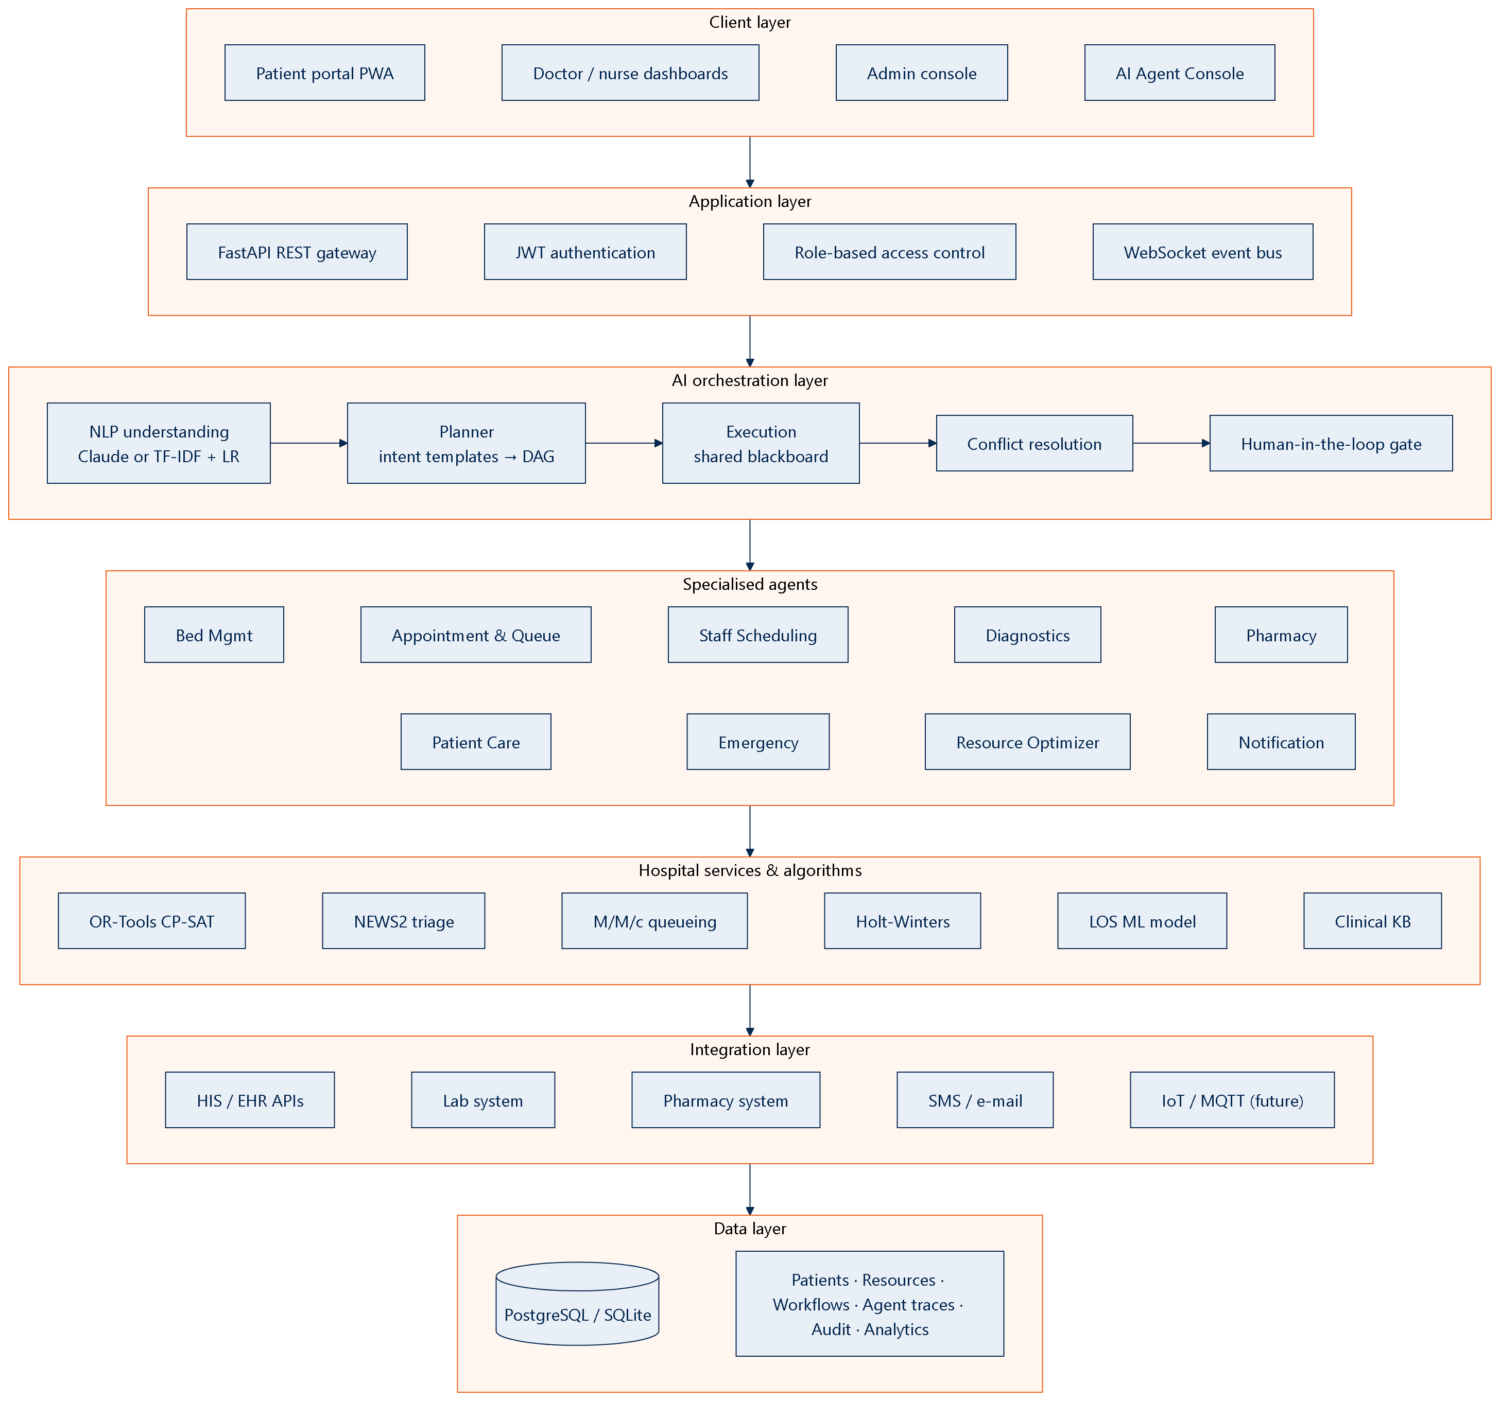
SYSTEM ARCHITECTURE / METHODOLOGY
INPUT → PROCESSING → AI / ALGORITHM → OUTPUT
INPUT
Natural-language requests · ER registrations · bedside vitals · bookings · live hospital data
PROCESSING
NLP intents & entities (TF-IDF + LR / Claude) → planner builds a dependency DAG of agent steps
AI / ALGORITHM
9 agents with CP-SAT, NEWS2, M/M/c queueing, Holt-Winters, Gradient Boosting; conflict resolution
OUTPUT
Explainable recommendations · safe actions auto-executed · approvals for critical ones · alerts & dashboards
Components: software-only — FastAPI · React PWA · SQLite / PostgreSQL · WebSockets (no special hardware)
16 September 2026
Slide 6 of 10
Notes:
Left: layered architecture from the synopsis. Right: the methodology as input → processing → AI → output. Every request follows the ten-step pipeline (intake, NLP, workflow, agent selection, coordination, constraints, recommendations, human approval, execution, logging).

Slide 7
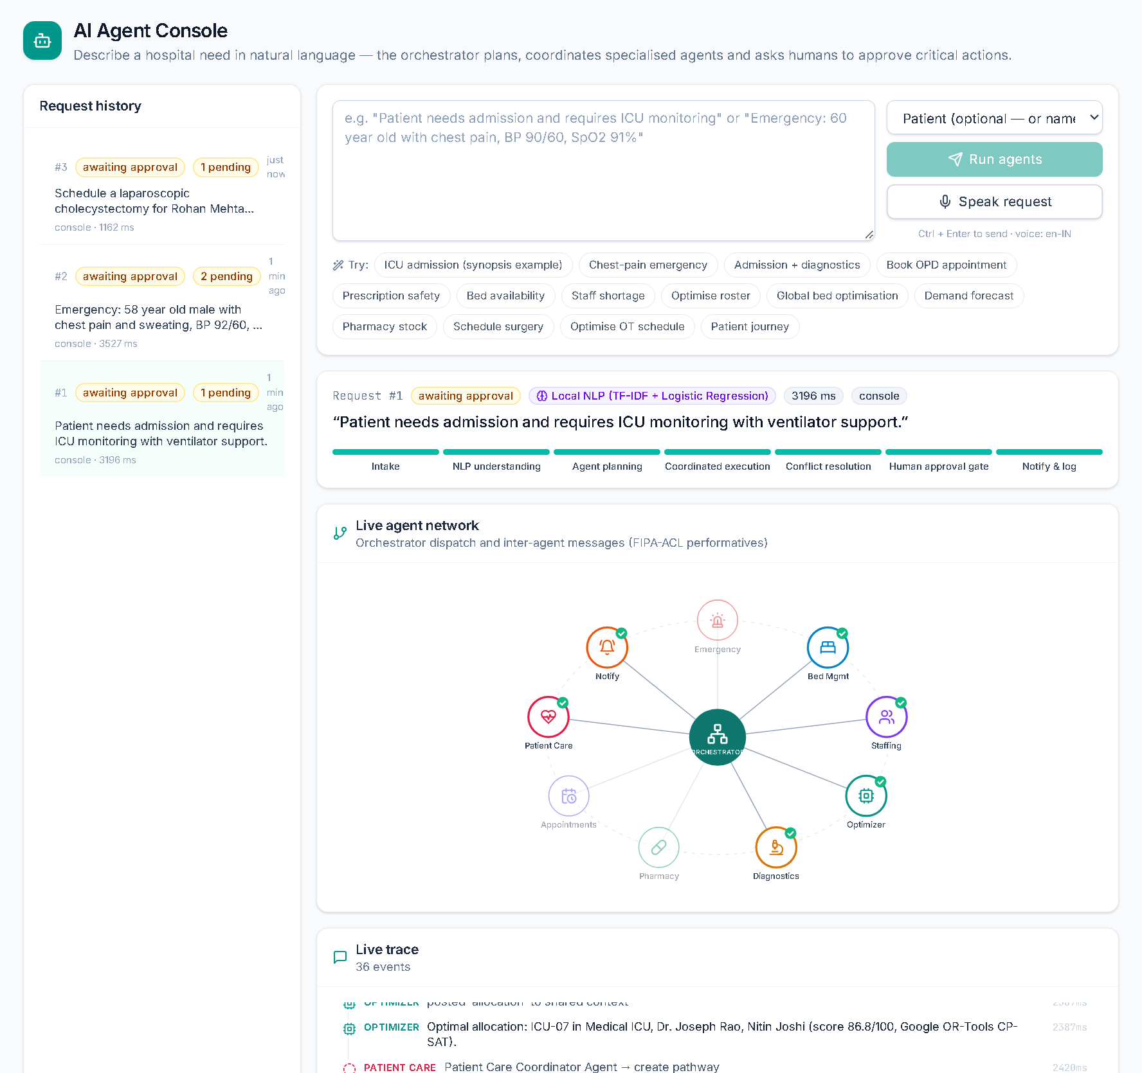
IMPLEMENTATION
1
Technologies used
PROTOTYPE / SYSTEM IMAGE
Python 3.11 · FastAPI · SQLAlchemy · React 19 + TypeScript · Tailwind · Recharts · WebSockets
2
Hardware components
None required — runs on any laptop / server; installable PWA for phones and tablets
3
Software / tools
SQLite (dev) / PostgreSQL (Docker) · OR-Tools · scikit-learn · NumPy · pytest · Docker Compose
4
Algorithms / models
NEWS2 triage · CP-SAT bed, roster & theatre optimisation · M/M/c queueing · Holt-Winters forecasting · Gradient-Boosting length of stay · LACE readmission risk · Monte-Carlo digital twin · TF-IDF + logistic-regression NLP with Hinglish normalisation (optional Claude)
5
Prototype development
29 screens for 7 roles + public TV display & kiosk · 11 agents + orchestrator · live simulator · 55 automated tests passing with GitHub Actions CI
AI Agent Console — live agent network, trace and plan for the ICU-admission request
16 September 2026
Slide 7 of 10
Notes:
Implementation details. The image shows the AI Agent Console running the synopsis example; mention the 38 automated tests.

Slide 8
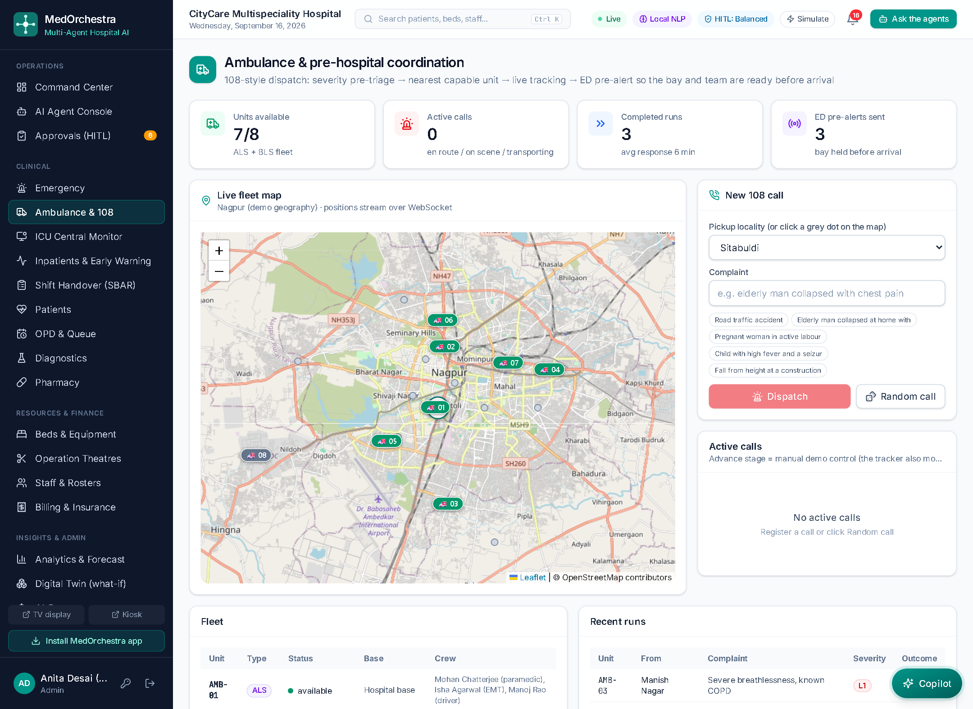
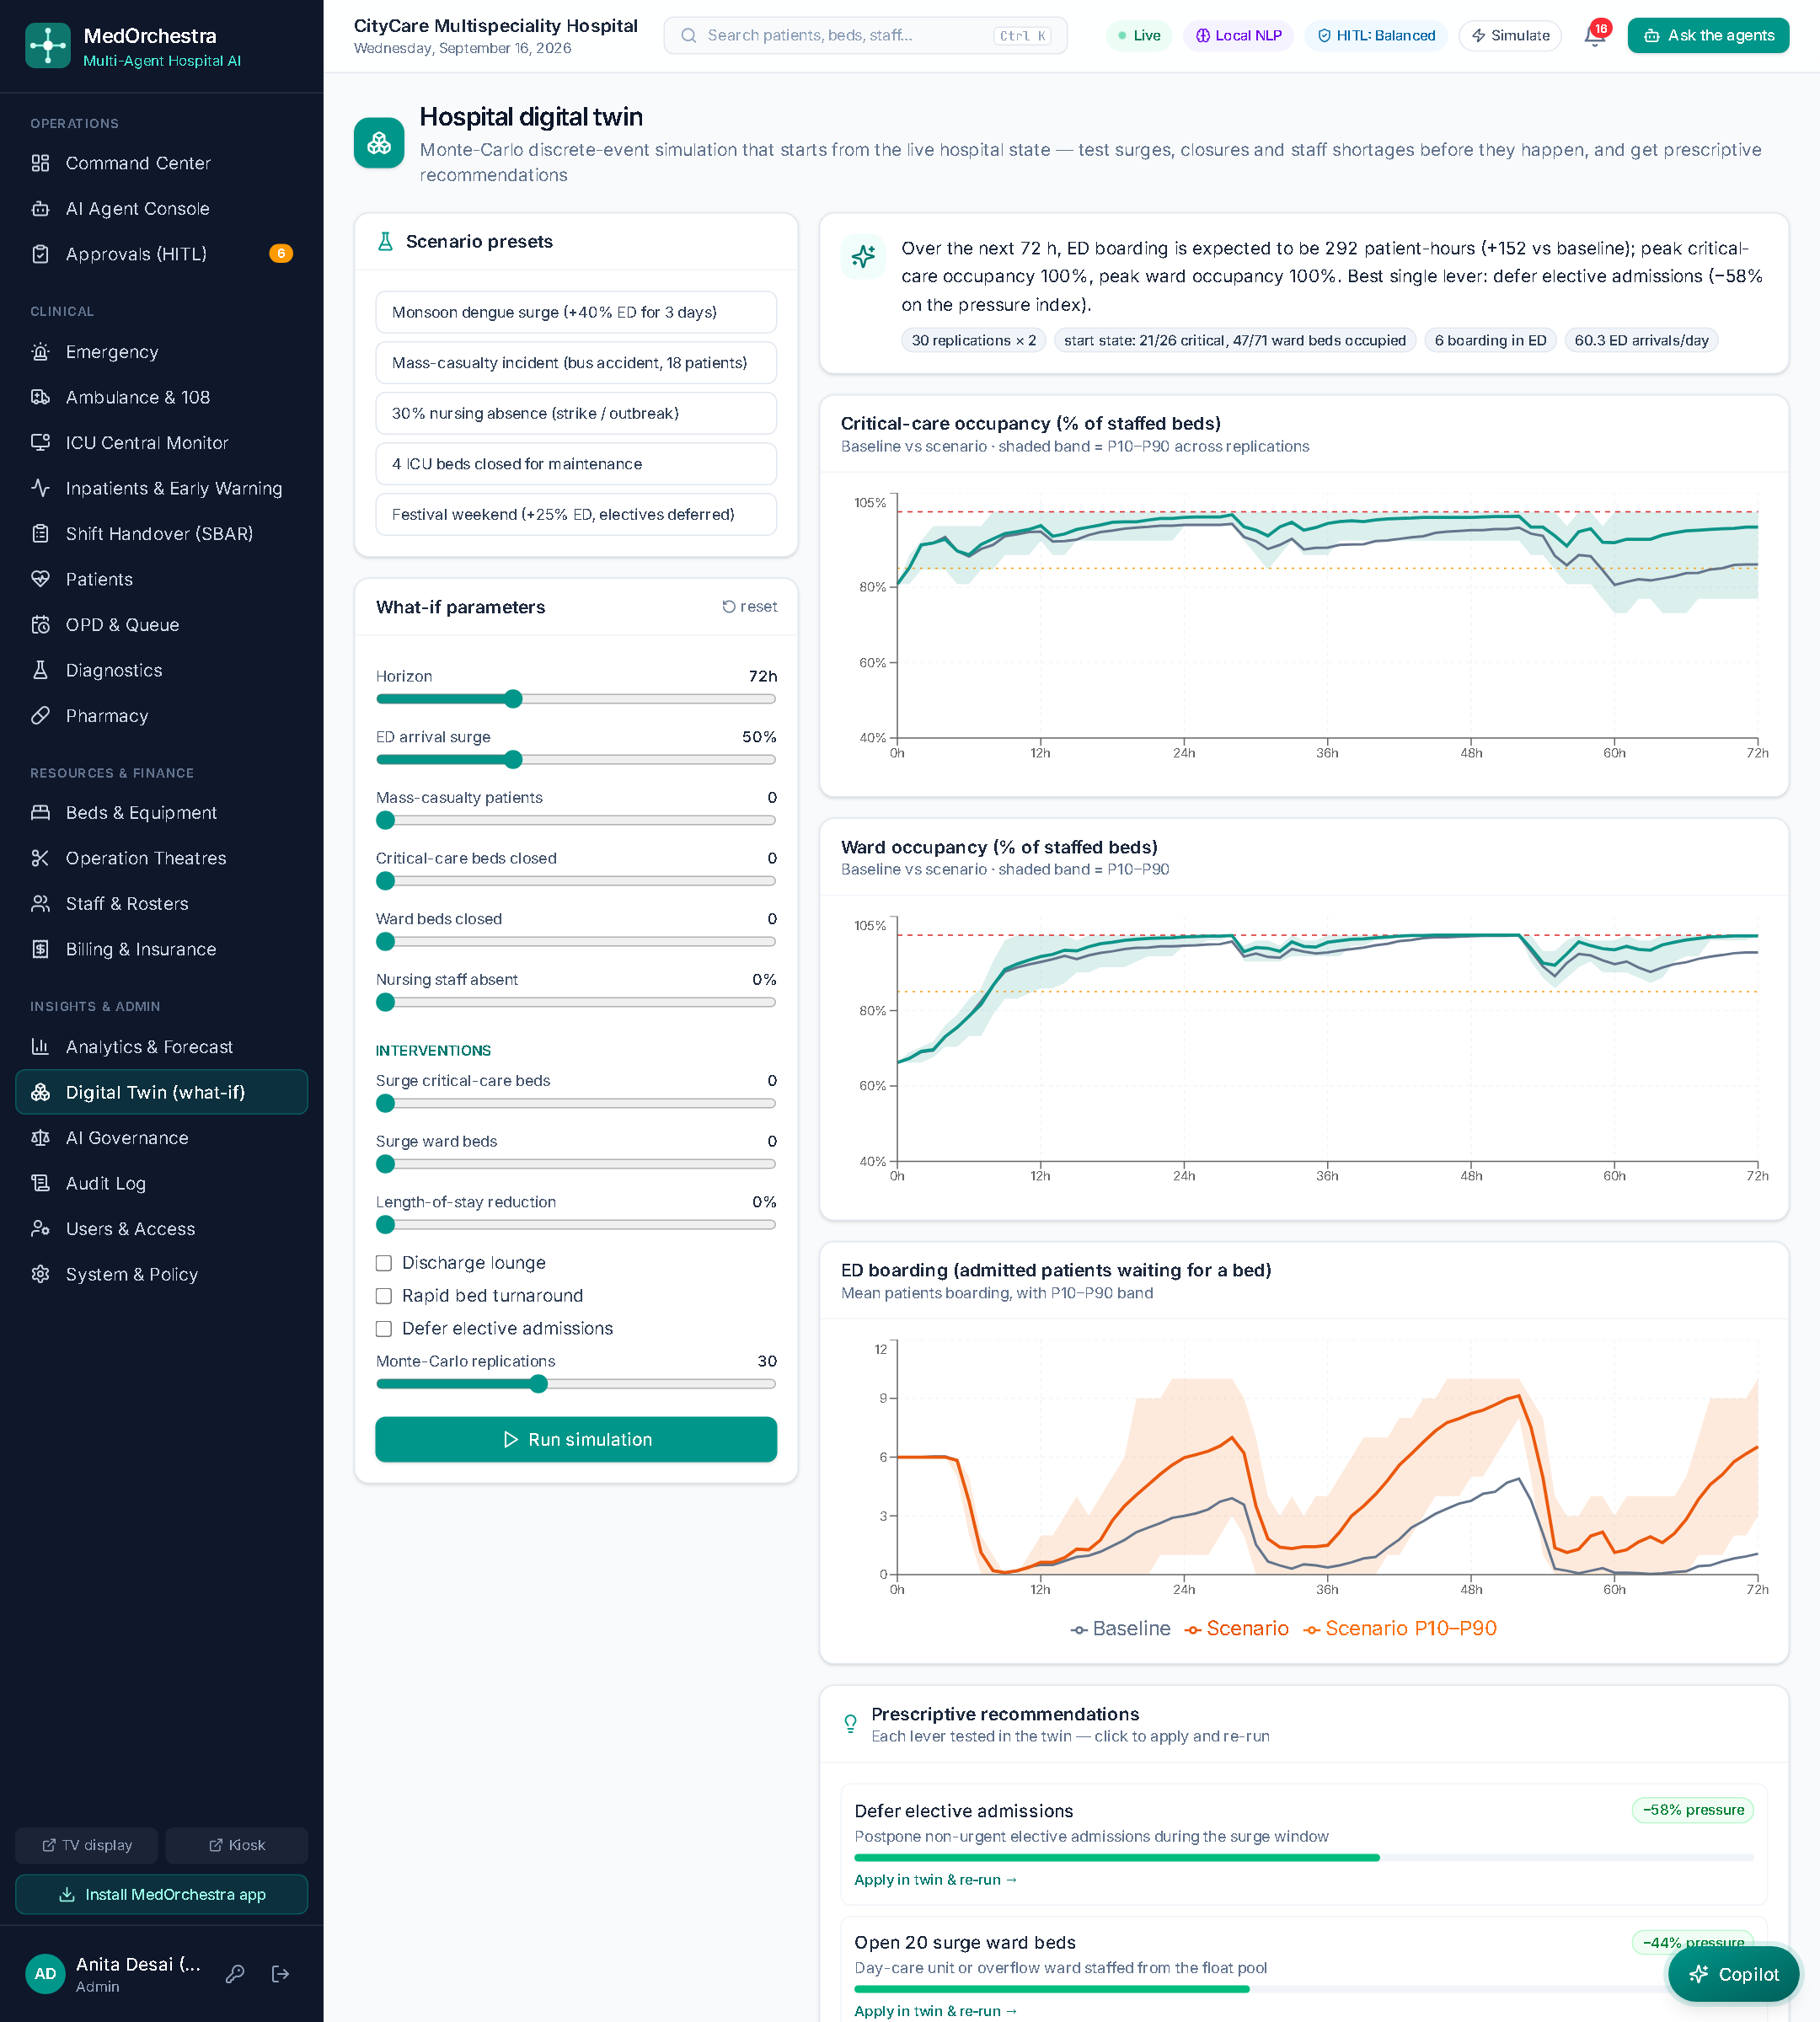
RESULTS / PROTOTYPE
SCREENSHOTS
Command center
108 dispatch & pre-arrival alert
Digital twin what-if
✓
95.8%
✓
3.07%
✓
−21%
intent accuracy held out (74% cross-validated)
bed-occupancy forecast MAPE (baseline 4.14%)
length-of-stay error vs baseline
✓
75→0
✓
−56%
✓
55 / 55
theatre overtime (min) after CP-SAT
ED pressure from the twin's best lever (defer elective admissions)
automated tests passing
16 September 2026
Slide 8 of 10
Notes:
Results measured by our evaluation script on the synthetic 108-bed hospital. They show correctness and feasibility; clinical effectiveness would need a real hospital study.

Slide 9
INNOVATION, IMPACT, DELIVERABLES & FUTURE SCOPE
Innovation
Explainable multi-agent orchestration · pre-arrival ambulance coordination that holds a bay during transport · Monte-Carlo digital twin that recommends the best intervention · Hinglish copilot · configurable autonomy · CP-SAT for beds, rosters and theatres
★
Impact
Faster emergency mobilisation and door-to-bay time · shorter OPD waits · theatre overtime removed · earlier escalation · no missed charges and cashless PM-JAY claims · capacity planned before the surge · accountable AI with a governance dashboard
↗
Deliverables
Working web app + PWA (29 screens, 7 roles, public display & kiosk) · FastAPI backend with 11 agents · 55 automated tests + CI · project report · architecture docs & demo script · Docker deployment
✓
Future scope
HL7 FHIR / ABDM integration and real PM-JAY claim submission · IoT smart beds feeding the monitor · retraining and recalibration on real hospital data · multi-hospital referral network · full Hindi interface
→
16 September 2026
Slide 9 of 10
Notes:
Highlight the innovations and the impact; list what we are submitting and where the project can go next.

Slide 10
CONCLUSION & REFERENCES
CONCLUSION
REFERENCES
Built MedOrchestra — all 12 synopsis modules working end-to-end with 11 cooperating AI agents.
Proven algorithms (CP-SAT, NEWS2, queueing, forecasting, ML, discrete-event simulation) make every recommendation measurable and explainable.
Safe by design: risk-tiered human approval, configurable autonomy and a complete audit trail.
Extended it well beyond the synopsis: 108 pre-hospital coordination, billing with PM-JAY and insurer claims, a Monte-Carlo digital twin, an ICU central monitor, a Hinglish copilot, public waiting-room screens and an AI-governance dashboard.
Limitation: synthetic data and simulated integrations — clinical validation is the next step.
[1] M. Wooldridge, An Introduction to MultiAgent Systems, 2nd ed., Wiley, 2009.
[2] Royal College of Physicians, National Early Warning Score (NEWS) 2, London, 2017.
[3] B. Cardoen, E. Demeulemeester, J. Beliën, “Operating room planning and scheduling: A literature review,” EJOR, 201(3), 2010.
[4] World Health Organization, Ethics and Governance of Artificial Intelligence for Health, 2021.
[5] L. V. Green, “Queueing analysis in healthcare,” in Patient Flow, Springer, 2006.
[6] P. R. Winters, “Forecasting sales by exponentially weighted moving averages,” Management Science, 6(3), 1960.
[7] J. H. Friedman, “Greedy function approximation: A gradient boosting machine,” Annals of Statistics, 29(5), 2001.
[8] L. Perron, V. Furnon, OR-Tools, Google — developers.google.com/optimization
Thank you — questions & live demo
Login: admin / admin123 · doctor / doctor123 · nurse / nurse123 · patient / patient123
16 September 2026
Slide 10 of 10
Notes:
Conclude, mention the limitation honestly, then move to the live demo.

