Slide 1
SOFTWARE ENGINEERING LAB · PROJECT-BASED LEARNING
2
Smart Classroom Electricity Management System
modules built
78
test cases
Vacancy detection, AC-state inference and appliance control
45
Jira work items
Vineet Shah · Roll No. 28 · 5S CSE, A6-B2
Software Engineering Lab (24CS01PR0502) · 2026-27
Notes:
Individual SE PBL project. The problem statement is from my Idea Lab project; for this PBL I built two software modules, managed the work in Jira and tested it with 78 test cases.

Slide 2
Why classrooms waste electricity
1
Appliances stay ON
2
Sensors miss the picture
3
AC state is invisible
Lights, fans and ACs keep running after a lecture ends. Manual switching and fixed timers cannot follow irregular schedules.
PIR sensors cannot see whether fans or lights are on, and miss people who sit still.
One temperature sensor cannot tell whether the AC is still cooling an empty room.
Proposed system
CCTV + YOLOv8 counts people, fans and lights; four DHT11 sensors read four room regions; an ESP32 switches relays; a web dashboard shows alerts and lets an operator act.
Smart Classroom Electricity Management · SE Lab PBL · Vineet Shah
2
Notes:
Problem statement from the Idea Lab project 'Electricity Management through Computer Vision & Temperature Sensing'.

Slide 3
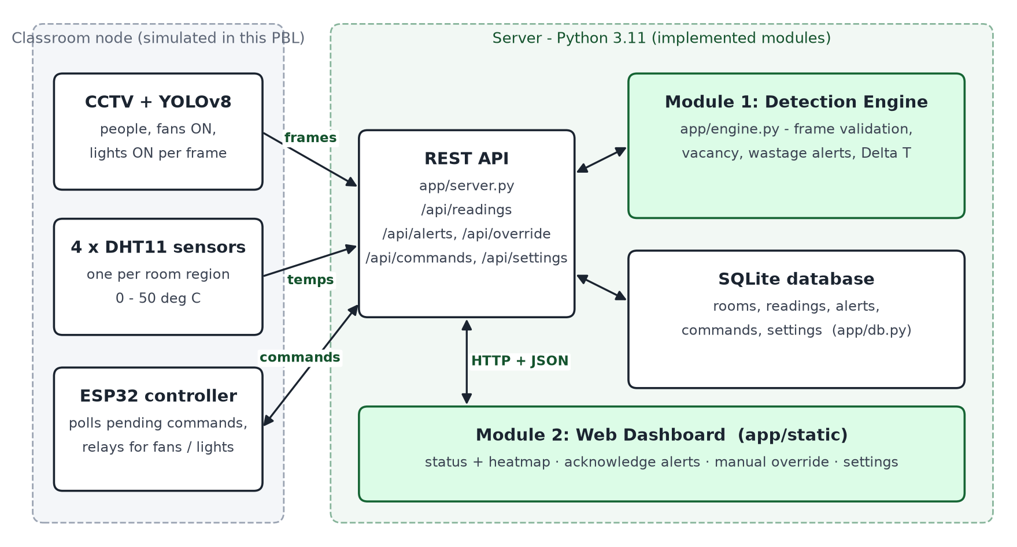
What this PBL builds
Implemented
Module 1 - detection engine
Module 2 - REST API, SQLite database and web dashboard
Simulated
CCTV + YOLOv8, four DHT11 sensors and the ESP32 are replaced by app/simulator.py, which sends the same data
Python 3.11 standard library · SQLite · HTML, CSS, JavaScript
Smart Classroom Electricity Management · SE Lab PBL · Vineet Shah
3
Notes:
Green boxes are what I implemented. The hardware and the trained model were not available, so a simulator posts the same frames and executes relay commands like the ESP32.

Slide 4
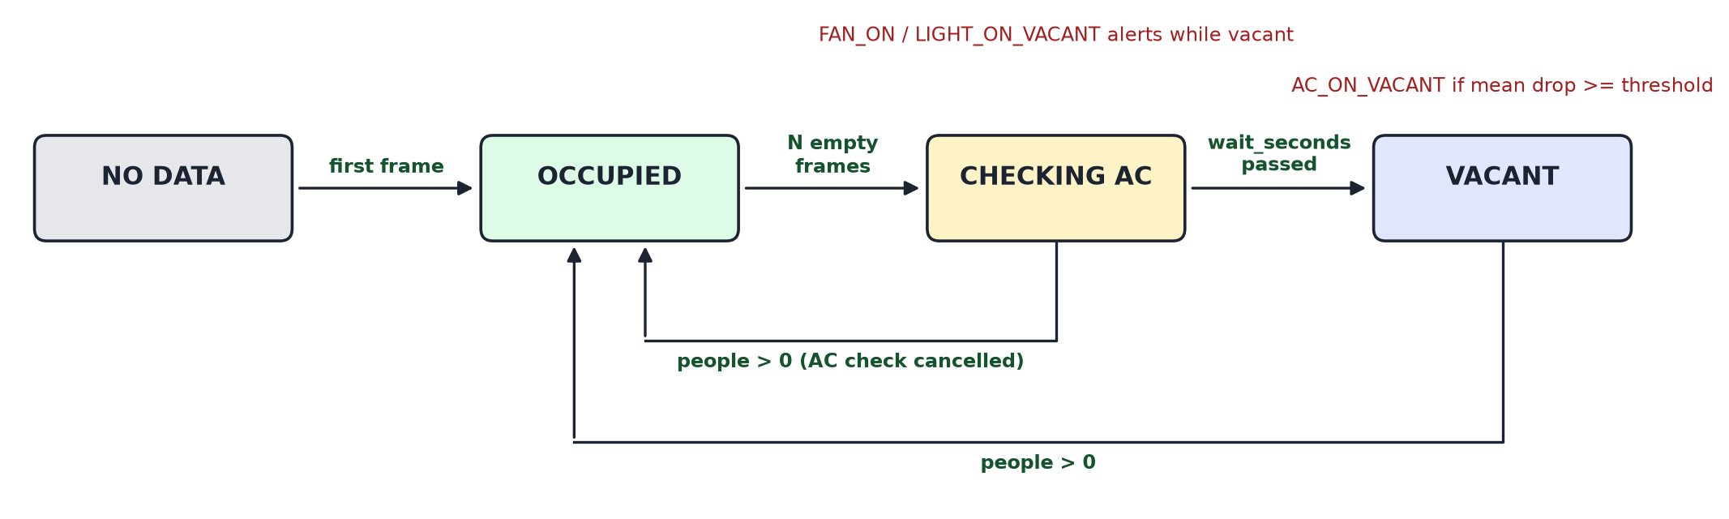
Module 1 · Vacancy and AC-state detection engine
Vacancy
Wastage alerts
AC inference
Room is vacant only after N consecutive frames with no people (default 10). Any person resets the count.
FAN_ON_VACANT and LIGHT_ON_VACANT are raised while the room is vacant, once per occurrence.
After wait_seconds, mean temperature drop over the 4 regions >= threshold means the AC is still ON.
Smart Classroom Electricity Management · SE Lab PBL · Vineet Shah
4
Notes:
app/engine.py - RoomMonitor processes one frame at a time and validates every input (counts 0-50, temperatures 0-50 deg C, increasing timestamps).

Slide 5
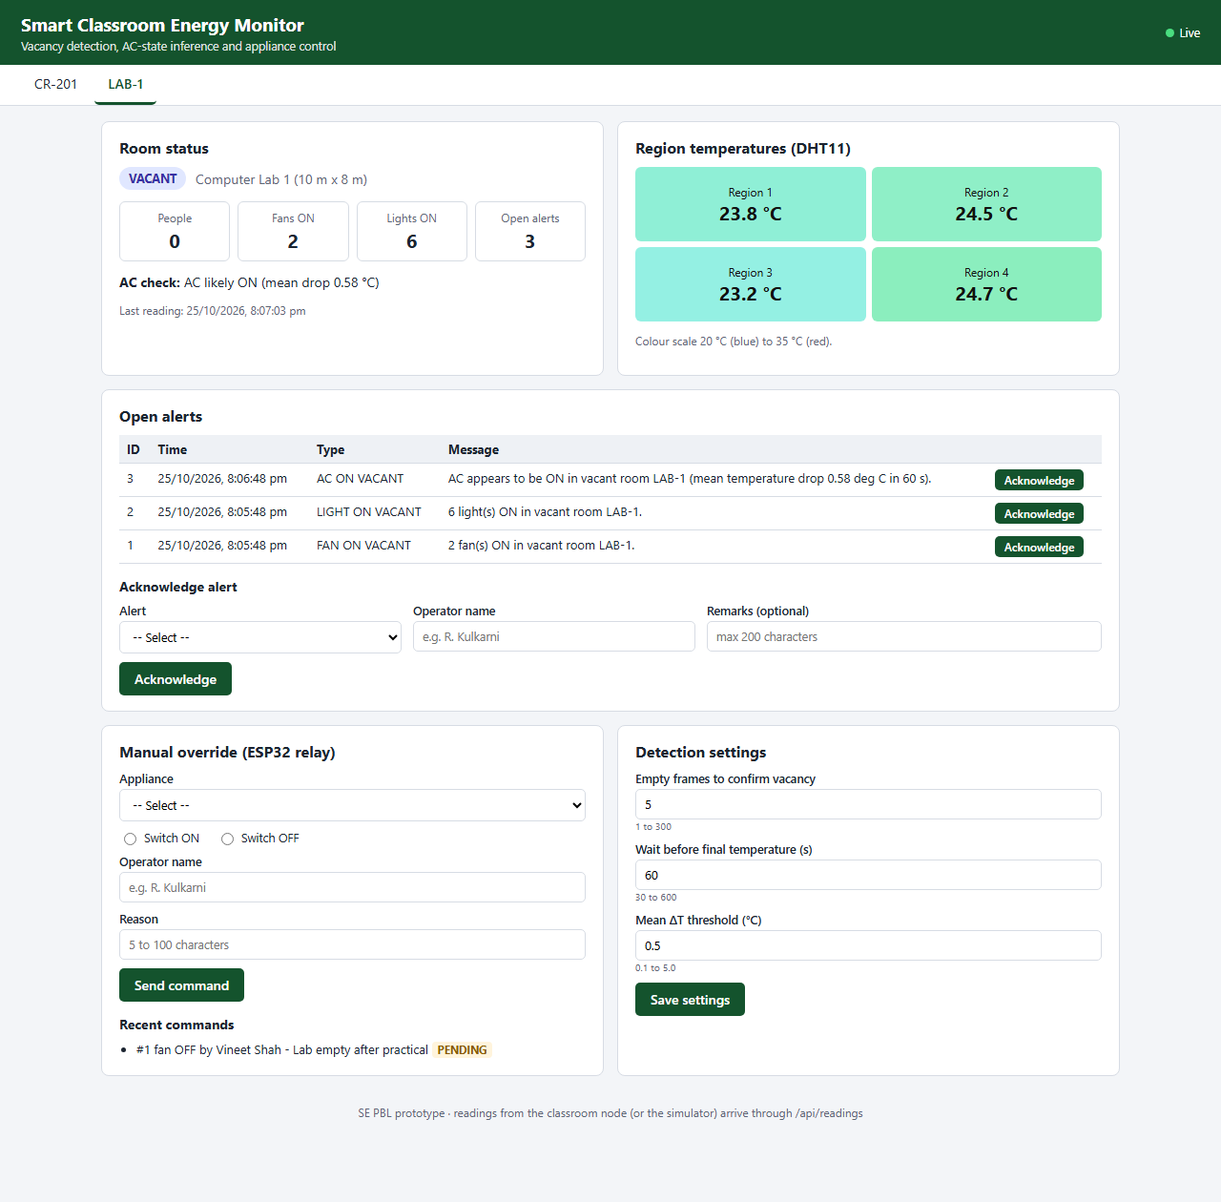
Module 2 · Monitoring dashboard and control
1
Live room status
state badge, people, fans and lights ON, AC check, 2x2 heatmap
2
Alerts
open alerts listed newest first; operator acknowledges with name and remarks
3
Manual override
fan or light ON/OFF queued for the ESP32, marked done when executed
4
Settings
vacancy frames, wait time and threshold, validated and stored in SQLite
5
REST API
/api/readings, /alerts, /override, /commands, /settings
Smart Classroom Electricity Management · SE Lab PBL · Vineet Shah
5
Notes:
Screenshot from the simulator run on 25-10-2026: LAB-1 left with 2 fans, 6 lights and the AC on - three open alerts and a pending fan OFF command.

Slide 6
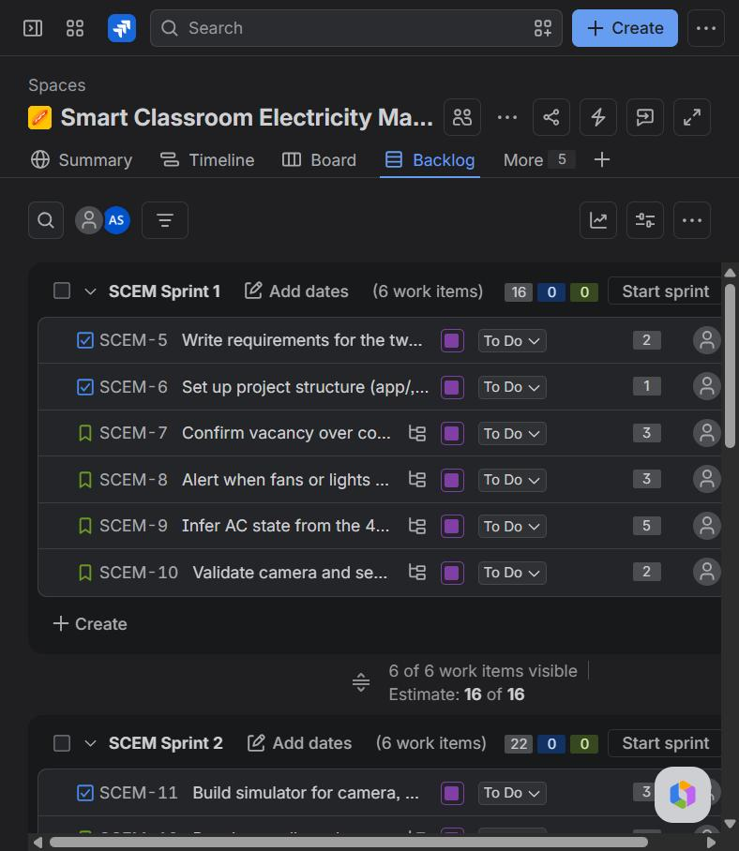
Managed in Jira · space SCEM
4
9
10
epics
user stories
tasks
18
4
3
subtasks
bugs
sprints
Epic -> Story / Task / Bug -> Subtask
Backlog imported from jira/jira_import.csv
Workflow: To Do -> In Progress -> Done
Each bug carries steps, severity, priority and a fix + retest comment
Smart Classroom Electricity Management · SE Lab PBL · Vineet Shah
6
Notes:
Site rbunagpur-team-zhx8jd75.atlassian.net, space Smart Classroom Electricity Management (key SCEM), Scrum, team-managed. Screenshot: sprint planning in the backlog.

Slide 7
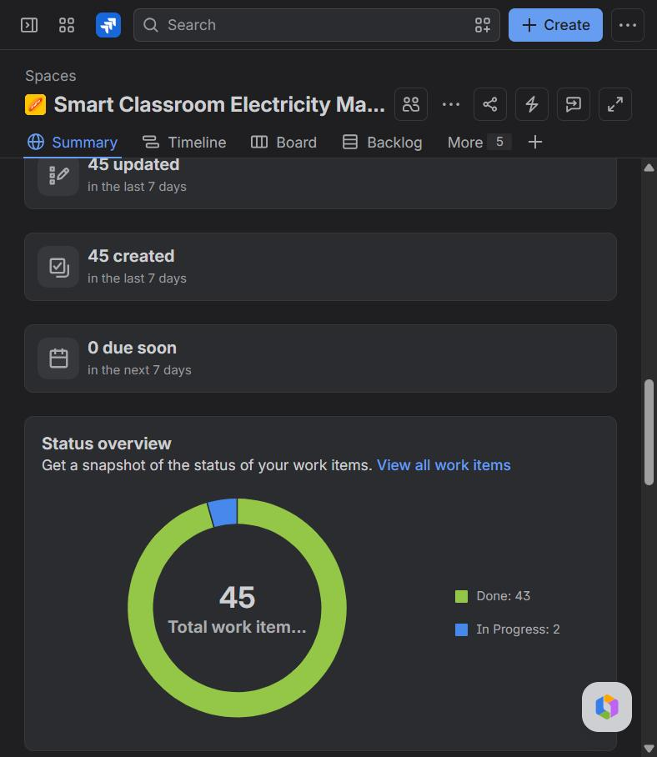
Three sprints, tracked to Done
Sprint | Goal | Items | Points | State
SCEM Sprint 1 25-10 19:30-19:50 | Detection engine (Module 1) and requirements | 6 | 16 | Completed
SCEM Sprint 2 25-10 19:50-20:00 | Dashboard, API, database and simulator (Module 2) | 6 | 22 | Completed
SCEM Sprint 3 25-10 20:00 - 01-11 | Testing, bug fixing and documentation | 11 | 16 | Active
Sprint 3 holds the testing tasks and the four bugs; the report and presentation task stays In Progress until submission.
Smart Classroom Electricity Management · SE Lab PBL · Vineet Shah
7
Notes:
Status on 26-10-2026: 43 work items Done, 2 In Progress (SCEM-23 report and presentation, and its epic SCEM-4).

Slide 8
78 automated test cases
32
24
7
15
Unit tests
engine
API tests
server + DB
Integration
end to end
UI tests
in Edge
✓
Functional
every requirement checked through its output
✓
Equivalence partitioning
valid and invalid classes for each input
✓
Boundary value analysis
min-1, min, max, max+1 for every limit
✓
Validation
every API and form error message
✓
Unit and integration
engine alone, then engine + API + DB + ESP32 loop
Format: Test Case ID · Module · Test Scenario · Test Data · Expected Result · Actual Result · Status
Smart Classroom Electricity Management · SE Lab PBL · Vineet Shah
8
Notes:
Expected results come from the requirements (docs/requirements.md), written before the first run. python -m tests.run_tests executes all cases and records the actual result of each.

Slide 9
Run 1 found 4 real bugs
73 / 5
78 / 0
BUG-01 · SCEM-24
Minor / Medium
→
Room with no readings shown as OCCUPIED
Run 1: passed / failed
Run 2 (retest): passed / failed
BUG-02 · SCEM-25
Major / High
False AC alert at 0.499 deg C drop (rounding)
Each failure was analysed, logged as a Bug in Jira, fixed in code and retested.
Fix and retest comments are on each bug (SCEM-24 to SCEM-27).
BUG-03 · SCEM-26
Minor / Low
Missing room_id gave 404 'Room None'
BUG-04 · SCEM-27
Trivial / Low
Settings errors showed internal field names
Smart Classroom Electricity Management · SE Lab PBL · Vineet Shah
9
Notes:
BUG-02 was the most serious: the mean drop was rounded to 2 decimals before the threshold comparison. Found by the BVA case threshold - 0.001.

Slide 10
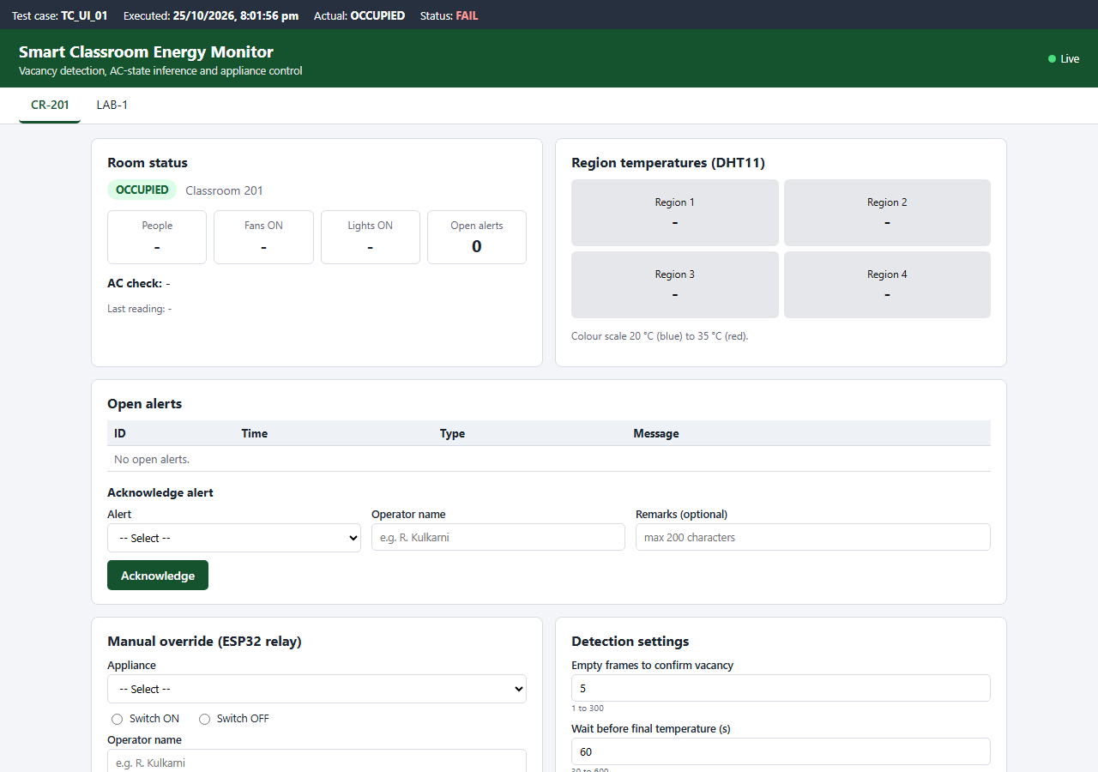

Bug fix and retest evidence · BUG-01
Before fix: OCCUPIED, TC_UI_01 FAIL
After fix: NO DATA, TC_UI_01 PASS
Same seeded data, same test case, captured from the real dashboard in Microsoft Edge before and after the fix
Smart Classroom Electricity Management · SE Lab PBL · Vineet Shah
10
Notes:
The dark bar at the top of each screenshot is added by the UI test harness and shows the test case, time and result.

Slide 11
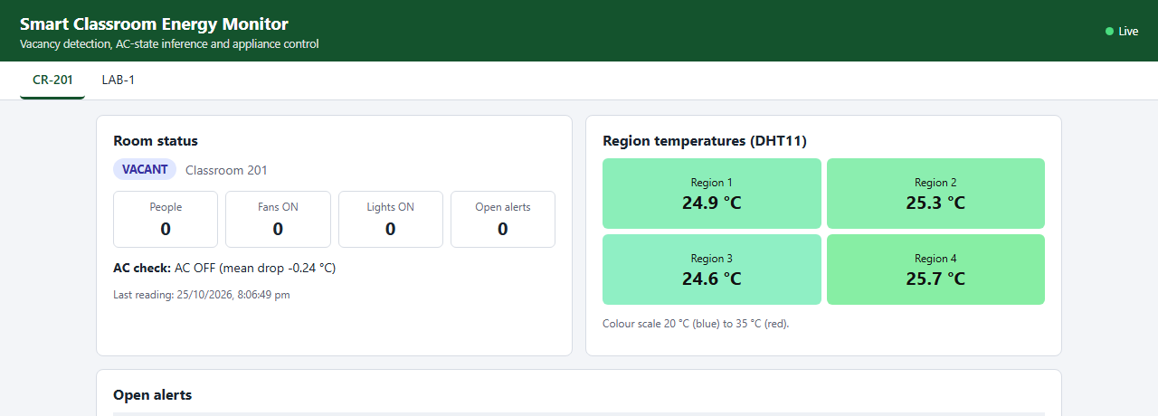
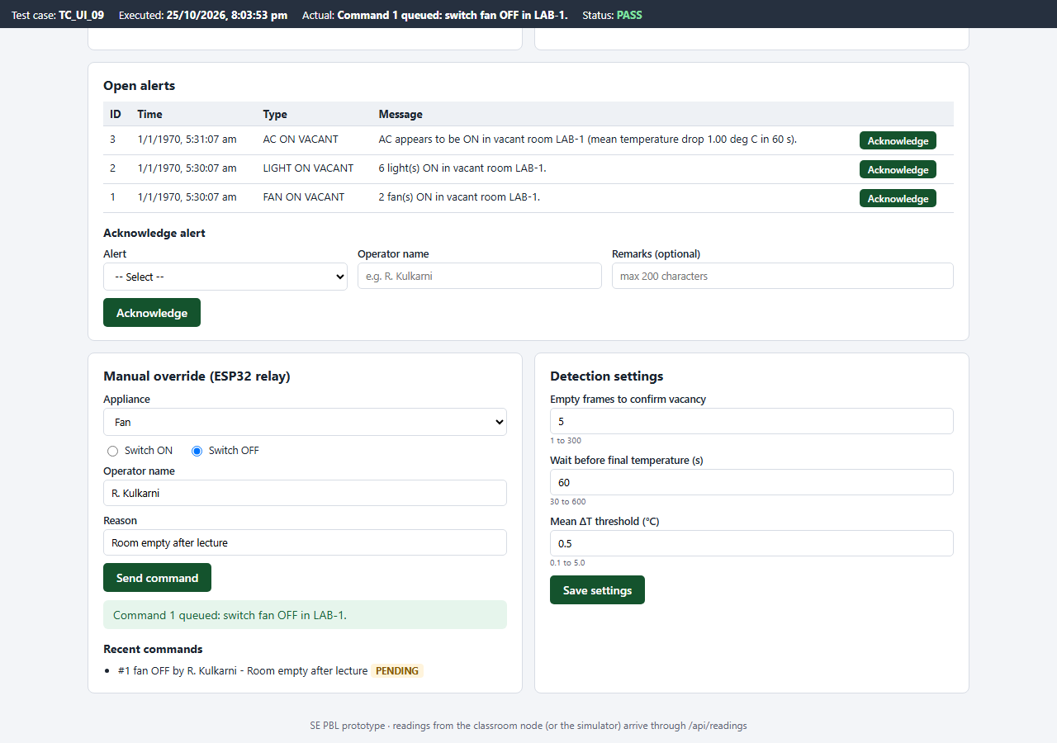
Live demonstration
1
Start the server
python -m app.server --port 8090
2
Run the classroom simulator
python -m app.simulator --room LAB-1 --scenario ac_left_on
CR-201 after everything was switched off: AC inferred OFF (room warmed by 0.24 deg C)
3
Watch and act
alerts appear; acknowledge, override a fan, change a setting
4
Run all tests
python -m tests.run_tests
Smart Classroom Electricity Management · SE Lab PBL · Vineet Shah
11
Notes:
Demo order: server, simulator scenario ac_left_on for LAB-1 (fan, light and AC alerts), acknowledge an alert, send fan OFF, then all_off for CR-201, then the test run.

Slide 12
Conclusion and next steps
What was achieved
Two working modules with database, validation and integration
Jira project: 45 work items, 3 sprints, bugs tracked to closure
78 test cases; 4 bugs found, fixed and retested; 78 / 78 pass
Next steps
Connect the real CCTV + YOLOv8, DHT11 sensors and ESP32
MQTT between classroom node and server
Daily energy-wastage report and mobile alerts
Thank you · Questions?
Notes:
Close with the results and the next steps toward the full hardware system.

