Slide 1
SOFTWARE ENGINEERING LAB · PROJECT-BASED LEARNING
2
Unified Student Placement System
modules built
155
test cases
Job Posting & Eligibility Verification · Job Application & Tracking
49
Jira work items
Vineet Shah · Roll No. 28 · 5S CSE, A6-B2
Software Engineering Lab (24CS01PR0502) · Prof. D. A. Borikar
Notes:
SE PBL on my lab case study, the Unified Student Placement System. Two modules of the SRS were built, managed in Jira and tested with 155 test cases.

Slide 2
Why campus placement needs one system
1
Manual screening
2
Errors and missed deadlines
3
No visibility
Placement officers check every student against every company's CGPA, branch and backlog rules by hand.
Ineligible and duplicate applications, stale copies of data in spreadsheets, late applications.
Students and recruiters cannot see where an application stands; updates go out by e-mail and notice boards.
USPS (my SE lab SRS)
One web platform for students, recruiters and the placement cell: approved job postings, automatic eligibility with reasons, applications with tracking ids and a live status timeline.
Unified Student Placement System · SE Lab PBL · Vineet Shah, Roll No. 28
2
Notes:
Problem statement from the SRS scope (1.4): spreadsheets, e-mail threads and notice boards are replaced by one platform.

Slide 3
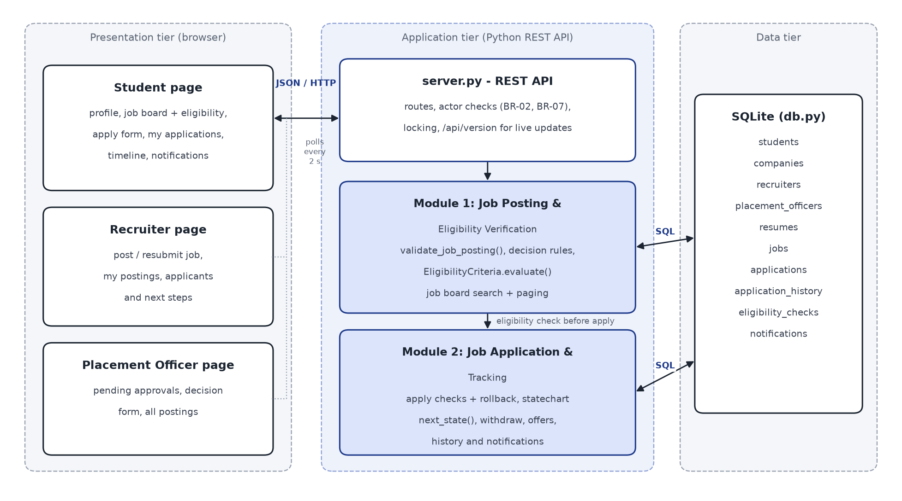
What this PBL builds
Implemented
Module 1 - job posting, approval, search, eligibility check
Module 2 - application, statechart workflow, tracking, notifications
Built from my lab work
SRS FR-09 to FR-17, use cases UC-1 / UC-2, Expt-3 class diagram, Expt-5 statechart, SRS 6.1 tables
Python 3.11 standard library · SQLite · HTML, CSS, JavaScript
Unified Student Placement System · SE Lab PBL · Vineet Shah, Roll No. 28
3
Notes:
Three-tier design from SRS 2.1. Login, interview scheduling, offer documents and reports are other SRS modules and are outside this PBL; the page lets me pick the acting user.

Slide 4
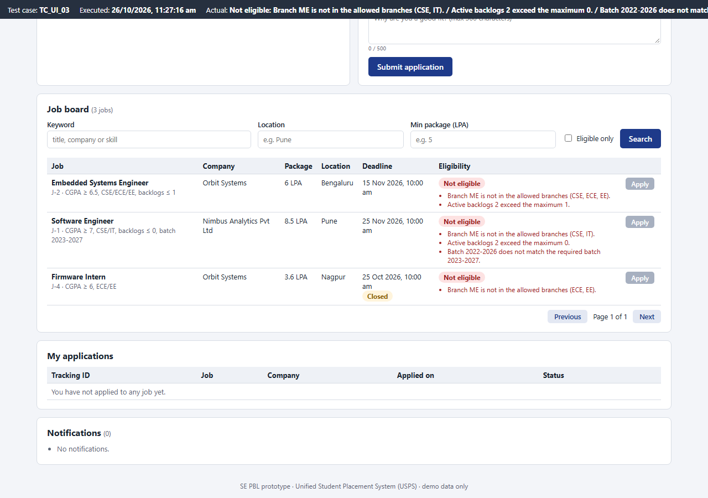
Module 1 · Job posting and eligibility verification
1
Post a job (FR-10)
title, package, location, deadline + eligibility rule-set; validated on the server
2
Company approval (FR-09)
recruiter of an unapproved company cannot post
3
Officer decision (FR-11, BR-02)
approve, reject or return with remarks; returned jobs are resubmitted
4
Search and filter (FR-12)
keyword, location, minimum package, eligible only, pages
5
Eligibility check (FR-14, BR-03)
every unmet criterion listed; Apply disabled when not eligible
Unified Student Placement System · SE Lab PBL · Vineet Shah, Roll No. 28
4
Notes:
Screenshot: student Rohan (ME, 2 backlogs, batch 2022-2026) sees every unmet criterion and the Apply button is disabled. Rules are in app/rules.py - EligibilityCriteria.evaluate() from the Expt-3 class diagram.

Slide 5
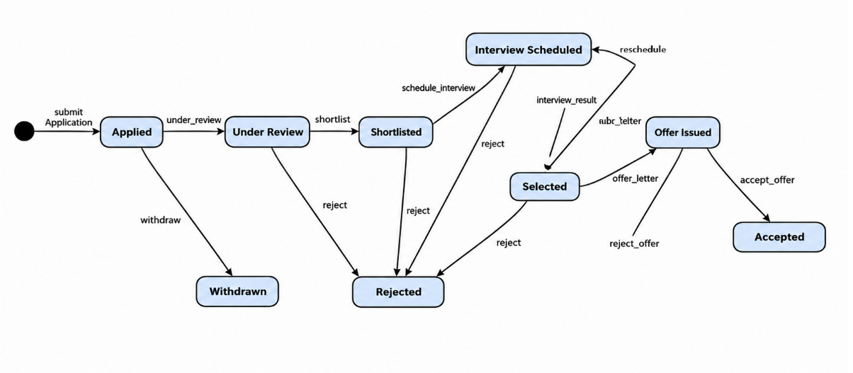
Module 2 · Job application and tracking
Apply (UC-1)
Statechart (Expt-5)
Tracking (FR-17)
published, before deadline, not placed, eligible, no duplicate, own active resume; tracking id USPS-26-0001; saved in one transaction
every step goes through next_state(); offers only after selection (BR-08); recruiters touch only their own applicants (BR-07)
timeline with every step and actor, notifications, withdraw before the deadline, accept marks the student placed (BR-01)
Unified Student Placement System · SE Lab PBL · Vineet Shah, Roll No. 28
5
Notes:
The statechart I drew in Expt-5 is coded as a transition table (APPLICATION_TRANSITIONS); anything the diagram does not allow is refused with a 409 message.

Slide 6
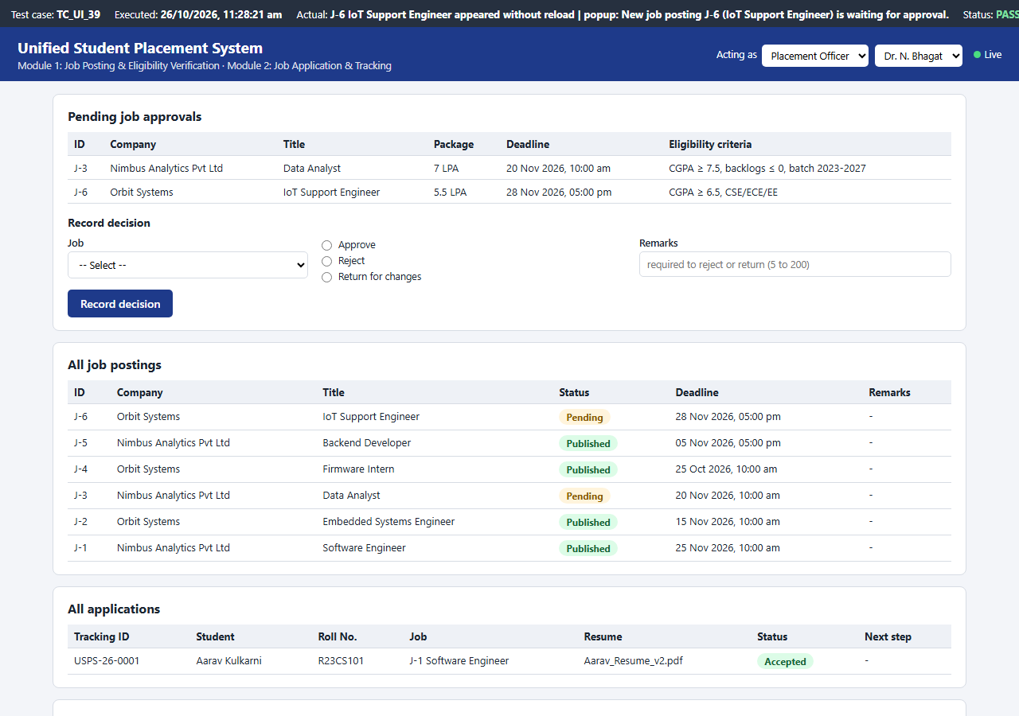
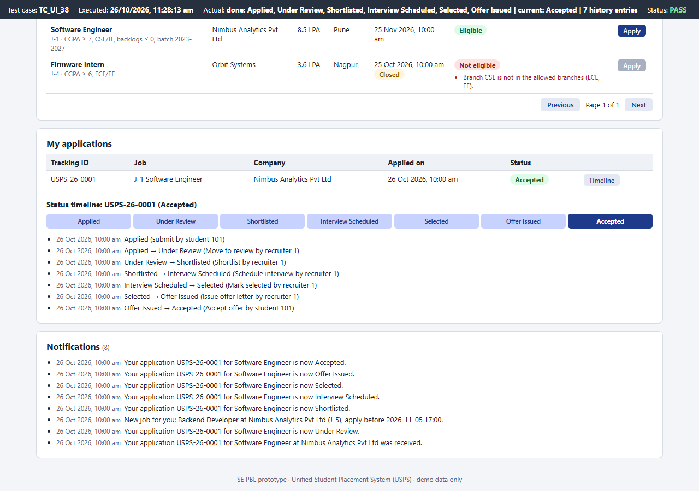
Three roles, one live page
Officer: a job posted by a recruiter elsewhere appears without reload, with a pop-up
Student: status timeline after accepting the offer
Every open page asks /api/version every 2 seconds and redraws itself when anyone changes data
Unified Student Placement System · SE Lab PBL · Vineet Shah, Roll No. 28
6
Notes:
Recruiter posts -> officer's pending list updates; officer approves -> eligible students' job boards update and they get a 'New job for you' notification.

Slide 7
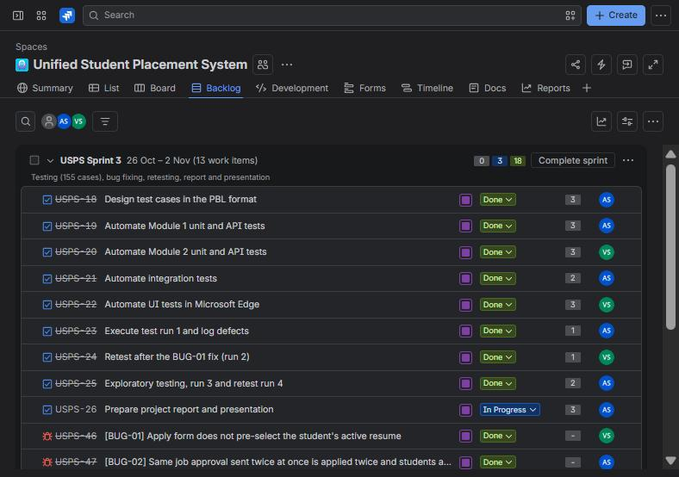
Managed in Jira · space USPS
4
11
11
epics
user stories
tasks
19
4
3
sub-tasks
bugs
sprints
Epic -> Story / Task / Bug -> Sub-task, with story points and priorities
Workflow: To Do -> In Progress -> In Review -> Done
Two members: my institute ID (admin) and my second ID, invited, with 14 work items assigned
Each bug has steps, severity, priority and a fix + retest comment
Unified Student Placement System · SE Lab PBL · Vineet Shah, Roll No. 28
7
Notes:
Site rbunagpur-team-zhx8jd75.atlassian.net, space Unified Student Placement System (key USPS), Scrum, team-managed. Screenshot: backlog of the active Sprint 3.

Slide 8
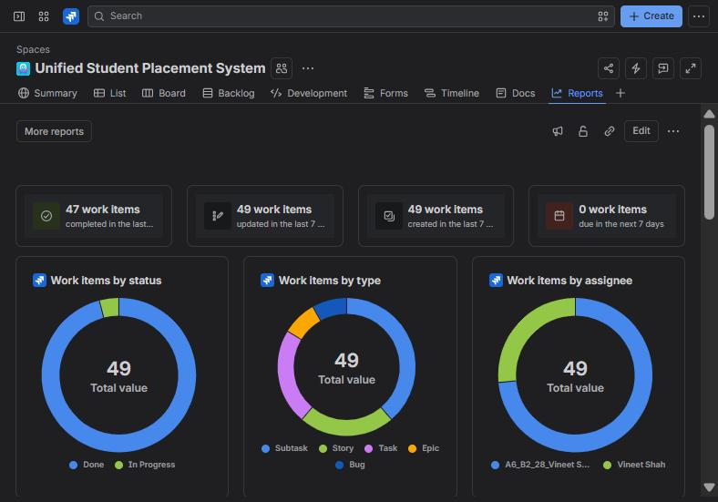
Three sprints, tracked to Done
Sprint | Goal | Items | Points | State
USPS Sprint 1 26-10 10:30-10:50 | Requirements and Module 1: job posting, approval, search and eligibility check | 7 | 22 | Completed
USPS Sprint 2 26-10 10:50-11:05 | Module 2: application, statechart workflow, tracking, notifications and live updates | 6 | 21 | Completed
USPS Sprint 3 26-10 - 02-11 | Testing (155 cases), bug fixing, retesting, report and presentation | 13 | 21 | Active
Sprint 3 holds the testing tasks and the four bugs; the report and presentation task stays In Progress until submission.
47 of 49 work items Done on 26-10-2026.
Unified Student Placement System · SE Lab PBL · Vineet Shah, Roll No. 28
8
Notes:
Reports dashboard: 49 work items by status, type and assignee.

Slide 9
155 automated test cases
61
42
11
41
Module 1
unit + API
Module 2
unit + API
Integration
end to end
UI tests
in Edge
✓
Functional
every requirement checked through the API and the page
✓
Equivalence partitioning
valid / invalid classes: words for numbers, unknown branch, wrong resume
✓
Boundary value analysis
CGPA 6.99 / 7.00, cover note 500 / 501, apply 1 min before / at deadline
✓
Validation
every API and form error message
✓
Unit and integration
rules alone, then both modules + DB: rollback, concurrency, restart
Format: Test Case ID · Module · Test Scenario · Test Data · Expected Result · Actual Result · Status
Unified Student Placement System · SE Lab PBL · Vineet Shah, Roll No. 28
9
Notes:
Expected results come from docs/requirements.md, written before the first run. A fixed test clock lets the tests cross deadlines. python -m tests.run_tests records the actual result of each case.

Slide 10
Testing found 4 real bugs
136 / 151
151 / 151
BUG-01 · USPS-46
Major / High
Active resume not pre-selected; apply refused
Run 1: passed
Run 2 retest: passed
BUG-02 · USPS-47
Major / High
152 / 155
155 / 155
Double approval at once, students notified twice
Run 3 +4 cases: passed
Run 4 retest: passed
BUG-03 · USPS-48
Major / High
Same status change applied twice at once
Run 1: 15 UI failures, one root cause (BUG-01)
Exploratory testing after run 2 found BUG-02 to BUG-04; new cases written
Every bug logged in Jira, fixed, retested
BUG-04 · USPS-49
Minor / Medium
Posting approved after its deadline
Unified Student Placement System · SE Lab PBL · Vineet Shah, Roll No. 28
10
Notes:
BUG-02 and BUG-03 are race conditions: two requests read the same state before either saved. Fixed with one re-entrant lock around every check-and-update. BUG-04 also changed requirement FR-1.4.

Slide 11
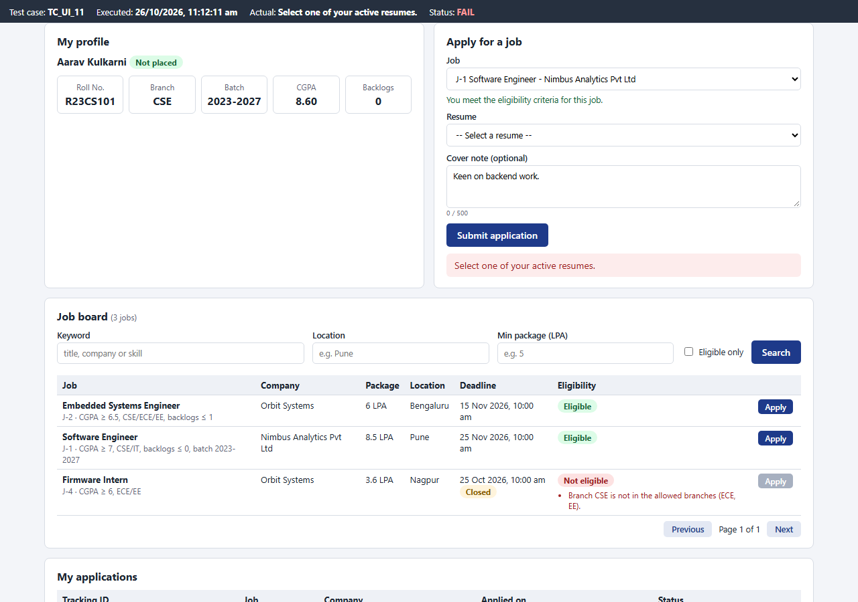
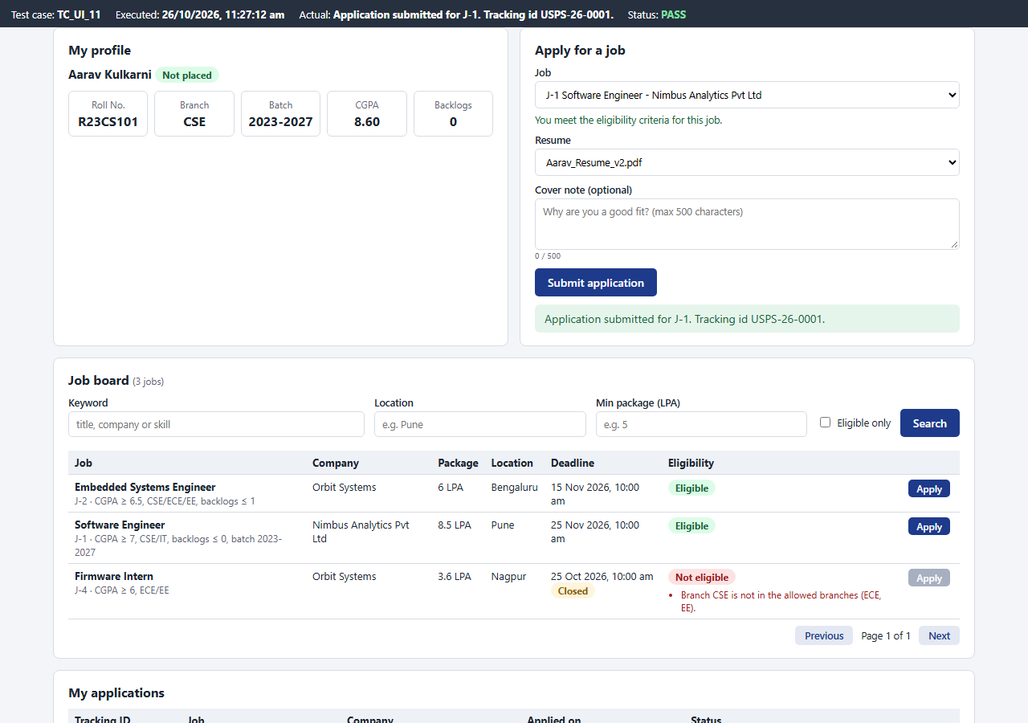
Bug fix and retest evidence · BUG-01
Before fix: TC_UI_11 FAIL (run 1)
After fix: TC_UI_11 PASS (run 2)
Same demo data and test case, captured from the real page in Microsoft Edge before and after the fix
Unified Student Placement System · SE Lab PBL · Vineet Shah, Roll No. 28
11
Notes:
The dark bar at the top of each screenshot is added by the UI test harness and shows the test case, time and result. Evidence for BUG-02 to BUG-04 is in the report (run 3 vs run 4).

Slide 12
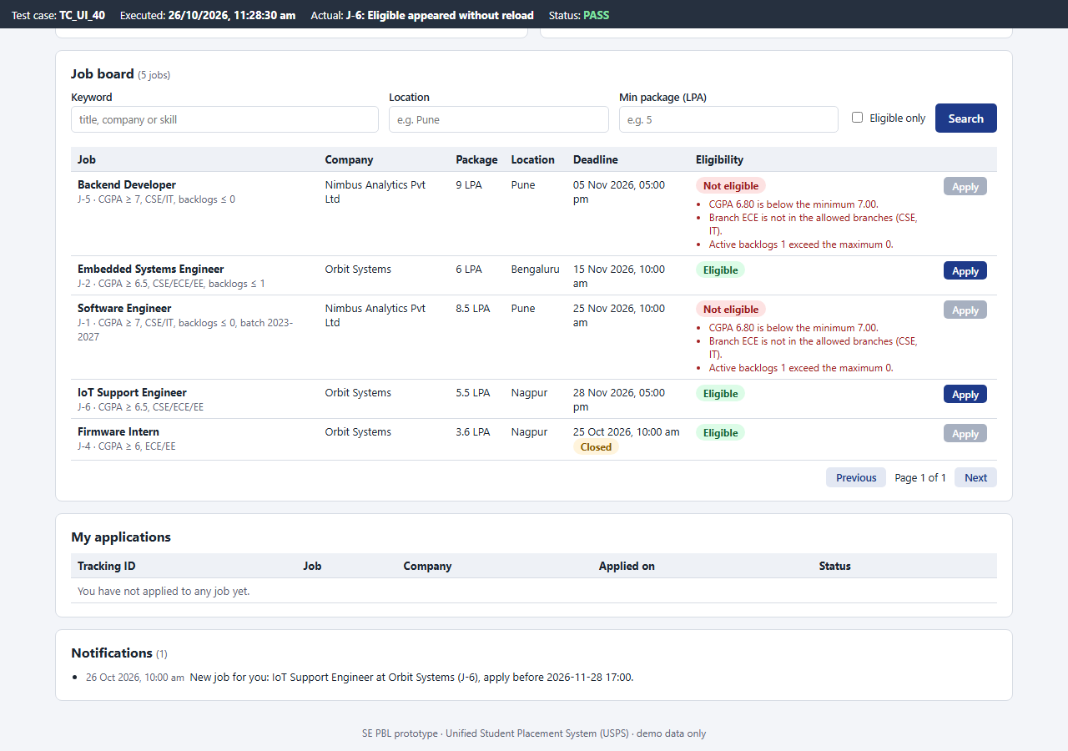
Live demonstration
1
Start the portal
python run.py -> http://127.0.0.1:8091
2
Recruiter posts, officer approves
two windows: the job appears live, students are notified
3
Student applies and is tracked
tracking id, statechart steps, timeline, accept offer
4
Run all tests
python -m tests.run_tests
Approved job reaches the eligible student's open job board without a reload
Unified Student Placement System · SE Lab PBL · Vineet Shah, Roll No. 28
12
Notes:
Demo order: recruiter Ritika posts, officer approves in the second window, Diya applies, recruiter takes the application to Offer Issued, Diya accepts and becomes placed; then the test run.

Slide 13
Conclusion and next steps
What was achieved
Two working modules of my SRS with database, validation, statechart and live pages
Jira space: 49 work items, 3 sprints, 2 members, bugs tracked to closure
155 test cases; 4 bugs found, fixed and retested; 155 / 155 pass
Next steps
Login and role-based access (SRS 4.1)
Interview scheduling and offer letters (SRS 4.6, 4.7)
E-mail notifications and placement reports
Thank you · Questions?
Notes:
Close with the results and the remaining SRS modules.

