Slide 1

Dayananda Sagar College of Engineering
Department of Computer Science & Engineering
DYNAMIC GESTURE RECOGNITION
Mownika Reddy K A
Sambhrama K
Prajna Harish
Vinayak Bhat
under the guidance of
Dr. Deepak G
Associate Professor
Dept. of CSE, DSCE.

Slide 2
Introduction
Methodology
Algorithm
Research Results
Conclusion
Table of Content

Slide 3

INTRODUCTION
This project's major goal is to use advanced deep learning techniques to recognize human gestures for human-computer interaction. There are only a few ways to interact with computers: using a keyboard, mouse, or touch screen, for example. When it comes to adapting more adaptable computer technology, each of these devices has its own set of constraints. One of the most important methods for creating user-friendly interfaces is gesture recognition.
In the process of recognizing hand gestures, the complexity and diversity of gestures will extremely impact on the recognition rate and reliability. The existence of machine learning techniques can be effectively exploited in the task of improving the rate of hand gesture recognition.

Slide 4
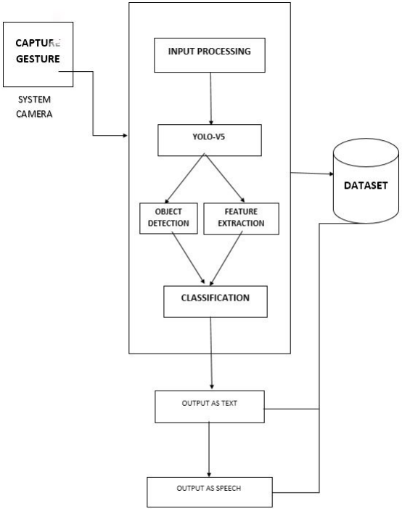
METHODOLOGY
Collect images to build a dataset
Pre-process Data and Create Labels and Features using labelimg
Build and Train YOLO V5 Neural Network.
Make Predictions & Save Weights
Detecting Gestures in Real time
Conversion of recognized gesture into voice in Real time

Slide 5
ALGORITHM
YOLO (You Only Look Once): YOLO is a real-time object detection algorithm that processes the entire image in a single forward pass, without the need for region proposals.
It uses a single convolutional neural network to predict bounding boxes and class probabilities directly from the raw image pixels. YOLO is known for its speed and efficiency, making it a popular choice for real-time applications such as autonomous driving.
To improve object detection accuracy, the RCNN Multibox approach is used as a secondary detector. It follows a two-stage architecture, proposing regions of interest (RoIs) in the first stage and refining them in the second stage.
By integrating RCNN Multibox with YOLOv5, the system can refine results, reduce false positives, and enhance overall reliability.

Slide 6
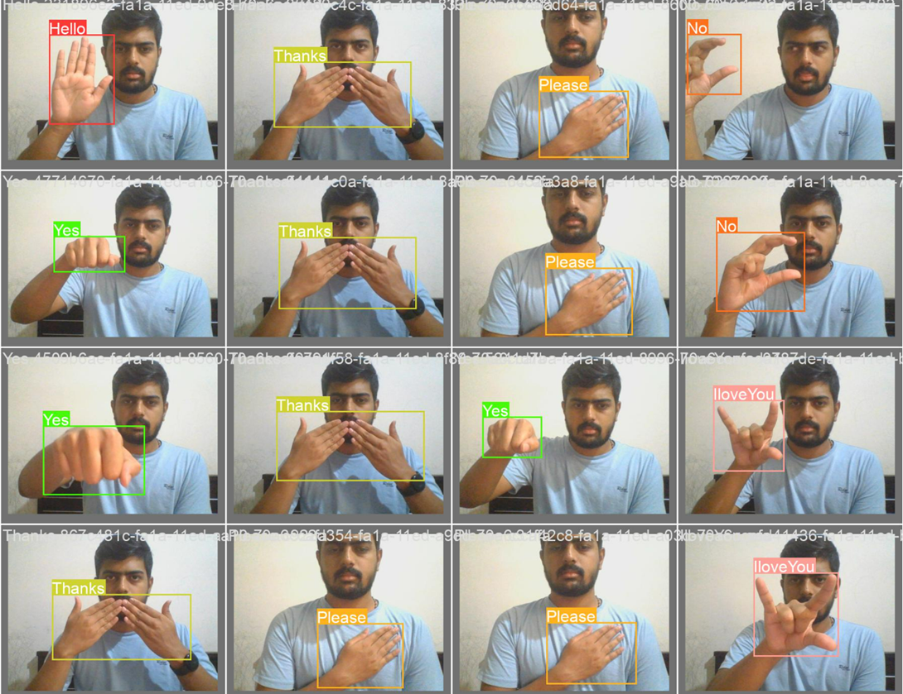
RESULTS
The model has undergone successful training for a range of specific signs. It is noteworthy to mention that the achieved results are contingent upon the signer involved, as individual characteristics can impact the system's performance.
However, it is gratifying to report that our current implementation has demonstrated commendable accuracy levels, accompanied by remarkably low latency.

Slide 7
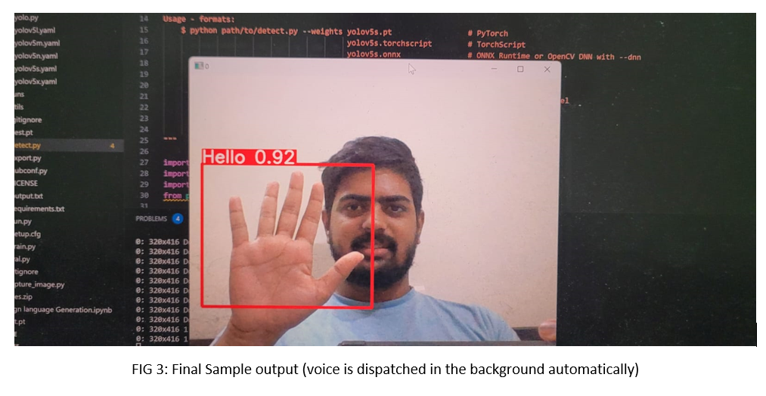

Slide 8
1. High Accuracy: Dynamic gesture recognition systems have achieved high accuracy rates in recognizing and classifying the trained dynamic gestures. With the advancements in deep learning techniques by using YOLOv5, R-CNN, the accuracy of our dynamic gesture recognition model has significantly improved.
2. Real-Time Performance: Dynamic gesture recognition systems have demonstrated the capability to process and recognize gestures in real time, allowing for immediate response and interaction. Our model exhibits minimal latency.
3. Sign Language Recognition to voice: Dynamic gesture recognition has shown promise in recognizing and interpreting sign language gestures. By accurately recognizing and translating sign language gestures into text or spoken language, it can facilitate communication between hearing-impaired individuals and non-sign language users.

Slide 9
CONCLUSION
In conclusion, gesture recognition technology has made significant advancements in recent years, enabling various applications in fields such as human-computer interaction, virtual reality, robotics, and gaming.
Gesture recognition systems can interpret and understand human gestures, allowing users to interact with devices and interfaces in a more intuitive and natural manner.

