Slide 1
DDD, Event Sourcing & Materialized Views
Cleaner Architecture
By Assad Faizi

Slide 2
Agenda
Introduction to the Hexagonal Architecture
Introduction to some DDD Principles - Aggregates and Domain Events
Commands and Event Handlers with Domain Models
Introduction to Event Sourcing
Code Demo
Introduction to Materialized Views

Slide 3
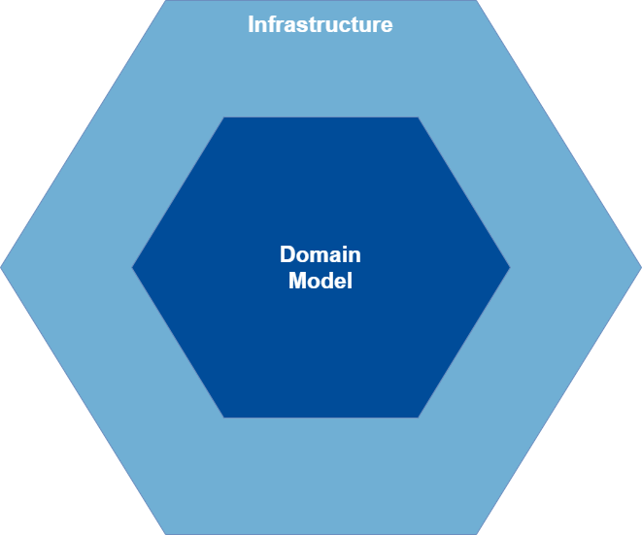
Introducion to the Hexagonal Architecture
AKA: Onion Architecture

Slide 4
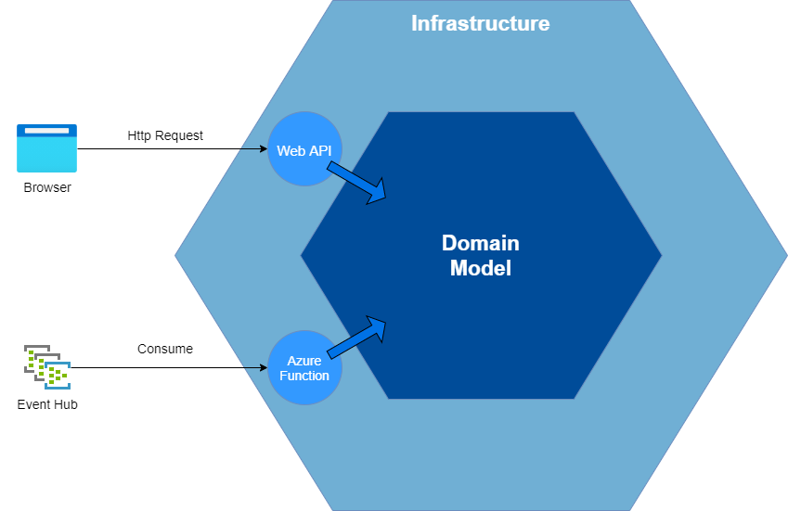
Introducion to the Hexagonal Architecture

Slide 5
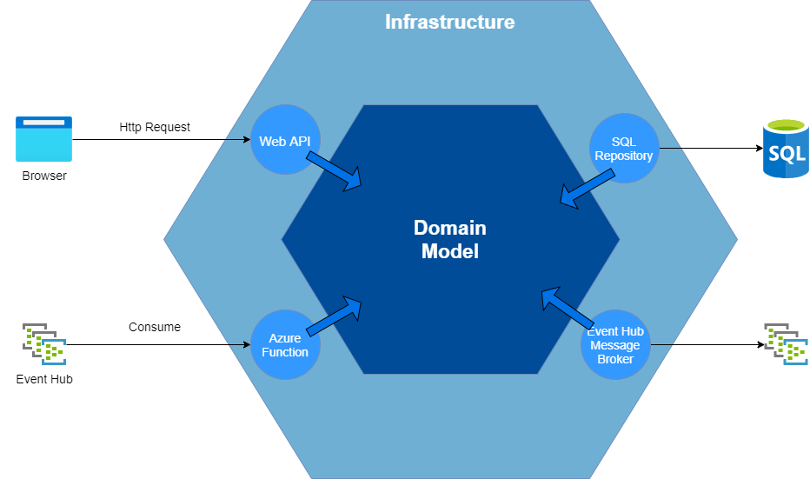
Introducion to the Hexagonal Architecture

Slide 6
DDD Principles - Aggregates
Delivery Plan
Delivery Order

Slide 7
DDD Principles - Aggregates
Delivery Plan Aggregate
<<Aggregate Root>>
Delivery Plan
Shipment
1
1
1
Delivery Order
Aggregate
1
1
0..*
Vessel
Leg
<<Aggregate Root>>
Delivery Order
1
Transaction
0..*
Leg
Transaction

Slide 8
DDD Principles - Domain Events
Delivery Planning Microservice
Physical Database Transaction
Delivery Plan Aggregate
<<Domain Event>>
DeliveryPlanCreated
<<Aggregate Root>>
Request
(Scope)
Delivery Plan
1
1
Shipment
1
Delivery Order
Aggregate
1
1
0..*
Vessel
Leg
<<Aggregate Root>>
Delivery Order
1
Transaction
0..*
Leg
Transaction
ref: https://lostechies.com/jimmybogard/2014/05/13/a-better-domain-events-pattern/

Slide 9

Command and Event Handlers with Domain Models
CreateDeliveryPlanCommandHandler
DeliveryPlanCreatedEventHandler
<<Domain Event>>
DeliveryPlanCreated
Delivery Plan
Aggregate
Delivery Order
Aggregate
<<DTO>>
CreateDeliveryPlanCommand
<<Aggregate Root>>
Delivery Plan
<<Aggregate Root>>
Delivery Order
Add to Context
Http Request
And/Or
Event Consumer
Add to Context
<<DTO>> DeliveryPlanCreated
IntegrationEvent
<<DTO>> DeliveryOrderCreated
IntegrationEvent
IDeliveryPlanRepository
IDeliveryOrderRepository
DeliveryPlanSQL
Repository
DeliveryOrderSQL
Repository
Published e.g. Event Hub

Slide 10


Aggregate Root as Entry Point for all State Change
CreateDeliveryPlanCommandHandler
var deliveryPlan = new DeliveryPlan();
deliveryPlan.CargoStuffingId = 1;
deliveryPlan.Vessel.Name = “The Voyager”;
Delivery Plan Aggregate
<<Aggregate Root>>
Entry
Point
Delivery Plan
1
1
Shipment
var deliveryPlan = new DeliveryPlan();
var legToUpdate = deliveryPlan.Legs[0];
legToUpdate.Update(…);
legToUpdate.ProviderCode = “HDDR”;
1
1
1
0..*
Vessel
Leg
var deliveryPlan = new DeliveryPlan();
deliveryPlan.UpdateLeg(…);
deliveryPlan.UpdateShippingDetails(newCargoStuffingId, …);

Slide 11
Event Sourcing – Saving Events
Delivery Plan Aggregate
<<Aggregate Root>>
Request
(Scope)
Delivery Plan
1
1
Shipment
1
1
1
0..*
Vessel
Leg
Delivery Order
Aggregate
Raise
<<Aggregate Root>>
Delivery Order
<<Event>>
LegAdded
<<Event>>
LegRemoved
<<Domain Event>>
DeliveryPlanUpdated
1
<<Event>>
ShipmentDetailsUpdated
0..*
Leg
Event Store
ref: https://www.innoq.com/en/blog/domain-events-versus-event-sourcing/

Slide 12
Event Sourcing – Rehydrate Events to Domain Model
Delivery Plan Aggregate
Apply
Version 1
<<Event>>
DeliveryOrderCreated
<<Aggregate Root>>
Write
Request
(Scope)
Delivery Plan
<<Event>>
LegAdded
1
1
Shipment
Apply
Version 2
1
Apply
Version 3
<<Event>>
LegRemoved
1
1
0..*
Vessel
Version 4
<<Event>>
ShipmentDetailsUpdated
Leg
Apply
Load
Event Store

Slide 13
Get to the code already ☺…

Slide 14
CreateDeliveryPlanCommandHandler
DeliveryPlanCreatedEventHandler
<<Domain Event>>
DeliveryPlanCreated
Delivery Plan
Aggregate
Delivery Order
Aggregate
<<DTO>>
CreateDeliveryPlanCommand
<<Aggregate Root>>
Delivery Plan
<<Aggregate Root>>
Delivery Order
Add to Context
Http Request
And/Or
Event Consumer
Add to Context
<<DTO>> DeliveryPlanCreated
IntegrationEvent
<<DTO>> DeliveryPlanCreated
IntegrationEvent
<<DTO>> DeliveryOrderCreated
IntegrationEvent
IDeliveryPlanRepository
IDeliveryOrderRepository
DeliveryPlanSQL
Repository
DeliveryOrderSQL
Repository
Published e.g. Event Hub

Slide 15

Materialized Views
Flat List Tables
ID | Status | Vessel | Code | Type | …
DeliveryPlanCreated IntegrationEventHandler
Event
Transform
Group | Total | Count
<<DTO>> DeliveryPlanCreated
IntegrationEvent
DeliveryPlanSQLRepository
Aggregate Tables
Event Hub
Read Store
Ref: https://docs.microsoft.com/en-us/azure/architecture/patterns/materialized-view

Slide 16
Additional References
https://docs.microsoft.com/en-us/dotnet/architecture/microservices/microservice-ddd-cqrs-patterns/ddd-oriented-microservice
https://jimmybogard.com/domain-driven-refactoring-intro/
https://enterprisecraftsmanship.com/posts/domain-vs-application-services/ Pure (isolated) vs Impure (non-isolated) Domain Services
https://lostechies.com/jimmybogard/2010/03/30/strengthening-your-domain-the-double-dispatch-pattern/
https://docs.microsoft.com/en-us/azure/architecture/patterns/event-sourcing
https://github.com/amolenk/CosmosEventSourcing
https://devblogs.microsoft.com/cesardelatorre/domain-events-vs-integration-events-in-domain-driven-design-and-microservices-architectures/
https://blog.cleancoder.com/uncle-bob/2012/08/13/the-clean-architecture.html
https://eng.uber.com/microservice-architecture/

Slide 17
https://github.com/Maersk-Global/delivery-planning-cqrs-ddd-es

