Slide 1
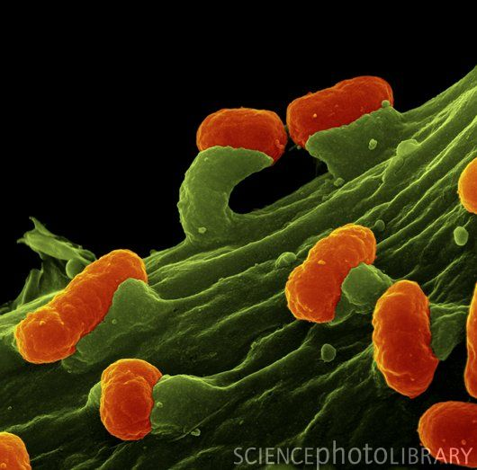
Introducción a la pangenómica microbiana
usando GET_HOMOLOGUES
Pablo Vinuesa
Centro de Ciencias Genómicas – UNAM,
vinuesa[at]ccg.unam.mx
http://www.ccg.unam.mx/~vinuesa/
Introducción a la filogenómica y pangenómica microbiana,
TIB2019-T3, 1 Agosto 2019
https://github.com/vinuesa/TIB-filoinfo

Slide 2
Outline
I. Basic concepts in microbial comparative (pan-)genomics
Methods for orthology inference
Genome mosaicism, genomic islands and HGT
The prokaryotic cloud, shell and core genes
Microbial core- and pan-genomes
II. get_homologues, a powerful and highly configurable software package for microbial pan-genomics
Overview of the package’s capabilities (get_homologues.pl and accessory scripts)
Using GET_HOLOLOGUES to explore factors affecting the calling of homologues
III. A pangenomic analysis of pIncA/C plasmids using GET_HOMOLOGUES
Defining a robust core- and pan-genome of pIncA/C plasmids
Exploring the gene space of pIncA/C plasmids: core, shell, cloud
Pan-genome trees vs. core genome trees (supermatrices)
Identifying lineage-specific genes in NDM-1 producing plasmids
Notes:
<número>

Slide 3
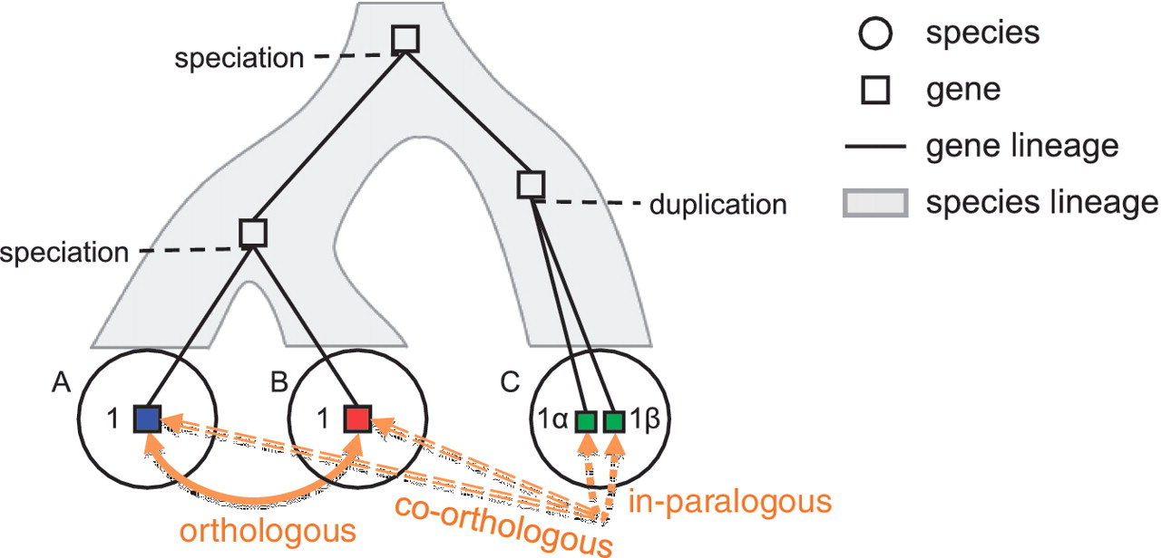
Computational methods to identify homologous gene families
Orthology, co-orthology and paralogy relationships in the evolution of four genes
that arose from a single common ancestor.
Gene trees are not
the same as
species trees!!!
Kristensen D M et al. Brief Bioinform 2011;12:379-391
Orthologs: essentialy instances of ‘the same gene’ in different species. Tend to retain function accross large phylogenetic distances. Key markers for phylogenetics and genome annotation.
Paralogs: Tend to diverge over time to perform different functions via subfunctionalization or neofunctionalization routes.
Notes:
Tema 1: Conceptos básicos de homología y filogenética
Introducción a la Filoinformática - Universidad de Sevilla, 13-17 de Junio de 2011
© Pablo Vinuesa 2011, vinuesa@ccg.unam.mx; http://www.ccg.unam.mx/~vinuesa/filoinfo_us11/
<número>

Slide 4
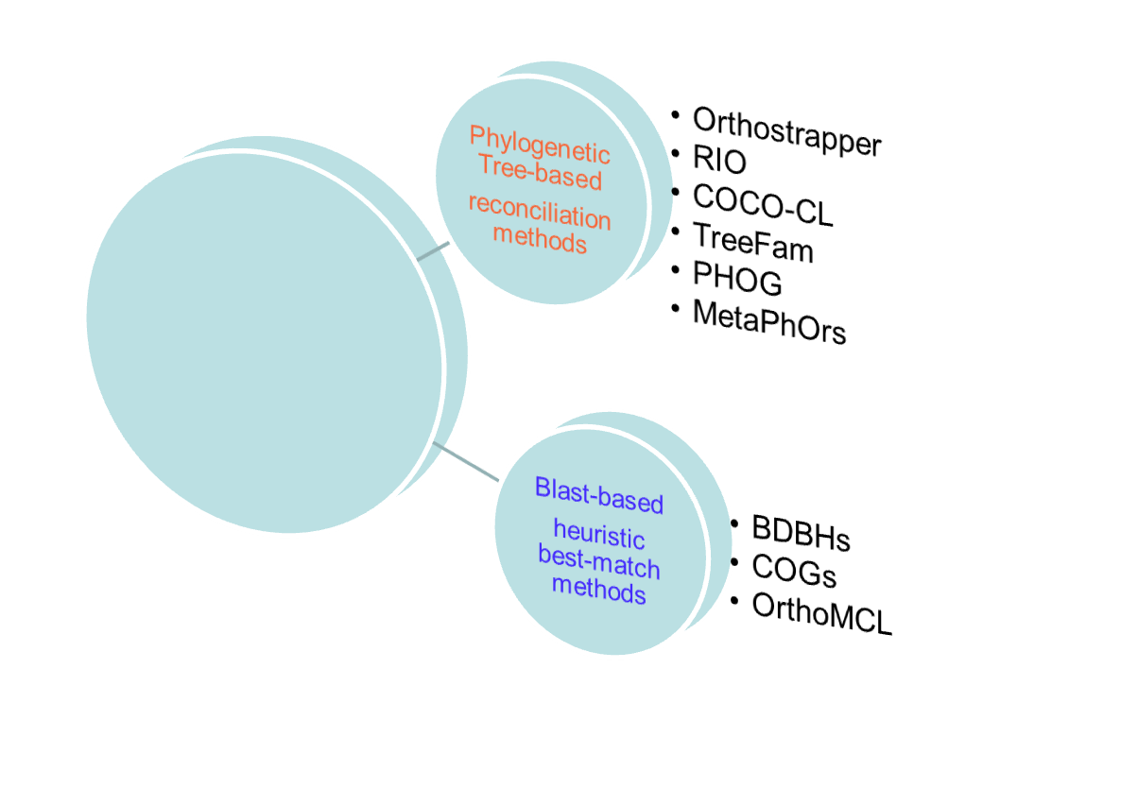
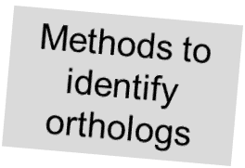
Computational methods to identify homologs
Most direct approach
but known to be
subjected to increasing artifacts as evol. dist. increases due to:
- alignment problems
- long-branch attraction
- heterotachy
- tree searches stuck
in local sub-optimal
maxima
More adequate
for bacteria, as
they don’t follow
a clear tree-like
evolutionary path
(HGT).
The only practical
strategy for large
datasets, therefore most common method in compa-rative genomics

Slide 5
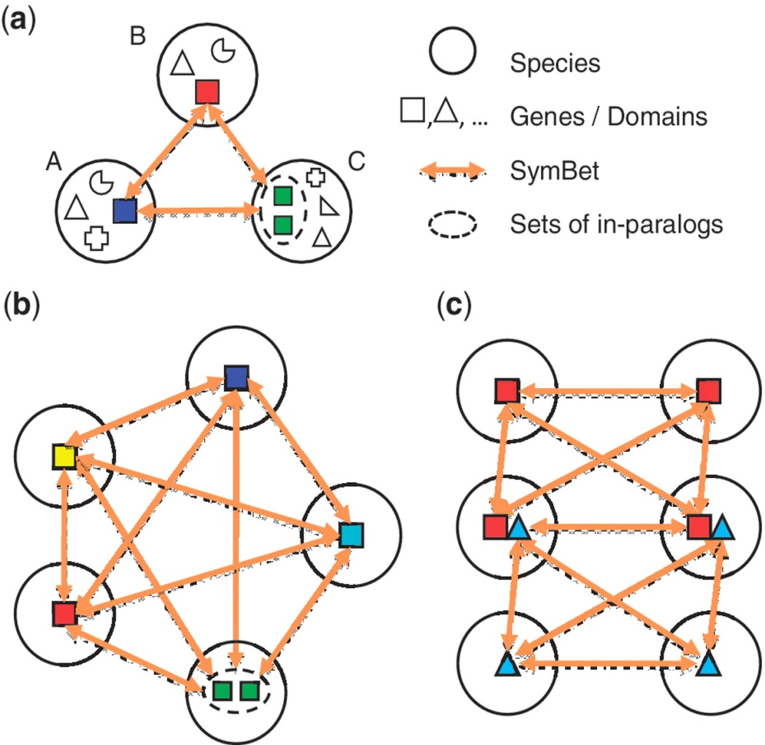
Computational methods to identify orthologs: BBHs
Grouping of genes in different species that are each others’ BLAST BBHs
into sets of orthologs and co-orthologs.
Linking pairs of BBHs from
multiple genomes has a property
of self-verification, as their consis-
tency would be very unlikely due to
chance, especially between phylo-
genetically distant lineages.
Methods for clustering of pairwise
BBHs vary, but the most widely
used approach involves a single-
linkage clustering procedure, where any
two clusters sharing a common BBH are
merged until convergence.
Problems with: differential gene loss,
domain recombination/gain/loss
Kristensen D M et al. Brief Bioinform 2011;12:379-391
Notes:
Tema 1: Conceptos básicos de homología y filogenética
Introducción a la Filoinformática - Universidad de Sevilla, 13-17 de Junio de 2011
© Pablo Vinuesa 2011, vinuesa@ccg.unam.mx; http://www.ccg.unam.mx/~vinuesa/filoinfo_us11/
<número>

Slide 6
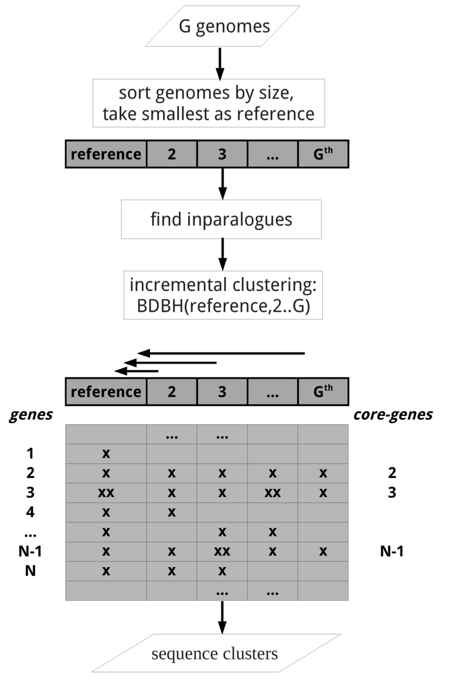
Computational methods to identify orthologs: BDBHs
The bidirectional best-hit approach (BDBH)
As implemented in GET_HOMOLOGUES
(Contreras-Moreira & Vinuesa 2013)
Find inparalogues in all genomes
Find reciprocal best blast hits between
reference and remaining genomes
Cluster sequences based on filtering
criteria such as:
- % alignment coverage
- min. % sequence identity
- E-score cut-off
- Pfam domain-composition
- sinteny

Slide 7
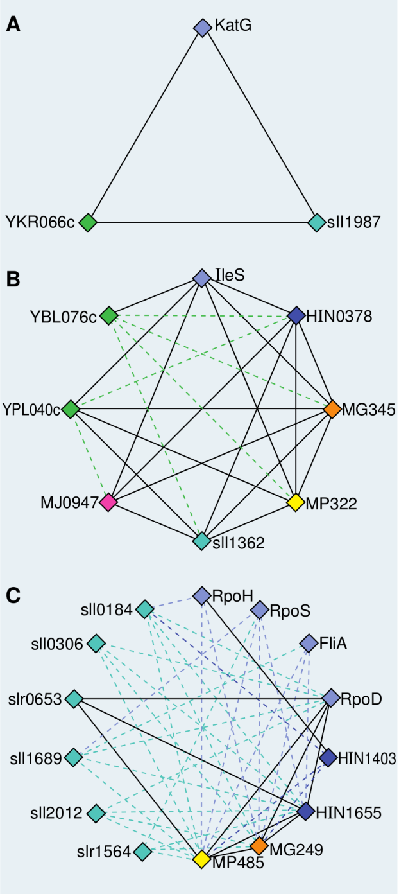
Computational methods to identify orthologs: COGtriangles
Method | Description
Clusters of orthologous groups (COGs), variants and derivatives | Identifies three-way BBHs between orthologs or sets of co-orthologs in three different species, and these groups expanded (merging triangles whenever they share a common side) until saturation, followed by manual splitting of large groups improperly joined by multidomain proteins or complex mixtures of in- and out-paralogs.
Tatusov et al. Science 1997. Vol. 278:631-637
Kristensen et al. Bioinformatics 2010. Vol. 26:1481-1487
Notes:
Tema 1: Conceptos básicos de homología y filogenética
Introducción a la Filoinformática - Universidad de Sevilla, 13-17 de Junio de 2011
© Pablo Vinuesa 2011, vinuesa@ccg.unam.mx; http://www.ccg.unam.mx/~vinuesa/filoinfo_us11/
<número>

Slide 8
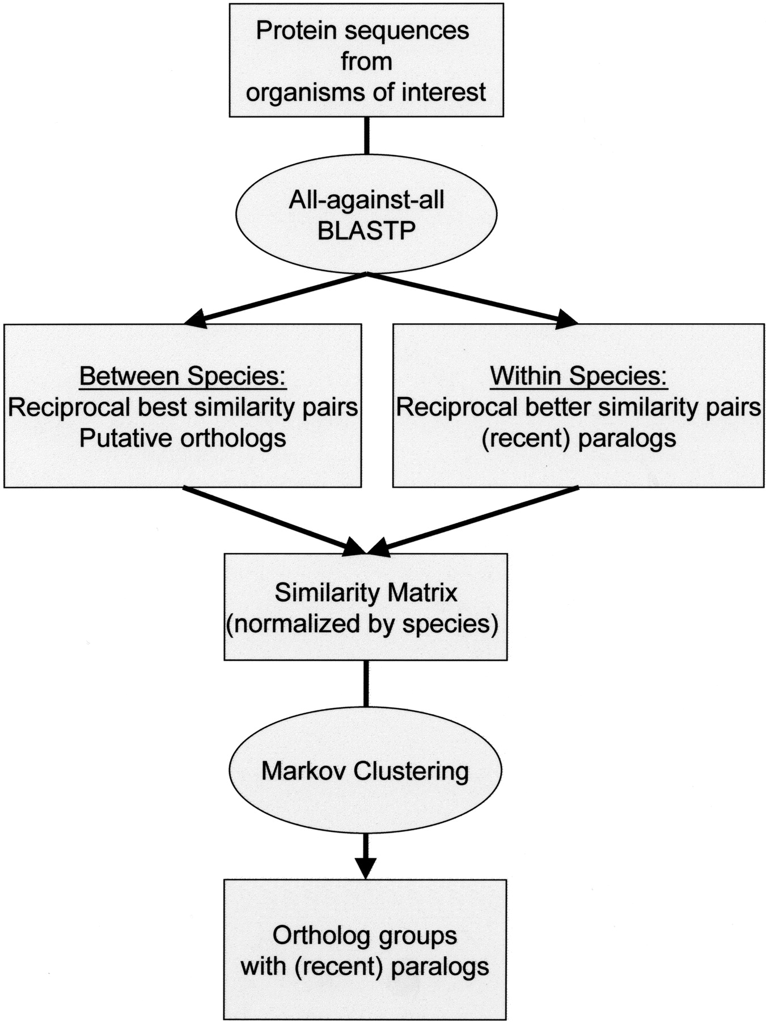
Computational methods to identify orthologs: OrthoMCL
Method | Description
OrthoMCL | Forms groups of orthologs and co-orthologs using a Markov clustering process involving iterative simulations of stochastic (randomized) flow on the edges of a BBH graph, with clusters of desired tightness identified depending on a given ‘inflation’ parameter determined by trial and error.
Li L et al. Genome Res. 2003;13:2178-2189

Slide 9
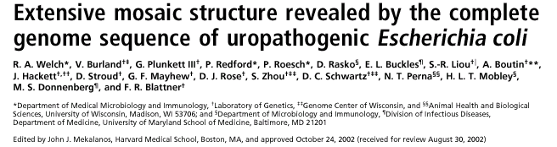
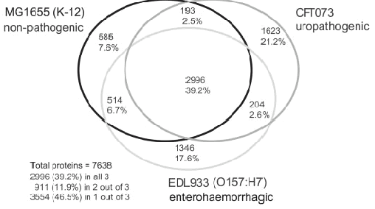
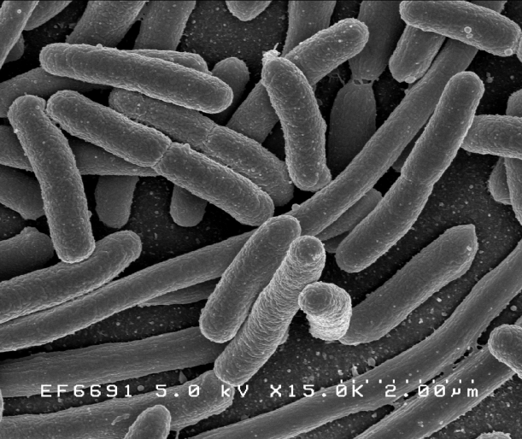
Basic concetps in bacterial comparative genomics –
Mosaic genome structure and the pan-genome
Notes:
<número>
Enfoquémonos en la pregunta: ¿Qué genes son potencialmente adecuados como marcadores moleculares para sistemática bacteriana?
Muchas especies bacterianas tienen lo que se conoce como pangenomas abiertos, con una pequeña fracción de genes conservados entre las cepas de la especie (el genoma núcleo o core) y una fracción mucho mayor de genes cepa-específicos. Esto fue primeramente mostrado en un trabajo del grupo de Fred Blattner en el que compararon los genomas de tres cepas de Ecoli, una comensal, una enterohemorrágica y una uropatogénica. Como muestra este diagrama de Venn, las tres cepas comparten sólo un 39% de los genes.

Slide 10
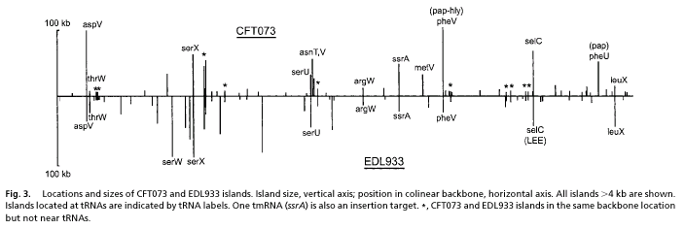
Basic concetps in bacterial comparative genomics –
Mosaic genome structure and the pan-genome
“accessory/flexible genome
(shell + cloud genes)”:
patchy distribution among strains
ecological specialization
Plasmids, phages, GIs, ICE, integrons, ISs …
highly transferable (HGT)
“core genome”:
orthologous gene families
species/population trees
population genetics
Genome annotation
(adapted from Welch et al., 2002)
Notes:
<número>
Obviamente sólo los genes del core genómico son de utilidad para inferir filogenias multiespecie y para hacer análisis de genética de poblaciones para obtener estimas de la intensidad de las distintas fuerzas evolutivas que moldean las estructuras genéticas de especies particulares.
Los loci accesorios, esto es, aquellos presentes sólo en una fracción de las cepas de una especie, frecuentemente codifican funciones relacionadas con la especialización ecológica tales como genes de virulencia o simbiosis, los cuales son muy informativos sobre atributos ecológicos de las cepas que los contienen, pero que frecuentemente tienen una historia evolutiva independiente de la de los genes del core. Este hecho recalca la naturaleza quimérica o en mosaico de muchos genomas bacterianos.

Slide 11
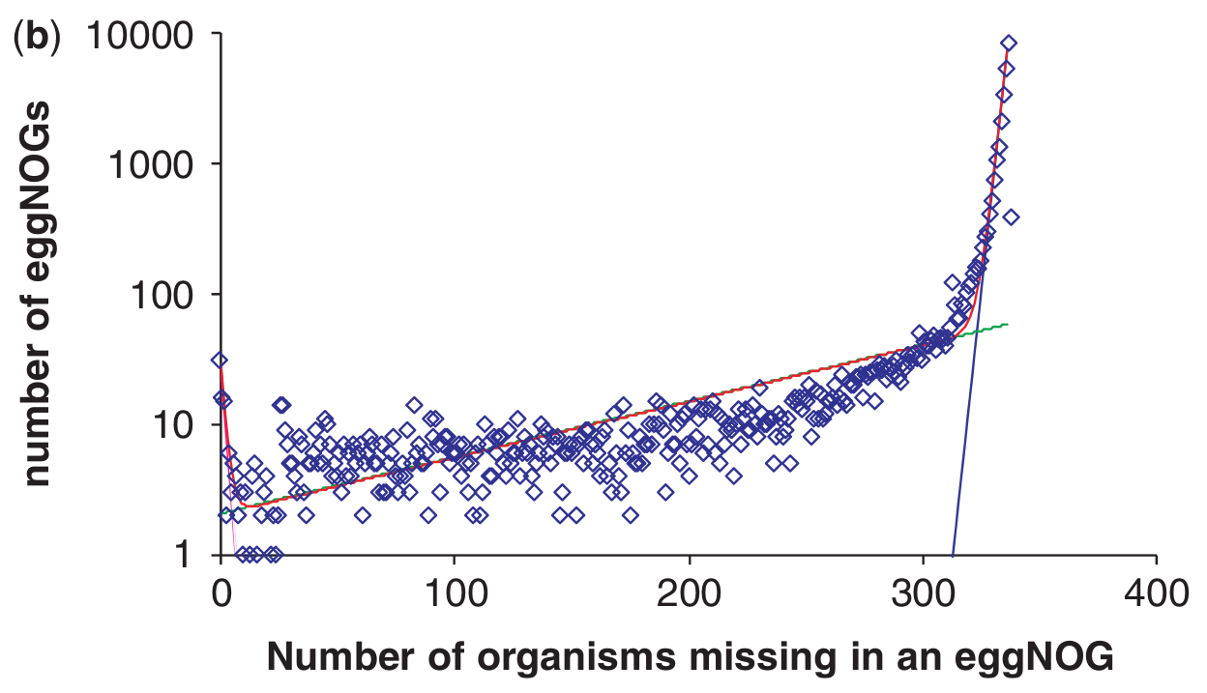



Basic concetps in bacterial comparative genomics –
Mosaic genome structure and the pan-genome
Distribuion of COGs by the number of organisms included in each cluster:
Narrowly
distributed
cloud
genes
Moderately
conserved
shell genes
Highly
conserved
core genes
Fit of an exponential decay function with three exponents:
The core (~70 clusters), shell (~5700 clusters) the cloud (~ 24,000 clusters)
Koonin & Wolf, NAR 2008. Vol 36, No. 21

Slide 12
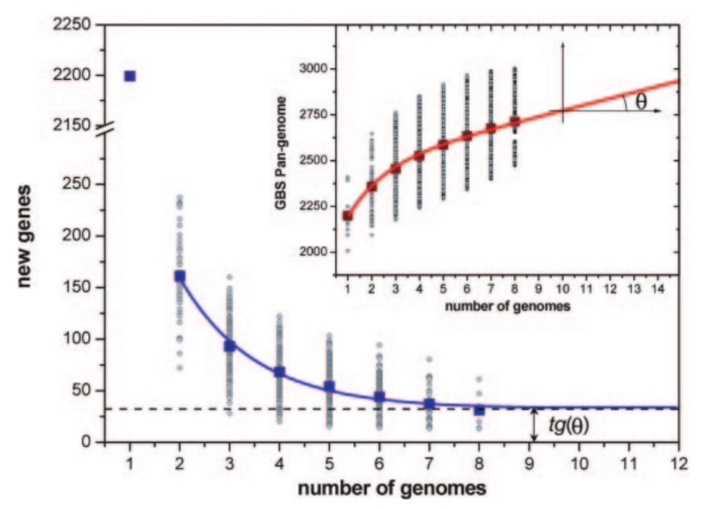
Basic concetps in bacterial comparative genomics –
the pan-genome (Tettelin et al. 2005)
The core and pan-genome for 8 Streptococcus agalactiae genomes
pangenome
core-genome
Tettelin, H. et al. (2005). Proc. Natl. Acad. Sci. U. S. A. 102(39): 13950-13955.

Slide 13
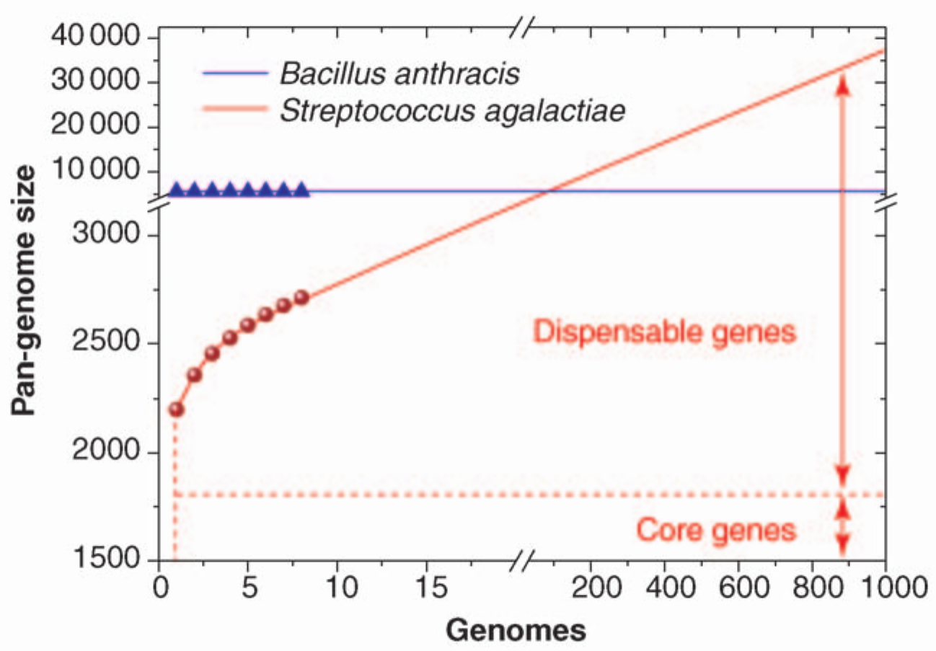
Basic concetps in bacterial comparative genomics –
the pan-genome (Tettelin et al. 2005)
Open pangenome
Closed pangenome
Tettelin, H., et al. (2008). “Curr. Opin. Microbiol. 11(5): 472-7.

Slide 14
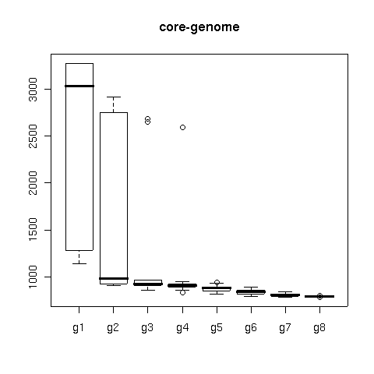
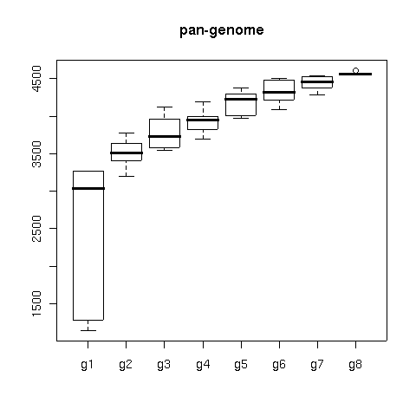
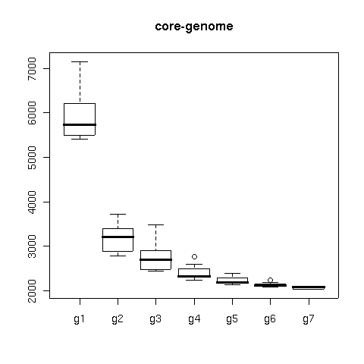
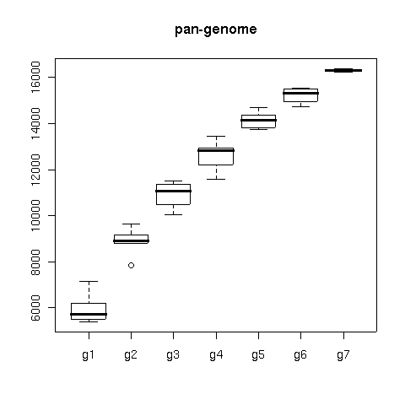
Basic concetps in bacterial comparative genomics –
the pangenome (Tettelin et al. 2005)
Size estimations of the
core and pan-genomes
of the animal-associated Rhizobiaceae
( 5 Brucella spp., 4 Bartonella spp.)
100
_[Mesorhizobium_sp._BNC1]
_[Mesorhizobium_loti_MAFF303099]
_[Ochrobactrum_anthropi_ATCC_49188]
100
100
_[Brucella_ovis_ATCC_25840]
_[Brucella_suis_1330]
100
100
_[Brucella_canis_ATCC_23365]
77
_[Brucella_abortus_bv._1_str.
100
100
_[Brucella_melitensis_16M]
_[Bartonella_henselae_str._Houston-1]
100
100
100
_[Bartonella_quintana_str._Toulouse]
100
_[Bartonella_tribocorum_CIP_105476]
_[Sinorhizobium_meliloti_1021]
_[Bartonella_bacilliformis_KC583]
100
_[Sinorhizobium_medicae_WSM419]
100
100
100
_[Agrobacterium_vitis_S4]
100
_[Agrobacterium_tumefaciens_str._C58]
100
_[Agrobacterium_radiobacter_K84]
100
_[Rhizobium_leguminosarum_bv._viciae_3841]
_[Rhizobium_etli_CFN_42]
_[Fulvimarina_pelagi_HTCC2506]
_[Aurantimonas_sp._SI85-9A1]
0.09
Size estimations of the
core and pan-genomes
of the plant-associated Rhizobiaceae
( 2 Rhizobium, 2 Sinorhizobium, 3 Agrobacterium)
Vinuesa & Contreras-Moreira, in prep.
Notes:
<número>
This slide shows the size estimations that we have obtained for the core and pangenomes of the fast growing rhizobia based on two genome sequneces from Rhizobium, two from Sinorhizobium and 3 from Agrobacterium. Their core genome is arround 2000 genes, while their pangenome is at least an order of magnitud larger, probably well over 30 thousand genes. The sister clade contains the human pathogens Brucella and Bartonella, which have much smaller core and pan genomes, as shown on the slide.
This analysis cearly illustrates the complexities in the mode of evolution of closely related bacterial lineages and teaches us that great care has to be taken in order to choose the organisms for which to develop PCR primers and molecular markers for multigene analyses, if we want to minimize the impact of systematic errors on phylogeny estimation.

Slide 15
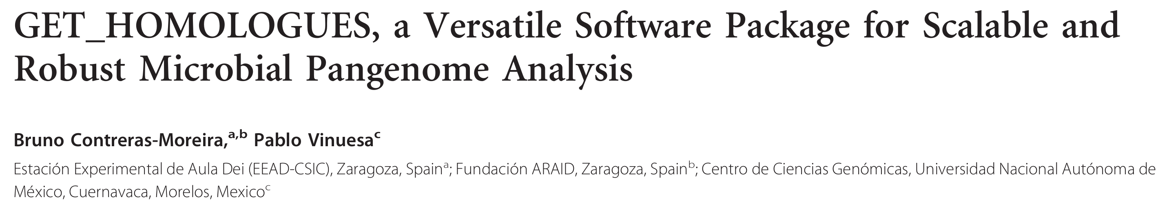




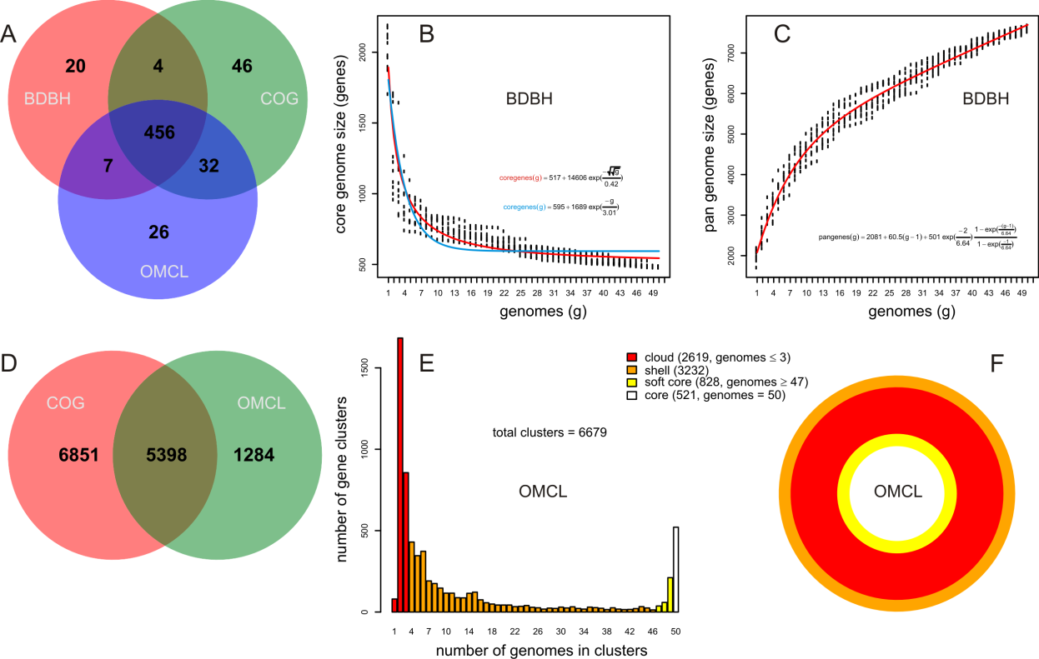
Clustering of prot. and nt secs.
(CDSs) in homologous groups
(paralogs, orthologs).
2. Identification of orthologous intergenic regions
3. Definition, statistical analysis and plotting of pan- and core-genomes, LSEs …
4. Comparative genome analyses, including analysis of the pan-genome structure (core, soft-core, shell and cloud) and
identification of lineage-specific clusters

Slide 16
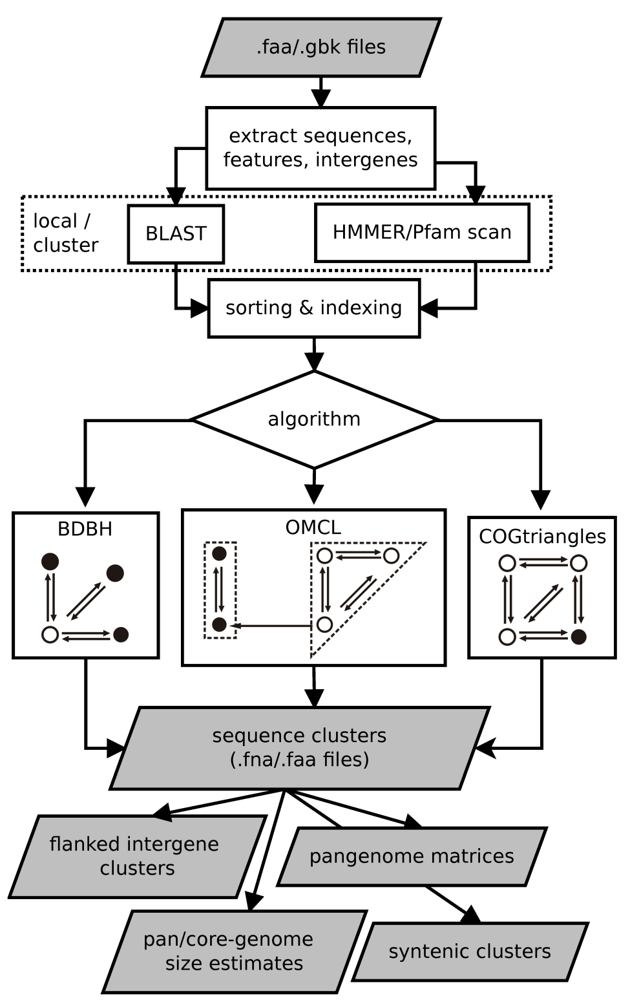
Overview of the GET_HOMOLOGUES package
Block 1: Extracting featrues from GBK files
Block 2: Blasting, sorting & indexing
Block 3: clustering
Block 4: parsing, statistical analysis
and graphical display of
pan-genomes and core-
genomes with auxiliary
scripts

Slide 17
get_homologues: a software package for microbial comparative genomics.
get_homologues.pl installation
Written in Perl, tested in 32 and 64-bit Linux, Mac OS X systems
Installed along with dependencies using install.pl
Bundled with precompiled binary files (COGtriangles, OMCL and BLAST+)
Required dependencies (Perl modules)
Bio::Seq, Bio::SeqIO,
Optional software and database dependencies:
hmmscan (from the HMMER3 package) for Pfam domain scanning
Pfam HMM library and hmmpress for db formatting
BerkleyDB (perl module)
R

Slide 18
get_homologues: a software package for microbial comparative genomics.
Running get_homologues.pl
Input data: whole genome GenBank or FASTA files
Typing $ ./get_homologues.pl -h, on the terminal will show the basic options:
usage: ../get_homologues.pl [options]
-h this message
-v print version, credits and checks installation
-d directory with input amino acid FASTA files (.faa) or (overrides -i)
GenBank files (.gbk), 1 per taxon; allows for new files to be added
there later,creates output folder named 'directory_homologues'
-i input amino acid FASTA file with [taxon names] in headers,
(required unless -d is set, creates output folder named 'file_homologues'
forces -m local)
Optional parameters:
-o only run BLAST/Pfam searches and exit (useful to pre-compute searches)
-c report genome composition analysis (follows order in -I file if enforced,
ignores -r,-t,-e)
-s save memory by using BerkeleyDB; default parsing stores sequence hits in RAM
-m runmode [local|cluster] (default local)
-I file with .faa/.gbk files in -d to be included (takes all by default, requires -d)
Algorithms instead of default bidirectional best-hits (BDBHs):
-G use COGtriangle algorithm (COGS, PubMed=20439257) (requires 3+ genomes|taxa)
-M use orthoMCL algorithm (OMCL, PubMed=12952885)
… output truncated

Slide 19
get_homologues: a software package for microbial comparative genomics.
Running get_homologues.pl
usage: ../get_homologues.pl [options]
… cont.
Options that control clustering:
-D require equal Pfam domain composition (best with -m cluster or -n threads)
when defining similarity-based orthology
-S min %sequence identity in BLAST query/subj pairs (range [1-100],default=1 [BDBH|OMCL])
-N min BLAST neighborhood correlation PubMed=18475320 (range [0,1],default=0 [BDBH|OMCL])
-b compile core-genome with minimum BLAST searches (ignores -c [BDBH])
Options that control clustering:
-t report sequence clusters including at least t taxa (default t=numberOfTaxa,
t=0 reports all clusters [OMCL|COGS])
-a report clusters of sequence features in GenBank files (requires -d and .gbk files,
instead of default 'CDS' GenBank features example -a 'tRNA,rRNA',
NOTE: uses blastn instead of blastp,
ignores -g,-D)
-g report clusters of intergenic sequences flanked by ORFs (requires -d and .gbk files)
in addition to default 'CDS' clusters
-f filter by %length difference within clusters (range [1-100], by default sequence
length is not checked)
-r reference proteome .faa/.gbk file (by default takes file with
least sequences; with BDBH sets
first taxa to start adding genes)
-e exclude clusters with inparalogues (by default inparalogues are
included)
-x allow sequences in multiple COG clusters (by default sequences are allocated
to single clusters [COGS])
-F orthoMCL inflation value (range [1-5], default=1.5 [OMCL])

Slide 20
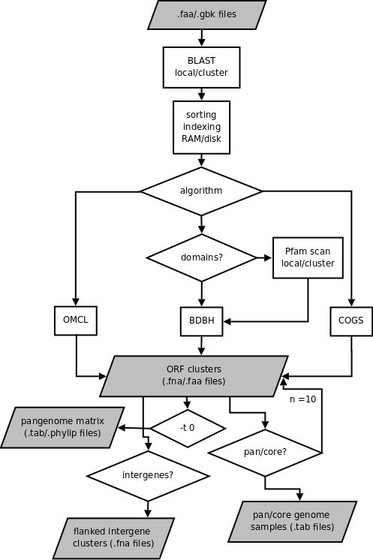
get_homologues: a software package for microbial comparative genomics.
Running get_homologues.pl – choosing a proper clustering algorithm
Venn diagram showing the overlap between
clusters of orthologous sequences produced
by the three algorithms using the 119
Stenotrophomonas genomes analyzed by
Vinuesa et al. 2018.

Slide 21
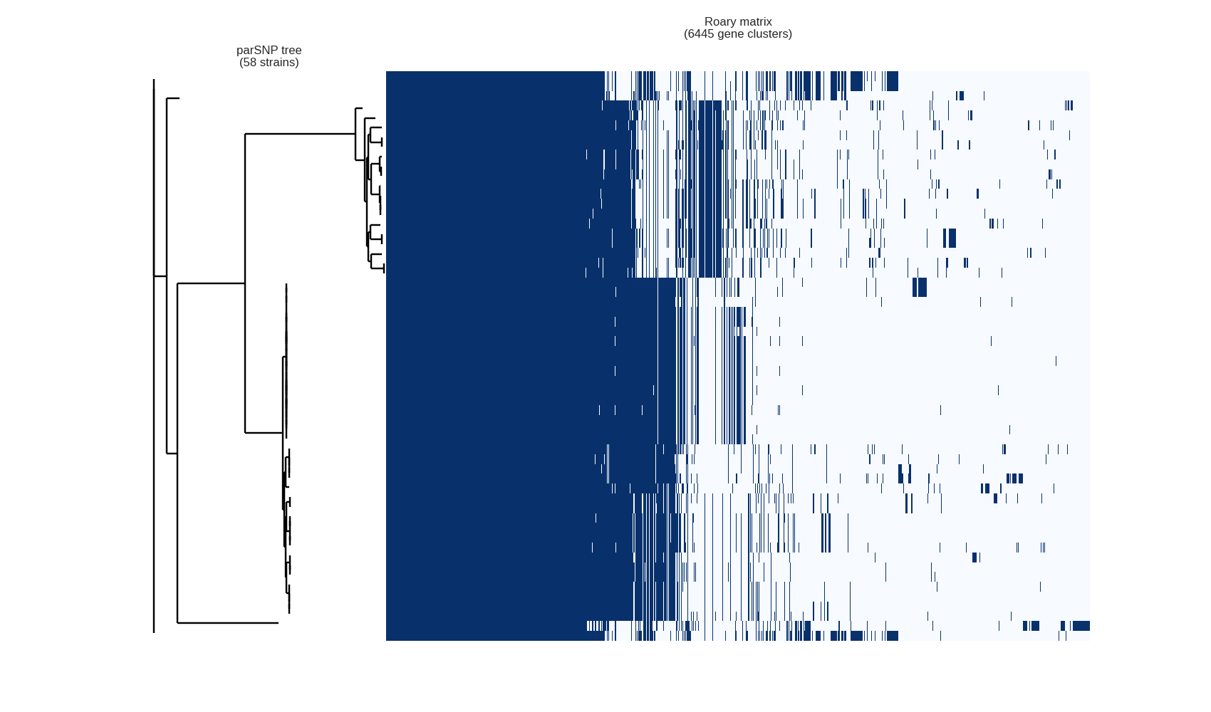
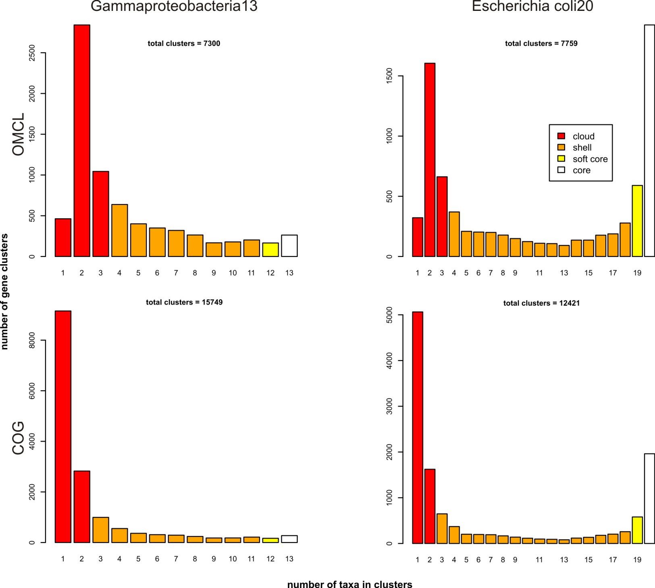
get_homologues: a software package for microbial comparative genomics.
Running get_homologues.pl – performing a core/pan-genome analysis
For a pangenome analysis use options:
–t 0 (get all clusters
of homologous sequences)
–M or –G (MCL or COGtriangles)
Lineage-specific genes
Note 1: the use of the BDBH clustering algorithm
is useless to compute pan-genomes.
Note 2: it is possible to compute a consensus
pan-genomes using the intersection between the
clusters detected by the COG and OMCL algorithms
with the help of the compare_clusters.pl script, provided
with the distribution
Pan-genome:
core
shell
cloud

Slide 22
E. coli pangenome phylogeny esimated using the consensus panmatrix of presence/absence data for 46 fully sequenced genomes of Escherichia spp. / Shigella spp. and Citrobacter spp.
standard parsimony analysis:
heristic search+TBR swapping
+ 1000 bootstrap replicates
81,5
E._coli_ETEC_H10407
E._coli_C_ATCC_8739
92,6
74,73
E._coli_K_12__MG1655
K12 & B strains
100
E._coli_DH1
99
E._coli_BW2952
100
E._coli_B_REL606
99,6
E._coli_BL21_DE3
126 EHEC-specific
Genes when compared
With K12 groups
99,53
E._coli_IAI1
E._coli_55989 EAEC
64,93
E._coli_E24377A ETEC
E._coli_HS
83,97
100
E._coli_O157_H7_EC4115
100
E._coli_O157_H7_TW14359
EHEC
100
E._coli_O157H7
57,47
100
E._coli_O55_H7_CB9615
100
E._coli_O111_H__11128
56,43
100
E._coli_O26_H11_11368
E._coli_O103_H2_12009
63,83
E._coli_W
E._coli_SE11
100
E._coli_UMN026 EAEC
95,9
E._coli_042 EAEC
99,8
E._coli_SMS_3_5 ENVIRONMENTAL MDR
60,3
E._coli_IAI39 ExPEC-UPEC
100
E._coli_536
ExPEC-UPEC
100
E._coli_ABU_83972
55,37
E._coli_CFT073
E._coli_SE15
82,97
69,83
E._coli_IHE3034 ExPEC
100
E._coli_UM146 AIEC
100
E._coli_UTI89 UPEC
96,53
96,6
83,73
100
E._coli_APEC_O1
E._coli_S88 ExPEC
70,47
E._coli_O83_H1_NRG_857C AIEC
E._coli_ED1a
E._coli_0127_H6_E2348_69 EPEC
Shigella spp.
100
S._flexneri_5_8401
0
100
S._flexneri_2002017
100
S._flexneri_2a_2457T
100
S._boydii_Sb227
86,7
S._boydii_CDC_3083_94
S._sonnei_Ss046
E. albertii, E. fergusonii,
Citrobacter spp.
100
C. koseri ATCC BAA-895
95,3
C._rodentium_ICC168
0
E._fergusonii_ATCC_35469
E._albertii_TW07627
Notes:
<número>

Slide 23
learning about group-specific genes and lineage-specific gene expansions with parse_pangenome_matrix.pl (126 genes specifically found in EHEC and not in K2 – B group commensals)
# genes present in set A and absent in B (126):
4631_predicted_hydrolases.faa
4638_predicted_reductase.faa
5036_predicted_antirepressor_protein.faa
5047_SfpA_-systemic_factor_protein_A--like_protein.faa
5081_T3SS_secreted_effector_NleH_homolog.faa
5361_predicted_DNA_methylase.faa
5364_predicted_DNA-binding_protein.faa
5376_predicted_protein.faa
5377_predicted_terminase_large_subunit.faa
5572_predicted_replication_protein.faa
5730_predicted_protein.faa
5753_predicted_terminase_small_subunit.faa
5755_predicted_head_protein-prohead_protease.faa
5758_predicted_DNA_packaging_protein.faa
5760_predicted_minor_tail_protein.faa
5765_predicted_tail_length_tape_measure_protein.faa
5775_T3SS_secreted_effector_NleA-EspI_homolog.faa
6116_predicted_protein.faa
6148_predicted_phage_tail_tape_measure_protein.faa
6150_predicted_tail_protein.faa
6396_yeeL.faa
7283_predicted_protein.faa
7284_predicted_4-hydroxybenzoate_decarboxylase.faa
7445_predicted_DNA-binding_protein.faa
7447_predicted_lipoprotein.faa
7496_T3SS_secreted_effector_NleB_homolog.faa
7497_T3SS_secreted_effector_NleE_homolog.faa
7498_Efa1-LifA_protein.faa
7846_leader_peptidase_HopD.faa
7931_predicted_protein.faa
8053_lpfE.faa
8187_escF.faa
8188_cesD2.faa
8189_espB.faa
8190_espD.faa
8191_espA.faa
8192_sepL.faa
8193_escD.faa
8194_eaeA.faa
8195_cesT.faa
8196_tir.faa
8197_map.faa
8198_cesF.faa
8199_espH.faa
8200_sepQ.faa
8202_predicted_protein.faa
8205_mpc.faa
8208_escJ.faa
8213_grlR.faa
8219_component_of_T3SS.faa
8221_component_of_T3SS.faa
8222_component_of_T3SS.faa
8223_ler.faa
8225_espG.faa
8226_predicted_protein.faa
8966_finO.faa
8967_predicted_protein.faa
8968_traX.faa
9010_predicted_protein.faa
9063_putative_type_III_effector_protein.faa
9250_putative_type_VI_secretion_system_protein.faa
9252_putative_type_VI_secretion_system_protein.faa
9254_putative_type_VI_secretion_system_protein.faa
9382_autotransporter.faa
10341_phage_protein.faa
10615_putative_type_III_effector_protein_-leucine_rich_repeat_protein-.faa
11949_CRISPR-associated_protein.faa
11951_CRISPR-associated_protein.faa
12055_transcriptional_regulator.faa
12058_epaQ.faa
13138_conserved_hypothetical_protein.faa
17706_hemolysin-activating_lysine-acyltransferase_HlyC.faa
17707_hemolysin_A.faa
18889_putative_permease_component_of_sugar_ABC_transport_system.faa
18890_putative_permease_component_of_sugar_ABC_transport_system.faa
19110_conserved_hypothetical_protein.faa
19552_conserved_hypothetical_protein.faa
29487_conserved_hypothetical_protein.faa
32862_terW.faa
32867_hypothetical_protein.faa
32868_conserved_hypothetical_protein.faa
32869_terZ.faa
32870_terA.faa
32871_terB.faa
32872_terC.faa
32873_terD.faa
49048_Hypothetical_protein.faa
60626_hypothetical_protein.faa
60792_conserved_hypothetical_protein.faa
64451_putative_helicase.faa
67501_ykgM.faa
111250_T3SS_secreted_effector_EspX-homolog.faa
111251_T3SS_secreted_effector_EspN-homolog.faa
111252_T3SS_secreted_effector_EspK-homolog.faa
111697_porcine_attaching-effacing_associated_protein_Paa-adherence_factor_AdfO.faa
112041_T3SS_secreted_effector_EspM-like_protein.faa
112043_T3SS_secreted_effector_EspW-like_protein.faa
112237_CAAX_amino_terminal_protease_family_protein.faa
112305_putative_AraC_family_regulatory_protein.faa
112382_hypothetical_protein.faa
112383_hypothetical_protein.faa
112791_putative_antirepressor.faa
112820_hypothetical_protein.faa
113505_T3SS_secreted_effector_NleG-homolog.faa
113669_putative_tellurium_resistance_protein_TerE.faa
113677_hypothetical_protein.faa
113690_putative_diacylglycerol_kinase.faa
113691_putative_membrane-associated-_metal-dependent_hydrolase.faa
113694_urease_gamma_subunit_UreA.faa
113695_urease_beta_subunit_UreB.faa
113696_urease_alpha_subunit_UreC.faa
113697_urease_accessory_protein_UreE.faa
113698_urease_accessory_protein_UreF.faa
113699_urease_accessory_protein_UreG.faa
115021_hypothetical_protein.faa
115088_putative_outer_membrane_precursor_Lom.faa
115141_putative_lipid_A_myristoyl_transferase_MsbB2.faa
220621_head-tail_preconnector_gp5.faa
222154_putative_membrane_protein.faa
222155_sucrose_specific_repressor.faa
222480_padI.faa
222481_putative_transcriptional_regulator.faa
222619_putative_inner_membrane_protein.faa
222622_putative_ATP-binding_protein_of_ABC_transport_system.faa
223482_waaD.faa
223483_waaI.faa

Slide 24
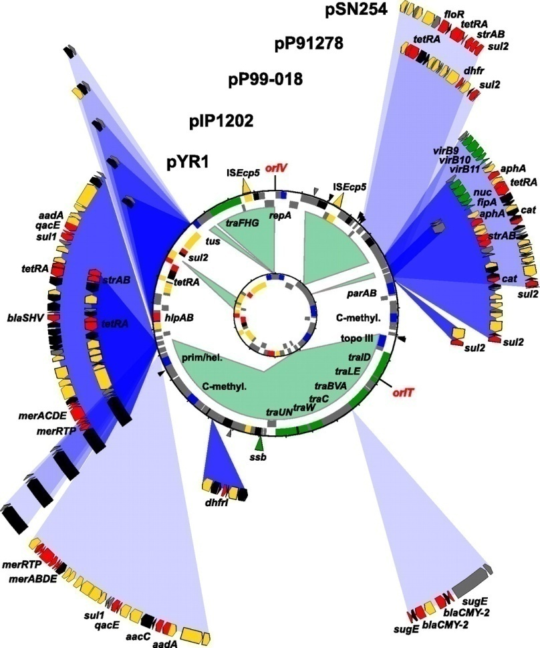
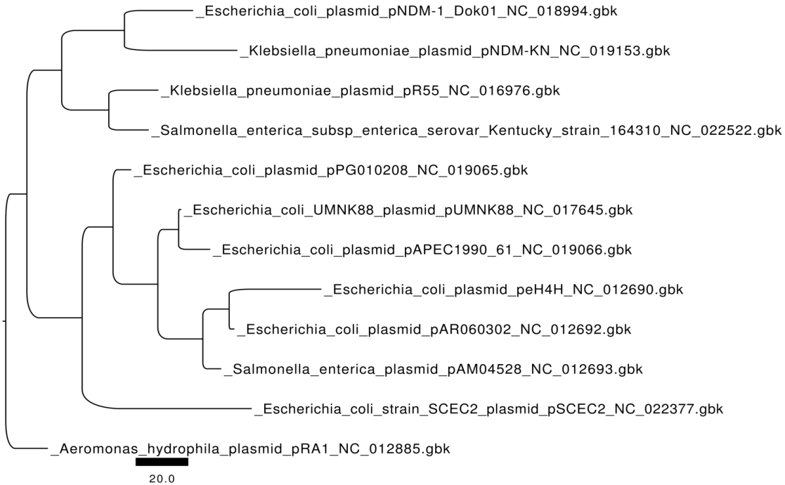
Robust identification of orthologues and paralogues for microbial pan-genomics using GET_HOMOLOGUES: a case study of pIncA/C plasmids
Pablo Vinuesa^{1*} and Bruno Contreras-Moreira^{1,2,3*}
1 Centro de Ciencias Genómicas, Universidad Nacional Autónoma de México, Cuernavaca, Morelos, Mexico.
2 Fundación ARAID, Zaragoza, Spain.
3 Estación Experimental de Aula Dei, Consejo Superior de Investigaciones Científicas (EEAD-CSIC). Avda. Montañana, 1005, 50059 Zaragoza, Spain.
In: “Bacterial Pan-genomics”. Methods in Molecular Biology. Marco Galardini, Alessio Mengoni
and Marco Fondi Eds. Humana Press, Springer, 2014. In press
Fricke W F et al. J. Bacteriol. 2009;191:4750-4757

Slide 25
The GET_HOMOLOGUES tutorial:
1) cp the instructions script to your home
cp /home/vinuesa/genomica_UAEM/get_hom/code4_GET_HOMOLOGUES_OMICAS-UAEM-UNAM.txt .
Or download/visualize it from the GitHub repository:
https://github.com/vinuesa/OMICAS_UAEM/blob/master/docs/get_hom/code4_GET_HOMOLOGUES_OMICAS-UAEM-UNAM.txt
2) Open the script with nedit and keep a terminal open to issue the commands
gedit code4_GET_HOMOLOGUES_OMICAS-UAEM-UNAM.txt &
Analyses to be performed:
A pangenomic analysis of pIncA/C plasmids using GET_HOMOLOGUES
Defining a robust core- and pan-genome of pIncA/C plasmids
Exploring the gene space of pIncA/C plasmids: core, shell, cloud
Pan-genome trees vs. core genome trees (supermatrices)
Identifying lineage-specific genes in NDM-1 producing plasmids

Slide 28
Consensus core genome ML-phylogeny for 12 Samonella enterica sv. Typhimurium RefSeq
Genomes and 10 new draft genomes for Mexican strains based on 3824 orthologous genes
Ref strains used
for orientation
cf chromosomal
contigs
New Mexican
draft genomes

Slide 29
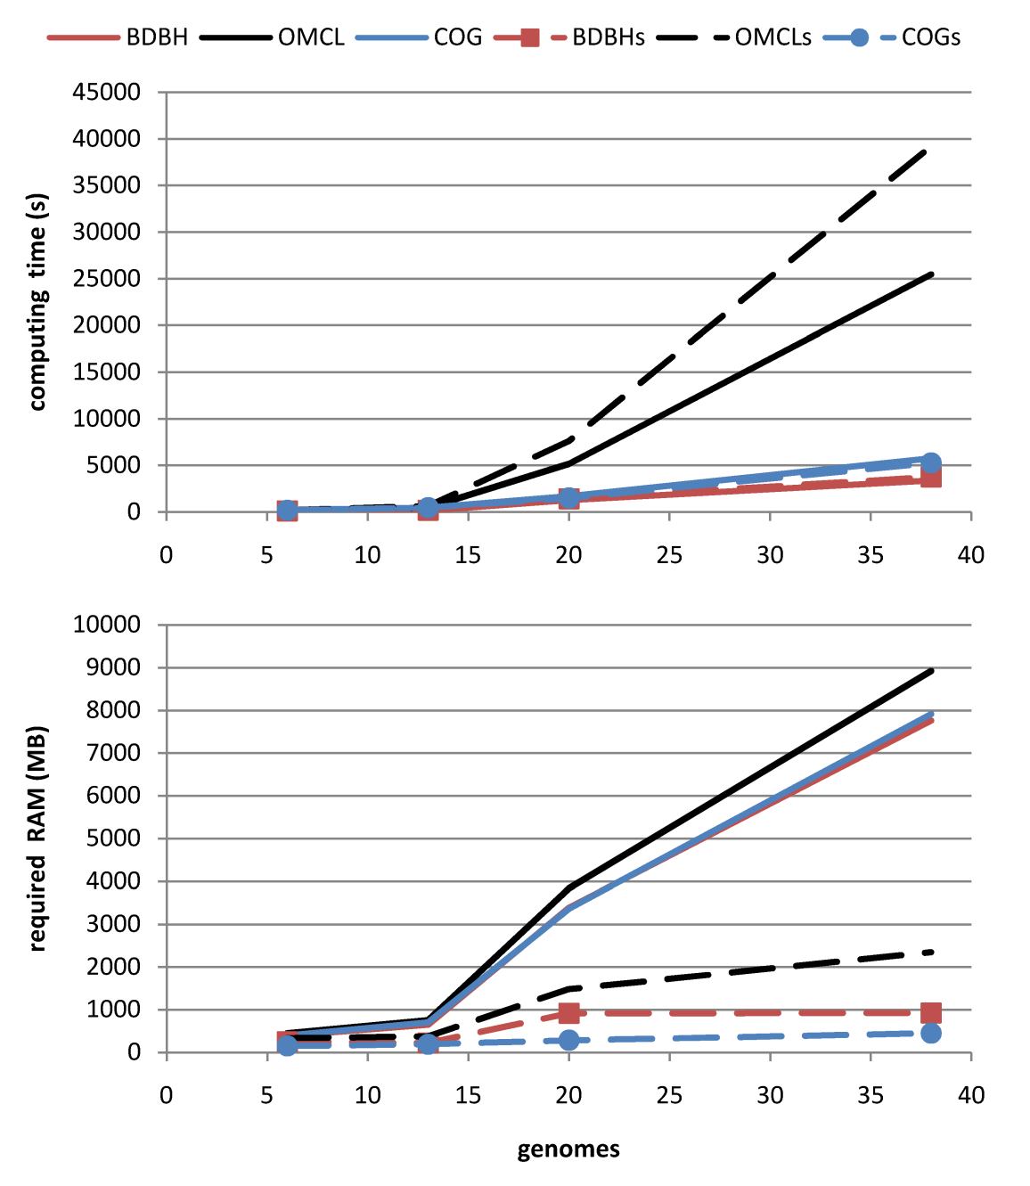
get_homologues: a software package for microbial comparative genomics
Running get_homologues.pl – memory usage and the –s option (BerkeleyDB)

Slide 30
Robust microbial pan-genome analysis and orthology detection by a combination
of bidirectional best-hit approaches and domain scanning
Pablo Vinuesa & Bruno Contreras-Moreira (in prep. for NAR)
Table 1. Datasets used in this work, including microbial species sampled at different
taxonomic depth. Out of 101 E. coli genomes surveyed, 57 were considered as complete
assemblies while the remaining were handled as drafts in progress.
Dataset name (number of genomes) | number of sequences | smallest-largest proteome (KB) | taxonomy | reference
Enterobacteriaceae42 | 196654 | 3725-5768 | family | this paper
Escherichia coli101 | 497131 | 4068-5608 | species | this paper
Escherichia coli57 | 269710 | 4068-5972 | species | this paper
Escherichia coli20 | 93612 | 4116-5449 | species | Touchon et al. (2)
Vibrionales38 | 165536 | 3425-6064 | order | Thompson et al. (5)
Gammaproteobacteria13 | 42011 | 564-5571 | phylum | Lerat et al. (3)
yeast6 | 32079 | 4714-5861 | class | Salichos & Rokas (4)
Notes:
Table 1 summarizes the composition and features of each of these datasets, including relevant citations to the literature. Three algorithms are thoroughly compared in this article: BDBH, OMCL and COG. They all build on BLAST+ sequence similarity results, and hence can all be called bidirectional best hit approaches, as all of them compute symmetric hits between pairs of genomes. However, beyond this BLAST dependency, each algorithm is different, as highlighted in Table 2.
<número>

Slide 31
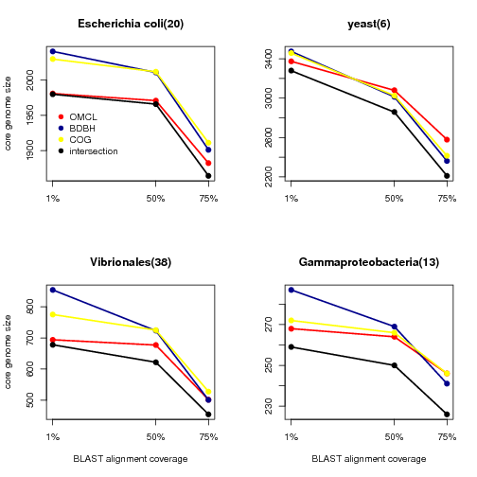
Alignment coverage is the most influential parameter
for the calculation of core-genomes
Notes:
Core-genomes are defined as collections of genes present in all genomes within a group of interest, as opposed to those present only in a few genomes. As all three algorithms tested in this work depend on previous sequence similarity searches, it might be expected that alignment quality should have an effect on automatically-generated core-genomes. Now quality can be estimated in a variety of ways, for instance, with E-value or % sequence identity. However, our tests suggested that alignment quality was best measured in terms of coverage, i.e. the fraction of any query sequence aligned to its bidirectional best hit.
Furthermore, unlike other parameters, coverage was shown to be sensitive to domain composition of protein sequences, as shown in the next section. Indeed, the results in Figure 1 clearly show that increasing coverage results in smaller core-genomes regardless of the tested set of sequences.
It is remarkable that lowering the required coverage from 75% to 50% has a larger impact on the resulting core-genome than moving it from 50% to 1%. It can be seen that the impact is much larger when comparing distantly related genomes than when strains of the same species are considered. For instance, lowering the coverage from 75% to 1% produced only 6% more gene clusters among 20 Escherichia coli strains, while this change among 38 Vibrionales genomes produced 52% more core clusters. A significant 40% increase was observed among 6 yeast genomes. The observed increase among 13 γ-proteobacteria was limited, as the core-genome was already quite reduced, probably due to the large taxonomic distance between the sampled genomes.
<número>

Slide 32
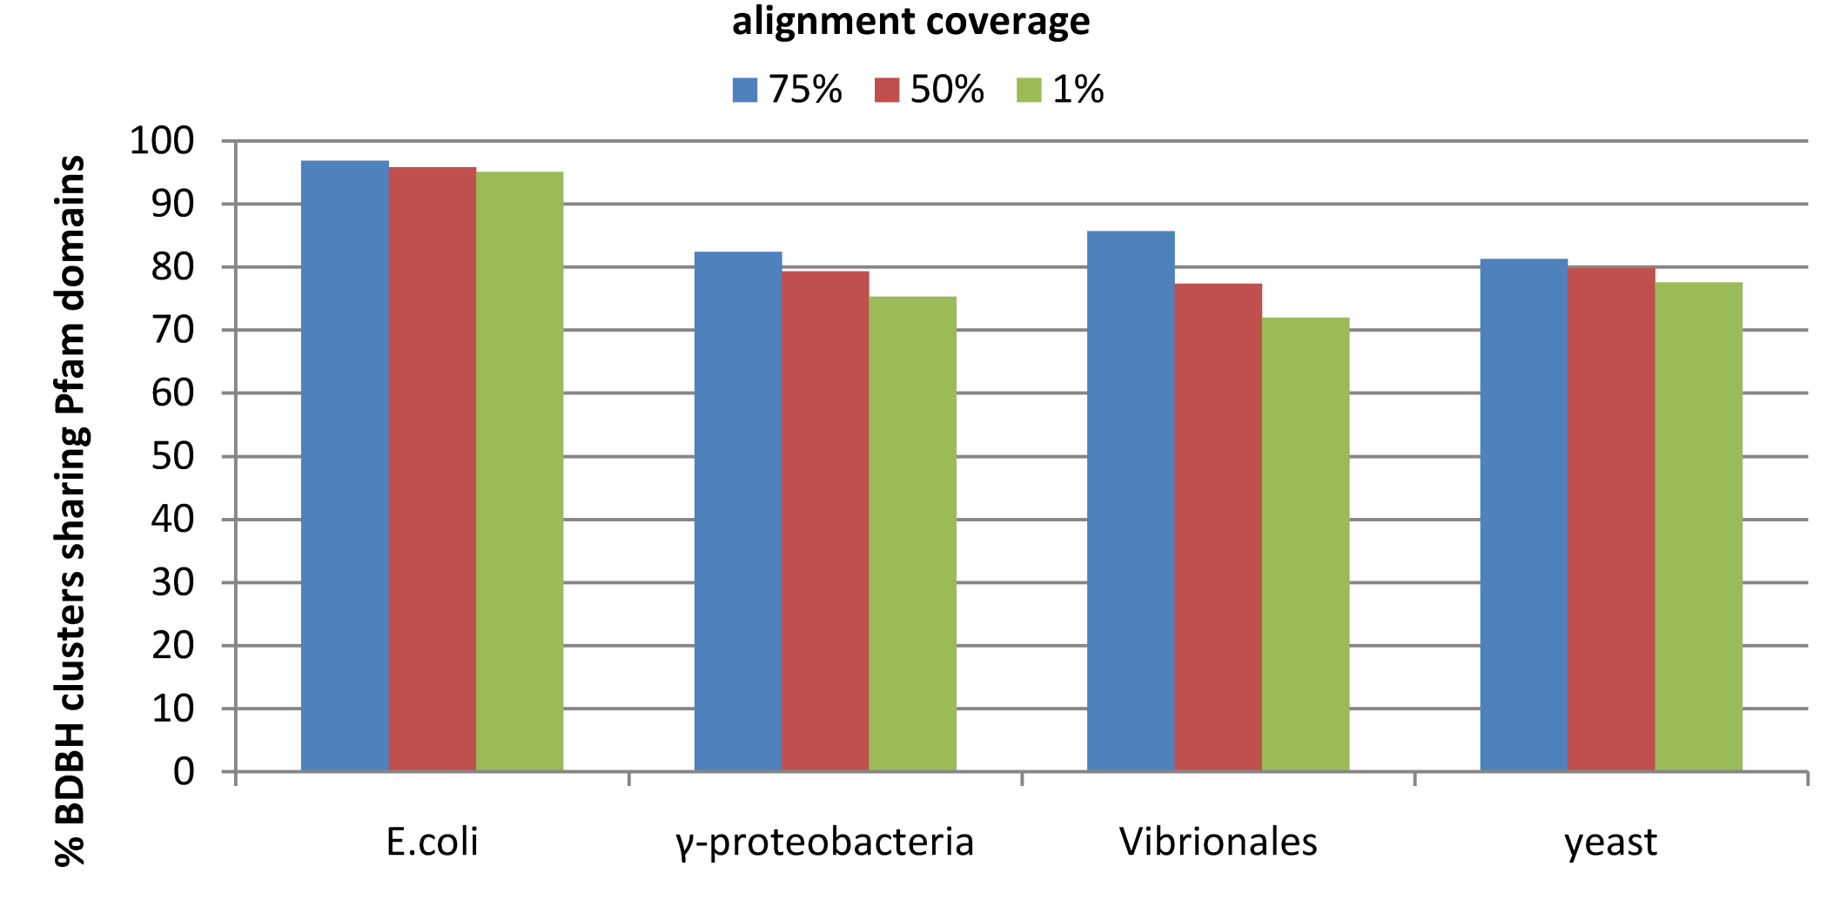
Increasing coverage thresholds improves the comparison
with Pfam protein domains
Notes:
In order to further investigate the impact of alignment coverage, the protein sequences analyzed in the previous section were domain-annotated by scanning the Pfam library of hidden Markov models (see Materials and Methods). The results are shown in Figure 2, which displays the percentage of BDBH core-clusters that contain sequence with identical domain composition. The data in the figure show that increasing alignment coverage improves the quality of the produced clusters. In other words, by lowering the coverage cut-off there more sequences are clustered together with different domain compositions, and hence likely different functions (14,15). Considering all tests, with 75% coverage we obtain on average 88% of clusters which share domains. This figure drops to 82% with 1% coverage. As in the previous section, we observe that this behavior correlates with the taxonomy of the involved sequences: it has little impact among 20 E.coli strains (around 2% clusters), but a large effect among 38 genomes of order Vibrionales (14%). Overall these results confirm the key influence of alignment coverage on automatically produced clusters of possibly orthologous genes.
<número>

Slide 33
Increasing coverage thresholds improves the comparison
with Pfam protein domains
Notes:
In order to further investigate the impact of alignment coverage, the protein sequences analyzed in the previous section were domain-annotated by scanning the Pfam library of hidden Markov models (see Materials and Methods). The results are shown in Figure 2, which displays the percentage of BDBH core-clusters that contain sequence with identical domain composition. The data in the figure show that increasing alignment coverage improves the quality of the produced clusters. In other words, by lowering the coverage cut-off there more sequences are clustered together with different domain compositions, and hence likely different functions (14,15). Considering all tests, with 75% coverage we obtain on average 88% of clusters which share domains. This figure drops to 82% with 1% coverage. As in the previous section, we observe that this behavior correlates with the taxonomy of the involved sequences: it has little impact among 20 E.coli strains (around 2% clusters), but a large effect among 38 genomes of order Vibrionales (14%). Overall these results confirm the key influence of alignment coverage on automatically produced clusters of possibly orthologous genes.
<número>

Slide 34
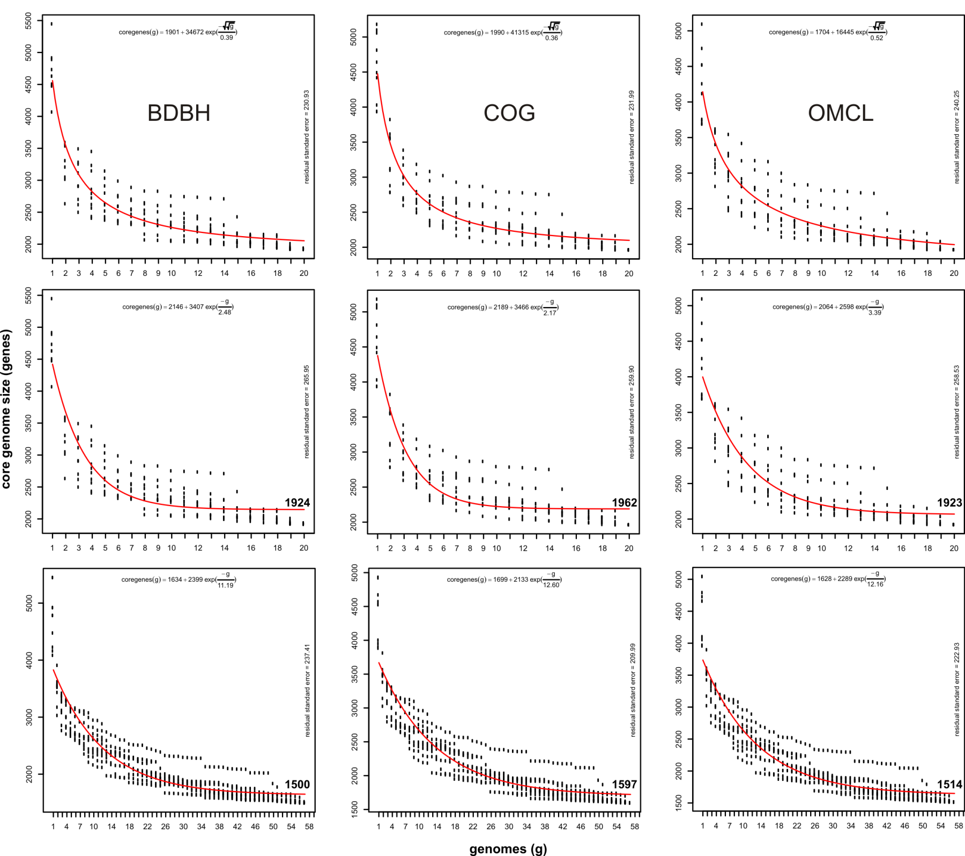
Estimating
core genomes
E. coli 20
Willembrock-fit
E. coli 20
Tettelin-fit
E. coli 57
Willembrock-fit
Notes:
Working with five serotypes of Streptococcus agalactiae, Tettelin and collaborators proposed the key concepts in this context: the core-genome, already introduced in previous sections, and the pan-genome, “a dispensable genome consisting of partially shared and strain-specific genes” (10). These terms have since been widely adopted and further developed by the community, but still there is no consensus on the precise way these genome subsets should be constructed (see for instance (3,5,11,13)). Therefore in this section we wanted to challenge the algorithms in Table 2 and put them to the task of estimating core and pan-genomes by sampling, as done in the pioneer work of Tettelin. For these experiments we first took 20 genomic sequences of E.coli strains first employed by Touchon and collaborators (2), and then a total of 57 complete genomic sequences of E.coli isolates available in GenBank as of May, 2012. The graphs in Figure 3 represent core-genomes calculated after 10 random-sampling experiments.
<número>

Slide 35
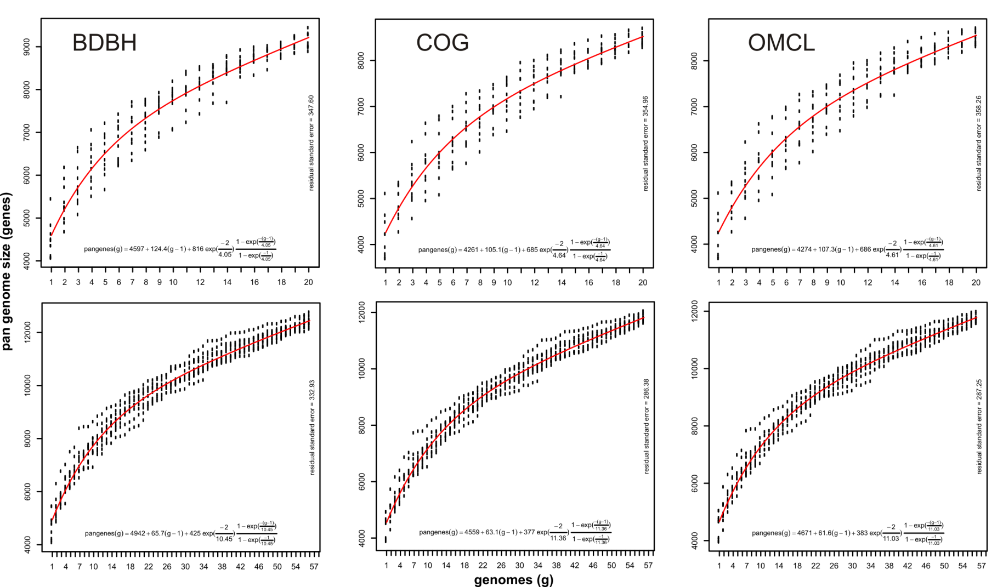
Estimating pan-genome sizes for E. coli 20 (upper row) and E. coli 57 (lower)
124 new genes /genome
105 new genes /genome
107 new genes /genome
66 new genes /genome
63 new genes /genome
62 new genes /genome
Notes:
we turn to pan-genomes, fitting the formulas first proposed by Tettelin. The top row (20 E.coli genomes) shows that adding new genome on average adds 105-124 new genes to the genomic pool, depending on the employed algorithm. However, this estimate gets reduced to 62-66 new genes when all 57 genomes are considered.
<número>

Slide 36
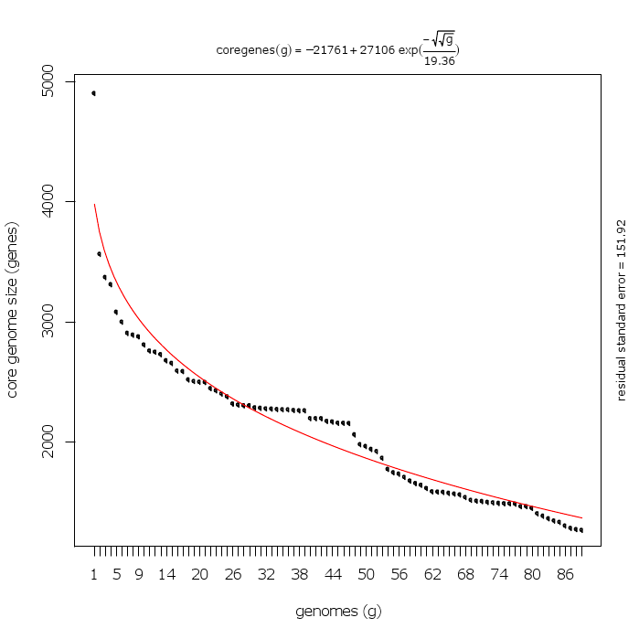
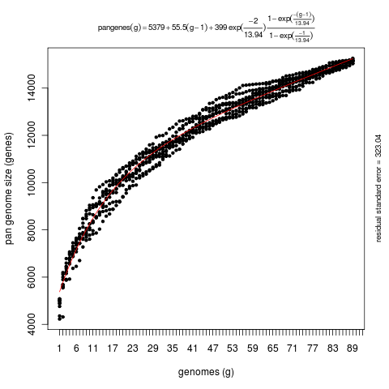
get_homologues: a software package for microbial comparative genomics.
Running get_homologues.pl – what are the sizes of the E. coli core- and pan-genomes
Draft genomes
On average, every
new E. coli genome
adds some 55 new genes
to its known pangenome
Complete genomes
Core genome for 89 E. coli genomes
BDBH + COG + OMCL intersection
pangenome for 89 E. coli genomes
COG + OMCL intersection

Slide 37
Different algorithms produce notably different pan-genomic cluster sizes

Slide 38
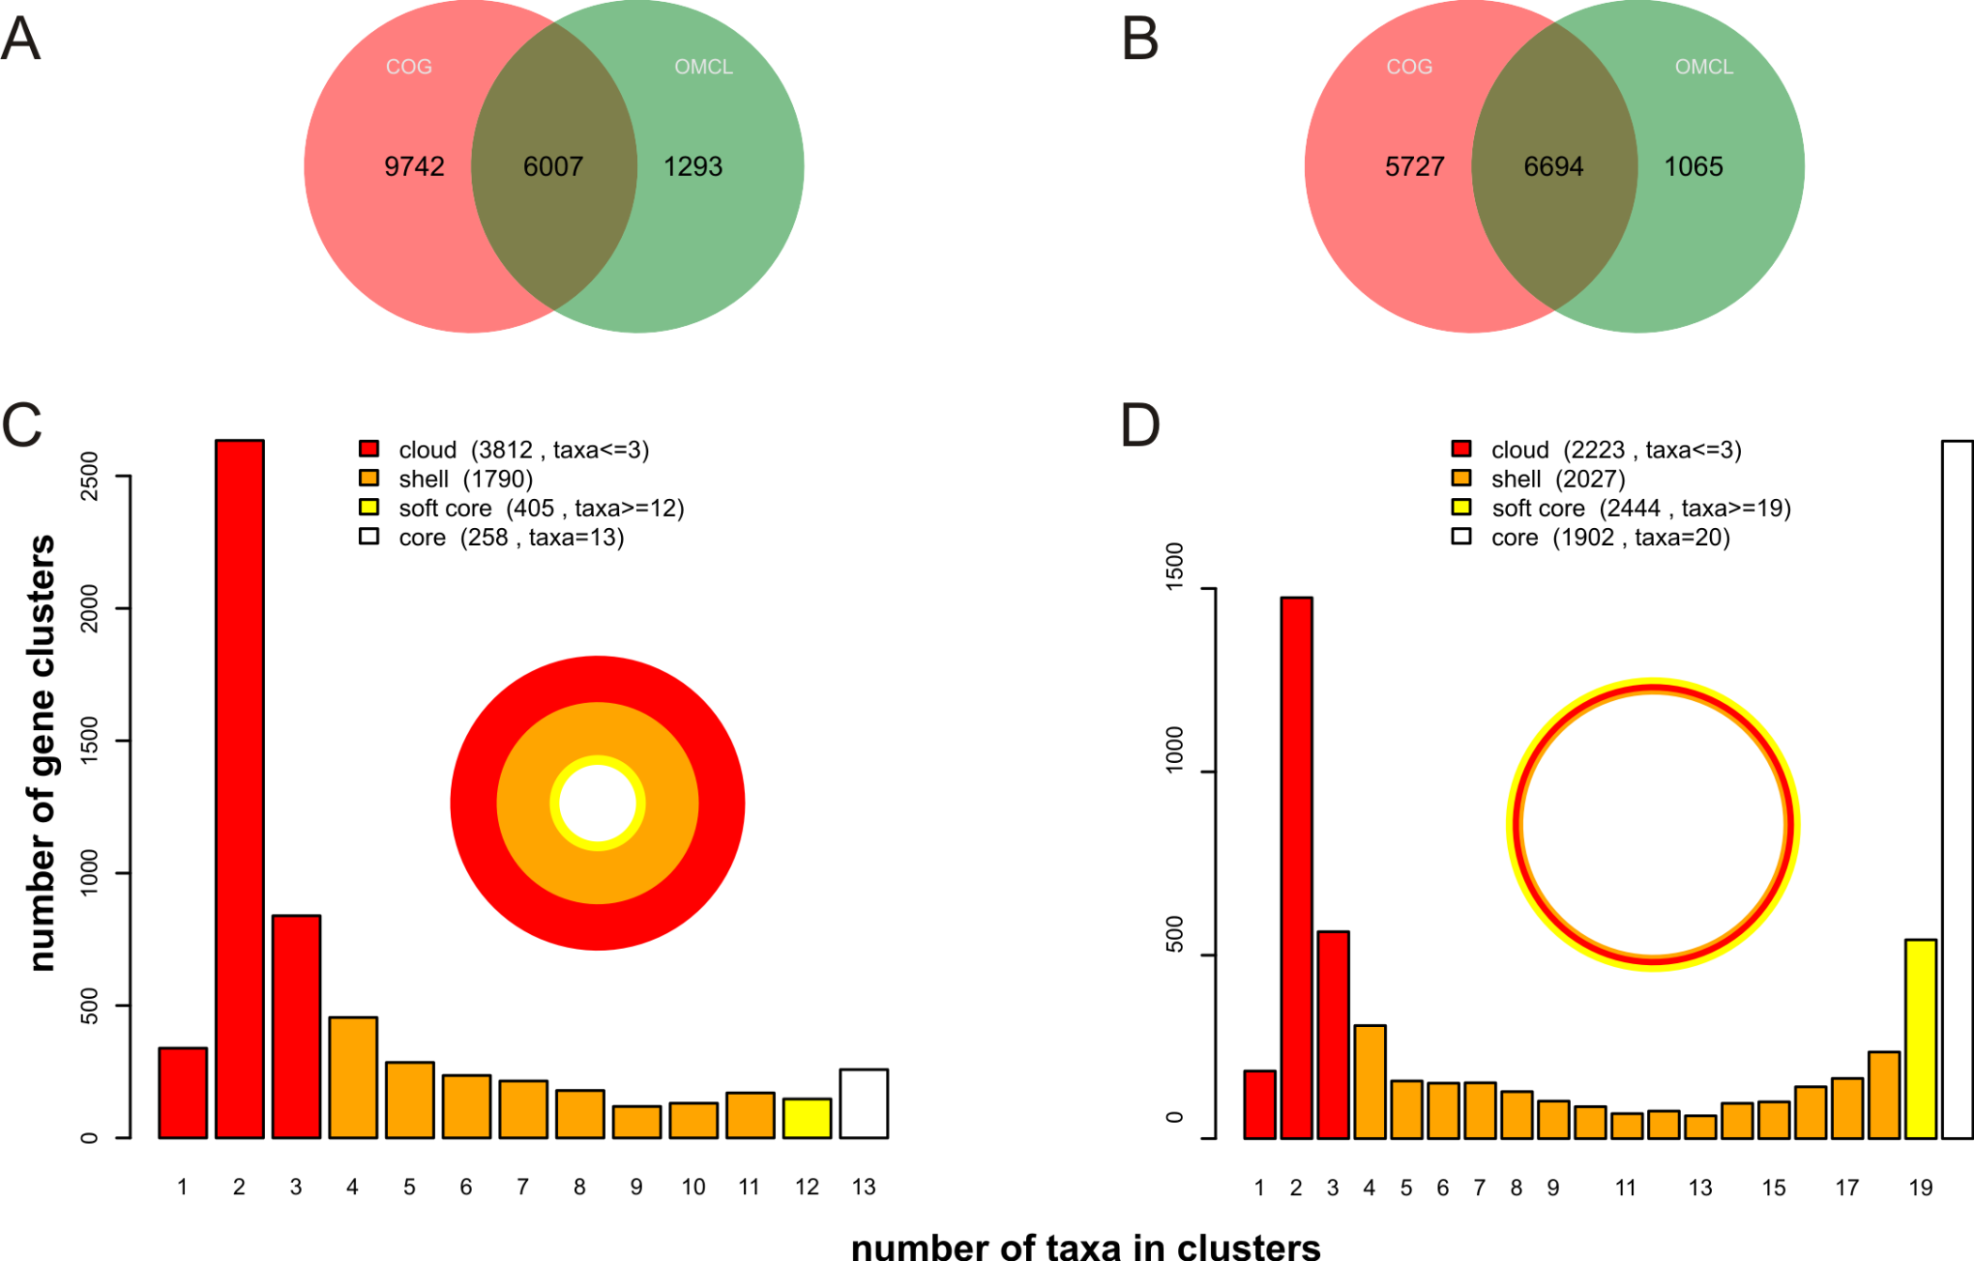
Venn analysis as a way to define consensus pan-genomes
Gammaproteobacteria13
Escherichia coli20

