Slide 1
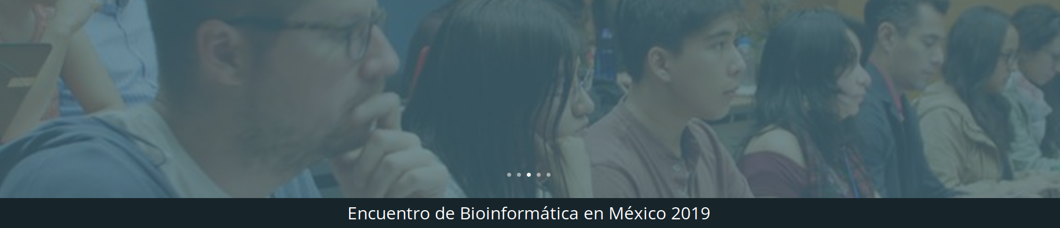
- TIB2019-T3 -
Análisis comparativo de genomas microbianos: Pangenómica y filoinformática
Profesor: Pablo Vinuesa, http://www.ccg.unam.mx/~vinuesa/
@pvinmex
Ayudantes: Ali Berenice Posada Reyes y Julio Valerdi Negrero
Acceso al material del curso:
https://github.com/vinuesa/TIB-filoinfo
Sesión 8: Estima de filogenias genómicas con GET_PHYLOMARKERS

Slide 2
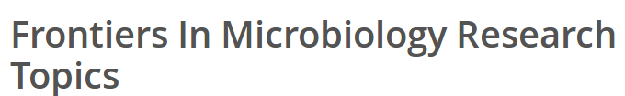

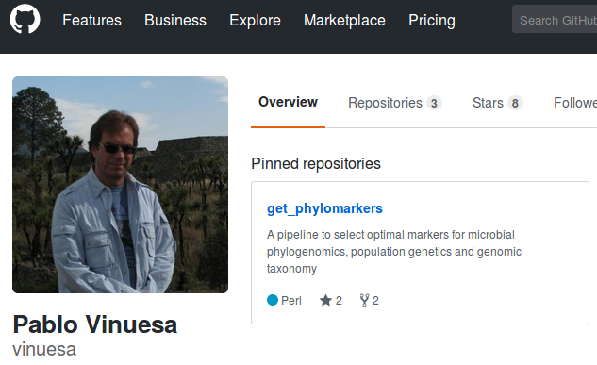
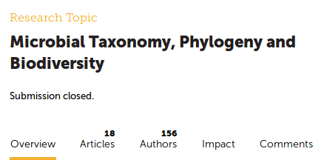
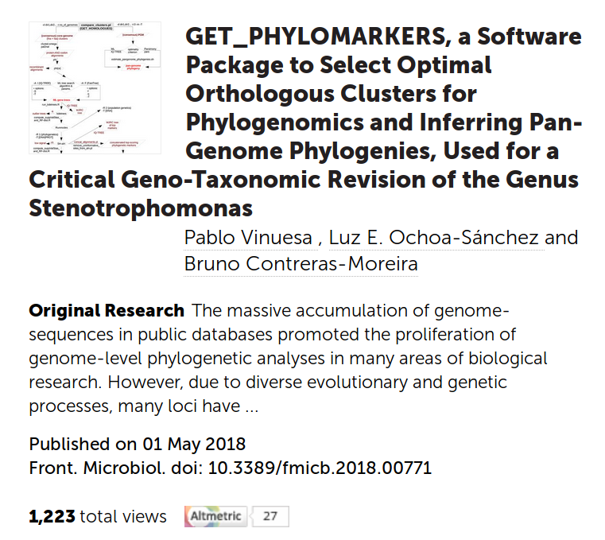
https://github.com/vinuesa/get_phylomarkers

Slide 3
Flowchart showing how the GET_PHYLOMARKERS package integrates with GET_HOMOLOGUES
Vinuesa et al., 2018

Slide 4
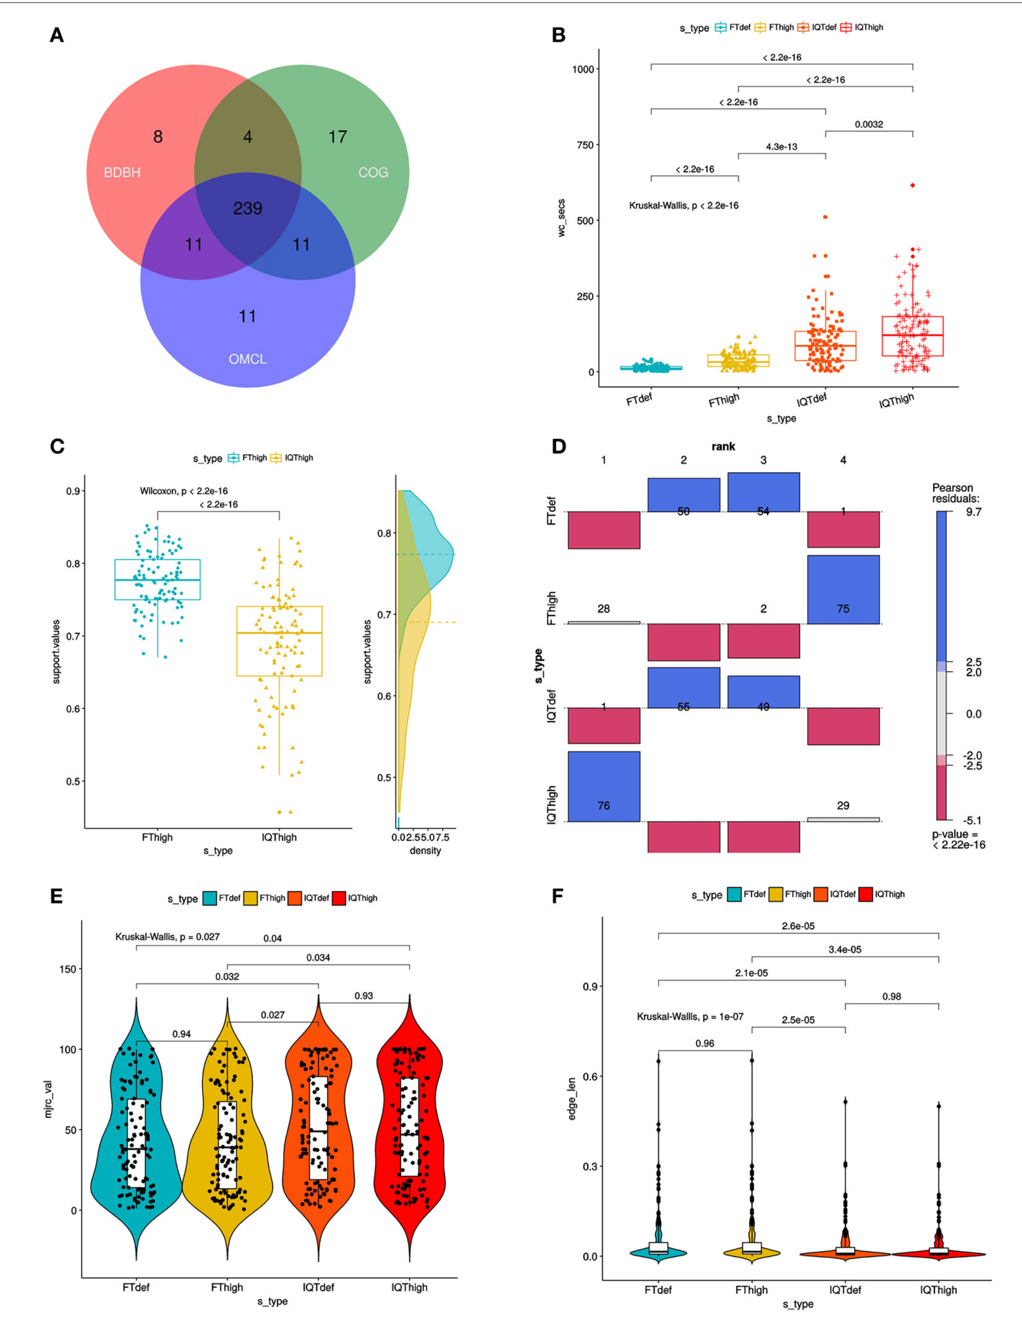
Benchmark analyses
of the phylogenetic
performance
of FT vs IQ-TREE
Computation time required by
FT and IQT when run under
“default” (FTdef, IQTdef) and
thorough (FThigh, IQThigh)
search modes (s_type)
on the 239 consensus
Clusters
Kruskal-Wallis p < 2.2e-16
Consensus core-genome
(n=239) computed with
GET_HOMOLOGUES
Association plot
summarizing the results of
multi-way Chi-Square
analyses of the lnL
score ranks (1–4, meaning
best to worst) of the 105 top-
scoring ML gene-trees
passing the kdetrees filter in
the IQThigh run (Table 2)
for each search-type
p < 2.2e-16
Distribution of
SH-alrt branch support
values of gene-trees found
by the FThigh and IQThigh
Searches.
Wilcoxon signed-rank test
p < 2.2e-16
Distribution of consensus
values from majority-rule
consensus trees computed
from the gene trees passing
all the filters, as a function
Of search-type.
Kruskal-Wallis p < 0.027
Distribution of the edge-
lengths of species-trees
Computed from the con-
catenated top-scoring
Markers, as a function of
Search-type
Kruskal-Wallis p < 1e-7

Slide 5
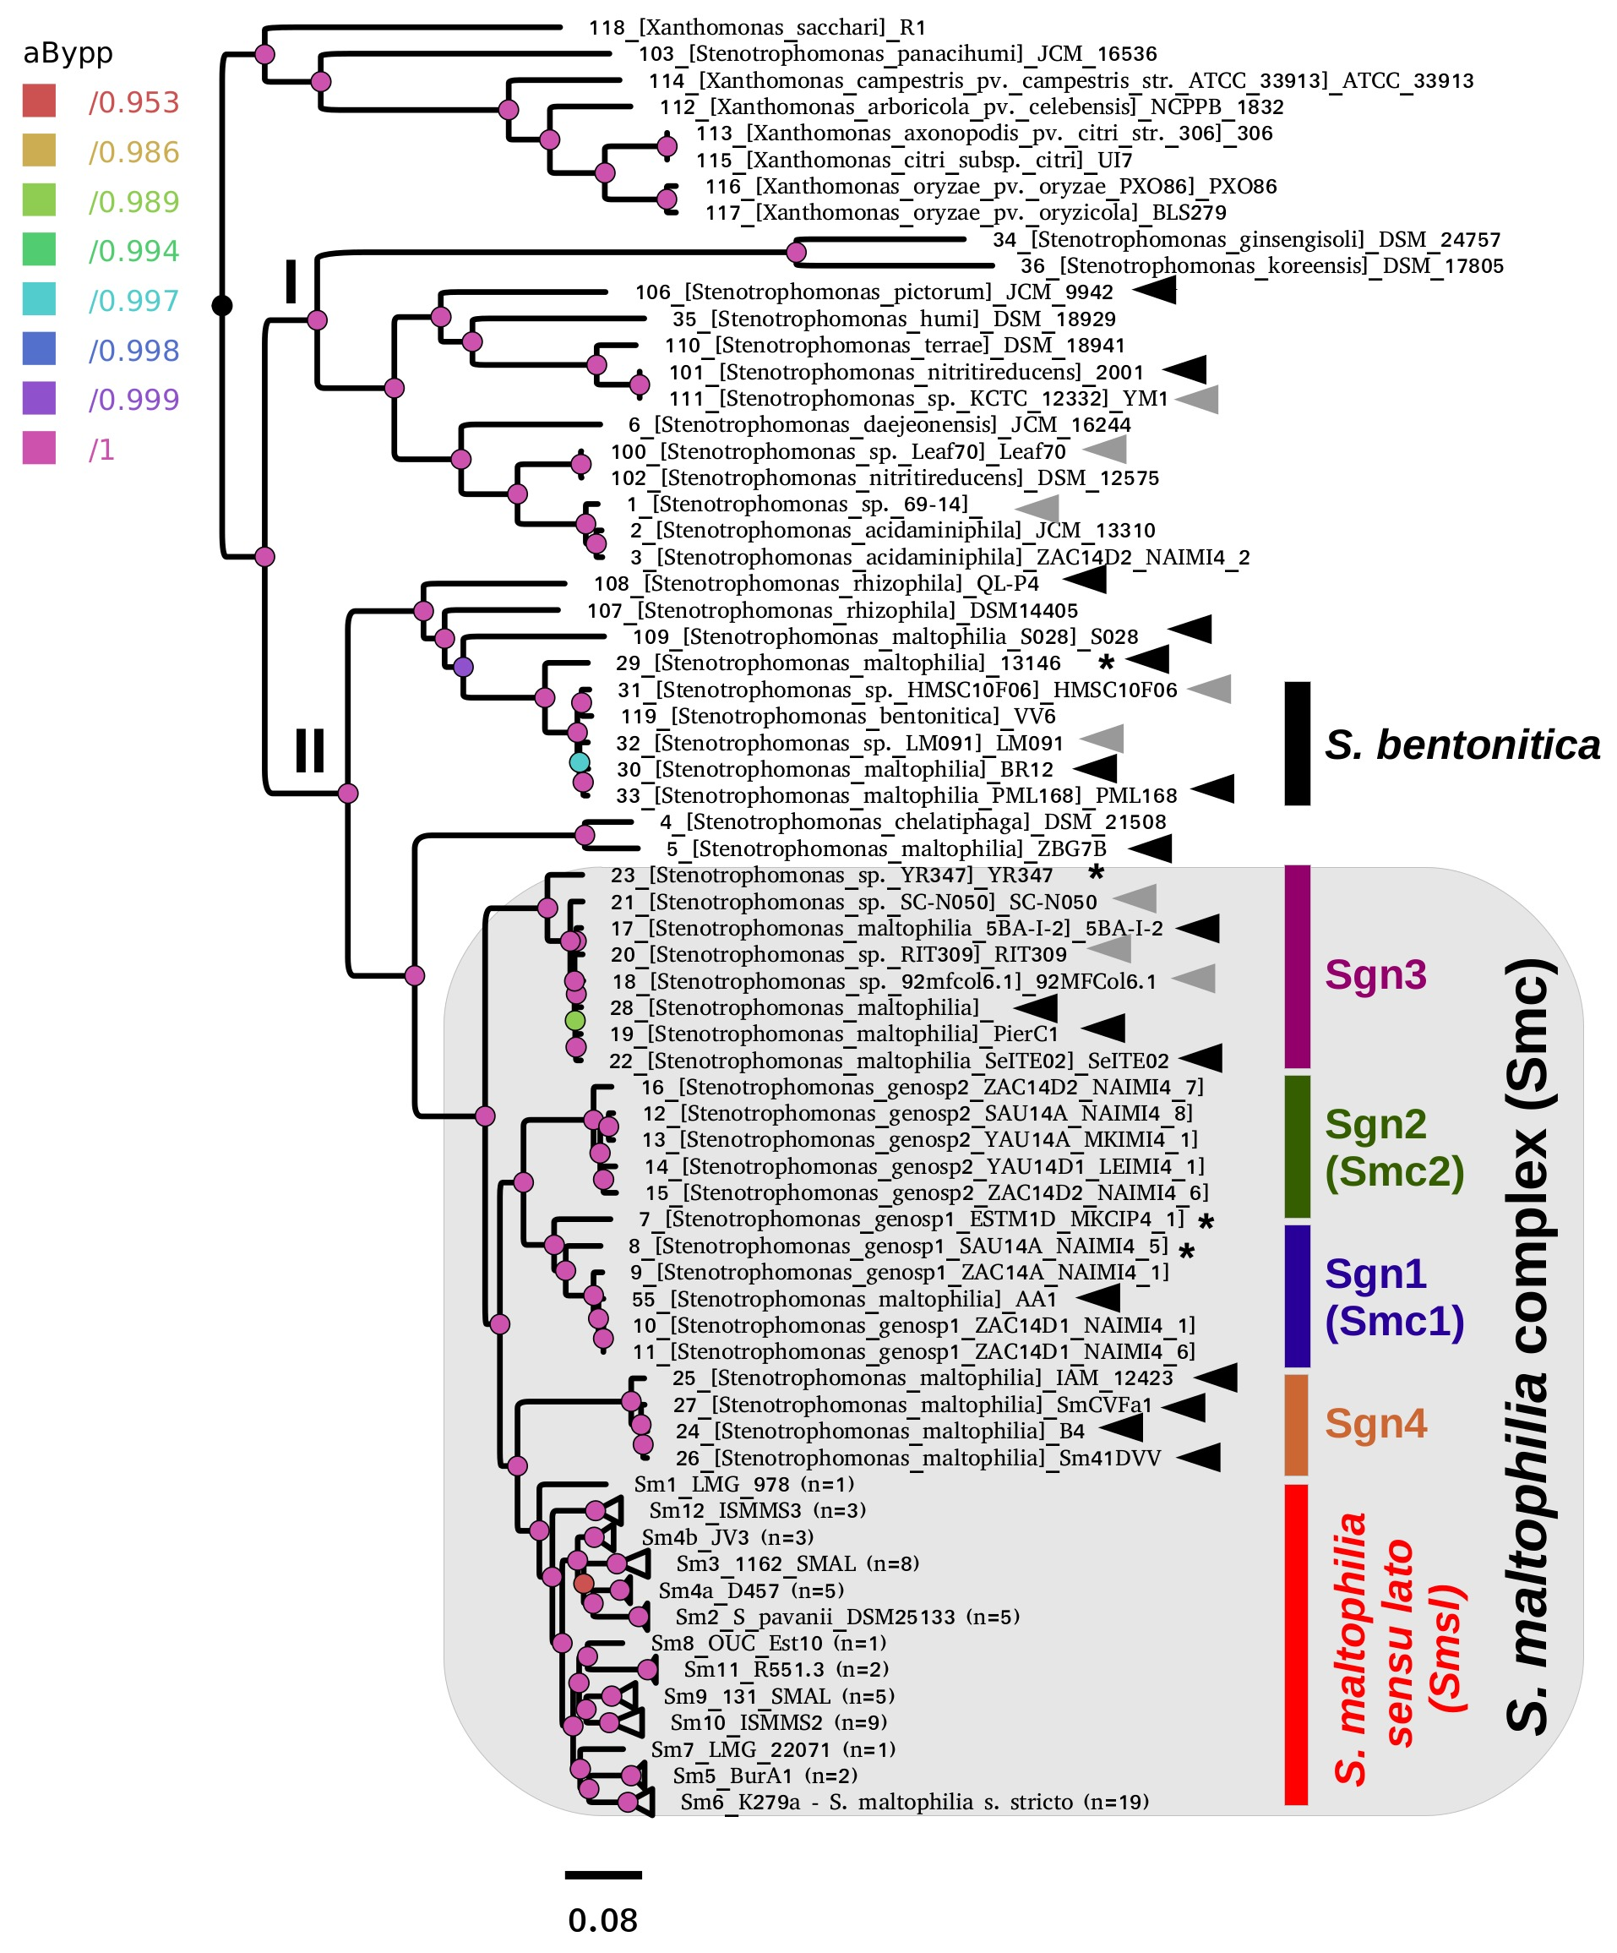
ML species tree
118 genomes
Top 52(/231) markers
GTR+ASC+F+R7
~8% misclassified genomes 13/169
~8% unclassified genomes 14/169
reclassified 27 RefSeq
genome sequences!
The Smc is split into 5 major lineages
including S. maltophilia s. lato
13 clades (species?) are recognized
within the latter, which are consistent
with a 95.9% cgANIb cutoff
Vinuesa et al., 2018
Figure 5

Slide 6
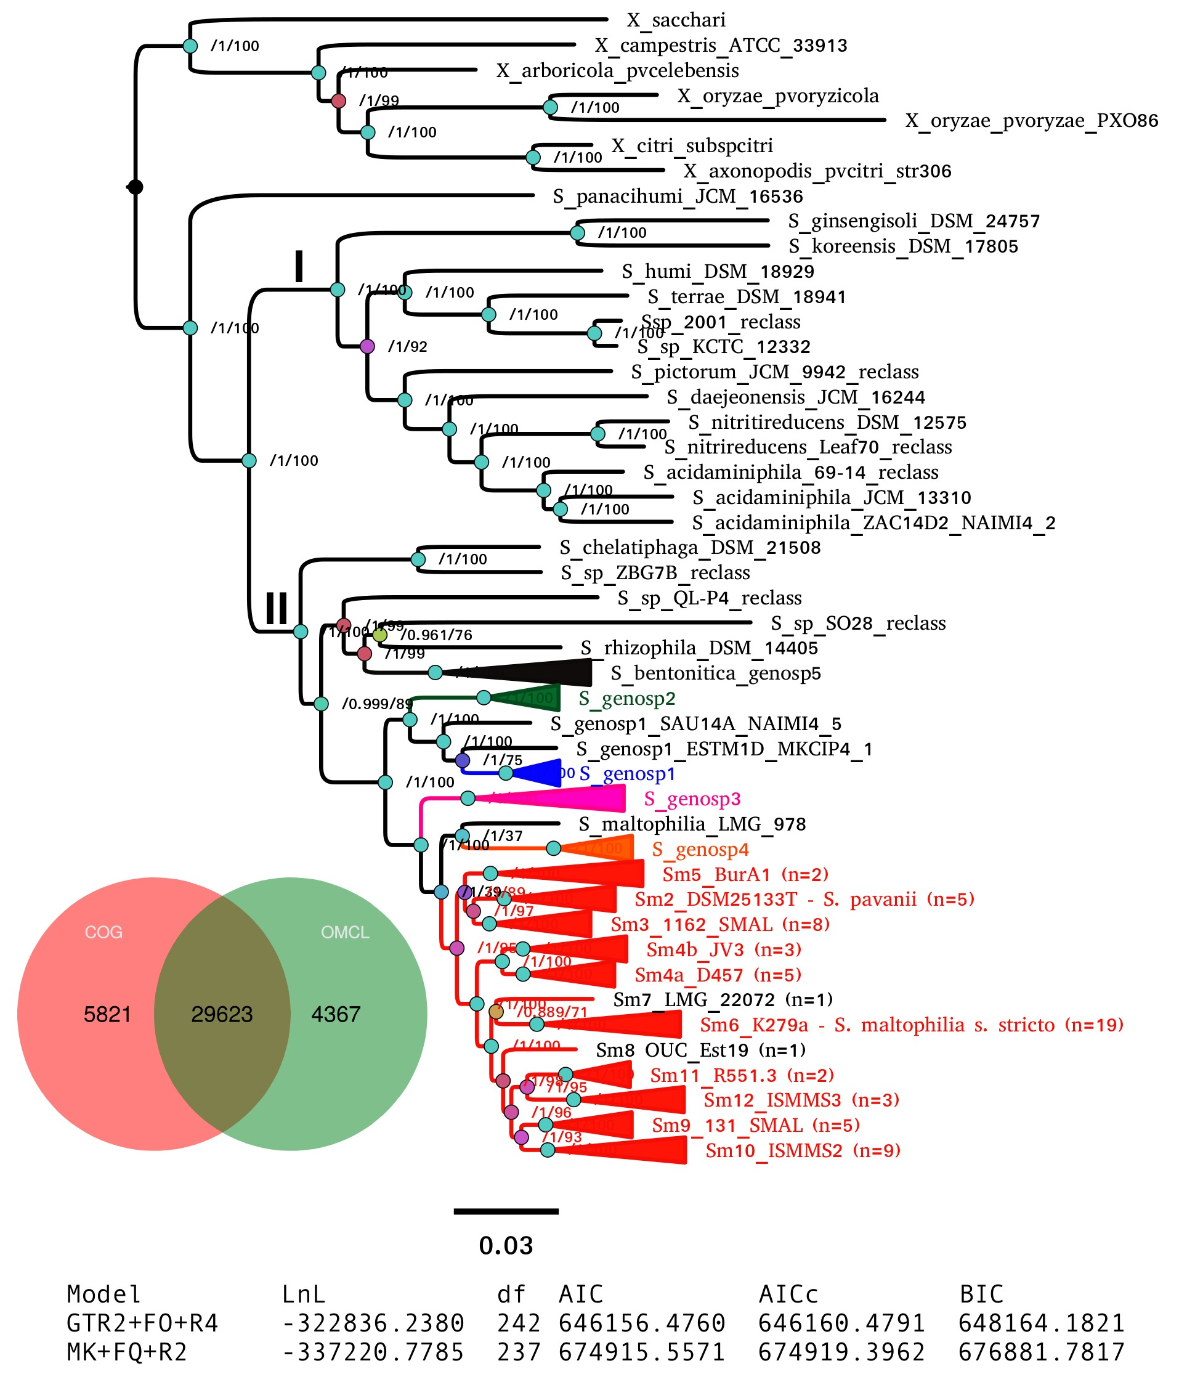
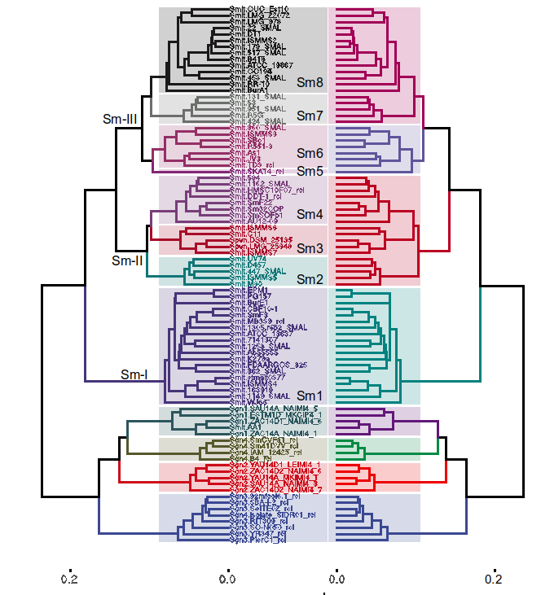
ML pan-genome tree
118 genomes
29,623 markers
GTR2+F0+R4
Unsupervised learning methods to find
species-like clusters in the Smc
based on the pan-genome matrix
Vinuesa et al., 2018

Slide 7
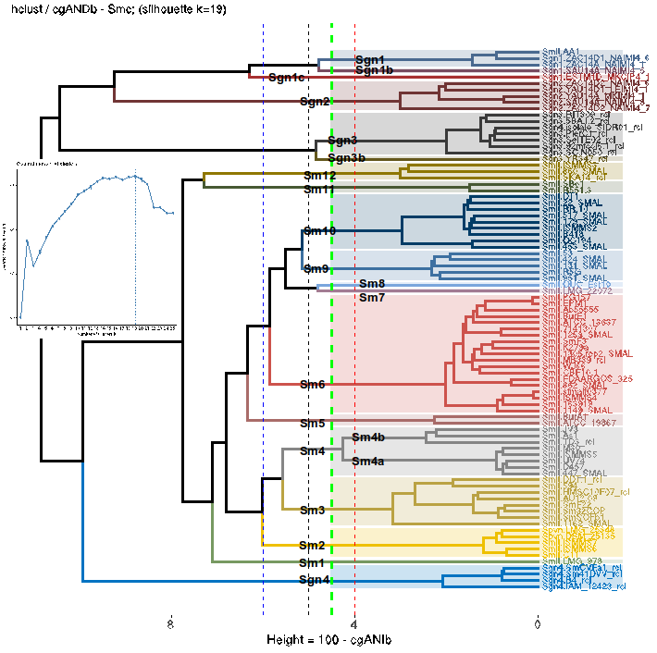
Unsupervised learning methods to find groups within the Smc and S. maltophilia s. lato
lineages based on cgANDb ( = 100 - cgANIb)
up to 13 potential species
resolved within Smsl
at cgANDb = 4.1 (cgANIb = 95.9)
Vinuesa et al., 2018
Figure 8

