Slide 1
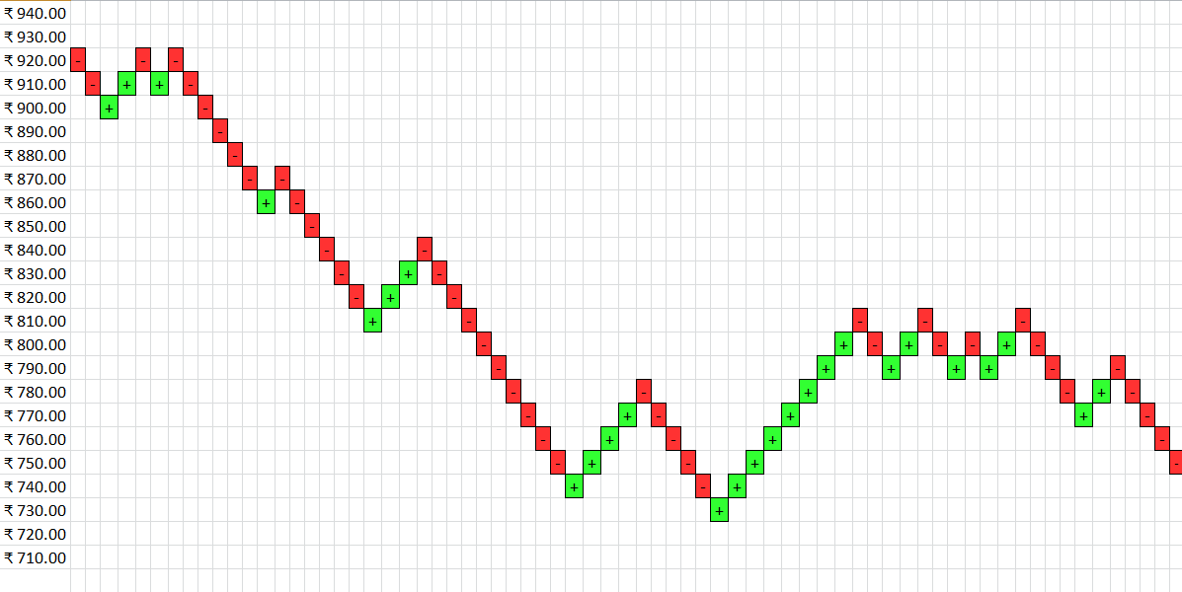
RENKO CHART GENERATOR APPLICATION
This Application is used for Plotting the Japanese Renko Charts of a single script of any Stock/ETF based on a given Brick size

Slide 2

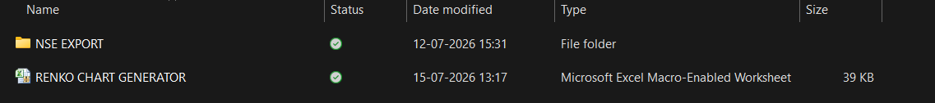
RENKO CHART GENERATOR APPLICATION
This Application is used for Plotting the Japanese Renko Charts based on given Box Size.
The “RENKO CHART GENERATOR” Folder consists of a subfolder called “NSE EXPORT” and the “RENKO CHART GENERATOR.xlsm” Macro File. Both the Folder and the File are required to generate Renko Plots.

Slide 3
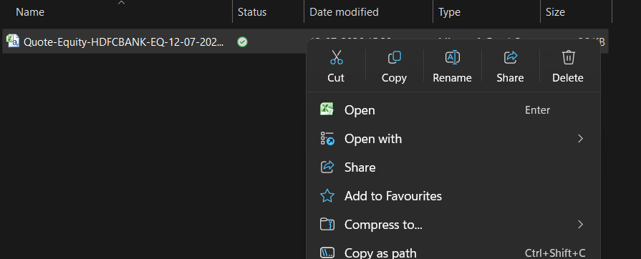
SETTING UP THE RENKO CHART GENERATOR APPLICATION
Open the “NSE EXPORT” Folder, Delete the existing File.

Slide 4
EXPORTED HISTORICAL DATA
Now Place the downloaded Historical Data File of any Stock/ETF into “NSE EXPORT” Folder
Note:
This Application is designed to view the Renko Chart of a single script only so the “NSE EXPORT” Folder must contain only one Stock/ETF’s Historical Data Export
Exported File should be in any of Excel Formats - .xlsx, .xls, .csv etc.,
It should consist of only one Worksheet
The Data Headers and Data should start from Cell “A1” and the Range of Headers should have the Columns by the Name – “DATE” and “CLOSE”(Both with Upper Case) having information on valid dates in the “DATE” Column and Closing Prices in the “CLOSE” column respectively.
The File must have at least 150 Trading days of Historical Data as this application is designed to print Renko Charts of the recent 100 Trading days

Slide 5
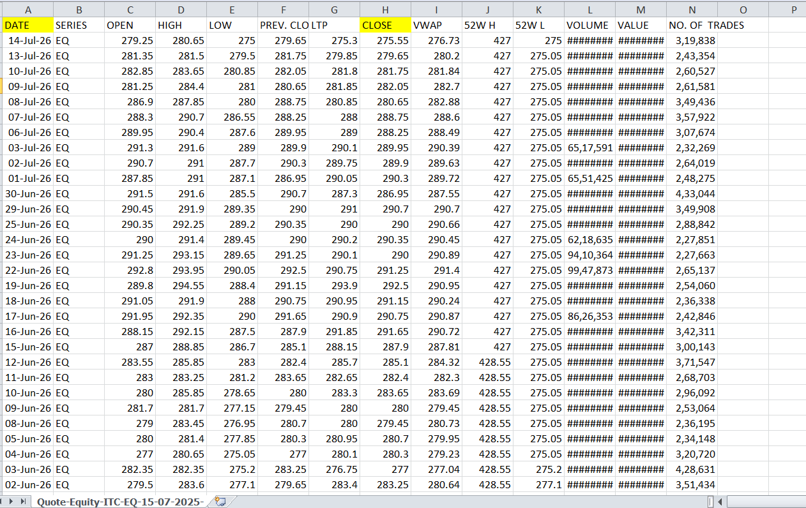
EXPORTED HISTORICAL DATA
Your Exported Historical Data should look something like this!

Slide 6
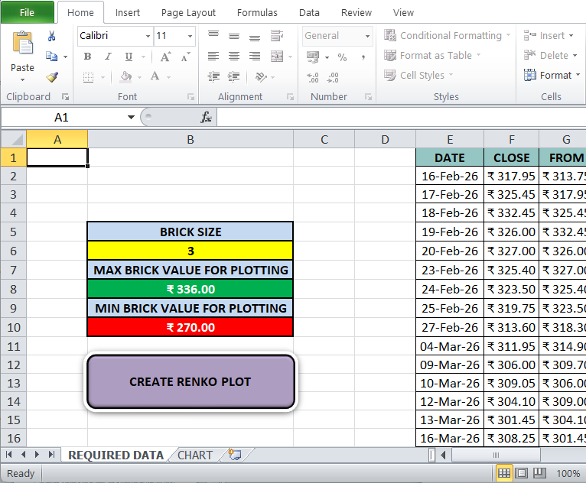
RUNNING THE APPLICATION
Double Click and Open the “RENKO CHART GENERATOR.xlsm” Macro File. It has 2 Worksheets – “REQUIRED DATA” and “CHART”
Please enable Macros as this File Application uses the Standard VBA Application to generate Renko Charts

Slide 7
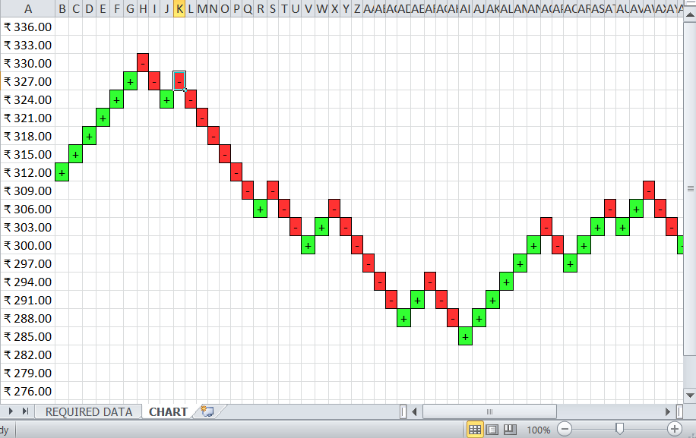
RUNNING THE APPLICATION
All you do now is enter the required “BRICK SIZE” in the cell “B6” of “REQUIRED DATA” Worksheet, Click on “CREATE RENKO PLOT” Button and Enjoy the stunning Renko Plots!!!
You can change the “BRICK SIZE” , Click on “CREATE RENKO PLOT” Button and generate charts for different Brick size Values!!!

