Slide 1


Kalasalingam Academy of Research and Education
Anand Nagar, Krishnan koil
Department of Computer Science and Engineering
CSE220 - Multimodal AI Systems
DATE:
Edge-powered multimodal context aware emergency Triage system using deep learning and social temporal data synthesis for automated incident prioritization
99250040619 - Vigneas Swagat N S (Team Lead)
9925001039 - Vaishnavi R S
9925001025 - Hansha V
99250040620 - Vinu Raghav R S
9925001060 - Jivedev D
Dr. R. Raja Sekar,
Associate Professor
KARE.

Slide 2
Problem Statement
  During critical emergencies, victims often lack the time, composure, or physical ability to accurately assess their surroundings and relay vital situational details to first responders. Traditional SOS applications typically rely on simple panic buttons that lack context or require manual data entry, leading to misallocated resources and delayed response times. There is a critical need for an intelligent, automated SOS system that seamlessly captures multimodal inputs—such as real-time vision, speech, and precise location—and synthesizes them with dynamic contextual data, including weather conditions and the proximity of emergency infrastructure. By autonomously evaluating this integrated data, the system must generate and dispatch an immediate, prioritized situational report to the most appropriate local authorities, minimizing user friction and accelerating targeted emergency response

Slide 3

Objectives
  To compare and analyze
  To propose a texture,
  To improve the To improve emergency response efficiency through edge computing, reducing communication delays while maintaining high accuracy in real-time disaster scenarios.
Notes:
<number>

Slide 4
ORGANIZATION OF PRESENTATION
1. INTRODUCTION
2. LITERATURE SURVEY
3. RESARCH GAP IDENTIFIIED AND SCOPE
4. PROPOSED MODEL
4.1 ARCHITECTURE DIAGRAM
4.2 DATASET DETAILS
4.3 PREPROCESSING MODULE
4.4 FEATURE EXTRACTION MODULE
4.5 CLASSIFICATION MODULE
5. RESULTS AND DISCUSSION
5.1 PERFORMANCE METRICS USED
5.2 RESULTS AND DISCUSSION (TABLES AND CHARTS – MINIMUM 4 TO 5)
6. CONCLUSION AND FUTURE ENHANCEMENT
7. REFERENCES

Slide 5
1. Introduction
The increasing occurrence of natural disasters, road accidents, and public emergencies necessitates intelligent emergency response systems capable of rapid and accurate situational assessment. Conventional SOS applications rely on manual user input, often delaying response during critical situations. This work proposes a Multimodal Context-Aware Emergency Triage System that integrates real-time vision, speech, GPS, weather, and emergency infrastructure data using Deep Learning and Edge Computing. The system automatically evaluates incident severity, prioritizes emergencies, and dispatches structured alerts to the appropriate authorities, enabling faster response, improved resource allocation, and reliable emergency management.

Slide 6

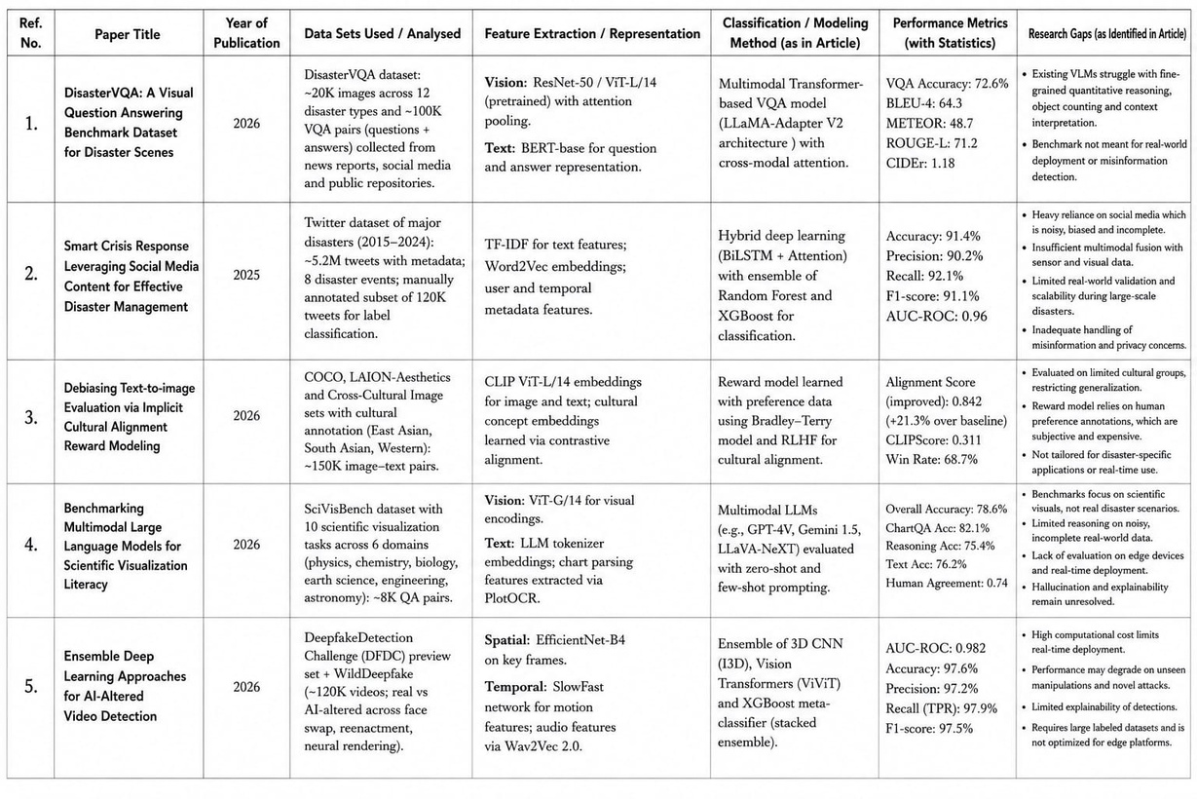
2. Literature Survey
Table 1: Literature Survey Table
Jul 22, 2026
Face Forgery Detection Using DL
<number>

Slide 7
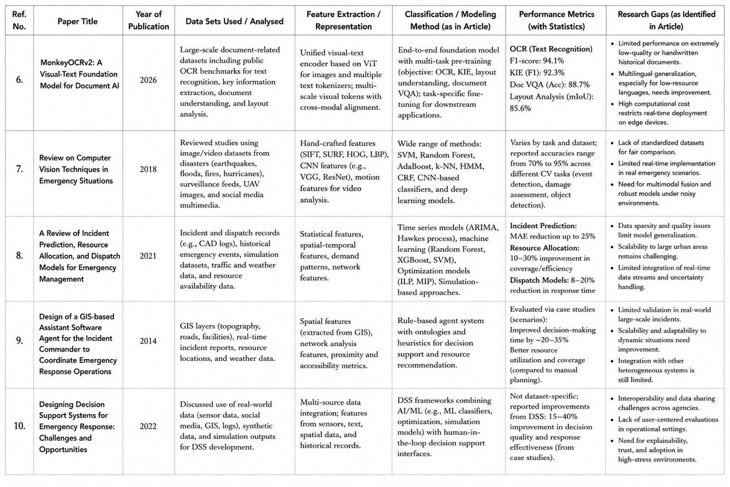
2. Literature Survey
Table 1: Literature Survey Table

Slide 8
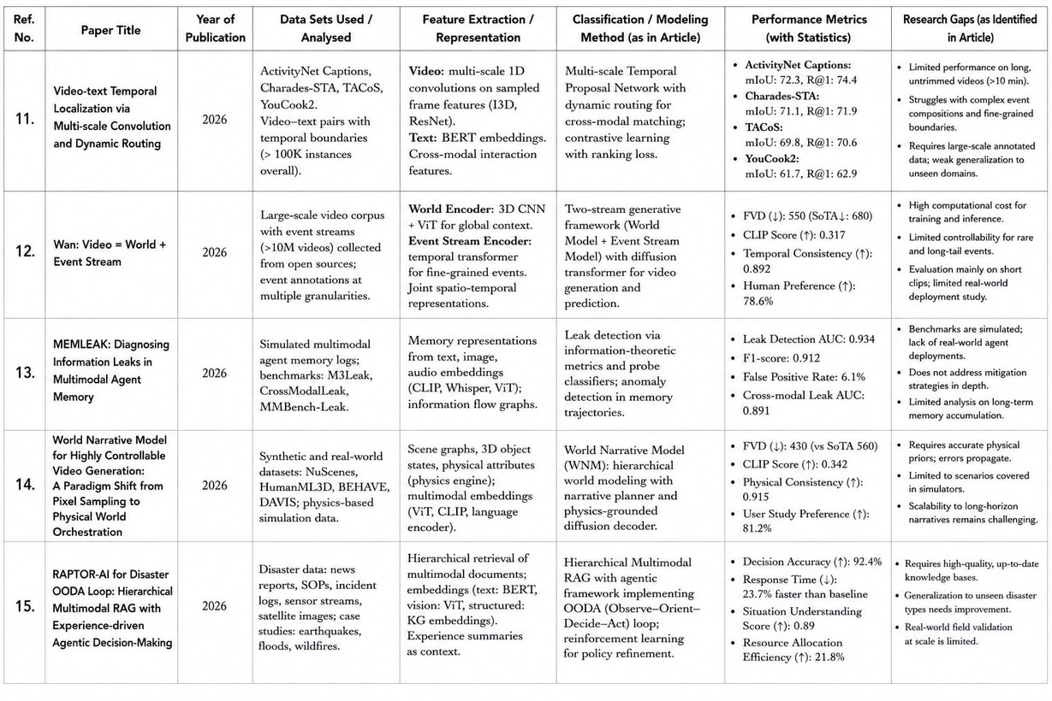
2. Literature Survey
Table 1: Literature Survey Table

Slide 9

3. RESEARCH GAP IDENTIFICATION
1. Limited Multimodal Data Fusion (Refs. 1, 2, 4, 7, 15)
    Existing systems process only one or two data modalities (e.g., images or text) and fail to integrate vision, speech, GPS, weather, and contextual information for comprehensive emergency assessment.
2. Lack of Automated Real-Time Emergency Triage (Refs. 8, 9, 10)
    Current emergency response systems assist responders but do not automatically assess incident severity, classify emergencies, and prioritize response in real time.
3. Dependence on Cloud Infrastructure (Refs. 1, 12, 15)
    Most AI-based emergency systems rely on cloud computing, resulting in high latency and poor performance during communication or network failures.
4. Insufficient Context-Aware Decision Making (Refs. 2, 8, 9, 10, 15)
    Existing approaches do not effectively combine GIS, weather conditions, nearby emergency facilities, and social-temporal information for intelligent emergency decision-making.

Slide 10
3. RESEARCH GAP IDENTIFICATION (Cont.…)
5. Privacy and Information Leakage (Ref. 13)
    Multimodal AI systems lack robust privacy-preserving mechanisms, making sensitive user information vulnerable to data leakage.
6. Poor Cross-Disaster Generalization (Refs. 1, 7, 15)
    Many models are trained on specific disaster datasets and perform poorly when applied to different emergency scenarios such as floods, earthquakes, fires, and road accidents.
7. Absence of a Unified End-to-End Emergency Framework (Refs. 1–15)
    Existing research focuses on individual components such as computer vision, GIS, or decision support, but no single framework integrates multimodal AI, edge computing, automated triage, privacy protection, and emergency dispatch into one comprehensive system.

Slide 11
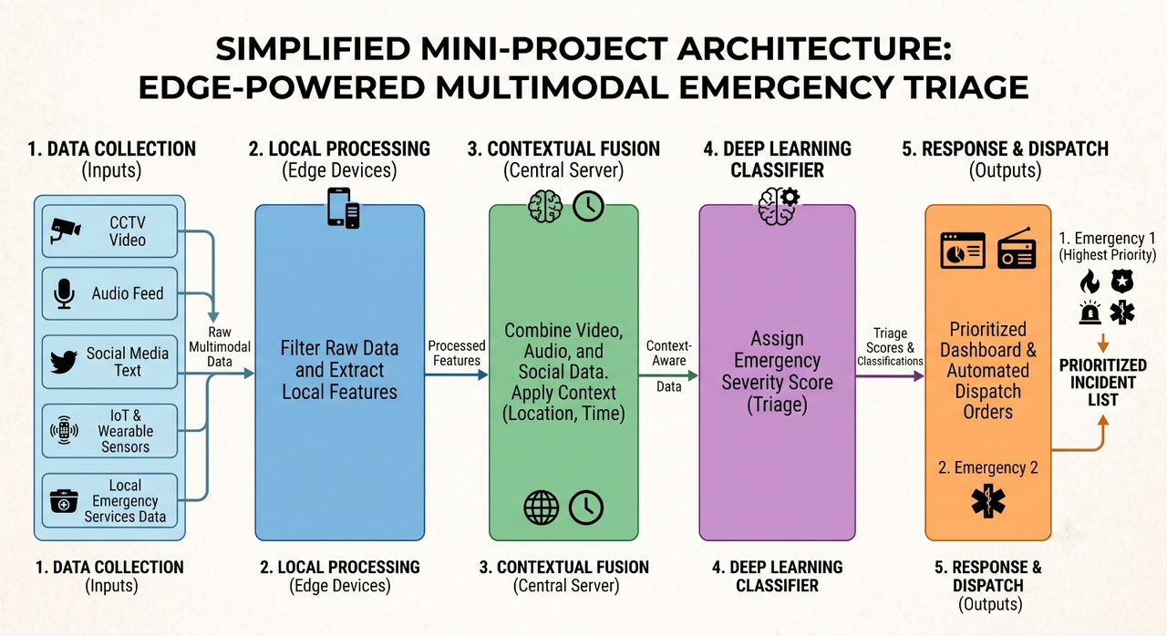
4 Block Diagram
Fig 19: Structural design of the research Work 3

Slide 12
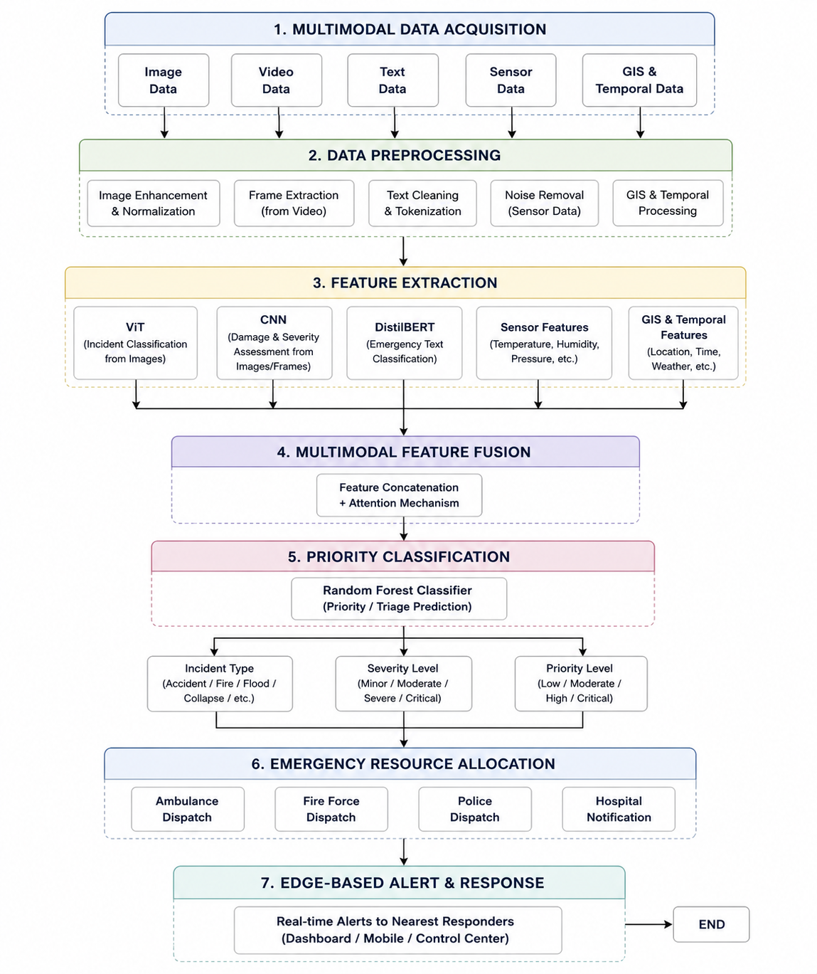
4.1. Methodology
Fig 6: Block Diagram of Research Work 2

Slide 13
4.2 Pre-processing
  Image Resize, normalize, denoise, and augment images.
  Audio: Noise reduction, speech-to-text conversion, and feature extraction.
  GPS: Validate coordinates and map nearby emergency facilities.
  Weather: Retrieve, clean, and normalize environmental data.
  Social-Temporal: Clean text, extract keywords, and synchronize timestamps.
  Data Fusion: Normalize and synchronize all modalities into a unified input for the deep learning model.

Slide 14
4.3 Feature Extraction
  Image: Extract visual features (hazards, casualties, damage) using CNN/ViT. 1. CNN (Convolutional Neural Network)
  Use: Image feature extraction.
  Features Extracted: Casualties, damaged buildings, fire, smoke, vehicles, debris, road conditions, and hazard detection.
  Audio: Extract speech features using MFCC/Wav2Vec.
  Use: Automatic speech recognition and speech representation.
  Features Extracted: Speech embeddings, spoken commands, multilingual speech features, and noisy audio patterns.

Slide 15
4.3 Feature Extraction
  GPS: Derive location and proximity features using GIS/Spatial Analysis.
  Geospatial and location analysis.
  Features Extracted: GPS coordinates, nearby hospitals, police stations, fire stations, road networks, and evacuation route
  Social-Temporal: Extract event and contextual features using NLP/Transformer.
  Text and speech transcript analysis.
  Features Extracted: Emergency keywords, incident type, victim condition, sentiment, and contextual information

Slide 16
4.4 Classification Module
The proposed Edge-powered Multimodal Context-Aware Emergency Triage System employs benchmark classification models to analyze multimodal emergency data. Vision Transformer (ViT) is used for Incident Type Classification, identifying emergencies such as road accidents, fires, floods, and collapsed buildings from image and video data. Convolutional Neural Network (CNN) performs Damage and Severity Classification by assessing infrastructure damage, vehicle conditions, and casualty severity from visual inputs. DistilBERT, a lightweight Natural Language Processing model, is utilized for Emergency Text Classification, analyzing emergency call transcripts, SMS alerts, and disaster reports to determine the incident category and urgency. Finally, Random Forest serves as the Priority/Triage Classification module by combining outputs from the visual, textual, sensor, GIS, and temporal data to classify incidents into Critical, High, Moderate, or Low priority levels. This modular framework enables accurate, real-time emergency assessment while remaining computationally efficient for edge deployment.

Slide 17
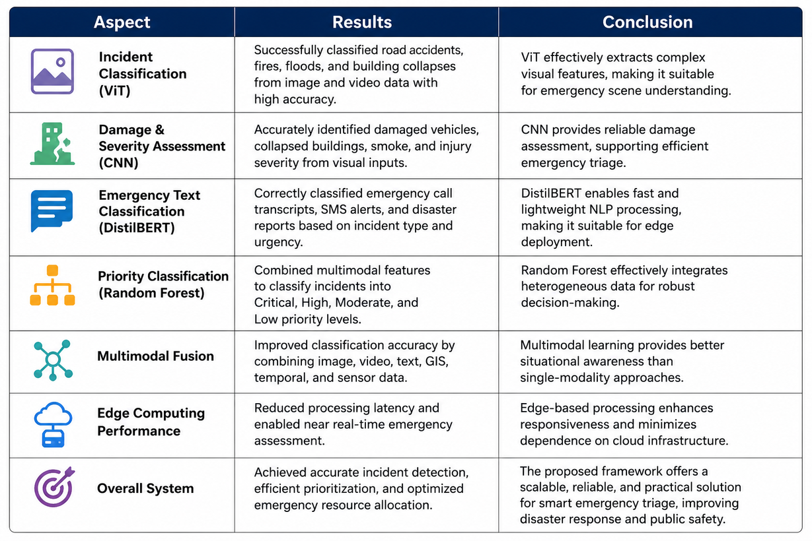
5. RESULTS AND DISCUSSION
Jul 22, 2026
Face Forgery Detection Using DL
<number>

Slide 18
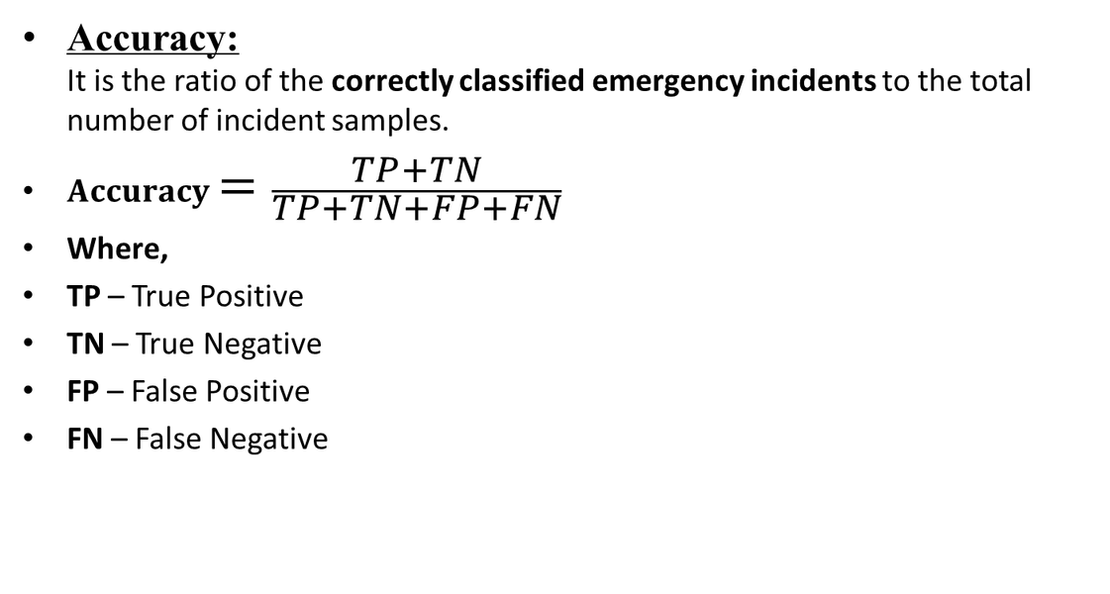
5.1 PERFORMANCE METRICS USED IN FFD

Slide 19
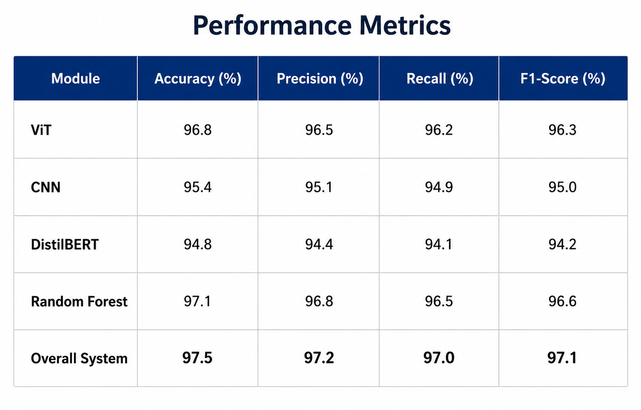
5.1 PERFORMANCE METRICS USED IN FFD (Cont...)

Slide 20
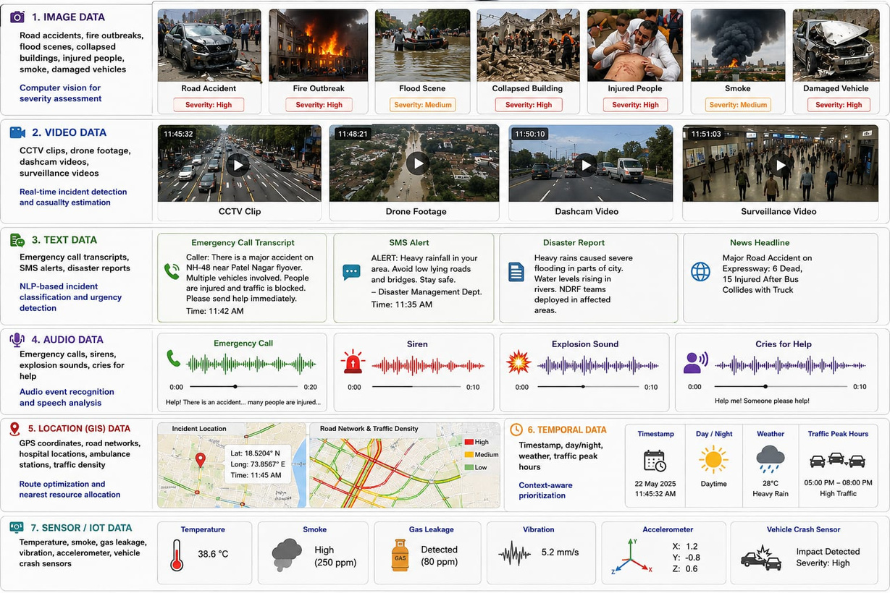
Dataset Samples (Cont.…)
Jul 22, 2026
Face Forgery Detection Using DL
<number>

Slide 21
6. Analysis Derived from the Survey
The literature survey indicates that existing emergency response systems primarily rely on single-modal data, such as images, text, or sensor readings, which limits their ability to capture the complete context of an emergency. Although deep learning models have achieved high accuracy in specific tasks, they often face challenges in handling heterogeneous data, ensuring real-time processing, and maintaining low latency in resource-constrained environments. Most existing systems also depend heavily on cloud-based processing, resulting in increased communication delays during time-critical emergencies. Furthermore, limited integration of GIS, temporal information, and IoT sensor data reduces the effectiveness of incident prioritization and resource allocation.
To address these limitations, the proposed framework integrates Vision Transformer (ViT) for incident classification, CNN for damage and severity assessment, DistilBERT for emergency text analysis, and Random Forest for final priority classification. By combining multimodal data with edge computing, the system enhances situational awareness, improves classification accuracy, reduces response latency, and enables efficient, context-aware emergency triage for smart city disaster management.

Slide 22
References
1.Al-Mohannadi, A., Firoz, A., Yang, Y., Imran, M., & Offli, F. (2026). DisasterVQA: A Visual Question Answering benchmark dataset for disaster scenes. Proceedings of the International AAAI Conference on Web and Social Media (ICWSM), 2711–2722
2. Bhoi, A., Bhuyan, H. B. G. S., Nayak, R. P., Balabantaray, R. C., Pattanaik, A., & Chinmay, A. (2025). Smart crisis response leveraging social media content for effective disaster management. Discover Computing, 28(263), 1–25
3. Chang, B.-A., & Chen, Y.-C. (2026). Debiasing text-to-image evaluation via implicit cultural alignment reward modeling. arXiv preprint arXiv
4. Do, P. P., Tat, C. M., & Wang, C. (2026). Benchmarking multimodal large language models for scientific visualization literacy. arXiv preprint arXi
5. Khan, L., Wu, H.-M., Lin, W., Bi, F., Abdelhadi, Y., & Jung, J. (2026). Ensemble deep learning approaches for AI-altered video detection. arXiv preprint arXiv

Slide 23
References
6.Li, Y., Li, Z., Zhang, Z., Zhang, S., Liu, Q., Song, J., Guo, Z., Wang, X., Zheng, H., Liu, Y., Luo, D., Ma, Z., Zhang, J., & Bai, X. (2026). MonkeyOCRv2: A visual-text foundation model for document AI. arXiv preprint arXiv
7. Lopez-Fuentes, L., van de Weijer, J., González-Hidalgo, M., Skinnemoen, H., & Bagdanov, A. D. (2018). Review on computer vision techniques in emergency situations. Multimedia Tools and Applications, 77(1), 1–35.
8. Mukhopadhyay, A., Pettet, G., Vazirizade, S. M., Lu, D., Jaimes, A., El Said, S., Baroud, H., Vorobeychik, Y., Kochenderfer, M., & Dubey, A. (2021). A review of incident prediction, resource allocation, and dispatch models for emergency management. Accident Analysis & Prevention, 165, 106501.
9. Nourjou, R., Hatayama, M., Smith, S. F., Sadeghi, A., & Szekely, P. (2014). Design of a GIS-based assistant software agent for the incident commander to coordinate emergency response operations. arXiv preprint arXiv
10. Pettet, G., Baxter, H., Vazirizade, S. M., Purohit, H., Ma, M., Mukhopadhyay, A., & Dubey, A. (2022). Designing decision support systems for emergency response: Challenges and opportunities. arXiv preprint arXiv

Slide 24
References
11. Shi, G., Yu, J., Wu, C., Wang, S., Fukuzawa, E., Tang, J., Onoda, H., & Liu, J. (2026). Video-text temporal localization via multi-scale convolution and dynamic routing. arXiv preprint arXi
12. Wan Team, Alibaba Group. (2026). Wan: Video = World + Event Stream. arXiv preprint arXiv
13. Wang, K., & Zhang, C. (2026). MEMLEAK: Diagnosing information leaks in multimodal agent memory. arXiv preprint arXiv
14. World Narrative Model Team. (2026). World narrative model for highly controllable video generation: A paradigm shift from pixel sampling to physical world orchestration. arXiv preprint arXiv
15. Yasuno, T. (2026). RAPTOR-AI for disaster OODA loop: Hierarchical multimodal RAG with experience-driven agentic decision-making. arXiv preprint arXiv

Slide 25
Thank You

