Slide 1
Introduction to EFEL and integrating it into LandEvolve
Adding faults, earthquakes and earthquake-triggered landslides to a landscape evolution tool
Notes:
Introduces LandEvolve, explains what it lacked, introduces EFEL and its components, then shows a sample run on a Kaikoura DEM.

Slide 2
BACKGROUND
LandEvolve
A desktop app for simulating erosion and sediment transport as a landscape evolves over time, built on Landlab, an open-source Python toolkit for landscape evolution models.
STEP 1
STEP 2
STEP 3
STEP 4
Select Input & Duration
Select Processes
Simulate
View Results
A DEM: a grid of ground heights, e.g. from LiDAR
Select total simulation duration and timestep
Erosion, sediment transport, Diffusion etc
The model steps through duration using the timestep, e.g. every 10 years
Maps, 3D views and animations
Code and instructions: github.com/vinuri-s/landEvolve
2
Notes:
LandEvolve is a desktop app (Python and PyQt6) for Mac and Windows, built on Landlab.

Slide 3
BACKGROUND
What LandEvolve did not have: faults
WHAT IT COULD DO
WHAT IT COULD NOT
Erosion and sediment transport
Hillslope soil creep
Rainfall, runoff and vegetation
Simple uplift at a set rate
Model a fault that moves the ground up and sideways
Produce earthquakes on that fault
Trigger landslides from earthquake shaking
In tectonically active regions these are a large part of how the landscape changes.
3
Notes:
Before this work LandEvolve only had a simple uplift option, which raises the land at a set rate.

Slide 4
EFEL
EFEL: Elastic Fault, Earthquake and Landslide
A set of components for Landlab that adds tectonics with real mechanics.
It models a fault that slowly slips, the earthquakes on it, and the landslides the shaking triggers.
Written by A. M. Forte (Louisiana State University), open source under the MIT licence.
Uses Okada's elastic-dislocation equations to move the ground.
GET IT
github.com/amforte/elastic_fault_earthquake_and_landslide
Cite: Forte, A. M., EFEL 1.0, Geoscientific Model Development (in review).
4
Notes:
EFEL 1.0 by Adam M. Forte (Louisiana State University); described in a paper in review at Geoscientific Model Development.

Slide 5
EFEL
The components in EFEL
COMPONENT 1
COMPONENT 2
COMPONENT 3
Fault
Earthquakes
Landslides
DippingFault
VerticalFault
EarthquakeSequence
CoseismicLandslider
A crack that slowly slips and moves the ground.
A catalogue of sudden slip events on the fault.
Landslides triggered by each earthquake's shaking.
They rely on Landlab's own components for the rest: AdvectionSolverTVD shifts terrain sideways and BedrockLandslider routes landslide debris downhill.
5
Notes:
Each component feeds the next: the fault defines where earthquakes can happen, and earthquakes trigger the landslides.

Slide 6
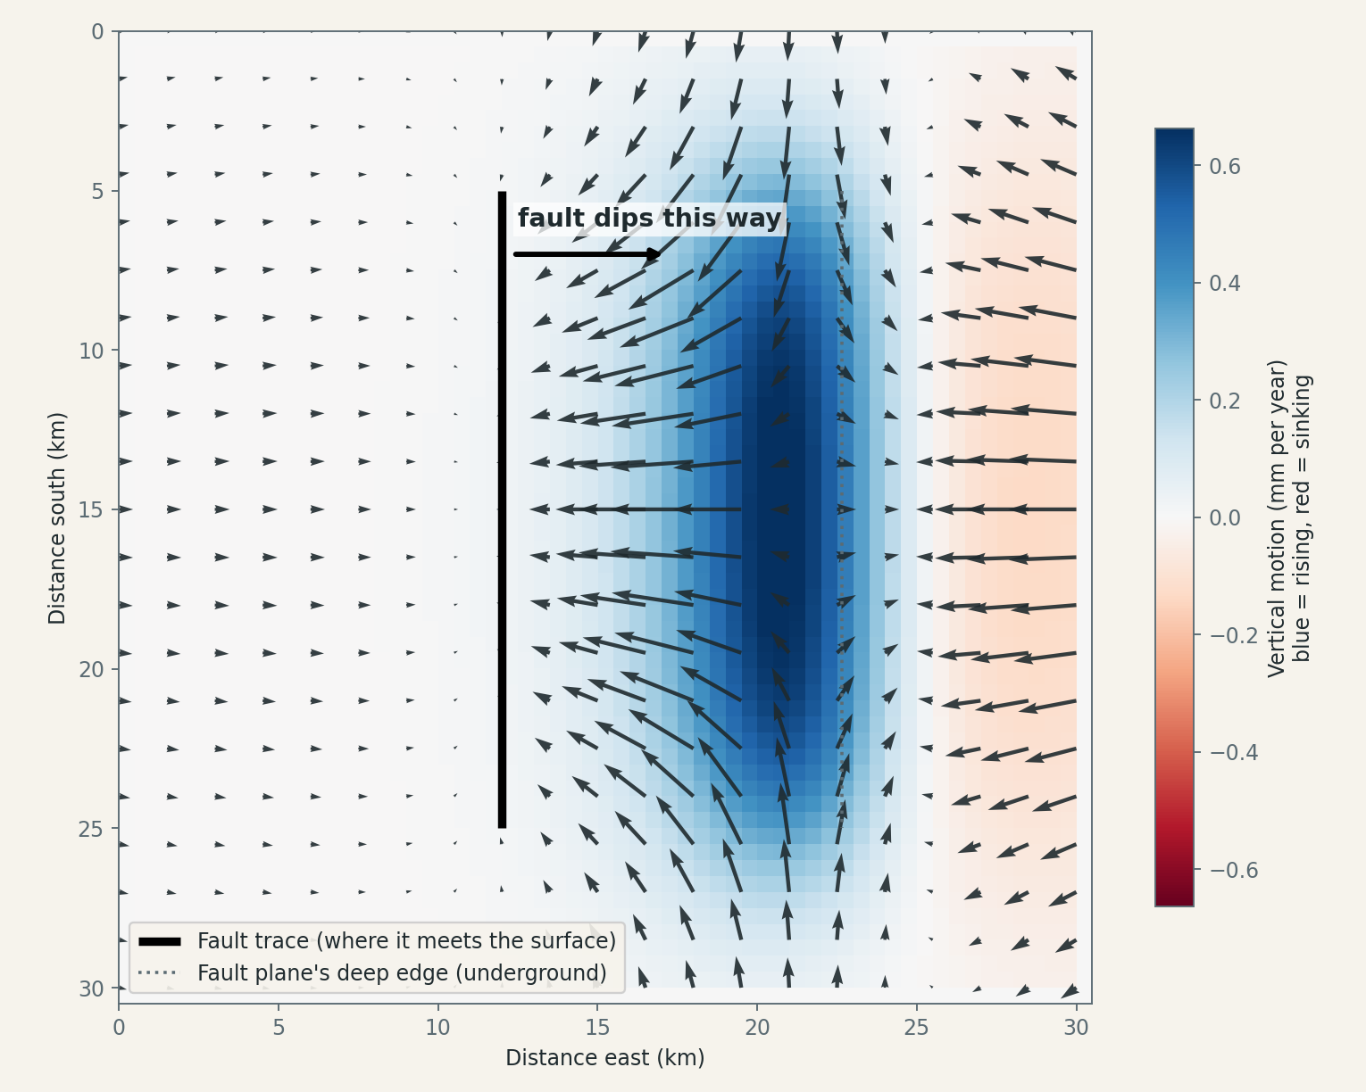
EFEL COMPONENTS · 1 OF 3
Fault: DippingFault and VerticalFault
A crack in the ground that slips slowly between earthquakes.
The ground acts like an elastic sheet: the fault drags it up and sideways.
DippingFault: thrust or normal faults, tilted under the land.
VerticalFault: strike-slip faults, with optional bends.
Output for a 20 km thrust fault: blue is uplift, arrows are sideways motion
INPUTS IT NEEDS
grid the Landlab grid (the terrain)
tip_location x, y and depth of the fault's top edge
strike compass direction the fault runs
dip tilt of the fault (DippingFault only)
length, width size of the fault plane, in metres
ds_rate, ss_rate slip rates: up/down-dip and sideways
u_rate extra uniform uplift rate
seismogenic_zone top and bottom depth of the quake zone
topographic_correction account for the terrain's height
fields_to_advect which terrain layers to shift sideways
6
Notes:
DippingFault handles thrust and normal faults; VerticalFault handles strike-slip faults and can have bends. Both use okada4py, a compiled solver for Okada's 1992 equations.

Slide 7
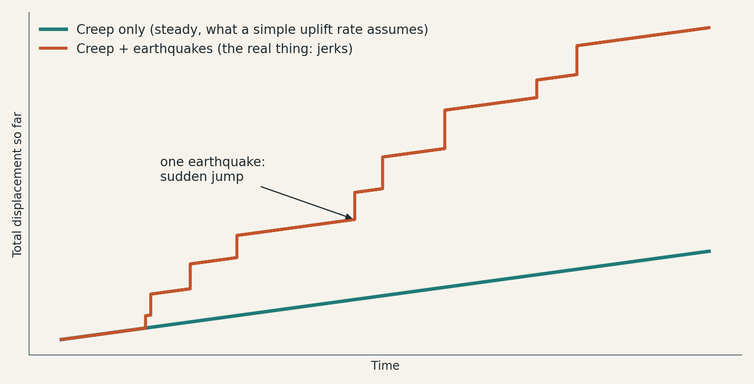
EFEL COMPONENTS · 2 OF 3
Earthquake sequence: EarthquakeSequence
Makes the catalogue of earthquakes in advance for the whole run.
Many small, few large, sized by the fault's length and width.
Timing can be random or clustered, with optional aftershocks.
Each quake is a patch of sudden slip applied in the time step it falls in.
Illustration: steady creep (teal) versus creep plus earthquakes (orange)
INPUTS IT NEEDS
grid, fault the terrain and the fault above
T how many years to generate
dt time step, in whole years
Mw_min, Mw_max smallest and largest earthquake size
Mw_event the size, for fixed-size catalogues
freq_moment_dist size distribution (e.g. truncated Pareto)
annual_rate_dist, rate_variance_mag random or clustered timing
simulate_aftershocks add aftershock sequences
moment_fraction share of the slip released in earthquakes
seed random seed, to repeat a catalogue
7
Notes:
Sizes come from the fault's dimensions using Leonard (2014) scaling. Total energy matches the fault's slip budget. The catalogue is made with one of three methods: variable, fixed or largest-possible magnitude.

Slide 8
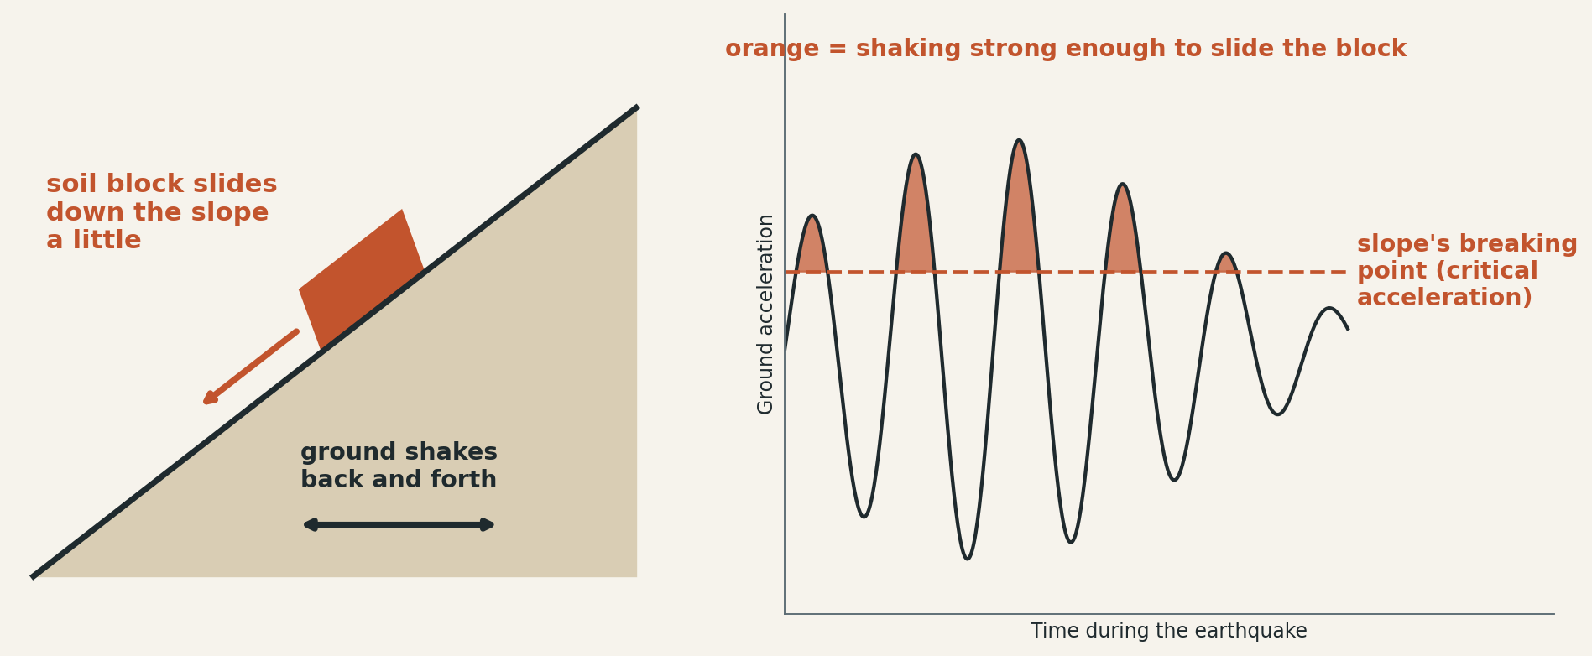
EFEL COMPONENTS · 3 OF 3
Coseismic landslider: CoseismicLandslider
Turns each earthquake's shaking into landslides.
Works out how hard every cell shakes (quake size, distance, soil).
Compares that with how well the slope holds (steepness, cohesion, friction, wetness).
Cells that would slide more than a threshold fail, and the material runs downhill.
Only shaking above the slope's breaking point moves the block
INPUTS IT NEEDS
grid, eq the terrain and the earthquake sequence
gmpe_model ground-shaking equation (e.g. Chiou and Youngs)
vs30_method, vs30_setting soil stiffness method, tectonic setting
cohesion how strongly the ground holds together
angle_int_frict internal friction angle
rho_r rock density
w ground wetness, 0 to 1
hydraulic_conductivity how fast water moves through ground
min_newmark_disp slide distance (cm) that counts as failure
porosity, seed debris porosity; seed for random shaking
8
Notes:
Follows Newmark's sliding-block method, as used for coseismic landslides by Jibson (2007). Debris movement uses Landlab's BedrockLandslider. EFEL takes cohesion in pascals; LandEvolve shows kPa. It also needs slope and flow-direction fields on the grid, which LandEvolve provides from its flow routing.

Slide 9
INTEGRATION
How EFEL appears in LandEvolve
Fault Tectonics
Earthquakes
Coseismic Landslides
Wraps DippingFault and VerticalFault. Set position, strike, dip and slip in plain map terms.
Wraps EarthquakeSequence. Choose the size mix, the smallest quake and the timing.
Wraps CoseismicLandslider. Set the shaking model and slope strength.
Needs: nothing else
Needs: Fault Tectonics
Needs: Earthquakes and Water Flow Routing
Each is a process you add in LandEvolve, alongside erosion and sediment transport, with its own settings panel.
Erosion maps stay clean: a copy of the terrain moved only by tectonics is subtracted, so fault movement is not mistaken for erosion.
9
Notes:
EFEL's code is included in the app (app/engine/efel); LandEvolve wraps its classes in app/engine/tectonics.py. It needs the compiled okada4py package.

Slide 10
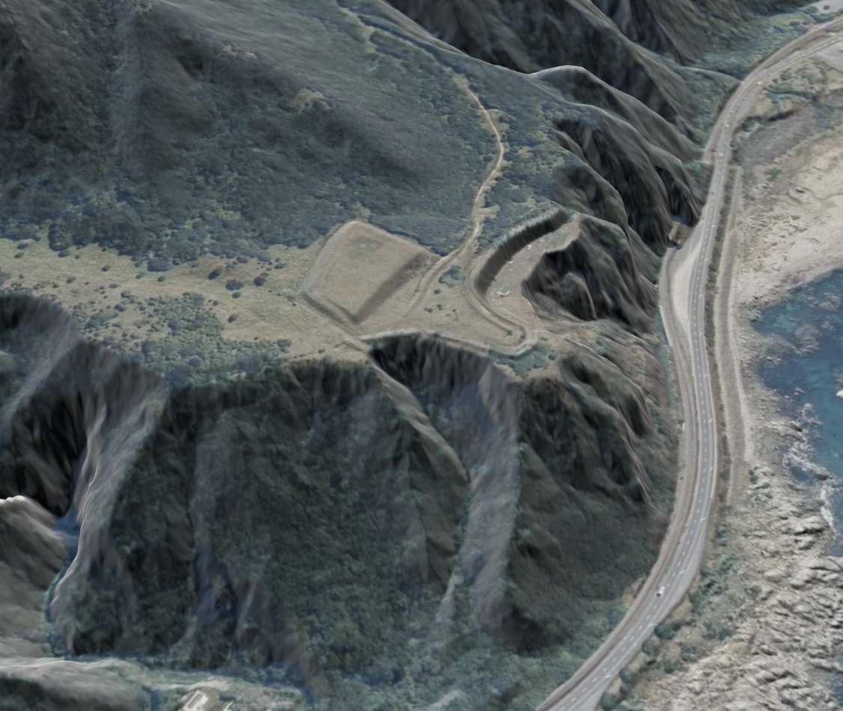
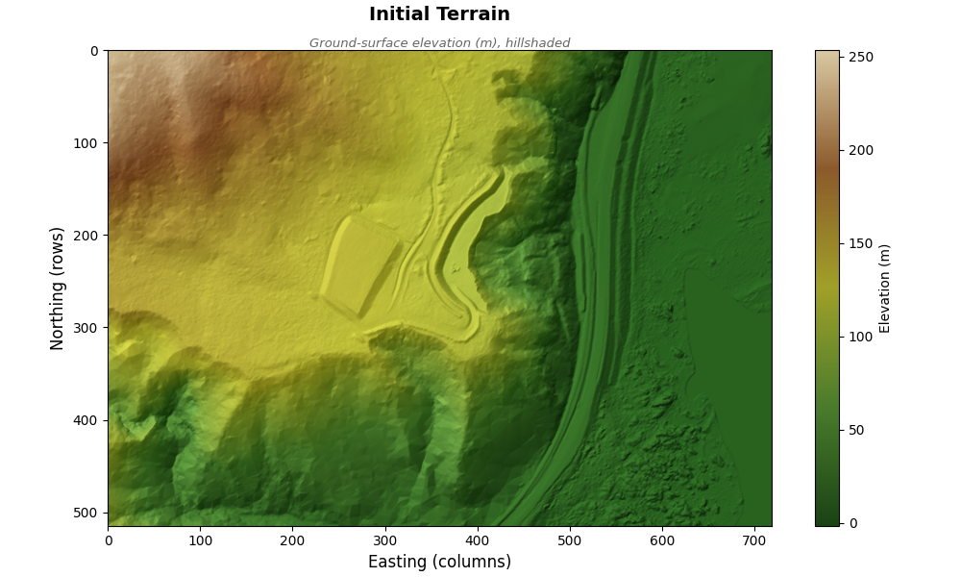
SAMPLE RUN
The study site: Kaikoura, New Zealand
DEM: elevation with hillshade
Location: about 42.22° S, 173.85° E, Kaikoura coast
Size: 719 m by 515 m, at 1 m cells
Height: from about -1.5 m to 254 m
Source: LiDAR DEM, in NZTM coordinates
10
Notes:
Extent in NZTM (EPSG:2193): x 1,670,164 to 1,670,883, y 5,324,895 to 5,325,410. About 173.850 to 173.859 E and 42.225 to 42.220 S. The satellite image can be captured from the Location Preview in LandEvolve.

Slide 11
SAMPLE RUN
A test on a real DEM from Kaikoura, New Zealand
Simulated tectonics with flow routing, erosion and sediment transport and hillslope diffusion.
Part | Setting
Terrain and time | Kaikoura LiDAR DEM, 515 by 719 cells at 1 m. 1000 years in 10-year steps
Fault tectonics | 8 km long, 30° dip, thrust, 5 mm per year of slip, top of the fault 100 m deep
Earthquakes | Realistic size mix, magnitude 5.0 and up, earthquake zone 1 to 5 km deep
Coseismic landslides | Cohesion 10 kPa, friction angle 45°, ground wetness 0.3, fail above 5 cm of slide
Flow routing | D8: water flows to the steepest of 8 neighbours
Erosion, sediment transport | SPACE large-scale eroder, sediment erodibility 1e-4, bedrock erodibility 1e-5
Hillslope diffusion | Soil creep, linear diffusivity 0.01, depth-dependent
Note | These are dummy values for testing only
Introduction to EFEL and integration into LandEvolve
11
Notes:
Simulation 59. Tectonics (fault, earthquakes, landslides) was simulated together with flow routing, erosion and sediment transport, and hillslope diffusion. The parameter values are placeholders chosen only to exercise the components, not calibrated to Kaikoura.

Slide 12
SAMPLE RUN · RESULTS
Tectonics animation
TECTONICS_TIMELINE.HTML
Steps through the 1000 years.
Blue/red colour: land raised or lowered by the fault.
Arrows: the land also moves sideways.
Stars, circles: earthquakes.
Brown patches: landslide scars.
Strip below: every earthquake by time and size.
Tectonics animation
(animation to be added)
Introduction to EFEL and integration into LandEvolve
12
Notes:
Placeholder for tectonics_timeline.html from simulation 59.

Slide 13
SAMPLE RUN · RESULTS
Fault Section animation
FAULT_SECTION.HTML
A slice across the fault, through time.
Blue line: the fault's vertical push.
Brown line: the actual surface change, including erosion and landslides.
Lower panel: the fault plane underground, footwall left, hanging wall right.
Fault Section animation
(animation to be added)
Introduction to EFEL and integration into LandEvolve
13
Notes:
Placeholder for fault_section.html from simulation 59.

Slide 14
SAMPLE RUN · RESULTS
Terrain Evolution animation
TERRAIN_TIMELINE.HTML
The terrain surface itself, year by year.
Colour is elevation, draped over a hillshade.
The black line is the fault trace.
Watch the steep slopes fail and the land shift.
Terrain Evolution animation
(animation to be added)
Introduction to EFEL and integration into LandEvolve
14
Notes:
Placeholder for terrain_timeline.html from simulation 59.

Slide 15
SAMPLE RUN · RESULTS
Erosion Timeline animation
SEDIMENT_TIMELINE.HTML
Cumulative erosion and deposition so far.
Red: material lost. Blue: material gained.
Tectonic change is removed, so this shows erosion and landslides only.
Erosion Timeline animation
(animation to be added)
Introduction to EFEL and integration into LandEvolve
15
Notes:
Placeholder for sediment_timeline.html from simulation 59.

Slide 16
LINKS
Links and references
LandEvolve github.com/vinuri-s/landEvolve
EFEL github.com/amforte/elastic_fault_earthquake_and_landslide
Okada (1992) Internal deformation due to shear and tensile faults in a half-space. BSSA 82(2).
Leonard (2014) Earthquake fault scaling relations. BSSA 104(6).
Jibson (2007) Regression models for coseismic landslide displacement. Engineering Geology 91.
Landlab Hobley et al. (2017); Barnhart et al. (2020); BedrockLandslider: Campforts et al. (2020).
Introduction to EFEL and integration into LandEvolve
16

