Slide 1
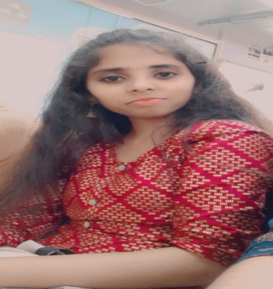



VINUTHA M S
Analyst/Software Engineer
Bachelor of Engineering and Technology, Computer Science and Engineering : 2017 - 2021
Bangalore
Skills
vinutha.m-s@capgemini.com
TECHNICAL | OutSystems, PowerApps,C, C++, Core Java Spring Boot, Advance Java.
DATABASE | SQL database – Oracle, MySQL No SQL database – MongoDB
UI Tech | HTML 5 & CSS 3,JavaScript and Bootstrap
Tools | Git
Add On skills | Peer learning, Github,Maven, Postman.
Additional Skills: | Project Management, Team Building, Project Management, Team Leader, Strategic/Tactical Planning, Business Analysis and Development, Excellent Communication and Interpretation skills
+91 9380564374
A4
Trained On OUTSYSTEMS and POWERAPPS
Hands on Experience in creating Traditional and Reactive application on outsystems.
Proficient in creating OutSystems Applications.
Hands on Experience in creating Traditional and Reactive application on PowerApps.
Proficient in creating PowerApps Applications.
Hands on experience in developing web pages using HTML5, CSS3, Object Oriented Java script. Good understanding of Document Object Model (DOM) and DOM Functions.
Hands on experience in creating microservices with Spring boot, Post Man, Swagger API
Brain Train
The Brain Train Portal Designed for Fresher’s to test and improve on technical knowledge .This portal start with user registering with the application and then appear for the quiz available on the application and thereby viewing scores in the respective levels of tests and getting certificate.
Bus Reservation System
(Based on Java Spring boot and Angular) (Front-end-Angular, Back-end Spring boot):- A bus reservation system is a mobile or web software solution designed to provide customers with a personalized easy-to-utilize user experience for booking and purchasing tickets online. It stores customers' personal data records, scheduled routes, frequent trips, drop points
Check out my work on GitHub & Video Profile

