Slide 1
SPORTS BOARDCAST
SCHEDULING TOOLS

Slide 2
About Project
SPORTS BOARDCAST SCHEDULING TOOLS CAN HELP WITH PLANNING AND EXECUTING
SPORTS PRODUCTIONS,INCLUDING SCHEDULING COMMUNICATION BOARDCASTING

Slide 3
KEY FEATURES
1. REAL TIME UPDATES:- PROVIDES REAL TIME UPDATES ON ANY CHANGES IN A SCHEDULE
OR UNEXPECTED EVENTS
2. INTERACTIVE AND PERSONLIZED ADS:- CAN CREATE AN EXPERIENCE THAT CAPTURES VIEWERS
ATTENTION AND MAKE THEM ACTIVE PARTICIPANTS IN THE EVENT
3.MULTIPLE CHANNEL MANAGEMENT:- ENABLES SCHEDULING BOARDCAST ACROSS DIFFERENT CHANNELS AND PLATFORMS
4. SOCIAL MEDIA INTEGIRATION:- CAN BE USED TO SHARE LIVE EVENTS AND GAMES WITH AUDIENCE AND BUILD FANBASE

Slide 4
5.LIVE STREAMING:- HAS MADE IT POSSIBLE FOR SPORTS ORGINAZATION AND MEDIA OUTLETS TO SHARE LIVE EVENTS WITH AUDIENCE AND ON MOBILE SCREEN
6. AUTOMATED REMINDERS:- SENDS REMINDERS FOR UPCOMING MATCHES OR EVENTS
7. ACCESSIBILTY AND CONVIENCE:- STREAMING SERVICES HAVE MADE IT EASIER FOR FANS TO WATCH SPORTS WITH OUT RELYING ON TRADITIONAL OR SATELLITE TV

Slide 5
library included
tkinter :- That allows developers to create a graphical user interface(GUI’S) for python applications
scrolledtext:- A text box which is used edit large amount of text in a scrollable area

Slide 6
PROBLEM STATEMENT
BOARDCAST :- which includes properties like event_id , event_name, and timings
# Define the Broadcast class
class Broadcast:
def __init__(self, event_id, event_name, timing, channel, location, duration):
self.event_id = event_id # unique ID for the event
self.event_name = event_name # name of the event (e.g., FIFA World Cup Final)
self.timing = timing # when the event will be broadcast (date/time)
self.channel = channel # TV channel broadcasting the event
self.location = location # location of the event (e.g., stadium)
self.duration = duration # duration of the event (e.g., 2 hours)
self.rights = None # Rights information (if applicable)

Slide 7
BOARDCASTMANAGER:- which will CRUD operations , scheduling , and rights management
C:create
R: read
U:update
D:delete

Slide 8
ADD BOARDCAST:- The user can fills details about the Boardcast event such as
Event_id ,name, timing , channel etc
UPDATE BOARDCAST:- update Boardcast button is used to modify the existing data
DELETE BOARDCAST:- to remove or delete the existing data
VIEW-ALL BOARDCAST:- to display a list of all the boardcast currently stored in a system

Slide 9
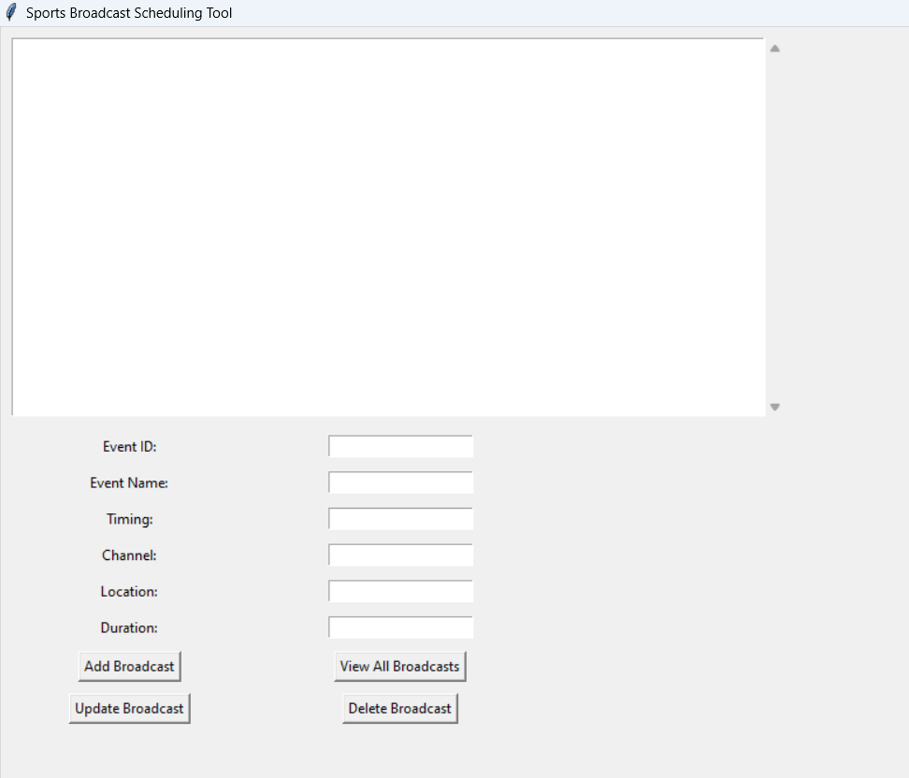
OUTPUT MENU

Slide 10
Thank you

