Slide 1
Address Distribution
IPV4 Address,32bits.
IPV6 Address,128bits.

Slide 2
2 Types in Addressing
Classful Addressing
Classless Addressing
Classful Addressing
vinutha@gmail.com:Host ID and network ID
The whole address space was divided into five classes (class A, B, C, D, and E), This scheme is referred to as classful addressing.

Slide 3
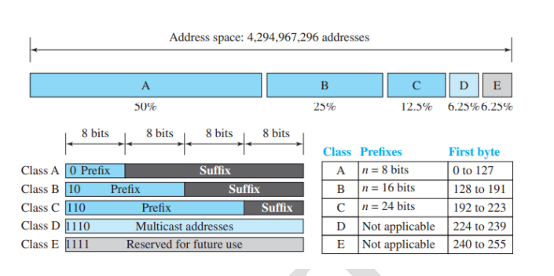
Occupation of the address space in classful addressing

Slide 4
Class A:Bigger Organization.
Class B:Medium Organization.
Class C:Smaller Organization.
Class D:Multicast.
Class E:Reserved for future use.
Class D, Class E is not divided into prefix and suffix and is used as reserve

Slide 5
Address Depletion:
The addresses were not distributed properly, the Internet was faced with the problem of the addresses being rapidly used up, resulting in no more addresses available for organizations and individuals that needed to be connected to the Internet.
Class A has 128 blocks, in one block 16,777,216.

Slide 6
To overcomes the address depletion
Supernetting:
Subnetting:
Supernetting was devised to combine several class C blocks into a larger block to be attractive to organizations that need more than the 256 addresses available in a class C block.
Subnetting was devised to divide a large block into smaller ones.
a class A or class B block is divided into several subnets. Each subnet has a larger prefix length than the original network.

Slide 7
Advantage of Classful Addressing
we can easily find the class of the address and, the prefix length for each class is fixed, we can find the prefix length immediately.

Slide 8
Classless Addressing
Subnetting and supernetting in classful addressing did not really solve the address depletion problem.

