Slide 1
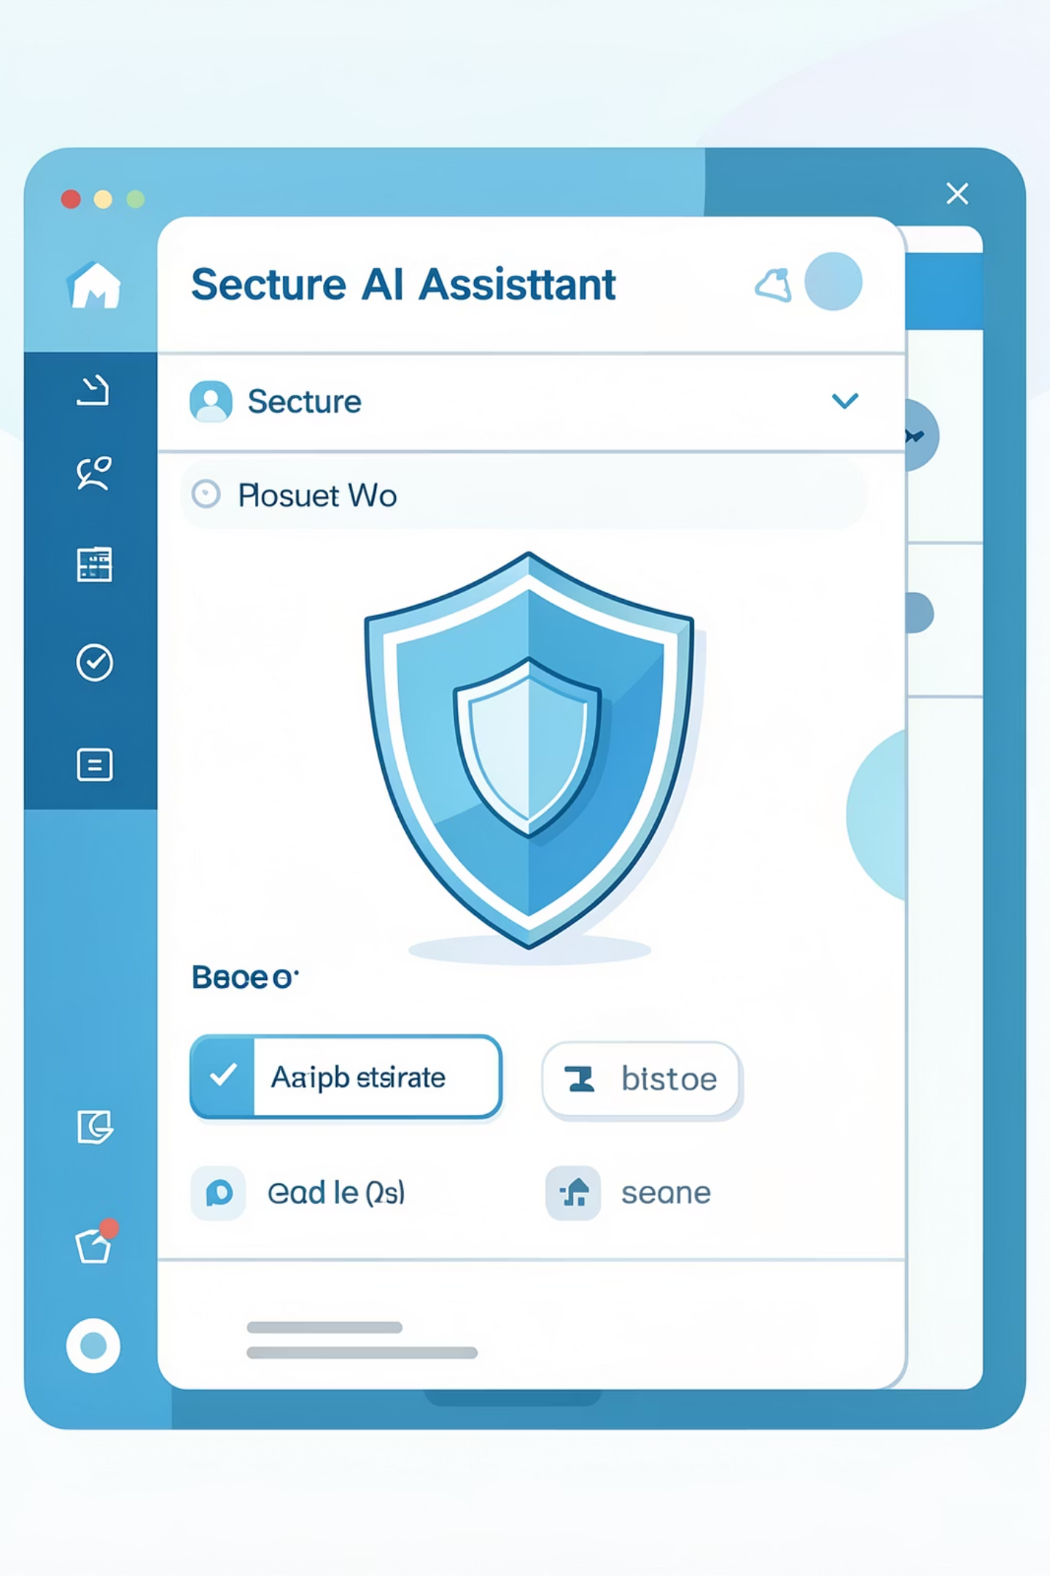
Enterprise RBAC Chatbot
A security-first RAG system combining intelligent AI with robust Role-Based Access Control for enterprise environments.

Slide 2

Security-First AI for the Enterprise
The Challenge
Our Solution
Deploying AI assistants in corporate environments while protecting sensitive data across departments.
Retrieval-Augmented Generation (RAG) architecture ensures responses are grounded in authorized documents
RBAC filtering at the document level prevents unauthorized access before AI processing
Semantic search enables context-aware understanding beyond simple keyword matching

Slide 3
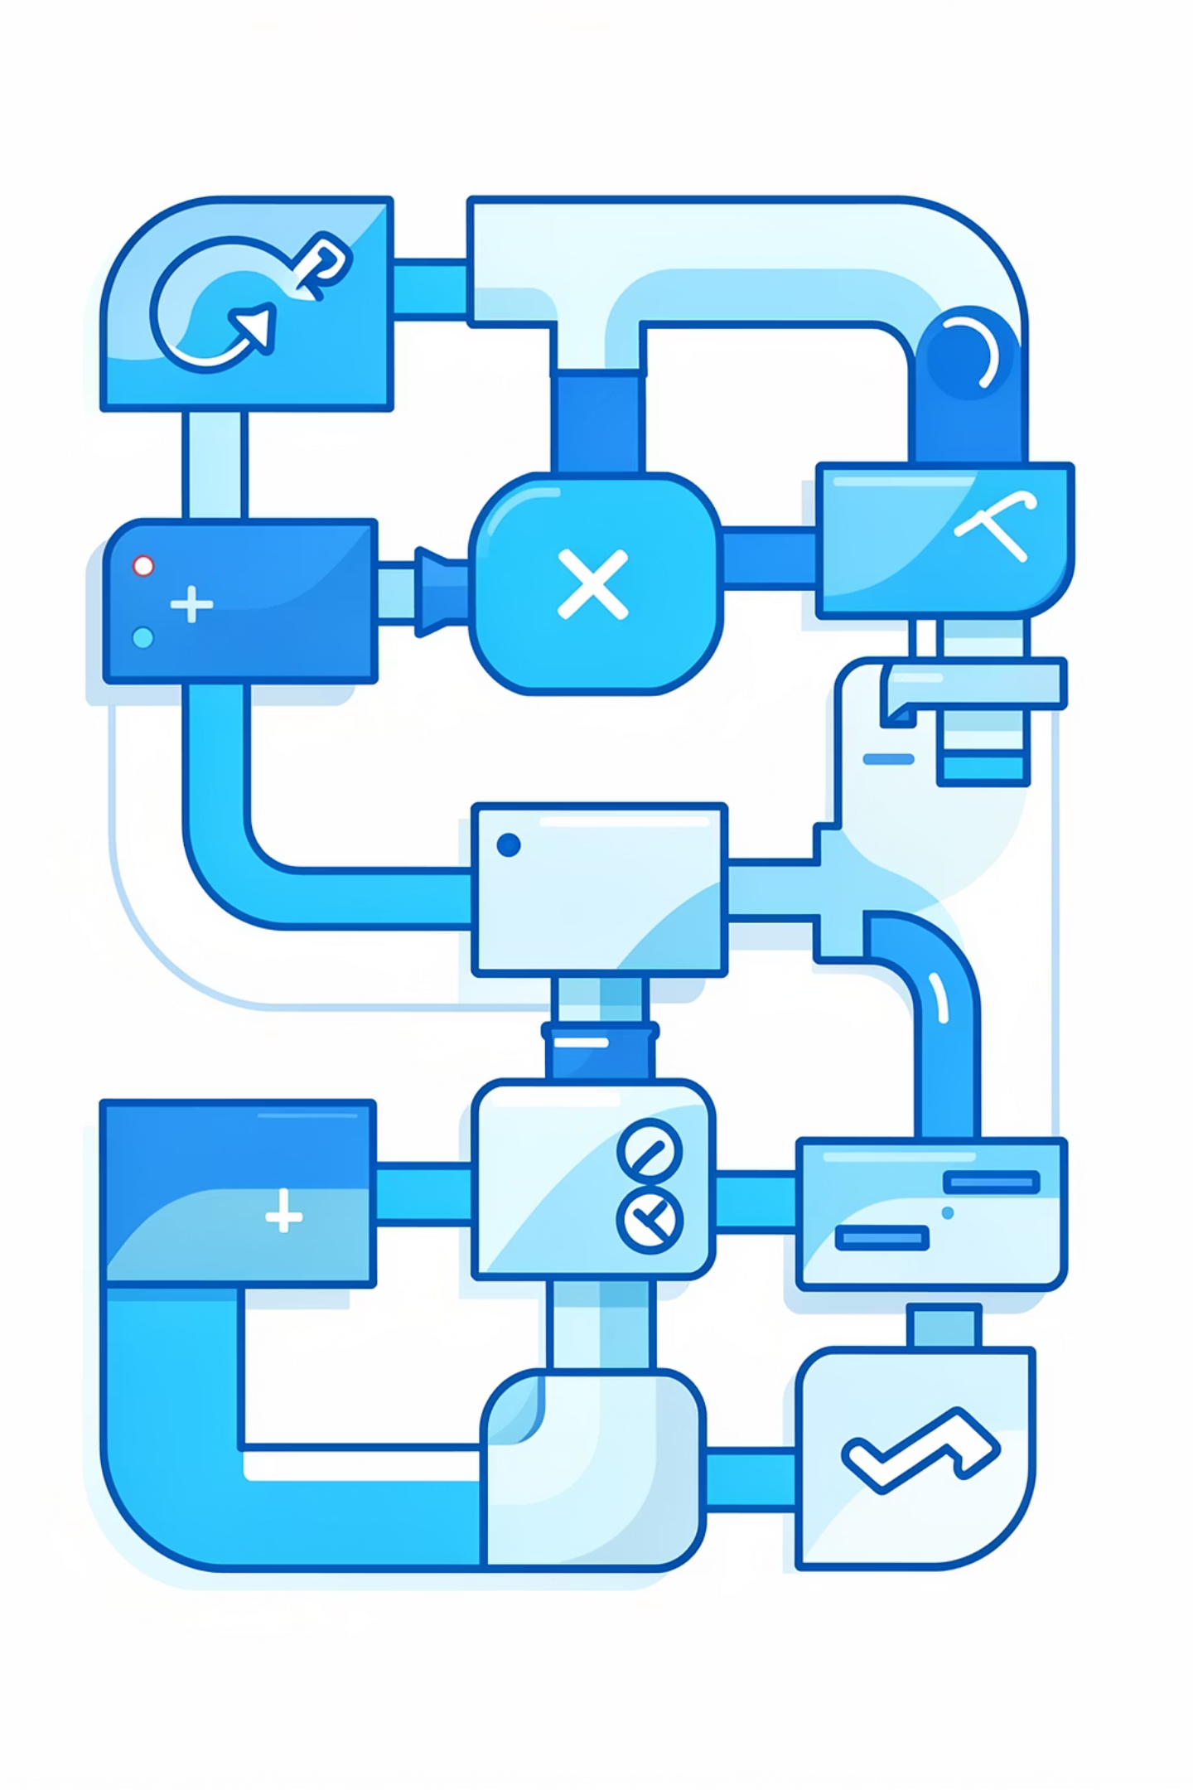
The RAG Pipeline Architecture
A multi-stage system that transforms raw documents into secure, context-aware AI responses.
01
Data Ingestion & Preprocessing
Parsing, chunking, and metadata tagging
02
Vectorization & Storage
Embeddings and semantic indexing
03
Secure Search & RBAC
Query processing with role-based filtering
04
Response Generation
Context-aware AI using authorized data

Slide 4
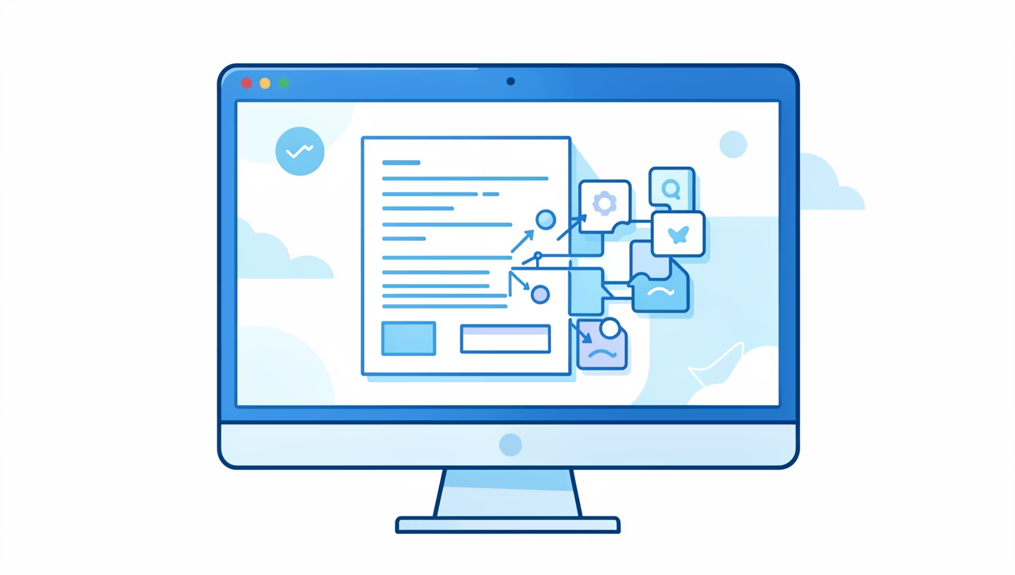
Data Ingestion & Preprocessing
Week 1-2 Flow
Parsing: Documents (Markdown, CSV, PDF) converted to raw text.
Chunking: Recursive splitters create 500-1000 character segments, optimizing for LLM token limits.
Metadata Tagging: Each chunk tagged with source department (Finance, HR, Engineering) — the foundation of RBAC.

Slide 5
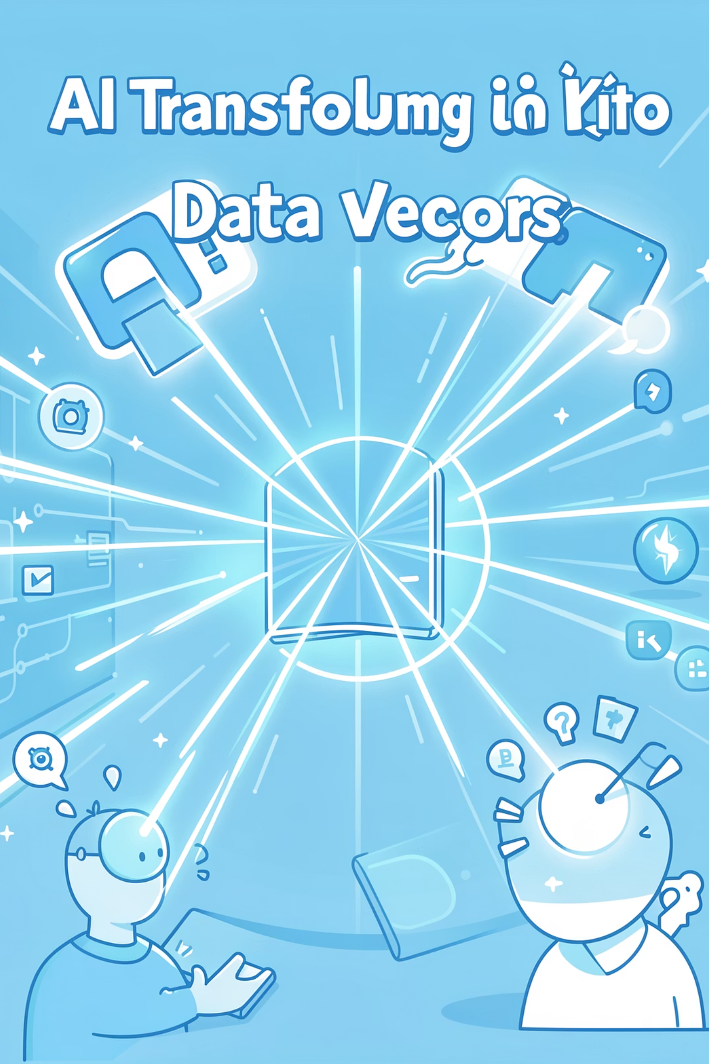
Vectorization & Semantic Search
Embeddings Generation
Vector Database
ChromaDB stores embeddings for semantic search rather than keyword matching.
all-MiniLM-L6-v2 Sentence-Transformer converts text chunks into high-dimensional numerical vectors.
Week 3 Deployment
High-performance vector storage enables fast, context-aware retrieval.

Slide 6





Secure Search & RBAC Filtering
Week 4: The Security Layer
Query Vector
Semantic Retrieval
User questions converted to vectors
Top similar chunks found in ChromaDB
RBAC Filter
Authorized Context
JWT role validates document access
Only approved chunks sent to LLM
Example: hr_user accesses HR and General docs — Finance documents automatically filtered and removed from context.

Slide 7

Response Generation: RAG Engine
Week 5-6 Implementation
Context Injection: Only authorized chunks passed to LLM
Prompt Control: "Use ONLY provided context. If answer isn't there, say you don't know."
Data Flow: Documents filtered → Authorized context injected → AI generates response

Slide 8
LLM Configuration Matrix
Flexible deployment supporting cloud and local options.
Provider
Model
Connection Type
Hugging Face (Current)
microsoft/Phi-3-mini-4k-instruct
Cloud API (Requires Key)
Ollama (Fallback)
llama3.2:3b
100% Local (Privacy Focused)
Current Environment (.env): Base URL at router.huggingface.co with managed API keys for secure authentication.

Slide 9


Enterprise Security Framework
Authentication
FastAPI with JWT tokens ensures verified user identities
Authorization
Granular document-level access control by role and department
Privacy
No data leakage between departments enforced at query time
Auditability
Query logs track retrieved documents and similarity scores

Slide 10



The Future of Secure Enterprise AI
Bridging AI & Security
Advanced capabilities meet strict enterprise requirements, protecting proprietary data.
Empowering Employees
Instant access to authorized information without security compromises.
Ready for Enterprise Deployment
Deploy confident that every response respects role-based access boundaries while delivering intelligent, context-aware assistance.

