Slide 1
Deep Learning…
…happens when computers think deep!
- Vinuth Tulasi

Slide 2
Intro to Machine Learning 2
Most of the theory/content for today is taken from Professor Yaser Abu-Mostafa’s course on “Learning from data”
The materials on this course are uploaded at https://github.com/vinutht/DeepLearning
For Deep Learning we follow http://www.deeplearningbook.org/

Slide 3
Outline
Lossy Compression
Formalizing Learning
Is Learning Feasible

Slide 4
Lossy Compression – An Intuition
Compression and Machine Learning – do they look alike?
Are parameters really just like memory, a place holder for keeping learnt data (Read as byte/word in RAM).
Parametric vs Non Parametric explained with the above intuition.

Slide 5
Essence of Learning
A pattern exists.
We cannot pin it down mathematically.
We have data.

Slide 6
Formalizing Learning
Input: x
Output: y
Target Function: f : X -> Y
Data: (x1, y1),(x2,y2), · · · ,(xN ,yN)
Hypothesis: g : X → Y

Slide 7
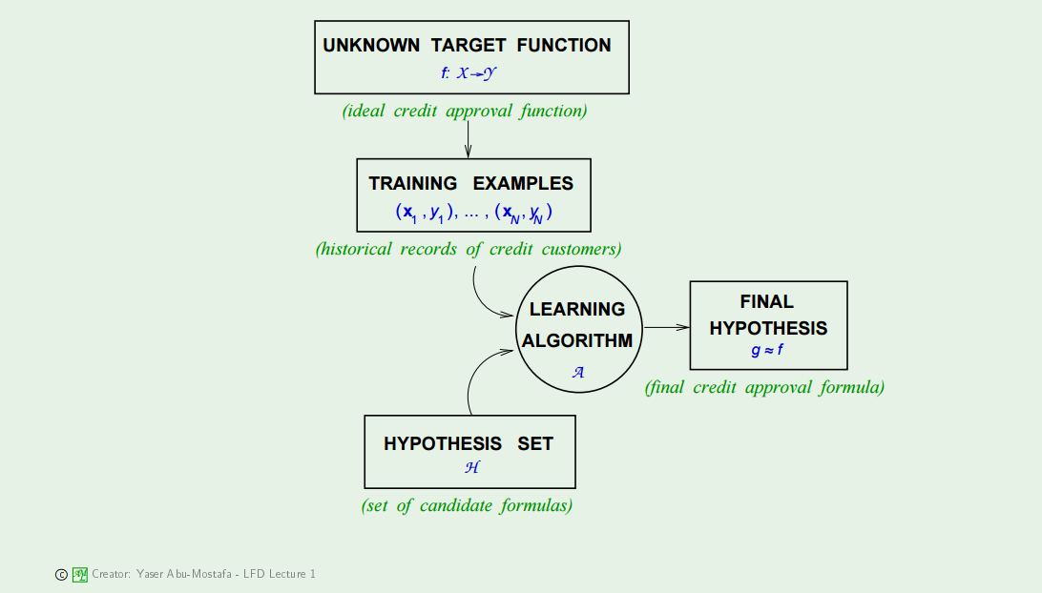

Slide 8
Hypothesis Space
Target Function, f(X) is the function which defines the input data. This is most often unknown.
Hypothesis Function, h(X) – ML algorithm will try to guess a function to approximate the target function. This function is the hypothesis function.
Hypothesis Space, H(X) – The set of all such hypotheses is known as hypothesis set or hypothesis space. For example, the linear regression algorithm has the set of all linear functions of its input as its hypothesis space.
The goal of ML algorithm is to find the final hypothesis that best approximates the unknown target function.

Slide 9
Learning Model
Learning Model = Hypothesis Set ( H = {h} ) + The learning Algorithm
{H, Learning Algo}: {Perceptron, Perceptron Learning Algorithm}, {Regression, Gradient Descent}, {Neural Network, Back Propagation}, etc.
Parameters differentiates one hypothesis from another.

Slide 10


Is learning really feasible
Sample mean (v) versus Population mean (mu)
In a big sample (large N ), s is probably close to µ (within Epsilon).
Hoeffding's Inequality –
Probably approximately correct (PAC) – (mu approx. eq v) => (v approx. eq mu)
Hoeffding’s inequality holds good for single hypothesis but the hypothesis set can hold M such hypothesis, so the new inequality will therefore be

Slide 11
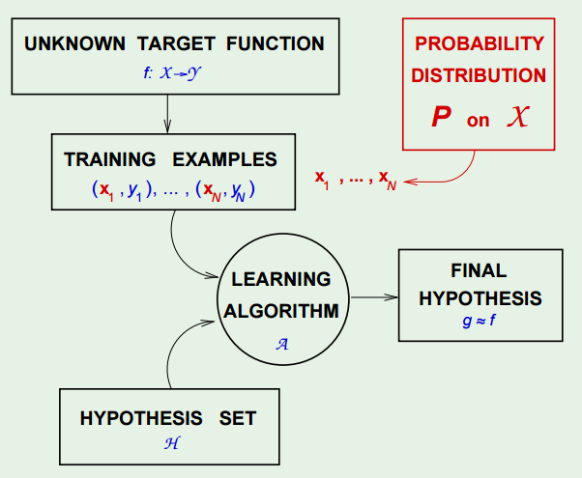

Slide 12
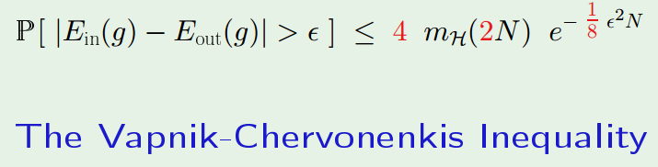
What can we replace M with?

Slide 13
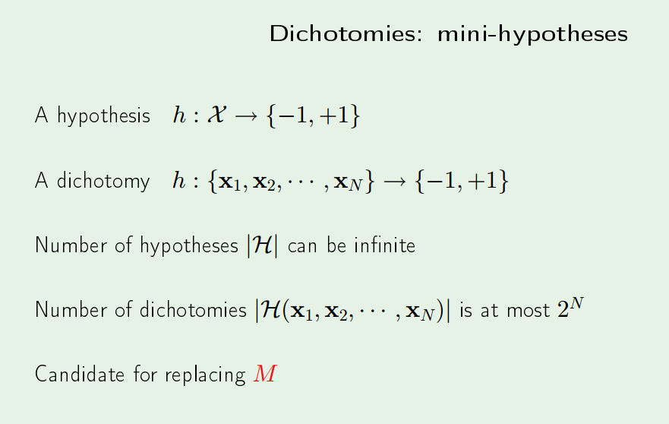
M is replaced with m – the mini hypothesis

Slide 14
Check out the slides at http://work.caltech.edu/slides/slides05.pdf

Slide 15
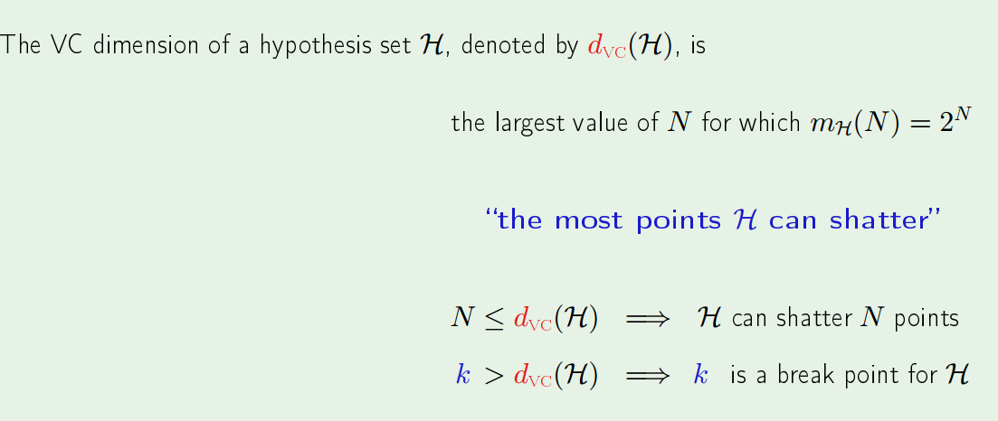
VC Dimension

Slide 16
Generalization
The central challenge in machine learning is that we must perform well on new, previously unseen inputs—not just those on which our model was trained. The ability to perform well on previously unobserved inputs is called generalization.
If VC Dimension is finite, the final chosen hypothesis will generalize.
VC Dimension = d + 1, where d is the dimension in the geometric sense (not to be confused with features). In other words VC dimension is the number of parameters. Put differently VC Dimension = geometric-dimension + 1 = Number of Parameters (features) w0, w1, w2, w3,…, w(d).
VC Dimension is also referred to as the capacity of the Model. It is also some times called degrees of freedom.

Slide 17
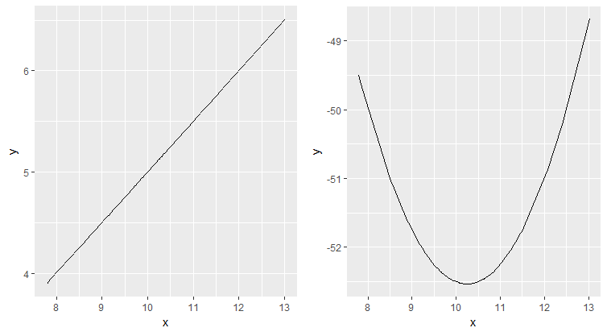
Model Capacity – Linear vs Polynomial

Slide 18
Thank you
- Vinuth Tulasi

