Slide 1
Deep Learning…
…happens when computers think deep!
- Vinuth Tulasi

Slide 2
Agenda
What is Deep Learning?
Introduction to Machine Learning

Slide 3
Deep Learning
Deep Learning is a branch of Machine Learning whose algorithms are based on and inspired by how the human neurons interprets the input and generates the output.
URL: http://www.deeplearningbook.org/

Slide 4
Introduction to Machine Learning

Slide 5
Machine Learning Algorithm
A machine learning algorithm is an algorithm that is able to learn from data.
A computer program is said to learn from experience E with respect to some class of tasks T and performance measure P, if its performance at tasks in T, as measured by P, improves with experience E.

Slide 6
Task
Task by definition means a basic unit of work to be done or undertaken.
What is an ML task and what isn’t?
Different kinds of tasks.
Classification
Regression
Forecasting
Anomaly Detection
Clustering
Dimensionality Reduction
Recommendation

Slide 7
Performance Measure
In order to evaluate the abilities of a machine learning algorithm, we must design a quantitative measure of its performance.
The performance measure is like the grade or the result of the machine of its performance on a particular task.
Accuracy is just the proportion of examples for which the model produces the correct output.
Error rate is the proportion of examples for which the model produces an incorrect output.

Slide 8
Model
A model is a representation for a particular purpose.
Models describes a task mathematically.
Model can be thought of as a mathematical function.
Function is a mathematical concept which describes the relationship between the output and one or more inputs. It is represented generally as y = f(x). Here y is the output/dependent/response variable and x is the input/independent/explanatory variable.

Slide 9
Experience
Machine learning algorithms can be broadly categorized as unsupervised or supervised by what kind of experience they are allowed to have during the learning process.

Slide 10
Supervised Learning
Supervised learning algorithms are the algorithms which know what to learn from the given data.
They are used in classification and prediction.
They learn about the relationship between the predictor variables and the outcome variable.

Slide 11
Unsupervised Learning
Unsupervised learning algorithms are the algorithms which do not know what to learn from the given data.
They are used in clustering, anomaly detection, dimension reduction methods and association rules.
They learn some useful properties of the structure of the dataset.

Slide 12
Dataset Representation
Data is represented most often using matrices and vectors.
Matrix is a rectangular array of numbers arranged in rows and columns.
Vector represents a quantity that has both magnitude and direction.

Slide 13
Hello World Example – Linear Regression
As the name implies, linear regression solves a regression problem. In other words, the goal is to build a system that can take a vector X ∈ R^n as input and predict the value of a scalar Y ∈ R as its output.
Line formula: Y = b + m*X
Slope is the slope is a measure of the steepness of a line, or a section of a line, connecting two points.
Parameters are values that control the behavior of the system. They are also referred to as co-efficients / weights. In the above equation b is the parameter.
The parameter b is the bias. This terminology derives from the point of view that the output of the transformation is biased toward being b in the absence of any input.

Slide 14

Linear Regression (more formally)
Task, T: to predict Y from X by outputting Y = b + m*X
Performance Measure, P: Mean Squared Error (MSE)

Slide 15
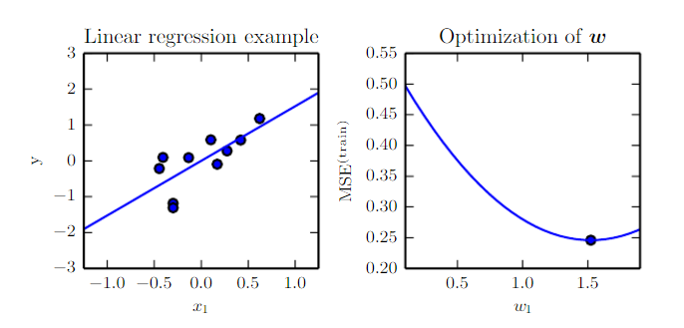
Optimization

Slide 16
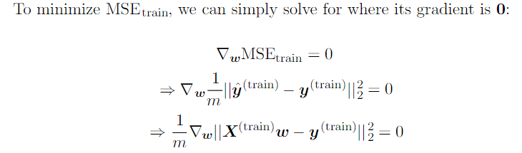
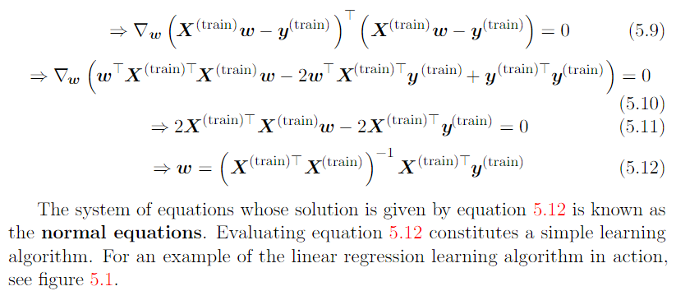
Normal Equation

Slide 17
Training Set, Validation Set, Test Set
Training Data are the data from which the classification or prediction algorithms learns or is trained, about the relationship between predictor variables and the outcome variable.
Once the algorithm has learned from the training data, it is then applied to another sample of data (the validation data) where the outcome is known, to see how well it does in comparison to other models.
If many different models are being tried out, it is prudent to save a third sample of known outcomes (the test data) to use with the model finally selected to predict how well it will do. The model can then be used to classify or predict the outcome of interest in new cases where the outcome is unknown.

Slide 18
At the last
Statistics Vs Data Mining
Core tenets of statistics – computing is difficult and data are scarce – do not apply to data mining. Data mining is simply put “Statistics at scale, speed, and simplicity”.
Data Mining vs Machine Learning
Machine Learning relates with the study, design and development of the algorithms that give computers the capability to learn without being explicitly programmed (definition of Arthur Samuel). Data Mining can be defined as the process that starting from apparently unstructured data tries to extract knowledge and/or unknown interesting patterns. During this process machine Learning algorithms are used.
Artificial Intelligence (AI)
is usually defined as the science of making computers do things that require intelligence when done by humans. It is the science and engineering of making intelligent machines, especially intelligent computer programs.

Slide 19
Thank you

