Slide 1
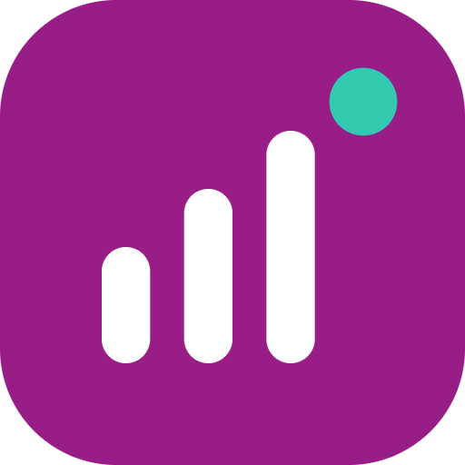
WEMA BUSINESS ACCOUNT
TRF/772101384
−₦207,500
NaijaBiz IQ
Stock
Adebayo Provisions · paid every week
Financial intelligence for Nigerian small businesses, built on Wema transactions.
POS SETTLEMENT 02/09
+₦246,245
Sales
Customer card payments
Wema Hackaholics 7.0 · University of Ibadan · 7–9 October 2026
POS PURCHASE
−₦28,700
[Team name] · [Presenter names]
Not sure yet
We'll ask Aisha
Notes:
Good [morning/afternoon]. We are [team name]. This is NaijaBiz IQ.
On the right are three real lines from a small business's Wema statement. On their own they say almost nothing: a reference number, a settlement, a card purchase. NaijaBiz IQ reads each line and works out what it means. When it isn't sure, it asks instead of guessing.
That is the whole idea in one picture: Wema already has the transactions; we turn them into intelligence.

Slide 2
Small businesses have data, not answers
THE PROBLEM
Am I actually making money?
Where is my money going?
Will I have enough cash later this month?
Can I afford ₦300,000 of stock?
A bank statement shows what happened. It doesn't say what it means, or what's coming next.
Notes:
Every day, money comes in and goes out of a small business. The owner can see the balance, but the balance doesn't answer the questions that matter.
Read the four questions. These are the questions a small business owner asks every week, and today the answer is a guess.
The data to answer them already exists: it's in the bank account.

Slide 3
Meet Aisha
WHO IT'S FOR
+12%
She runs a mini mart in Ibadan. Money comes in and goes out every day, but she has no financial analyst.
sales growth over the last 3 months
−22%
Business | Aisha Mini Mart, Bodija
Team | Aisha and 2 staff
Monthly sales | ₦2.2M in April → ₦2.76M in September
Pays regularly | 3 suppliers, rent, salaries, diesel, power
cash balance in September
₦740K → ₦580K
Sales are growing. Cash is shrinking. Why?
Aisha is an illustrative persona. Every figure comes from her 6-month demo dataset, analysed by the prototype.
Notes:
Meet Aisha. She runs Aisha Mini Mart in Bodija, Ibadan, with two staff. Her sales have grown from about 2.2 million naira a month in April to 2.76 million in September.
Good news, right? But look at the right: her sales grew 12% over three months, and yet her cash balance fell 22% in September alone.
She can see her balance going down. She can't see why. That's the question NaijaBiz IQ answers.
(If asked: Aisha is a persona; her six months of transactions are a realistic demo dataset, and every number in this presentation is computed by the prototype from it.)

Slide 4





NaijaBiz IQ turns Aisha's transactions into answers
THE SOLUTION
Understand
Predict
Advise
Decide
Get ready
What is happening in my business?
What is likely to happen next?
What should I do about it?
Can I afford this purchase?
Am I building healthy financial habits?
Not accounting software. A financial intelligence layer on top of the bank account Aisha already uses.
Notes:
NaijaBiz IQ is a financial intelligence layer. It doesn't ask Aisha to keep books or type anything in. It reads the transactions Wema already has and answers five kinds of question.
Understand: what is happening. Predict: what is likely to happen. Advise: what to do. Decide: can I afford this. And get ready: is my business building the habits that lead to healthy growth.
Importantly, this is not accounting software and not another chatbot. It sits on top of the account she already uses.

Slide 5
From transaction to decision
HOW IT WORKS
STEP 1
STEP 2
STEP 3
Read
Categorize
Calculate
247 transactions from Aisha's Wema account
97.6% correct. When it isn't sure, it asks.
Sales, spending, cash flow and a safety reserve
STEP 4
STEP 5
STEP 6
Forecast
Advise
Decide
Day-by-day cash for the next 14 days
Ranked actions and a Business Health Score
Can I afford this? A clear answer, a safer amount
The engine calculates; the insight layer explains. Every number Aisha sees is checked against the engine.
Notes:
Six steps, all automatic.
One: read the transactions — for Aisha, 247 over six months. Two: categorize each one using its description, who it was paid to, when, and whether it repeats. It gets 97.6% right on this data, and when it isn't sure it asks Aisha instead of guessing. Three: calculate sales, spending, cash flow and a minimum cash reserve, to the naira. Four: forecast her cash day by day for the next two weeks. Five: advise — ranked actions and a Business Health Score. Six: decide — can she afford what she's planning?
One design rule matters: the engine does all the maths. The plain-language layer only explains, and every number in an explanation is checked against the engine, so it can never invent a figure.

Slide 6
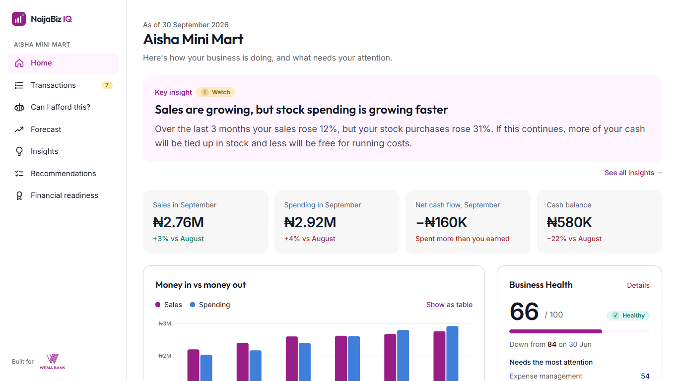
Aisha's business, in plain words
THE PRODUCT
+12% vs +31%
sales vs stock spending, last 3 months
84 → 66
Business Health Score since 30 June
₦393K
expected lowest balance, around 12 Oct
7 → 2
transactions left to review after one answer: it learns
Notes:
[Switch to the live demo here if possible — DEMO.md steps 2 to 6. If not, use this slide.]
This is what Aisha sees. The first thing on her screen is not a table of numbers; it's the answer to "why is my cash going down?": her sales grew 12%, but her stock purchases grew 31%. She's buying stock faster than she sells it.
Her Business Health Score has fallen from 84 at the end of June to 66 today — still healthy, but slipping, and it tells her which areas are weakest.
The forecast warns that her cash will likely be at its lowest, about 393 thousand naira, around 12 October, when two supplier payments fall due.
And it learns: seven transactions it couldn't identify; she answers one — "that card purchase was generator fuel" — and it recognises four similar ones on its own.

Slide 7
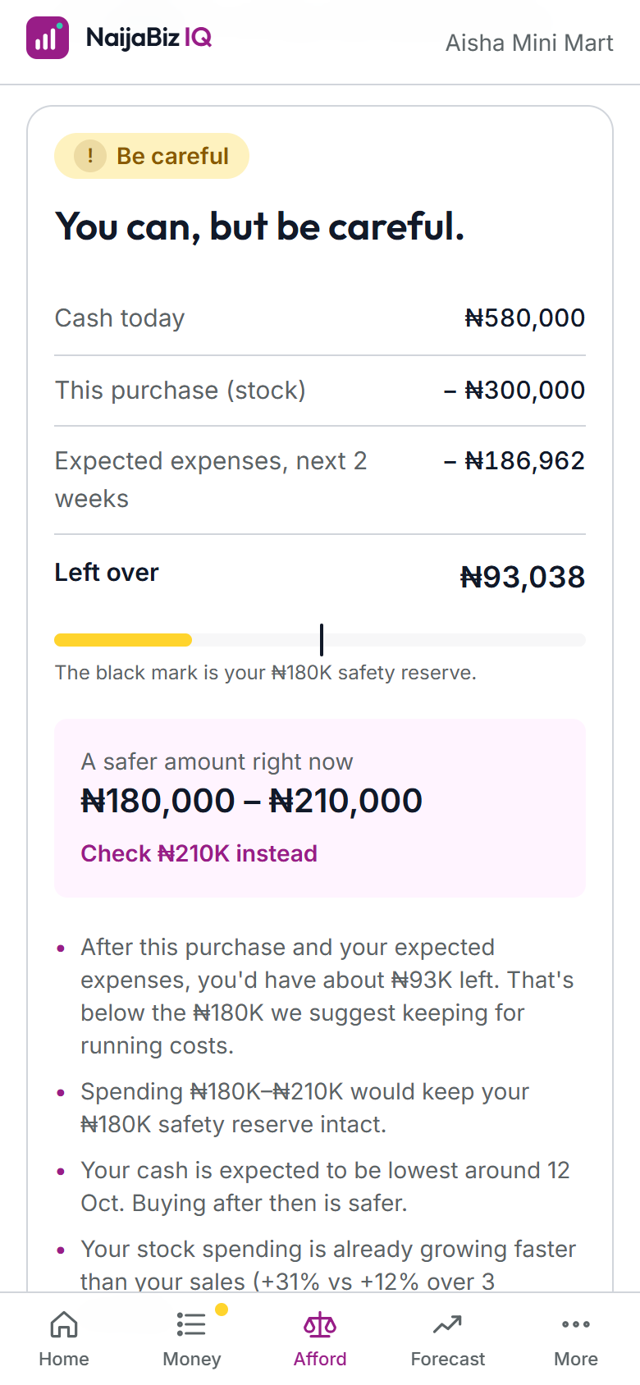
Can Aisha afford ₦300,000 of stock?
THE DECISION
You can, but be careful.
Cash today | ₦580,000
This purchase | −₦300,000
Expected expenses, next 2 weeks | −₦186,962
Left over | ₦93,038
Safer amount right now: ₦180,000 – ₦210,000
₦93K is below her ₦180K reserve (10 days of running costs). At ₦210K: "Yes, you can afford this comfortably."
Notes:
This is the moment that matters most. Aisha wants to buy 300 thousand naira of stock. Can she afford it?
[Live: type 300000, tap Check.]
NaijaBiz IQ says: you can, but be careful. Here's why, in plain sums: she has 580 thousand today. The purchase takes 300. Based on her regular payments and recent spending, she's expected to need another 187 thousand over the next two weeks. That leaves 93 thousand — below the 180 thousand we suggest she keeps for ten days of running costs.
So it doesn't just say yes or no; it gives her a safer amount: 180 to 210 thousand. [Tap "Check ₦210K instead".] At 210, the answer is: yes, comfortably.
That's the whole pipeline — transactions, analysis, forecast, risk, recommendation — ending in a business decision.

Slide 8
What the prototype already does
WORKING TODAY
247
97.6%
14 days
100%
transactions understood in seconds
categorized correctly, with no confident mistakes
of cash pressure seen ahead
of numbers in explanations checked against the engine
Also built in: works fully offline · designed for phones first · accessibility-checked (WCAG 2.1 AA) · 94 automated tests
Figures measured on the 6-month demo dataset.
Notes:
This isn't a mock-up. Everything you've seen runs on a working engine.
It reads 247 transactions in seconds. It categorizes them 97.6% correctly on this data, and it has zero confident mistakes: whenever it isn't sure, it asks. It sees cash pressure two weeks ahead. And 100% of the numbers in its explanations are checked against the engine, so it never makes up a figure.
It also works offline, it's built for phones first because that's how small business owners bank, it passes an accessibility scan, and it's covered by 94 automated tests.

Slide 9
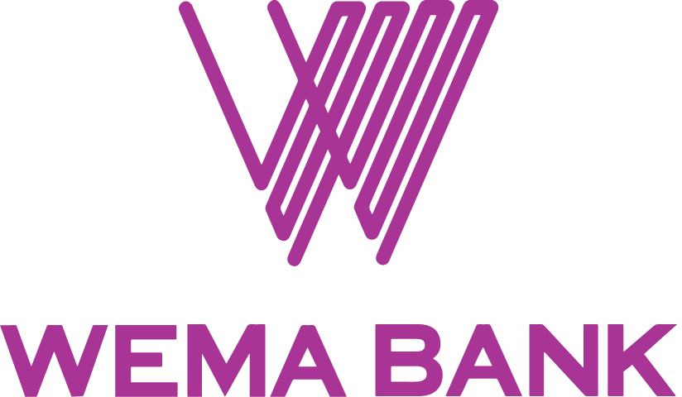
Built on data Wema already has
WHY IT MATTERS TO WEMA
A reason to open the app every week
Healthier SME customers
Owners come back for answers, not just balances.
Owners who see cash pressure early can act before it becomes a crisis.
Prototype: the Wema connection is simulated. In production, Aisha connects once, with consent, and her data stays up to date.
A clearer view of SME activity
A responsible path to products
With consent, insight into how small businesses are really doing.
Readiness signals show who is ready for more. Never an automatic loan decision.
Notes:
Why does this matter to Wema?
First, engagement: a balance is something you check; answers are something you come back for every week.
Second, healthier customers: an owner who sees cash pressure two weeks early can act before it becomes a crisis.
Third, with the customer's consent, Wema gets a clearer picture of how its small business customers are really doing.
And fourth, a responsible path to products. The readiness profile shows healthy financial habits. It never approves a loan by itself, but it can show when a business is ready for a conversation about more.
To be clear about the prototype: the Wema connection is simulated with demo data. In production, Aisha connects her account once, with consent, and NaijaBiz IQ stays up to date.

Slide 10
From prototype to product
WHAT'S NEXT
NEXT
THEN
LATER
Go live
Go deeper
Grow with Wema
Real Wema connection, with consent
Continuous transaction sync
Learning tuned to each business
Supplier and stock insights
Scenario planning: hire, expand, restock
Benchmarks against similar businesses
Personalized Wema services
Responsible financing pathways
SME financial coaching
Notes:
Where does this go after the hackathon?
Next: go live — a real Wema connection with the customer's consent, transactions syncing continuously, and categorization that learns each business.
Then: go deeper — supplier and stock insights, scenario planning like "can I afford to hire someone?", and benchmarks against similar businesses.
Later: grow with Wema — personalized services, responsible financing pathways built on readiness, and ongoing financial coaching for small business owners.

Slide 11
Wema already has the transactions.
NaijaBiz IQ turns them into intelligence.
Thank you. Questions?
Built for
[Team name] · [Presenter names] · [Contact]
Notes:
To close.
Aisha didn't need another app to type numbers into. She needed someone to tell her what her own transactions meant: that she was buying stock faster than she was selling it, that her cash would be tight around the 12th, and that 300 thousand was too much right now but 210 was fine.
This isn't just a dashboard. It's a financial intelligence layer that helps a small business owner understand what is happening, see what is coming, and make better decisions.
Wema already has the transactions. NaijaBiz IQ turns those transactions into intelligence.
Thank you — we'd love your questions. [Likely questions and answers are in DEMO.md.]

