Slide 1

Project Presentation on “Analysis Of Machine Learning Algorithms On Real Time Data Sets”
Yugandhar G (1RN14CS123)
Prashanth M (1RN14CS068)
Praveen M (1RN14CS072)
Vinyas R (1RN14CS120)
Guide:
Mrs. Sudhamani M J
Asst. Prof. Dept. of CSE, RNSIT
Department of Computer Science and Engineering
RNS Institute of Technology
2018

Slide 2
PROBLEM STATEMENT
Analysis of Machine Learning Algorithms on Various Data Sets
Project revolves around comprehensive and comparative study of several Machine learning algorithms involving real time data sets.

Slide 3
INTRODUCTION
Analysis of Machine Learning Algorithms on Various Data Sets
Machine learning is a branch of science that deals with programming the systems in such a way that they automatically learn and improve with experience.
Classification is a machine learning technique that uses known data to determine how the new data should be classified into a set of existing categories.
Clustering is used to form groups or clusters of similar data based on common characteristics.
Regression is a parametric technique used to predict continuous variable given a set of independent variables.

Slide 4
Data Sets
Analysis of Machine Learning Algorithms on Various Data Sets
Finger vein dataset consists of 632 samples of 2 persons index finger. Minor and Major axis Length are considered for experimentation.
Agar wood Oil composition dataset contains 50 samples of different species of agar wood having oil and water composition as features.
Fisher Iris dataset consists of 50 samples from each of three species of Iris (setosa, virginica and versicolor). Consists of four features - the length and the width of the sepals and petals.
Glass dataset compromises of 214 samples of 2 different variety of glass based on their chemical composition.
2018

Slide 5
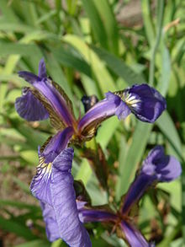

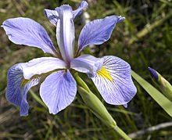
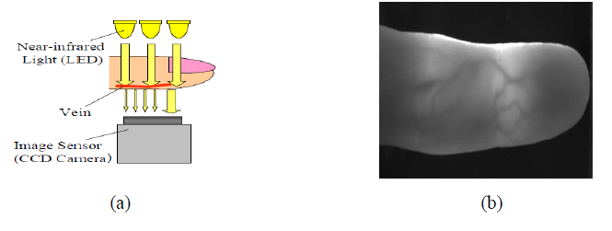
Analysis of Machine Learning Algorithms on Various Data Sets
Iris setosa
Iris versicolor
Iris verginica
Image captured by transmission method

Slide 6
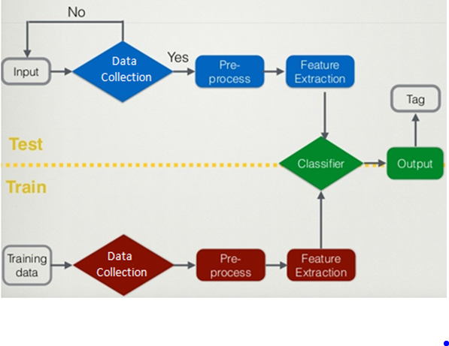
System Architecture
Analysis of Machine Learning Algorithms on Various Data Sets

Slide 7
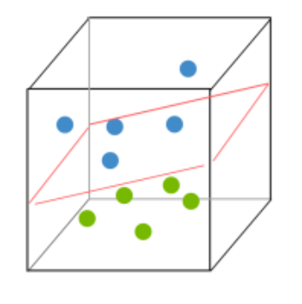
SUPPORT VECTOR MACHINE
Analysis of Machine Learning Algorithms on Various Data Sets
SVM is an algorithm to determine the optimal boundaries of the data groups for group classification.
Two class SVM aims at separating the two data groups data by an optimal separating hyper plane.

Slide 8
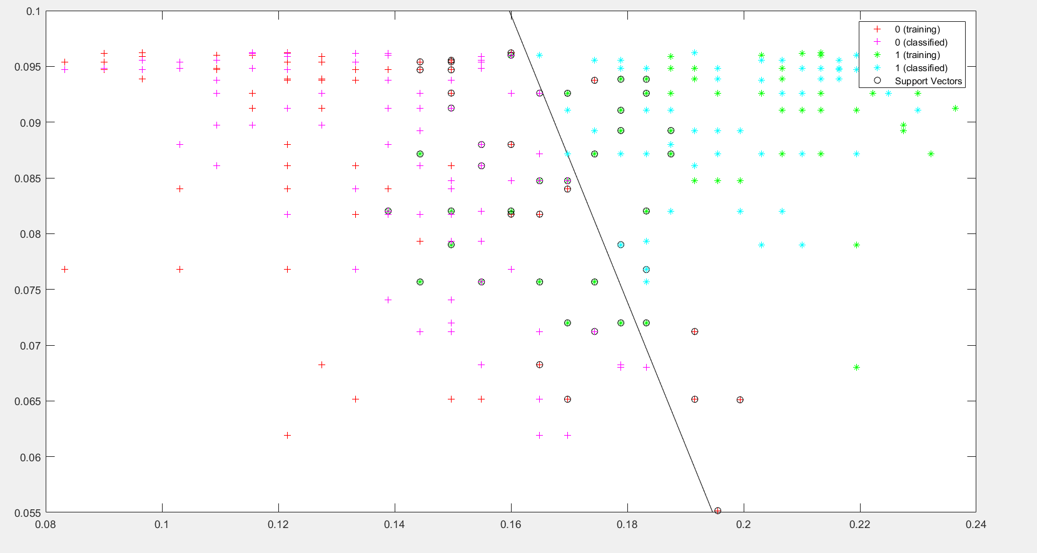
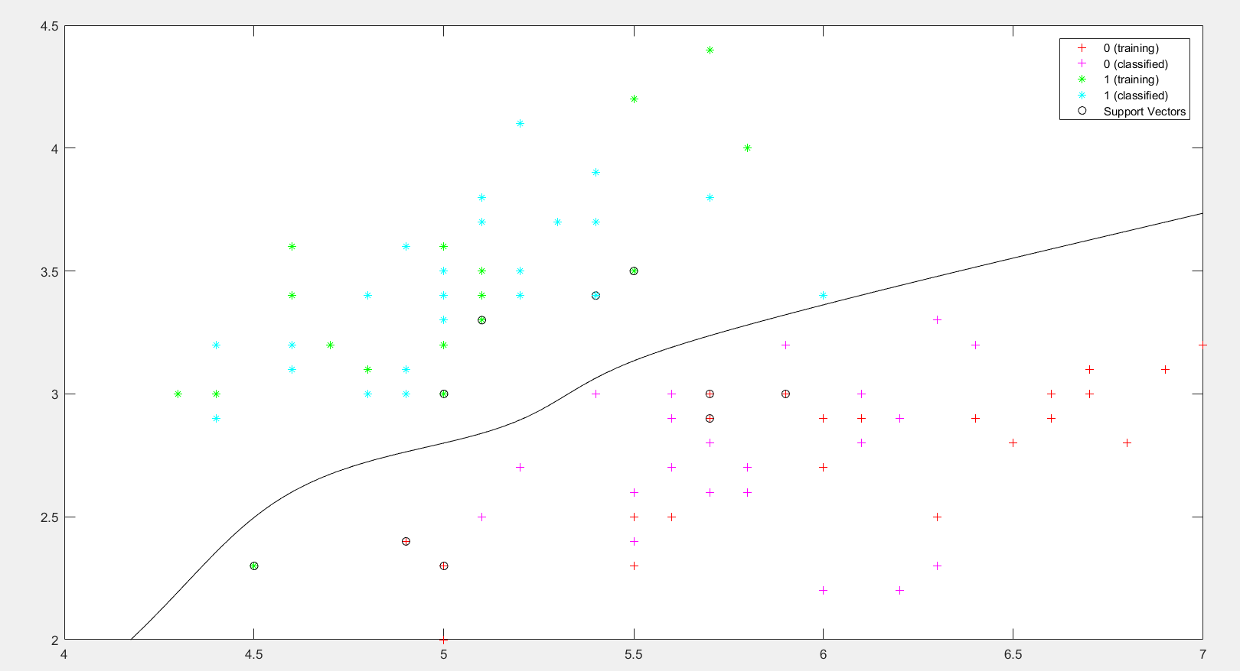
Finger vein data set
Fisher Iris data set

Slide 9
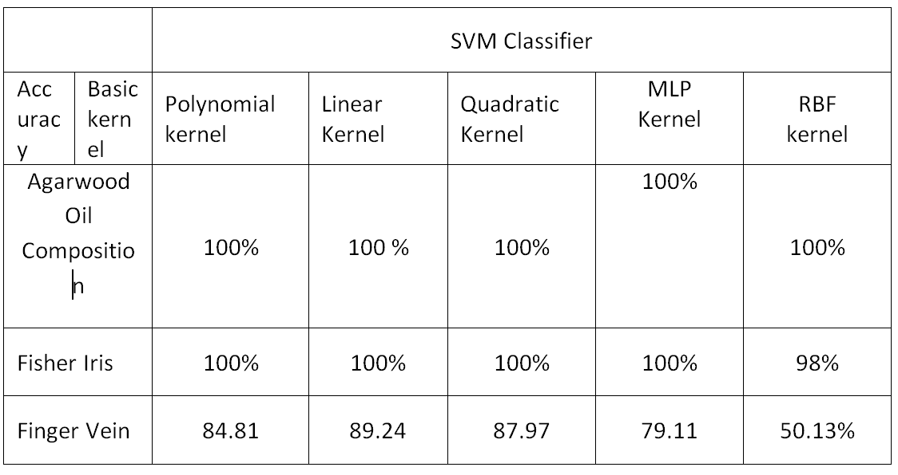
SVM Performance
Analysis of Machine Learning Algorithms on Various Data Sets

Slide 10
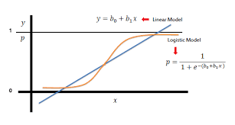
Logistic Regression
Analysis of Machine Learning Algorithms on Various Data Sets
Statistical method for analyzing a dataset in which there are one or more independent variables that determine an outcome.

Slide 11
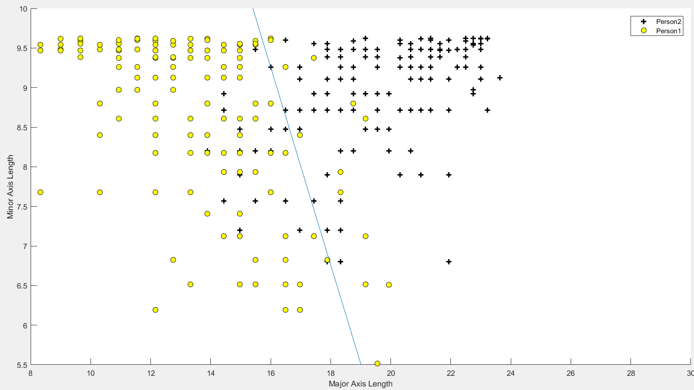
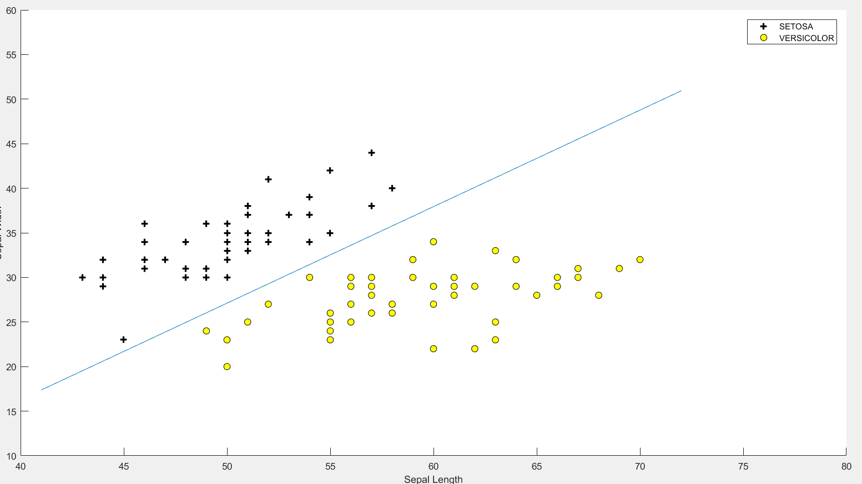
Analysis of Machine Learning Algorithms on Various Data Sets
Finger vein data set
Fisher Iris data set

Slide 12
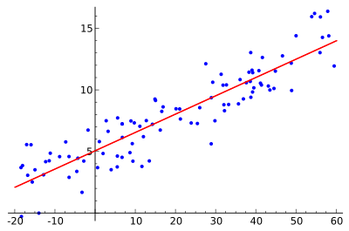
Linear Regression
Analysis of Machine Learning Algorithms on Various Data Sets
Linear regression is a linear approach for modelling the relationship between a scalar dependent variable y and one or more explanatory variables denoted X.

Slide 13
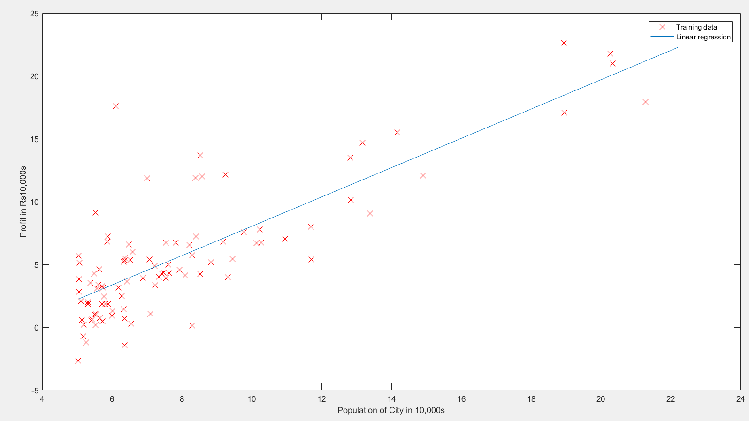
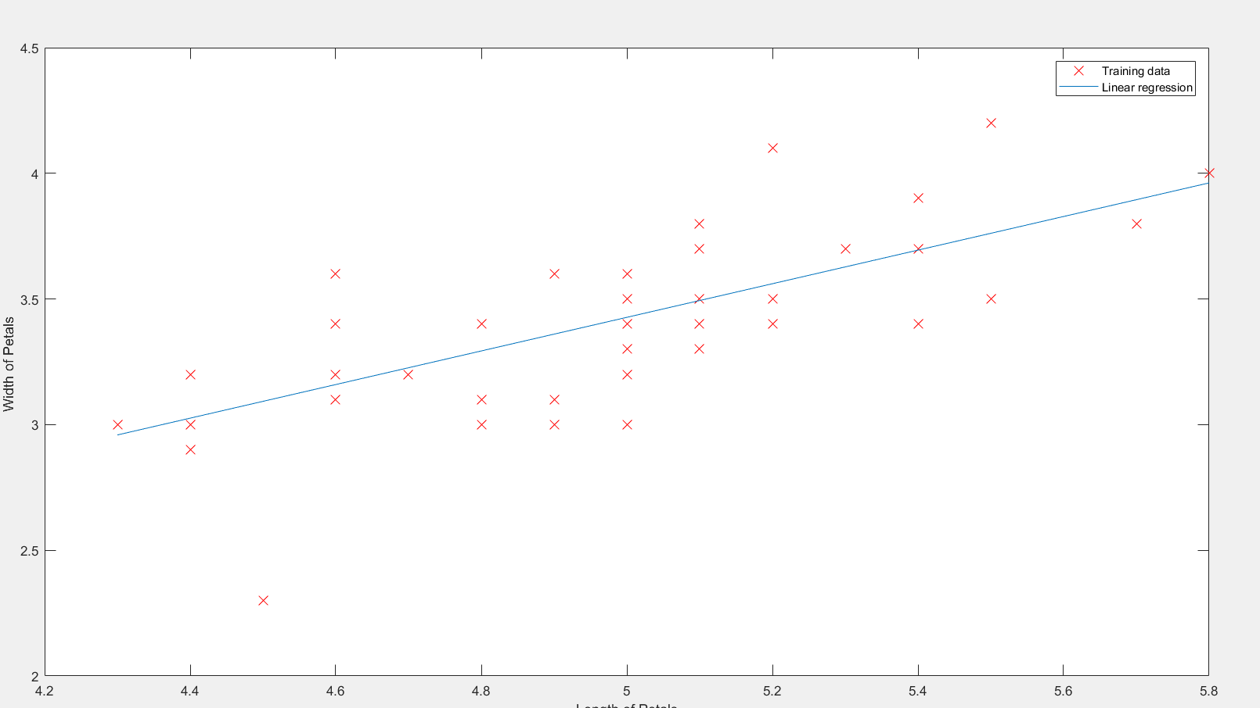
Analysis of Machine Learning Algorithms on Various Data Sets
Population density data set
Fisher Iris data set

Slide 14
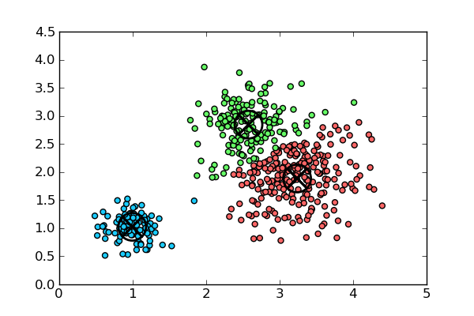
K-Means
Analysis of Machine Learning Algorithms on Various Data Sets
k-means algorithm which is an incremental approach to clustering data dynamically adds one cluster center at a time through a deterministic global search procedure.

Slide 15
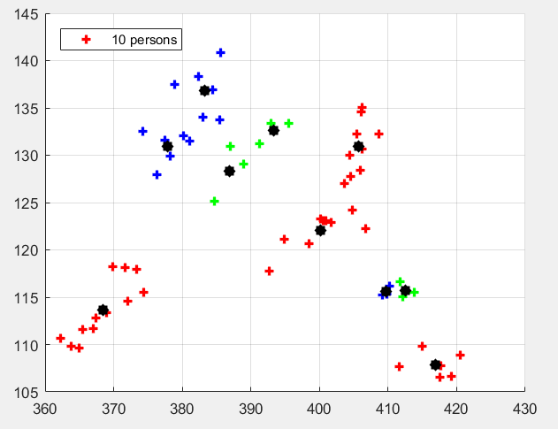
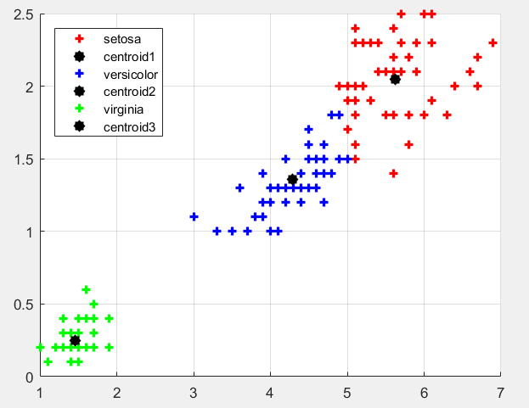
Analysis of Machine Learning Algorithms on Various Data Sets
Finger vein data set
Fisher Iris data set

Slide 16
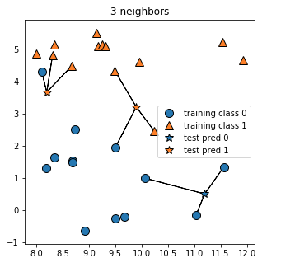
K Nearest Neighbors
Analysis of Machine Learning Algorithms on Various Data Sets
The accuracy of k-nearest neighbor (kNN) classification depends significantly on the metric used to compute distances between different examples.

Slide 17
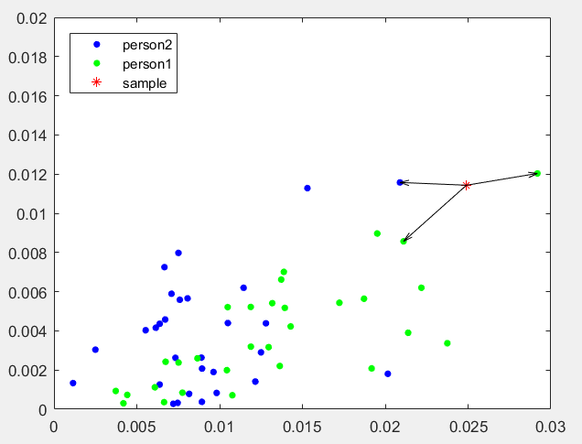
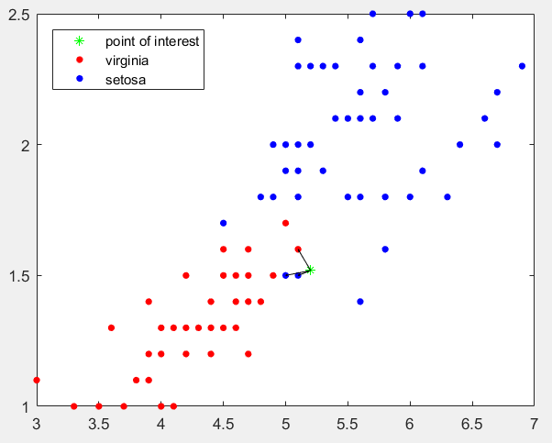
Analysis of Machine Learning Algorithms on Various Data Sets
Finger vein data set
Fisher Iris data set

Slide 18
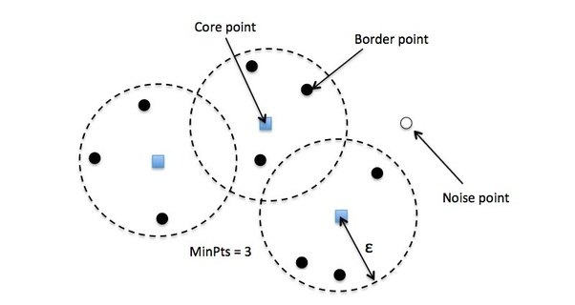
DBSCAN
Analysis of Machine Learning Algorithms on Various Data Sets
Density-based clustering algorithm, given a set of points in some space
It groups together points that are closely packed together

Slide 19
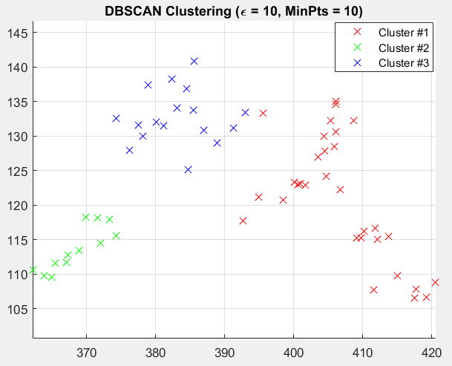
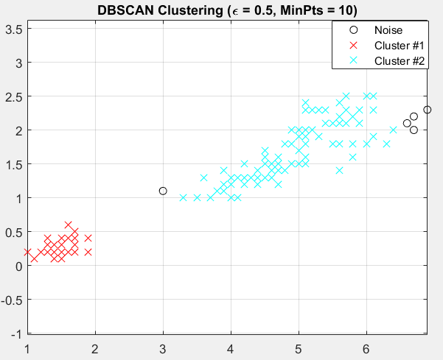
Analysis of Machine Learning Algorithms on Various Data Sets
Finger vein data set
Fisher Iris data set

Slide 20

Random Forest
Analysis of Machine Learning Algorithms on Various Data Sets
Random Forests are considered for classification of multisource remote sensing.
Decision from each tree is chosen using 2 methods: Voting method and Averaging method.

Slide 21
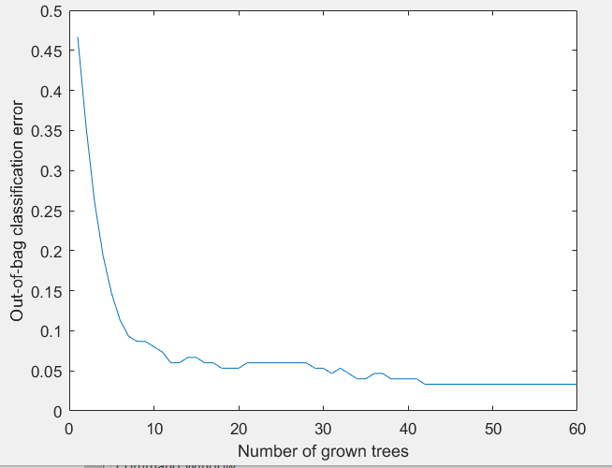
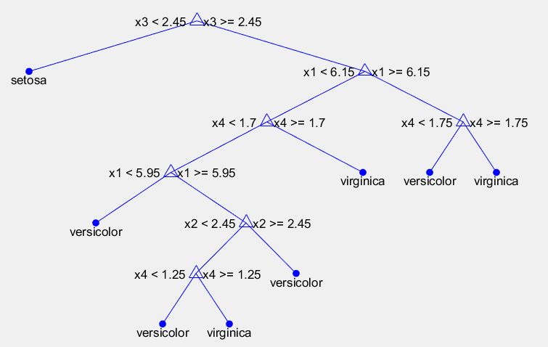
Analysis of Machine Learning Algorithms on Various Data Sets
Fisher Iris data set
Fisher Iris data set

Slide 22
Conclusion
Analysis of Machine Learning Algorithms on Various Data Sets
Algorithms implemented in this project provides a basis for machine learning, whose test cases and outcomes can be used for further research and optimizing the algorithms.
Experiments were carried out using different real time datasets and UCI data sets to analyze and compare their classification performance.
Feature extraction concept used here can be implemented in the field of image processing which will result in adaptable and resilient image processing technology.

Slide 23
Analysis of Machine Learning Algorithms on Various Data Sets
Future Work
A multimodal scheme where several approach systems will be combined to form a unit identification system can be studied.
As a future work, the proposed approach will be tested on other datasets.
Focus can be given to integration and comparison between the ROC(Receiver Operating Characteristics ) curves.
The proposed approach contains several phases, namely, acquisition, enhancement, feature extraction and classification.

Slide 24
References
Analysis of Machine Learning Algorithms on Various Data Sets
https://in.mathworks.com/help/
http://ieeexplore.ieee.org/document/8049171/?reload=true
https://www.analyticsvidhya.com/blog/2016/11/an-introduction-to-clustering-and-different-methods-of-clustering/
https://www.coursera.org/learn/machine-learning/lecture/zcAuT/welcome-to-machine-learning
https://books.google.co.in/books?id=8cxpDQAAQBAJ&pg=PA340&lpg=PA340&dq
https://www.youtube.com/watch?v=D_2LkhMJcfY
https://stackoverflow.com/questions/45151351/
https://www.youtube.com/watch?v=aiJ8II94qck

Slide 25
THANK YOU!!!

Slide 26
Suggestions….!

