Slide 1
Problem Description
Travelling Salesman Problem (TSP): Given a set of cities and distance between every pair of cities, the problem is to find the shortest possible route that visits every city exactly once and returns to the starting point.

Slide 2
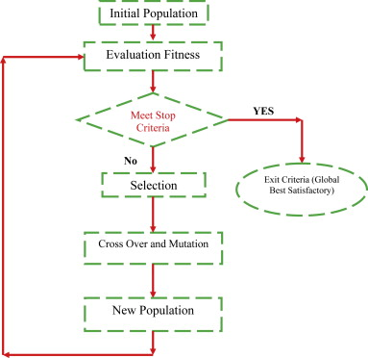
Approach
The initial population consist s of all the possible outcomes for the given problem statement. The whole sample space denotes the population.
Fitness function defines a standard function which governs a standard optimal solution to the given problem statement.
Crossover offers multiple variation in the chromosomes to generate randomization in the parent chromosomes to generate different optimal solutions
Mutation provides an elimination process through which all non-optimal solutions are negated and eliminated.
The resulting new population consists of the various chromosomes with initial population except the mutated chromosomes.

Slide 3

Fitness Function
The Fitness function defines the standard basis to obtain an optimal solution from the parent chromosomes
It is defined in a way to obtain the minimum distance travelled by the salesperson from all the different combinations obtained
The Fitness function for the current problem statement is defined as the reciprocal of the total distance travelled
The Calculated Distance method defines the distance travelled between xcoordinates and ycoordinates of the cities travelled.
Array of Random order of cities and along with (X,Y) coordinate is generated using generateBaseOrder

Slide 4
Implementation
InitializePopulation method is used to initialize the initial population randomly. It creates Genotypes which has a 4-bit string representation of binary number of each city.
SortPopulation method is used to sort the population based on the fitness score generated for each phenotype.
Regeneration method is used to generate new population or generation using crossover method by choosing random parents from the population. The population is maintained constant in the process.In the Genotype Class, we are using two different constructors two differ the type to initialize a phenotype. The class contains phenotype generation method and compareTomethod.
CalculateFitnessScore is used to calculate FitnessScore based on the total distance calculated in CalculateDistance method. FitnessScore is obtained by using the follow formula.FitnessScore = (1/TotalDistance).
CalculateDistance method is used to calculate Distance between a pair of cities using the xcoordinate and ycoordinate of the cities.In Driver Class, we have implemented the main function which runs the whole algorithm. Along with the main function generateBaseOrder method is implemented in the driver class.

