Slide 1
Final Project Presentation
Group C, NLP
Marta Colmenar Herrera, Mena Lerf, Vinzenz Uhr
19.12.2023

Slide 2
Agenda
Environment
Baseline results
Preprocessing
Further tuning BERT
Final results BERT
GPT like model
Discussion

Slide 3
Environment
Environment
Baseline results
Preprocessing
Further tuning BERT
Final results BERT
GPT like model
Discussion

Slide 4
Setup
Pipeline
Tools
Custom preprocessing as in task 1
Tokenization defined by clincalBERT model (WordPiece)
Split text because of 512 token limitation
Split into trainings and test set with 20% testsize and label stratification
Training
Evaluation
Jupyter Notebook for demonstration
Training on Ubelix
Pytorch for model training
NLTK for preprocessing
Tensorboard for visualization
Notes:
Prepocessing: remove punctuation, to lowercase (-> done by BERT tokenization as well), remove stopwords, lemmatization -> also done by BERT should be left out

Slide 5
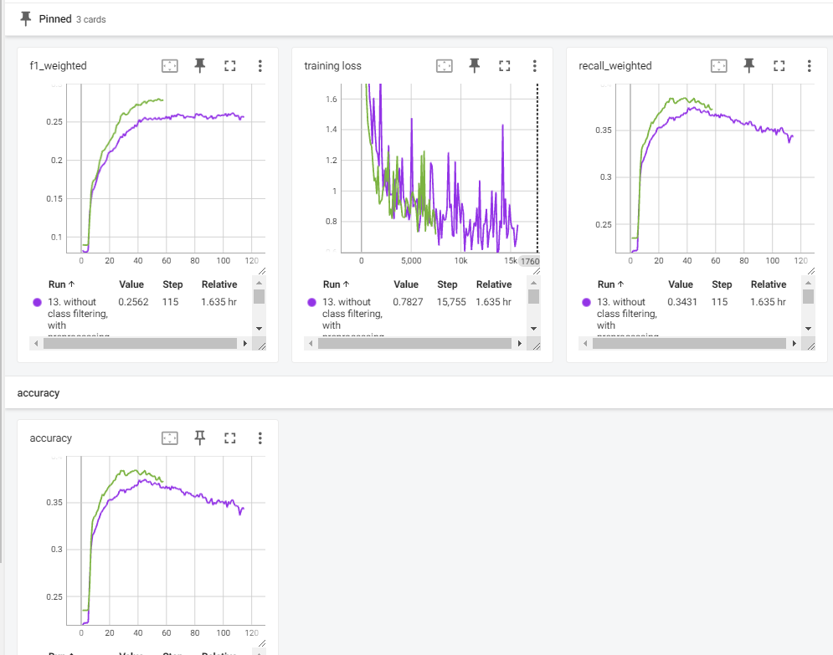
Training and evaluation metrics
Metrics
Tensorboard
Training loss every 1/8 epoch
Evaluationmetrics every epoch
Accuracy
Precision
Recall
F1 score
Bild einfügen

Slide 6
Baseline results
Environment
Baseline results
Preprocessing
Further tuning BERT
Final results BERT
GPT like model
Discussion

Slide 7
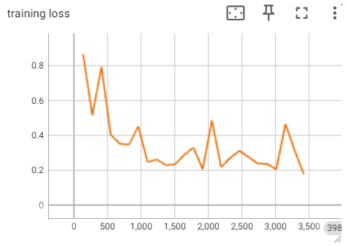
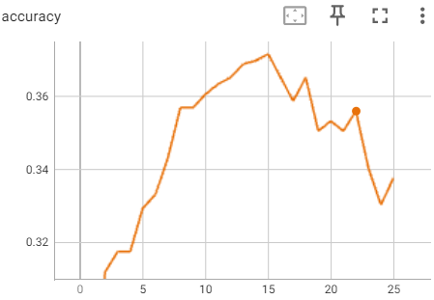
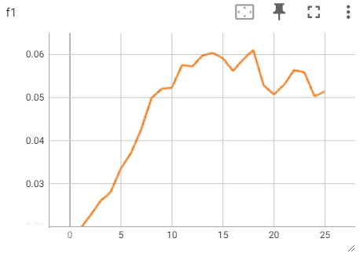
BERT baseline
Learns something from data
Best accuracy around 0.37
Low F1 score with 0.06
Notes:
Disclaimer: Misleading scores, because no stratification in trainings and test split and no weighted sampling.

Slide 8
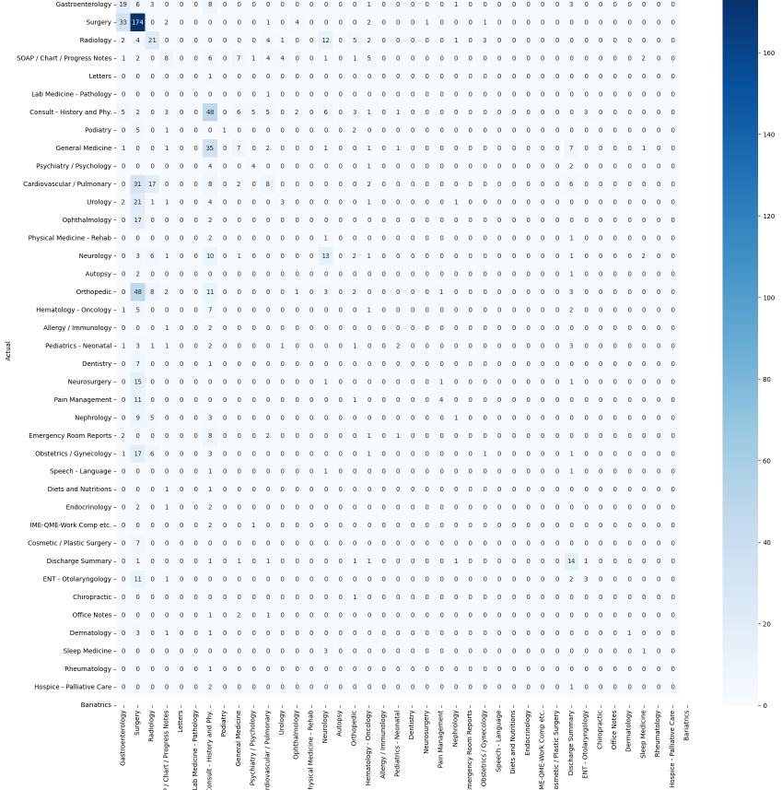
Confusion matrix
Conclusion
Too much weight given to class surgery

Slide 9
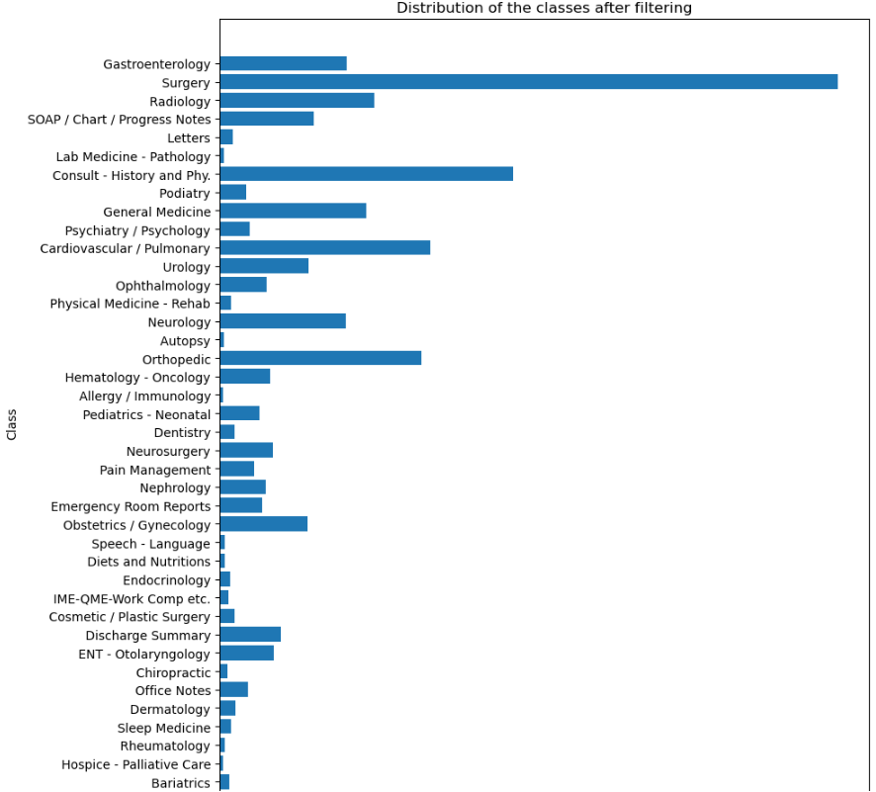
Class imbalance

Slide 10
Machine Learning baselines
Scores
Naïve Bayes
Accuracy: 0.28
F1: 0.22
Random Forest
Accuracy: 0.21
F1: 0.28
Support Vector Machines
Accuracy: 0.26
F1: 0.20
Notes:
Disclaimer: Dataset are balanced compared to the scores in the slides before

Slide 11
Preprocessing
Environment
Baseline results
Preprocessing
Further tuning BERT
Final results BERT
GPT like model
Discussion

Slide 12
Custom preprocessing
Preprocessing steps
Lowercase
Replace ‘\n’, ‘t’ and ‘\r’ with ‘ ‘
WordNet Lemmatizer
Remove stop words
Remove punctuation tokens

Slide 13
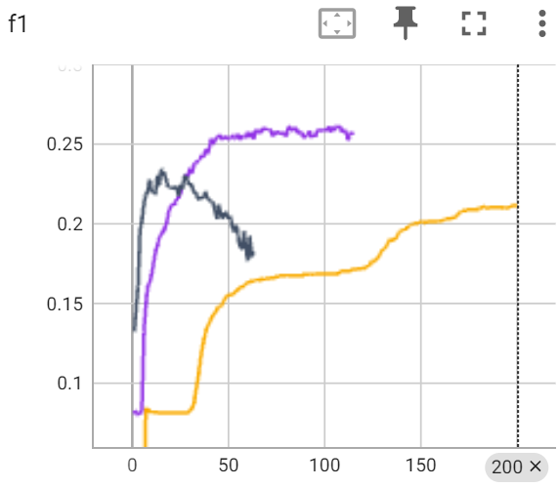
Evaluation
Results
with preprocessing
with preprocessing but no lemmatization without preprocessing
Mostly preprocessing leads to better evaluation scores

Slide 14
Conclusion
With our dataset more preprocessing increases the evaluation scores
We can imagine that the dataset is difficult to learn and that the classifier favours any kind of complexity reduction
We assume this behaviour changes with a bigger training set

Slide 15
Further tuning BERT
Environment
Baseline results
Preprocessing
Further tuning BERT
Final results BERT
GPT like model
Discussion

Slide 16
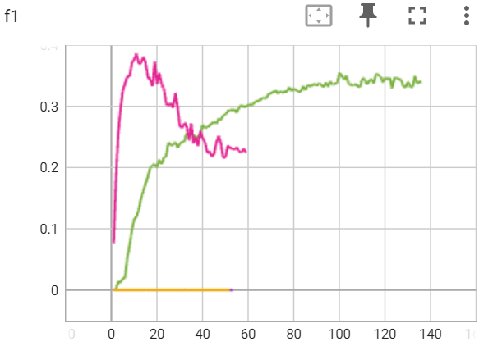
Different learning rate
Lr 5e-4
Lr 5e-5
Lr 5e-6
Lr 5e-7
Results
Best F1 5e-4: 0.01
Best F1 5e-5: 0.01
Best F1 5e-6: 0.38
Best F1 5e-7: 0.35
Insert

Slide 17
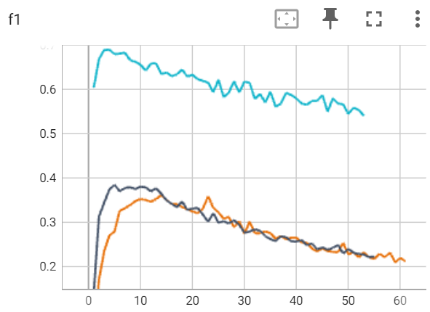
Reduce number of classes
Results
with 40 classes
with 23 classes (num samples > 30) with 4 classes
Best F1 40 classes: 0.35
Best F1 23 classes: 0.38
Best F1 4 classes: 0.69

Slide 18
Final results BERT
Environment
Baseline results
Preprocessing
Further tuning BERT
Final results BERT
GPT like model
Discussion

Slide 19
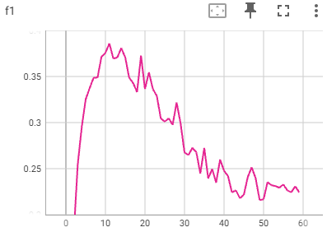
Evaluation metrics
Results
40 classes
With custom preprocessing
Early stopping based on F1 score
F1 score: 0.38
Precision: 0.32
Recall: 0.59

Slide 20
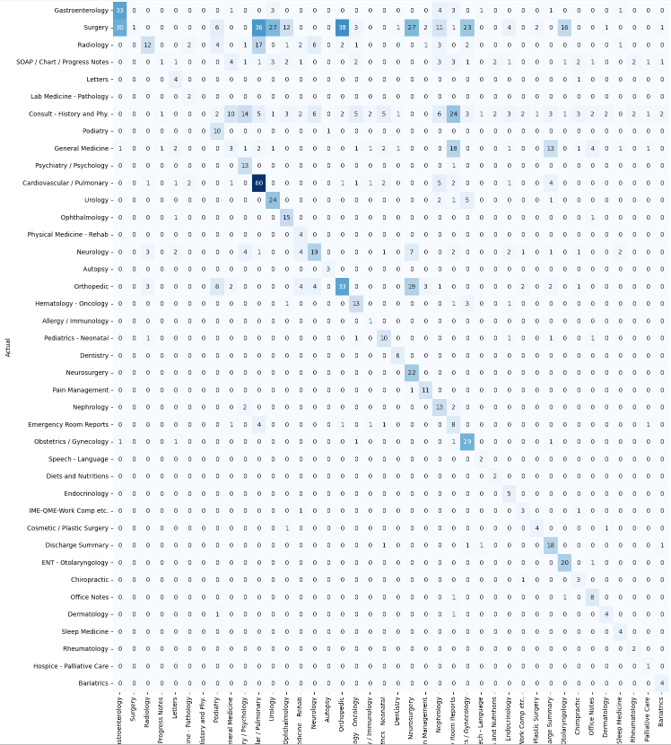
Confusion matrix

Slide 21
GPT like model
Environment
Baseline results
Preprocessing
Further tuning BERT
Final results BERT
GPT like model
Discussion

Slide 22
Used GPT model
Name: Perplexity Mistral
Size: 7B Parameters
Prize: $0.07/1M input tokens

Slide 23
Used prompt
You are a doctor assistant and your task is to classify clinical reports. Your answer should have the following format with the correct class inside the brackets: "The correct class is []"
Following 40 classes delimited with ',' are allowed: Gastroenterology, Surgery, […], Bariatrics
Classify the report below delimited by triple backticks.
Report: ``` [Report] ```

Slide 24
Extracting class
Using regex, we extracted the class that the model responded to. If we couldn't find a class, we took the class 40 "unknown”

Slide 25
GPT Results
Without preprocessing:
Acc: 0.20
F1: 0.23
With preprocessing:
Acc: 0.24
F1: 0.23

Slide 26
Discussion
Environment
Baseline results
Preprocessing
Further tuning BERT
Final results BERT
GPT like model
Discussion

Slide 27
Discussing results
The scores are too low to be used in a real application
Training on classes with six samples does not make sense → need more data per class or (depending on application) merge similar classes.
Data: hard to get in medical domain
Baseline: use naive bayes to see performance (boost?) of BERT -> We did that and included the results in this presentation

Slide 28
Further possibilities
Trying other models
Increase training size with cross-validation
Other preprocessing steps
Comparing to non-BERT baseline

Slide 29
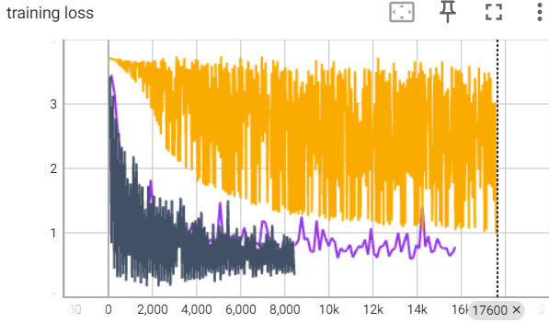
Open questions
Oscillating training loss
Lr: 5e-7
Batch size: 32
-> We could solve that with a better text splitting mechanism
Impact splitting text because of restriction in token size
Top-k scores
Oscillating training loss
Notes:
Influence if we split training data?
There may always be something in the introduction that clearly indicates an OP report. If we cut this, it will no longer apply.
Only allowing texts with fewer than 512 tokens restricts the scope of the model.
Alternatives: Use another NLP model which writes us a shorter summary. This can then have completely different side effects because it is no longer real data but synthetic data.

Slide 30
Discussion / Questions

