Slide 1
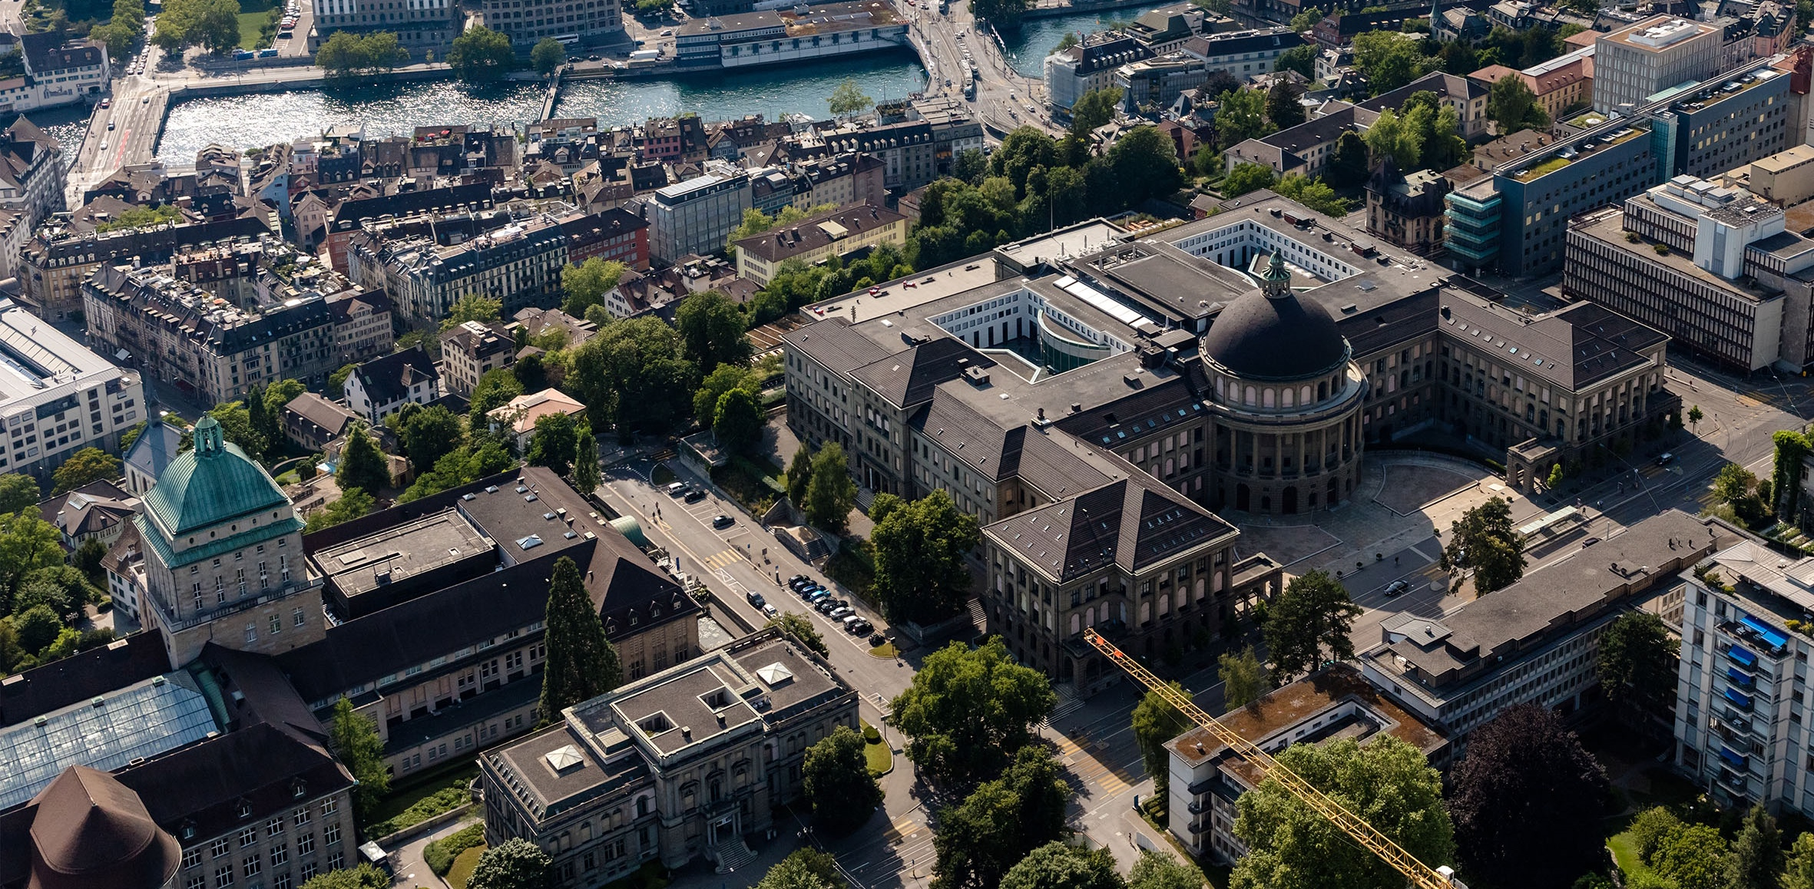
Meeting 3
Vinzenz Tütsch
13.12.2023

Slide 2
Topics
Overleaf
ADMM
Code
Outlook

Slide 3
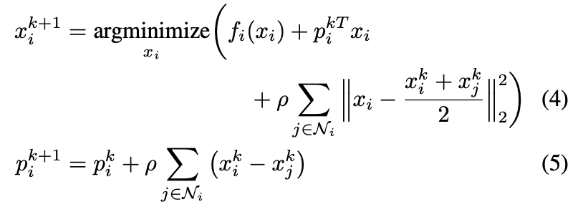
ADMM
Consensus variable z update
No consensus variable required

Slide 4
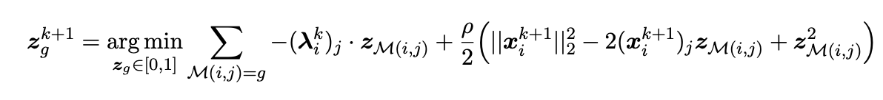
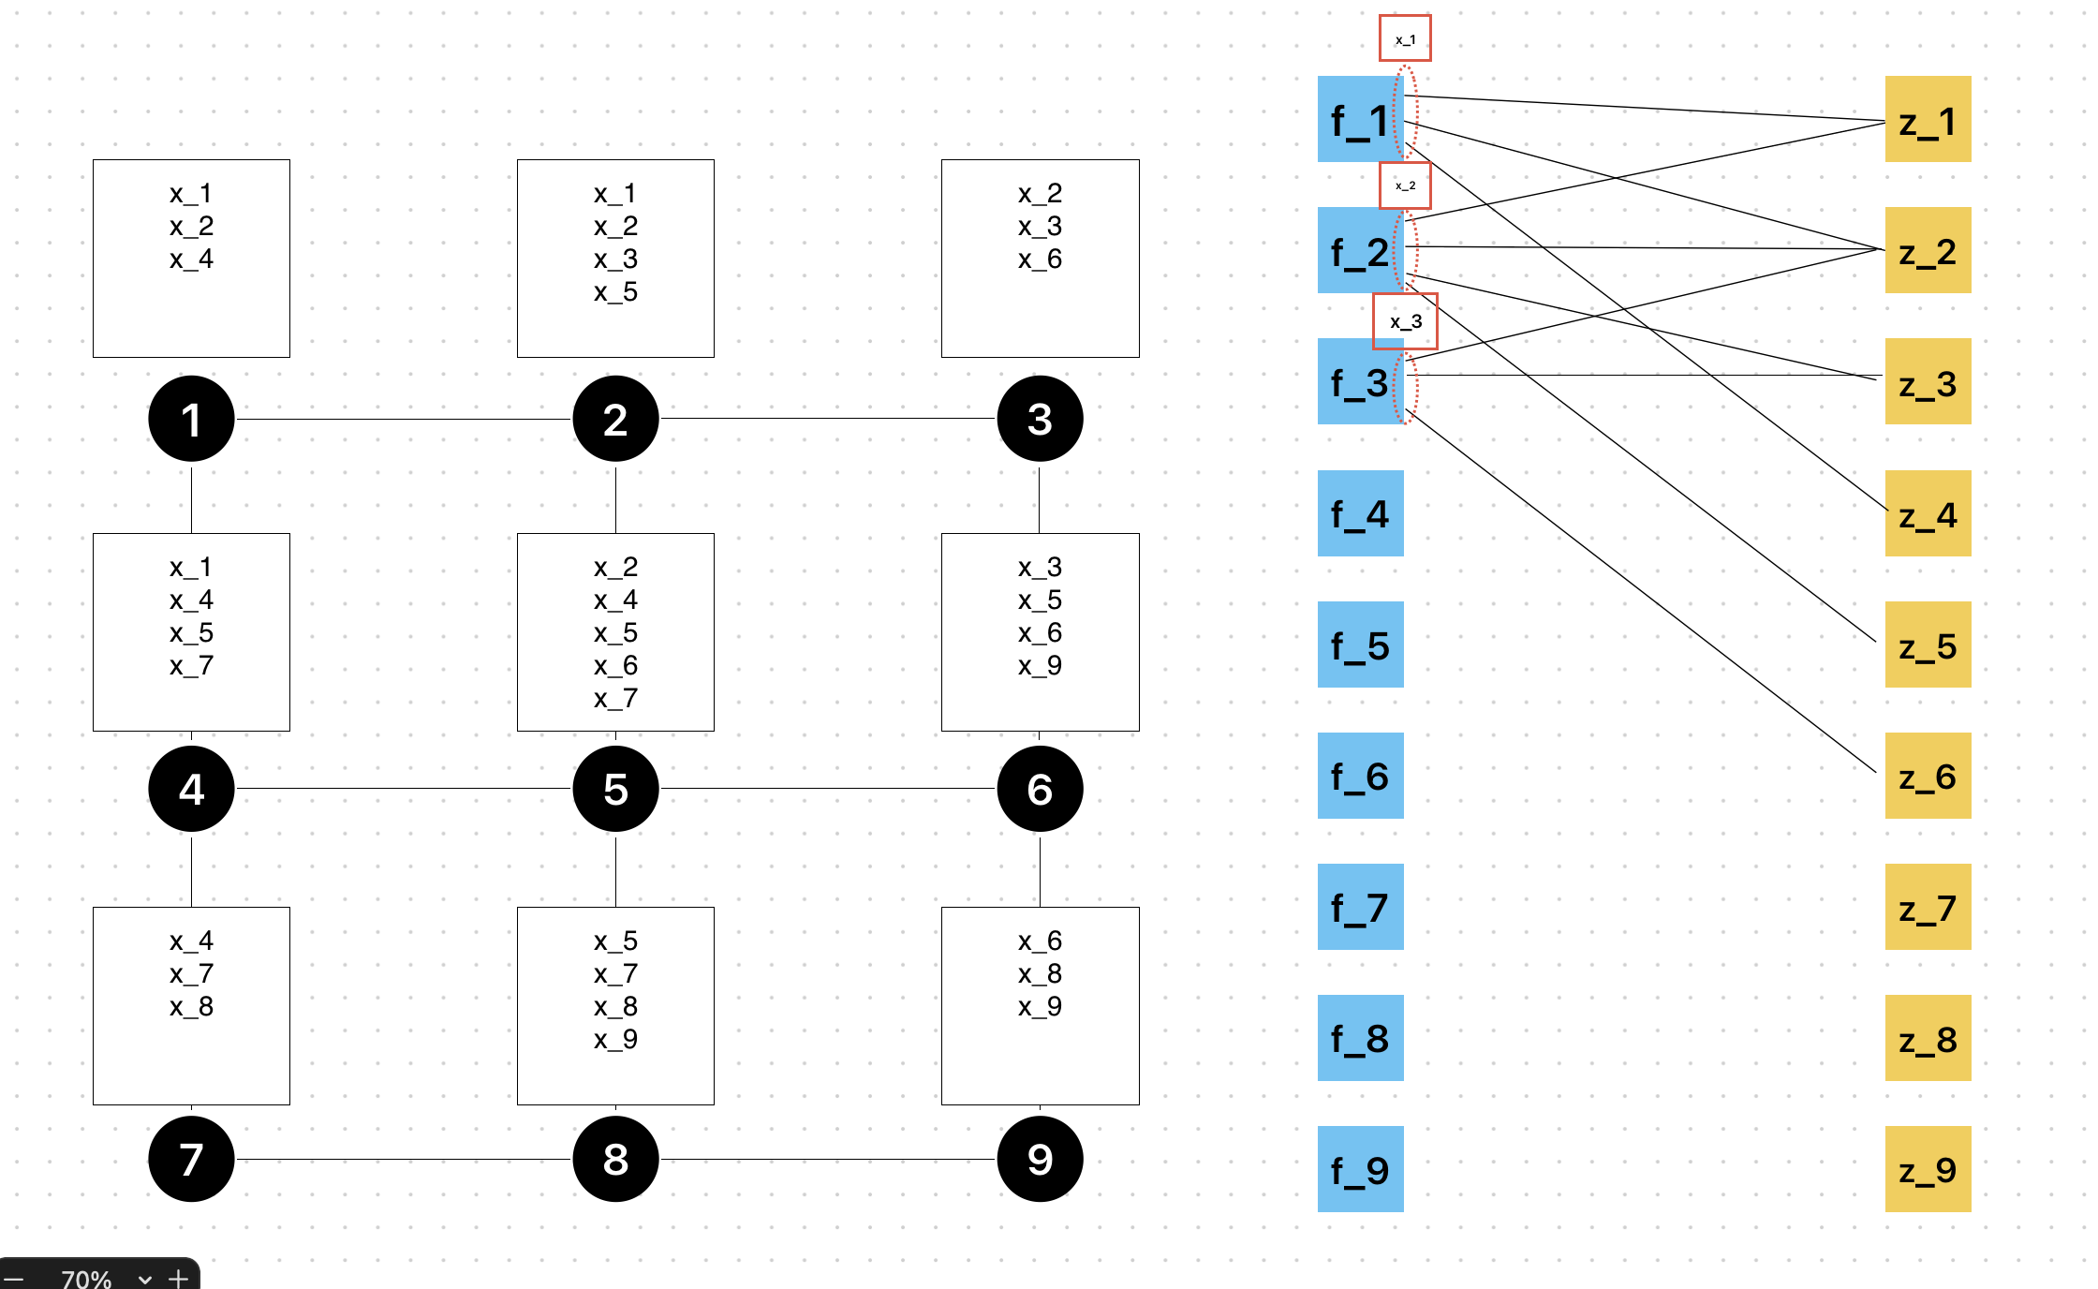
ADMM
Consensus variable z update
Z update is made by “central” node

Slide 5
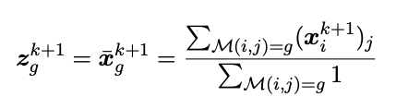

ADMM
Consensus variable z update
Z update is made by “central” node
Binary or continuous
For Continuous we do not need to share the dual variables among neighbours
No consensus variable required
Continuous
Binary

Slide 6
Overleaf
Structure of Literature Review (MP and RL)
Mention names of older algorithms
Length (Move to Introduction?)
Format of references (manually delete information?)

Slide 7
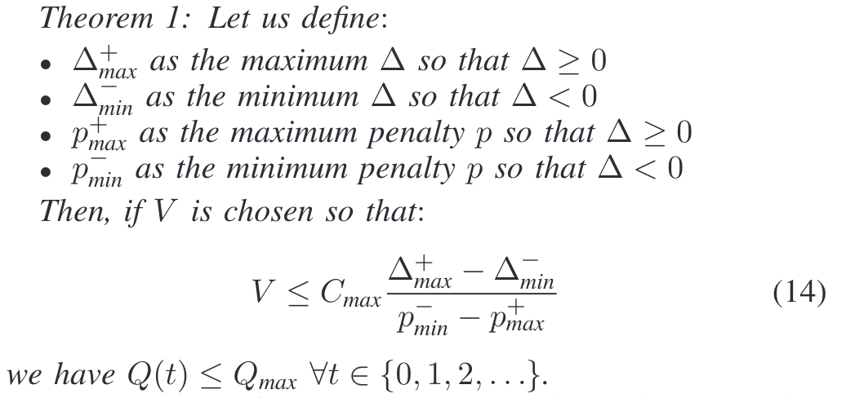
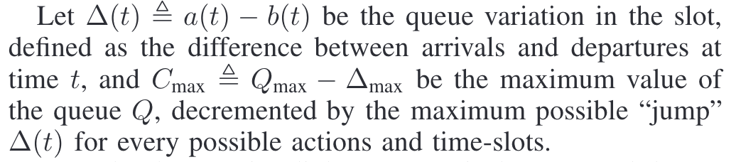
Code
Network and Demand
Choose parameters
V
Capacity per lane
Saturation flow rate
Discrete or continuous z

Slide 8
Outlook
Code & Simulations
Add further sections in overleaf

