Slide 1
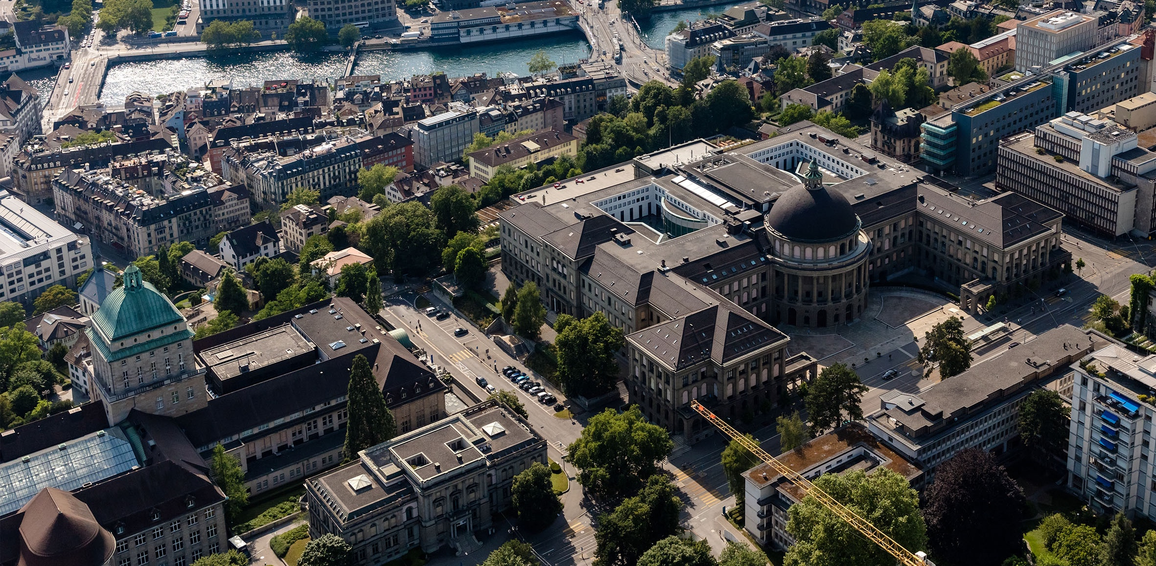
Meeting 5
Vinzenz Tütsch
25.01.2024

Slide 2
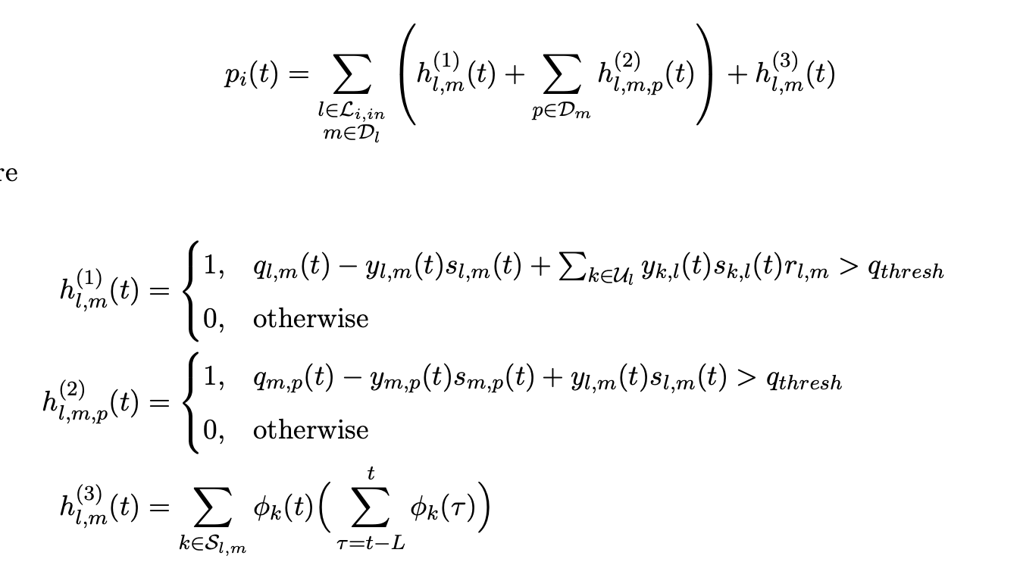
Simulation
LDPP-T: is the first penalty function (T stands for Threshold) → Theoretical guarantee
Here is still the mistake that the bracket should be around h^3

Slide 3

Simulation (LDPP-T)
Lane Capacity
ADMM IT
$$ρ$$
Z var
L
V_1
V_2
V_3
10_30_0.1_binary_5_0_1_1
Objective Values | Pressure Values | Throughput | Vehicle Speed | Waiting Vehicles Per Intersection | Waiting Vehicles Per Lane | Waiting Vehicles Per Lane Max
('10_30_0.1_binary_5_0_1_1', 250.49, 88.5, 250.49, 88.5) | ('10_30_0.1_binary_5_0_1_1', 81.52, 27.11, 81.52, 27.11) | ('10_30_0.1_binary_5_0_1_1', 0.32, 0.12, 0.32, 0.12) | ('10_30_0.1_binary_5_0_1_1', 1.32, 0.85, 1.32, 0.85) | ('10_30_0.1_binary_5_0_1_1', 26.06, 10.83, 26.06, 10.83) | ('10_30_0.1_binary_5_0_1_1', 1.68, 0.7, 1.68, 0.7) | ('10_30_0.1_binary_5_0_1_1', 9.94, 3.27, 9.94, 3.27)
('10_30_1_binary_5_1_5_1', 277.87, 105.91, 277.87, 105.91) | ('10_30_0.1_binary_5_5_1_0', 87.16, 26.32, 87.16, 26.32) | ('10_30_5_binary_5_0_5_1', 0.32, 0.12, 0.32, 0.12) | ('10_30_5_binary_5_0_5_1', 1.26, 0.84, 1.26, 0.84) | ('10_30_5_binary_5_0_5_1', 27.3, 10.68, 27.3, 10.68) | ('10_30_5_binary_5_0_5_1', 1.76, 0.69, 1.76, 0.69) | ('10_30_5_binary_5_0_5_1', 10.32, 3.2, 10.32, 3.2)
('25_30_5_binary_5_1_1_1', 278.9, 97.1, 278.9, 97.1) | ('25_30_1_binary_5_5_0_0', 88.35, 26.67, 88.35, 26.67) | ('25_30_5_binary_5_0_1_1', 0.31, 0.12, 0.31, 0.12) | ('10_30_1_binary_5_1_5_1', 1.22, 0.88, 1.22, 0.88) | ('10_30_1_binary_5_1_5_1', 27.48, 10.91, 27.48, 10.91) | ('10_30_1_binary_5_1_5_1', 1.77, 0.7, 1.77, 0.7) | ('10_30_1_binary_5_5_5_0', 10.34, 3.21, 10.34, 3.21)
Travel Time w Buffer | Travel Time wo Buffer | Waiting Time Per Vehicle | Waiting Time Per Vehicle Max | Number of Stops | Number of Vehicles Entered the Network | Phase Change Frequency
('10_30_0.1_binary_5_0_1_1', 477.64, 8.77) | ('10_30_0.1_binary_5_0_1_1', 377.79, 5.28) | ('10_30_0.1_binary_5_0_1_1', 271.71, 6.97) | ('25_30_1_binary_5_5_0_1', 1062.14, 135.25) | ('25_30_0.1_binary_5_0_0_5', 3.12, 0.06) | ('10_30_0.1_binary_5_0_1_1', 1920.0, 5.66) | ('25_30_5_binary_5_0_1_5', 0.45, 0.02)
('10_30_5_binary_5_0_5_1', 486.85, 11.75) | ('10_30_5_binary_5_0_5_1', 389.78, 12.51) | ('10_30_5_binary_5_0_5_1', 285.35, 17.84) | ('10_30_0.1_binary_5_0_1_1', 1090.11, 102.45) | ('25_30_5_binary_20_1_1_0', 3.15, 0.22) | ('10_30_5_binary_5_0_5_1', 1888.0, 11.31) | ('25_30_0.1_binary_5_0_0_5', 0.45, 0.01)
('10_30_1_binary_5_1_5_1', 495.48, 0.21) | ('10_30_1_binary_5_1_5_1', 399.56, 1.32) | ('10_30_1_binary_5_1_5_1', 298.58, 0.93) | ('25_30_1_binary_5_5_0_0', 1098.69, 254.83) | ('25_30_5_binary_5_0_1_5', 3.17, 0.05) | ('25_30_5_binary_5_0_1_1', 1887.0, 2.83) | ('25_30_1_binary_20_0_1_5', 0.46, 0.01)
The first value represents the mean over the entire simulation time and the second value is the variance over the simulation time (The remaining two values have an error that I only corrected later) (e.g. in the top left corner: Mean: 250.49, Std: 88.5)
The same applies to the second table: The first value is the mean over all simulations and the second is the variance) (e.g. in the top left corner: Mean 477.64 sec, Std: 8.77 sec)
Notes:
I made a description on top of the slide on how to decipher the values in the table. I hope it is clear on how to read it. Otherwise let me know
The string “binary” for ”Z var” only means that I used the binary updated equation for the global ADMM z-variable (as we discussed earlier) and not the continuous version
I did multiple simulations for each parameter setting. Then I averaged them to get rid of the variance.
The same parameters have the same color
As you can see, the best parameters gives preference to V2 over V1. However, I think we can still keep the V1 term (as it makes intuitively sense and this result might not apply to all networks)
The question however is whether you want to give each term (V1 – V3) a different weight.

Slide 4
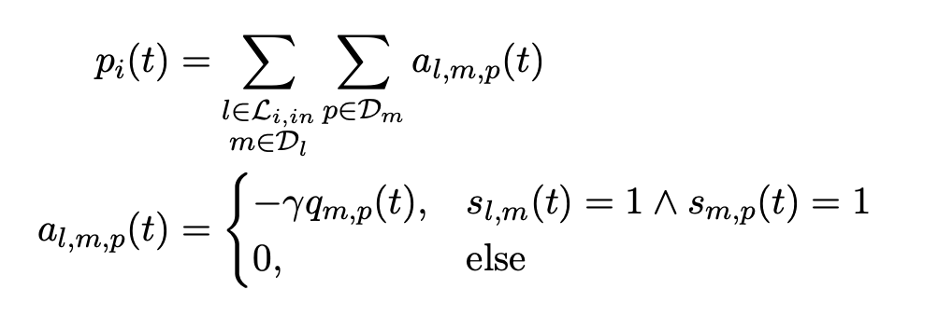
Simulation
LDPP-GF: is the second penalty function (GF stands for Green flow) → No theoretical guarantee

Slide 5


Simulation (LDPP-GF)
ADMM IT
$$ρ$$
Z var
$$γ$$
V
30_0.1_binary_constant_0
Objective Values | Pressure Values | Throughput | Vehicle Speed | Waiting Vehicles Per Intersection | Waiting Vehicles Per Lane | Waiting Vehicles Per Lane Max
('30_1_binary_constant_12', 310.79, 103.76, 310.79, 103.76) | ('30_1_binary_constant_12', 89.04, 30.24, 89.04, 30.24) | ('30_0.1_binary_constant_2', 0.28, 0.14, 0.28, 0.14) | ('30_1_binary_constant_12', 1.11, 0.94, 1.11, 0.94) | ('30_2_binary_constant_2', 32.53, 11.57, 32.53, 11.57) | ('30_2_binary_constant_2', 2.1, 0.75, 2.1, 0.75) | ('30_1_binary_constant_12', 10.93, 3.37, 10.93, 3.37)
('30_2_binary_constant_2', 325.98, 114.74, 325.98, 114.74) | ('30_2_binary_constant_2', 95.16, 32.58, 95.16, 32.58) | ('30_1_binary_constant_12', 0.28, 0.14, 0.28, 0.14) | ('30_0.1_binary_constant_2', 1.11, 0.96, 1.11, 0.96) | ('30_1_binary_constant_12', 32.61, 12.4, 32.61, 12.4) | ('30_1_binary_constant_12', 2.1, 0.8, 2.1, 0.8) | ('30_0.1_binary_constant_2', 11.05, 3.4, 11.05, 3.4)
('30_1_binary_constant_1', 334.27, 114.84, 334.27, 114.84) | ('30_5_binary_constant_12', 95.73, 31.37, 95.73, 31.37) | ('30_2_binary_constant_2', 0.27, 0.14, 0.27, 0.14) | ('30_5_binary_constant_1', 1.08, 0.97, 1.08, 0.97) | ('30_5_binary_constant_12', 32.9, 11.85, 32.9, 11.85) | ('30_5_binary_constant_12', 2.12, 0.76, 2.12, 0.76) | ('30_5_binary_constant_1', 11.05, 3.28, 11.05, 3.28)
Travel Time w Buffer | Travel Time wo Buffer | Waiting Time Per Vehicle | Waiting Time Per Vehicle Max | Number of Stops | Number of Vehicles Entered the Network | Phase Change Frequency
('30_5_binary_constant_12', 550.22, 21.77) | ('30_5_binary_constant_12', 451.96, 40.95) | ('30_2_binary_constant_2', 369.26, 61.81) | ('30_5_binary_constant_1', 1304.42, 18.27) | ('30_5_binary_constant_6', 3.52, 0.4) | ('30_0.1_binary_constant_2', 1832.5, 36.06) | ('30_2_binary_constant_12', 0.58, 0.02)
('30_2_binary_constant_2', 550.23, 33.79) | ('30_2_binary_constant_2', 452.89, 41.81) | ('30_5_binary_constant_12', 371.38, 56.54) | ('30_2_binary_constant_0', 1308.92, 147.59) | ('30_0.1_binary_constant_12', 3.55, 0.69) | ('30_5_binary_constant_12', 1815.0, 69.3) | ('30_5_binary_constant_6', 0.58, 0.12)
('30_0.1_binary_constant_2', 551.36, 45.74) | ('30_0.1_binary_constant_2', 458.93, 51.98) | ('30_0.1_binary_constant_2', 372.47, 71.25) | ('30_1_binary_constant_0', 1364.69, 68.31) | ('30_1_binary_constant_6', 3.65, 0.16) | ('30_5_binary_constant_1', 1813.0, 87.68) | ('30_1_binary_constant_2', 0.59, 0.13)
Notes:
- For \gamma parameter: constant only means that I did not make it depending on the number of cars on each lane, but it was constant = 1 during the entire simulation. The weight of the penalty was then only set by V
- It is interesting that this penalty performs worse than the first penalty function, since in my thesis it had a better performance.
The reason might be because now I introduce an idle time where all phases have a red light for 5 seconds (20 seconds green time). Apparently, this had a bigger effect on this penalty function
However, I have seen a paper that had only 3 seconds idle time. I could try to decrease the idle time if that helps somehow.

