Slide 1
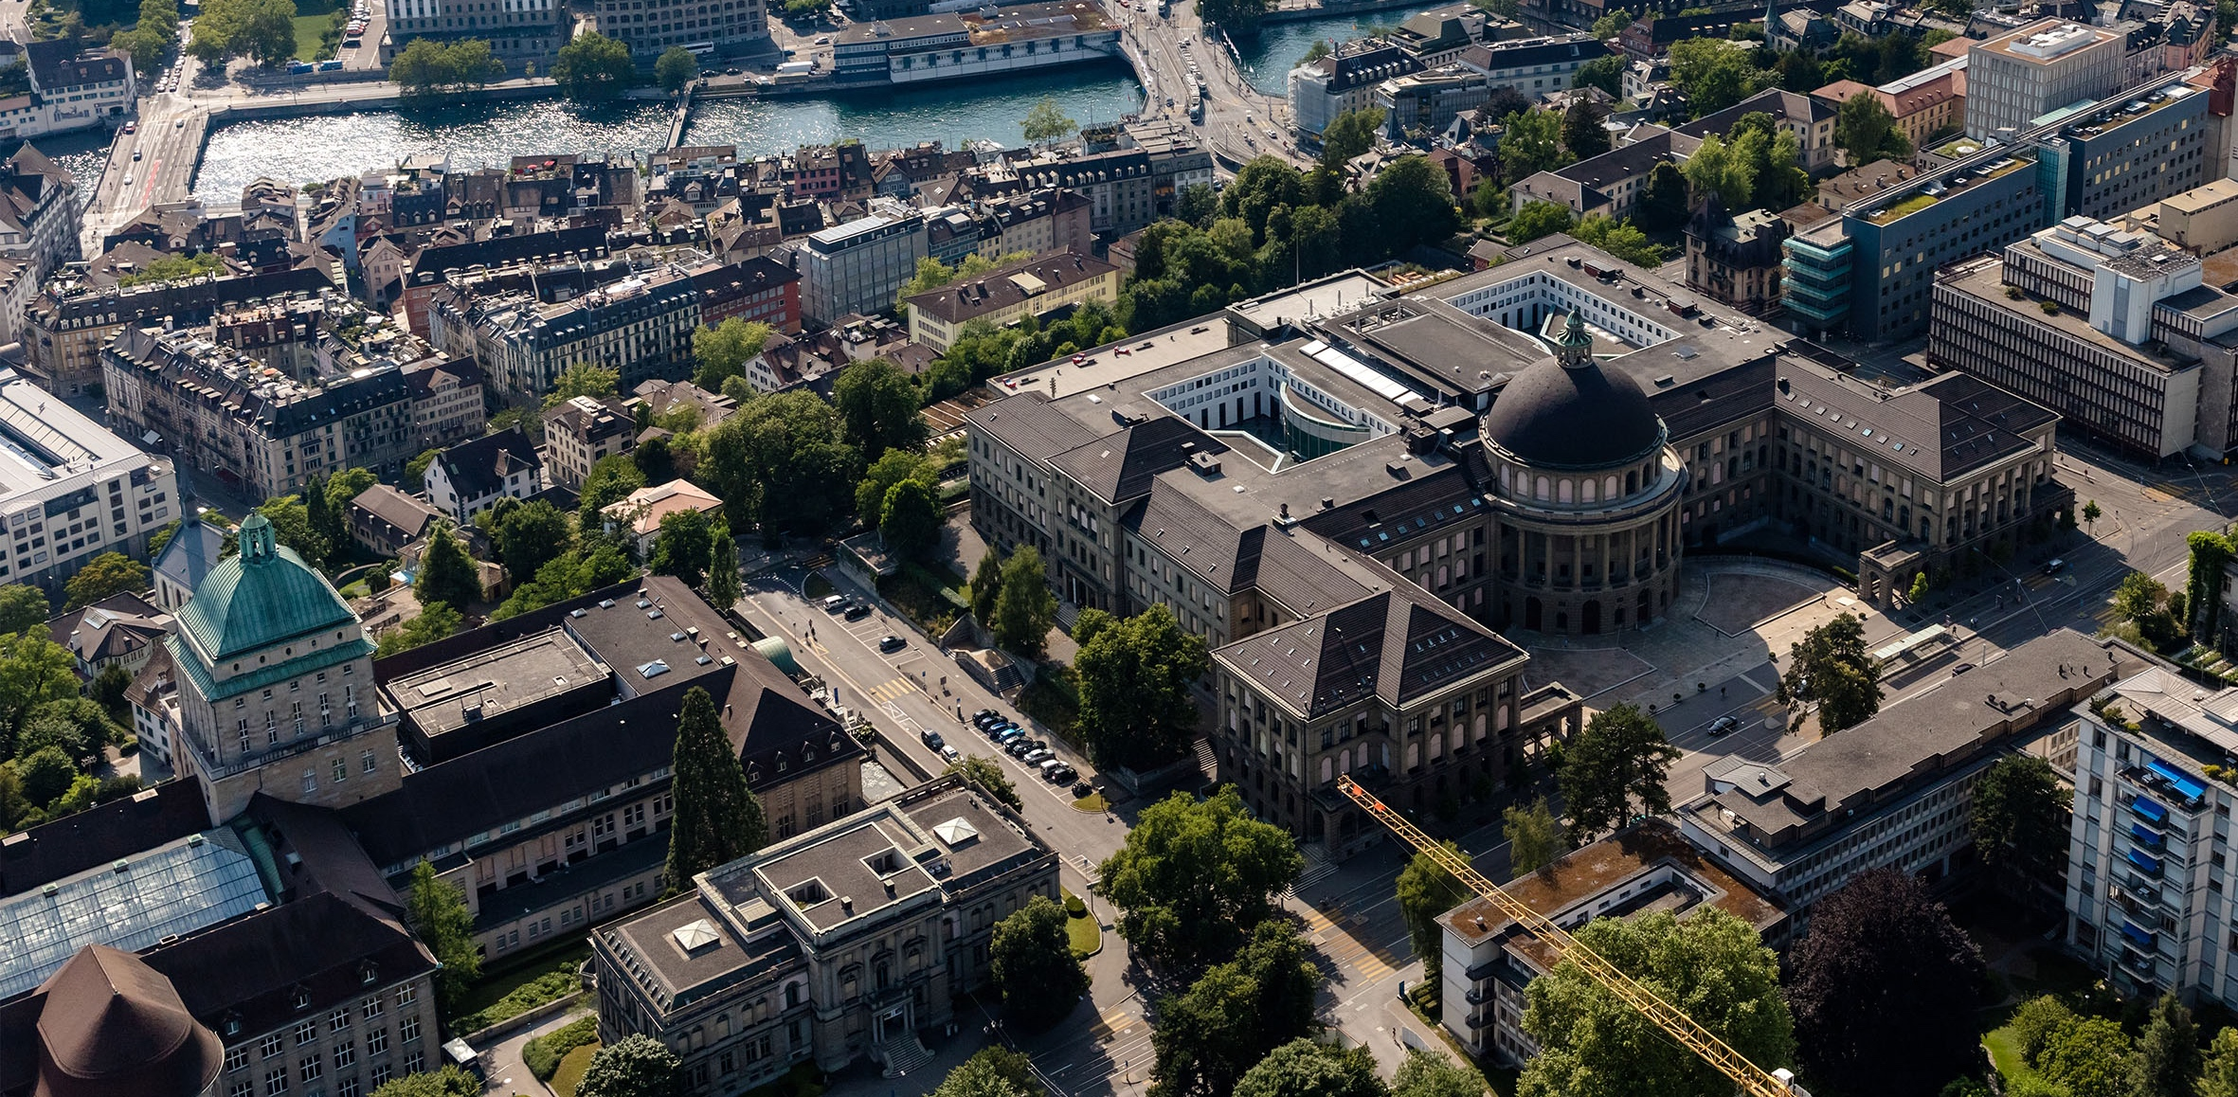
Meeting 1
Vinzenz Tütsch
16.11.2023

Slide 2
Topics
Overview
Traffic Signal Control
Consensus
Simulation
To Do

Slide 3
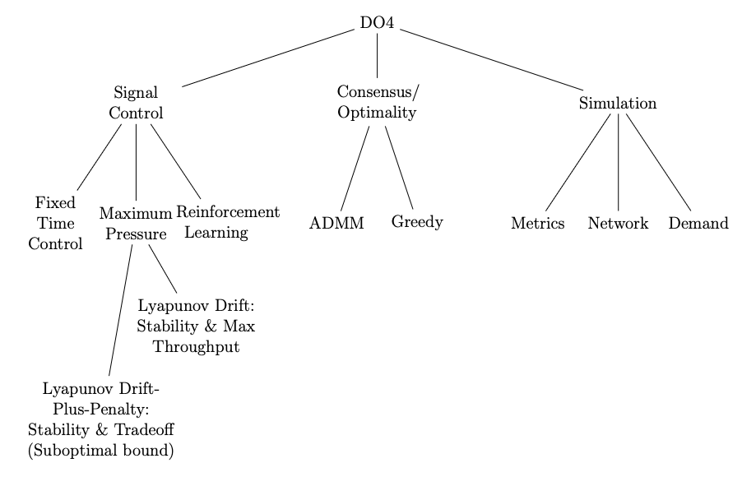
Overview

Slide 4
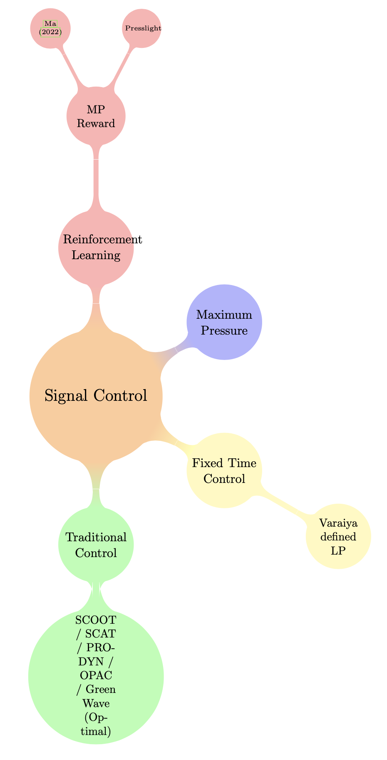
Traffic Signal Control
Green Wave: Optimal solution for an arterial network (comparison)

Slide 5
Traffic Signal Control
Algorithm | + | -
Original Max Pressure | Theoretical max throughput (model) | May lead to gridlocks and queue spill over Not work conserving (waste green time)
Weighted queues / Pressures | Takes queue lengths into consideration
MP-Pract | Frequent decision revisions but with a reduced cost. | Loose theoretical stability
Min Green Time | Increase effective green ratio Reduction of travel time Reduced switching cost
Le’s Model (Cyclic) | Guarantees no skipped phases | Possibly infinitely short green times
Cyclic LP formulation (MP) | Min green time, cyclic Efficient solution (same complexity as MP) | Smaller stability region than MP
Notes:
MP-pract:
The theory of MP developed in P.Varaiya (2013), shows that the queue length resulting from MP control is inversely proportional to the number of decisions per cycle. (Even though I cannot find the same analytical part, my simulation previsouly had the same conclusion)
However, this induces the cost of switching the phase more frequently and with including the lost time, it might even make throughput worse

Slide 6
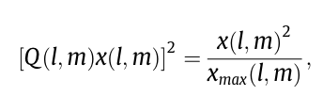
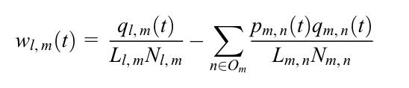
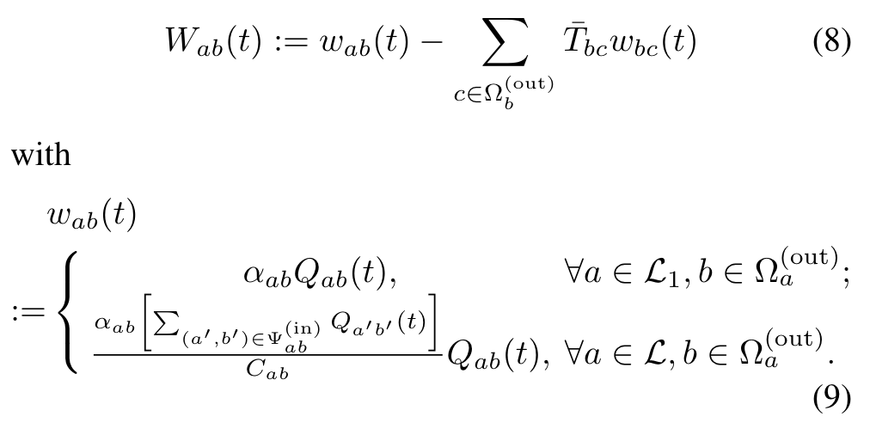
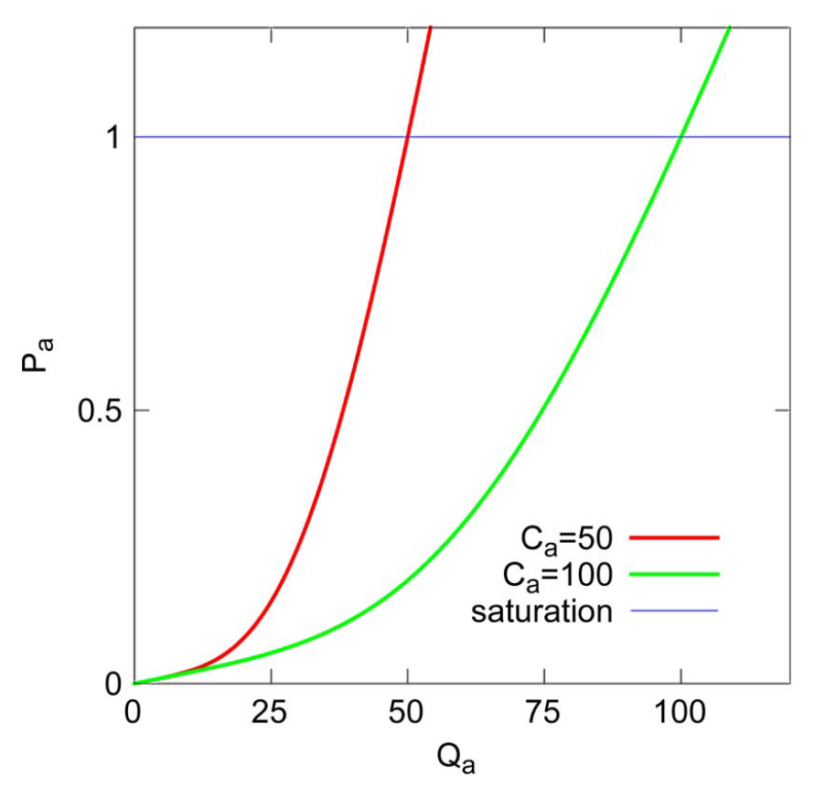
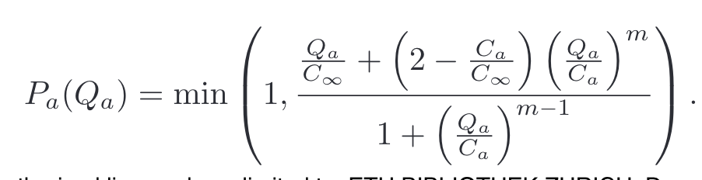
MP – Weighted Queues / Pressures
Varaiya
Sun and Yin
Pressure Releasing
Capacity Aware BP
Notes:
Pressure Releasing:
Smaller throughput region as MP, but can be adapted by choosing the capacity value C
Takes upstream lanes into consideration
Capacity Aware MP:
Guarantees Work Conservation (if it is possible to give green time to a lane such that cars will move, than the controller will choose such a lane and not waste green time)
Convex Pressure
Fairness at low occupancy
Stability at low occupancy (basically MP controller)
Issue: Last pocket problem: vehicle at a node whose queue length remains very small may be starved for a long time, as backpressure control gives priority to nodes with larger queue lengths

Slide 7
Traffic Signal Control
Algorithm | + | -
Lyapunov Drift Plus Penalty (Energy) | Theoretical stability & energy minimization (design for parameter V)
Backpressure based LDPP | Similar idea as our controller with different penalty (considers capacity of downstream lane) Theoretical stability
Bidding Algorithm (similar to LDPP) | Theoretical optimality and stability (same as MP but different weight) Similar “greedy” algorithm to resolve consensus | I believe not guaranteed optimal consensus algorithm
Notes:
Energy penalty: LDPP but try to minimize energy while stabilizing queues (choose V to bound queue lengths)
Backpressure: Similar as we did but different penalty. Does not depend on downstream decision, but only downstream queue condition

Slide 8
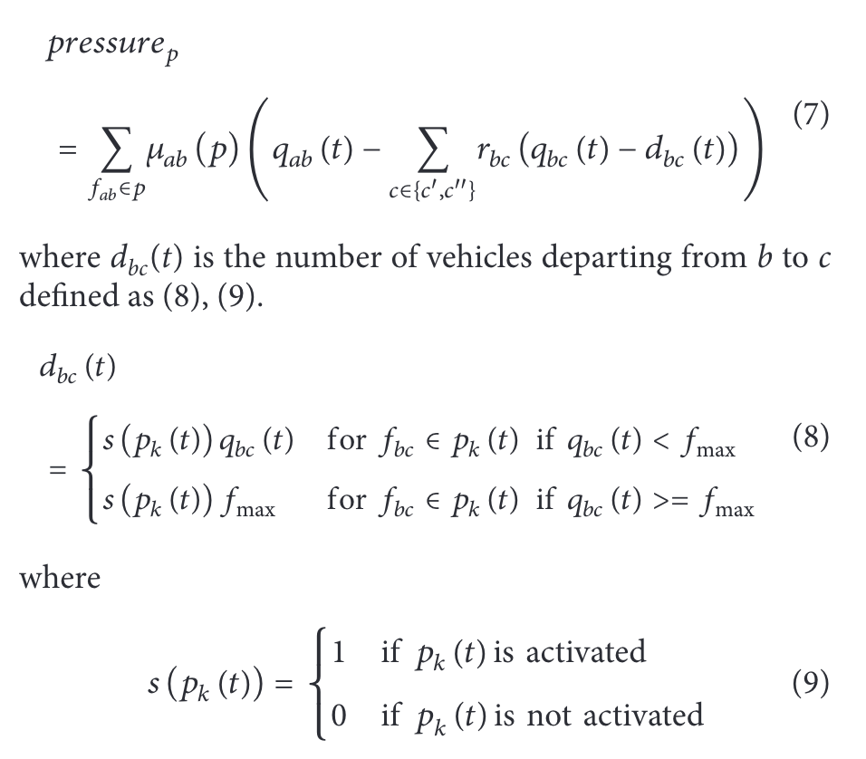
Bidding Algorithm
+ Consensus Algorithm (Bidding)
Under some conditions:
Guarantee convergence to a conflict-free assignment
Provable worst-case performance
Notes:
Basically similar to what we wanted to do. Find a new “pressure definition” that takes downstream decisions into consideration
Guaranteed stability
Somewhat similar consensus algorithm as our greedy algorithm but requires global communication

Slide 9
Consensus
Hard to find theoretical results for MINLP
ADMM heuristics that work well (http://www.mi-kanno.mist.i.u-tokyo.ac.jp/kanno/presen/acsmo2018.pdf )
Different solutions (Not ADMM)
A New Distributed Optimization Algorithm for MINLPs with Affinely Coupled Decision Variables
Solving Extremely Difficult MINLP Problems Using Adaptive Resolution Micro-GA with Tabu Search
A good recipe for solving MINLPs
ADMM
Optimality
Complexity Analysis
Greedy
Optimality

Slide 10
Consensus
Hard to find theoretical results for MINLP
ADMM heuristics that work well (http://www.mi-kanno.mist.i.u-tokyo.ac.jp/kanno/presen/acsmo2018.pdf )
Different solutions (Not ADMM)
A New Distributed Optimization Algorithm for MINLPs with Affinely Coupled Decision Variables
Solving Extremely Difficult MINLP Problems Using Adaptive Resolution Micro-GA with Tabu Search
A good recipe for solving MINLPs
ADMM
Optimality
Complexity Analysis
Greedy
Optimality
8 Phases → 8 decision variables per intersection
“Optimization range” in a grid spans over 5 intersections → 8^5 = 32’768 combinations

Slide 11
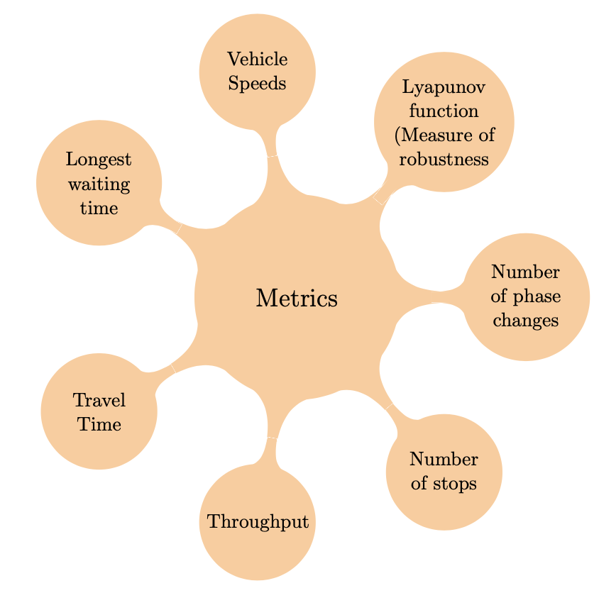
Simulation
Metrics
Network
Introduce time between phase changes (idle time)
Grid, Real world, Arterial
Demand
Find real demand
Compare to what algorithm
Green Wave (Optimal solution to arterial network)
RL – Methods (Implementation ?)
Original MP
Fixed Time or Traditional

Slide 12
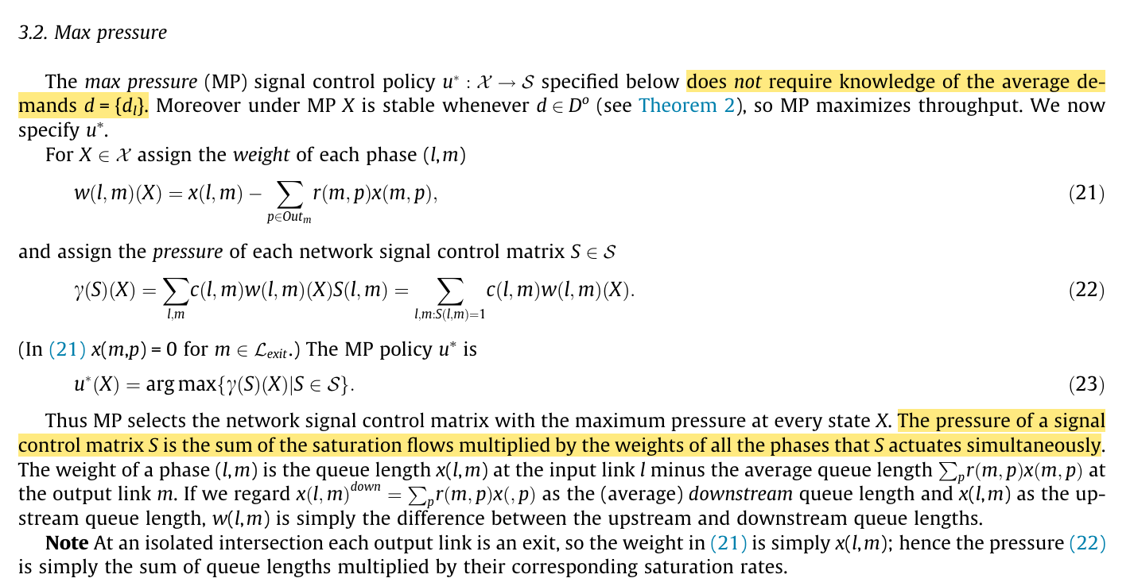
To Do
Implementation of Max Pressure
Ingress nodes have no capacity constraint, that is, infinite capacity.
Exit nodes have no queued vehicles, on which arrived vehicles leave network immediately.

Slide 13
To Do
Choose pressure function
Original
Capacity aware
Bidding
Normalize
Büchi Automaton
Introduction Overleaf
Start with implementation (Network / Demand / Simulation)

