Slide 1
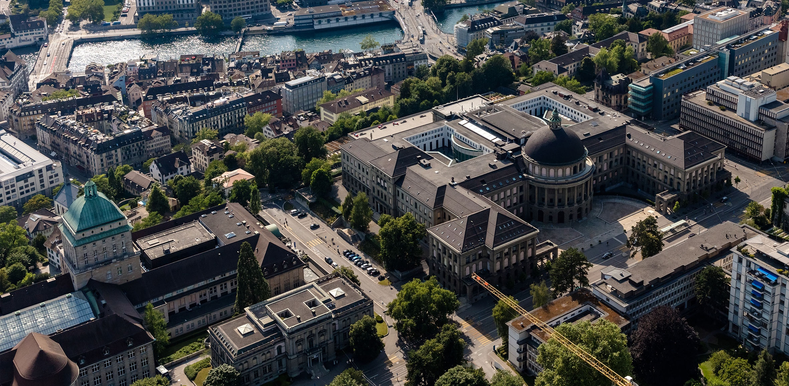
Meeting 6
Vinzenz Tütsch
22.02.2024

Slide 2
Topics
Code
Manhattan
Overleaf

Slide 3
Code
Found 2 minor mistakes that influenced the performance → redo simulation

Slide 4
Manhattan
Difficult to generate evenly traffic in a random way without generating huge traffic jams

Slide 5
Overleaf
Restructured according to comments from Kenan

