Slide 1
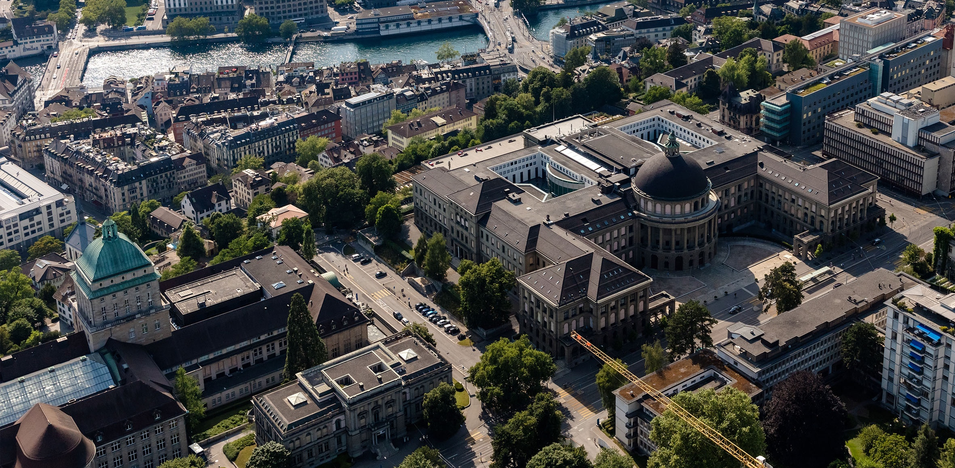
Meeting 7
Vinzenz Tütsch
06.03.2024

Slide 2
Topics
Simulation Results after Error Correction
New Manhattan Network
Issue with Ray
Overleaf

Slide 3
Simulation Results after Error Correction
5_1_3_0 → L = 5, V1 = 1, V2 = 3, V3 = 0
Travel Time w Buffer | Travel Time wo Buffer | Waiting Time Per Vehicle | Waiting Time Per Vehicle Max | Number of Stops | Number of Vehicles Entered the Network | Phase Change Frequency
('LDPP-T-ADMM_20_0_1600_13_30_0.5_binary_5_1_3_0', 268.18, 15.74) | ('LDPP-T-ADMM_20_0_1600_13_30_0.5_binary_5_1_3_0', 232.55, 7.57) | ('LDPP-T-ADMM_20_0_1600_13_30_0.5_binary_5_1_3_0', 123.68, 10.1) | ('LDPP-T-ADMM_20_0_1600_13_30_2_binary_20_3_1_1', 357.39, 88.15) | ('LDPP-T-ADMM_20_0_1600_25_30_2_binary_5_3_0_0', 3.4, 0.78) | ('LDPP-T-ADMM_20_0_1600_13_30_0.5_binary_20_0_3_0', 2081.0, 0.0) | ('LDPP-T-ADMM_20_0_1600_25_30_2_binary_5_3_0_0', 0.74, 0.24)
('LDPP-T-ADMM_20_0_1600_13_30_0.5_binary_20_1_3_0', 272.08, 2.59) | ('LDPP-T-ADMM_20_0_1600_13_30_0.5_binary_20_0_3_0', 235.17, 3.84) | ('LDPP-T-ADMM_20_0_1600_13_30_0.5_binary_20_0_3_0', 126.93, 5.39) | ('LDPP-T-ADMM_20_0_1600_25_30_0.5_binary_5_0_1_1', 407.72, 30.88) | ('LDPP-T-ADMM_20_0_1600_13_30_2_binary_20_1_3_3', 3.41, 0.24) | ('LDPP-T-ADMM_20_0_1600_13_30_0.5_binary_20_1_1_0', 2081.0, 0.0) | ('LDPP-T-ADMM_20_0_1600_25_30_2_binary_20_1_0_0', 0.78, 0.21)
('LDPP-T-ADMM_20_0_1600_13_30_0.5_binary_20_0_3_0', 276.53, 0.24) | ('LDPP-T-ADMM_20_0_1600_13_30_0.5_binary_5_0_3_0', 235.49, 1.96) | ('LDPP-T-ADMM_20_0_1600_13_30_0.5_binary_20_1_3_0', 127.43, 2.63) | ('LDPP-T-ADMM_20_0_1600_25_30_2_binary_5_3_1_1', 417.75, 161.73) | ('LDPP-T-ADMM_20_0_1600_25_30_2_binary_20_3_3_0', 3.43, 0.43) | ('LDPP-T-ADMM_20_0_1600_13_30_0.5_binary_20_1_3_0', 2081.0, 0.0) | ('LDPP-T-ADMM_20_0_1600_13_30_0.5_binary_20_0_1_0', 0.78, 0.22)
('LDPP-T-ADMM_20_0_1600_13_30_0.5_binary_5_0_3_0', 276.61, 0.77) | ('LDPP-T-ADMM_20_0_1600_13_30_0.5_binary_20_1_3_0', 237.21, 3.25) | ('LDPP-T-ADMM_20_0_1600_13_30_0.5_binary_5_0_3_0', 129.88, 2.27) | ('LDPP-T-ADMM_20_0_1600_25_30_2_binary_5_1_1_3', 419.31, 71.85) | ('LDPP-T-ADMM_20_0_1600_25_30_0.5_binary_20_3_1_0', 3.45, 0.55) | ('LDPP-T-ADMM_20_0_1600_13_30_0.5_binary_20_3_1_0', 2081.0, 0.0) | ('LDPP-T-ADMM_20_0_1600_25_30_2_binary_20_3_3_0', 0.79, 0.19)
('LDPP-T-ADMM_20_0_1600_13_30_0.5_binary_5_3_3_0', 281.94, 3.85) | ('LDPP-T-ADMM_20_0_1600_13_30_0.5_binary_5_3_3_0', 239.03, 5.99) | ('LDPP-T-ADMM_20_0_1600_13_30_0.5_binary_5_3_3_0', 132.96, 4.71) | ('LDPP-T-ADMM_20_0_1600_13_30_0.5_binary_5_0_0_0', 420.08, 19.52) | ('LDPP-T-ADMM_20_0_1600_13_30_2_binary_20_1_3_0', 3.46, 0.25) | ('LDPP-T-ADMM_20_0_1600_13_30_0.5_binary_20_3_3_0', 2081.0, 0.0) | ('LDPP-T-ADMM_20_0_1600_25_30_0.5_binary_20_3_1_0', 0.79, 0.16)
('LDPP-T-ADMM_20_0_1600_13_30_2_binary_5_1_3_0', 282.83, 15.82) | ('LDPP-T-ADMM_20_0_1600_13_30_0.5_binary_5_1_1_0', 242.1, 6.86) | ('LDPP-T-ADMM_20_0_1600_13_30_0.5_binary_5_1_1_0', 134.57, 5.5) | ('LDPP-T-ADMM_20_0_1600_25_30_0.5_binary_5_0_0_1', 431.25, 36.26) | ('LDPP-T-ADMM_20_0_1600_25_30_2_binary_20_0_1_0', 3.51, 0.52) | ('LDPP-T-ADMM_20_0_1600_13_30_0.5_binary_5_0_0_0', 2081.0, 0.0) | ('LDPP-T-ADMM_20_0_1600_25_30_2_binary_5_0_0_0', 0.79, 0.19)
('LDPP-T-ADMM_20_0_1600_13_30_2_binary_20_3_3_0', 288.41, 27.13) | ('LDPP-T-ADMM_20_0_1600_13_30_2_binary_5_1_3_0', 242.31, 8.16) | ('LDPP-T-ADMM_20_0_1600_13_30_2_binary_5_1_3_0', 134.82, 9.31) | ('LDPP-T-ADMM_20_0_1600_25_30_2_binary_5_1_1_1', 431.42, 64.94) | ('LDPP-T-ADMM_20_0_1600_25_30_2_binary_20_3_1_0', 3.53, 0.45) | ('LDPP-T-ADMM_20_0_1600_13_30_0.5_binary_5_0_1_0', 2081.0, 0.0) | ('LDPP-T-ADMM_20_0_1600_25_30_0.5_binary_5_1_0_0', 0.8, 0.21)

Slide 4
New Manhattan Network
Simulation
More traffic?
Better Fixed Time Policy?

Slide 5
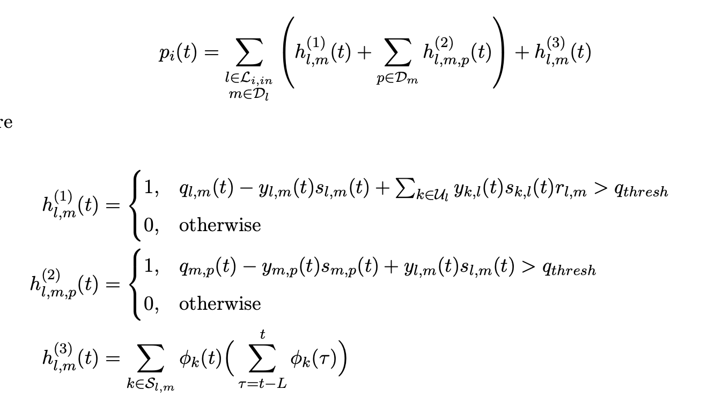
Simulation
Pretend 2 straight lines to be only 1
(Merge)

Slide 6
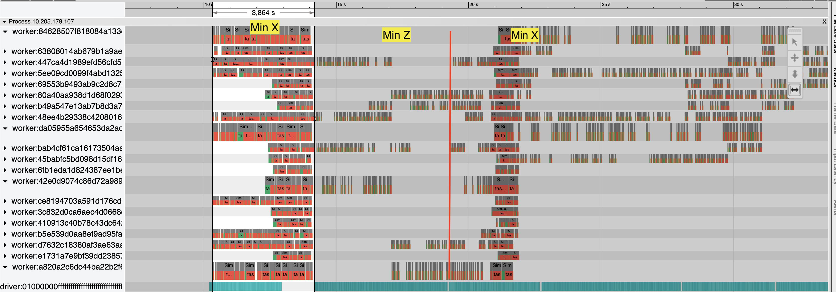
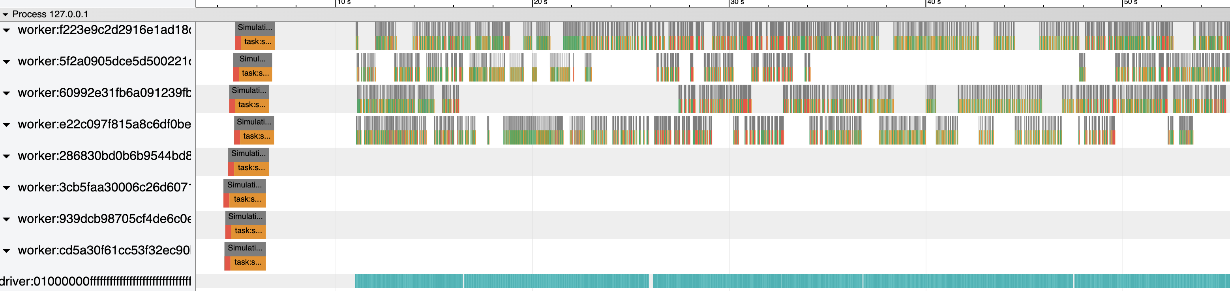
Issue with Ray
290 Intersections with 20 Workers (Euler / my Computer)

Slide 7
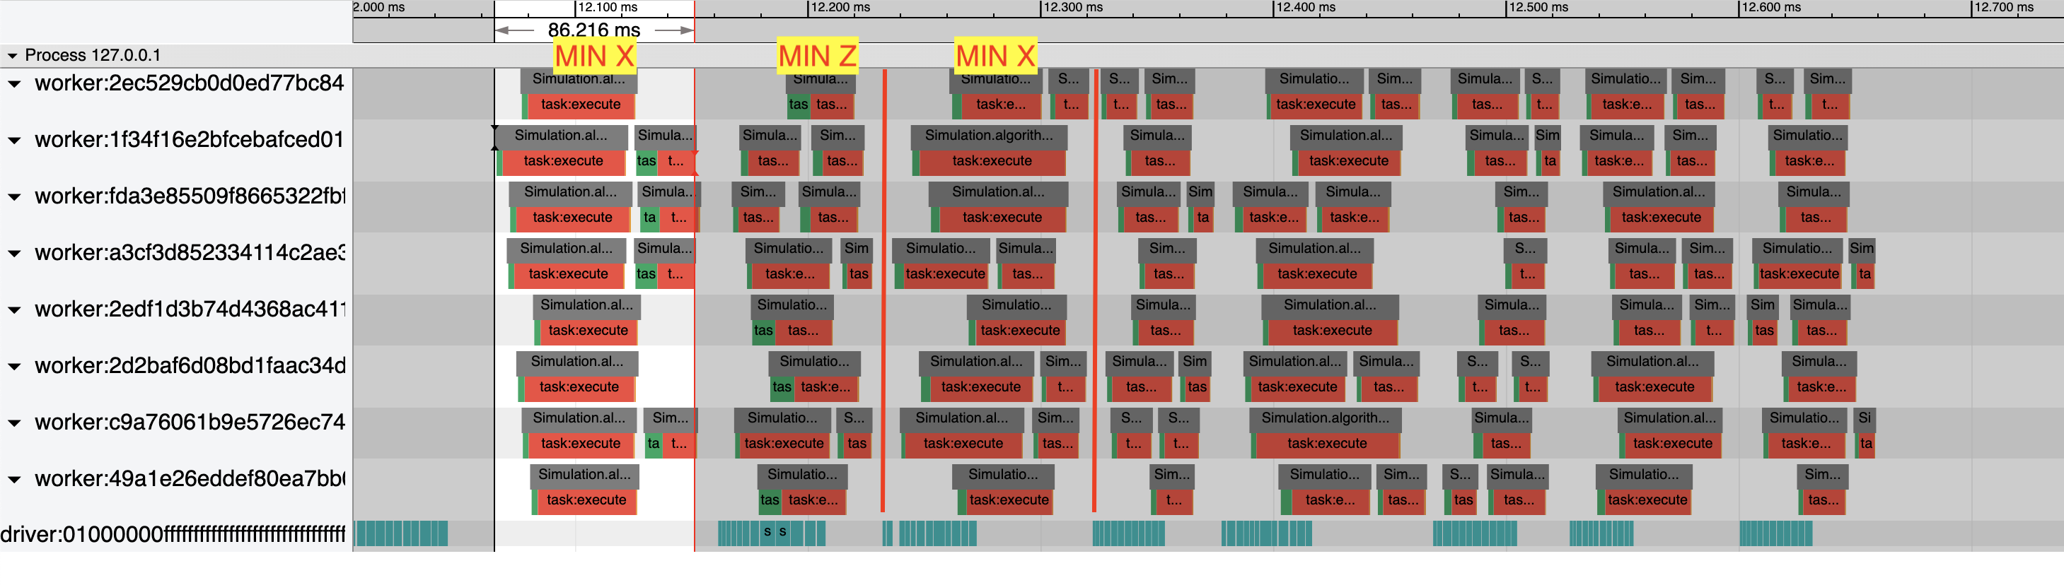
Issue with Ray
12 Intersections with 8 Workers (My computer)

Slide 8
Overleaf
Comments on my changes from last time?

