Slide 1
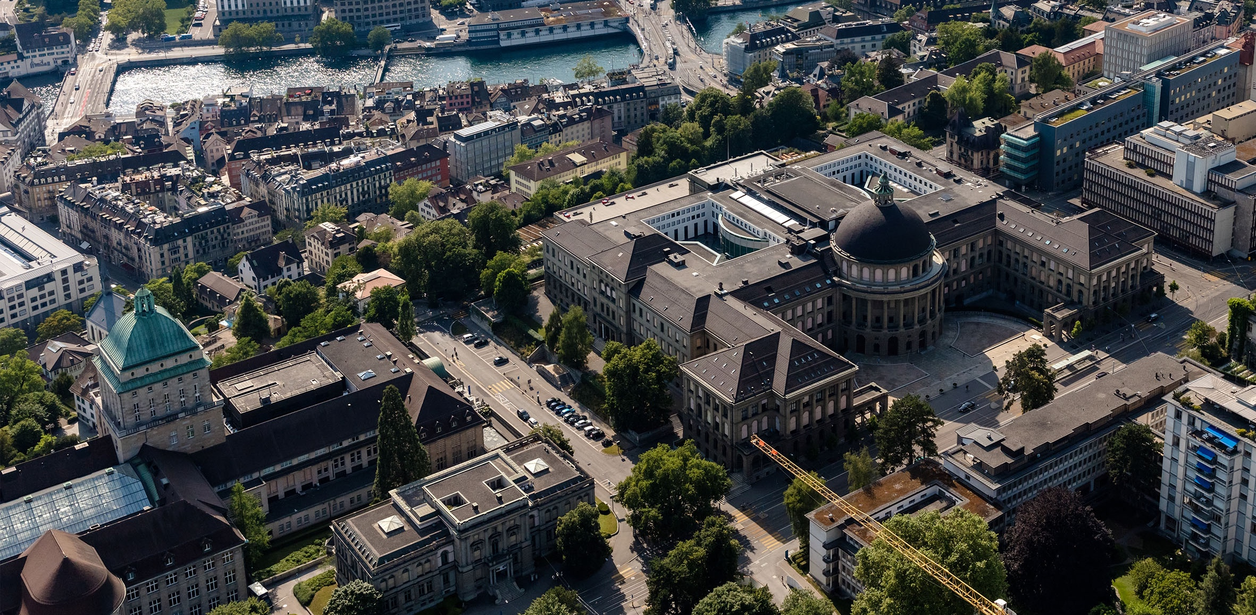
Meeting 9
Vinzenz Tütsch
03.04.2024

Slide 2
Topics
Overleaf

Slide 3
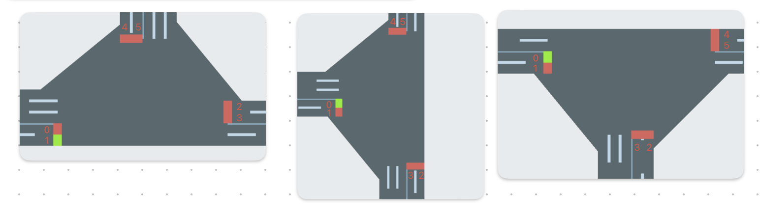
Overleaf
Include Image Phases
Paper Title and Controller name
ADMM formulation (basics)
2 same images (congestion pattern)
Computation Time CA_MP
Conclusion and Abstract

