Slide 1
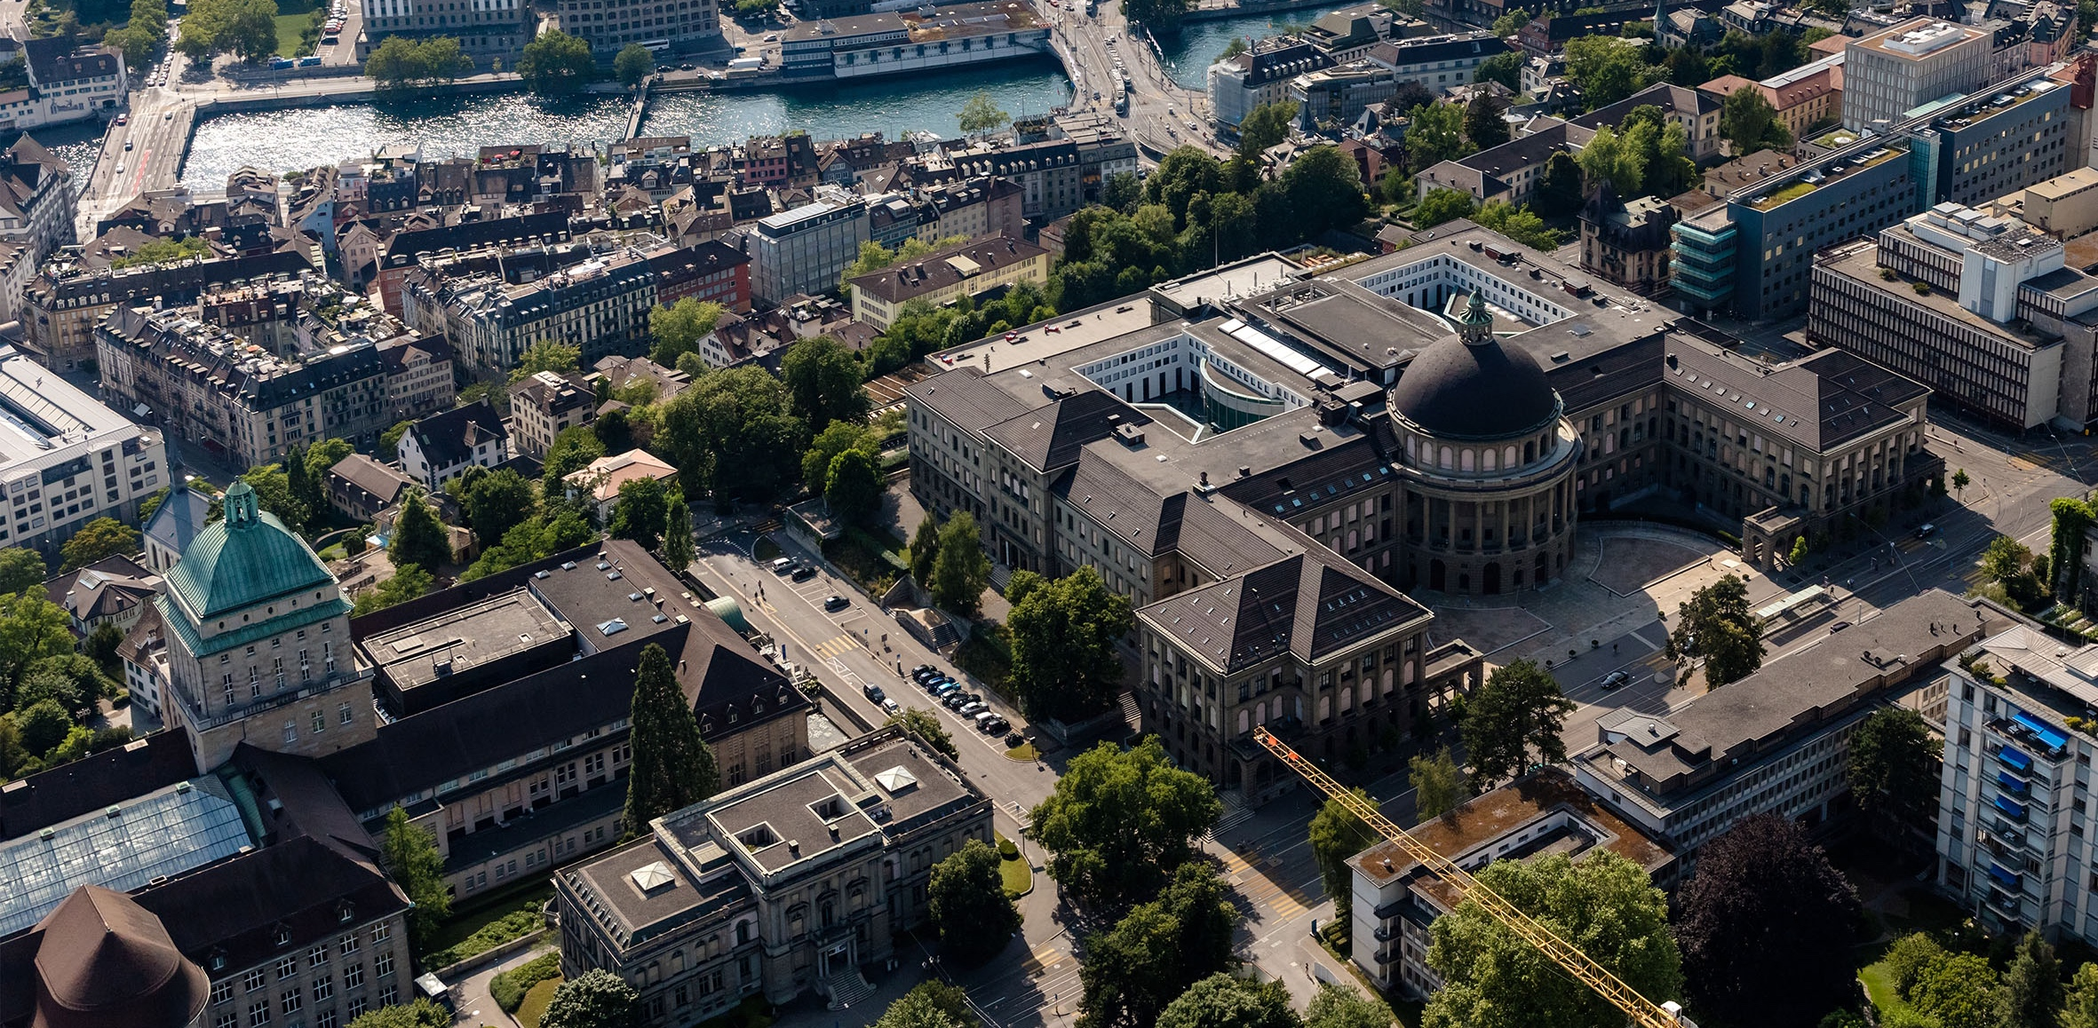
Meeting 8
Vinzenz Tütsch
20.03.2024

Slide 2
Topics
Simulation Results Manhattan
Overleaf

Slide 3
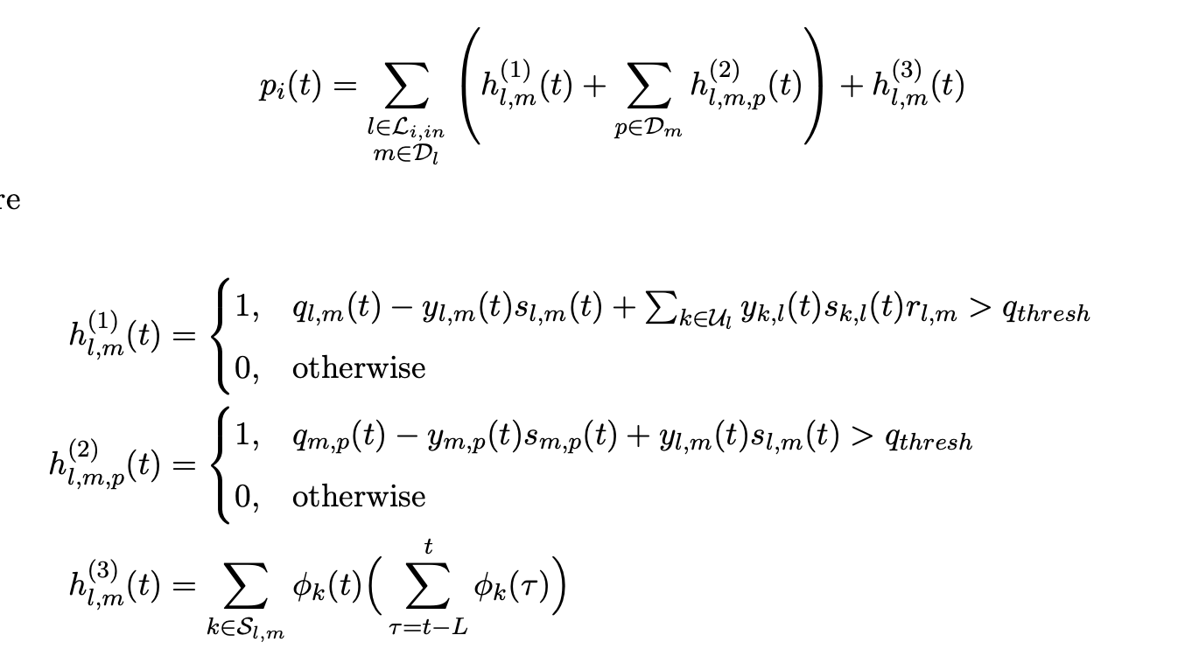
Simulation Results Manhattan
Using the threshold penalty
ADMM and Greedy beat MP
Greedy is computationally much cheaper

Slide 4
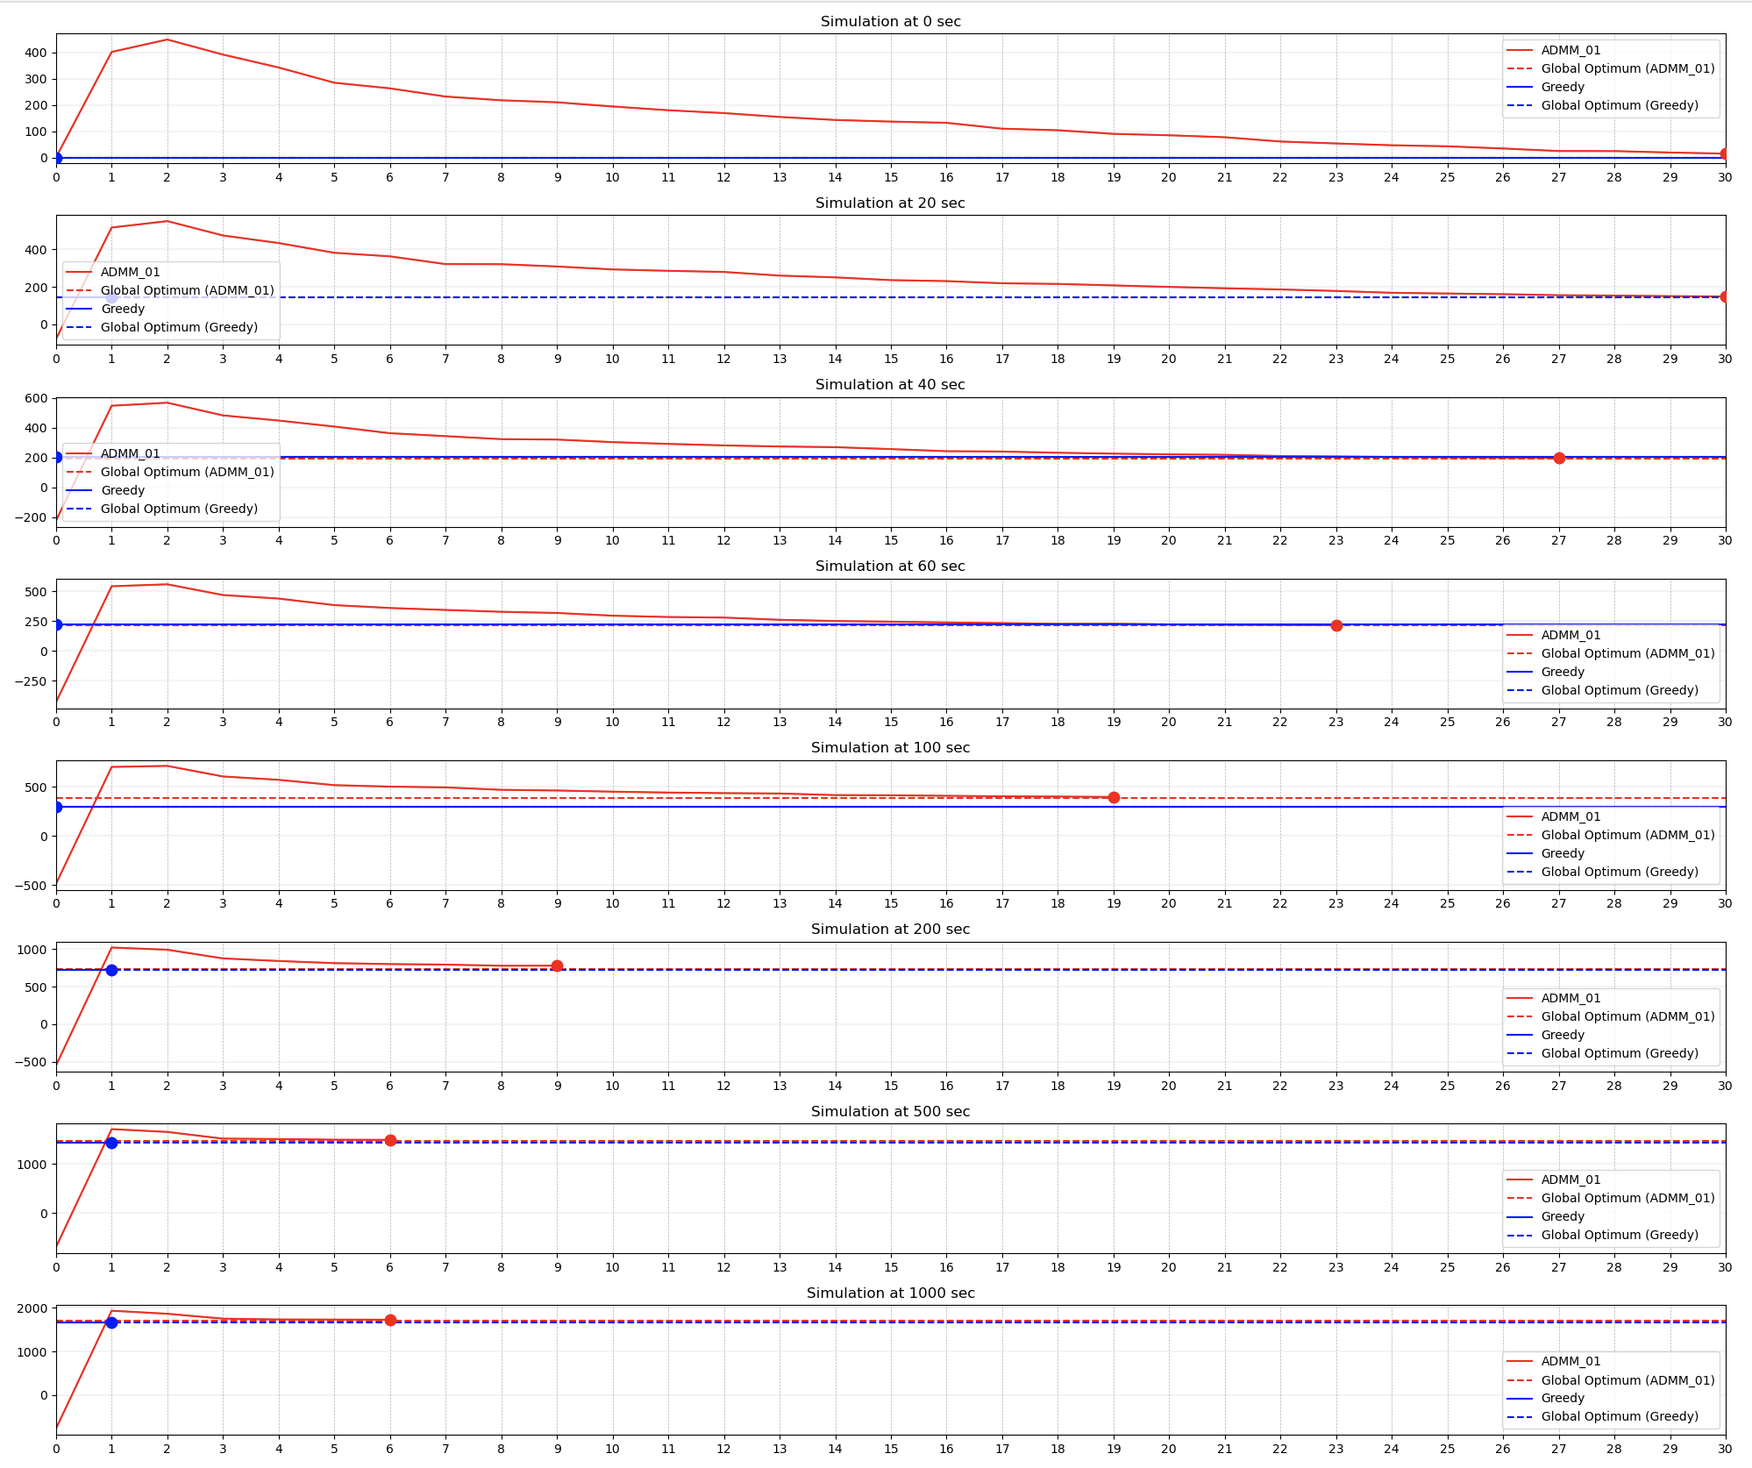
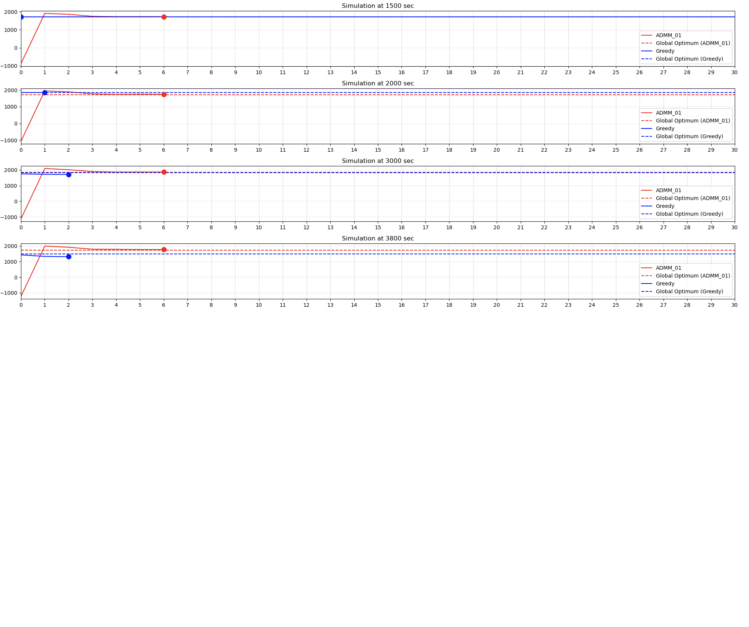
Simulation Results Manhattan
Using the threshold penalty
ADMM and Greedy beat MP
Greedy is computationally much cheaper

Slide 5
Simulation Results Manhattan
Using the threshold penalty
ADMM and Greedy beat MP
Greedy is computationally much cheaper
For an “easy” penalty function, Greedy has not much problem finding the optimum
And sometimes Greedy performed even better than ADMM (with stopping criterion) → maybe due to simpler algorithm (do not need to tune \rho)

Slide 6
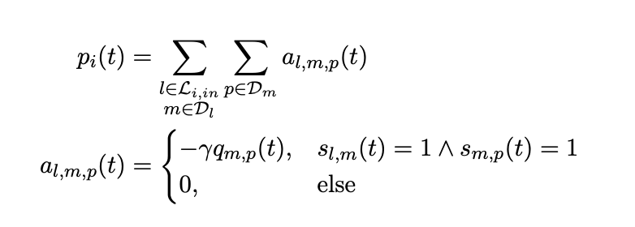
Simulation Results Manhattan
Using the threshold penalty
ADMM and Greedy beat MP
Greedy is computationally much cheaper
For an “easy” penalty function, Greedy has not much problem finding the optimum
And sometimes Greedy performed even better than ADMM (with stopping criterion) → maybe due to simpler algorithm (do not need to tune \rho)
Using the Green flow penalty (ADMM worse with the same parameters)

Slide 7
Simulation Results Manhattan
Using the threshold penalty
ADMM and Greedy beat MP
Greedy is computationally much cheaper
For an “easy” penalty function, Greedy has not much problem finding the optimum
And sometimes Greedy performed even better than ADMM (with stopping criterion) → maybe due to simpler algorithm (do not need to tune \rho)
Using the Green flow penalty (ADMM worse with the same parameters)
Capacity Aware Controller beat MP (not fully tuned)
Centralized Controller takes super long
Fixed Time

Slide 8
Future
Do few more simulations to complete everything
Overleaf
Simulation Setup and Results: CityFlow, Road Network and Demand, Simulation Comparison
Discussion points from previous weeks
Shorten paper?

