Slide 1
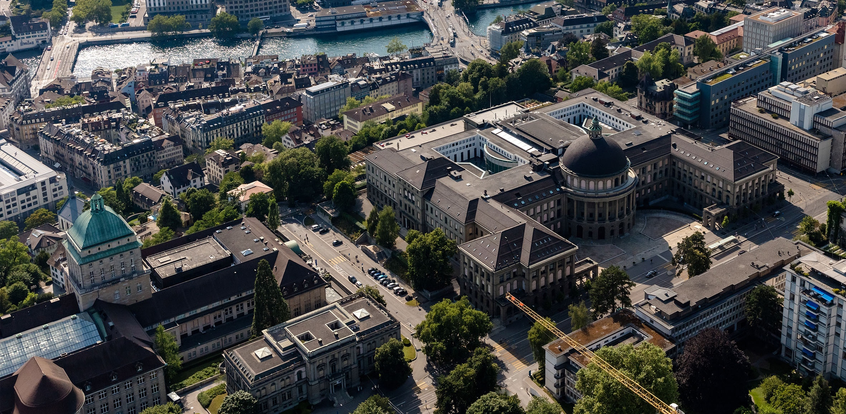
Meeting 2
Vinzenz Tütsch
30.11.2023

Slide 2
Topics
Summary of literature review / Work Conservation
Büchi Automata
Mainly Coding and setting up environment

Slide 3
Summary of literature review
In overleaf (possibly need to add a RL paragraph)
Some ideas possible controller “features”

Slide 4
Büchi Automata
Goal is to visit a (sub)set of a set of accepting state set infinitely often
Struggle to combine it with our approach

Slide 5
Coding
Use Ray for parallel computing
Euler to do the computation (set up but # of CPU only)
Reinstallations and set up issues (cityflow, gurobi, ray, euler)
Rewrite code with better structure (on my personal git)
Implement idle time (all signals red)
Communication delay?

