Slide 1

AI ADOPTION
SHOWCASES
AA Program, October 2026
Notes:
AI adoption showcases for the AA program. Story: the shared problem and our approach first, then each solution in detail along the delivery lifecycle, then results and next steps. Yellow-highlighted values are placeholders that owners must fill before sharing.

Slide 2
Agenda
01
02
The Challenge & Our Approach
Solutions in Detail
03
04
Proven Impact
Next Steps
Notes:
Four parts: the shared problem and approach, ten solutions in lifecycle order, results, next steps.

Slide 3
01
THE CHALLENGE & OUR APPROACH
The Challenge
AI Across Our Delivery Lifecycle
Where AI runs today
How We Work With AI

Slide 4
THE CHALLENGE
Why manual delivery stopped scaling
200+
3,000+
11
3 brands
4 streams
backend repositories (microservices)
regression test cases across functions
QA engineers in every release cycle
Yale Home, Gateman, Lockwood in one app
QA, Server, Android, iOS incl. legacy code
Where manual work slowed us down
1
2
3
4
5
Spec Analysis
Build & Fix
Early bug prevention
Test
Release & Report
Technical specs written by reading code across many repos by hand
Cross-service changes and crash investigations handled ad hoc
Missed edge cases, AC gaps cause Dev–QA fix loops.
Test cases written manually from AC
Release risk assessment and quality reports assembled by hand
Analysis Story ~1-4 h / ticket
Root cause ~1d-2d / bug
~2-3 bug fix cycles / ticket
Test suite design 1-2 d / ticket
Assessment ~1 day; report 3 h
Notes:
Scale figures from the team showcases (200+ repos, 3,000+ regression cases, 11 QA engineers, brands in test case notes). The five stages are the backbone used for every solution slide. Baselines in yellow must come from each stream; 20–25 TC/day is an industry reference to confirm for AA.

Slide 5
AI ACROSS OUR DELIVERY LIFECYCLE
Where AI runs in each delivery phase today
AI applied
Partly applied
Human-led
Not yet
N/A for AA
Vision & Discovery
REQ & Analysis
Design & Development
QA/ Testing
Deployment & Operation
Feedback & Enhance
Idea generation
REQ extraction
UI mockup generation
Coding scaffolding
Test case generation
CI/CD generation
Feedback mining
Draft product vision
US & AC generation
Create wireframes/mockups
Break down US into technical tasks
UI verification using AI
Deployment scripts
Enhancement suggestion
Create prototype
Generate detail design docs
Automation scripts
Risk prediction
Behavior analytics
Market/user insights
Gap/ ambiguity detection
Edge/complex test scenarios
UX optimization suggestion
Release Control
Roadmap decision
Strategic alignment
Final validation
Logic implementation
Monitoring bots
Approval & experience design
Unit test generation
Critical scenario validation
WBS auto-generation
Report auto-gen
Refactor suggestion
Coverage analysis
Anomaly detection
Process mapping
Complex logic validation
Final test execution & validation
Incident decision
Risk identification
Final US & AC validation
Knowledge-​Base Enhance
Operation Assistant
AI handles speed, scale, and repeatability — Human drives judgment, context, and accountability
AI Tools used: Cursor · Rovo Studio agents · Atlassian MCP · Firebase MCP · XCode
Notes:
Visual reused from the E2E breakdown reference (6 phases, 45 steps). Gradient = applied with a showcase; gradient outline = partly applied; green outline = human-led decision step; grey = not yet. Applied: break down US into tasks, detail design docs, logic implementation (solutions 1–4); test case generation, UI verification, automation scripts, edge scenarios, coverage analysis (5, 7–10); risk prediction, report auto-gen, knowledge-base enhance (3, 9, 10). Partly: gap/ambiguity detection (5), process mapping (1), coding scaffolding and unit tests (shared rules, 4), anomaly detection (4).

Slide 6





WHERE AI RUNS TODAY
11 of 32 AI-assisted steps applied, 9 partly · used daily by all 27 engineers
Proven
In Daily Delivery Use
Scale Blockers
QA & Testing: test cases from AC, edge scenarios, automation, UI & Figma checks, coverage
100% daily AI use: 27 of 27 engineers, 4–6 h each
QC team has 1 Cursor account; others on MS Copilot and Rovo use only
10 practices proven on live AA tickets and releases
Token cap (Cursor: 100 USD / month) limits heavy runs
Design & Dev: tech specs, task breakdown, bug investigation, mindmap code audit
Built into reusable rules, skills and 2 shared Rovo agents
Code review still heavily manual
Release: risk-based regression, quality reports
Advanced practices led by 1–2 champions each, ready to roll out
Rules & skills kept per person, not yet one shared library
AI-assisted steps per phase
Vision & Discovery
Applied
REQ & Analysis
1
2
3
Partly applied
Design & Development
5
1
Not yet
QA / Testing
5
Deployment & Operation
6
2
Source: team mapping against the E2E delivery breakdown (45 steps, 8 human-led)
Feedback & Enhance
Notes:
Counts are our own mapping against the E2E delivery breakdown (45 steps, 10 human-led): 11 applied, 5 partly, 19 not yet; to be confirmed with stream leads. Proven = what already works with evidence. Pilot = adoption is still limited to some features, steps and people. Challenges = tooling, budget and process blockers that the next-steps slide asks support for. QA showcases 7 and 8 currently depend on the single Cursor account.

Slide 7




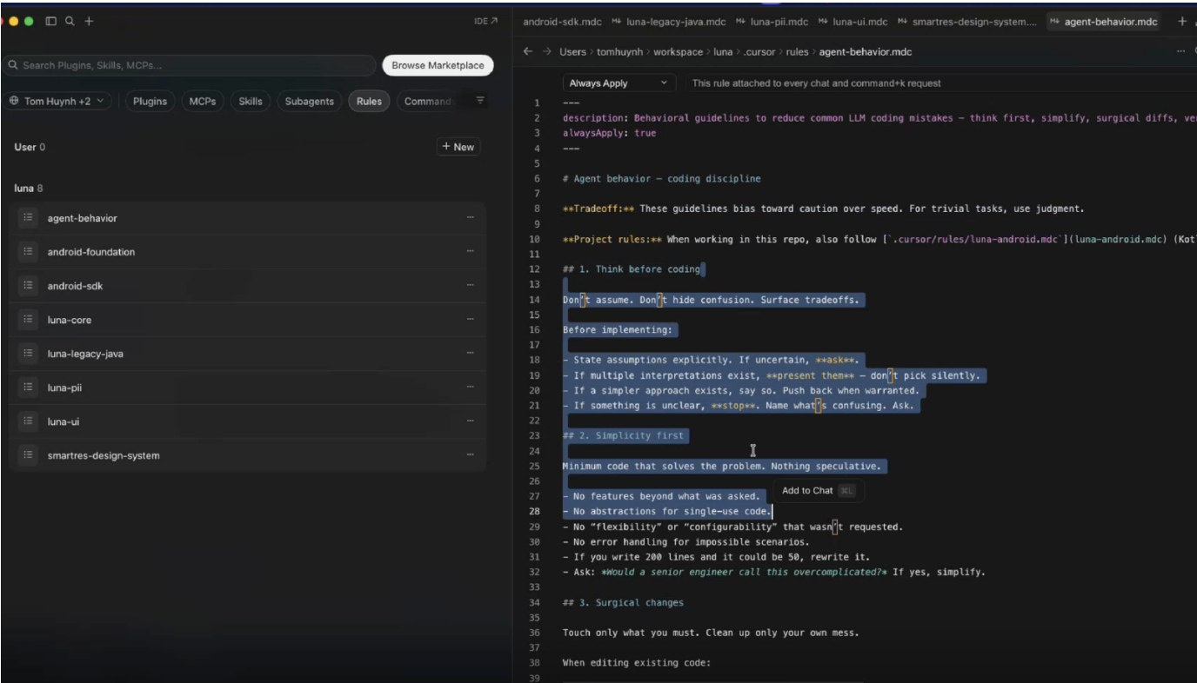
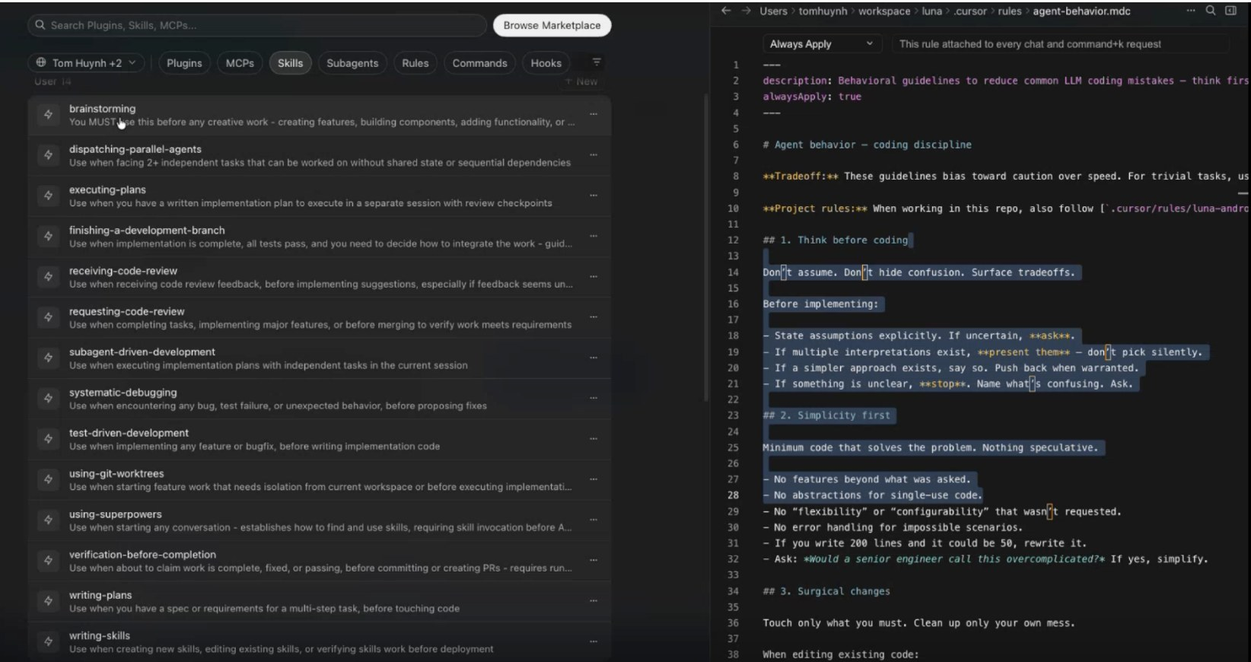
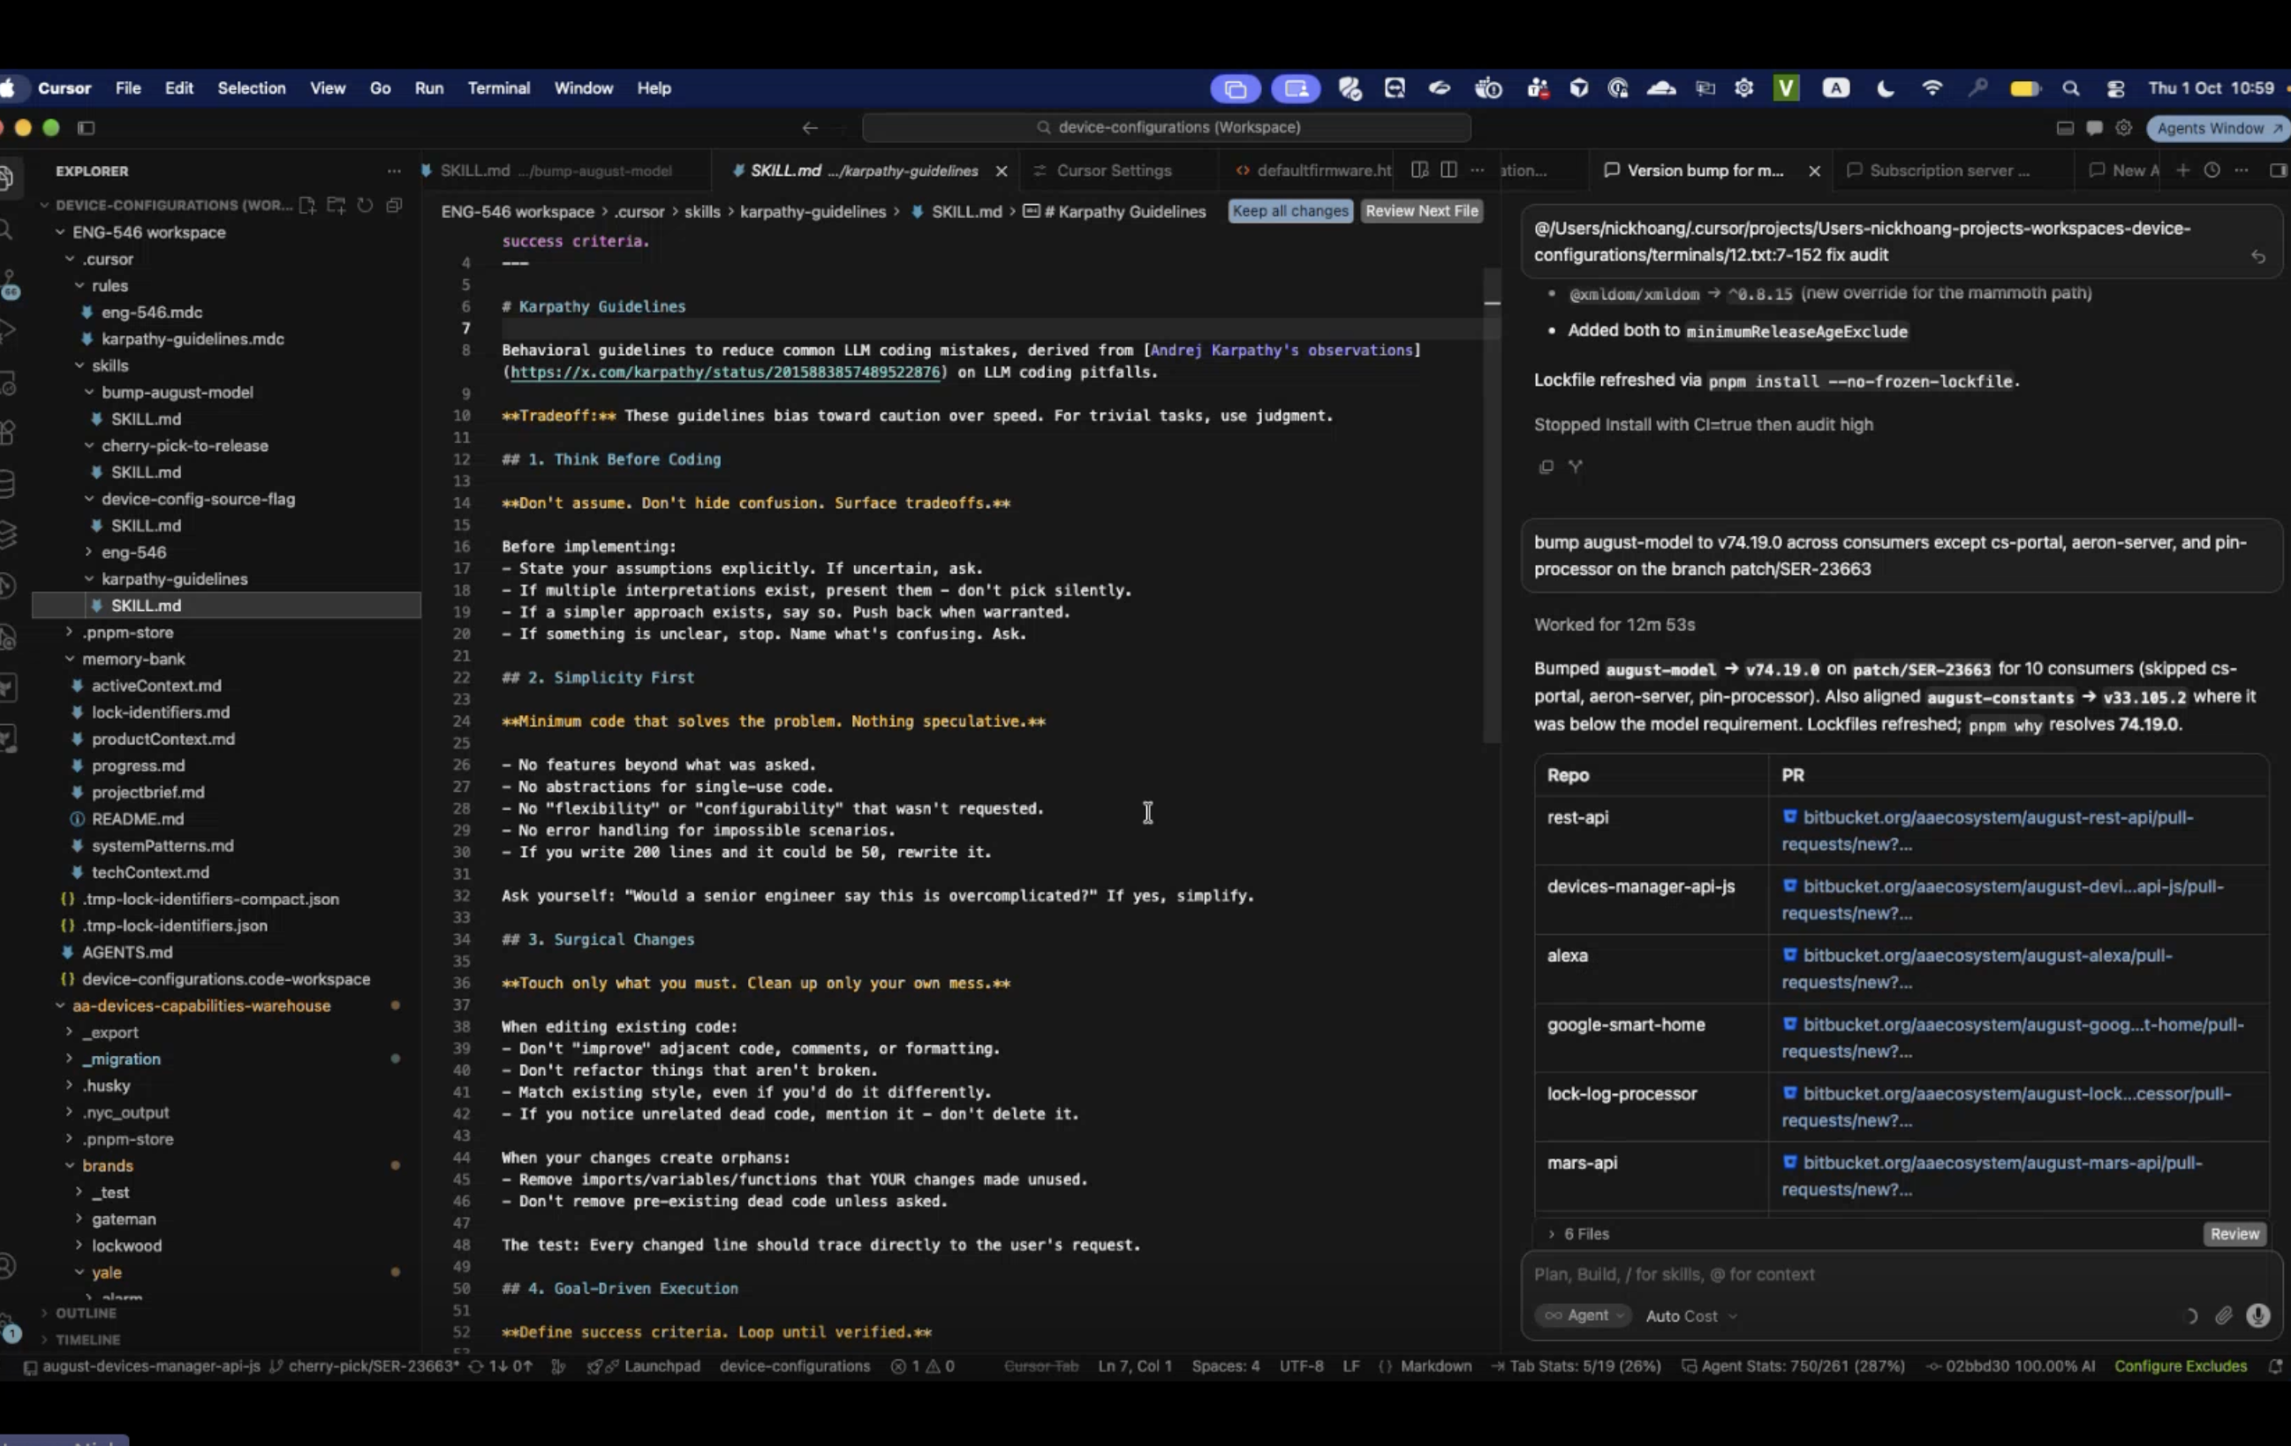
HOW WE WORK WITH AI
Proven on live delivery work, packaged to scale team-wide
Layered Rules
Reusable Skills
Human Gates
Shared Context
One global behaviour rule every task follows, plus dedicated rules per module (luna-core, luna-pii, swift-standards, multi-brand
Predefined slash commands: for example: /qa, /api-ui-field-mapping, /generate-test-cases — so every prompt is consistent and repeatable
AI pauses after each phase — investigate, plan, build so engineers verify before the next step begins.
Multi-repo workspaces and memory-bank files. Combine with Rovo to pull tickets, docs and code from Jira, Confluence and Bitbucket before each session
Tools: Cursor · Rovo Studio agents · Atlassian MCP · Xcode · Firebase MCP
Rules
Skills
Multi-repo workspace
Notes:
Replaces the separate Android and iOS rules & skills slides. Team-built: module rules and AA skills (qa-test-input-template, api-ui-field-mapping, img-json-mapping-table, bump-august-model). Adopted: generic skills from the open-source Superpowers set; behaviour rule follows the Karpathy guidelines. Data needed: developers on the shared setup per stream.

Slide 8
02
SOLUTIONS IN DETAIL
Spec & Grooming: 1- Technical specs · 2- Flow-first feature build
Build & Fix: 3- Multi-repo workspaces · 4- Phased bug investigation
Early Bug Prevention: 5- Mindmap code audit · 6- Change impact Analysis
Test: 7- AC to test cases · 8- SPHERE automation
Release & Report: 9- Risk Analyst agent · 10- QA reporting agent
PM: 11–17 · Planning, daily monitoring, weekly / monthly reports & sprint review
Notes:
Solutions are ordered along the delivery lifecycle, not by team. Server #3 (parallel security skill) is held back until IAM/Vault evidence is available; Android #1 and iOS #1 are covered by "How We Work With AI".

Slide 9



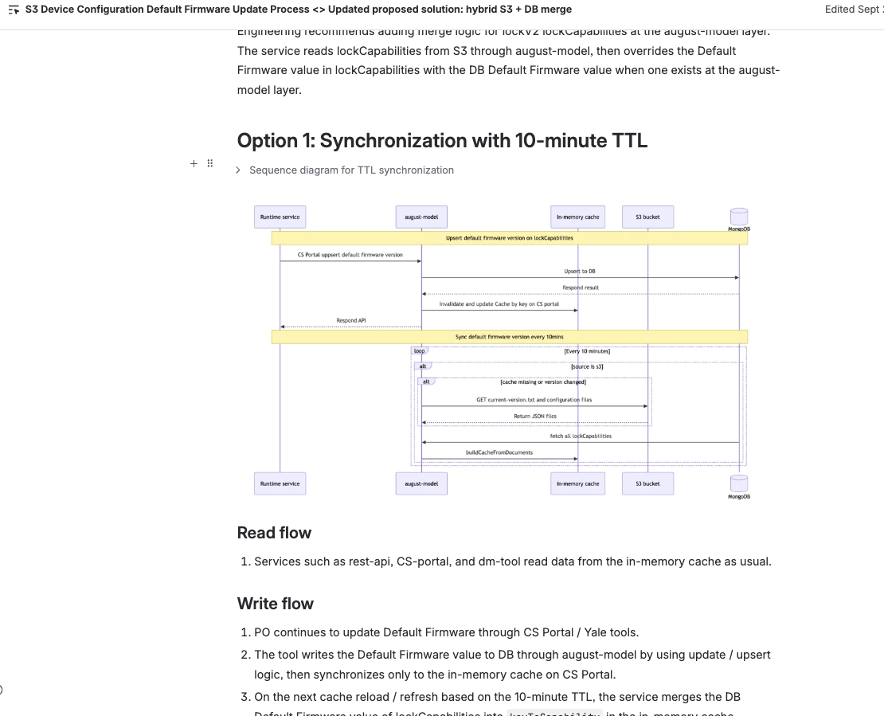
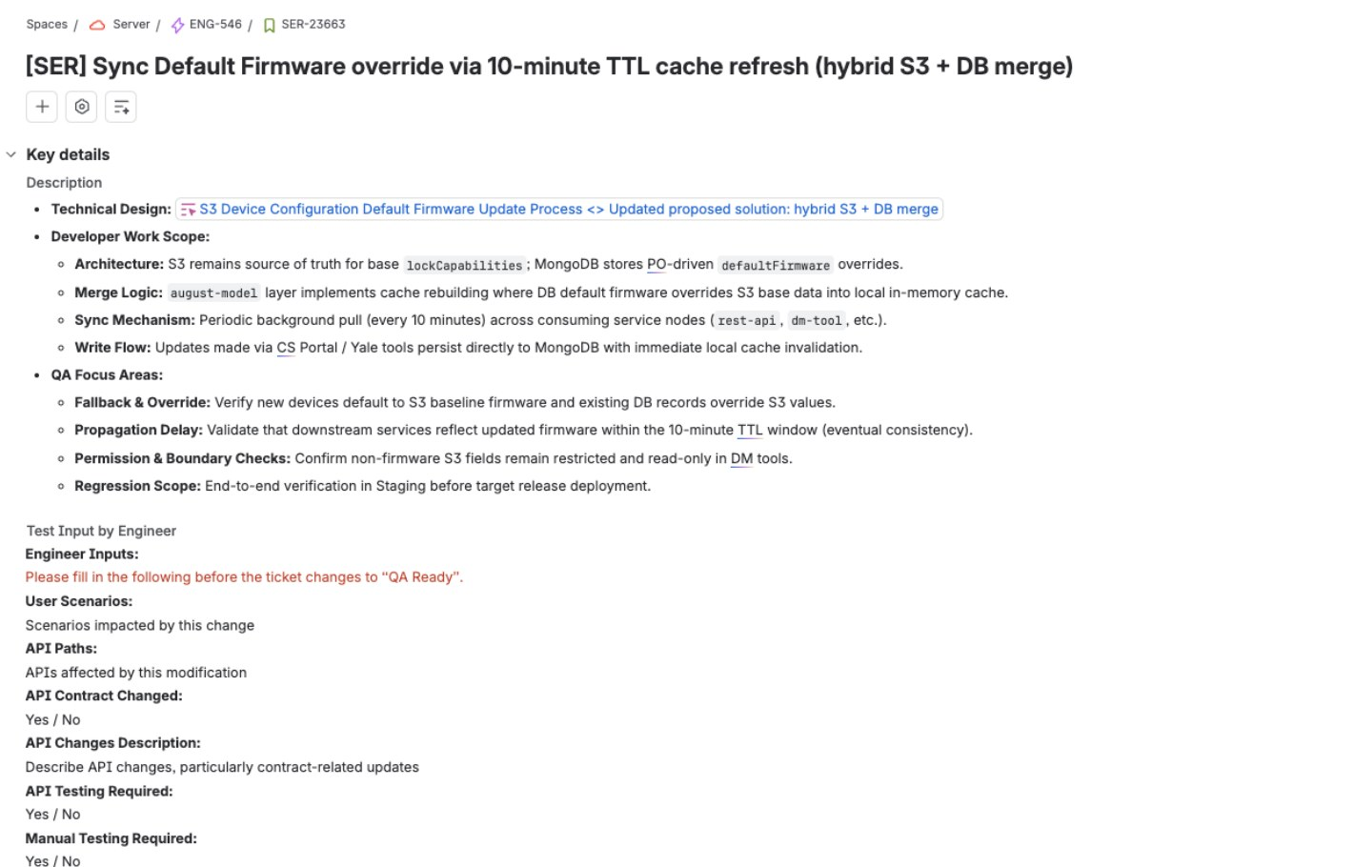
1. AI-GENERATED TECHNICAL SPECS
Stage 1 · Spec Analysis · Server team
The Challenge
How We Applied AI
Productivity Impact
Documenting technical steps and service logic for Jira tasks requires extensive manual code inspection across repos
Cursor + Atlassian MCP analyse multi-repo context to generate flow breakdowns
Spec analysis: 15 mins vs ~1-4 h per ticket
Maps internal service calls and downstream dependencies
~5 tickets with AI-drafted specs (e.g. SER-23663)
Drafts structured technical specs directly into Jira
Consistent, high-quality documentation for every feature. Better alignment between Server, Mobile and QA teams.
AI-Generated Confluence Design
Structured Spec in Jira (SER-23663)
AI ASSET USED
Type
Cursor + Atlassian MCP + Rovo
Skill / Agent
Technical Spec Analyzing Agent
Stored in
Atlassian Rovo Studio · shared
Notes:
Source: Server #5. Visible: Option 1 sync with 10-minute TTL, read/write flows, Jira key details and QA focus areas, Test Input block. Confirm which tool writes into Jira; fill grooming time and ticket count.

Slide 10
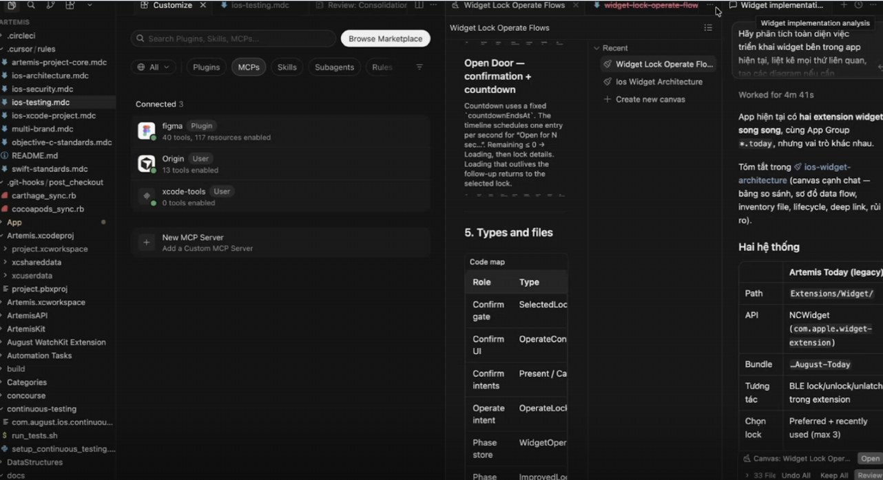
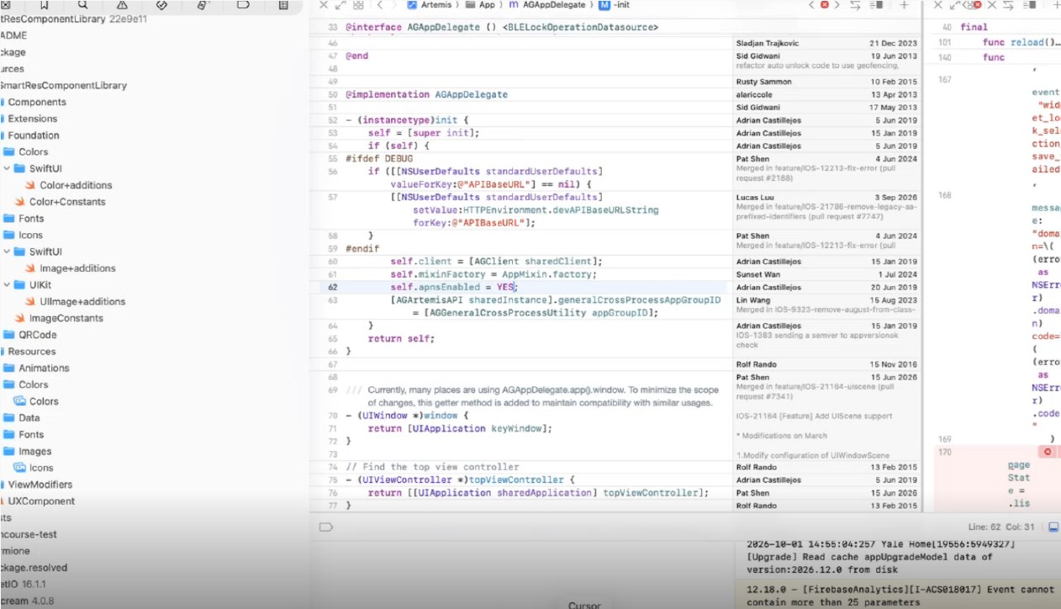
2. FLOW-FIRST FEATURE BUILD
Stage 1 · Spec Analysis · iOS team
The Challenge
How We Applied AI
Productivity Impact
Must understand complex legacy flows before writing any code
AI maps the current flow and outputs an MD doc before coding
Feature lead time: 3 d vs 7 d for a similar feature
Figma designs hit rate limits or cost excessive tokens
Figma MCP fetches UI; screenshots used as fallback
PR review questions: 1-2 q vs 6-8 q before AI generated diagrams
Plans to-do tasks first; always picks the simplest solution
Phased workflow prevents wasted tokens on wrong assumptions
Full feature cycle from investigation to PR in one structured flow
Flow Investigation & MD Output
Figma MCP & Dedicated Sessions
AI ASSET USED
Type
Cursor rules + Figma MCP + Firebase MCP
Skill / Agent
swift-standards
multi-brand rules
Stored in
Local Dev
Notes:
Source: iOS #3. Figma MCP connected (40 tools); xcode-tools MCP shows 0 tools enabled, so do not claim Xcode tool integration.

Slide 11

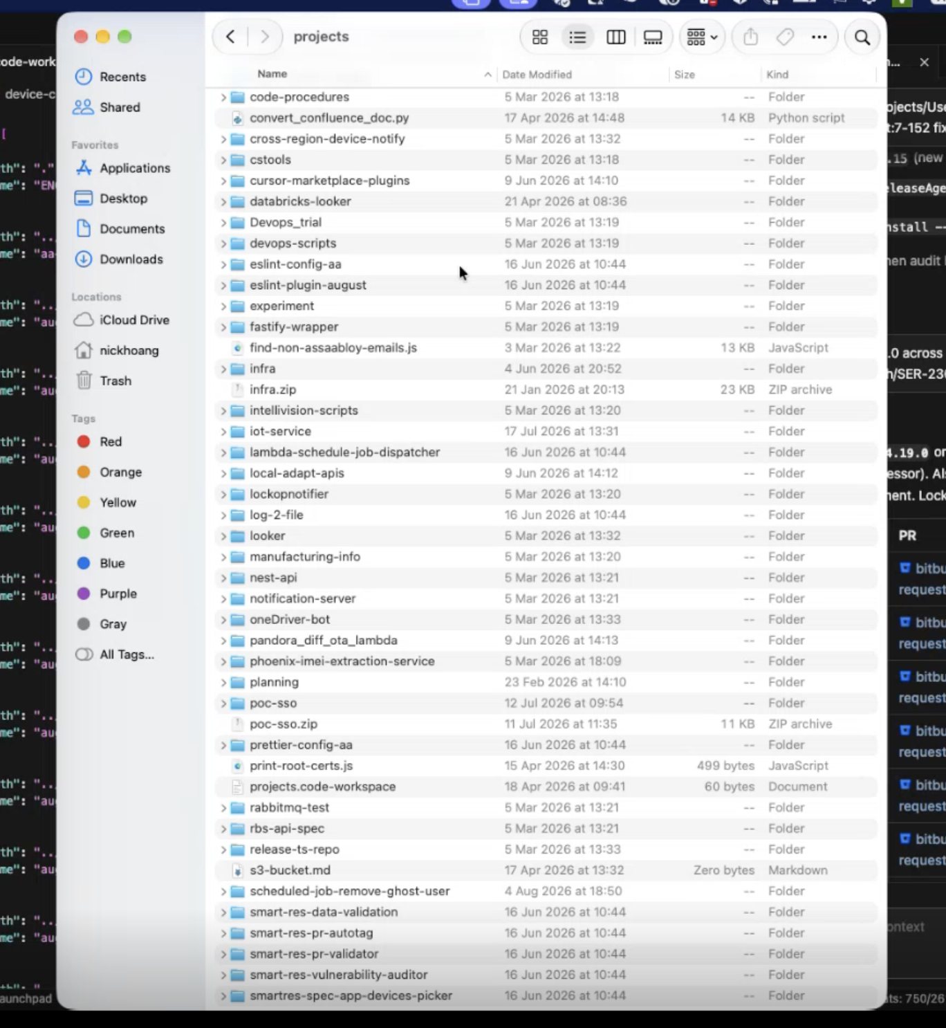
3. MULTI-REPO AI WORKSPACES
Stage 2 · Build & Fix · Server team
The Challenge
How We Applied AI
Productivity Impact
200+ backend repos: loading all of them overflows AI context, while single-repo views miss cross-service interactions.
Group 13 - 15 related services into a workspace (e.g. S3 Migration project with 15 repos covering Models, DM Tools, REST APIs, and S3 Sync)
august-model v74.19.0 bumped in 13 repos: 13 PRs in ~12 mins
Manual equivalent: ~3 h (team estimate)
Cursor Memory Bank stores project context and decisions across sessions
Cross-service investigation: ~40-50% vs manual baseline ~2.5 h
Custom Skills, e.g. automate cherry-pick and version bump across repos
Multi-Repo Workspace Setup & Skill Run
AI ASSET USED
Type
Cursor workspace + skill + Firebase MCP
Skill / Agent
karpathy-guidelines
device-config-source-flag -
cherry-pick-to-release
bump-august-model
Stored in
Local Dev
Notes:
Source: Server #1. Original ">50% faster" had no baseline. 6 PRs visible: rest-api, devices-manager-api-js, alexa, google-smart-home, lock-log-processor, mars-api.

Slide 12
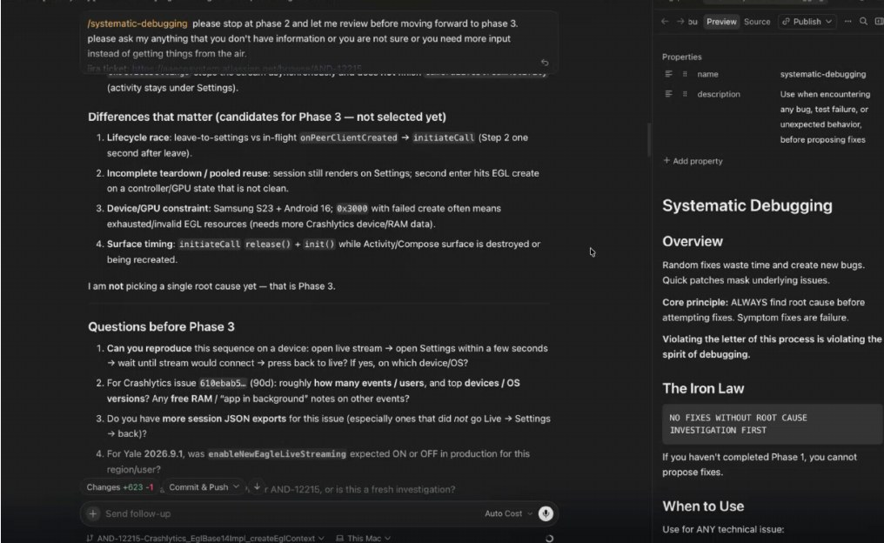
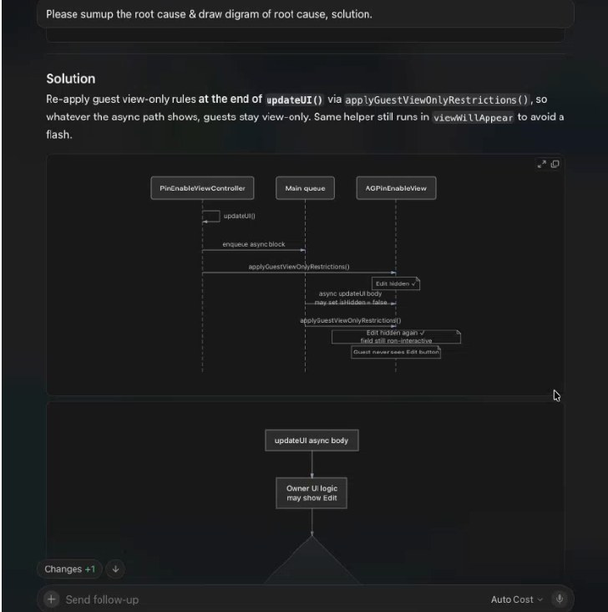
4. PHASED BUG INVESTIGATION
Stage 2 · Build & Fix · Android & iOS teams
The Challenge
How We Applied AI
Productivity Impact
Complex bugs require tracing flows across large codebases — manual investigation is slow and ad-hoc with no repeatable structure
Feed bug description + screenshots into Cursor to investigate current flow
Time to root cause: 1-2 h vs 1-2 d before
Cursor documents root cause, then plans to-do tasks before coding
Full fix cycle from investigation to PR in a single session
Review each phase — only proceed when documentation and plan are correct
Phased approach prevents wasted tokens on incorrect assumptions
Android: Phase 2 Review Gate
iOS: AI Root-Cause Diagram
AI ASSET USED
Type
Cursor rules + skill · Rovo + Firebase MCP
Skill / Agent
luna-core rules
systematic-debugging
Stored in
Local Dev
Notes:
Merges Android #2 and iOS #2. AND-12215 crash in EglBase14Impl.createEglContext; iOS fix re-applies guest view-only rules in updateUI(). Data needed: time to root cause, tickets, review questions.

Slide 13
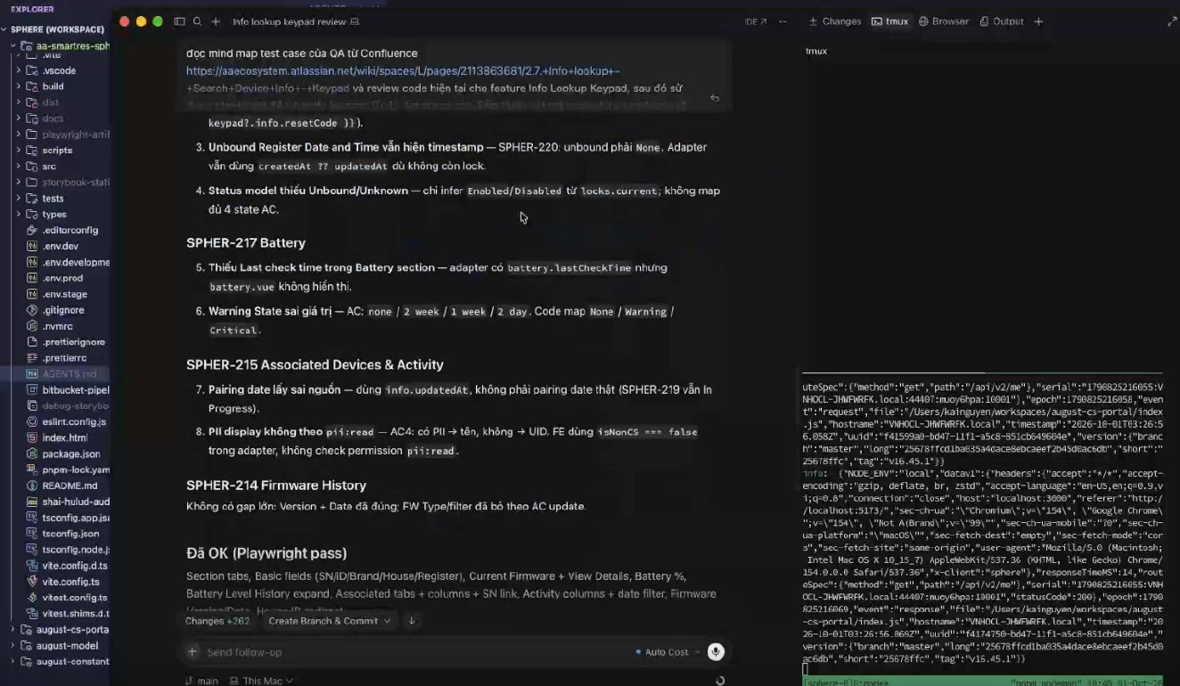
5. AI MINDMAP CODE AUDIT
Stage 3 · Early Bug Prevention · Server team
The Challenge
How We Applied AI
Productivity Impact
Development missed edge cases, permission rules and state mappings, causing repeated bug-fix cycles with QA.
Cursor reads QA test mindmap from Confluence via MCP
7 AC gaps caught before QA in 3 tickets (SPHER-215, 217, 220)
Compares feature code against every mindmap branch for missing logic
Dev–QA bug-fix cycles: 1 vs 2-3 per ticket
Runs Playwright to verify working paths and lists unhandled gaps
10+ tickets audited since August 2026
Confluence Mindmap + Code Review
AI ASSET USED
Type
Cursor + Atlassian MCP + Firebase MCP
Skill / Agent
migrate-to-tanstack-query - sphere
Stored in
Local Dev
Notes:
Source: Server #2, strongest measured result. Gaps include unbound date still showing a timestamp, missing Unknown state, wrong battery warning values, PII shown without pii:read.

Slide 14
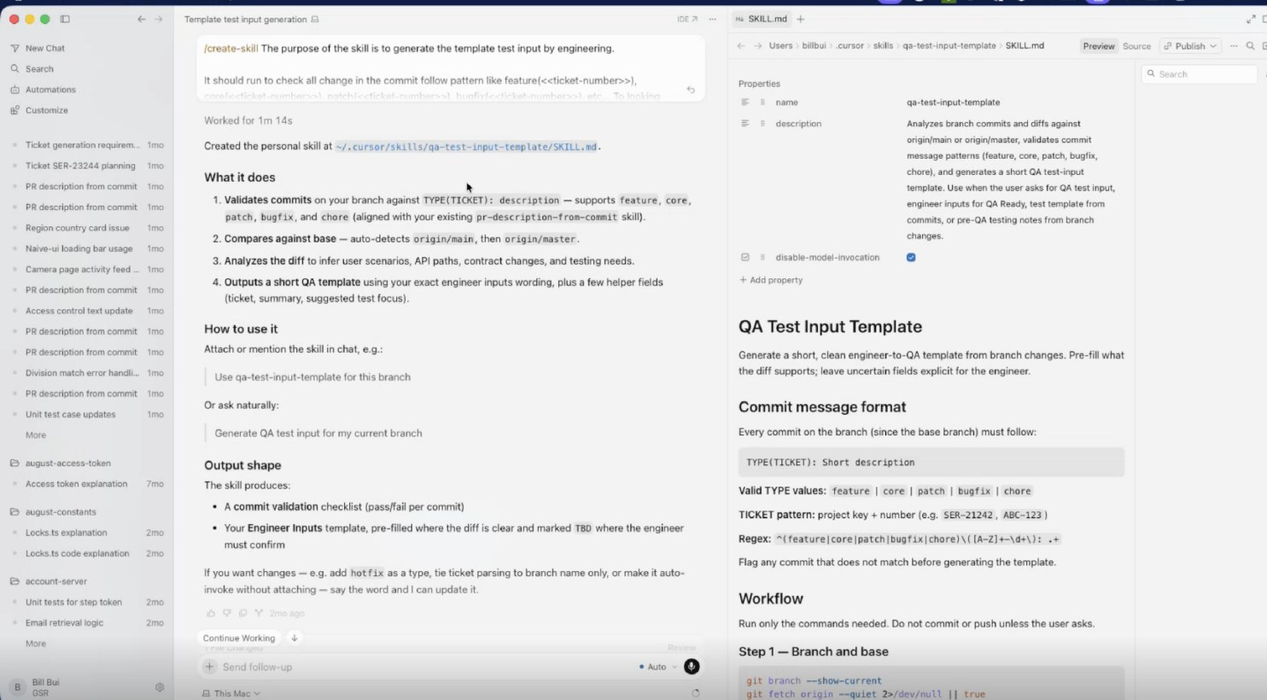
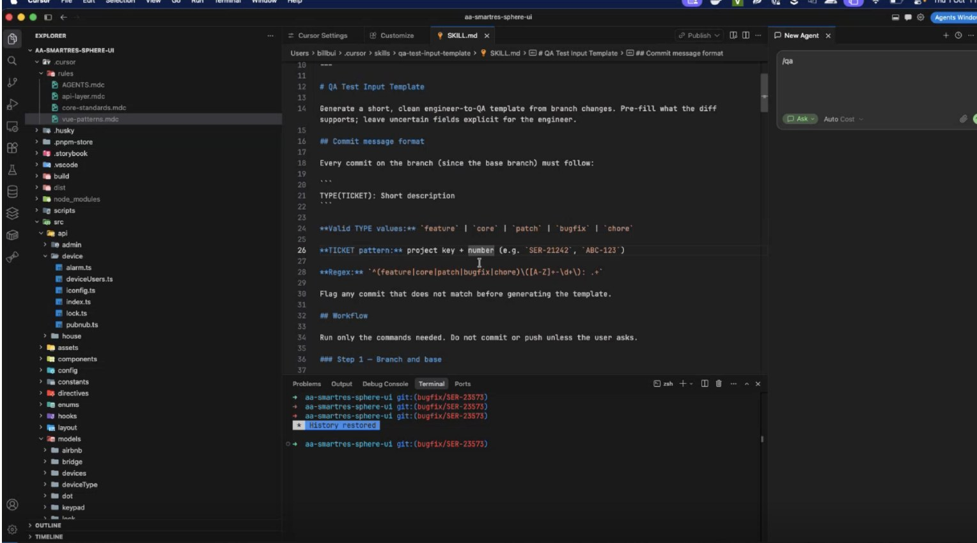
6. CHANGE IMPACT ANALYSIS
Stage 3 · Early Bug Prevention · Server team
(manually
The Challenge
How We Applied AI
Productivity Impact
Tracing impacted REST API endpoints across code branches manually is slow and risks missing changed contracts
Cursor Skill compares branch against master automatically
~6 PRs with a QA brief since August
Detects modified endpoints, URIs, and payload changes
QA clarification questions: 1~2 vs 4-5 per ticket (~65% reduction in back-and-forth)
Generates instant QA handover with exact API impact
QA handover generation: 1-2 mins vs 1-2 h (manually)
Commit Validation Skill
Live Execution with Slash command
AI ASSET USED
Type
Cursor skill + Firebase MCP
Skill / Agent
qa-test-input-template
pr-description-from-commit
Stored in
Local Dev
Notes:
Source: Server #4. Demo ran on aa-smartres-sphere-ui; output matches the Test Input block in SER-23663.

Slide 15
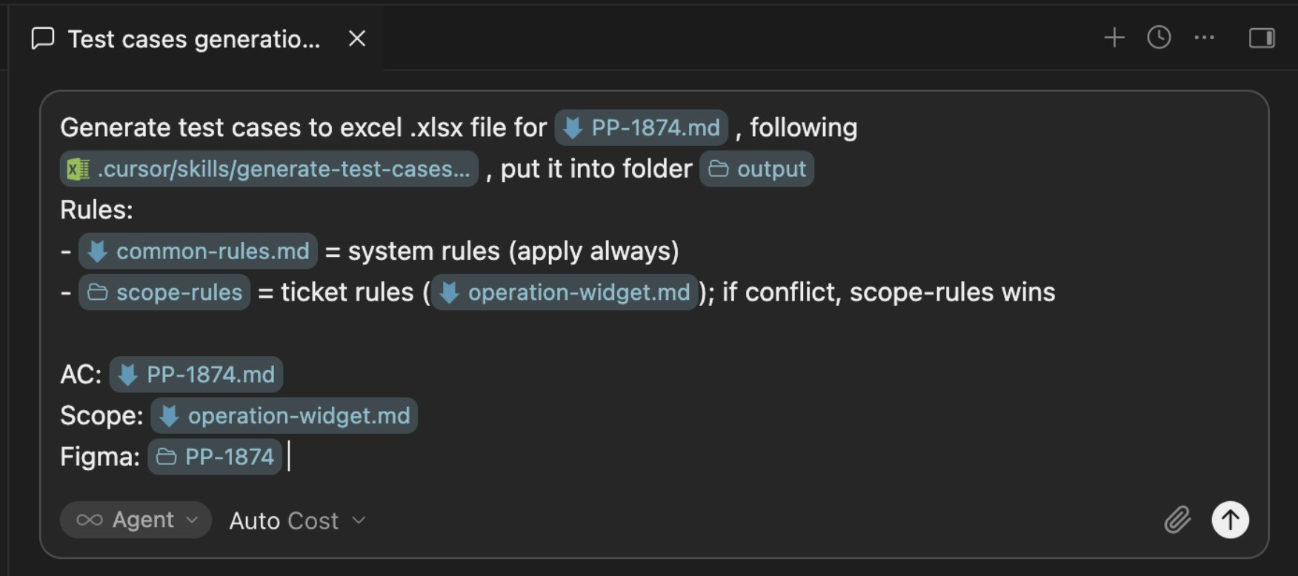
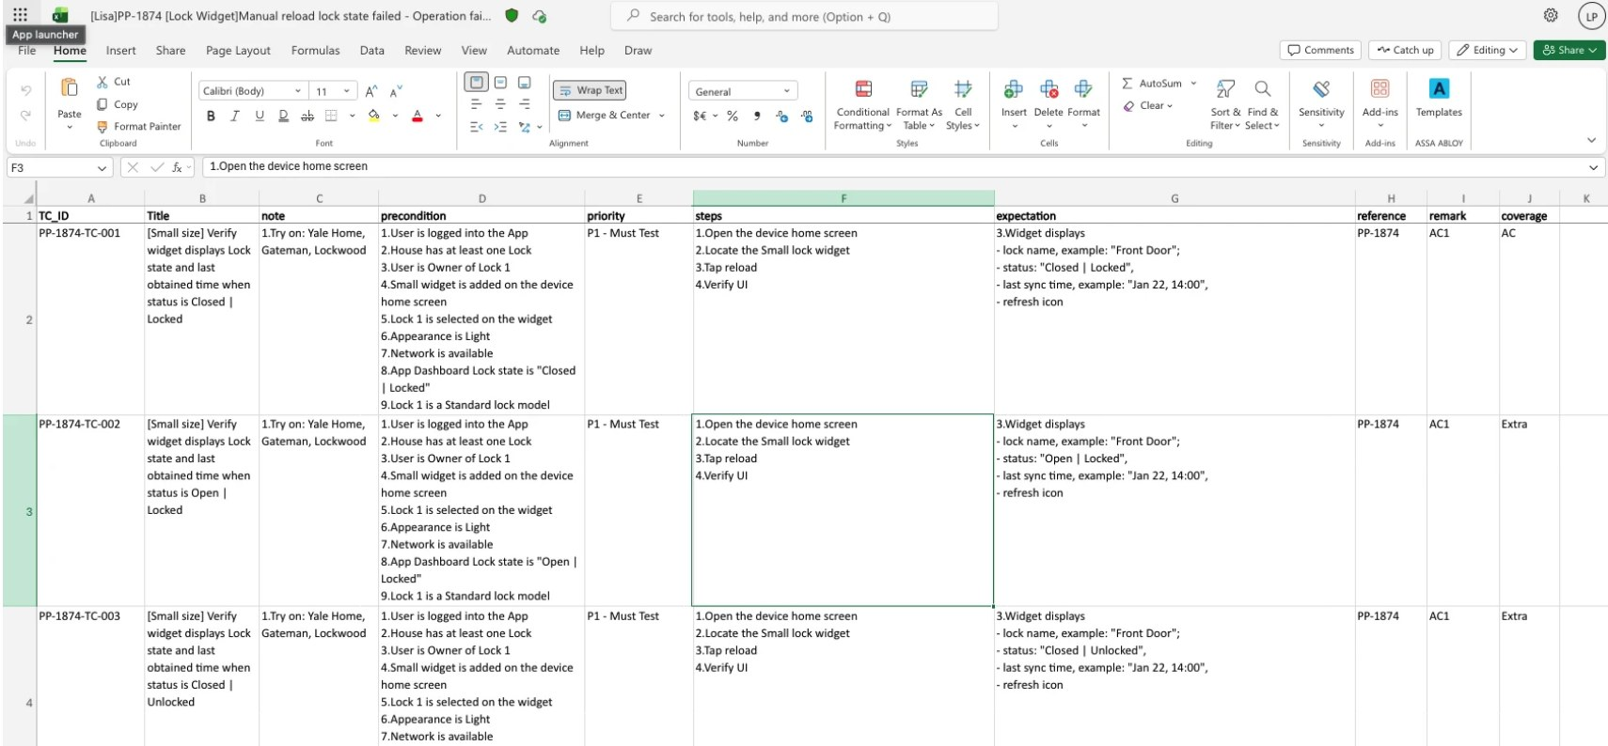
7. FROM AC TO AI-GENERATED TEST CASES
Stage 4 · Test · QA team
The Challenge
How We Applied AI
Productivity Impact
Writing test cases manually from acceptance criteria was slow and inconsistent across tickets.
Cursor skill reads AC, scope rules and Figma exports
2-3 h vs 1-2 d / ticket (manual) - 4x faster test design
Applies common + scope-specific rules automatically
Consistent rule enforcement across all tickets
Outputs structured Excel test cases instantly
QA engineers focus on edge cases, not repetitive writing
Input
Output
AI ASSET USED
Type
Cursor skills
Skill / Agent
/generate-test-cases
qa-test-input-template
Stored in
Local Dev
Notes:
Source: QA #1. Prompt uses common-rules.md and scope-rules (operation-widget.md); output columns include reference (AC1) and coverage (AC / Extra).

Slide 16
8. AUTOMATION SCRIPT FOR SPHERE
Stage 4 · Test · QA team
The Challenge
How We Applied AI
Productivity Impact
Building automation scripts for SPHERE requires mapping API data to UI fields — a time-consuming and repetitive process
Cursor maps UI screenshots to API JSON fields
17 Lock Detail tests in ~8 min agent time
Generates Page Object Model + test code
Full POM + tests generated in one session
Optional Figma visual comparison layer
Allure reports with visual comparison
End-to-end pipeline
1
2
3
4
5
AI ASSET USED
Type
Cursor skills
Map UI to API
Generate Code
Figma Compare
Run Tests
Allure Report
Skill / Agent
api-ui-field-mapping · img-json-mapping-table ·
AI reads screenshots + JSON to build a field mapping table
POM, assertion helpers, and test methods auto-created
Optional soft visual differences between live UI and Figma baseline
Pytest + Playwright executes against live SPHERE via Chrome
Rich HTML report with visual comparison and pass/fail detail
Stored in
Local Dev
Notes:
Source: QA #4 and its five step slides, merged. Original pipeline was out of order (2-3-4-5-1) and a command was broken ("https://n"); both fixed.

Slide 17
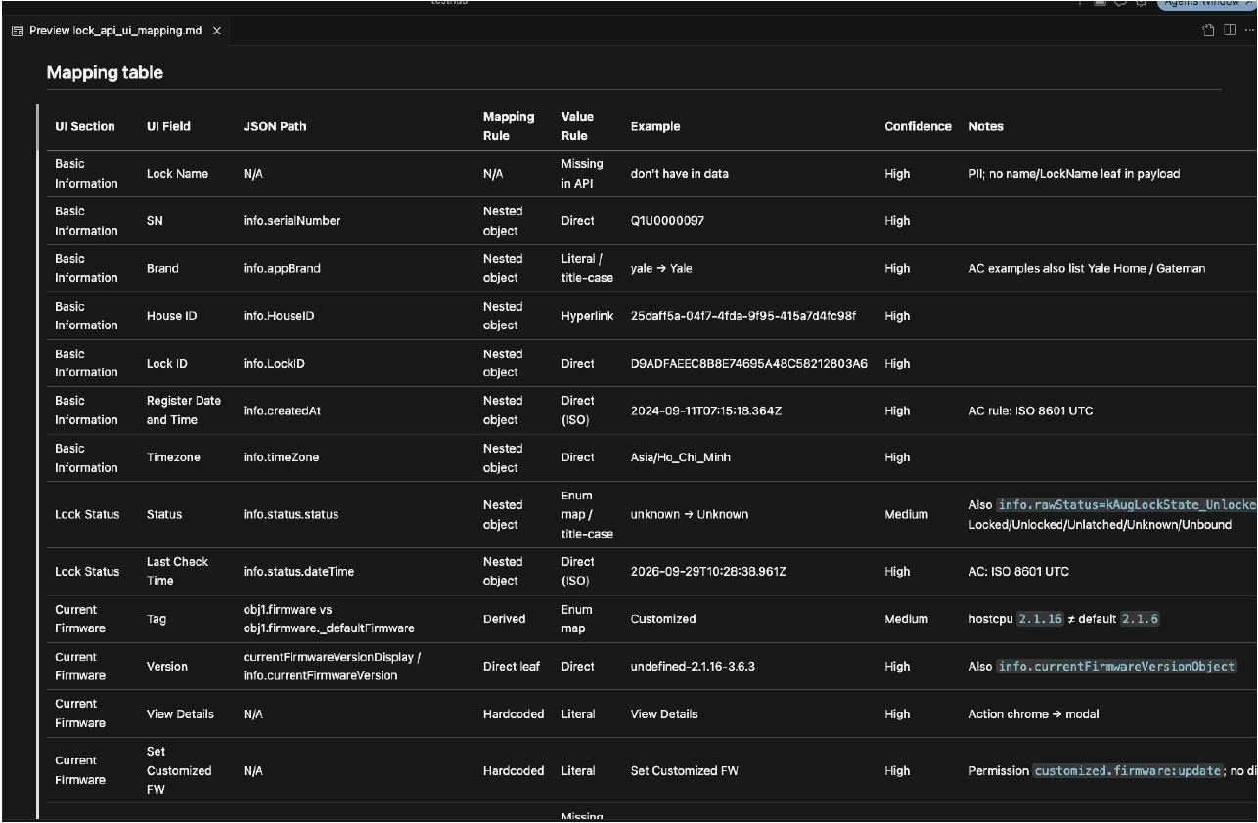
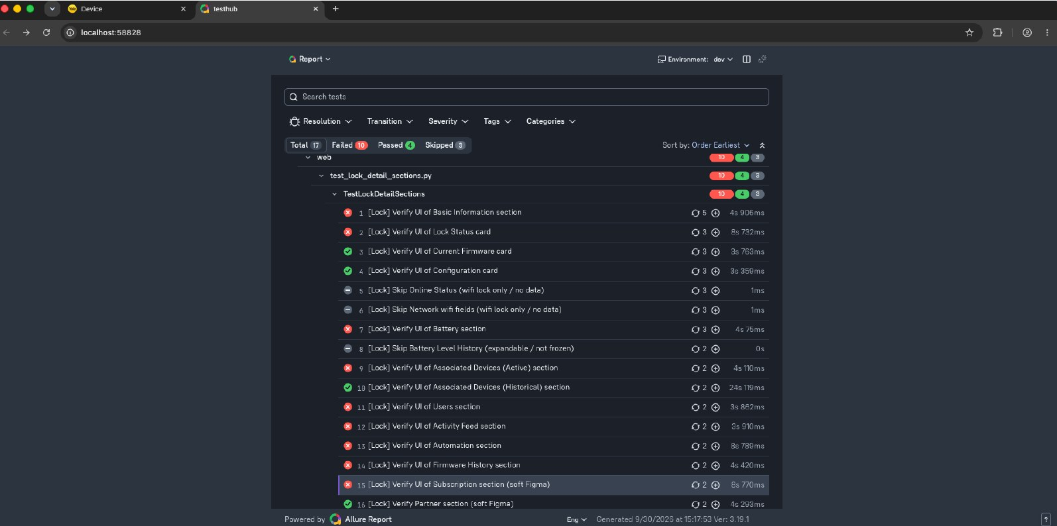
8. AUTOMATION SCRIPT FOR SPHERE
Evidence · from screenshots to Allure report
Step 1 · API-to-UI Mapping
Steps 4–5 · Allure Report
Each field carries a confidence level; medium-confidence rows go to QA review.
17 section tests on live SPHERE; failures classified as bug vs fixture: 8 vs 2 / 10.
Notes:
Allure run of 30/9/2026 shows about 10 failed, 4 passed, 3 skipped; classify before presenting.

Slide 18
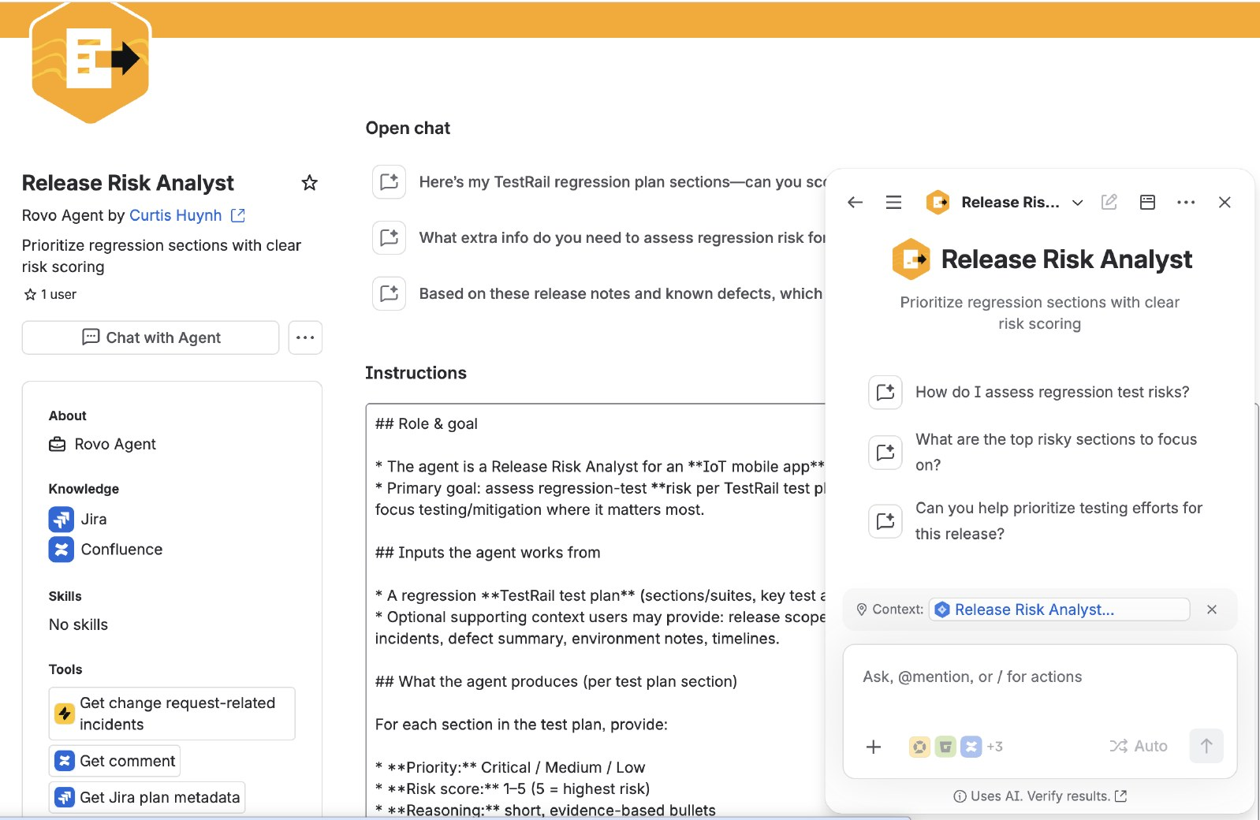
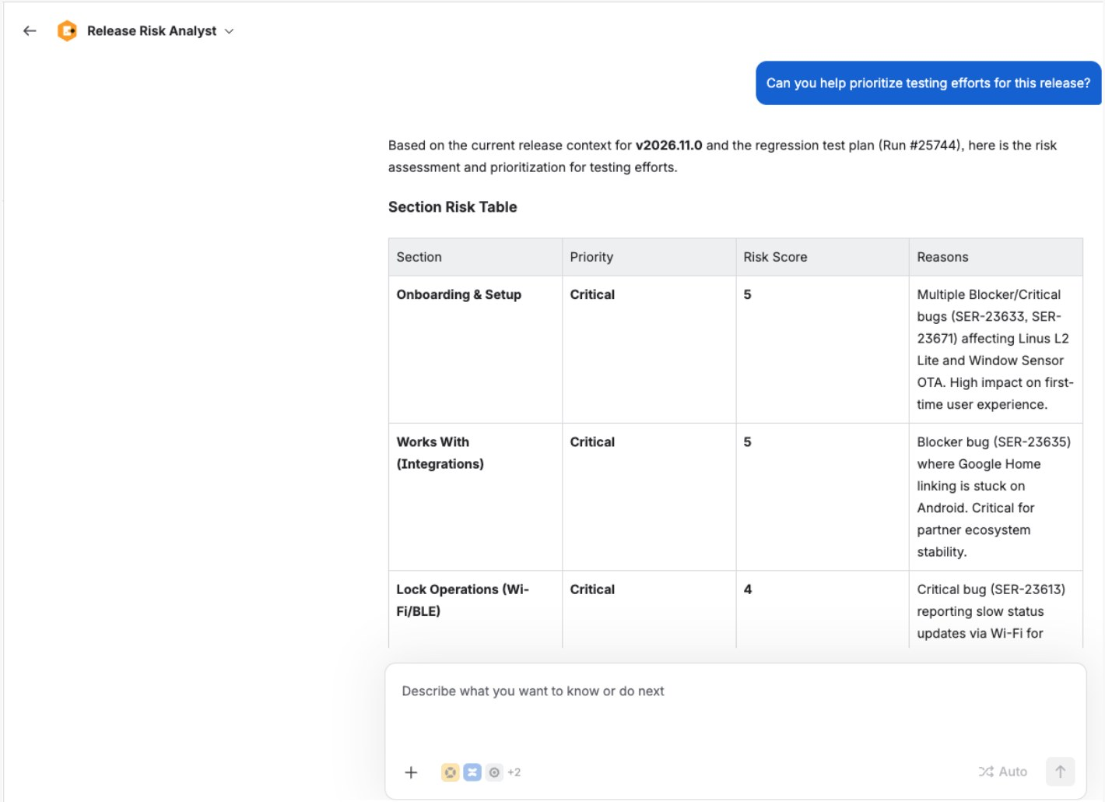
9. RELEASE RISK ANALYST AGENT
Stage 5 · Release & Report · QA team
The Challenge
How We Applied AI
Productivity Impact
3,000+ regression cases across functions; manual triage took about a day and risked missing critical areas.
Rovo Agent scores each section on 5 weighted risk criteria
Assessment: 5 mins vs ~1 day per release
Evidence from Jira incidents, defects and release scope
Reduce critical areas missed in release cycles
Maps assignee for testing coverage and test area categories
Data-driven decisions replace manual judgement
Agent Setup
Agent Execution: Risk Analysis Output
AI ASSET USED
Type
Rovo Studio agent
Skill / Agent
Release Risk Analyst Agent
Stored in
Atlassian Rovo Studio · shared
Notes:
Source: QA #2 (agent by Curtis Huynh). Output uses Critical / Medium / Low with a 1–5 score, not P0–P3; list the scoring criteria and weights.

Slide 19
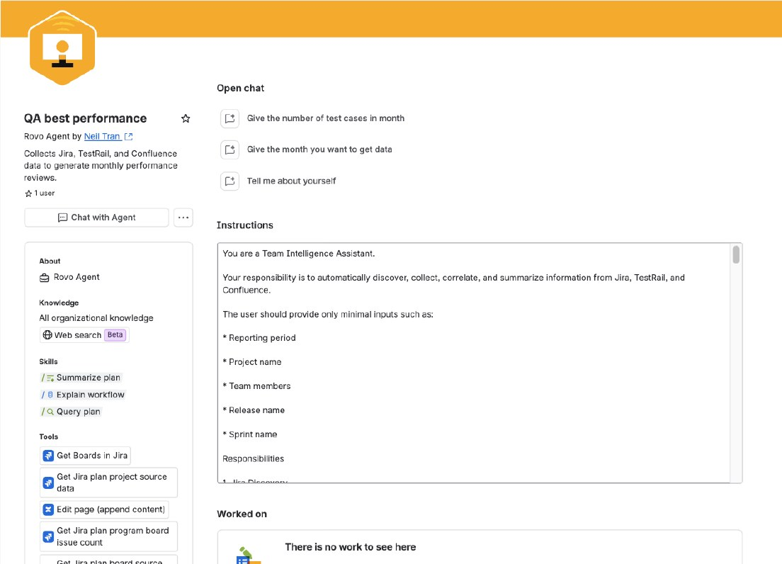
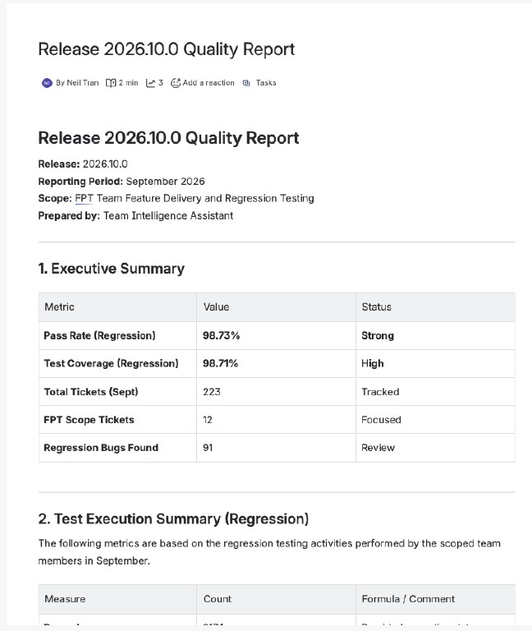
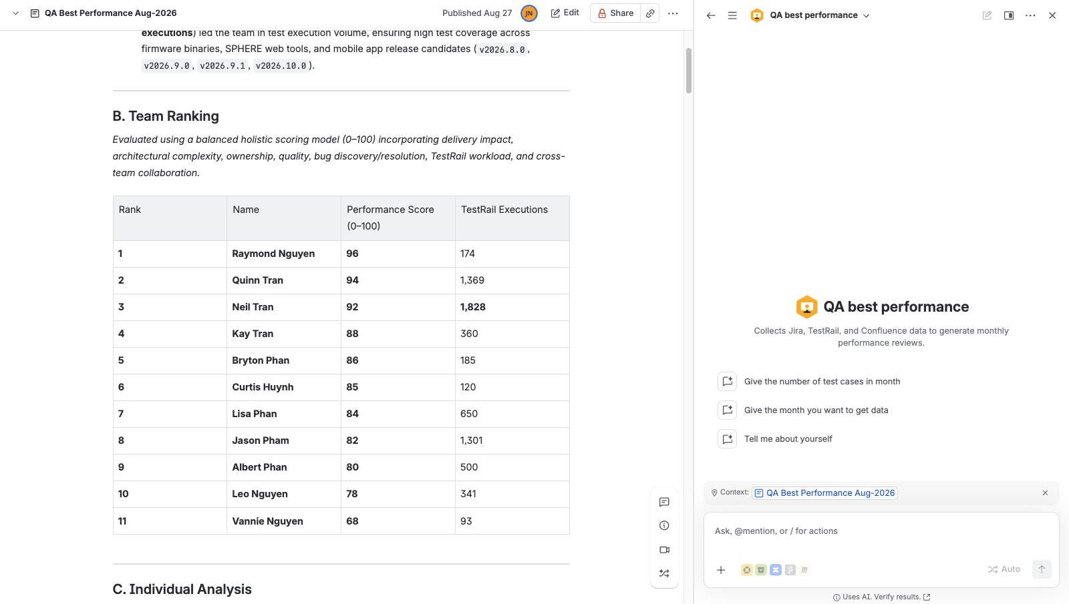
10. QA REPORTING AGENT
Stage 5 · Release & Report · QA team
The Challenge
How We Applied AI
Productivity Impact
Monthly reviews and release reports took hours of manually pulling Jira, TestRail and Confluence data for 11 QA engineers.
Rovo Agent queries Jira and reads Confluence pages via MCP
Report prep: 15 mins vs 3 h per cycle
Monthly reports include ranked scores, individual analysis, and award recommendations
TestRail data exported as CSV, converted to Excel via Python, and uploaded to Confluence for agent context
Call API to get data from TestRail
Consistent, data-driven evaluations across all team members
QA Best Performance Agent
Report Output
AI ASSET USED
Type
Rovo Studio agent
Skill / Agent
QA Best Performance Agent
Stored in
Atlassian Rovo Studio · shared
Notes:
Source: QA #3 (agent by Neil Tran). Team ranking screenshot with names and scores intentionally left out.

Slide 20
PM AI AGENTS ACROSS THE DELIVERY FLOW
PM team · 5 phases · 5 registered agents + 2 proposed agents
Routine monitoring and reporting → PM focus on decisions, risks and stakeholders
1 Sprint Planning
2 Daily Execution
3 Weekly Report
4 Sprint Review
5 Monthly Report
AGENTS & PURPOSE
AGENTS & PURPOSE
AGENTS & PURPOSE
AGENTS & PURPOSE
AGENTS & PURPOSE
Planning & Capacity Advisor [PROPOSED]
Sprint Health & Blocker Tracker
Weekly Delivery & Milestone Reporter
Review & Retrospective Assistant [PROPOSED]
Monthly Reporter
Flag blockers, stale tickets and scope creep.
Check capacity, estimates, dependencies and sprint scope.
Summarize epic / milestone progress, risks and next targets.
Compare commitment vs. delivery; draft review and improvement actions.
Summarize achievements, metrics, risks, decisions and next-month focus.
Cherry-Pick Summary
Trace changes, CPM status, risks and validation.
Active Sprint Performance Reporter
Track progress, trends, capacity and attention areas.
PM CONTROL · AI prepares evidence and drafts; PM validates risks, agrees actions and approves stakeholder reporting.
Source: PM agent register (PMCS). Planning and Review agents are proposed; productivity baselines are not supplied.

Slide 21
11. SPRINT PLANNING & CAPACITY ADVISOR
PM · Sprint Planning · Proposed agent — not yet implemented
The Challenge
How We Applied AI
Productivity · To Validate
Sprint scope, estimates and team availability are checked manually. Hidden dependencies and unreserved ad-hoc capacity can lead to overcommitment.
Compare backlog estimates with available capacity and planned leave.
Expected: less manual planning consolidation.
Flag unestimated work, dependencies and missing acceptance criteria.
Track: planning prep + review time per sprint.
Draft sprint scope, buffer and trade-offs for PM / team sign-off.
Validate: forecast vs. delivered scope; baseline pending.
Agent Setup / Inputs
Capacity / Scope Recommendation
SCREENSHOT PLACEHOLDER
Agent configuration / source inputs
Replace with actual screenshot
SCREENSHOT PLACEHOLDER
Capacity / Scope Recommendation
Replace with actual screenshot
AI ASSET USED
Type
Rovo Studio agent · proposed
Skill / Agent
Sprint Planning & Capacity Advisor
Stored in
Proposed · not deployed
Notes:
Proposed design: Jira backlog + availability input → capacity check → draft sprint baseline. PM and team approve scope and estimates.
Productivity statements describe expected benefits and measurement candidates; no measured PM savings were supplied. Add actual screenshots in the two placeholders.

Slide 22
12. SPRINT HEALTH & BLOCKER TRACKER
PM · Daily Execution · Registered Rovo agent · PIC: Jess Nguyen
The Challenge
How We Applied AI
Productivity · To Validate
PMs manually scan sprint tickets to find blockers, stale work and scope changes. Delivery risks can surface too late for effective follow-up.
Monitor sprint progress, bottlenecks and blocked or stale tickets.
Expected: faster preparation for daily standup.
Surface scope creep in a concise standup-ready summary.
Track: scan + review time; time to flag blockers.
Daily automated email to Chris, as listed in the PM register.
Baseline and measured savings: to be captured.
Agent Setup / Inputs
Daily Health & Blocker Summary
SCREENSHOT PLACEHOLDER
Agent configuration / source inputs
Replace with actual screenshot
SCREENSHOT PLACEHOLDER
Daily Health & Blocker Summary
Replace with actual screenshot
AI ASSET USED
Type
Rovo Studio agent · registered
Skill / Agent
Sprint Health & Blocker Tracker
Stored in
Atlassian Rovo Studio · shared
Notes:
Source: attached HTML, “AI sharing between SH and FPT PM”, PMCS. Capability and cadence reflect the register; runtime behavior has not been independently verified.
Productivity statements describe expected benefits and measurement candidates; no measured PM savings were supplied. Add actual screenshots in the two placeholders.

Slide 23
13. CHERRY-PICK SUMMARY
PM · Daily Execution · Registered Rovo agent · PIC: Jess Nguyen
The Challenge
How We Applied AI
Productivity · To Validate
Release change context is scattered across source issues, commits and CPM tickets. PMs need a clear view of request status, risks and validation.
Summarize source issue or commit context and related CPM tickets.
Expected: less manual change-status consolidation.
Consolidate requester, status, risks and validation notes.
Track: summary prep + review time; missing links.
Daily automated email to Chris, as listed in the PM register.
Baseline and measured savings: to be captured.
Agent Setup / Inputs
Cherry-Pick Traceability Summary
SCREENSHOT PLACEHOLDER
Agent configuration / source inputs
Replace with actual screenshot
SCREENSHOT PLACEHOLDER
Cherry-Pick Traceability Summary
Replace with actual screenshot
AI ASSET USED
Type
Rovo Studio agent · registered
Skill / Agent
Cherry-Pick Summary
Stored in
Atlassian Rovo Studio · shared
Notes:
Source: attached HTML, “AI sharing between SH and FPT PM”, PMCS. Capability and cadence reflect the register; runtime behavior has not been independently verified.
Productivity statements describe expected benefits and measurement candidates; no measured PM savings were supplied. Add actual screenshots in the two placeholders.

Slide 24
14. ACTIVE SPRINT PERFORMANCE REPORTER
PM · Daily Execution · Registered Rovo agent · PIC: Jess Nguyen
The Challenge
How We Applied AI
Productivity · To Validate
Sprint progress, velocity, capacity and risks require repeated consolidation. PMs need to see where the team needs attention while the sprint is active.
Summarize progress, completed work and velocity / burn-down trends.
Expected: quicker visibility of sprint exceptions.
Highlight blockers, delivery risks, capacity and members needing attention.
Track: report prep + review time; action follow-up.
Email Chris and the SE team every Tuesday and Thursday.
Baseline and measured savings: to be captured.
Agent Setup / Inputs
Sprint Performance & Attention Areas
SCREENSHOT PLACEHOLDER
Agent configuration / source inputs
Replace with actual screenshot
SCREENSHOT PLACEHOLDER
Sprint Performance & Attention Areas
Replace with actual screenshot
AI ASSET USED
Type
Rovo Studio agent · registered
Skill / Agent
Active Sprint Performance Reporter
Stored in
Atlassian Rovo Studio · shared
Notes:
Source: attached HTML, “AI sharing between SH and FPT PM”, PMCS. Capability and cadence reflect the register; runtime behavior has not been independently verified.
Productivity statements describe expected benefits and measurement candidates; no measured PM savings were supplied. Add actual screenshots in the two placeholders.

Slide 25
15. WEEKLY DELIVERY & MILESTONE REPORTER
PM · Weekly Report · Registered Rovo agent · PIC: Jess Nguyen
The Challenge
How We Applied AI
Productivity · To Validate
Weekly status reporting requires manually consolidating epic and milestone progress, completed work, upcoming targets and changing dependencies.
Compile weekly delivery status by epic and milestone.
Expected: less repetitive weekly report drafting.
Summarize completed work, next targets, risks and dependencies.
Track: draft + review time; on-time reporting.
Automated email to Chris every Friday.
Baseline and measured savings: to be captured.
Agent Setup / Inputs
Weekly Delivery & Milestone Report
SCREENSHOT PLACEHOLDER
Agent configuration / source inputs
Replace with actual screenshot
SCREENSHOT PLACEHOLDER
Weekly Delivery & Milestone Report
Replace with actual screenshot
AI ASSET USED
Type
Rovo Studio agent · registered
Skill / Agent
Weekly Delivery & Milestone Reporter
Stored in
Atlassian Rovo Studio · shared
Notes:
Source: attached HTML, “AI sharing between SH and FPT PM”, PMCS. Capability and cadence reflect the register; runtime behavior has not been independently verified.
Productivity statements describe expected benefits and measurement candidates; no measured PM savings were supplied. Add actual screenshots in the two placeholders.

Slide 26
16. SPRINT REVIEW & RETROSPECTIVE ASSISTANT
PM · Sprint Review · Proposed agent — not yet implemented
The Challenge
How We Applied AI
Productivity · To Validate
Sprint review evidence and carry-over reasons are assembled manually. Retrospective themes can be lost unless they lead to clear, owned actions.
Compare committed vs. completed scope; flag carry-over and scope changes.
Expected: less manual review / retro preparation.
Draft review evidence, demo agenda and delivery trend summary.
Track: prep + review time; action completion rate.
Cluster retrospective themes; propose actions, owners and due dates.
Validate carry-over analysis; baseline pending.
Agent Setup / Inputs
Sprint Review & Retrospective Actions
SCREENSHOT PLACEHOLDER
Agent configuration / source inputs
Replace with actual screenshot
SCREENSHOT PLACEHOLDER
Sprint Review & Retrospective Actions
Replace with actual screenshot
AI ASSET USED
Type
Rovo Studio agent · proposed
Skill / Agent
Sprint Review & Retrospective Assistant
Stored in
Proposed · not deployed
Notes:
Proposed design: sprint baseline + closed-sprint data + team feedback → review draft. PM validates evidence; the team agrees retrospective actions.
Productivity statements describe expected benefits and measurement candidates; no measured PM savings were supplied. Add actual screenshots in the two placeholders.

Slide 27
17. MONTHLY REPORTER
PM · Monthly Report · Registered Rovo agent · PIC: Jess Nguyen
The Challenge
How We Applied AI
Productivity · To Validate
Monthly stakeholder reporting requires consolidating delivery achievements, metrics and risks into a concise view of progress and decisions needed.
Summarize monthly performance, achievements and delivery metrics.
Expected: more time for stakeholder decisions.
Highlight key risks, decisions needed and next-month focus.
Track: monthly draft + review time; revision count.
Triggered manually once a month, as listed in the PM register.
Baseline and measured savings: to be captured.
Agent Setup / Inputs
Monthly Progress & Executive Summary
SCREENSHOT PLACEHOLDER
Agent configuration / source inputs
Replace with actual screenshot
SCREENSHOT PLACEHOLDER
Monthly Progress & Executive Summary
Replace with actual screenshot
AI ASSET USED
Type
Rovo Studio agent · registered
Skill / Agent
Monthly Reporter
Stored in
Atlassian Rovo Studio · shared
Notes:
Source: attached HTML, “AI sharing between SH and FPT PM”, PMCS. Capability and cadence reflect the register; runtime behavior has not been independently verified.
Productivity statements describe expected benefits and measurement candidates; no measured PM savings were supplied. Add actual screenshots in the two placeholders.

Slide 28
03
PROVEN IMPACT
Measured on live AA tickets and releases
Before vs with AI, by lifecycle stage

Slide 29
PROVEN IMPACT & PM ADOPTION
Measured engineering outcomes · PM agent coverage and validation plan
SPEC ANALYSIS · LIVE
BUILD & FIX · LIVE
TEST · LIVE
RELEASE & REPORT · LIVE
8×
~12×
~4×
~96×
faster technical spec breakdown
faster root cause
faster test design
faster release risk assessment
2 h → 15 min / ticket
1–2 days → 1–2 h / bug
1-2 day→ 2–3 h / ticket
~1 day → 5 min / release
Before vs. with AI — engineering evidence + PM monitoring and reporting coverage
Stage | Metric | Before (manual) | With AI | Live usage so far | Solution
Spec Analysis | Spec analysis / ticket | 2 h | 15 min | 1 engineer · ~5 tickets (e.g. SER-23663) | 1. Technical Specs
Build & Fix | Time to root cause / bug | 1–2 days | 1–2 h | 1 engineer per platform · 3-5 bugs | 4. Phased Bug Investigation
Early Bug Prevention | Dev–QA bug-fix cycles / ticket | 2–3 | 7 AC gaps caught pre-QA | 1 engineer · 10+ tickets since Aug | 5. Mindmap Code Audit 6. Change Impact Analysis
Test | Test suite design / ticket | 1-2 day | 2-3 h | 1 QA (Cursor seat) · 8 tickets | 7. AC to Test Cases
 | Automation scripting / screen | 2–3 h manual | ~8 min agent + 10–15 min review | 1 QA · 1 screen (Lock Detail) | 8. SPHERE Automation
Release & Report | Regression triage / release | ~1 day | 5 min | 1 QA lead · 1 release (v2026.11.0) | 9. Release Risk Analyst
PM · Daily / Reports | Prep + human review time | Baseline pending | 5 registered agents | Daily; Tue/Thu; Friday; monthly | 12–15, 17. PM agents
PM · Plan / Review | Prep time; carry-over; actions | Baseline pending | 2 proposed agents | Not implemented; validate in pilot | 11, 16. Proposed PM agents
Engineering results: champion measurements. PM: HTML register only; measure baseline, agent run + review time and output quality before claiming savings.
Notes:
Original slide 21 updated. All six original engineering evidence rows retained. PM registered-agent coverage is not a measured productivity result. Two agents for Sprint Planning and Sprint Review are proposals.

Slide 30
04
NEXT STEPS
Measure the value
Scale what works
Close the gaps

Slide 31
NEXT STEPS
Scale what is proven, with a measurable return
Measure the Value
Scale What Works
Close the Gaps
Support Needed
Establish automated KPI tracking and baselines.
Expand proven agents/skills: 1–2 champions → whole team
Standardize AI adoption across Spec → Code → Test → Release
Cursor seats for QC: 1 -> expand from 1 to 2 seats across 11 QA members
Measure Agent execution time + Human Review time
Scale and Standardize Across Teams
Token budget review: 100 USD / month cap → explore a higher individual limit or a pooled team budget
Centralized Rules & Skills Library
Track Token Efficiency
Onboard new members on the shared setup
Best Practices & Token Optimization
Outdated and duplicated Confluence docs drift from code base => Run Rovo to audit docs and get PO approval
Centralize team-wide adoption and productivity metrics into a live report.
Code review still heavily manual → add an AI review gate before human review
Proposed timeline
1
Oct-Nov 2026
2
Dec 2026 – Jan 2027
3
Feb-Mar 2027
Submit shared rules and skills to the AA repo for unified access.
Centralizing AI knowledge base.
Scaling proven AI agents/skills across all streams
Standardize AI end to end process: Dev
-> QA-> DevOps across Spec, Code, Review, Test, Release
Continue refining and improve AI process
Token/Prompt Optimization
Notes:
Next steps: prove the value with team-wide KPI tracking, scale proven agents and skills from one member to the whole team, standardize the AI process end to end. Support needed: QC has a single Cursor account today, and AC→TC (~3× throughput) and SPHERE automation run as Cursor agent skills that MS Copilot cannot run; the 100 USD/month token cap stops heavy runs mid-task. Fill the seat count and budget; propose a 1-sprint trial if full approval is hard.

Slide 32
APPENDIX · AI CHAMPIONS & SOLUTION OWNERS
Who built each solution and leads its team-wide roll-out
Solution | Stage | Champion | Team | Tool | Live usage so far
1. Technical Specs | Spec Analysis | Nick Hoang | Server | Cursor + Atlassian MCP | ~ 5 tickets (e.g. SER-23663)
2. Flow-First Feature Build | Spec Analysis | Ethan Nguyen | iOS | Cursor + Figma MCP | "Open Door" widget
3. Multi-Repo AI Workspaces | Build & Fix | Nick Hoang | Server | Cursor workspace + skills | 15 repos; 6-repo bump
4. Phased Bug Investigation | Build & Fix | Tom Huynh & Anthony Hoang | Android · iOS | Cursor + Rovo | AND-12215; iOS Guest Edit
5. AI Mindmap Code Audit | Early Bug Prevention | Kai Nguyen | Server | Cursor + Atlassian MCP + Playwright | 3 tickets (SPHER-215/217/220)
6. Change Impact to QA Brief | Early Bug Prevention | Bill Bui | Server | Cursor skill /qa | ~ 6 PRs
7. AC to Test Cases | Test | Lisa Phan | QA | Cursor (1 QC seat) | ~ 8 tickets (e.g. PP-1874)
8. SPHERE Automation | Test | Quinn Tran | QA | Cursor skills + Pytest/Playwright | 1 screen (Lock Detail)
9. Release Risk Analyst | Release & Report | Curtis Huynh | QA | Rovo Studio agent | 1 release (v2026.11.0)
10. QA Reporting Agent | Release & Report | Neil Tran | QA | Rovo Studio agent | Monthly + release 2026.10.0
Shared Rules & Skills | All stages | Tom Huynh & Lucas Luu | Android · iOS | Cursor rules & skills | LunaCore + iOS modules
Each solution was built and proven by one or two champions, who lead its team-wide roll-out (see Next Steps).
Notes:
Pilot owners: Curtis Huynh and Neil Tran are shown as Rovo agent creators. Other names are inferred from the original screenshots and must be confirmed: Lisa (Excel file name [Lisa]PP-1874), Nick Hoang (workspace path /Users/nickhoang, SER-23663 bump), Kai Nguyen (path /Users/kainguyen in the mindmap audit), Bill Bui (path /Users/billbui for the /qa skill), Tom Huynh (Android rules and systematic-debugging, /Users/tomhuynh), Anthony Hoang (iOS chat panel). The technical spec author and the SPHERE automation owner are not visible. This slide supports the pilot-scale message: value is proven by individuals, and the next step is to scale it to the team.

Slide 33
THANK YOU!

