Slide 1

PROJECT
Programming Language Paradigms
Higher-Order Functions and Currying in Python, Kotlin and scala
Worked by:
Viola Zeneli
Sidrit Rrustemi
Denisa Korra

Slide 2
INTRODUCTION

Slide 3
Introduction to Higher-Order Functions and Currying
What Are Higher-Order Functions?
What is Currying?
A higher-order function is a function that:
Takes one or more functions as arguments.
Returns a function as its result.
1. Higher-order functions enable code reuse and reduce redundancy.
2. They allow for the creation of generic functions that can be used with different functions as arguments.
3. An example of a higher-order function is `map`, which applies a function to each element of a list.
Currying is the technique of converting a function that takes
multiple arguments into a sequence of functions, each taking a
single argument.
For example: If a function add(a, b) takes two arguments, we
transform it into add(a)(b) where a is provided first, and b is
provided later.
1. Currying transforms a function with multiple arguments into a sequence of functions, each taking a single argument.
2. It allows for partial application of arguments, creating specialized functions for specific use cases.
3. Currying enhances code readability and simplifies complex behavior.

Slide 4
Why Higher-Order Functions and Currying Matter in Functional Programming and Modern Languages
Functional Programming
Modern Languages
Reusability: Higher-order functions allow us to abstract behaviors, making code more reusable.
Modularity: Functions can be composed easily, leading to clean, modular code.
Flexibility: Currying allows partial application of functions, enabling flexibility in how arguments are provided.
Encapsulation of Behavior:
Allows customizable behavior in a clean, reusable manner.
Example: map, filter, and reduce functions in functional
programming rely on higher-order functions.
Partial Application:
Currying helps in creating partially applied functions, which
makes it easier to specialize functions for specific use cases.
These techniques facilitate immutability, declarative style, and easier composition of complex behavior.
Enhanced Readability:
Currying allows you to structure functions for more clarity and flexibility

Slide 5
HOF & CURRYING
IN PYTHON
DENISA KORRA

Slide 6
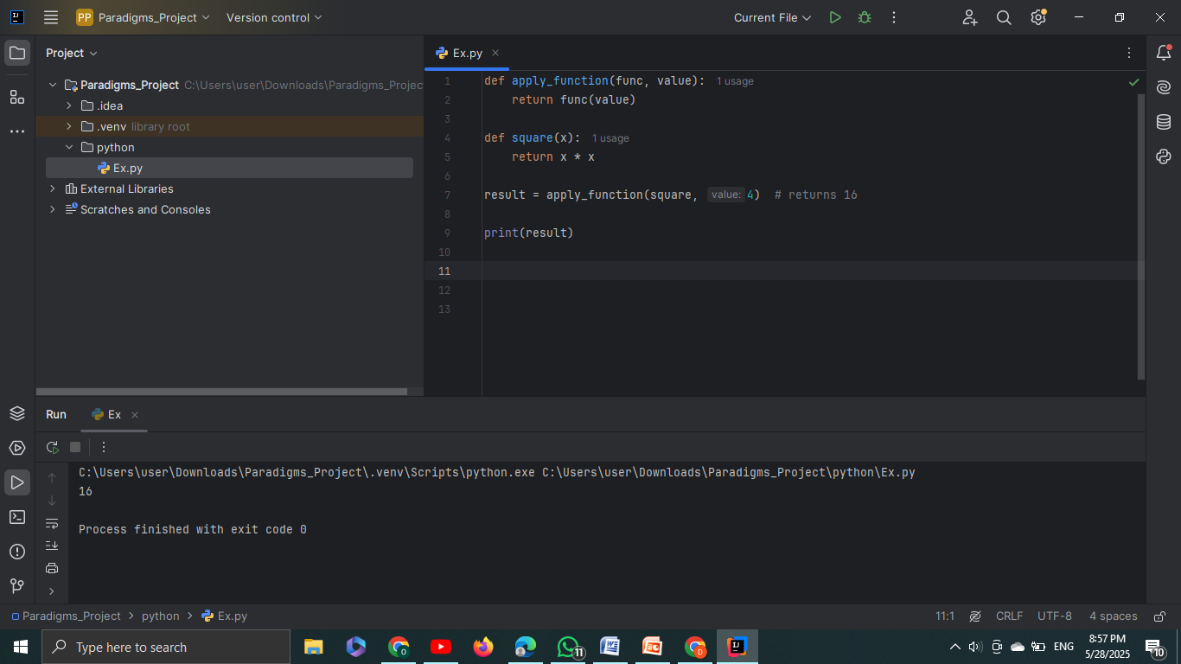
Hofs in python
Functions in Python are first-class citizens, meaning they
can be:
Assigned to variables.
Passed as arguments to other functions.
Returned from other functions.

Slide 7
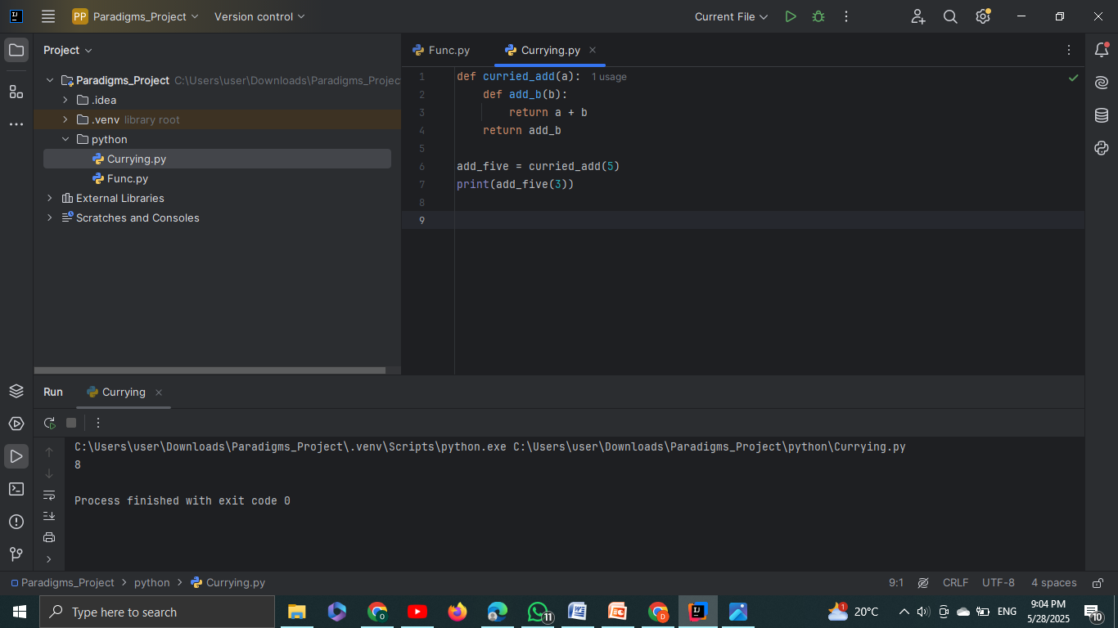
Currying in python
Python does NOT support currying natively but we can simulate it using closures.
Closure in Python allows a function to remember the
variables from its enclosing scope even after the outer
function has finished executing.

Slide 8
Differences between HOFs and Currying
Concept | Higher-Order Functions (HOFs) | Currying
How It Works | You can pass functions as arguments or return them from other functions. | You create a sequence of functions, each accepting one argument and returning another function.
Purpose | To abstract and manipulate behavior by passing functions around. | To partially apply arguments to a function step-by-step.
Use Case | Used for function composition, abstraction, and higher-level operations like map(), filter(), reduce(). | Used when you want to pre-set one or more arguments of a function and apply the remaining arguments later.
Real-World Example | - Event handlers in GUI programming where behavior is passed as a function. - Functional libraries like map(), filter(), reduce() which take functions as arguments. | - Logging where a part of the function (like a log level) is set, and other values (like message) are passed later. - Mathematical operations like add(a)(b) where a is fixed first, and b is added later.
When to Use | When you need flexibility, reuse code, or compose multiple operations into a single function. | When you want to reuse a function with some arguments pre-set, making the function more specialized for future use.

Slide 9
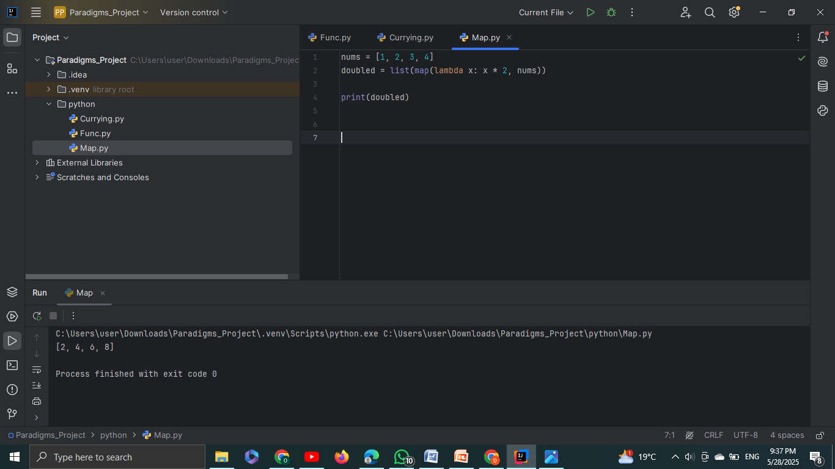
When and Why Each is Used in Real-World Code
HOFs in Real-World Code
Map()
Map, Filter, and Reduce:
These functions are built-in higher-order functions in Python. They take functions as arguments and return the result of applying that function to an iterable (list, tuple, etc.).
They allow concise and functional programming, where logic can be abstracted and reused.
You can pass custom functions into map(), filter(), or reduce() to apply specific behaviors on data collections.
The map() function applies a given function to each item in an iterable and returns a new iterable (list, tuple) of the results.

Slide 10
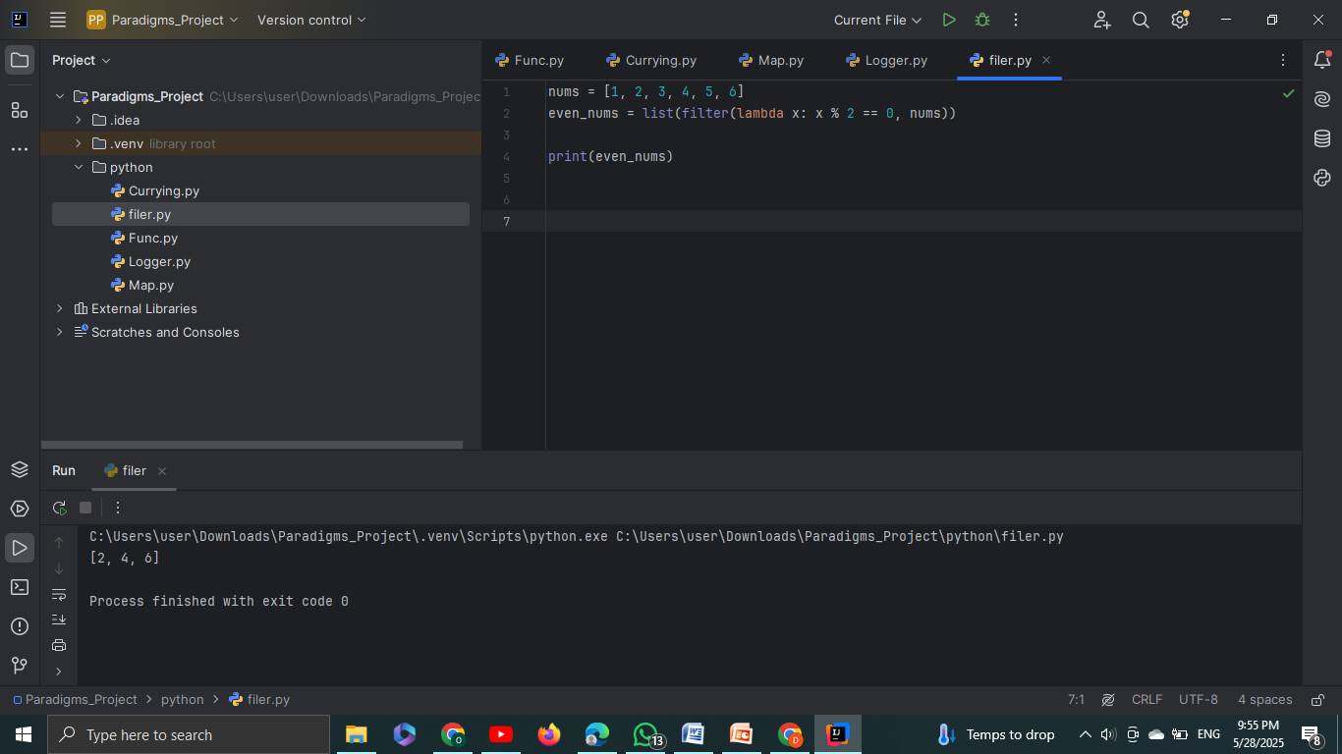
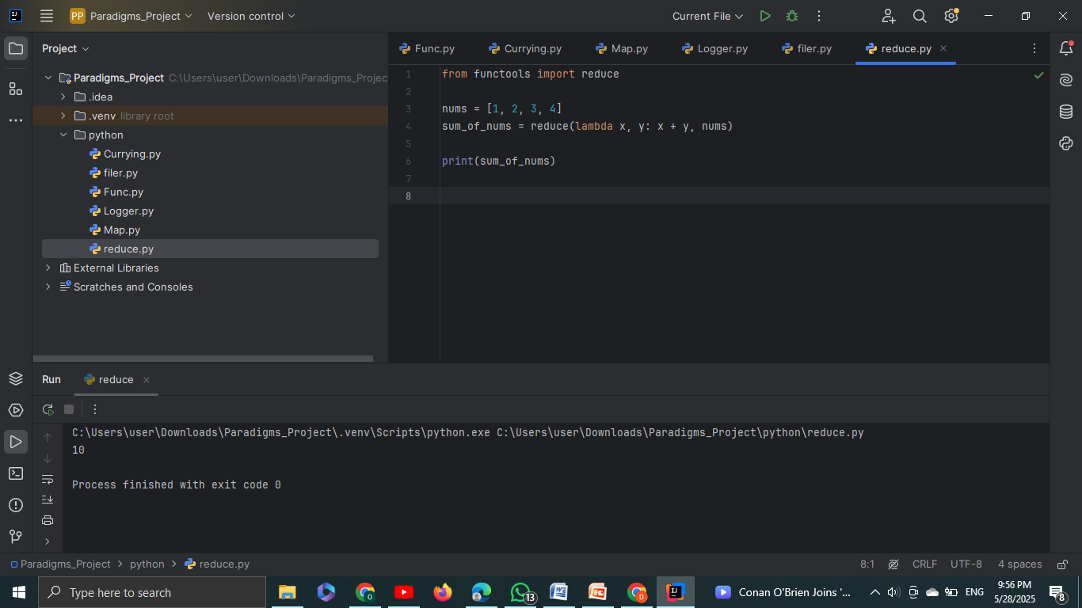
HOFs in Real-World Code
Filter()
Reduce()
The reduce() function reduces an iterable (list, tuple) to a single value by applying a function that takes two arguments, combining them into one. It keeps applying the function cumulatively to the elements of the iterable.
The filter() function filters out elements from an iterable based on a condition defined by a function. It returns a new iterable (filtered list) containing only the elements that satisfy the given condition.

Slide 11
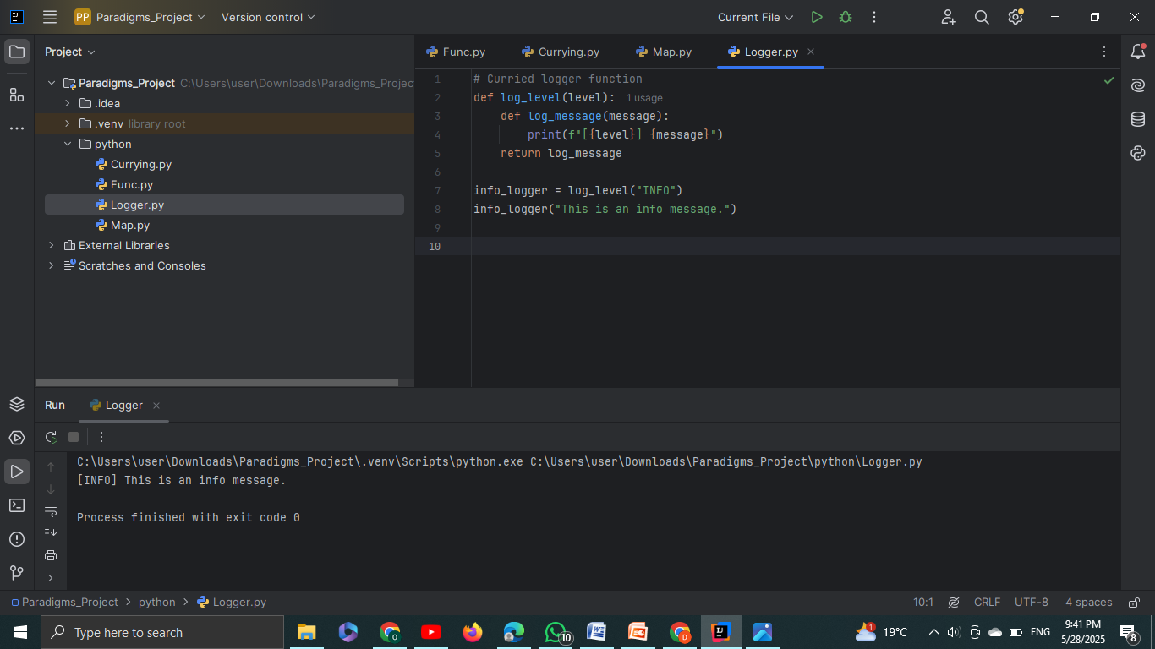
When and Why Each is Used in Real-World Code
Currying in Real-World Code
Logging:
A logging function might use currying to set the log level once and then accept log messages as needed later.
Why Currying:
It allows for partial application, where you set up part of the function (like the log level) once, and you can reuse that function for logging different messages.
Logging

Slide 12
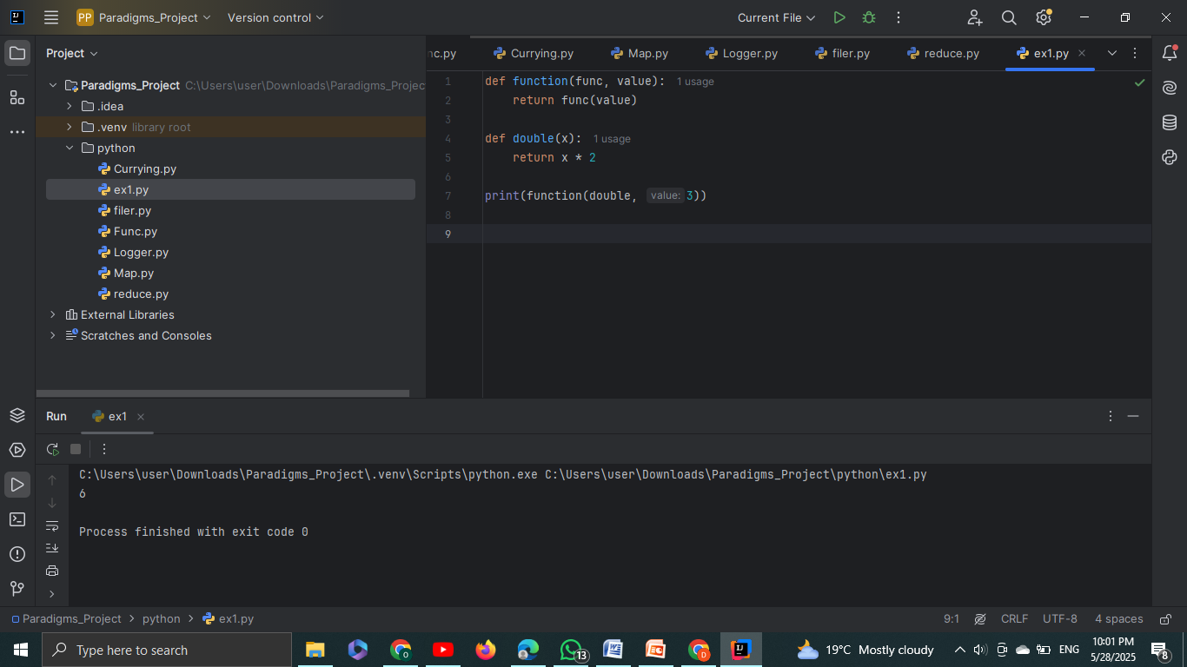
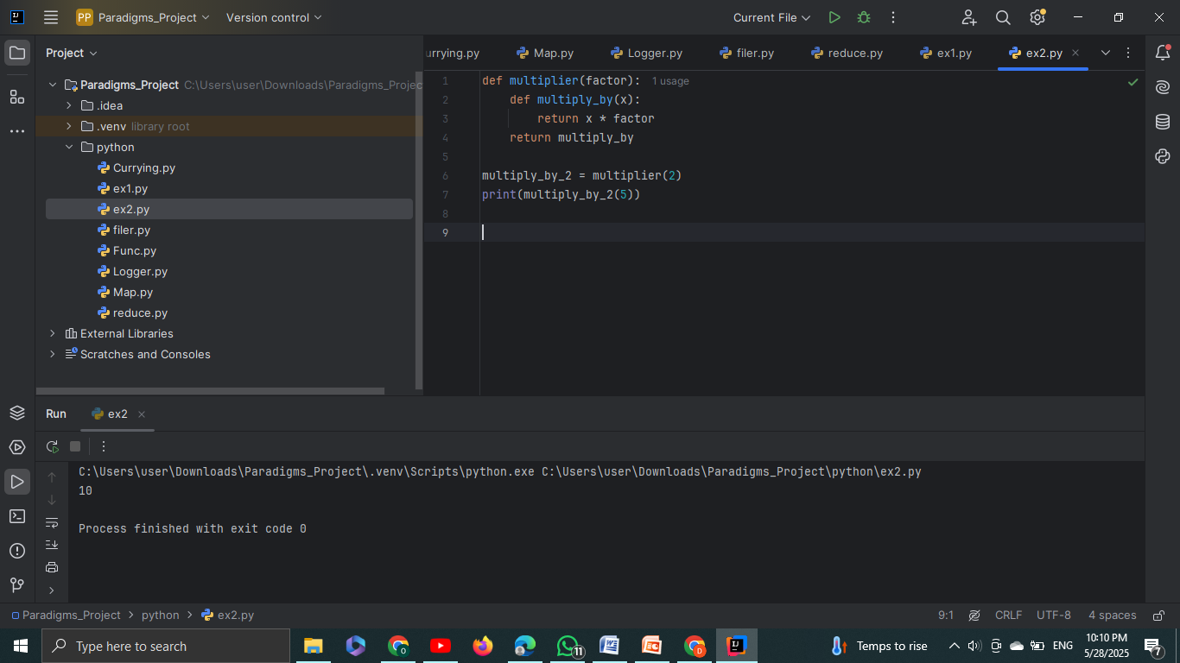
Custom Higher-Order Function
Function that takes another function as an argument
Function that returns another function

Slide 13
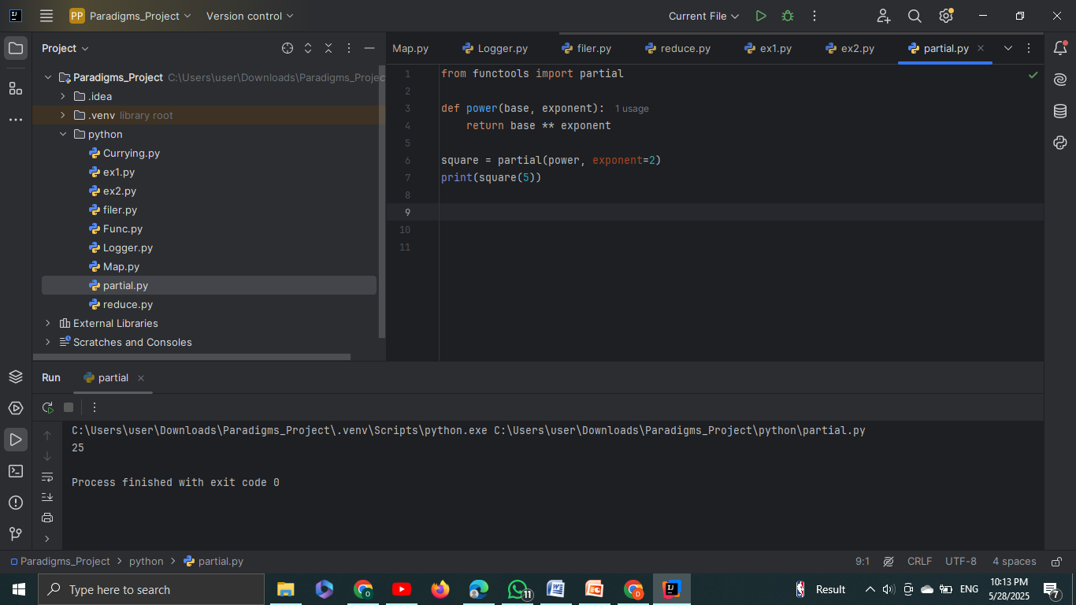
Partial Application Example
In Python, partial application can be achieved using the functools.partial() function, which is a built-in utility for fixing a certain number of arguments of a function, creating a new function that takes fewer arguments.
How It Works:
Partial application means applying a function to a subset of its arguments.
Instead of repeatedly passing the same argument every time you call a function, you can "fix" that argument and generate a new function that only requires the remaining arguments.

Slide 14
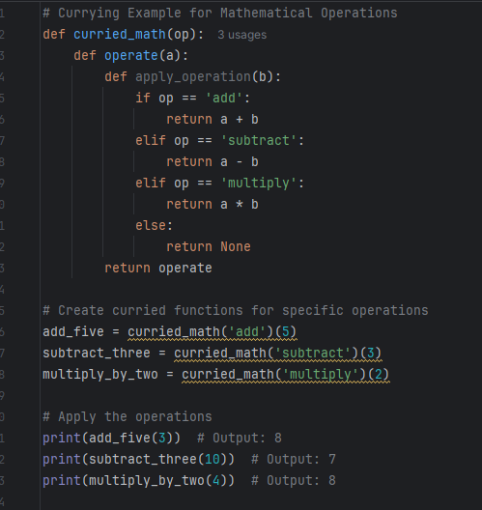
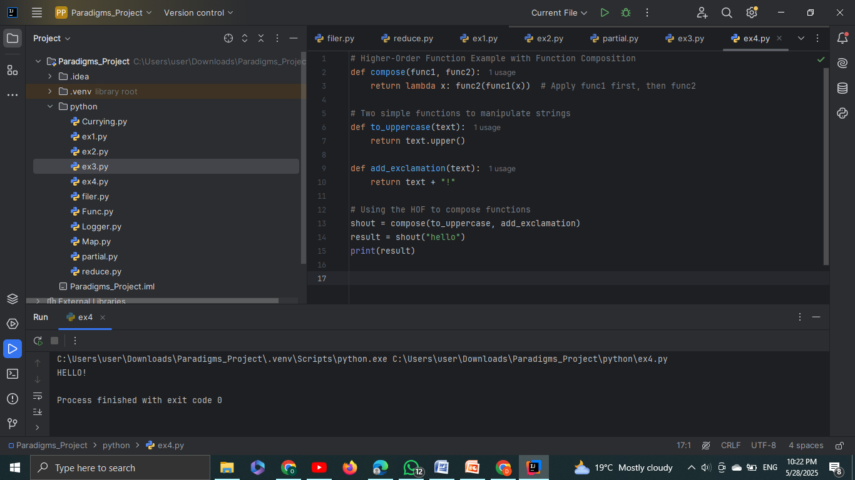
Higher-Order Function (HOF) with Function Composition
Currying Example with Custom Math Operation

Slide 15
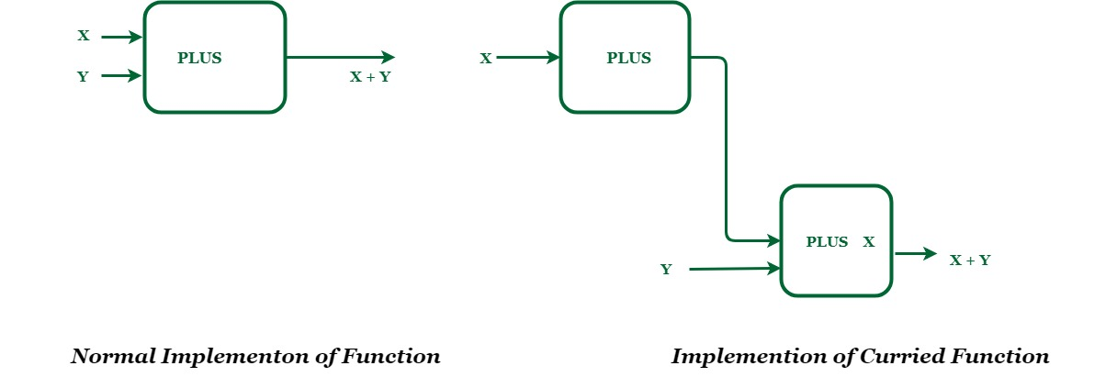
Let's take an example, PLUS is a function which adds two numberWe wish to add two numbers X and Y. X will be the input to PLUS function which returns a function named PLUS X.
PLUS X function takes one number and add X to it. Now input to this function will be Y. Final output will be X + Y.

Slide 16
advantages and disadvantages of higher ordered functions in python
Advantages | Disadvantages
1. Code Reusability: HOFs allow you to create generic functions that can be reused with different behavior by passing different functions. | 1. Complexity: HOFs can introduce complexity and make code harder to understand, especially for beginners. It can be difficult to track the flow of execution when functions are passed around.
2. Modularity: HOFs allow for modular code by abstracting behavior into functions. You can pass different functions to achieve different behaviors without changing the structure. | 2. Performance Overhead: Using HOFs, especially with functions like map(), filter(), or reduce(), can add extra overhead when compared to using simple loops, especially in tight loops or performance-sensitive applications.
3. Function Composition: HOFs facilitate function composition, where you can combine small functions to create complex operations. | 3. Debugging Difficulty: Debugging code with HOFs can be more challenging because functions are passed around dynamically, which can make it harder to set breakpoints or track values during execution.
4. Functional Programming Paradigm: They promote functional programming, making Python code more flexible, reusable, and easier to maintain. | 4. Can Lead to Nested Functions: Overuse of HOFs can lead to deeply nested functions or callbacks, making the code harder to follow and manage.
5. Cleaner Code: HOFs allow you to abstract complex logic and encapsulate it in functions, leading to cleaner, more readable code. | 5. Learning Curve: Python developers accustomed to imperative programming may find it difficult to understand and use HOFs effectively.
6. Higher Flexibility: HOFs provide more flexibility and customization because they allow you to pass different functions to modify behavior without changing the structure. | 6. Limited Support for Side Effects: Since functional programming (and HOFs) encourages pure functions (no side effects), certain real-world scenarios where side effects are needed (like modifying external states) can be more difficult to handle.
7. Encourages Cleaner Abstractions: HOFs can help abstract repetitive logic, reducing code duplication and allowing you to focus on higher-level problem-solving. | 7. Can Obscure Logic: Overuse of HOFs can make the code harder to reason about, especially when combined with anonymous functions (lambdas). It might obscure the main logic of the program.

Slide 17
advantages and disadvantages of currying in python
Advantages | Disadvantages
1. Partial Application: Currying allows for partial application, where you can fix some arguments of a function and apply the rest later. This makes it easier to create specialized functions. | 1. More Complex Syntax: Currying requires a more complex syntax compared to regular functions. In Python, simulating currying can introduce nested functions, which may be harder to follow for beginners.
2. Reusability: Currying allows you to create more reusable functions by pre-setting some arguments. You can use the curried function with different remaining arguments, making it highly flexible. | 2. Increased Overhead: Simulating currying in Python through closures or nested functions can introduce additional memory overhead and potentially slow down performance, especially if done extensively.
3. More Modular Code: It promotes a more modular approach by breaking down a function into smaller, focused functions. Each curried function can represent a part of the operation, improving clarity. | 3. Difficult to Debug: Debugging curried functions can be challenging, especially when working with closures. Tracking variable values across nested functions can become complicated.
4. Clearer Function Composition: Currying makes it easier to compose functions together, leading to cleaner and more expressive code. You can create a pipeline of operations by currying. | 4. Not Native to Python: Currying is not natively supported in Python. You have to simulate it using closures or libraries like functools.partial, making it less intuitive than in other languages like Haskell.
5. Increased Flexibility: You can create customized versions of functions by fixing arguments early. This leads to more flexible code where specific behavior can be set up upfront. | 5. Can Lead to Overuse: Overuse of currying can lead to overly complex function signatures or too many small functions, making the code more fragmented and harder to manage.
6. Makes Code More Readable in Some Cases: In scenarios like logging, math operations, or configuration settings, currying helps make the code more readable by pre-setting common arguments. | 6. Limited to Simple Functions: Currying is best suited for simple functions that can be split into unary functions. For more complex functions, currying may not be the most practical solution.
7. Supports Functional Programming Style: Currying encourages functional programming principles in Python, allowing you to use concepts like higher-order functions and function composition. | 7. Reduces Performance in Some Cases: When currying is used with deeply nested functions or closures, it can result in slower performance due to the additional function calls and memory consumption.

Slide 18
HOF & CURRYING
IN KOTLIN
VIOLA ZENELI

Slide 19
Higher-Order Functions in Kotlin
What are?
Why are important?
In Kotlin, a higher-order function is a function that either:
Takes another function as a parameter, or
Returns a function as a result.
This is made possible because functions are first-class citizens in Kotlin — meaning they can be:
Stored in variables
Passed to other functions
Returned from functions
Stored in data structures
Kotlin is a multi-paradigm language, but embraces functional programming. HOFs make code more concise and composable.
Using HOFs allows reusing logic with different behaviors and reducing code repetition.
You can pass in your own function or lambda to dynamically control behavior (e.g., sorting, filtering, reducing).
Notes:
© Copyright Showeet.com – Free PowerPoint Templates

Slide 20
Kotlin syntax support
EXAMPLE 1: FUNCTION AS PARAMETER
EXAMPLE 2: RETURNING A FUNCTION
// Here, op is a function type (Int, Int) -> Int
fun calculator(a: Int, b: Int, op: (Int, Int) -> Int): Int {
return op(a, b)
}
// its calling
val sum = calculator(3, 4, { x, y -> x + y })
println(sum) // Output: 7
fun chooseOperation(type: String): (Int, Int) -> Int {
return if (type == "add") { a, b -> a + b } else { a, b -> a * b }
}
val operation = chooseOperation("add")
println(operation(2, 3)) // Output: 5
//You can also simplify it using lambda
val sum = calculator(3, 4) { x, y -> x + y }

Slide 21
Kotlin Syntax Features for Higher-Order Functions
Lambda Expressions
Trailing Lambdas
Lambda expressions in Kotlin are anonymous functions defined using curly braces. They can take parameters and return values like named functions. Lambdas are essential for defining short, one-off functions and are the building blocks of higher-order functions.
When the last parameter of a function is a lambda, Kotlin allows moving the lambda outside of the parentheses. This makes the code more readable and is commonly used in Kotlin’s DSLs and collection APIs.
val add = { a: Int, b: Int -> a + b }
println(add(2, 3)) // Output: 5
// With type inference
val multiply: (Int, Int) -> Int = { x, y -> x * y }
// Traditional way
compute(3, 4, { a, b -> a * b })
// Trailing lambda syntax
compute(3, 4) { a, b -> a * b }

Slide 22
Kotlin Syntax Features for Higher-Order Functions
‘it’ Keyword
Function References
‘it’ is the implicit name given to the single parameter of a lambda in Kotlin. This makes simple lambda expressions even more concise by avoiding the need to explicitly name the parameter.
Kotlin allows referencing existing functions using the double colon (::) operator. These references can be passed as arguments to higher-order functions, allowing code reuse and avoiding redundant lambdas.
fun square(x: Int): Int = x * x
val op: (Int) -> Int = ::square
println(op(4)) // Output: 16
val doubled = listOf(1, 2, 3).map(::square)
val numbers = listOf(1, 2, 3, 4)
val evens = numbers.filter { it % 2 == 0 }
println(evens) // Output: [2, 4]

Slide 23
Kotlin Syntax Features for Higher-Order Functions
Lambda with Receiver
Returning Functions
Lambdas with receiver allow you to call methods on a receiver object inside the lambda without using a qualifier. These are used heavily in Kotlin DSLs.
Kotlin supports returning lambdas from functions, enabling closures. Returned functions can capture and use variables from their defining scope.
val greet: String.() -> String = { "Hello, $this!" }
println(”Viola".greet()) // Output: Hello, Viola!
fun makeAdder(x: Int): (Int) -> Int = { y -> x + y }
val addFive = makeAdder(5)
println(addFive(3)) // Output: 8

Slide 24
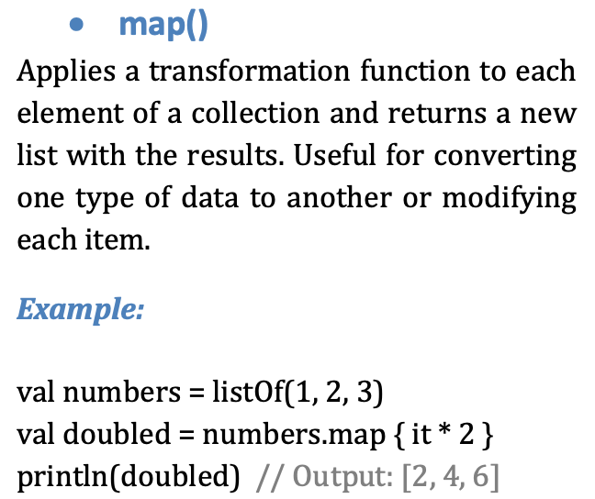
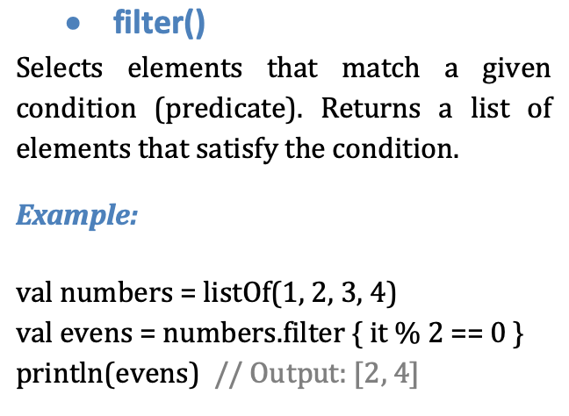
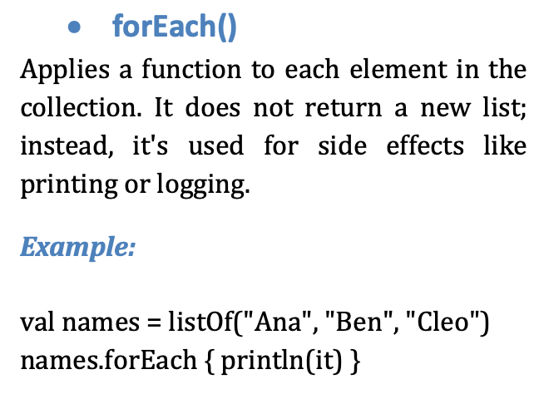
Built-in Higher-Order Functions in Kotlin
Kotlin's built-in higher-order functions simplify working with collections through functional programming patterns. Below is a detailed explanation of each key function including what it does, when it's useful, and example usage.

Slide 25
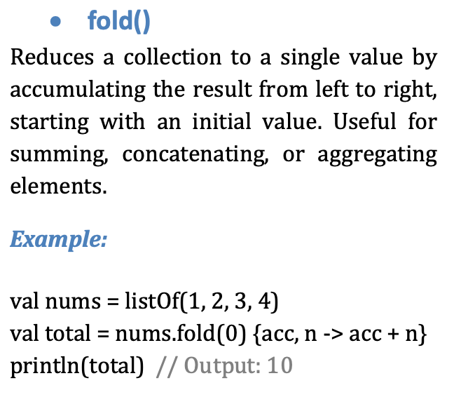
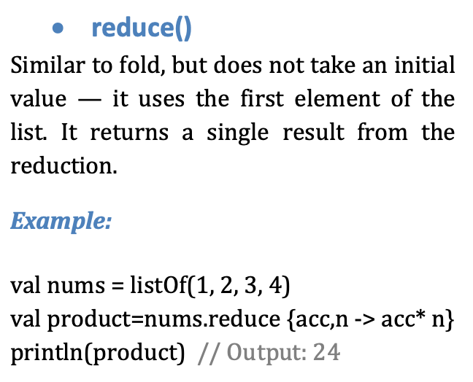
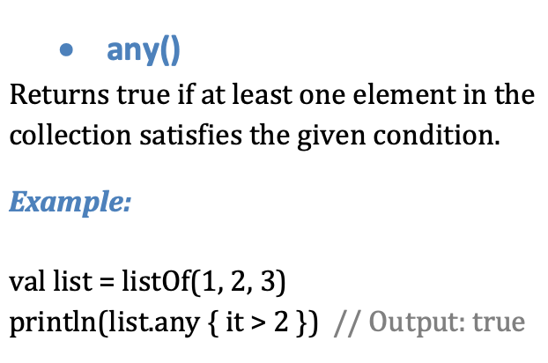
Built-in Higher-Order Functions in Kotlin

Slide 26
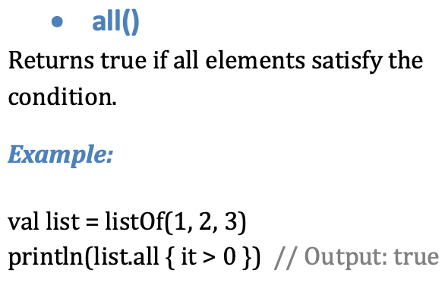
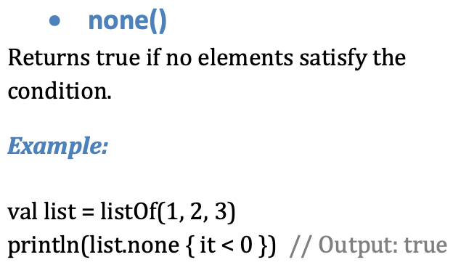
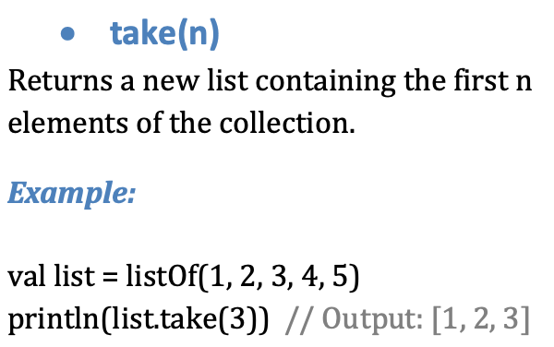
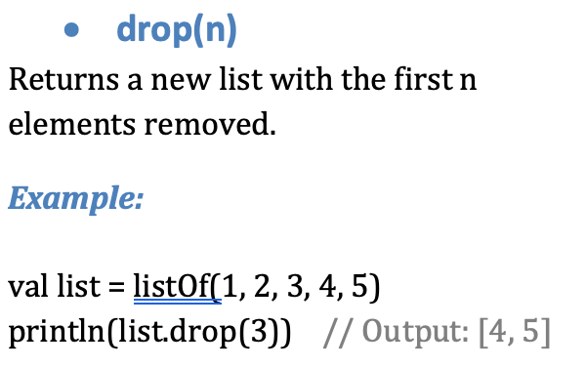
Built-in Higher-Order Functions in Kotlin

Slide 27
Currying in kotlin
Definition of Currying
How Currying Is Achieved In Kotlin?
Currying is the process of transforming a function that takes multiple arguments into a sequence of functions, each taking a single argument. Instead of calling a function with all parameters at once, you call a series of functions that return other functions.
For example, a function of type (A, B) -> C becomes: A -> (B -> C).
This technique enables function reuse and helps in building more modular and readable code.
Kotlin does not have native support for automatic currying like Haskell or Scala, but currying can be implemented manually using higher-order functions. You define a function that returns another function, each taking one argument.
Example:
fun multiply(x: Int): (Int) -> Int = { y -> x * y }
val double = multiply(2)
println(double(5)) // Output: 10
This simulates a curried function by returning a lambda.

Slide 28
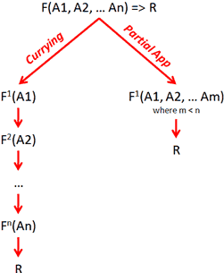
Currying vs Partial Application
Currying transforms a multi-parameter function into a chain of single-parameter functions.
Partial application fixes a few arguments of a function and returns a new function with fewer parameters.
Difference:
Currying always transforms to a series of unary functions.
Partial application can stop at any stage with any number of arguments fixed.
Example of partial application in Kotlin:
fun add(a: Int, b: Int) = a + b
val addFive = { x: Int -> add(5, x) }
println(addFive(3)) // Output: 8

Slide 29
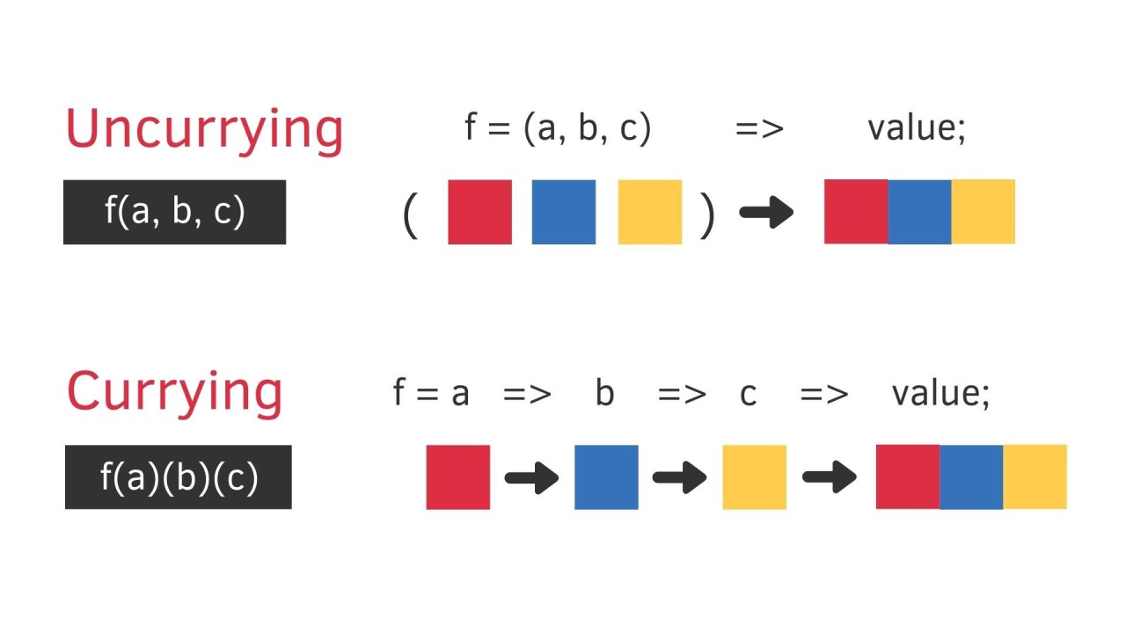
Manual currying in kotlin
Manual currying in Kotlin involves writing nested functions or lambdas that take one parameter at a time.
Example:
fun curriedSum(a: Int): (Int) -> (Int) -> Int = { b -> { c -> a + b + c } }
val result = curriedSum(1)(2)(3)
println(result) // Output: 6
Each invocation returns a new function expecting the next argument.

Slide 30
Use cases of hof and currying in kotlin
Use Case | HOFs | Currying
DSLs | Used to build readable config-like code (e.g., Jetpack Compose). | Rarely used.
Callbacks | Used a lot for passing logic in UIs or APIs. | Not used here.
Events | Common for click listeners, etc. | Not practical.
Data Pipelines | Chain functions like map, filter, etc. | Create flexible pipelines with partial values.
Custom Functions | Pass lambdas to reuse logic. | Return functions with pre-filled values.
Delayed Execution | Run lambdas later (e.g., with inline). | Wait until all arguments are supplied.

Slide 31
HOF & CURRYING
IN SCALA
SIDRIT RRUSTEMI

Slide 32
Higher-Order Functions in SCALA
What are HOFs?
Why are they important?
In Scala, a higher-order function is a function that either:
Takes another function as a parameter, or
Returns a function as a result.
This is made possible because functions are first-class citizens in Scala — meaning they can be:
Stored in variables
Passed to other functions
Returned from functions
Scala is a multi-paradigm language, but embraces functional programming. HOFs make code more concise and composable.
Using HOFs allows reusing logic with different behaviors and reducing code repetition.
You can pass in your own function or lambda to dynamically control behavior (e.g., sorting, filtering, reducing).
Notes:
© Copyright Showeet.com – Free PowerPoint Templates

Slide 33
FUNCTION AS PARAMETER
EXAMPLE 1
EXAMPLE 2
def applyOperation(x: Int, operation: Int => Int): Int = {
operation(x)
}
val square = (n: Int) => n * n
val result = applyOperation(5, square)
println(result) // Output: 25
def calculate(a: Int, b: Int, op: (Int, Int) => Int): Int = {
op(a, b)
}
val sum = calculate(3, 4, (x, y) => x + y)
val product = calculate(3, 4, _ * _)
println(s"Sum: $sum") // Output: Sum: 7
println(s"Product: $product") // Output: Product: 12
// You can also pass the lambda directly
val result2 = applyOperation(6, x => x + 10)
println(result2) // Output: 16

Slide 34
RETURNING A FUNCTION
EXAMPLE 1
EXAMPLE 2
def multiplier(factor: Int): Int => Int = {
(x: Int) => x * factor
}
val triple = multiplier(3) // triple is a function: Int => Int
println(triple(4)) // Output: 12
def greetWith(greeting: String): String => String = {
(name: String) => s"$greeting, $name!"
}
val sayHello = greetWith("Hello")
val sayWelcome = greetWith("Welcome")
println(sayHello("Scala")) // Output: Hello, Scala!
println(sayWelcome("Sidrit")) // Output: Welcome, Sidrit!

Slide 35

Trailing Lambdas IN SCALA
Trailing Lambdas
When the last parameter of a function is a lambda, Scala allows moving the lambda outside of the parentheses.
object LambdaExample extends App {
def compute(a: Int, b: Int, op: (Int, Int) => Int): Int = op(a, b)
// Traditional way
val result1 = compute(3, 4, (a: Int, b: Int) => a * b)
println(result1)
// Trailing lambda syntax
val result2 = compute(3, 4) { (a: Int, b: Int) => a * b }
println(result2)
}

Slide 36
“_” AS A PLACEHOLDER IN SCALA
“_” Placeholder
Function References
When you want to write a simple anonymous function but don't want to explicitly name the parameters, you can use _ as a placeholder.
Scala will replace each _ with a different parameter in order.
def compute(a: Int, b: Int, op: (Int, Int) => Int): Int = op(a, b)
// Using named params
val sum1 = compute(3, 4, (x, y) => x + y)
// Using _ placeholder syntax
val sum2 = compute(3, 4, _ + _)
println(sum1) // Output: 7
println(sum2) // Output: 7

Slide 37
Built-in Higher-Order Functions in SCALA
1. map
2. filter
Applies a function to each element, returns a new collection of results.
Returns a collection with elements that satisfy a predicate (boolean test).
val nums = List(1, 2, 3, 4)
// Using explicit parameter x
val doubled = nums.map(x => x * 2)
// Using explicit parameter x
val doubled = nums.map(_ * 2)
val nums = List(1, 2, 3, 4)
val evens = nums.filter(_ % 2 == 0) // List(2, 4)

Slide 38
Built-in Higher-Order Functions in SCALA
3. flatmap
4. reduce
Like map, but the function returns a collection which gets flattened.
Combines elements using a binary function to produce a single value.
val words = List("hello", "world")
val chars = words.flatMap(_.toList)
// List('h','e','l','l','o','w','o','r','l','d')
val nums = List(1, 2, 3, 4)
val sum = nums.reduce(_ + _) // 10

Slide 39
Built-in Higher-Order Functions in SCALA
5. fold
6. foreach
Similar to reduce but allows specifying a starting (initial) value.
Applies a function to each element, typically for side effects (returns Unit).
val nums = List(1, 2, 3)
val sum = nums.fold(0)( _ + _ ) // 6
val nums = List(1, 2, 3)
nums.foreach(println) // 1 2 3 (in new lines)

Slide 40
Built-in Higher-Order Functions in SCALA
7. exists and forall
8. sortBy
exists checks if any element satisfies a predicate.
forall checks if all elements satisfy a predicate.
Sort elements by a function or natural ordering.
val nums = List(1, 2, 3, 4)
nums.exists(_ > 3) // true
nums.forall(_ > 0) // true
val words = List("apple", "banana", "pear")
val sortedWords = words.sortBy(_.length)
// List("pear", "apple", "banana")

Slide 41
Currying in SCALA
Definition of Currying
Why use currying?
Currying is the process of transforming a function that takes multiple arguments into a sequence of functions, each taking a single argument.
In other words:
Partial application: You can fix some arguments and create a new function.
Function composition: It fits well with functional programming patterns.
Cleaner syntax: Especially when passing functions as arguments.
// Normal function: takes 2 parameters
def add(x: Int, y: Int): Int = x + y
// Curried version: a function that returns another function
def curriedAdd(x: Int)(y: Int): Int = x + y

Slide 42
HOW IS CURRYING ACHIEVED IN SCALA?
1. Using Multiple Parameter Lists
2. Using the curried Method
This is the most direct way to define a curried function:
You can convert a regular function into a curried one.
def multiply(x: Int)(y: Int): Int = x * y
val timesTwo = multiply(2)_ // Partial application
println(timesTwo(5)) // Output: 10
val add = (x: Int, y: Int) => x + y
val curriedAdd = add.curried
val addFive = curriedAdd(5)
println(addFive(3)) // Output: 8

Slide 43
Manual currying in SCALA
We start with a regular function:
Then we manually curry it:
val add = (x: Int, y: Int) => x + y
def manualCurriedAdd(x: Int): Int => Int = {
(y: Int) => x + y
}
manualCurriedAdd takes an Int and returns a function Int => Int.
You call manualCurriedAdd(5) to get a function that adds 5 to whatever you give it.
Equivalent to this:
def curriedAdd(x: Int)(y: Int): Int = x + y

Slide 44
WHY DO WE USE CURRYING IN SCALA?
1. Partial Application & Impoved Code Reuse
2. Better Function Composition
You can fix some parameters and create a new, more specific function.
Curried functions work well with higher-order functions and pipelines.
def multiply(x: Int)(y: Int): Int = x * y
val double = multiply(2) _ // Partially applied
println(double(5)) // Output: 10
val add = (x: Int) => (y: Int) => x + y
val add2 = add(2)
val result = List(1, 2, 3).map(add2) // List(3, 4, 5)

Slide 45
WHERE IS CURRYING MOSTLY USED?
1. Functional Programming
Currying is a core part of functional programming in Scala, Haskell, etc.
2. Frameworks like Play Framework (Scala Web)
In Play Framework, controller actions often use currying to inject dependencies like request handlers or authentication layers:
3. DSLs and APIs
Libraries that build domain-specific languages (DSLs), like Akka HTTP or Cats, often use currying for fluent API design.
4. Partial Functions
Currying makes it easier to create partially applied functions for use in higher-order functions like map, filter, etc.

Slide 46
LANGUAGE COMPARISONS

Slide 47
Comparison of HOFs in Python, Kotlin, and Scala
Aspect | Python | Kotlin | Scala
Function as First-Class | Yes, functions can be assigned and passed around. | Yes, functions are first-class citizens. | Yes, core FP concept. Everything is an object including functions.
Lambda Support | Yes, but single-expression lambdas only. | Yes, supports inline multi-parameter lambdas. | Yes, full-featured anonymous functions and blocks.
Built-in HOFs | map, filter, reduce (via functools), sorted, etc. | map, filter, fold, forEach, etc. in standard library. | map, filter, fold, reduce, etc. on collections and Streams.
Function Reference | Use function name without () or use functools.partial. | Use ::functionName syntax. | Pass function names directly, no special syntax needed.
Lambdas with Receivers | Not supported directly. | Yes, supports receivers for DSLs. | Supported using implicit classes or context.

Slide 48
Comparison of Currying in Python, Kotlin, and Scala
Aspect | Python | Kotlin | Scala
Native Support | No native currying. Can be done manually or with functools.partial. | No native support, but can be done manually via nested lambdas. | Yes, supports native currying using multiple parameter lists.
Syntax Simplicity | Manual via nested functions or lambda chains. | Requires explicit nested functions or lambdas. | Simple and elegant syntax: def add(a: Int)(b: Int).
Partial Application | Supported using functools.partial. | Manual only using inline lambdas. | Fully supported as a first-class feature.
Use in Practice | Rare in Python codebases. | Occasional for configuration or closures. | Common in functional-style Scala code.

Slide 49

THANK YOU!
vzeneli23@epoka.edu.al
srrustemi23@epoka.edu.al
dkorra23@epoka.edu.al

