Slide 1
MY JOURNAL TO PYTHON
NAME: MARJUN CEDRIC JOHN E. ALMONIA
TEACHER: MY DEAR GREAT TEAHER

Slide 2
AGENDA
Python
Data types: , strings, list, dict

Slide 3
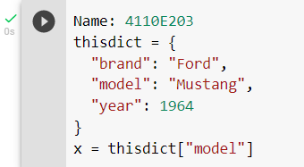
Python - Access Dictionary Item
4110E203
Accessing Items
You can access the items of a dictionary by referring to its key name, inside square brackets:

Slide 4
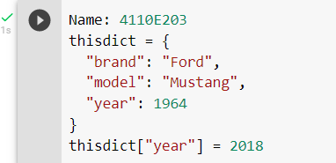
Python - Change Dictionary Items
4110E203
Change Values
You can change the value of a specific item by referring to its key name:
Example
Change the "year" to 2018:

Slide 5
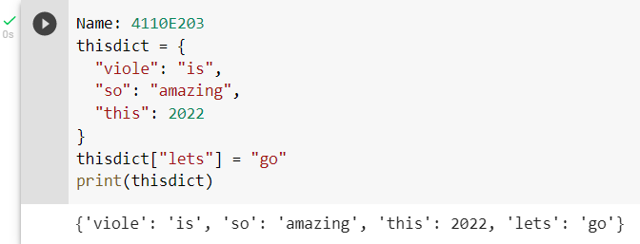
Python - Add Dictionary Items
4110E203
Adding Items
Adding an item to the dictionary is done by using a new index key and assigning a value to it:
Example:

Slide 6
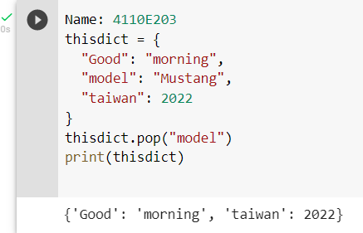
Python - Remove Dictionary Items ❮ PreviousNext ❯
4110E203
Removing Items
There are several methods to remove items from a dictionary:
Example:
The pop() method removes the item with the specified key name:

Slide 7
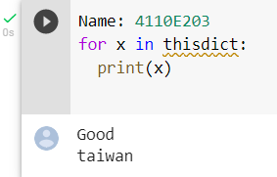
Python - Loop Dictionaries
4110E203
Loop Through a Dictionary
You can loop through a dictionary by using a for loop.
When looping through a dictionary, the return value are the keys of the dictionary, but there are methods to return the values as well.
Example:
Print all key names in the dictionary, one by one:

Slide 8
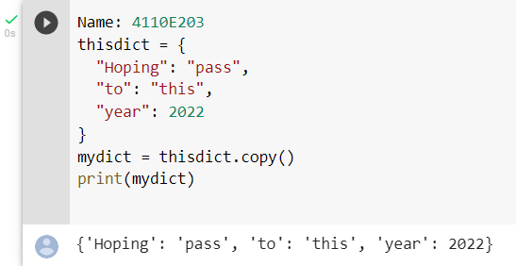
Python - Copy Dictionaries
4110E203
Copy a Dictionary
You cannot copy a dictionary simply by typing dict2 = dict1, because: dict2 will only be a reference to dict1, and changes made in dict1 will automatically also be made in dict2.
There are ways to make a copy, one way is to use the built-in Dictionary method copy().
Example:
Make a copy of a dictionary with the copy() method:

Slide 9
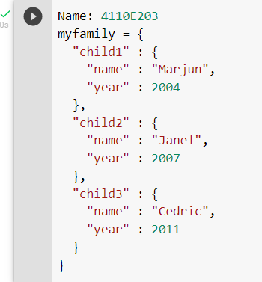
Python - Nested Dictionaries
4110E203
Nested Dictionaries
A dictionary can contain dictionaries, this is called nested dictionaries.
Example:
Create a dictionary that contain three dictionaries:

Slide 10
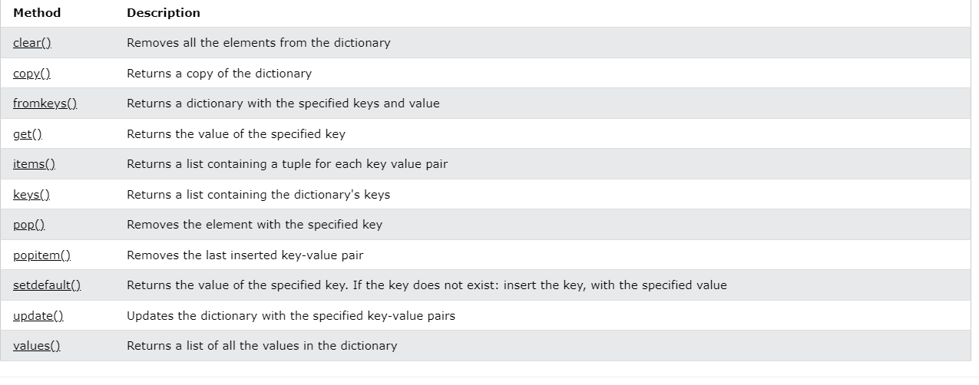
Python Dictionary Methods
4110E203
Dictionary Methods
Python has a set of built-in methods that you can use on dictionaries.

Slide 11
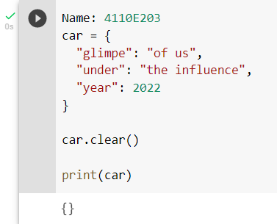
Python Dictionary Methods
4110E203
Example:
Clear().
Example: Remove all elements from the song list:

Slide 12
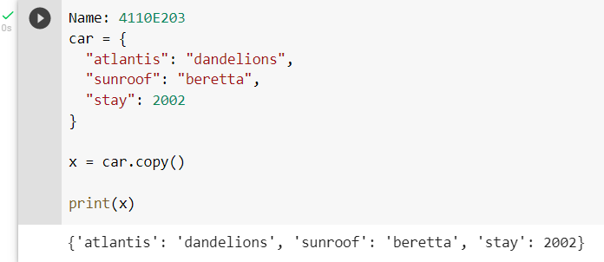
Python Dictionary Methods
4110E203
Copy().
Example: Copy the song dictionary:
Example:

Slide 13
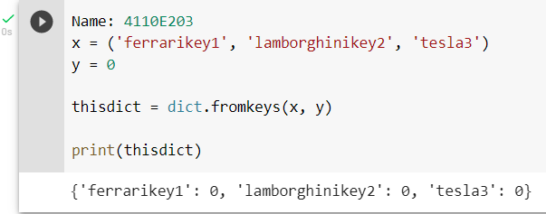
Python Dictionary Methods
4110E203
Fromkeys().
Example: Create a dictionary with 3 keys, all with the value 0:
Example:

Slide 14
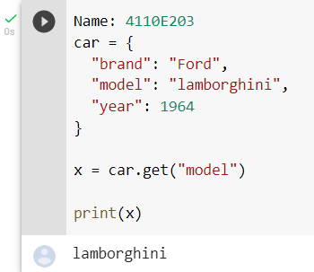
Python Dictionary Methods
4110E203
Get().
Example: Get the value of the "model" item:
Example:

Slide 15
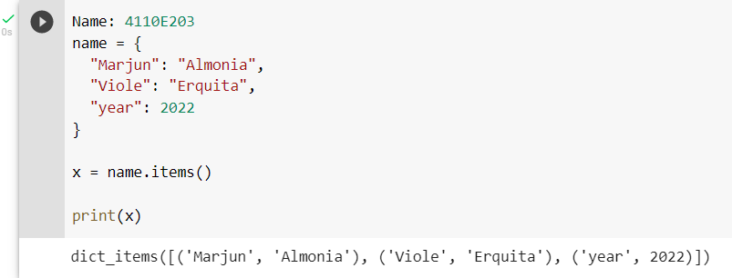
Python Dictionary Methods
4110E203
Items().
Example: Return the dictionary's key-value pairs:
Example:

Slide 16
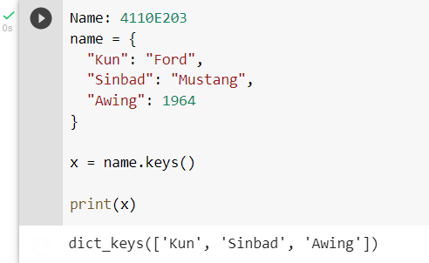
Python Dictionary Methods
4110E203
Example:
Keys().
Example: Return the keys:

Slide 17
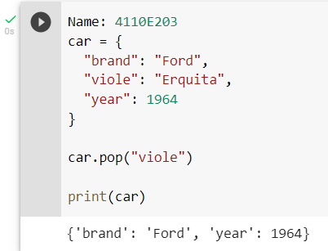
Python Dictionary Methods
4110E203
Pop().
Example: Remove "viole" from the dictionary:
Example:

Slide 18
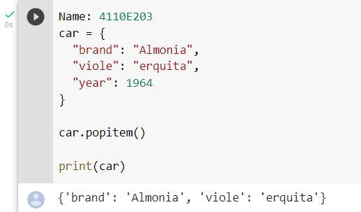
Python Dictionary Methods
4110E203
Popitem().
Example: Remove the last item from the dictionary:
Example:

Slide 19
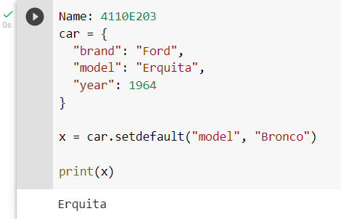
Python Dictionary Methods
4110E203
Setdefault().
Example: Get the value of the "model" item:
Example:

Slide 20
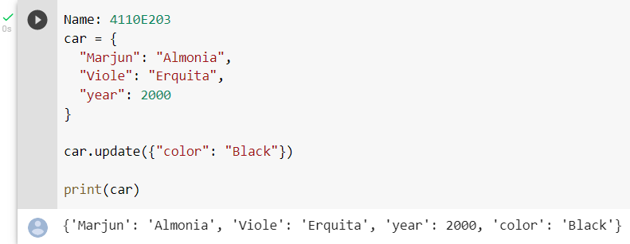
Python Dictionary Methods
4110E203
Update().
Example: Insert an item to the dictionary:
Example:

Slide 21
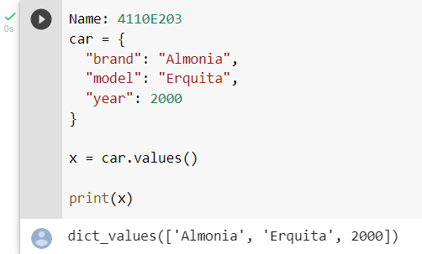
Python Dictionary Methods
4110E203
Values().
Return the values:
Example:

Slide 22
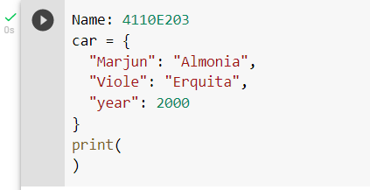
Python Dictionary Exercises
4110E203
Exercise:
Use the get method to print the value of the "model" key of the car dictionary.
Example:

Slide 23
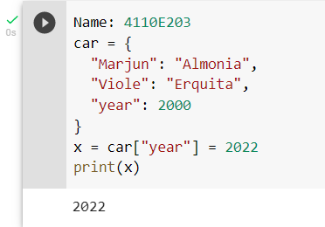
Python Dictionary Exercises
4110E203
Exercise2:
Change the "year" value from 2000 to 2022.
Example:

Slide 24
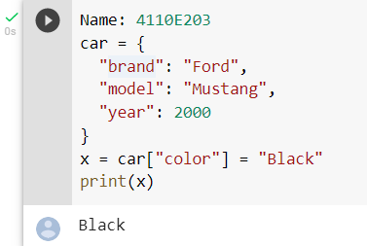
Python Dictionary Exercises
4110E203
Exercise3:
Add the key/value pair "color" : "black" to the car dictionary.
Example:

Slide 25
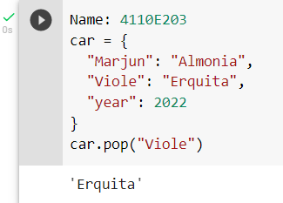
Python Dictionary Exercises
4110E203
Exercise4:
Use the pop method to remove "Viole" from the car dictionary.
Example:

Slide 26
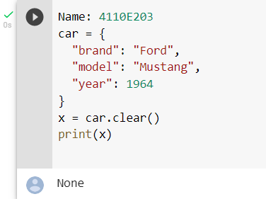
Python Dictionary Exercises
4110E203
Example:
Exercise5:
Use the clear method to empty the car dictionary.

Slide 27
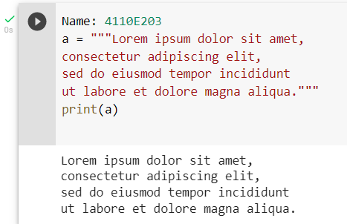
Python Strings
4110E203
Example:
You can use three double quotes:
Strings
Strings in python are surrounded by either single quotation marks, or double quotation marks.
'hello' is the same as "hello".
You can display a string literal with the print() function:

Slide 28
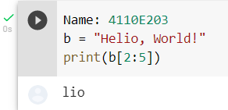
Python - Slicing Strings
4110E203
Slicing
You can return a range of characters by using the slice syntax.
Specify the start index and the end index, separated by a colon, to return a part of the string.
Example:

Slide 29
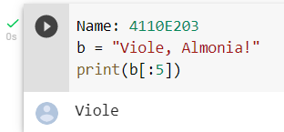
Python - Slicing Strings
4110E203
Slice From the Start
By leaving out the start index, the range will start at the first character:
Example:
Get the characters from the start to position 5 (not included):

Slide 30
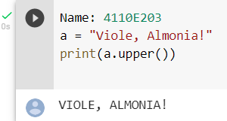
Python - Modify Strings
4110E203
Upper Case
Example:
The upper() method returns the string in upper case:

Slide 31
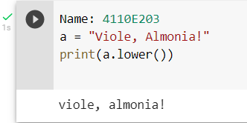
Python - Modify Strings
4110E203
Lower Case
Example:
The lower() method returns the string in lower case:

Slide 32
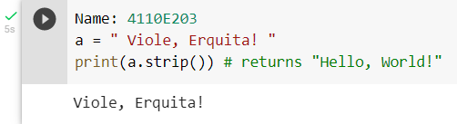
Python - Modify Strings
4110E203
Remove Whitespace
Whitespace is the space before and/or after the actual text, and very often you want to remove this space.
Example:
The strip() method removes any whitespace from the beginning or the end:

Slide 33
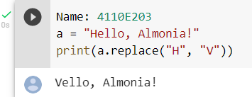
Python - Modify Strings
4110E203
Replace String
Example:
The replace() method replaces a string with another string:

Slide 34
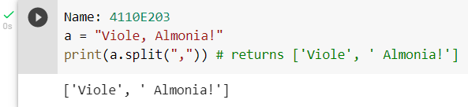
Python - Modify Strings
4110E203
Split String
The split() method returns a list where the text between the specified separator becomes the list items.
Example:
The split() method splits the string into substrings if it finds instances of the separator:

Slide 35
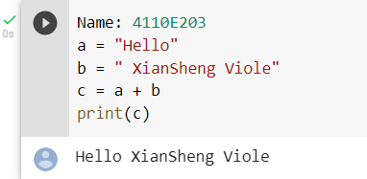
Python - String Concatenation
4110E203
String Concatenation
To concatenate, or combine, two strings you can use the + operator.
Example1:
Merge variable a with variable b into variable c:

Slide 36
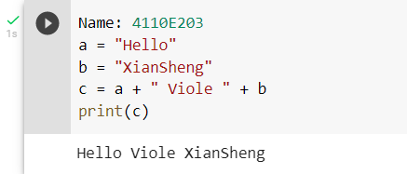
Python - String Concatenation
4110E203
String Concatenation
Example2:
To add a space between them, add a " ":

Slide 37
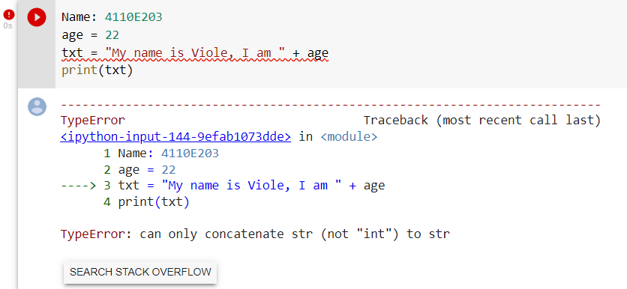
Python - Format - Strings
4110E203
String Format:
As we learned in the Python Variables chapter, we cannot combine strings and numbers like this:
Example1:

Slide 38
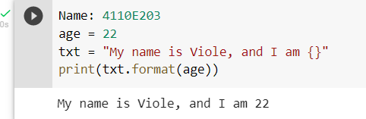
Python - Format - Strings
4110E203
String Format
Example2:

Slide 39
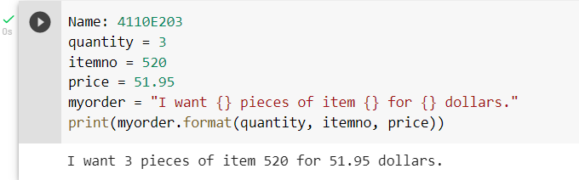
Python - Format - Strings
4110E203
String Format
Example3:

Slide 40
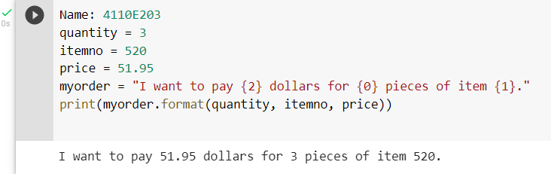
Python - Format - Strings
4110E203
String Format
Example4:

Slide 41
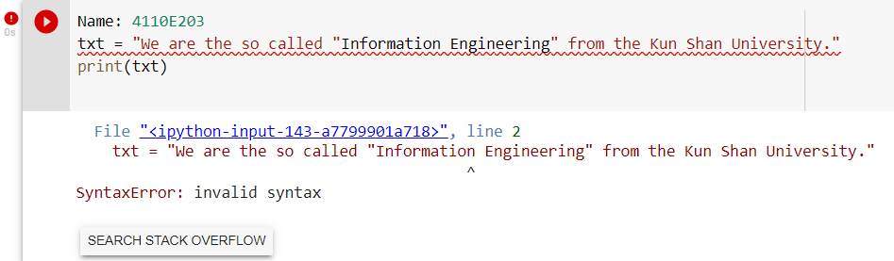
Python - Escape Characters
4110E203
Escape Character
To insert characters that are illegal in a string, use an escape character.
An escape character is a backslash \ followed by the character you want to insert.
An example of an illegal character is a double quote inside a string that is surrounded by double quotes:
Example1:
You will get an error if you use double quotes inside a string that is surrounded by double quotes:

Slide 42
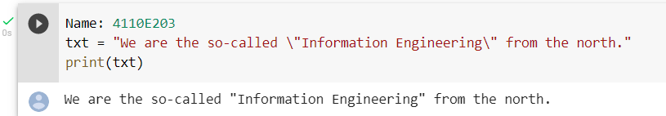
Python - Escape Characters
4110E203
Escape Character
Example2:
The escape character allows you to use double quotes when you normally would not be allowed:

Slide 43
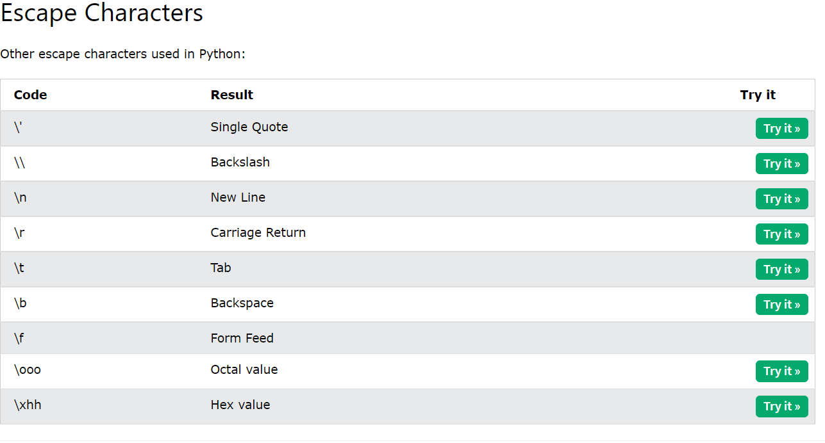
Python - Escape Characters
4110E203

Slide 44
Python - String Methods
4110E203
String Methods
Python has a set of built-in methods that you can use on strings.
Note: All string methods return new values. They do not change the original string.

Slide 45
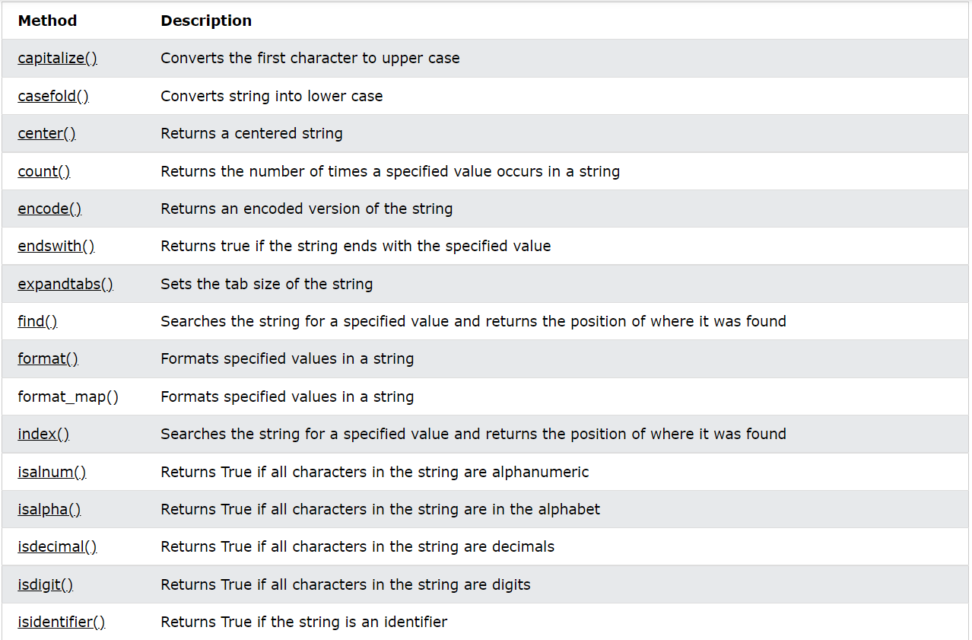
Python - String Methods
4110E203

Slide 46
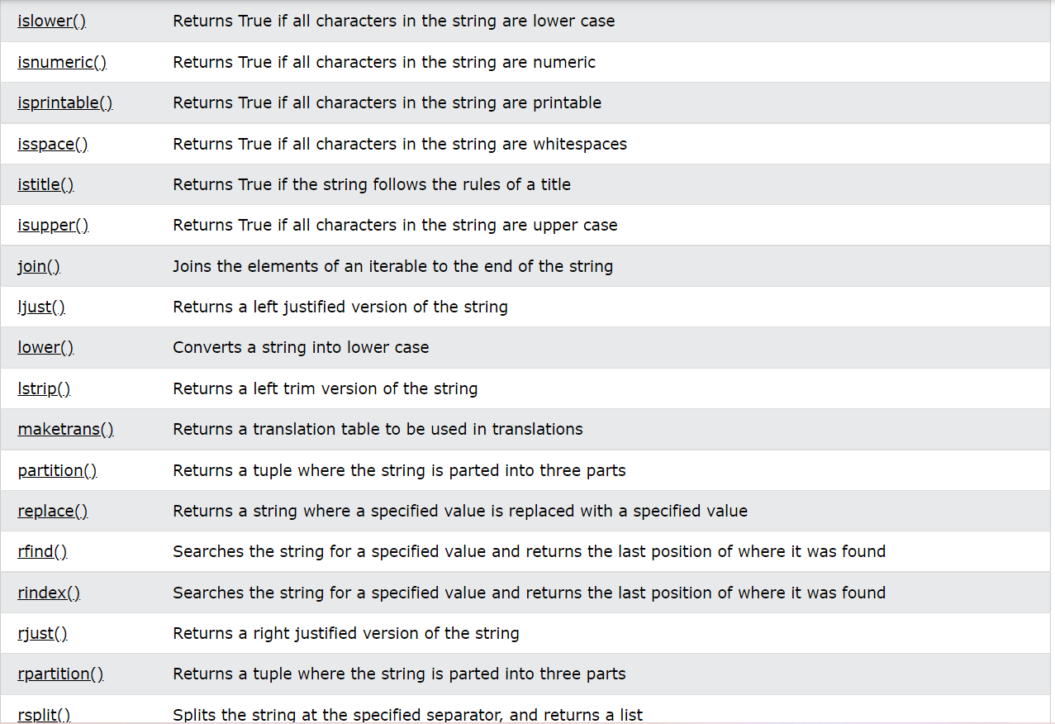
Python - String Methods
4110E203

Slide 47
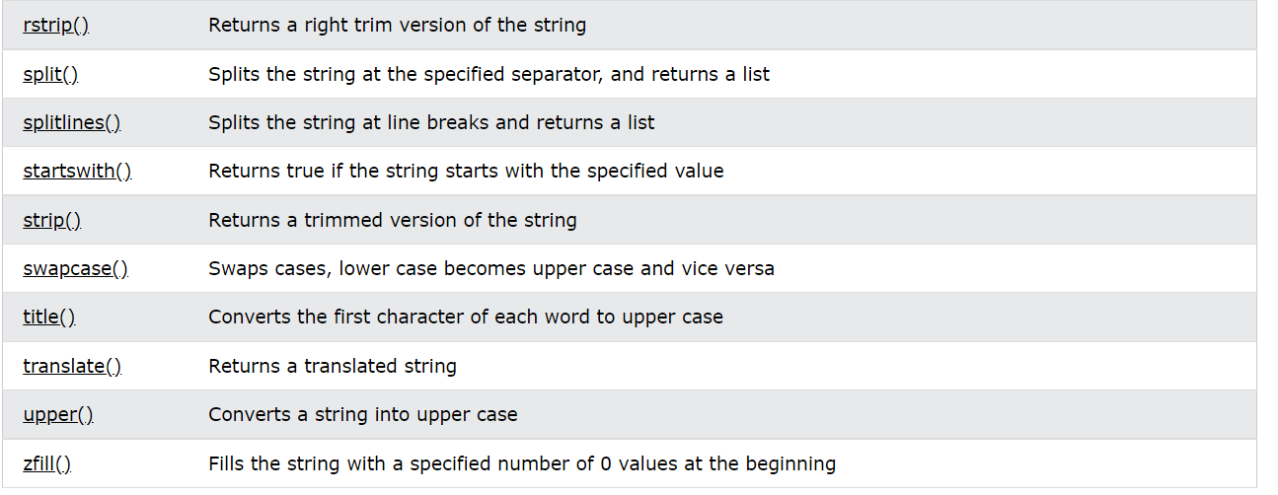
Python - String Methods
4110E203

Slide 48
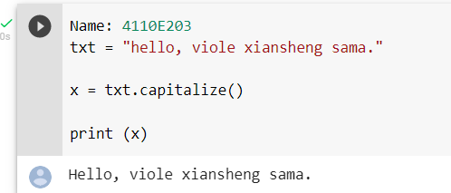
Python String capitalize() Method
4110E203
Example:
Upper case the first letter in this sentence:

Slide 49
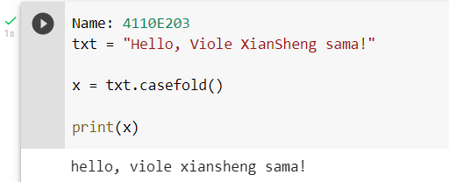
Python String casefold() Method
4110E203
Example:
Make the string lower case:

Slide 50
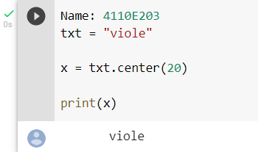
Python String center() Method
4110E203
Example:
Print the word "viole", taking up the space of 20 characters, with "banana" in the middle:

Slide 51
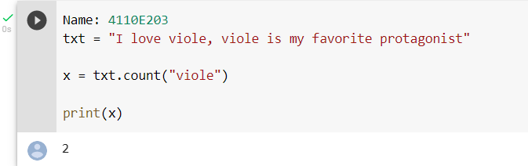
Python String count() Method
4110E203
Example:
Return the number of times the value "viole" appears in the string:

Slide 52
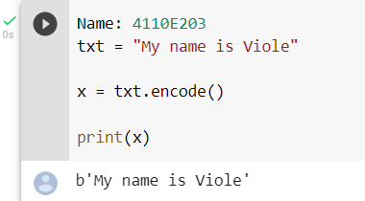
Python String encode() Method
4110E203
Example:
UTF-8 encode the string:

Slide 53
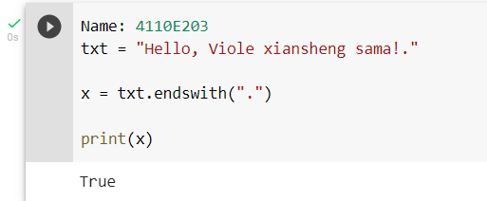
Python String endswith() Method
4110E203
Example:
Check if the string ends with a punctuation sign (.):

Slide 54

Python String expandtabs() Method
4110E203
Example:
Set the tab size to 2 whitespaces:

Slide 55

Python String find() Method
4110E203
Example:
Where in the text is the word "welcome"?:

Slide 56

Python String format() Method
4110E203
Example:
Insert the price inside the placeholder, the price should be in fixed point, two-decimal format:

Slide 57

Python String index() Method
4110E203
Example:
Where in the text is the word "welcome"?:

Slide 58

Python String isalnum() Method
4110E203
Example:
Check if all the characters in the text are alphanumeric:

Slide 59

Python String isalpha() Method
4110E203
Example:
Check if all the characters in the text are letters:

Slide 60

Python String isdecimal() Method
4110E203
Example:
Check if all the characters in the unicode object are decimals:

Slide 61

Python String isdigit() Method
4110E203
Example:
Check if all the characters in the text are digits:

Slide 62

Python String isidentifier() Method
4110E203
Example:
Check if the string is a valid identifier:

Slide 63

Python String islower() Method
4110E203
Example:
Check if all the characters in the text are in lower case:

Slide 64

Python String isnumeric() Method
4110E203
Example:
Check if all the characters in the text are numeric:

Slide 65

Python String isprintable() Method
4110E203
Example:
Check if all the characters in the text are printable:

Slide 66

Python String isspace() Method
4110E203
Example:
Check if all the characters in the text are whitespaces:

Slide 67

Python String istitle() Method
4110E203
Example:
Check if each word start with an upper case letter:

Slide 68

Python String isupper() Method
4110E203
Example:
Check if all the characters in the text are in upper case:

Slide 69

Python String join() Method
4110E203
Example:
Join all items in a tuple into a string, using a hash character as separator:

Slide 70

Python String ljust() Method
4110E203
Example:
Return a 5 characters long, left justified version of the word "banana":

Slide 71

Python String lower() Method
4110E203
Example:
Lower case the string:

Slide 72

Python String lstrip() Method
Example:
Remove spaces to the left of the string:

Slide 73

Python String maketrans() Method
Example:
Create a mapping table, and use it in the translate() method to replace any "S" characters with a "P" character:

Slide 74

Python String partition() Method
Example:
Search for the word "tower of god", and return a tuple with three elements:
1 - everything before the "match"
2 - the "match"
3 - everything after the "match"

Slide 75

Python String replace() Method
Example:
Replace the word "khun":

Slide 76

Python String rfind() Method
Example:
Where in the text is the last occurrence of the string "dios"?:

Slide 77

Python String rindex() Method
Example:
Where in the text is the last occurrence of the string "dios"?:

Slide 78

Python String rjust() Method
Example:
Return a 20 characters long, right justified version of the word "banana":

Slide 79

Python String rpartition() Method
Example:
Search for the last occurrence of the word "tower of god", and return a tuple with three elements:
1 - everything before the "match"
2 - the "match"
3 - everything after the "match"

Slide 80

Python String rsplit() Method
Example:
Split a string into a list, using comma, followed by a space (, ) as the separator:

Slide 81

Python String split() Method
Example:
Split a string into a list where each word is a list item:

Slide 82

Python String splitlines() Method
Example:
Split a string into a list where each line is a list item:

Slide 83

Python String startswith() Method
Example:
Check if the string starts with "Viole":

Slide 84

Python String strip() Method
Example:
Remove spaces at the beginning and at the end of the string:

Slide 85

Python String swapcase() Method
Example:
Make the lower case letters upper case and the upper case letters lower case:

Slide 86

Python String title() Method
Example:
Make the first letter in each word upper case:

Slide 87

Python String translate() Method
Example:
Replace any "V" characters with a "K" character:

Slide 88

Python String upper() Method
Example:
Upper case the string:

Slide 89

Python String zfill() Method
Example:
Fill the string with zeros until it is 10 characters long:

Slide 90

Python - String Exercises
Test Yourself With Exercises
Now you have learned a lot about Strings, and how to use them in Python.
Are you ready for a test?
Try to insert the missing part to make the code work as expected:
Exercise:
Use the len method to print the length of the string.

Slide 91

Python Lists
List
Lists are used to store multiple items in a single variable.
Lists are one of 4 built-in data types in Python used to store collections of data, the other 3 are Tuple, Set, and Dictionary, all with different qualities and usage.
Lists are created using square brackets:
Example:
Create a List:

Slide 92

Python - Access List Items
Access Items
List items are indexed and you can access them by referring to the index number:
Example:
Print the second item of the list:

Slide 93

Python - Change List Items
Change Item Value
To change the value of a specific item, refer to the index number:
Example:
Change the second item:

Slide 94

Python - Add List Items
Append Items
To add an item to the end of the list, use the append() method:
Example:
Using the append() method to append an item:

Slide 95

Python - Remove List Items
Remove Specified Item
The remove() method removes the specified item.
Example:
Remove "isagi":

Slide 96

Python - Loop Lists
Loop Through a List
You can loop through the list items by using a for loop:
Example:
Print all items in the list, one by one:

Slide 97

Python - List Comprehension
List Comprehension
List comprehension offers a shorter syntax when you want to create a new list based on the values of an existing list.
Example:
Based on a list of fruits, you want a new list, containing only the fruits with the letter "a" in the name.
Without list comprehension you will have to write a for statement with a conditional test inside:

Slide 98

Python - Sort Lists
Sort List Alphanumerically
List objects have a sort() method that will sort the list alphanumerically, ascending, by default:
Example:
Sort the list alphabetically:

Slide 99

Python - Copy Lists
Copy a List
You cannot copy a list simply by typing list2 = list1, because: list2 will only be a reference to list1, and changes made in list1 will automatically also be made in list2.
There are ways to make a copy, one way is to use the built-in List method copy().
Example:
Make a copy of a list with the copy() method:

Slide 100

Python - Join Lists
Join Two Lists
There are several ways to join, or concatenate, two or more lists in Python.
One of the easiest ways are by using the + operator.
Example:
Join two list:

