Slide 1
MY JOURNAL TO PYTHON
NAME: MARJUN CEDRIC JOHN E. ALMONIA
TEACHER: MY DEAR GREAT TEAHER

Slide 2
AGENDA
Python
Input and output: input() and print()
Data types: numerisc, strings, list, dict
Operators ON data type:

Slide 3
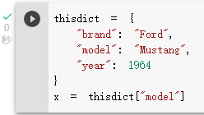
Python - Access Dictionary Item
Accessing Items
You can access the items of a dictionary by referring to its key name, inside square brackets:

Slide 4
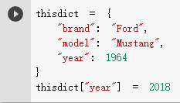
Python - Change Dictionary Items
Change Values
You can change the value of a specific item by referring to its key name:
Example
Change the "year" to 2018:

Slide 5
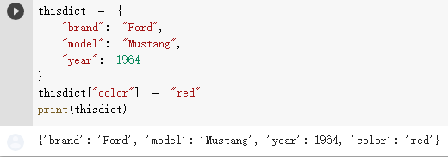
Python - Add Dictionary Items
Adding Items
Adding an item to the dictionary is done by using a new index key and assigning a value to it:
Example

Slide 6
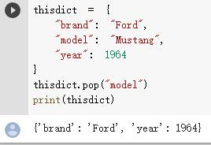
Python - Remove Dictionary Items ❮ PreviousNext ❯
Removing Items
There are several methods to remove items from a dictionary:
Example
The pop() method removes the item with the specified key name:

Slide 7
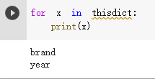
Python - Loop Dictionaries
Loop Through a Dictionary
You can loop through a dictionary by using a for loop.
When looping through a dictionary, the return value are the keys of the dictionary, but there are methods to return the values as well.
Example
Print all key names in the dictionary, one by one:

Slide 8
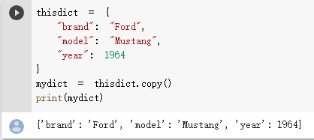
Python - Copy Dictionaries
Copy a Dictionary
You cannot copy a dictionary simply by typing dict2 = dict1, because: dict2 will only be a reference to dict1, and changes made in dict1 will automatically also be made in dict2.
There are ways to make a copy, one way is to use the built-in Dictionary method copy().
Example
Make a copy of a dictionary with the copy() method:

Slide 9
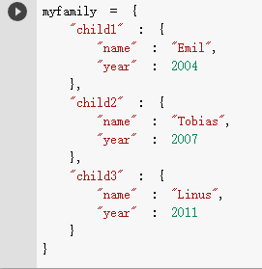
Python - Nested Dictionaries
Nested Dictionaries
A dictionary can contain dictionaries, this is called nested dictionaries.
Example
Create a dictionary that contain three dictionaries:

Slide 10
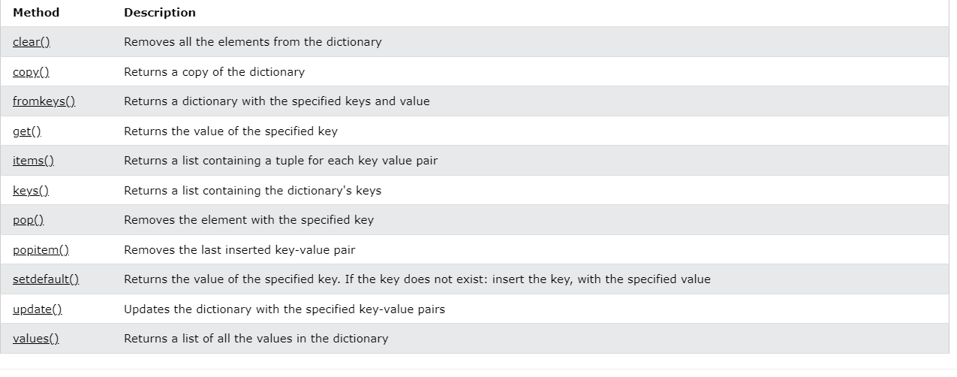
Python Dictionary Methods
Dictionary Methods
Python has a set of built-in methods that you can use on dictionaries.

Slide 11
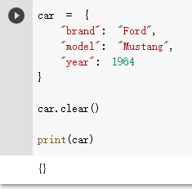
Python Dictionary Methods
Clear(). Example: Remove all elements from the car list:

Slide 12
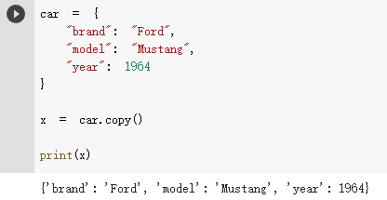
Python Dictionary Methods
Copy(). Example: Copy the car dictionary:

Slide 13
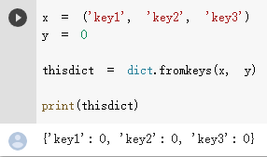
Python Dictionary Methods
Fromkeys(). Example: Create a dictionary with 3 keys, all with the value 0:

Slide 14
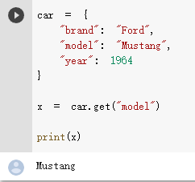
Python Dictionary Methods
Get(). Example: Get the value of the "model" item:

Slide 15
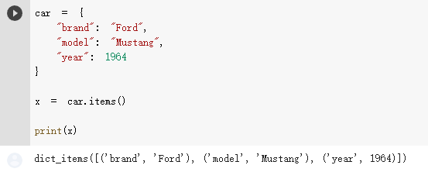
Python Dictionary Methods
Items(). Example: Return the dictionary's key-value pairs:

Slide 16
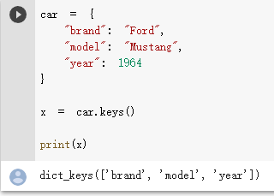
Python Dictionary Methods
Keys(). Example: Return the keys:

