Slide 1
E-health

Slide 2

Our business
Our website
Our users
Website activities and objectives

Slide 3
Personas

Slide 4
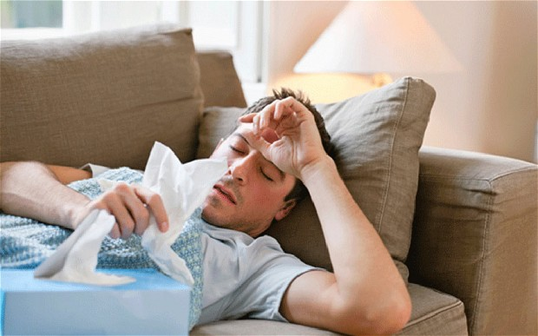
Tom
male
from Germany
20 years old
student
Tom has high temperature and very bad cough. He wants to find out what is likely to be his condition. He heard about e-health at work and decided to register and search for his symptoms. E-health gives back articles from healthfinder, MedlinePlus and Bing. The article from MedlinePlus say that those symptoms are likely to correspond to flu. The article from Bing is on fresher's flu.

Slide 5

Sara
female
from the UK
27 years old
accountant
Sara has cancer. She goes on e-health to look for motivating articles so she adjusts the sentiment score to high. She chooses users and reads other users' stories on how they managed with the condition and led a normal life. She found the articles that she read very inspiring so she decided to share it and create a new category to save it for another time.

Slide 6
System architecture

Slide 7
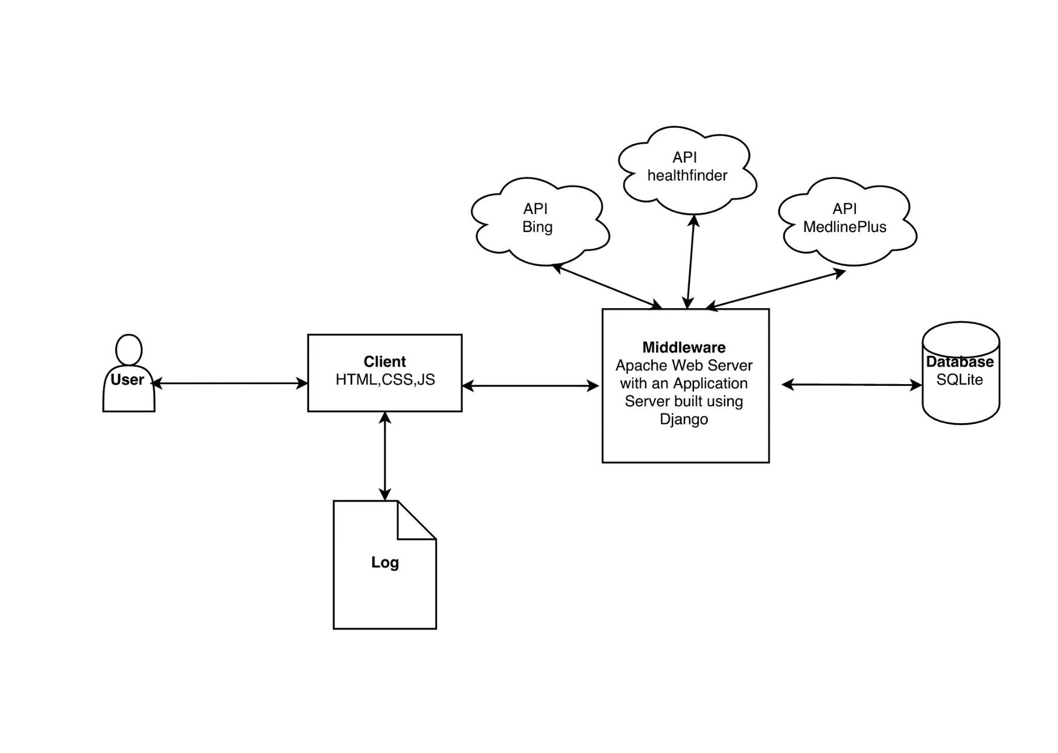

Slide 8
Functional Requirements
The user needs to be able to:
The application must:
Register, log in and maintain profile;
Search in a specific category;
Filter results based on readability/sentiment/subjectivity score;
Sort results by source;
Maintain folders in which to store pages they have found useful;
View and modify his/her search history;
Return accurate results quickly and reliably
Provide important information about each page
Allow the user to set his personal information to private/public

Slide 9
!Functional Requirements
Needs to look aesthetically pleasing;
Needs to be designed in an easy to use/easy to navigate way;
Needs access to the internet as well as to different search APIs.

Slide 10
E-r diagram

Slide 11
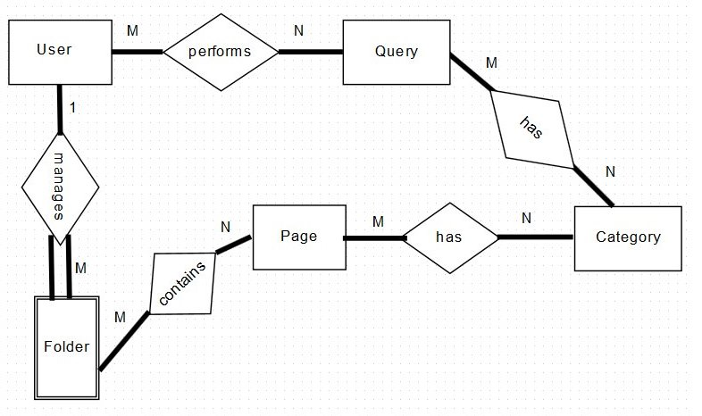

Slide 12
attributes

Slide 13
Page
String title
String summary
String source
String url
Integer readingScore
Integer sentimentScore
Integer subjectivityScore
Integer saves
User
String forename
String surname
String e-mail
String username
String password
Folder
Integer user_id
String name
Boolean public
Query
String content
long timestamp
Category
String name

Slide 14
wireframes

Slide 15
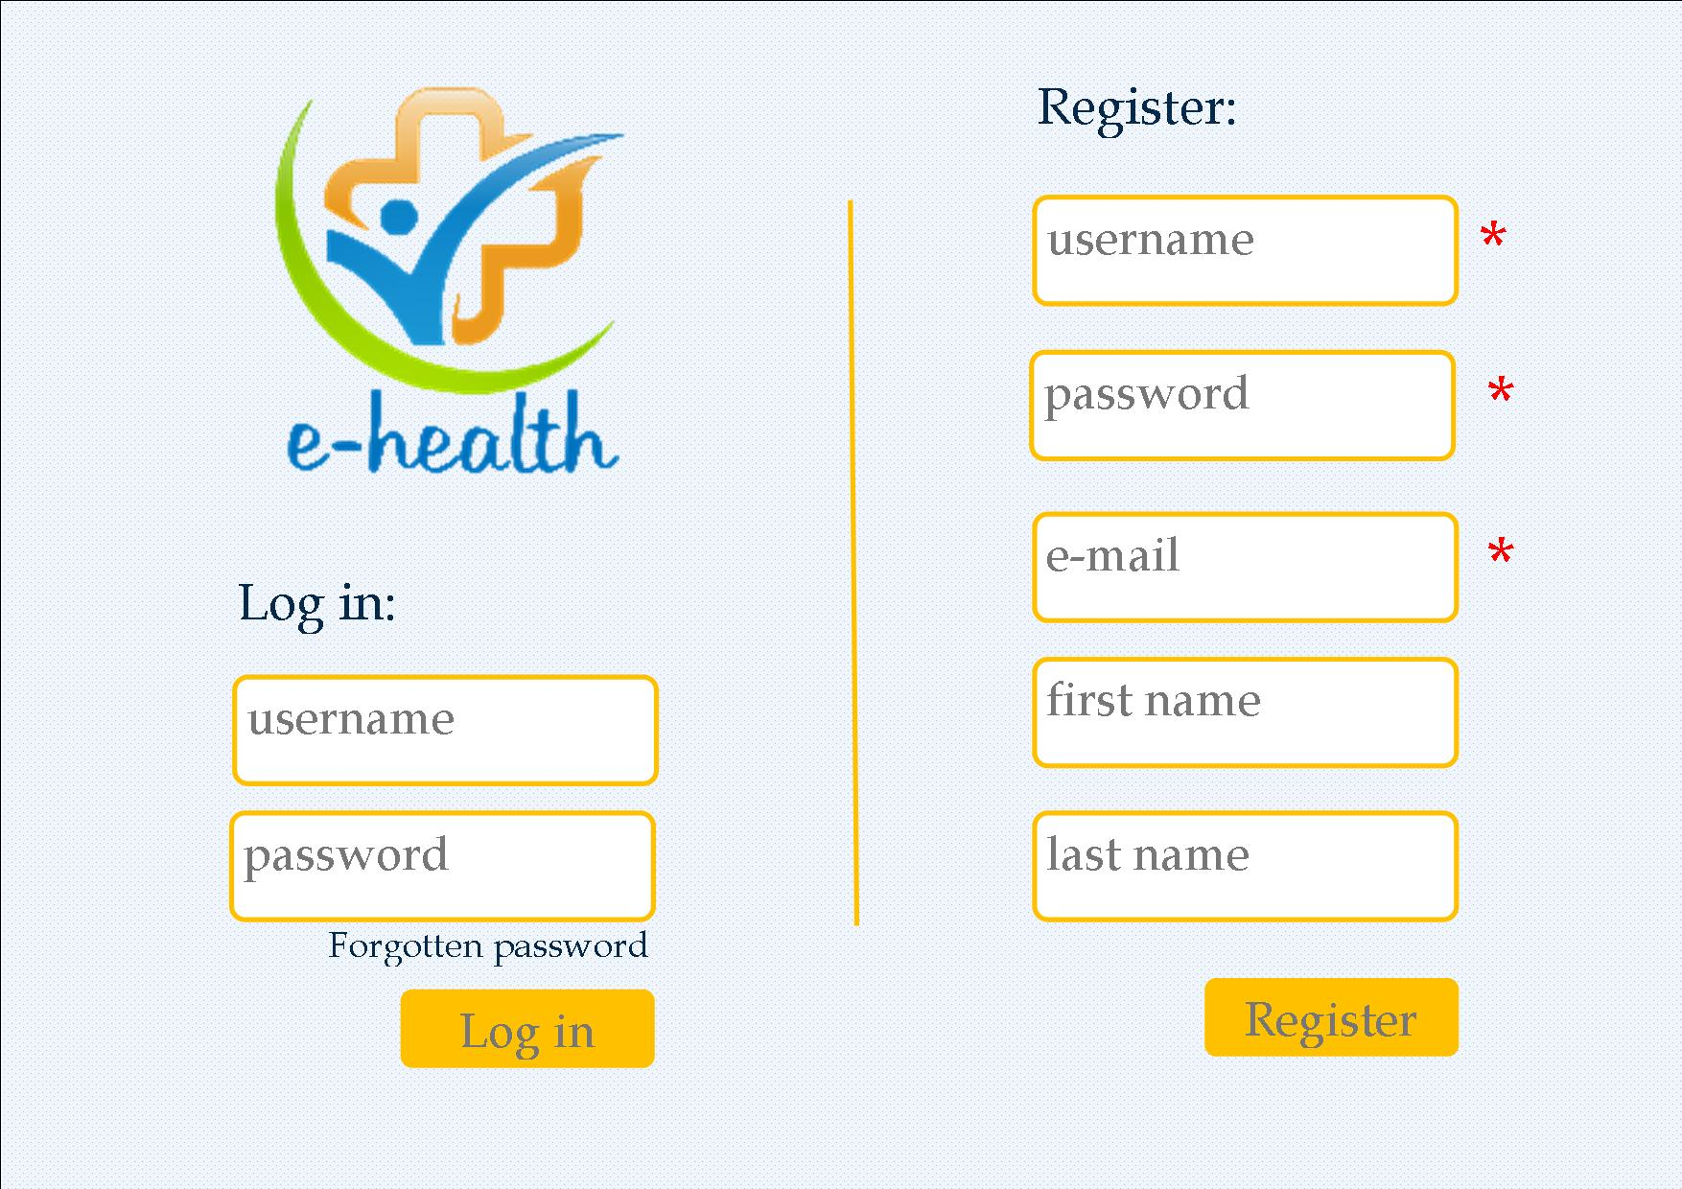

Slide 16
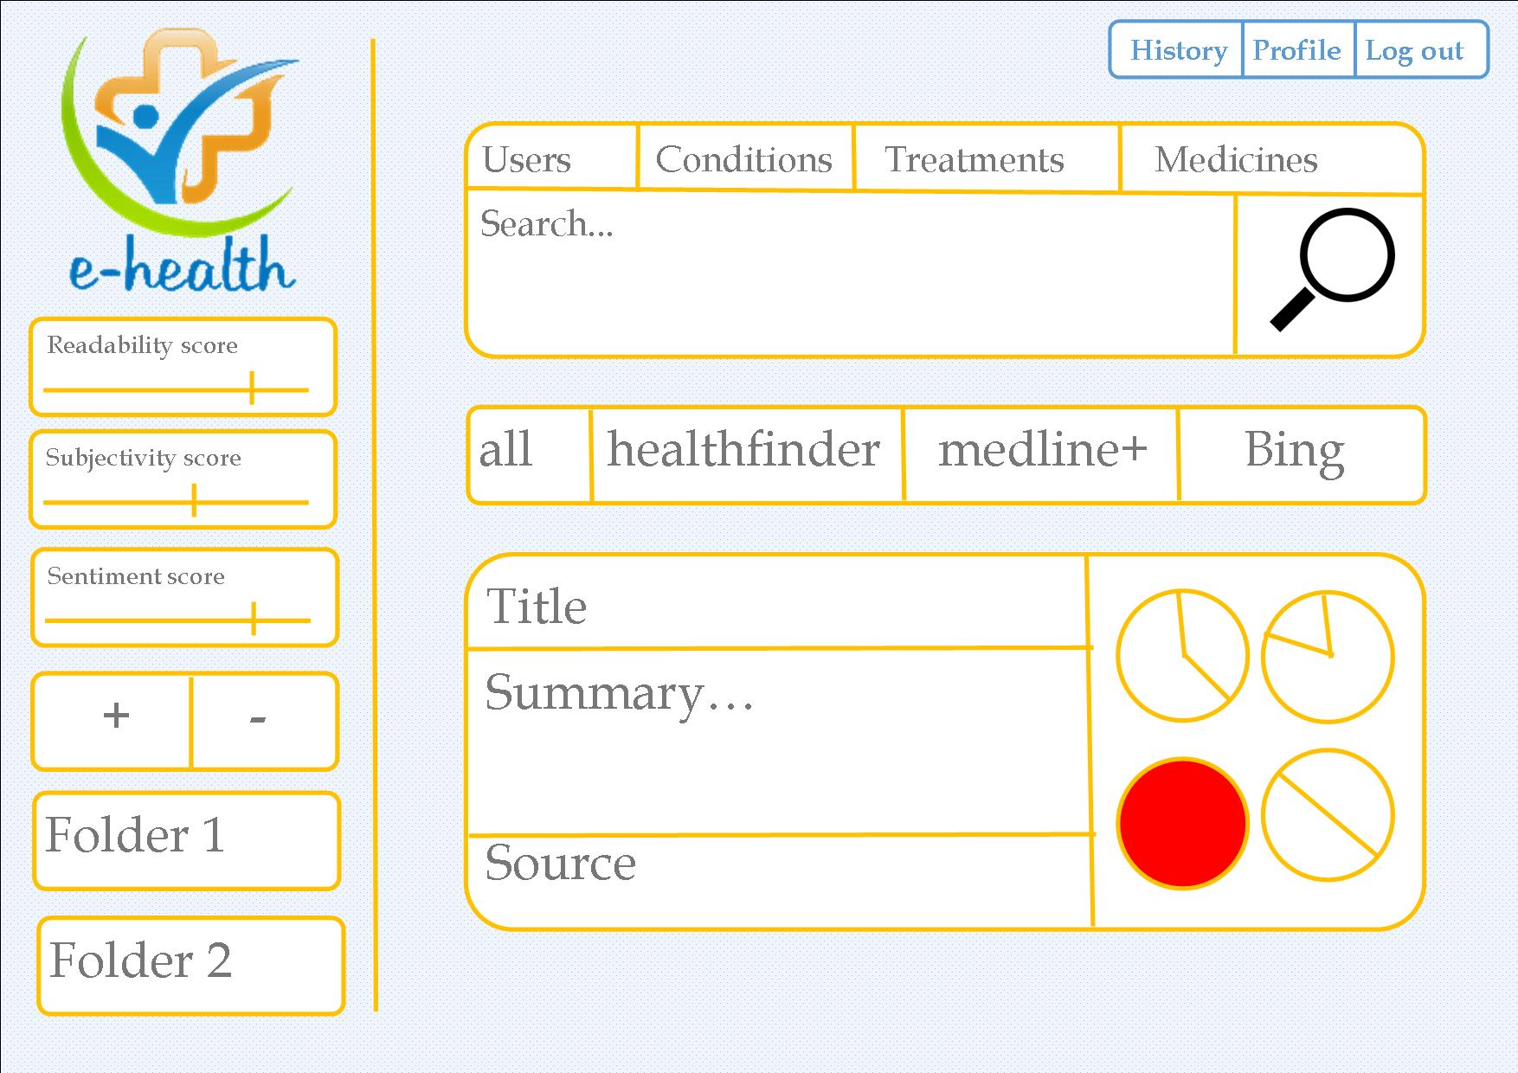

Slide 17
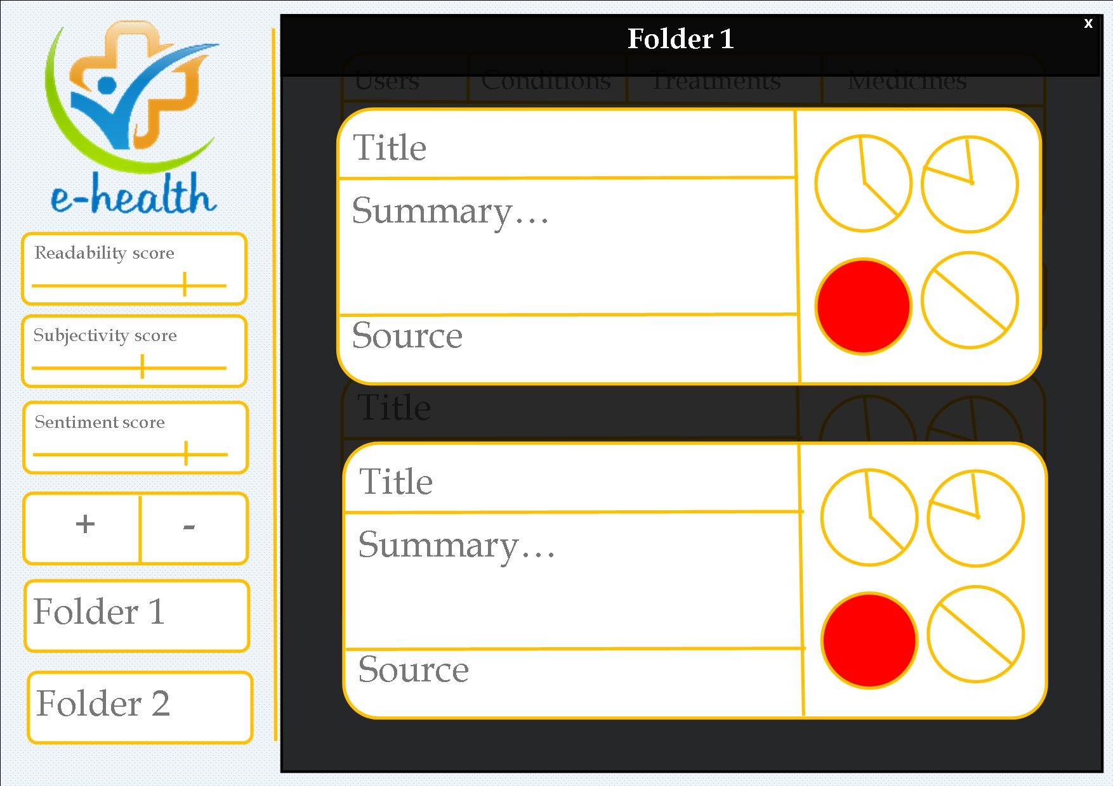

Slide 18
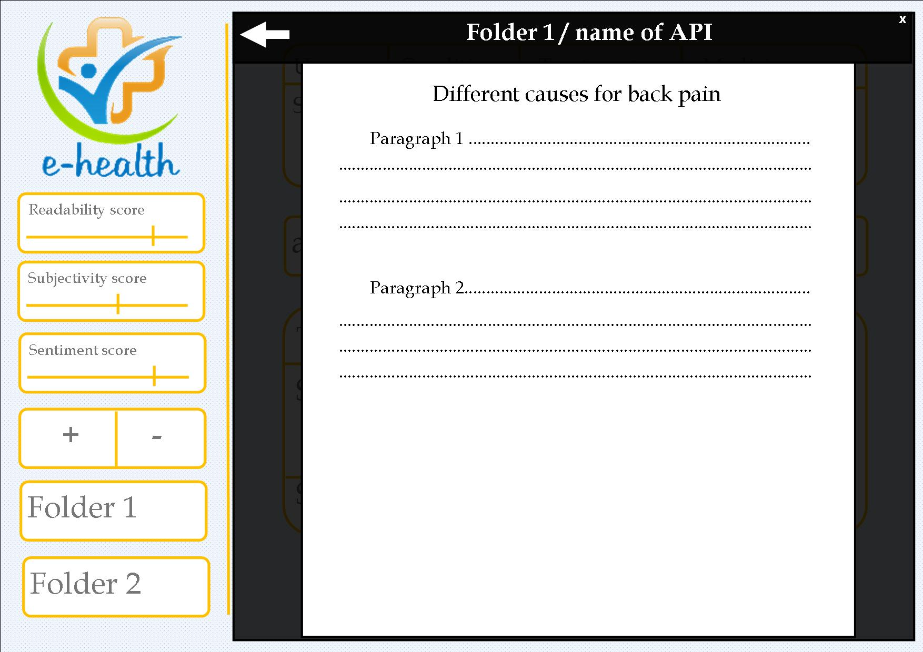

Slide 20
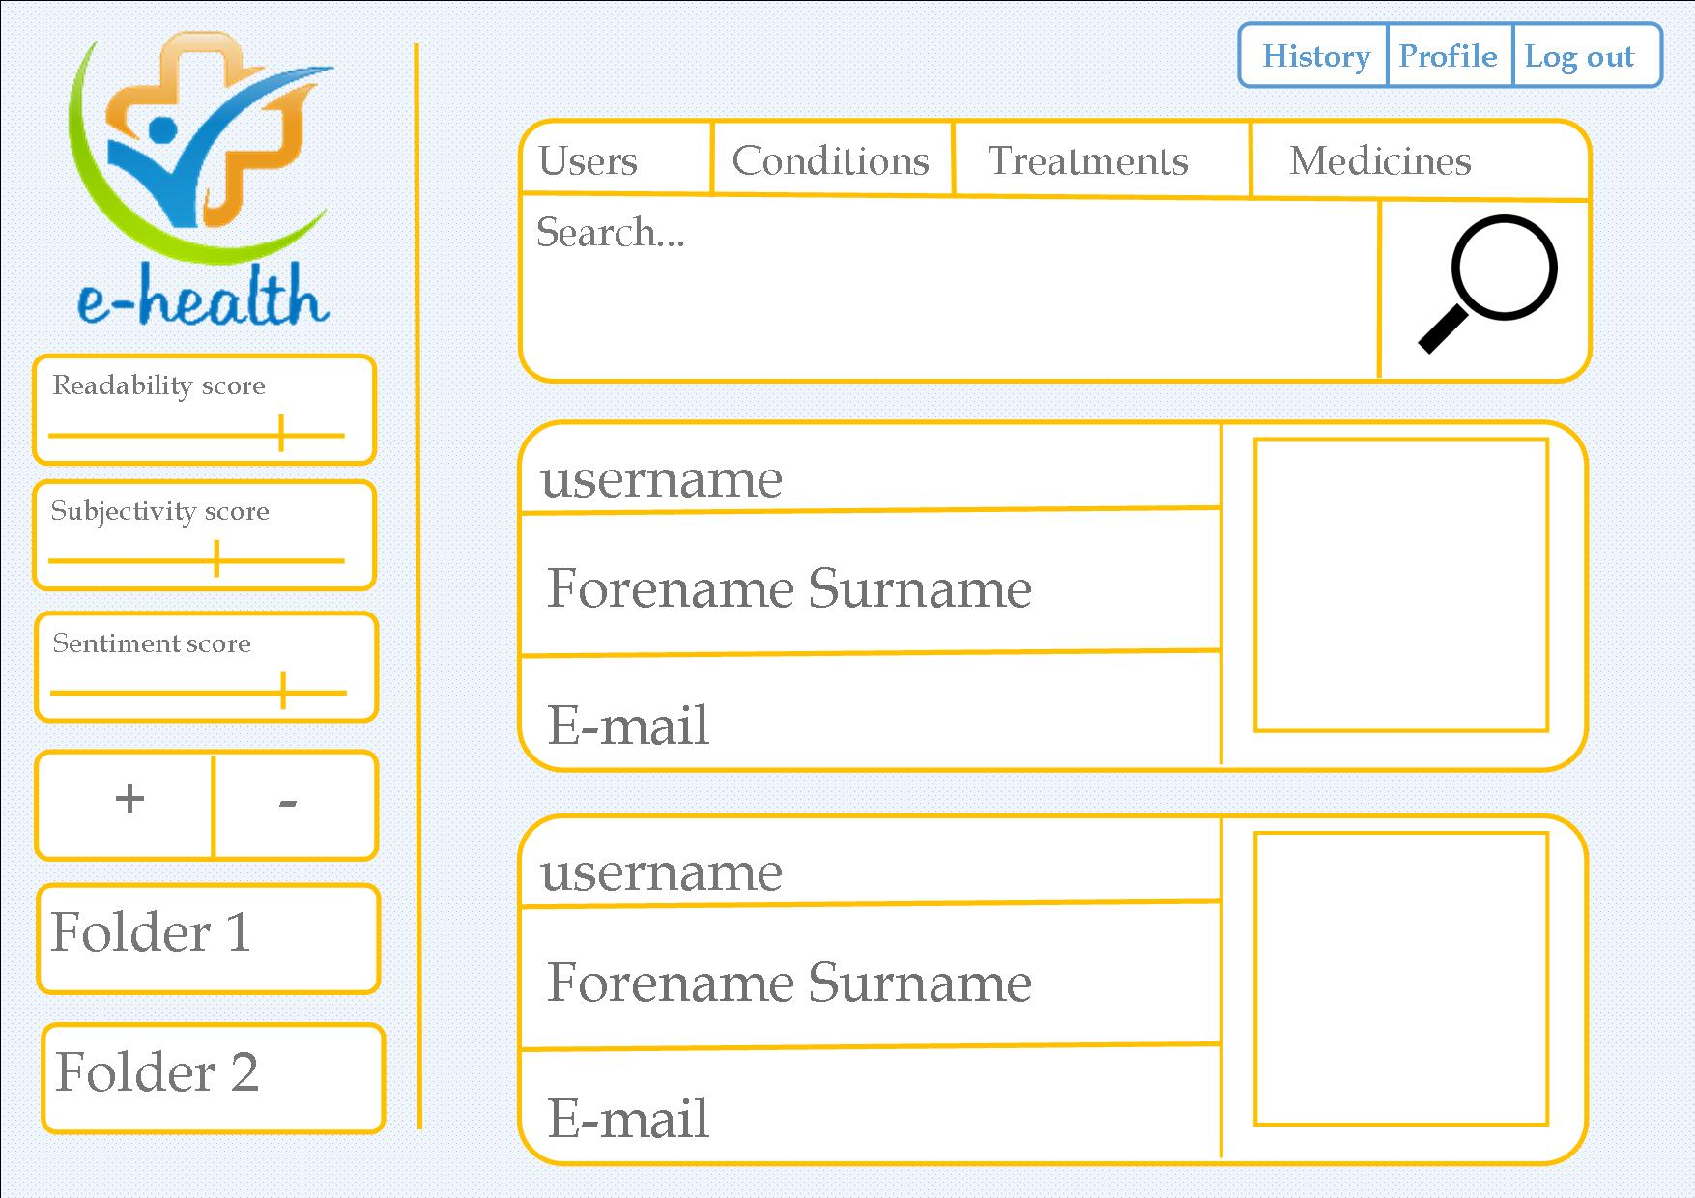

Slide 21
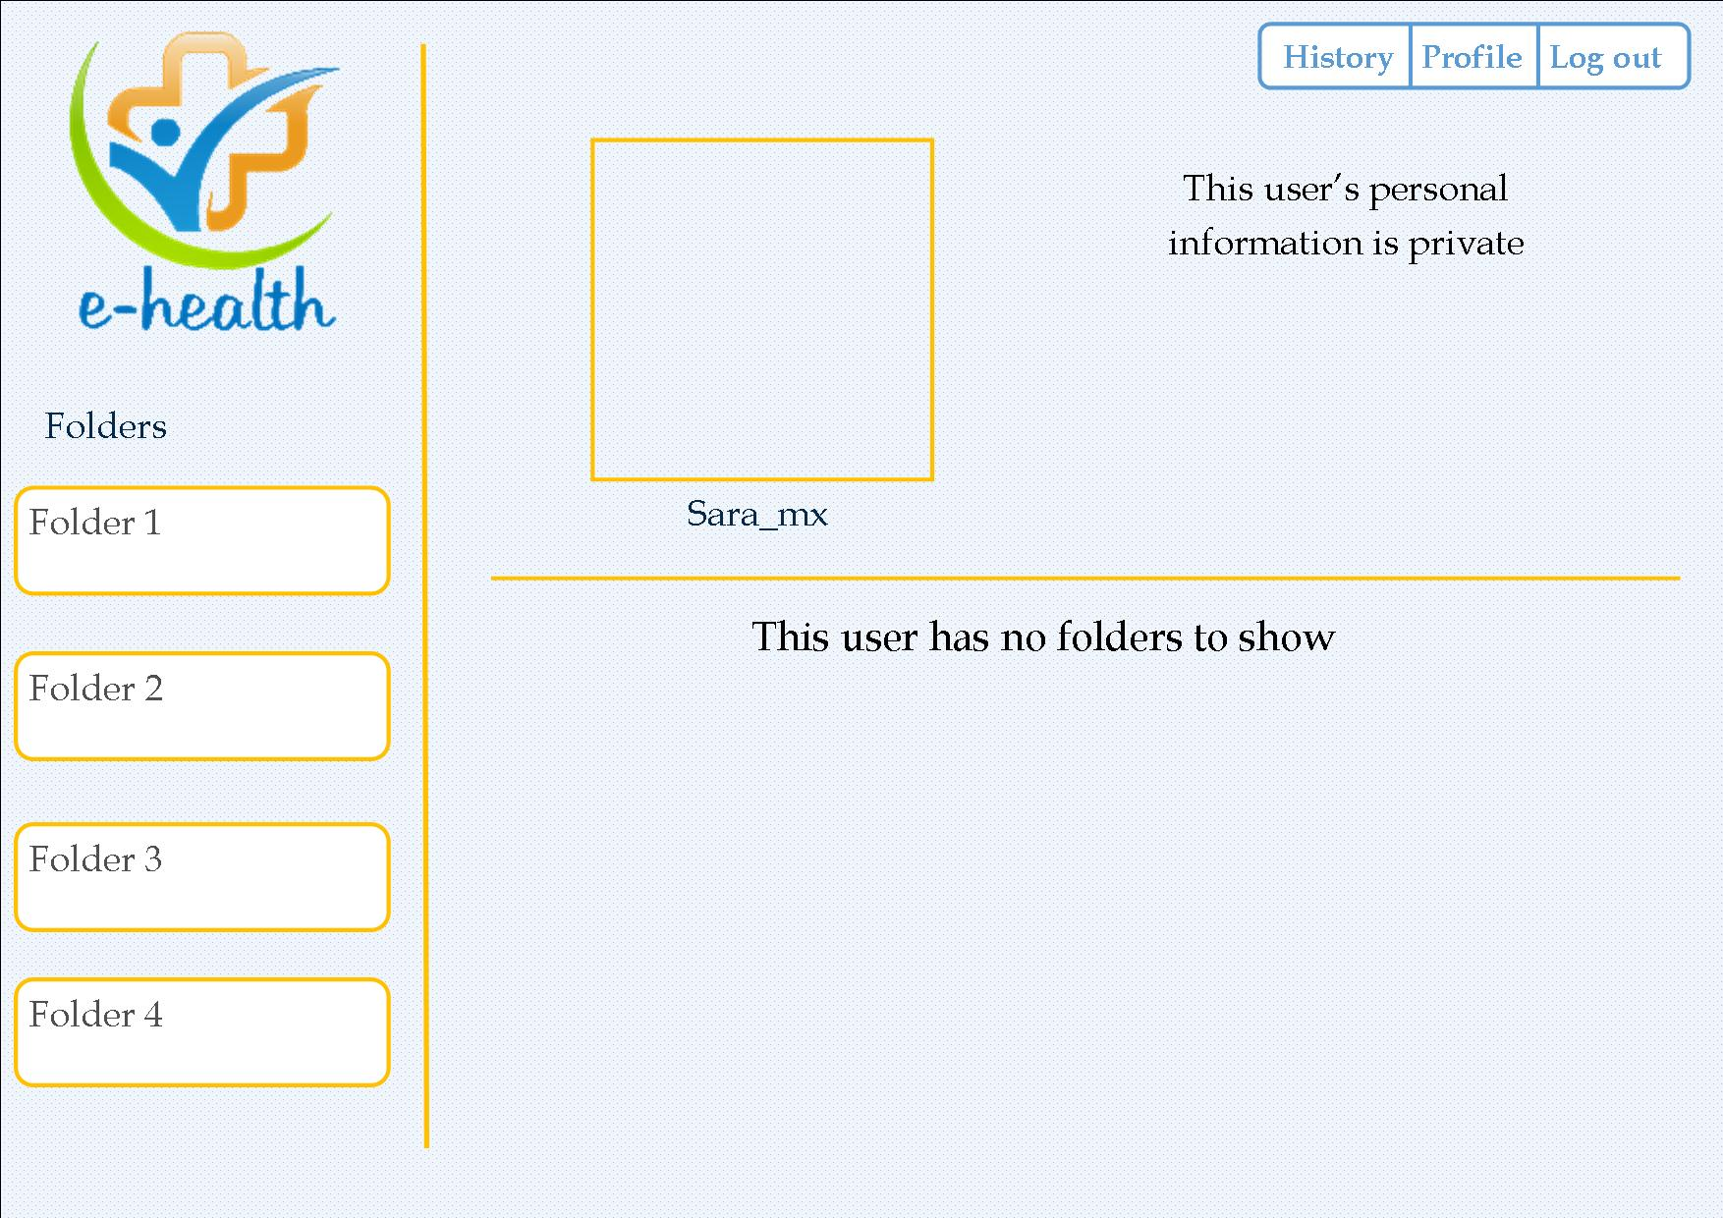

Slide 23
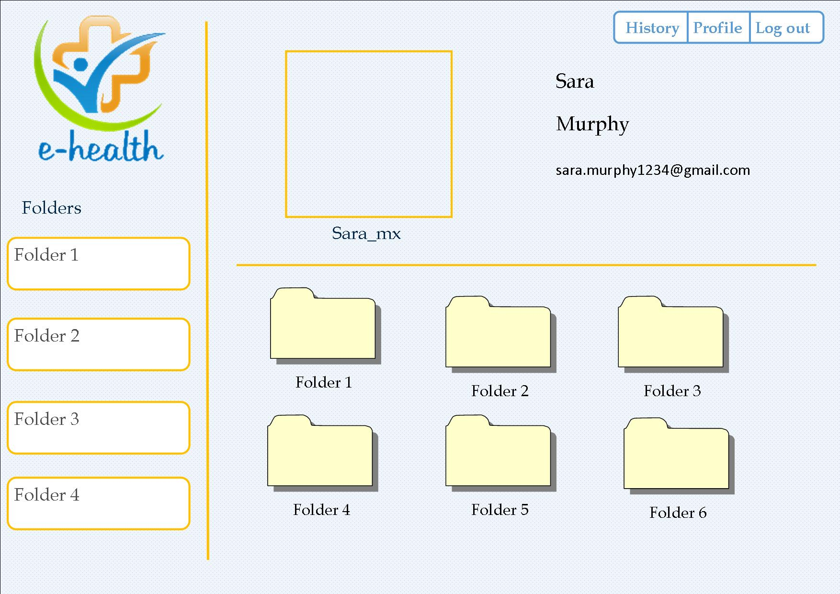

Slide 25
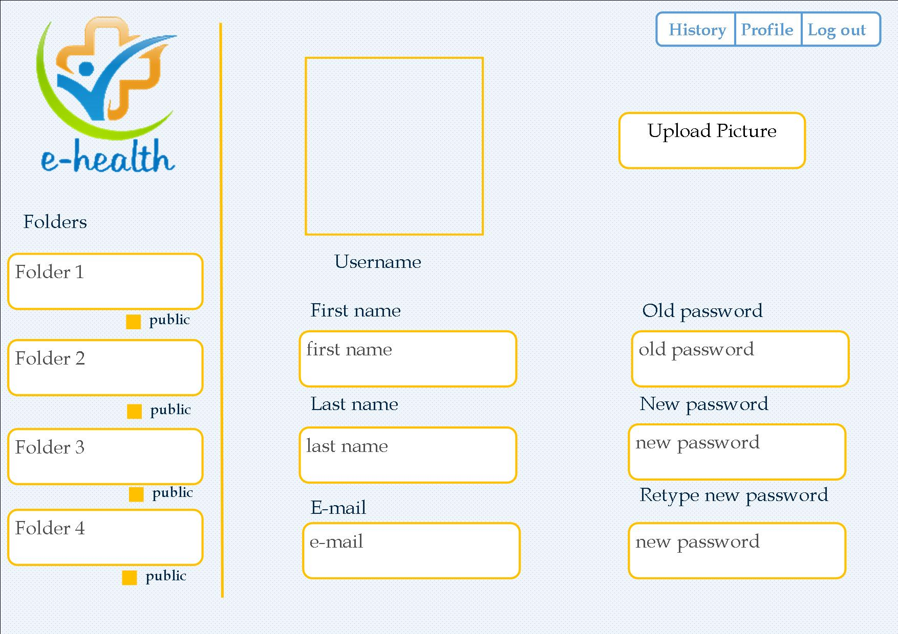

Slide 26
