Slide 1

English Learning
Android App
Nguyễn Minh Hiếu
Nguyễn Triệu Duy
Lecturer: Nguyễn Thanh Phong

Slide 2
Agenda
Electronic equipment is growing rapidly, especially smartphone.
The application of science and technology to study more and more.
Traditional learning can be frustrating for a learner, time consuming.
01
Problem
A mobile application that gives people access to English anytime, anywhere.
02
Method
We will show you our solution, our application
03
Application
Extend more functionality and add more lessons
04
Plan

Slide 3
Free PPT Templates: Allppt.com
You can download professional PowerPoint diagrams for free
Content Here
You can simply impress your audience and add a unique zing and appeal to your Presentations. Get a modern PowerPoint Presentation that is beautifully designed.
01
Option
Content Here
02
You can simply impress your audience and add a unique zing and appeal to your Presentations. Get a modern PowerPoint Presentation that is beautifully designed.
Option
Content Here
You can simply impress your audience and add a unique zing and appeal to your Presentations. Get a modern PowerPoint Presentation that is beautifully designed.
03
Option
Content Here
You can simply impress your audience and add a unique zing and appeal to your Presentations. Get a modern PowerPoint Presentation that is beautifully designed.
04
Option
www.free-powerpoint-templates-design.com

Slide 4
Tools
Android Studio
GitHub, Bitbucket
Trello

Slide 5
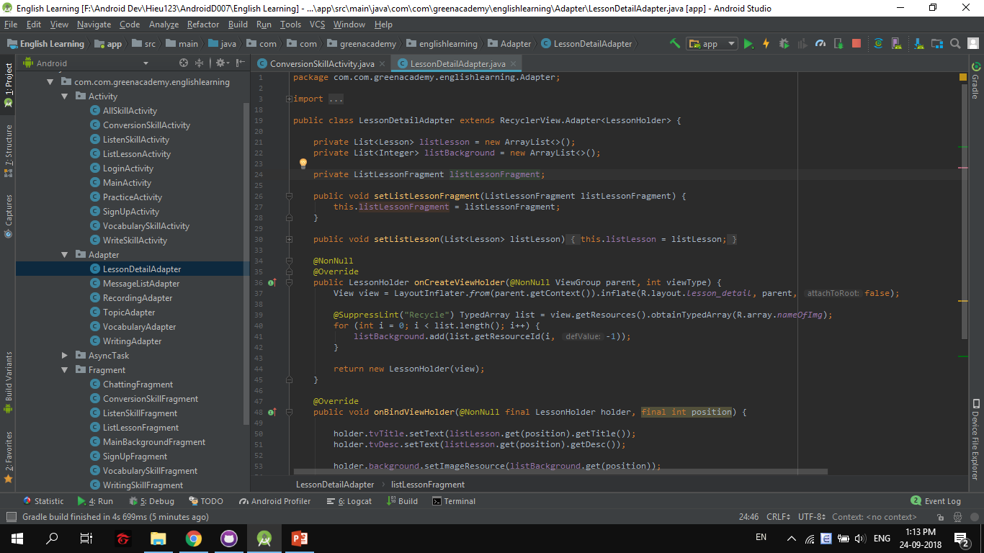

Slide 6
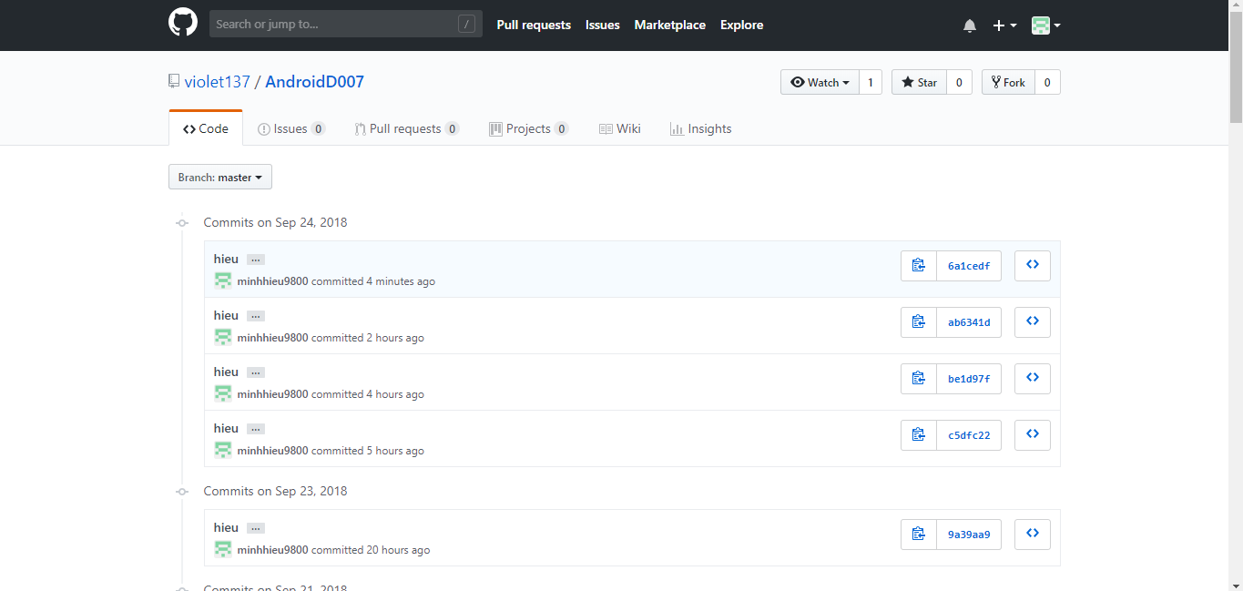

Slide 7
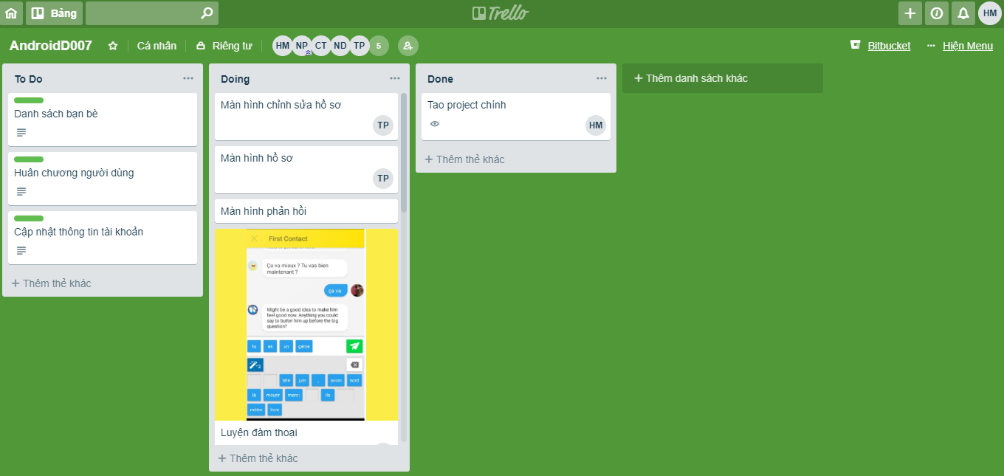

Slide 8
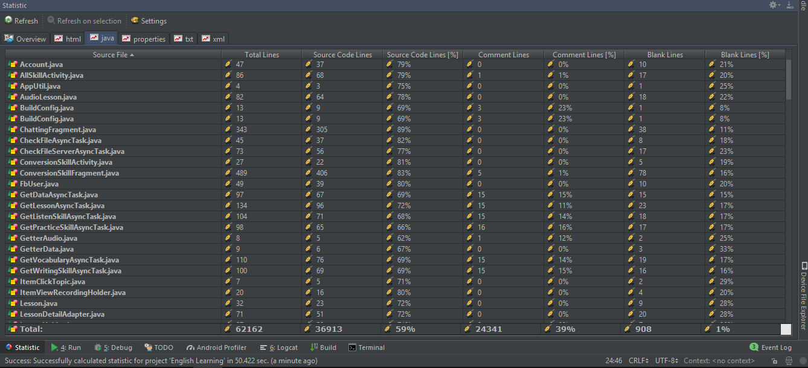
Line of Code

Slide 9
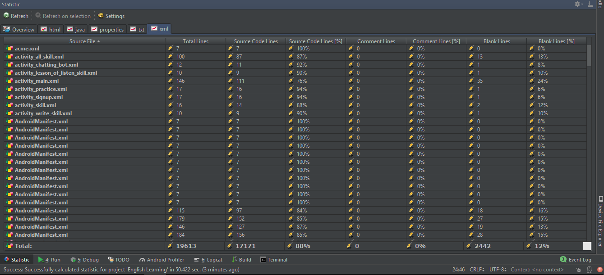

Slide 10




Function
Listening Skill
Writing Skill
Vocabulary
Conversation
www.free-powerpoint-templates-design.com

Slide 11
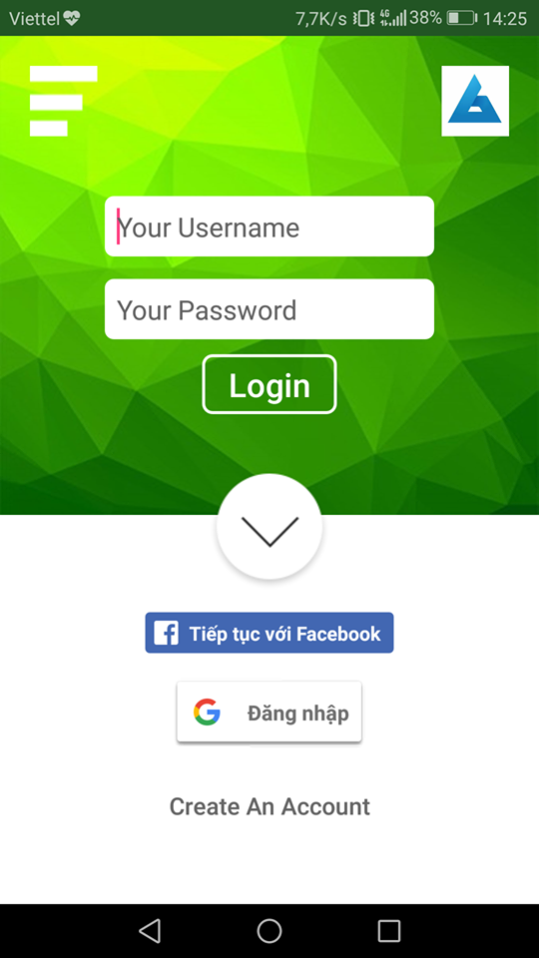
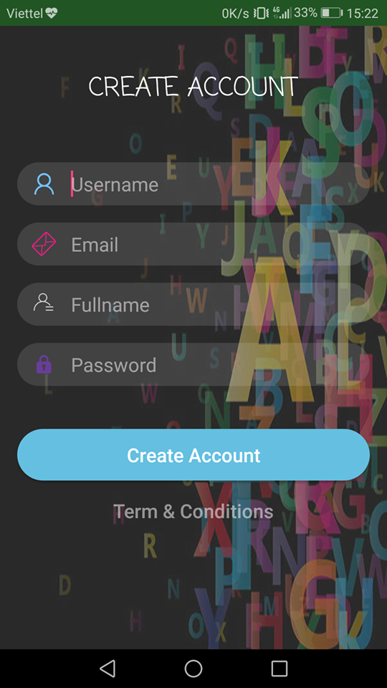

Slide 12
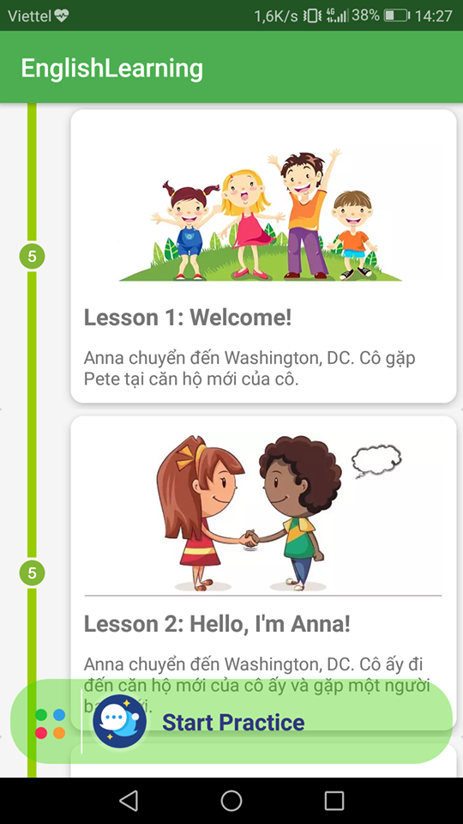
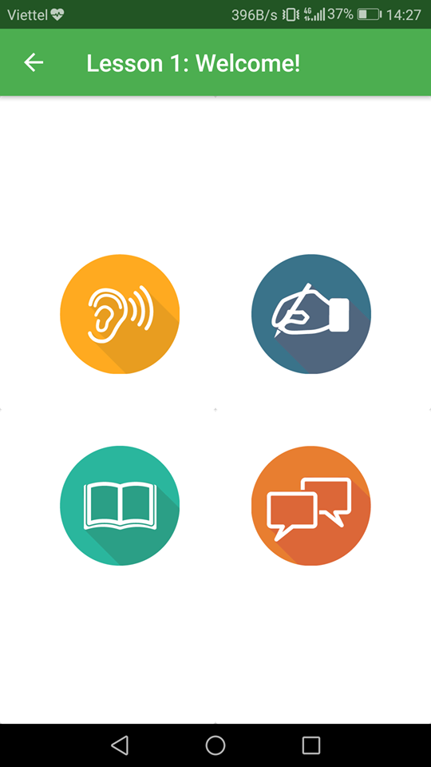

Slide 13
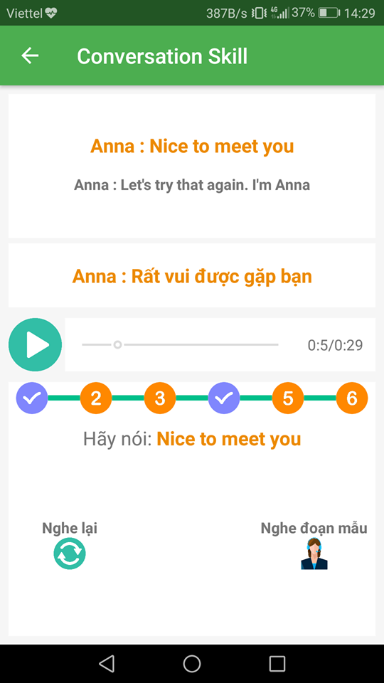
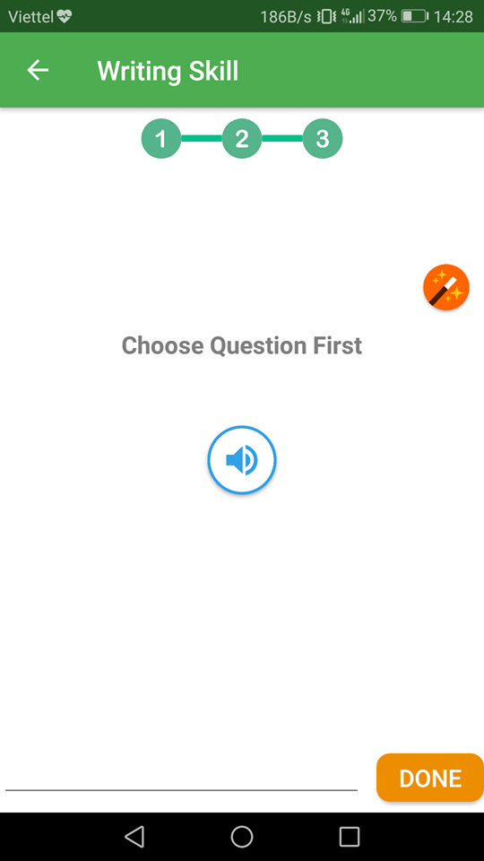

Slide 14
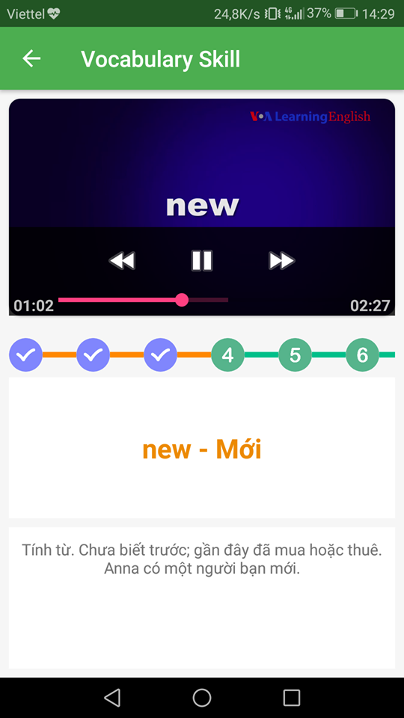
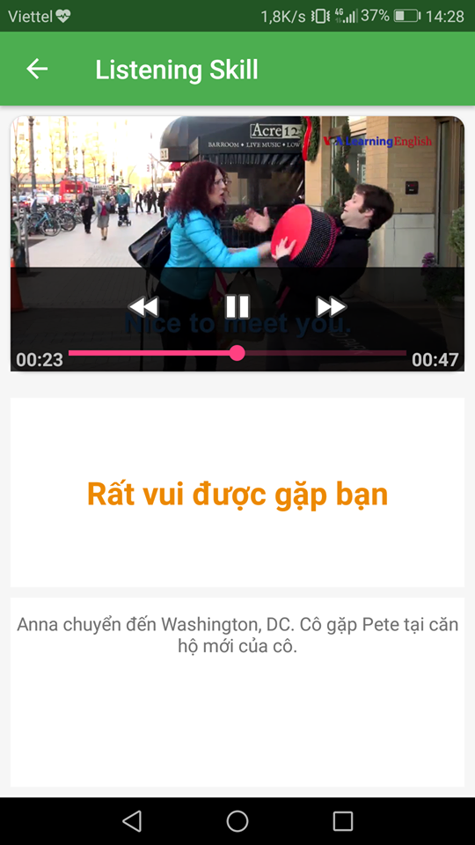

Slide 15
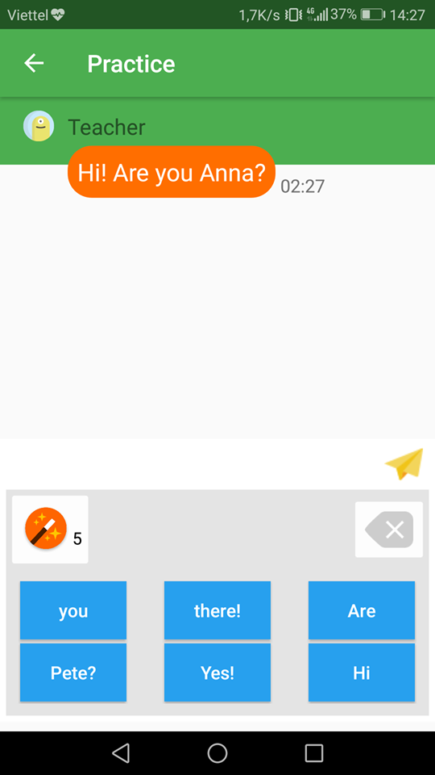

Slide 16
Demo & QA

Slide 17
Thanks for Watching!

