Slide 1
SEARCH:
Protein-A
Topic-1
Output:
Topic-1: proteins A, B
Topic-2: proteins A, C, D
Link to
Topic-1 page
Topic-2 page
Link to
Topic-1 page
Topic-1 page
Section-1
Section-2
Section-i
Section-i+1
Note: Numbers in the tables will be given in txt or json files; figures will be given as pictures (png/tiff/jpeg files)
Section-N

Slide 2
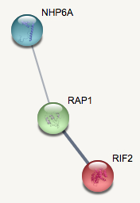
Topic-1 Page
Section-1: General information
Link to YEP webpage from protein names
Subsector tag count histogram
Topic table
STRING network
Subsector figure
Protein | Z-score | Protein peak tags contributing to this topic | Protein peak tags | Fraction of protein peak tags in this topic
Rap1 | 11.3 | 57,994 | 92,581 | 0.63
Nhp6a | 13.1 | 15,328 | 20,720 | 0.74
Rif2 | 10.7 | 4,083 | 8,056 | 0.51
TSS
TES
Topic tag counts

Slide 3
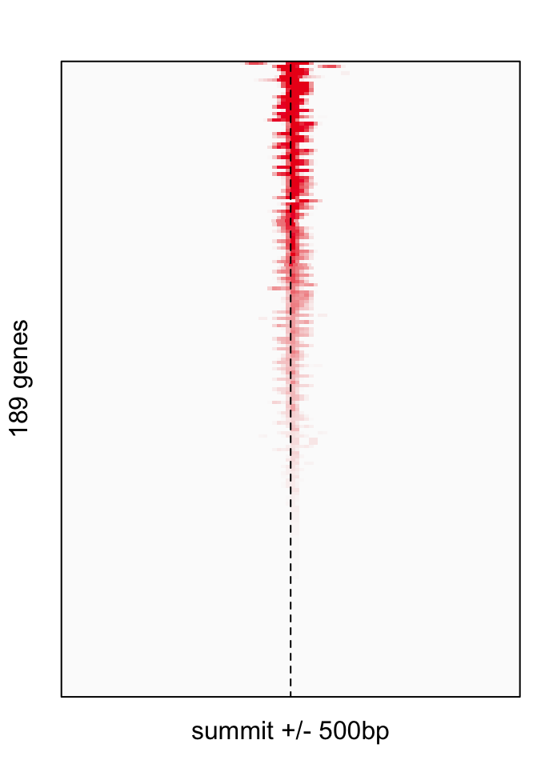
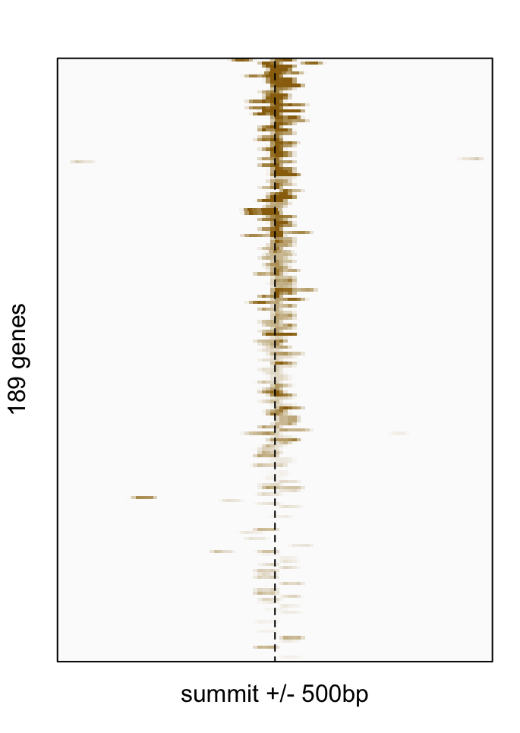
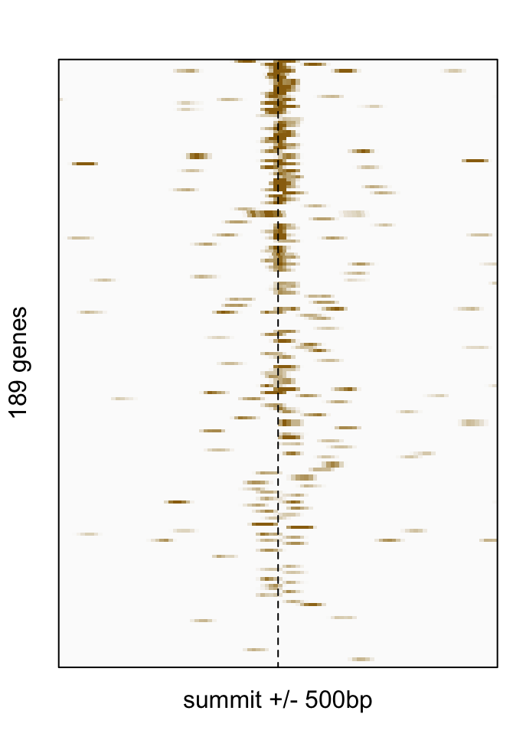
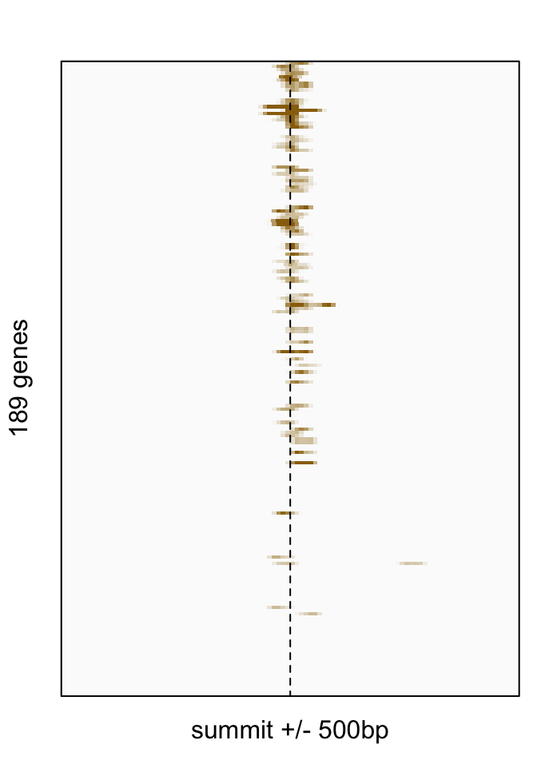
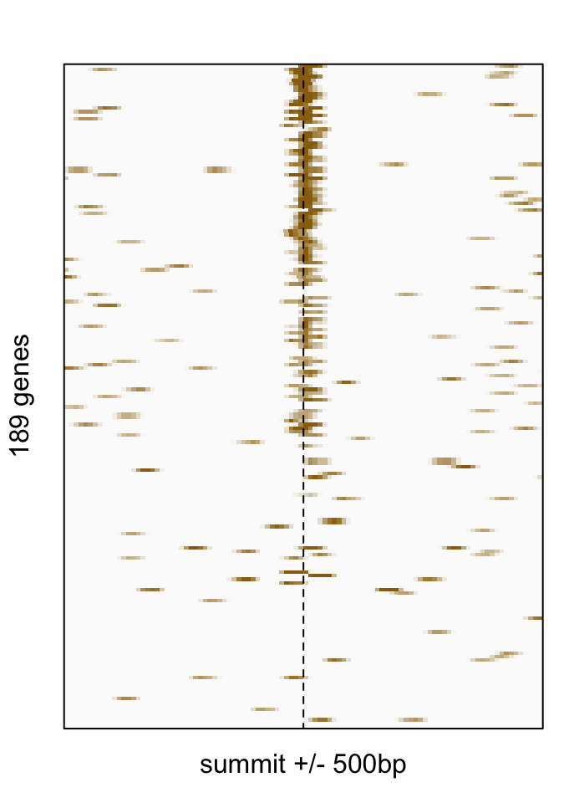
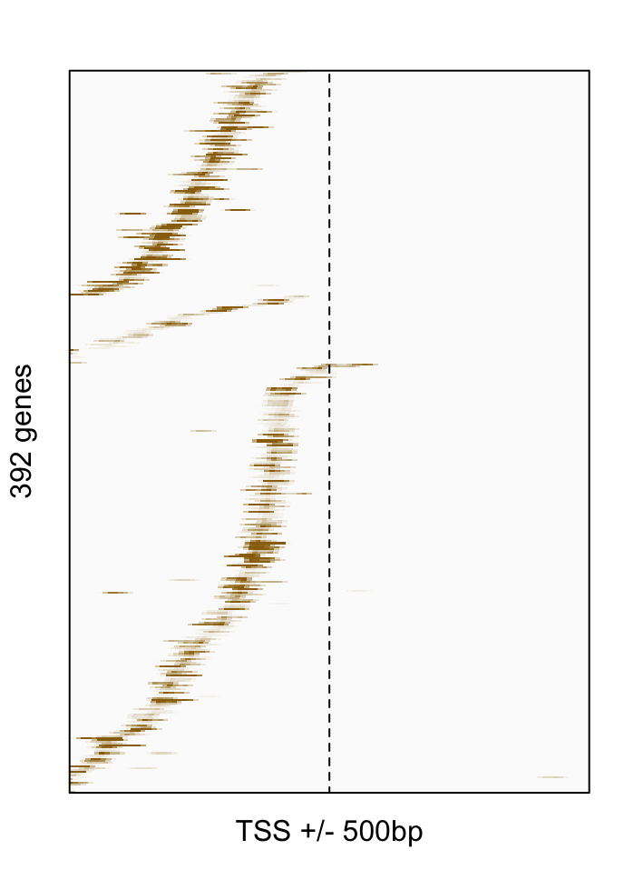
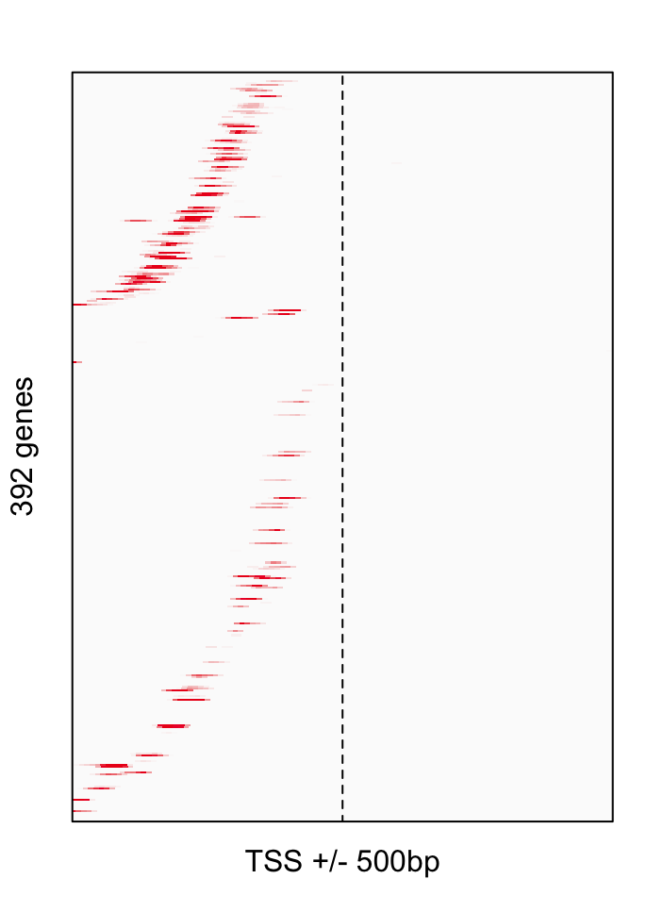
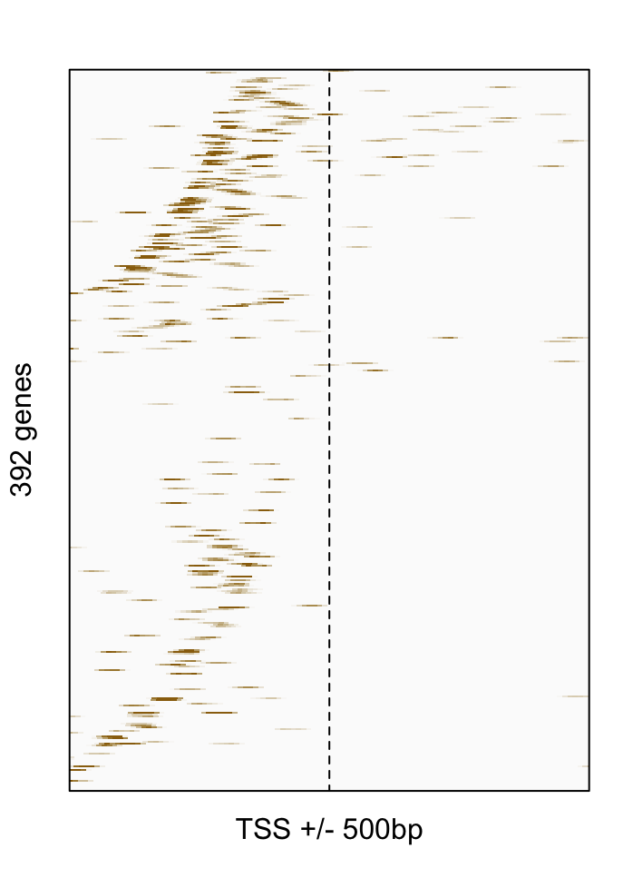
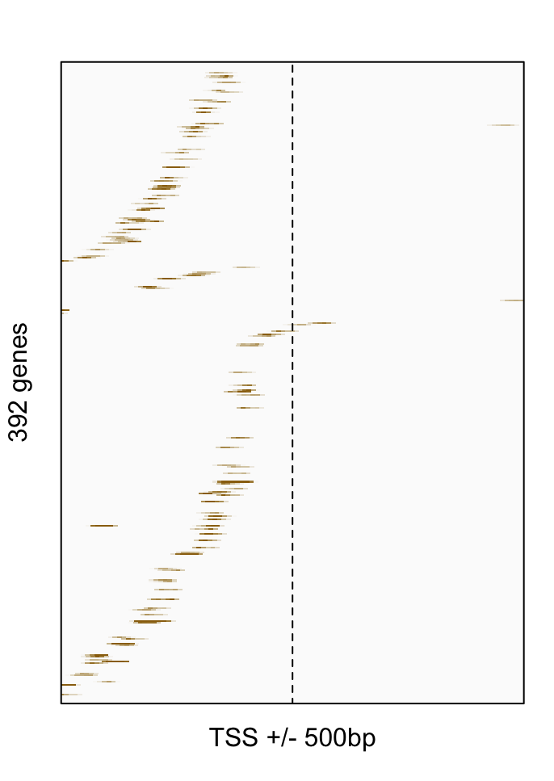
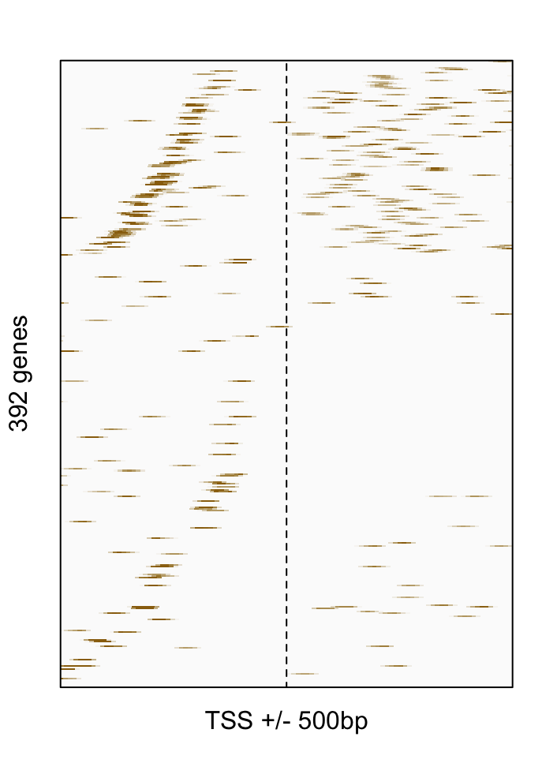
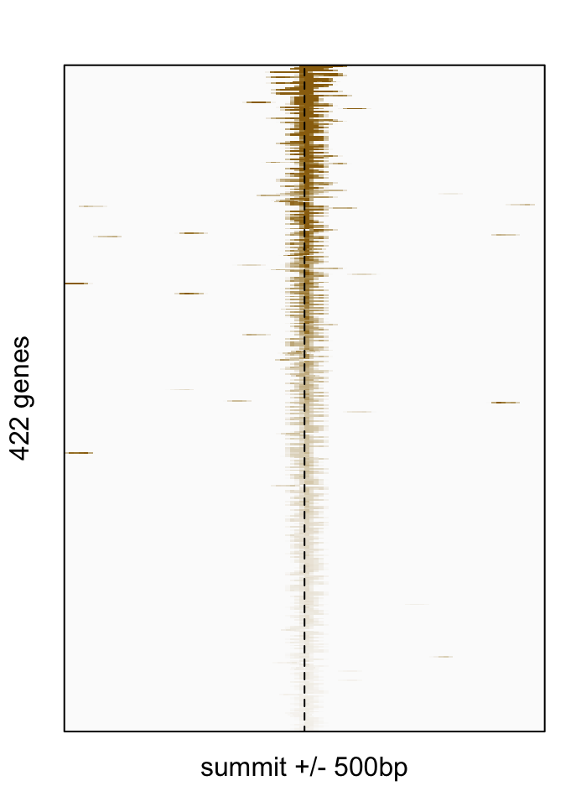
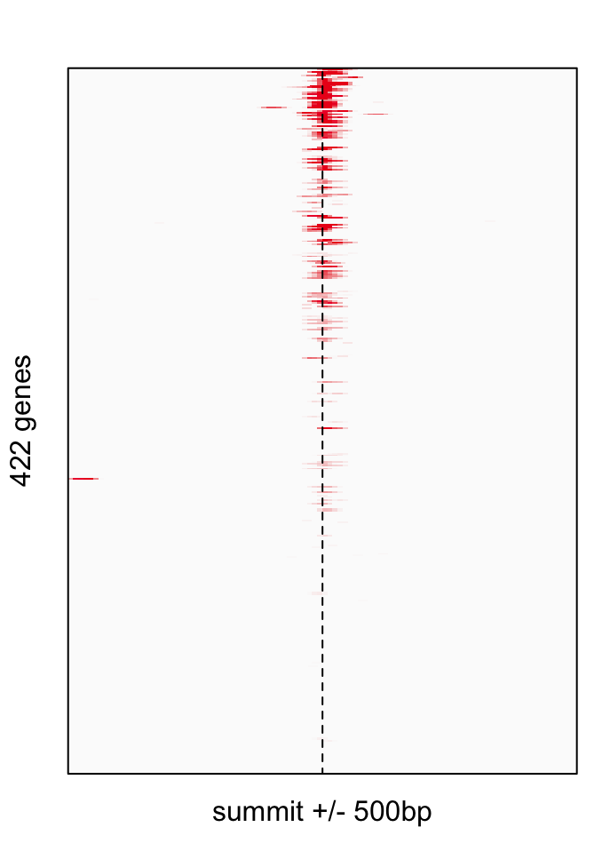
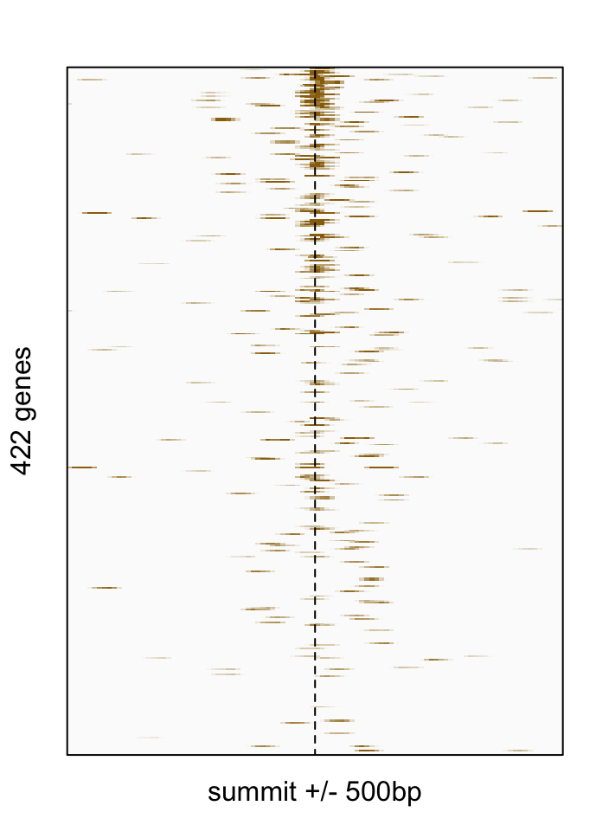
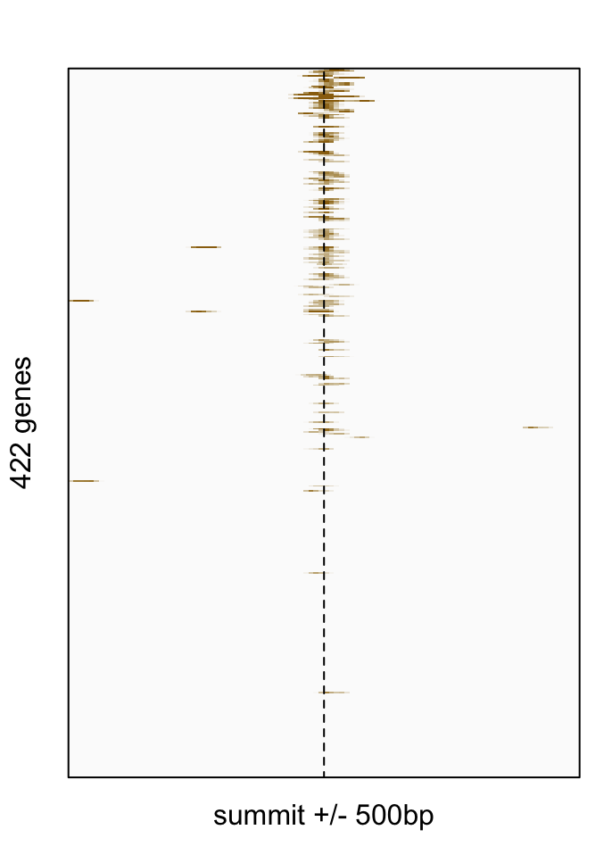
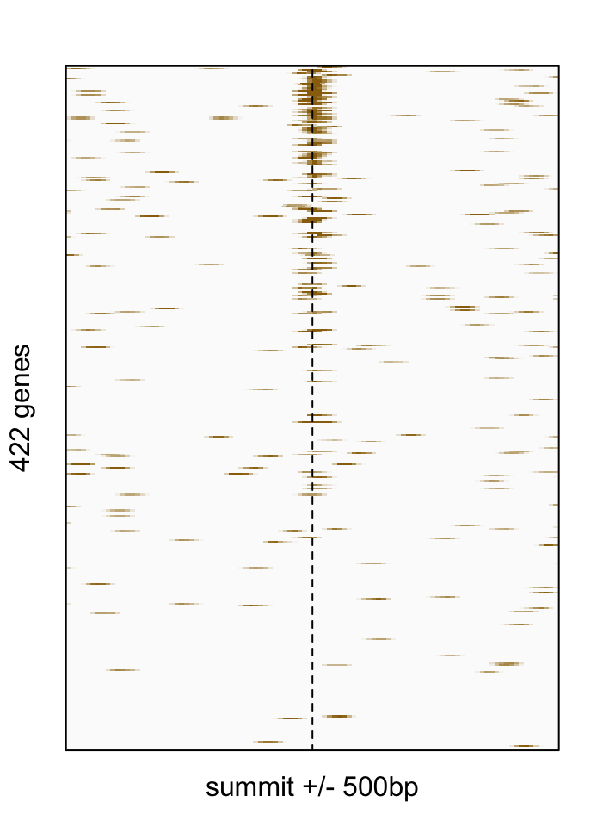
Section-2: Tag profiles
Profiles around binding regions
Topic 1
Protein-A
Protein-B
Protein-C
Protein-D
…
(Up to number of proteins in the topics)
Profiles around TSS
Topic 1
Protein-A
Protein-B
Protein-C
Protein-D
…
Profiles around TES
Topic 1
Protein-A
Protein-B
Protein-C
Protein-D
…

Slide 4
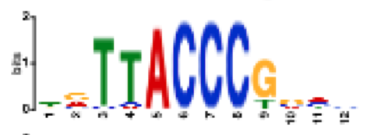
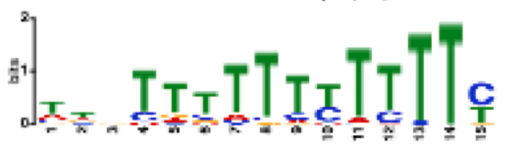
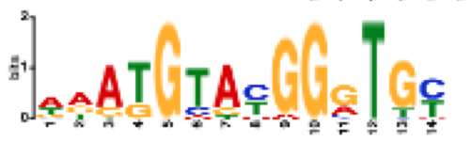
Section-3: Topic motifs
Motif-1
Logo
MEME results
STAMP results: match with known motifs
E-value | Sites | Width
2.3 E-904 | 619 | 12
Motif | Significance | Seq-1 | Seq-2
YDR026C | 3.11E-10 | ---CGGGTAA | NKCCGGGTAA
REB1 | 2.47E-08 | -TTACCCG | RTTACCC-
Link to YEP webpage from proteins
Motif-2
Logo
MEME results
STAMP results: match with known motifs
E-value | Sites | Width
8.7 E-55 | 182 | 15
Motif-3
Logo
MEME results
STAMP results: match with known motifs
E-value | Sites | Width
1.3 E-23 | 52 | 14
Motif | Significance | Seq-1 | Seq-2
FHL1 | 2.33E-15 | RCACCCRTACATYN | ACAYCCRTACA---
RAP1 | 2.27E-11 | RCACCCRTACATYN | NCACCCATAC----
SFP1 | 8.24E-11 | NRATGTAYGGGTGY | -NATGTAYGGR---

Slide 5
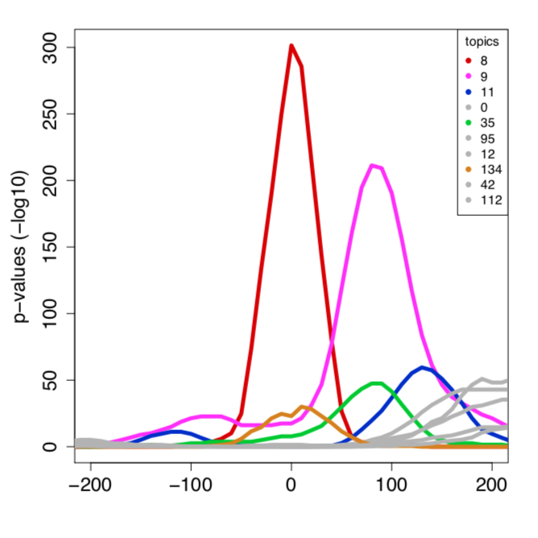
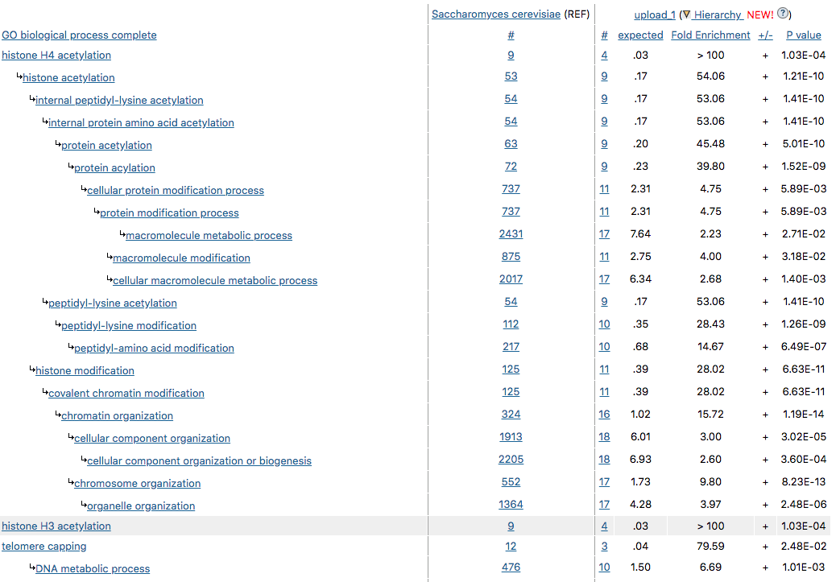
Section-4: Topic genes
Section 5: Topics around the reference topic
Gene List (link to txt file)
GO term analysis result
(table or link to AMIGO)
Significance of topic tag enrichment
Reference
topic bins
(+) side indicates where more proteins are present
Link to topic webpage from topics
Topics located in the same genes
Topic | # topic genes | # common genes | P-value
Topic-2 | 423 | 375 | 1.3 E-5
Topic-3 | 513 | 152 | 2.0 E-3
Topic-7 | 117 | 33 | 8.5 E-3
Topic | Summit position | Mean position | Summit P-value
Topic-8 | 0 | +10 | 1.3 E-300
Topic-9 | +90 | +70 | 2.0 E-225
Topic-11 | +130 | +120 | 8.5 E-53
… | … | … | …

Slide 6
Section-6: Files to download
Topic table file
Gene List (link to txt file)
Topic WIG file

