Slide 1

Top2Vec : Distributed Representations of Topics
2022.02.25.
DongHyun Kim
gmr4rnjs@gmail.com

Slide 2

Contents
Introduction
Model Description
Experiments
Discussion

Slide 3
Introduction
Topic modeling
Given a corpus comprised of many texts, a topic model will discover the latent semantic structure, or topics, present in the documents.
A useful topic model should find topics which represent a high-level summary of the information present in the documents.
Traditional Topic Modeling Methods
LDA : Generative probabilistic model which describes each document as a mixture of topics and each topic as a distribution of words.
pLSA : LDA+Dirichlet prior distribution over document-topic and topic-word distributions.
Both of them, use bag-of-words(BOW) representations of documents as input which ignore word semantics.
Notes:
For example, one can infer from a topic containing the words warming, global, temperature, and environment, that the topic is global warming.

Slide 4
Introduction (Cont.)
Distributed Representations of Words and Documents
The distributed representations means each concept learned by the network is presented by many neurons.
The distributional hypothesis, words with similar meanings are used in similar contexts.
Word2Vec, continuous skip-gram and BOW models, capture syntactic and semantic word relationships. Also, It learns word similarity by predicting which adjacent words should be present to a given context word in a sliding window.
For overcoming the weaknesses of BOW representations of documents, the distributed paragraph vector was proposed with doc2vec.

Slide 5
Introduction (Cont.)
Distributed Representations of Topics
The doc2vec is capable of learning document and word vectors that are jointly embedded in the same space.
In this joint, semantic embedding, the most similar word vectors to a document vector are likely the most representative of the document’s topic.
The semantic embedding, called continuous representation of topics, in which each point is a different topic best summarized by its nearest words make dense area of very similar topics.
In this paper, they show that topics found by top2vec are significantly more informative and representative than LDA and pLSA.

Slide 6
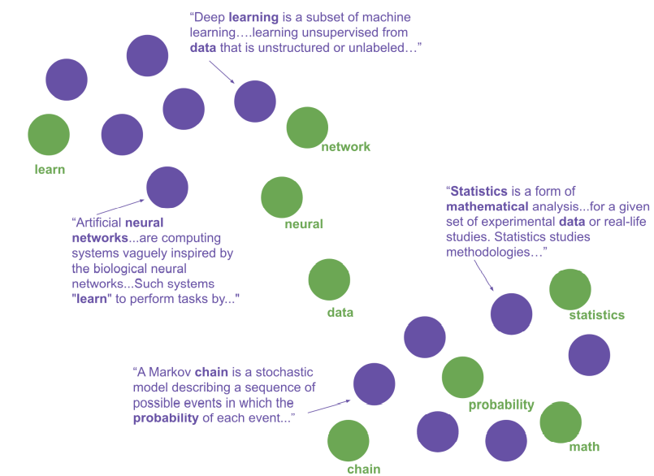
Model Description
Create Semantic Embedding
In semantic space, document and word vectors are embedded and topic vectors can be calculated.

Slide 7
Model Description
Two versions of the model
The Paragraph Vector with Distributed Memory (DM)
Distributed Bag of Words (DBOW)
The way the DBOW doc2vec model learns document vectors
The model consists of a matrix D_{c, d}
Also requires a context word matrix W’_{n,d ,}which can be pre-trained. In this paper, matrix W’ is pre-trained by a word2vec model.
Notes:
The DM model uses context words and a document vector to predict the target word within context window.
The DBOW model uses the document vector to predict words within a context window in the document.
c is the number of documents in the corpus and d is the size of the vectors to be learned for each document.

Slide 8
Model Description
Hyper-parameters have a large impact on doc2vec
Window size, the number of words left and right of the context word. – 15
Use hierarchical softmax.
Sub-sampling threshold, determines the probability of high frequency words being discarded from a given context window. – 10⁵
Minimum count, discards all words that have a total frequency that is less than that value. – 50(but this value largely depends on corpus size)
Vector size, the size of the document and word vectors that will be learned. – 300
Training epochs, the higher values for smaller data set – 40 to 400

Slide 9
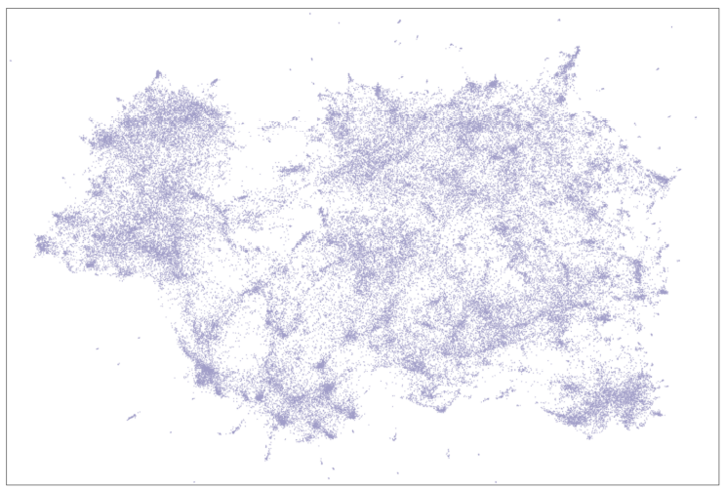
Model Description
300 dimensional document vectors are embedded into 2 dimensions using UMAP

Slide 10
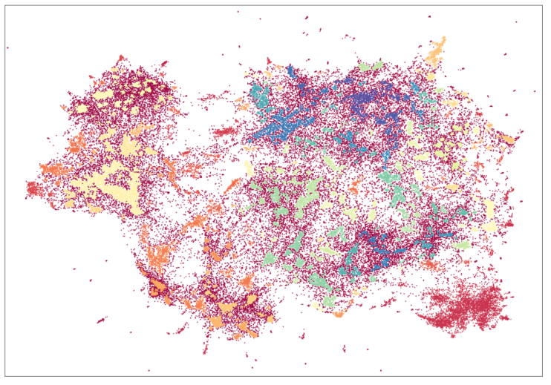
Model Description
After using UMAP, documents has labeled by HDBSCAN.

Slide 11
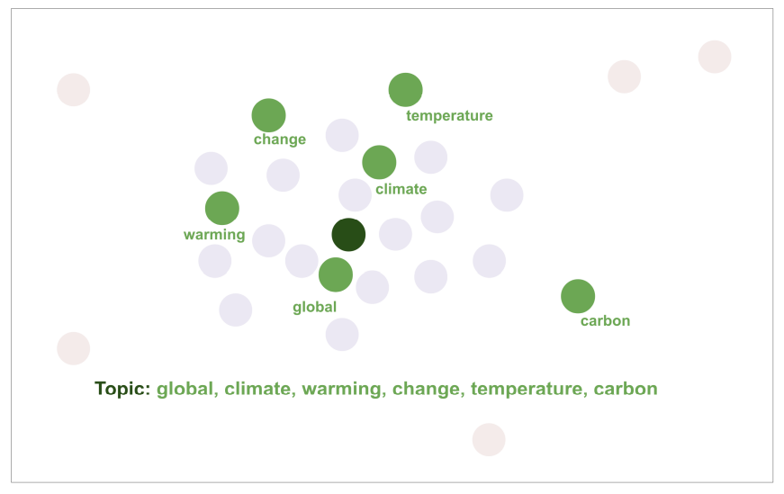
Model Description
Find Topic Words
In the semantic space, every point represents a topic that is best described semantically by its nearest word vectors.
Therefore, the words closes to the topic vector can be seen as the words that are most similar to all documents into the dense area.

Slide 12
Experiments
Total Information Gain
For evaluate topic models, scoring how well the topics describe the documents is important.
Top2vec topics T generated from documents D, the documents are partitioned into sub-sets.
The total information gained is measured for each of the sub-set of documents when described by the words nearest to their topic vector.

Slide 13


Experiments
Total information gain about all document.
Information gain calculation of each co-occurrence
between a document d and word w.
(Probability-Weighted amount of Information, PWI)
D : all documents
W : all words
d : target document
w : target words

Slide 14
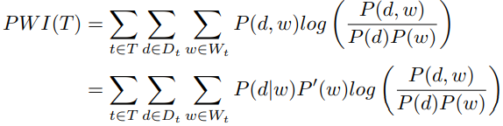
Experiments
PWI of topic T, The information gained about all documents
when described by their corresponding topic using the top n words of the topic.
D_{t} : all documents
W_{t} : all words
T : all topics
t : target topic
d : target document
w : target words

Slide 15
Discussion
LDA & pLSA seek to find topics that recreate the original documents word distributions with minimal loss. But these models place uninformative words in topics.
Top2vec can automatically find the number of topics and find topics that are more informative and representative of the corpus over traditional topic modeling methods.

Slide 16
Thank you for listening

