Slide 1

BERT : Pre-training of Deep Bidirectional Transformers for Language Understanding
2021.08.20
DongHyun KIM
gmr4rnjs@gmail.com

Slide 2

Contents
Introduction
Related Work
BERT
Experiments
Ablation Studies
Conclusion

Slide 3
Introduction
Backgrounds
Feature-based : The pre-trained representations is included to task-specific architectures as additional features. (Use double attached network. For example, ELMo)
Fine-tuning : Minimizing task-specific parameters and training on the downstream tasks using simply fine-tuning all pre-trained parameters. (For example, OpenAI GPT)
These methods use unidirectional language models to learn general language representations.
Limitation
Every token can only attend to previous tokens in the self-attention layers.

Slide 4
Introduction (Cont.)
Aim
The importance of bidirectional pre-training for language representations.
The pre-trained representations reduce the need for many heavily-engineered task-specific architectures.

Slide 5
Related Work
Unsupervised Feature-based Approaches
To pre-train word embedding vectors. Left-to-right language modeling have been used.
To train sentence representations, Ranking candidate next sentences.
ELMo extract context-sensitive features from a left-to-right and a right-to-left language model.
Unsupervised Fine-tuning Approaches
Sentence or document produce contextual token representation and have been pre-trained from unlabeled text and fine-tuned for a supervised downstream task.
Few parameters need to be learned. (OpenAI GPT achieved previously state-of-the-art result on the GLUE benchmark)

Slide 6
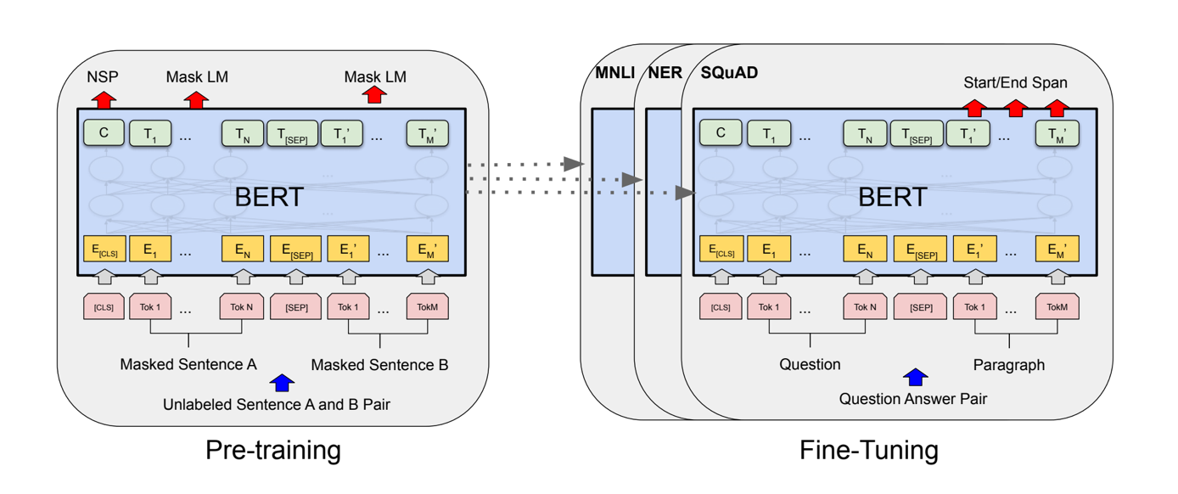
BERT
Pre-training : The model is trained on unlabeled data over different pre-training tasks.
Fine-tuning : The Bert model is initialized with the pre-trained parameters, and all parameters are fine-tuned using labeled data.

Slide 7
BERT (Cont.)
Model Architecture
Basically, Multi-layer bidirectional transformer encoder.
L is the number of layers, H is the number of hidden size, A is the number of self-attention heads.
BERT(BASE) is L=12, H=768, A=12, Total Parameters=110M.(Same size with OpenAI GPT)
BERT(LARGE) is L=24, H=1024, A=16, Total Parameters=340M.
Input/Output Representations
Use WordPiece embeddings(30,000 token in BERT English)
First token of all sentence is CLS : Used as the aggregate sequence representation for classification tasks.
Sentence pair + sentence pair => single sequence. Each sentences are discriminated by [SEP] token and Segment embedding.(sentence A embedding, sentence B embedding)

Slide 8
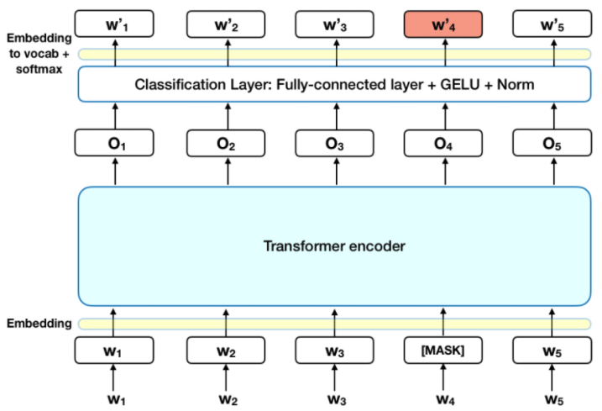
Pre-Training BERT
Masked LM(MLM)
Change some of words to [MASK] token
Using WordPiece, Tokenizing a plain text
Pre-training task : Predict only [MASK] token with a L2R or R2L method.
[MASK] token is only used in the pre-training phase, not in the fine-tuning phase.
MLM need more training step for converge than LM. But, Empirically, MLM have higher performance than LM.
(출처: rani horev’s blog : BERT explained)

Slide 9
Pre-Training BERT (Cont.)
Next Sentence prediction (NSP)
For Q&A, Natural Language Inference(NLI) in NLP task, Understanding the relationship between two sentences is important.
Binarized next sentence prediction task
50% : sentence A,B are correct next sentence
50% : sentence A, B are picked randomly in corpus.
Example :
Input = [CLS] the man bought a [MASK] car [SEP], he is satisfied with [MASK] and price [SEP] LABEL=IsNext
Input = [CLS] the man bought a [MASK] car [SEP], he bought a gallon [MASK] milk [SEP] LABEL=NotNext

Slide 10
Fine-Tuning BERT
Fine-tuning is straightforward.
By swapping out the appropriate inputs and outputs, decide BERT involve single text or text pairs.(Use self-attention mechanism of transformer)
Before applying bidirectional cross attention, a common pattern is encode text pairs for applications involving text pairs.
BERT unify these two stages by using the self-attention mechanism.
Encoding a concatenated text pair with self-attention effectively includes bidirectional cross attention between two sentences.
Simply plug in the task-specific inputs and outputs into BERT and fine-tune all the parameters end-to-end.

Slide 11
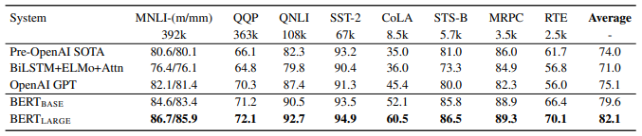
Experiments
GLUE Results
Achieve SOTA in all task. Even though training data is very little.
BERT(Large)’s performance is higher than BERT(Base).

Slide 12
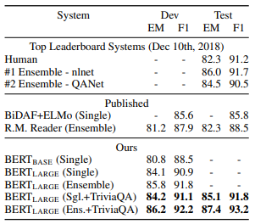
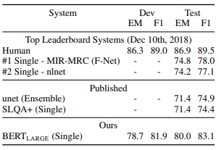
Experiments
SQuAD 1.1 & 2.0
1.1
The Stanford Question Answering Dataset is a collection of 100k crowdsourced Q&A pairs.
In BERT, Question is A embedding, Passage is B embedding. Change task to find start and end from substring which is answer of B embedding.
During fine-tuning, we only introduce a start vector and an end vector.
Find substring using dot product start&end vector with each token in passage.
BERT(Large) achieve top result in SQuAD with wide margin.
2.0

Slide 13
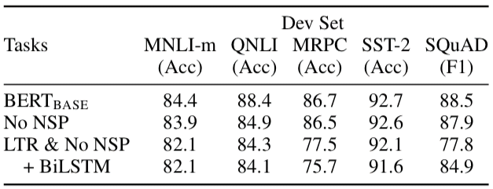
Effect of Pre-training Tasks
No NSP
Very Low performance in NLI.
LTR & No NSP +BiLSTM
Even though use BiLSTM instead MLM, performance is lower than using MLM.
Consequently, MLM task is more Deep Bidirectional.
No NSP
Use MLM, Not use NSP
LTR & No NSP
Use LTR instead MLM, Not use NSP

Slide 14
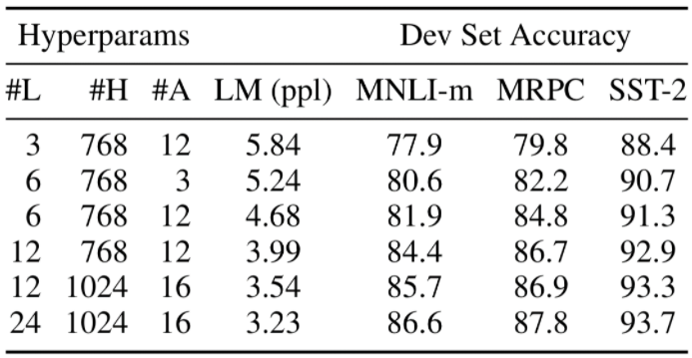
Effect of Model Size

Slide 15
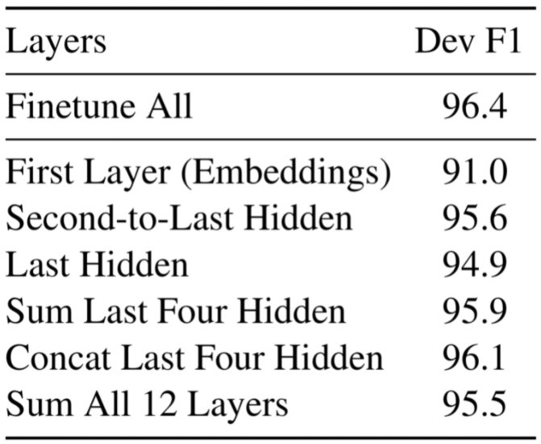
Feature-based Approach with BERT
Benefits of Feature-based Approach
Not all tasks can be represented by a Transformer encoder, and require a task-specific model architecture to be added.
There are major computational benefit, cheaper models on top of this representation.

Slide 16
Conclusion
Unsupervised pre-training is integral part of many language understanding system and achieve recent empirical improvements.
In particular, these results enable low-resources tasks to benefit from deep unidirectional architectures
Our major contribution is further generalizing these findings to deep bidirectional architectures, allowing the same pre-trained model to successfully tackle a broad set of NLP tasks.

Slide 17
Thank you for listening

