Slide 1
Machine Learning: Experimental Validation of In-house Advanced Data Classification Techniques.
Improvement in Random Forest algorithm implemented in R language.
Student author: Violeta Isusi
Supervisors: Dr. Mohamed Gaber
Dr. Cèsar Ferri

Slide 2
Index
Preliminary
  Machine Learning & Data Mining
  Classification Technique
  Decision trees for Classification
Random Forest & Diversified Random Forest
Iris Dataset
  Introduction
  Structure
Demo Predictions with Diversified Random Forest
Student author: Violeta susi - 1414477
Notes:
Gail Smillie, Paul Tytler
Marlene Forsyth, Julia Roberts
Ian Heywood, Jackie Nicol
Steering Group – GE, ACOC, partnership in D,
Other SE regions – Fife, Tayside, Lanarkshire, Borders?
100 plus SME beneficiaries locally, ~30 in other regions
Development Project 1st year
Delivery Project 3 years. Final year involves other Seregions
Development:
Modules, e-Business MSc, 2-modules Business Lab
-e-Business Bytes
Concept – each module broken down into Themes. 3-4 per module. Themes plus new activities, MCQs plus completion for SMEs.
SE – marketing and events
-Vicky Grampian Ent liaison. Splitting up
AS – module development
Laura Binnie, Emma Kennedy
SE did evaluation (before and after questionnaires
PR

Slide 3
Machine Learning & Data Mining
Machine Learning
“A computer program is said to learn from experience E with respect to some class of tasks T and performance measure P, if its performance at tasks in T, as measured by P, improves with experience E”. Mitchell (1997 p. 2, cited by Coursera, 2015)
Data Mining
  discovering patterns, automatically or semi-automatically, in large quantities of data. Witten (2011, p.7)
  allowing predictions to be made with the actual data. (Tan, Steinbach and Kumar, 2006)
Student author: Violeta susi - 1414477
Notes:
Gail Smillie, Paul Tytler
Marlene Forsyth, Julia Roberts
Ian Heywood, Jackie Nicol
Steering Group – GE, ACOC, partnership in D,
Other SE regions – Fife, Tayside, Lanarkshire, Borders?
100 plus SME beneficiaries locally, ~30 in other regions
Development Project 1st year
Delivery Project 3 years. Final year involves other Seregions
Development:
Modules, e-Business MSc, 2-modules Business Lab
-e-Business Bytes
Concept – each module broken down into Themes. 3-4 per module. Themes plus new activities, MCQs plus completion for SMEs.
SE – marketing and events
-Vicky Grampian Ent liaison. Splitting up
AS – module development
Laura Binnie, Emma Kennedy
SE did evaluation (before and after questionnaires
PR

Slide 4
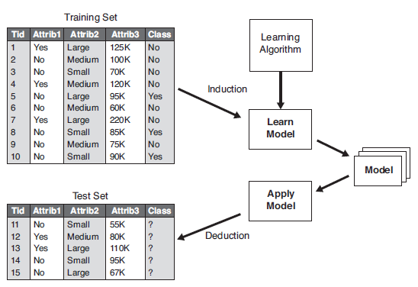
Classification Technique
(Tan, Steinbach and Kumar, 2006, p.148, figure 4.3: General approach for building a classification model)
Student author: Violeta susi - 1414477
Notes:
Gail Smillie, Paul Tytler
Marlene Forsyth, Julia Roberts
Ian Heywood, Jackie Nicol
Steering Group – GE, ACOC, partnership in D,
Other SE regions – Fife, Tayside, Lanarkshire, Borders?
100 plus SME beneficiaries locally, ~30 in other regions
Development Project 1st year
Delivery Project 3 years. Final year involves other Seregions
Development:
Modules, e-Business MSc, 2-modules Business Lab
-e-Business Bytes
Concept – each module broken down into Themes. 3-4 per module. Themes plus new activities, MCQs plus completion for SMEs.
SE – marketing and events
-Vicky Grampian Ent liaison. Splitting up
AS – module development
Laura Binnie, Emma Kennedy
SE did evaluation (before and after questionnaires
PR

Slide 5
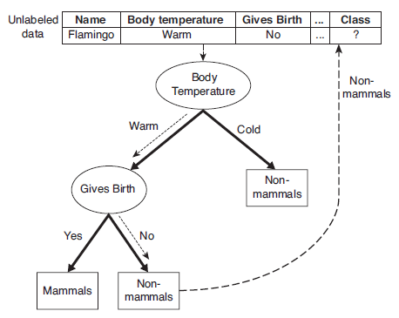
Decision Trees for Classification
(Tan, Steinbach and Kumar, 2006, p.152, figure 4.5: Classifying an unlabelled vertebrate. “The dashed lines represent the outcomes of applying various attribute test conditions on the unlabelled vertebrate. The vertebrate is eventually assigned to the Non-mammal class”)
Student author: Violeta susi - 1414477
Notes:
Gail Smillie, Paul Tytler
Marlene Forsyth, Julia Roberts
Ian Heywood, Jackie Nicol
Steering Group – GE, ACOC, partnership in D,
Other SE regions – Fife, Tayside, Lanarkshire, Borders?
100 plus SME beneficiaries locally, ~30 in other regions
Development Project 1st year
Delivery Project 3 years. Final year involves other Seregions
Development:
Modules, e-Business MSc, 2-modules Business Lab
-e-Business Bytes
Concept – each module broken down into Themes. 3-4 per module. Themes plus new activities, MCQs plus completion for SMEs.
SE – marketing and events
-Vicky Grampian Ent liaison. Splitting up
AS – module development
Laura Binnie, Emma Kennedy
SE did evaluation (before and after questionnaires
PR

Slide 6
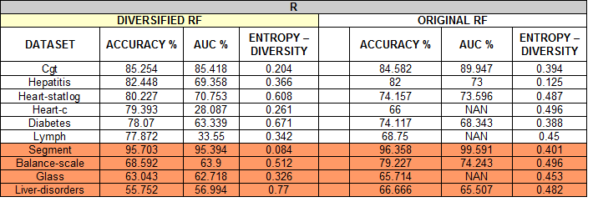
Random Forest & Diversified RF
Isusi's project (2015) Table 1: Diversified RF implemented in R in comparison with Original RF
Student author: Violeta susi - 1414477
Notes:
Gail Smillie, Paul Tytler
Marlene Forsyth, Julia Roberts
Ian Heywood, Jackie Nicol
Steering Group – GE, ACOC, partnership in D,
Other SE regions – Fife, Tayside, Lanarkshire, Borders?
100 plus SME beneficiaries locally, ~30 in other regions
Development Project 1st year
Delivery Project 3 years. Final year involves other Seregions
Development:
Modules, e-Business MSc, 2-modules Business Lab
-e-Business Bytes
Concept – each module broken down into Themes. 3-4 per module. Themes plus new activities, MCQs plus completion for SMEs.
SE – marketing and events
-Vicky Grampian Ent liaison. Splitting up
AS – module development
Laura Binnie, Emma Kennedy
SE did evaluation (before and after questionnaires
PR

Slide 7
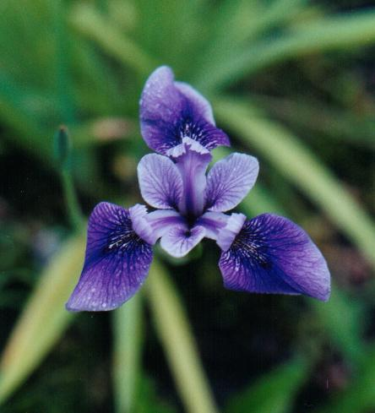
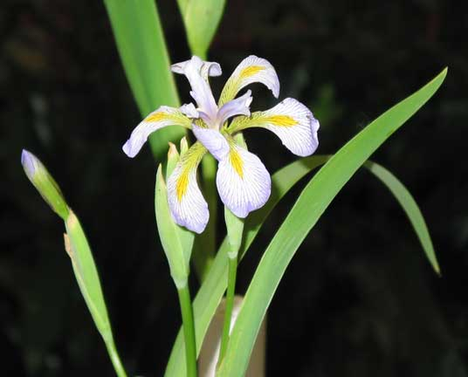

Iris Dataset
Depends on the width & length of petals & sepals
Virginica Versicolor Setosa
Student author: Violeta susi - 1414477
Notes:
Gail Smillie, Paul Tytler
Marlene Forsyth, Julia Roberts
Ian Heywood, Jackie Nicol
Steering Group – GE, ACOC, partnership in D,
Other SE regions – Fife, Tayside, Lanarkshire, Borders?
100 plus SME beneficiaries locally, ~30 in other regions
Development Project 1st year
Delivery Project 3 years. Final year involves other Seregions
Development:
Modules, e-Business MSc, 2-modules Business Lab
-e-Business Bytes
Concept – each module broken down into Themes. 3-4 per module. Themes plus new activities, MCQs plus completion for SMEs.
SE – marketing and events
-Vicky Grampian Ent liaison. Splitting up
AS – module development
Laura Binnie, Emma Kennedy
SE did evaluation (before and after questionnaires
PR

Slide 8
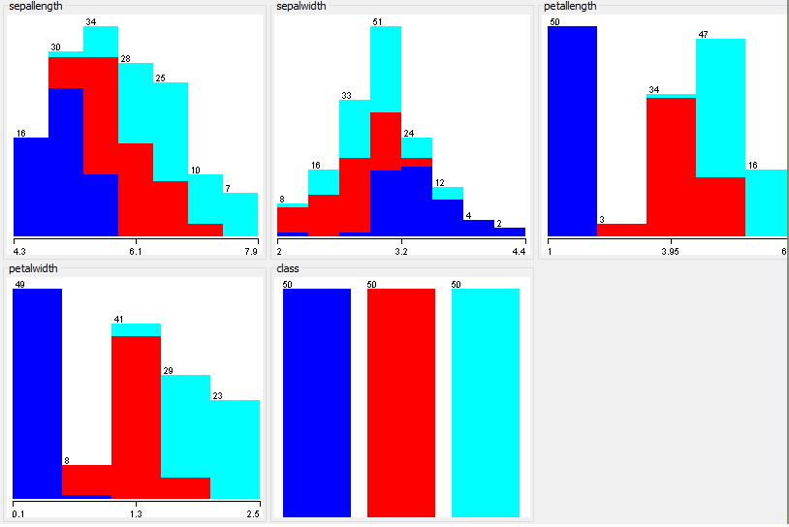
Iris Dataset
Student author: Violeta susi - 1414477
Notes:
Gail Smillie, Paul Tytler
Marlene Forsyth, Julia Roberts
Ian Heywood, Jackie Nicol
Steering Group – GE, ACOC, partnership in D,
Other SE regions – Fife, Tayside, Lanarkshire, Borders?
100 plus SME beneficiaries locally, ~30 in other regions
Development Project 1st year
Delivery Project 3 years. Final year involves other Seregions
Development:
Modules, e-Business MSc, 2-modules Business Lab
-e-Business Bytes
Concept – each module broken down into Themes. 3-4 per module. Themes plus new activities, MCQs plus completion for SMEs.
SE – marketing and events
-Vicky Grampian Ent liaison. Splitting up
AS – module development
Laura Binnie, Emma Kennedy
SE did evaluation (before and after questionnaires
PR

Slide 9
Demo
Input data:
  Attribute values
    Min Max
    sepal length: 4.3 7.9
    sepal width: 2.0 4.4
    petal length: 1.0 6.9
    petal width: 0.1 2.5
  Supposed class
    Iris-setosa
    Iris-versicolor
    Iris-virginica
Lichman, M. (2013)
Student author: Violeta susi - 1414477
Notes:
Gail Smillie, Paul Tytler
Marlene Forsyth, Julia Roberts
Ian Heywood, Jackie Nicol
Steering Group – GE, ACOC, partnership in D,
Other SE regions – Fife, Tayside, Lanarkshire, Borders?
100 plus SME beneficiaries locally, ~30 in other regions
Development Project 1st year
Delivery Project 3 years. Final year involves other Seregions
Development:
Modules, e-Business MSc, 2-modules Business Lab
-e-Business Bytes
Concept – each module broken down into Themes. 3-4 per module. Themes plus new activities, MCQs plus completion for SMEs.
SE – marketing and events
-Vicky Grampian Ent liaison. Splitting up
AS – module development
Laura Binnie, Emma Kennedy
SE did evaluation (before and after questionnaires
PR

Slide 10
References
Coursera. (2015). Machine Learning. [Online] Available from: https://www.coursera.org/learn/machine-learning [Accessed 30 April 2015]
Isusi, V., (2015). Machine Learning: Experimental Validation of In-house Advanced Data Classification Techniques. Improvement in Random Forest algorithm implemented in R language.
Lichman, M. (2013). UCI Machine Learning Repository .Iris Dataset. [online] . Irvine, CA: University of California, School of Information and Computer Science. Available from: https://archive.ics.uci.edu/ml/datasets/Iris/ [Accessed 28 April 2015]
Mitchell, T. (1997). Machine Learning, Boston: McGraw Hill.
SIGNA (2015) Species Iris Group of North America. [online] Available from: http://www.sigma.org [Accessed 03 May 2015]
Tan, P., Steinbach, M., Kumar, V., (2006). Introduction to Data Mining. Boston: Pearson Addison Wesley
Witten, I. H., Hall, M. A., Frank, E. (2011). Data Mining: Practical Machine Learning Tools and Techniques. 3 rd Edition. Morgan Kaufmann
Student author: Violeta susi - 1414477
Notes:
Gail Smillie, Paul Tytler
Marlene Forsyth, Julia Roberts
Ian Heywood, Jackie Nicol
Steering Group – GE, ACOC, partnership in D,
Other SE regions – Fife, Tayside, Lanarkshire, Borders?
100 plus SME beneficiaries locally, ~30 in other regions
Development Project 1st year
Delivery Project 3 years. Final year involves other Seregions
Development:
Modules, e-Business MSc, 2-modules Business Lab
-e-Business Bytes
Concept – each module broken down into Themes. 3-4 per module. Themes plus new activities, MCQs plus completion for SMEs.
SE – marketing and events
-Vicky Grampian Ent liaison. Splitting up
AS – module development
Laura Binnie, Emma Kennedy
SE did evaluation (before and after questionnaires
PR

